Slide 1

Lab 1 of Machine Learning in Practice 2024/25
Ivan Donadello

Slide 2
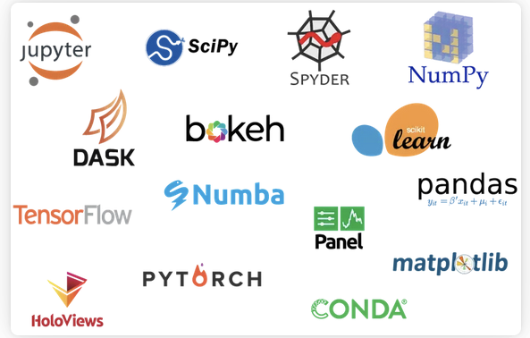
One Environment Fits All: Anaconda
A platform with many Python ML libraries available (https://www.anaconda.com/products/individual)
It includes Jupyter (https://jupyter.org/)
It includes Pycharm

Slide 3
One Environment Fits All: Anaconda
Your first exercise
Download and install Anaconda (link above);
Open Anaconda Navigator (or type jupyter notebook from a terminal)
Launch a Jupyter notebook (or type jupyter notebook from a terminal)
Create a new notebook with:
import pandas as pd
import numpy as np
import matplotlib.pyplot as plt
arr = np.array([1, 2, 3])
print(arr)
Run the cell

Slide 4
One Environment Fits All: Google Colab
An online platform with many Python ML libraries installed https://colab.research.google.com/?hl=it
GPU support!
You can access with your Google account
You can import/export data on your Google Drive
Your second exercise: the same of point 4 above but con Colab

Slide 5
One Environment Fits All: Jupyter
Jupyter notebooks are useful tools for writing tutorials, commenting code, coding, showing results.
They have their own syntax for writing comments: the markdown syntax.
Have a look at https://www.markdownguide.org/basic-syntax/.
GitHub READMEs use such a syntax.

