Slide 1
ETL (Extract-Transform-Load)
ETL stands for Extract-Transform-Load and it is a process of how data is loaded from the source system to the data warehouse.
Data is extracted from an OLTP database, transformed to match the data warehouse schema and loaded into the data warehouse database.
Many data warehouses also incorporate data from non-OLTP systems such as text files, legacy systems and spreadsheets.
Notes:
Add instructor notes here.

Slide 2
ETL - Example
For example, there is a retail store which has different departments like sales, marketing, logistics etc. Each of them is handling the customer information independently, and the way they store that data is quite different. The sales department have stored it by customer’s name, while marketing department by customer id.
Now if they want to check the history of the customer and want to know what the different products he/she bought owing to different marketing campaigns; it would be very tedious.
Notes:
Add instructor notes here.

Slide 3
Continuation…
The solution is to use a Data Warehouse to store information from different sources in a uniform structure using ETL. ETL can transform dissimilar data sets into an unified structure. Later use BI tools to derive meaningful insights and reports from this data.
Notes:
Add instructor notes here.

Slide 4
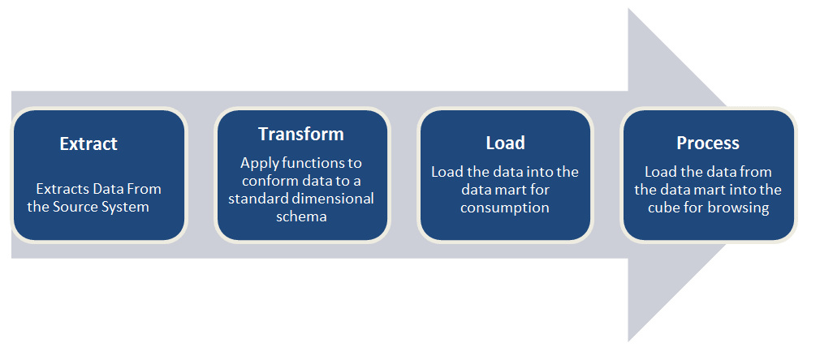
ETL – ROAD MAP
Notes:
Add the notes here.
Add instructor notes here.

Slide 5
ETL - Testing
ETL testing is done to ensure that the data that has been loaded from a source to the destination after business transformation is accurate. It also involves the verification of data at various middle stages that are being used between source and destination.
Cleansed Data from the Source file is loaded into Data Warehouse after implementing the transformation logic.
Source files can be any of Flat files, XML File or Database Tables.
Notes:
Add the notes here.
Add instructor notes here.

Slide 6
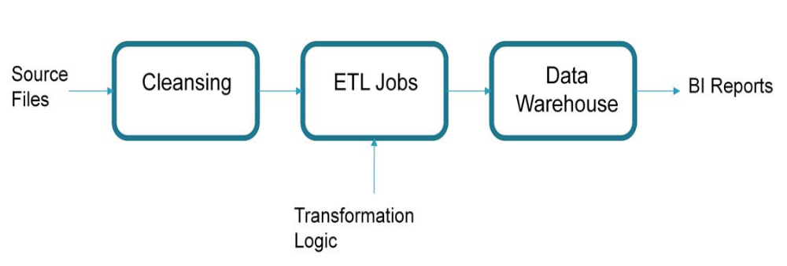
ETL – Testing (Road Map)
Capgemini Internal

Slide 7
Continuation…
Validating the Transformation logic implemented in ETL Jobs while loading the Data from Individual Source system to Data Warehouse.
Compare the data in Data Warehouse with source data according to the logic given in mapping document.
Mapping Document contains the Information regarding..
  Source System : Source File Name, Source Field(s) and its Data Type.
  Transformation Logic.
  Target System (Data Warehouse) : Target Table Name, Target Column Name and its Data Type.
Capgemini Internal

Slide 8
ETL Testing using SQL
Source Data Tables : Data from source files is replicated into database tables using any SQL Loader or Simple ETL Jobs.
Using SQL, Target (DWH) and Source tables are compared with Minus operator.
Applying the transformation logic on source fields according to the logic given and comparing it with the field in target.
Capgemini Internal
Notes:
Add the notes here.
Add instructor notes here.

Slide 9
Continuation….
  Syntax:
  SELECT T/L (Source_Field) FROM Source_Table
  MINUS
  SELECT Target_Field FROM Target_Table;
  No logic to be implemented on Target.
Capgemini Internal

Slide 10
MINUS QUERY
The data testing method “Minus Query” is one of the most preferred methods used by QA testing companies for ETL testing. It is used QA services to validate that the ETL mapping specifications are correctly implemented.
This query uses MINUS operator in SQL for subtracting two sets and evaluate the set difference. The difference will be displayed in the rows and in case of no difference, no result set will be displayed.
The MINUS operator returns the rows from first SELECT statement which are not returned by the second SELECT statement.
Notes:
Add the notes here.
Add instructor notes here.

Slide 11
How do you test with Minus Queries?
The Minus Queries are performed as the source-minus-target and target-minus-source. This query is used to make sure that no duplicate data exists in two datasets and the unnecessary columns are removed before loading the data.
The MINUS query will return the records that exist in Dataset1 and not in Dataset2 and display them in blue shaded area.
Condition for using Minus Statement: The SELECT statements in MINUS query should have same data types and same number of fields in result sets.
Notes:
Add the notes here.
Add instructor notes here.

Slide 12
Example
SQL MINUS operator with one field and same data type:
SELECT supplier_id
FROM suppliers
MINUS
SELECT supplier_id
FROM orders;

Slide 13
Source System Unique Key
All Attributes in the Target Table are validated with reference to Unique key in the table.
For each table in the Data Warehouse Unique key is implemented based on logic given in Mapping Document.
T/L (Src_Fld1, Src_Fld2)→ Unique_Key_DW
Syntax:
SELECT Unique_Key, Source_Field FROM Source_Table
MINUS
SELECT Unique_Key, Target_Field FROM Target_Table;

Slide 14
SSUK Check
Assuring that all the records present in Source Table are loaded into the Target Table
Syntax
  SELECT distinct Unique_Key FROM Source_Table
  MINUS
  SELECT distinct Unique_Key FROM Target_Table ;

