Slide 1
BI
MINI PROJECT
CENSUS REPORTING SYSTEM

Slide 2
TEAM MEMBERS
RAGHU SHANKAR KONGRA
SHREYA PANDEY
PRABU THIRUNAVUKKARASU
SOMYA SHIVHARE
PRABHAKAR BALASUNDARAM
NEETHU PATTLIKADAN

Slide 3
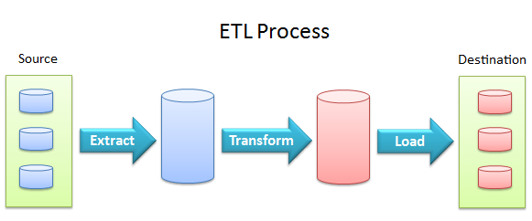
ETL PROCESS
Extraction is the operation of extracting data from a source system for further use in a data warehouse environment. This is the first step of the ETL process. After the extraction, this data can be transformed and loaded into the data warehouse.
Which extraction method do I choose?
This influences the source system, the transportation process, and the time needed for refreshing the warehouse.
How do I provide the extracted data for further processing?
This influences the transportation method, and the need for cleaning and transforming the data.

Slide 4
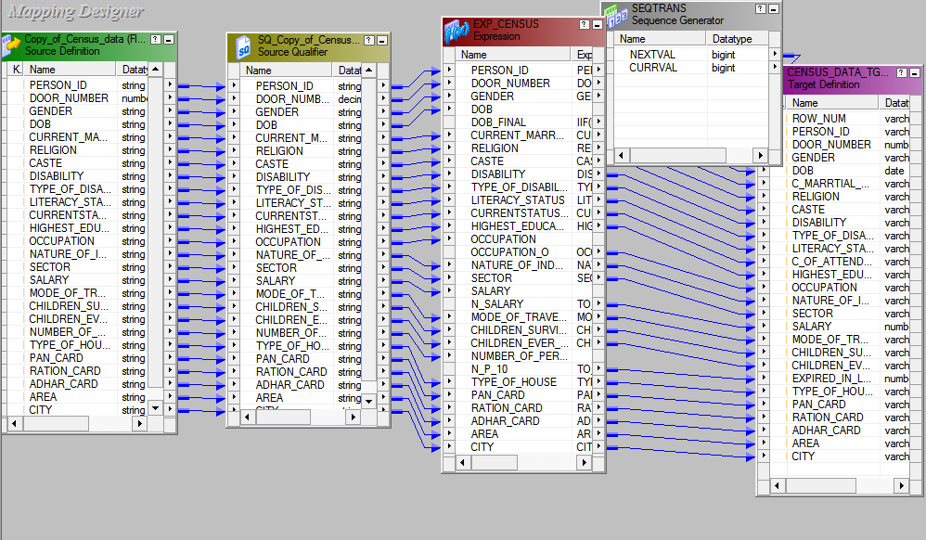
MAPPING
STAGING TABLE

Slide 5
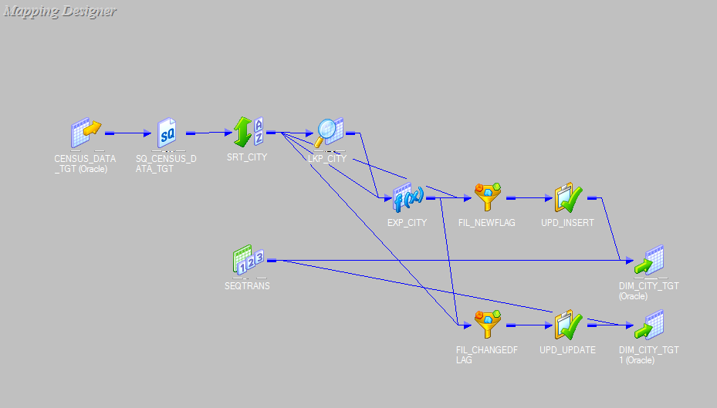
MAPPING OF DIMENSIONAL TABLE
MAPPING FOR CITY : SCD TYPE-1

Slide 6
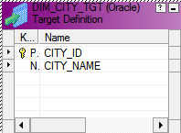
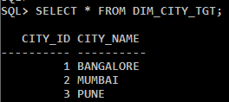

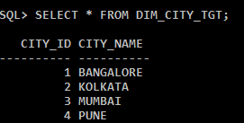
OUTPUT FOR CITY
DIMENSION TABLE : CITY
OUTPUT FOR CITY TABLE
INSERTING VALUES IN STAGING TABLE
OUTPUT AFTER INSERTING VALUES

Slide 7
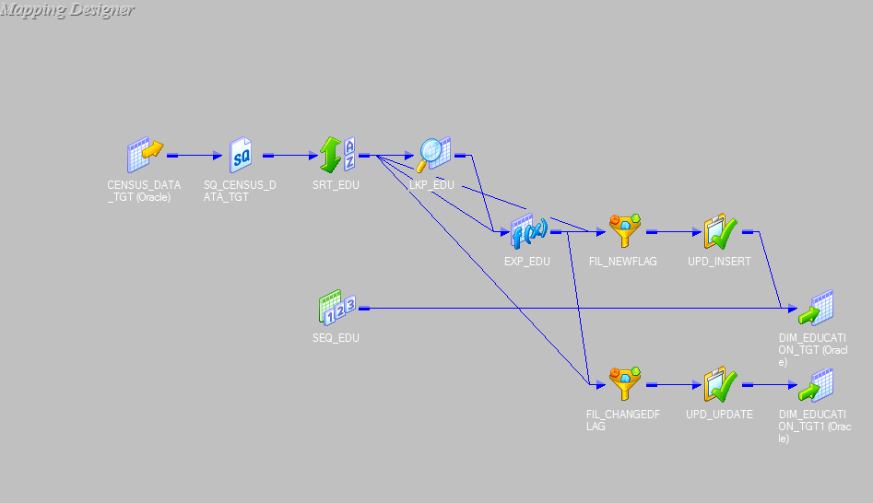
MAPPING FOR EDUCATION : SCD TYPE-1

Slide 8
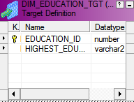
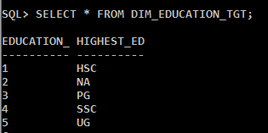
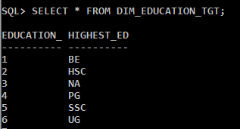
OUTPUT FOR EDUCATION
DIMENSION TABLE : EDUCATION
OUTPUT FOR EDUCATION TABLE
INSERTING VALUES IN STAGING TABLE
OUTPUT AFTER INSERTING VALUES

Slide 9
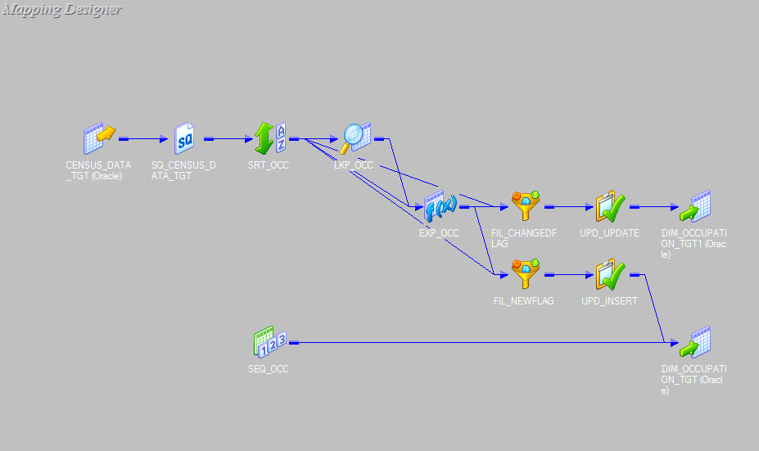
MAPPING FOR OCCUPATION : SCD TYPE-1

Slide 10
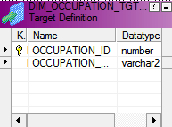
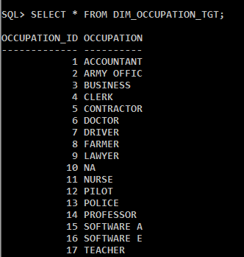
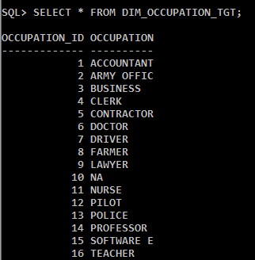
OUTPUT FOR OCCUPATION
DIMENSION TABLE :OCCUPATION
INSERTING VALUES IN STAGING TABLE
OUTPUT FOR OCCUPATION TABLE OUTPUT AFTER INSERTING VALUES

Slide 11
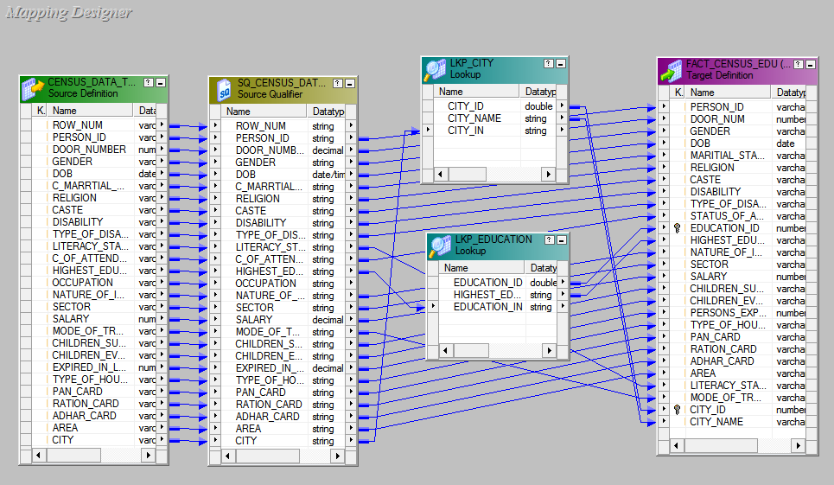
MAPPING FOR FACT TABLE : EDUCATION

Slide 12
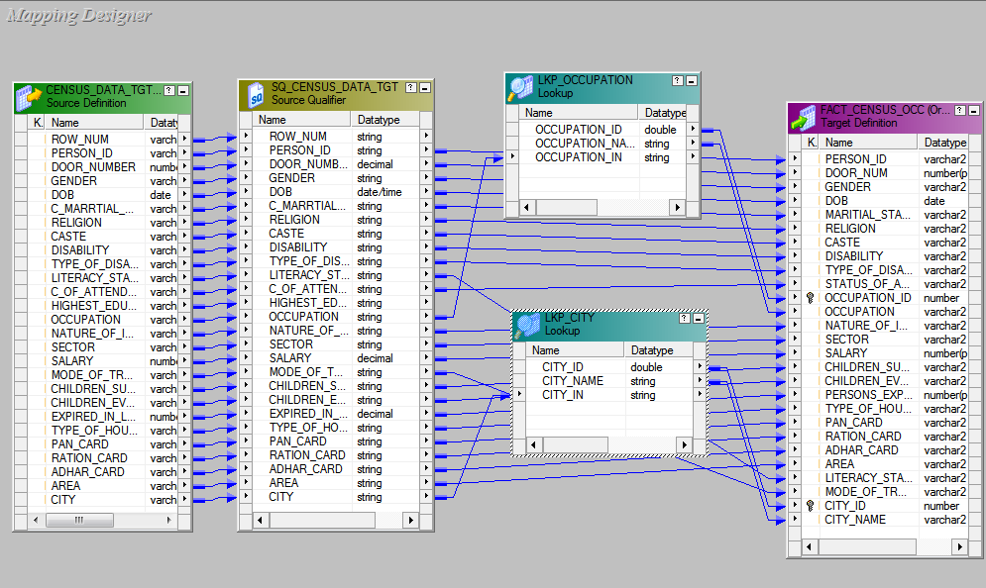
MAPPING FOR FACT TABLE : OCCUPATION

Slide 13
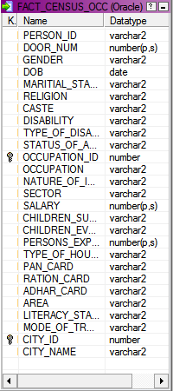
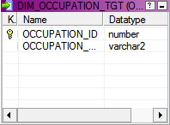
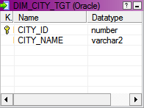
SCHEMA

Slide 14
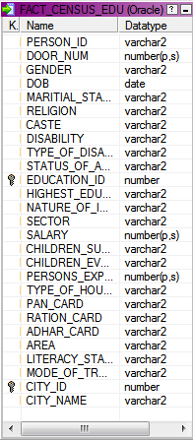
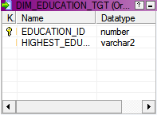
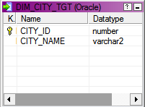
SCHEMA

