Slide 1
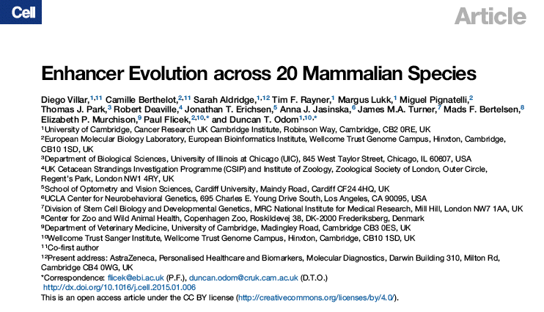
Maria Stalteri
March 2015

Slide 2
Introduction
Genome-wide study of evolution of enhancer sequences in mammals
ChIP-Seq analysis of H3K4me3 and H3K27Ac histone marks
In liver
From 20 mammalian species
Comparison of H3K4me3 (promoter) vs H3K27Ac (enhancer) regions
  Number of regions
  Length/intensity of regions
  Conservation across species
    Sequence conservation
    Functional conservation
  Distance from TSS
Notes:
Previous work referenced in the paper:
Studies of evolution ofTranscription Factor binding (2010, 2011, 2013),
Studies of enhancer and promoter evolution in sets of mammals(2012, 2013),
Where H3K27Ac levels were characterized across tissues and developmental states as a proxy for enhancer function.
Enhancers are identified by mapping regions enriched for H3K27Ac, acetylated lyysine 27 (2010).
Promoters are identified by sites containing both trimethylated K4 and acetylated K27, which mark sites of transcription initiation (2002, 2011).
There has been a study analysing the dynamics of H3K27Ac across organ development in mice(2013), which found that most H3K427Ac developmental variation occurs distally to TSSs and within predicted enhancer elements.
This paper maps promoter and enhancer evolution across 20 mammals.
.

Slide 3
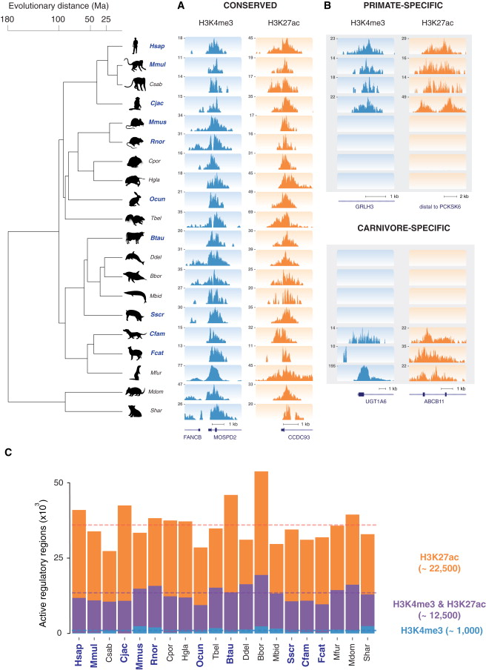
Phylogenetic Relationships of the 20 Mammals
Substantial fraction of mammalian tree
To get a combination of intra- and inter-lineage evolutionary distances
Primates
Rodents
Ungulates
  Cetaceans
Carnivores
Marsupials
Analysis of regulatory regions of previously uncharacterized mammals having highly divergent phenotypes
  Naked mole rat - cancer resistant
  Cetaceans - dolphins and whales
  Tasmanian devil - marsupial
Intra-order distance = 6 - 40 Ma
Inter-order distance = 80 - 180 Ma
Notes:
Figure 1A.
Intra-order = 6-40 Million years; inter-order = 80-180 Million ears divergence time;
18 placental species in 4 orders and 2 marsupial species in 2 orders. 20 species from 6 orders.
The 20 species were chosen
Other work - alignments of the 10 best assembled, best annotated genomes, from the Ensembl EPO pipeline,
Where EPO = the algorithms Enredo, Pecan, Ortheus.
Other work with best species from each order or clade - Human (primates), Mouse (rodents), Cow (ungulates) and Dog (carnivores).
Reformulate as question: Why were these particular 20 species chosen? The slide answers this.

Slide 4
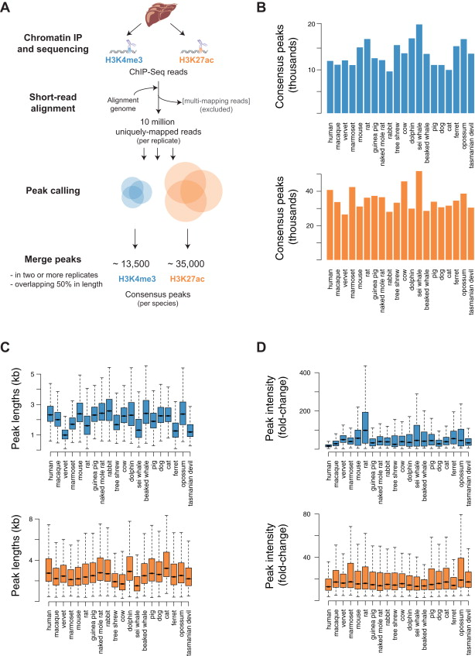
ChIP-SEQ Protocol
Fresh or frozen liver tissue
At least 2 biological replicates
Chromatin fragmented to ~300 bp
3 NGS samples from each individual:
  Input DNA
  H3K4me3 Ab
  H3K27Ac Ab
SE 50 bp
Alignment with BWA v.0.5.9
Multi-mapping reads removed with Samtools '-q1'
Peak calling with MACS v.1.4.2
Peaks present in at least 2 biol. replicates and overlapping at least 50% of length kept
Notes:
Figure S1A.
Liver tissue mainly fom adult males (but some females included - whales, tasmanian devil, perhaps other).
MACS peak calling. Retaining all statistically enriched regions p<10e-5.
No filtering on fold enrichment or FDR correction.
Different parts of the paper seem to quote different values for average number of promoter or enhancer peaks per species.
Perhaps: 13.5 K = 12.5K both H3K4me3 and H3K27Ac marks (promoters); 1K H3K4me3 marks only;
35K = 12.5K both H3K4me3 and H3K27Ac marks (promoters), 22.5 H3K27Ac only (enhancers).

Slide 5
H3K4me3 and H3K27ac Histone Marks in Mammalian Liver
~ 30 - 45 K regions enriched in liver for each species
~ 22.5 K H3K27ac only (enhancers)
~ 12.5 K H3K4me3 and H3K27ac (promoters)
~ 1K H3Kme3 only (promoters)
Results of ChIP-Seq analysis
Peaks present in 2 or more biological replicates
Most H3K4me3 enriched regions occur at transcription start sites
Regions enriched for H3K4me3 often also enriched for H3K27ac
H3K27ac alone often located far from transcription start sites
Notes:
Twice as many enhancer regions as promoter regions.
Identified by histone marks, not sequence similarity or alignability.
Fig. 1C.

Slide 6
Number of Consensus Peaks for Each Species
Blue - H3K4me3
Orange - H3K27Ac
Purple - H3K4me3 & H3K27Ac
Nearly 3X as many H3K27Ac peaks
Peaks were separated into
  H3K27Ac only (enhancers)
  H3K4me3 & H3K27Ac (promoters)
  H3K4me3 only (promoters)
Notes:
Figure S1B, Figure 1C.

Slide 7
Enhancers and Promoters in Mammalian Liver
Number of active regulatory regions per genome.
Species names in bold are high quality genomes.
 | H3K27Ac | H3K4me3
H3K27Ac alone, Enhancer | 22,500 | -
H3K4me3 & H3K27Ac, Promoter | 12,500 | 12,500
H3K4me3 alone, Promoter | - | 1,000
Totals | 35,000 | 13,500
Notes:
Figure 1C.
Number of active regulatory regions = number of experimentally-determined histone marks, enhancers and promoters.
The regions enriched in liver in each species separated into K27, K4me3 and K27, and K4me3 elements.
Same color code is used in all figures:
Orange - H3K27Ac marks, enhancers
Purple - co-existing H3K4me3 and H3K27Ac marks, promoters
Light Blue - H3K4me3 marks, promoters.
Species names in bold correspond to the highest quality genomes, incorporated into the Ensembl EPO multiple alignment.
In liver, a typical mammalian genome contains roughly 22,500 enhancers enriched for only H3K27Ac, etc.

Slide 8
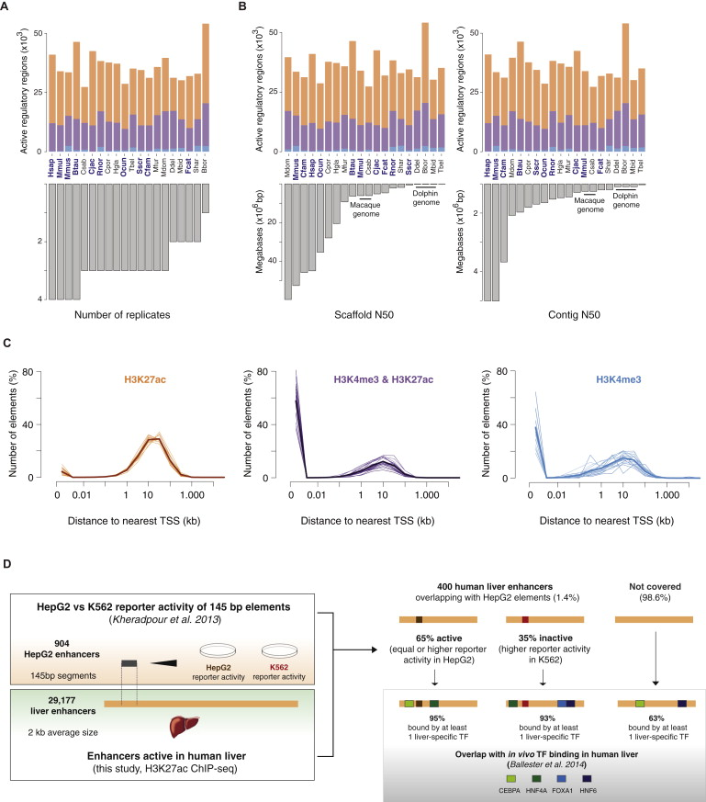
Analysis of Number of Regulatory Regions
Promoters/enhancers per species, arranged by:
    number of biological replicates
    assembly quality
      scaffold N50
      contig N50
H3K4me3&H3K27Ac - purple
H3K4me3 - blue
H3K27Ac - orange
Notes:
Figure S2A, S2B.
Note that the species namesin blue/bold are the genomes in the Ensembl EPO multiple alignment, considered to be the highest quality reference genomes.
Note that the Sei whale, Balaenoptera borealis, for which there was only 1 biological replicate, has a relatively high number of regulatory regions, probably because no peaks were discarded because not present in at least one other replicate.
Except for the Sei whale, the number of biological replicates has little effect on the number of active regulatory regions found.
The assemblyquality seems not to have had any effect on the number of promoters and enhancers found.
Reformulate slide title as a question:
Is the number of regulatory regions found per species affected by experimental parameters?:
Number of biological replicates (No; except for Bbor), or quality of genome assembly (as measured by scaffold N50 or contig N50)(No).

Slide 9
Distance to Nearest TSS for Enhancers/Promoters
Enhancers Promoters Promoters
Most H3K27Ac marks are distal to coding regions, in agreement with
categorization as enhancers
H3K4me3&H3K27Ac and H3K4me3 marks are largely located close
to annotated TSSs, consistent with being proximal promoters
The minority of H34Kme3&H3K27Ac and H3K4me3 marks distal to
TSSs may correspond to unannotated transcripts
Bold lines represent the average across all species
Notes:
Figure S2C.
Distribution of distances to the nearest Transcription Start Site (TSS) was calculated for all experimentally identified regions for each species. Bold lines represent the average distance distribution across all species.Distance is plotted on a log scale, and in kilobases.
H3K27Ac categorised as enhancers,
Reformulate as a question:
Is there any difference in the distance from TSS for the different histone marks? Yes.

Slide 10
Conserved and Lineage-Specific Regulatory Regions
Regulatory regions that are conserved are ones that are present in all 20 species.
More recently evolved regions are present only in some orders or species.
Notes:
Figure 1A, 1B.
Examples of conserved and lineage-specific regulatory regions, both trimethylated K4 marks (promoters), and acetylated K27 marks.
The extent of conservation of a region is denoted by the number of species, out of the 20, in which it is found.
The figure shows examples of highly conserved promoters and enhancers, and of primate-specific and carnivore-specific promoters and enhancers.

Slide 11
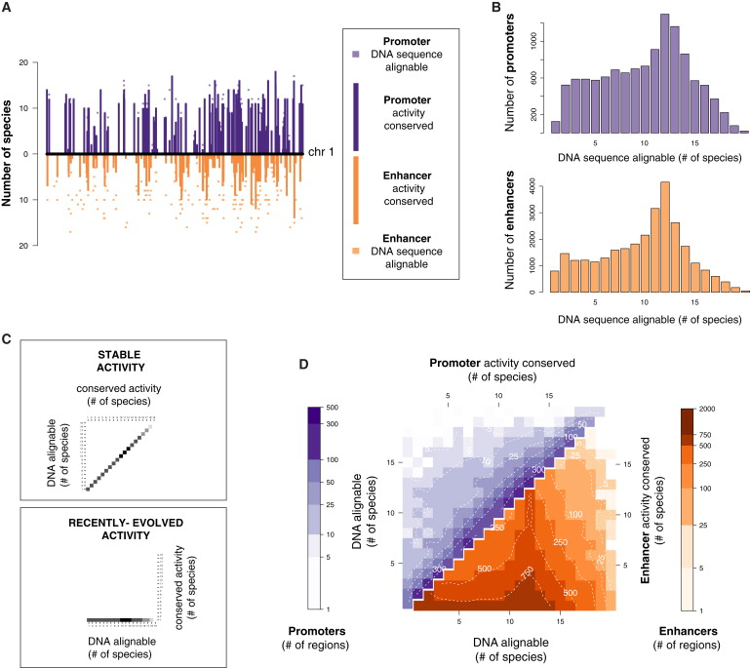
Evolution of Promoters and Enhancers
Enhancers evolve rapidly, promoters are highly conserved
A 10 Mb of human chr 1
Bars: number of species where promoters or enhancers are active
Squares: number of species where the sequence is alignable
B alignability of promoter and enhancer DNA sequences across species
differences in conservation of activity are not due to differences in alignability
Notes:
Figure 2A, 2B.
As for the other figures, Promoters are purple, Enhancers are orange.
Number of species where promoters or enhancers are active = extent to which that promoter/enhancer is conserved.
Bars: you can see that the promoters are conserved across a larger number of species than the enhancers.
Number of species where the sequence is alignable, there is an orthologous region = extent to which the sequence is conserved.
Figure 2A.
Squares: You can see that for the promoters, the number of species where the promoter activity is conserved is not very different from the number of species where the sequence is conserved,
Whereas for the enhancers
You can see that the sequence is conserved over a greater number of species than the enhancer activity,
So the sequence is conserved, but not the enhancer activity. (?does this make sense)
Sequence is conserved for both promoters and enhancers.
Promoter activity is highly conserved.
Enhancer activity is not as conserved.
Figure 2B.
Note that the plots are not on the same scale, but then there are about twice as many enhancer regions as promoters.
The DNA sequences underlying the promoters and enhancers can be aligned to similar numbers of sequences.
Differences in conservation are not due to alignability (or change/evolution of the DNA sequence).

Slide 12
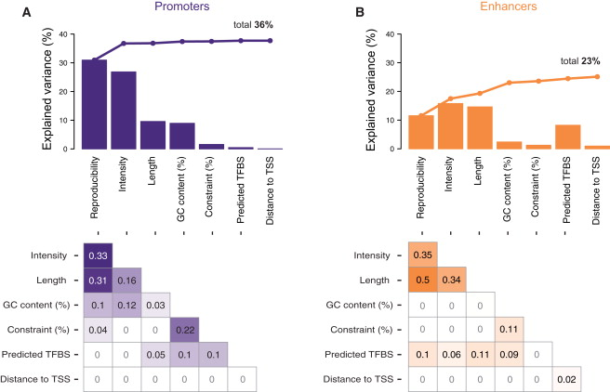
Features Contributing to Conservation of Activity
For both promoters and enhancers, enrichment reproducibility and intensity of signal are primary predictors of conservation
Experimental features
  Reproducibility
  Peak intensity
  Peak length
Genomic features
  GC content
  Sequence constraint
  TF binding sites
Notes:
FIgure 3.
For human liver, they looked at various experimental features or genomic features that might predict conservation of activity.
For promoters, these factors predict a total of36% of conserved activity, and 23% for enhancers.

Slide 13
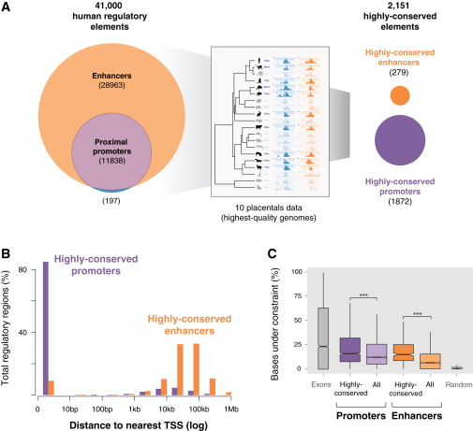
Highly Conserved Regulatory Regions in Liver
Human liver
41,000 active regions
Highly conserved:
16% of promoters (1872)
1% of enhancers (279)
Enhancers are 71% of active regions, but 13% of the highly conserved regions
Most highly conserved active regulatory regions are proximal promoters
Most highly conserved promoters are located at TSS, whereas highly conserved enhancers are tens to hundreds of kb from the nearest gene
Highly conserved promoter and enhancer regions show small increases in selective constraint of the underlying DNA sequence
Notes:
Figure 5.
A. Most Highly Conserved Liver Regulatory Regions Are Proximal Promoters.
As usual: promoters - purple, light blue; enhancers - orange;
Or rather: orange - K27Ac only, purple - both K4me3 and K27Ac, light blue - K4me3 only;
Human liver: 41,000 active regulatory regions; 28963 enhancers (70.6% of regions), 11838 proximal promoters, 197 K4me3 only proximal promoters;
Cross-species comparison with the 10 placental species with the highest quality genomes gave 2151 elements labelled as highly conserved,
1872 promoters and 279 enhancers (13% of conserved regions); ~1% of enhancers were highly conserved across the high-quality genomes; 16.8 % of promoters were highly conserved;
B. Distance from Transcription Start Site
Most highly conserved promoters are located at transcription start sites, whereas highly conserved enhancers are tens to hundreds of kilobases from the nearest gene.
C. Sequence Constraint
Percent of bases under sequence constraint:
The distribution of the fraction of bases under sequence constraint, plotted as box plots.
Compared to exons, which are coding regions and so would be under the most constraint:
This compares highly conserved promoters, all promoters, and highly-conserved enhancers, all enhancers;

Slide 14

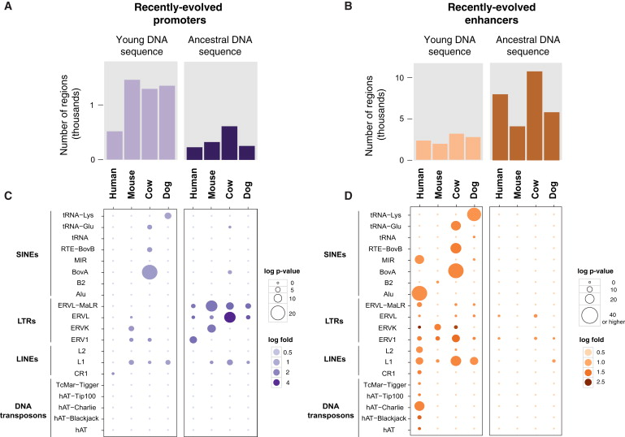
Recently-Evolved Promoters and Enhancers
Recently evolved promoters are largely derived from young DNA
Recently evolved enhancers are mostly exapted from ancestral DNA
About three times as many recently evolved active promoters are found in young DNA as in ancestral DNA
About twice as many recently evolved enhancers are exapted from ancestral DNA as are found in young DNA
Young DNA = Not shared with any other species Ancestral DNA = greater than 100 Ma
Notes:
Figure 6A, 6B.
Exaptation Drives Recently Evolved Enhancer, But Not Promoter, Activity.
Functional exaptation of ancestral DNA was recently reported for human-specific enhancers active in embryonic limb (Cotney, 2013).
They tested whether this was a prevalent mechanism in genome evolution, using the apomorphic regulatory regions found in this work.
Representative species for each placental order: Primates - Human, Rodents - Mouse, Ungulates - Cow, Carnivores - Dog.
Regions with recently evolved promoter and enhancer activity in liver were identified in a representative species from each of the 4 placental orders.
The bar plots show the number of promoter or enhancer regions in each species present in either young DNA sequence or ancestral DNA sequences.
You can easily see from the bar plots that there are many more promoters in the young DNA than the ancestral, and the reverse for enhancers.
Q: How did they identify which is young DNA and which is ancestral DNA? Alignability across species I think.
Whereas recently evolved promoters/enhancers are identified by presence (conservation) of the histone marks in other species/other orders.
Get the definition of exapted.
Evolutionarily younger DNA - not shared with any other species.
Ancestral DNA sequences - > 100 Million years old
Mouse: 1400 recently evolved promoters in young DNA, 260 in ancestral DNA.

Slide 15
Repeat Families Enriched in Recently-Evolved Promoters and Enhancers
ERV
Notes:
Figure 6C, 6D.
ERV = ? Endogenous Retrovirus.
Again, in the 4 representative species, one from each order of placental mammals, human, mouse, cow, dog:
This shows the various families of repeats present in newly-evolved promoters (in blue) and enhancers (in orange).
For example SINEs, LINEs, LTRs (long terminal repeats) and DNA transposons.
Makes sense, LTRs, long terminal repeats, are from retroviruses. The ERV repeats are in the LTR class.
Size of spots and intensity of color

Slide 16
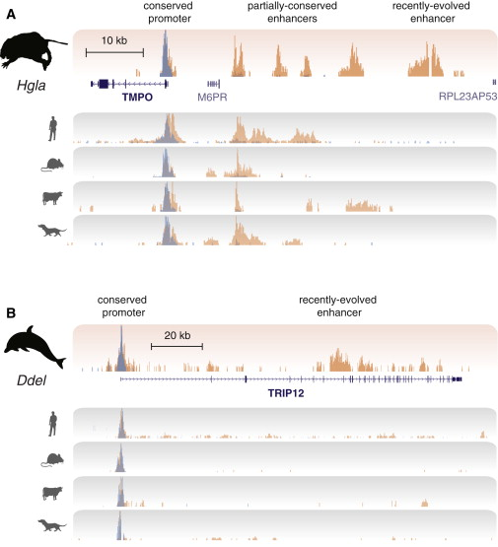
Recently Evolved Enhancers Associate with Genes under Positive Selection
Naked mole rat
TMPO thymopoeitin
Identified as under positive selection.
Promoter conserved (present in all)
4 enhancers present in subset
One recently evolved mole rat-specific
Dolphin
TRIP12
Thyroid hormone receptor interactor 12
Under positive selection in dolphins
Promoter conserved
No other mammals show liver enhancer
Candidate for regulatory regions associated with positive selection in dolphins
Blue – H3K4me3 Orange - H3K27Ac
Notes:
Figure 7. liver (the only tissue used in this study).
Genes under positive selection during naked mole rat and dolphin evolution.
Orthologous regions in human, mouse, cow, dog (one representative from each clade, primates/rodents/ungulates/carnivores).
Blue – Promoters, H3K4Me3 marks; Orange – Enhancers, H3K27Ac marks;
Naked mole rat – lists of genes under positive selection, see Kim et al, Nature 2011.
TMPO, human, thymopoietin
may play a role in the assembly of the nuclear lamina, and thus help maintain the structural organization of the nuclear envelope. It may function as a receptor for the attachment of lamin filaments to the inner nuclear membrane. Mutations in this gene are associated with dilated cardiomyopathy
Figure compares orthologous regions in human, mouse, cow and dog.

Slide 17
Evolution of Enhancers and Proximal Promoters
Promoter and enhancer sequences show only slight differences in alignability across the species used in the study
Promoter activity is evolutionarily stable
Rapid enhancer evolution, involving exaptation of ancestral DNA
Enhancer locations evolve rapidly, comparatively few are deeply conserved
Sequence features: % GC content, TF binding sites, sequence constraint
Experimental features: reproducibility, occupancy level/intensity, length
Best predictor of conservation in promoter regions is reproducibility and strength of enrichment of H3K4Me3 and H3K27Ac
Experimental features are stronger indicators of the conservation of regulatory activity than sequence features in promoter regions
Presence of TF binding sites can explain modest fraction of the conservation of enhancer activity
For both promoters and enhancers, enrichment reproducibility and intensity of signal is primary predictor of conservation
Notes:
Definition of exaptation:
Conservation of active liver promoters tracked closely with alignability of the DNA.
Indicating evolutionarily stable promoter activity.
The transcription initiation sites driving gene expression in liver are highly conserved.
Figure 2, Figure S3. Figure 3.
Definition of sequence constraint.

Slide 18
Limitations of study
1. Understanding of relationship between different histone marks and enhancer activity is not perfect.
Global mapping of H3K4me1 and p300 can also detect poised enhancer activity.
2. Other approaches to map regulatory sequences, such as Dnase-seq and ATAC-seq, can reveal all regions of open chromatin genome-wide, but cannot distinguish promoters and enhancers.
3. Assumption that adult liver is a representative tissue, and that the results can be generalized to other mammalian somatic tissues
4. The study couldn't evaluate how often regions with regulatory activity are tissue-specific, particulary for enhancers. DNA sequences not identified in this study may act as enhancers in other tissues.
Notes:
Most tissue samples were liver from young adult male individuals.

Slide 19
Summary
ChIP-Seq analysis of H3K4me3 and H3K27Ac histone marks
In liver, from 20 mammalian species
Comparison of H3K4me3 (promoter) vs H3K27Ac (enhancer) regions
  Number of regions
  Conservation across species
    Sequence conservation (alignability)
    Functional conservation (histone marks)
  Distance from TSS
Promoters are highly conserved, enhancers are rapidly evolving
Most highly conserved regulatory regions are proximal promoters
Recently evolved promoters are mainly in young DNA
Recently evolved enhancers are mostly in ancestral DNA
Recently evolved enhancers associate with genes under positive selection

Slide 21
The 20 Mammalian Species Used
Primates
  Hsap Homo sapiens Human
  Mmul Macaca mulatta Macaque
  Csab Chlorocebus aethiops sabaeus Vervet monkey
  Cjac Callithrix jacchus Marmoset
Rodentia
  Mmus Mus musculus Mouse
  Rnor Rattus norvegicus Rat
  Cpor Cavia porcellus Guinea pig
  Hgla Heterocephalus glaber Naked mole rat
  Ocun Oryctolagus cuniculus Rabbit
  Tbel Tupaia belangeri Tree shrew
Ungulates
  Btau Bos taurus Cow
  Cetaceans
    Ddel Delphinus delphis, Lagenorhyncus albirostris Dolphin
    Bbor Balaenoptera borealis Sei whale
    Mbid Mesoplodon bidens Sowerby's beaked whale
  Sscr Sus scrofa Pig
Carnivores
  Cfam Canis familiaris Dog
  Fcat Felis catus Cat
  Mfur Mustela putorius furo Ferret
Marsupials
  Mdom Monodelphis domestica Opossum
  Shar Sarcophilus harrisii Tasmanian devil

Slide 22
Data deposited in ArrayExpress: E-MTAB-2633
https://www.ebi.ac.uk/arrayexpress/experiments/E-MTAB-2633/
ChIP-Seq data
59 samples
7 protocols
Files
    Investigation description
    Sample and data relationship
    Processed data (zip file), the MACS data
Link to ENA
    ENA-ERP006568 (the NGS reads)
    http://www.ebi.ac.uk/ena/data/view/ERP006568
    4.5 billion reads, 231 billion bases
    Send file to GENOMESPACE
Notes:
Investigation description file says public release 19/05/2015 (? Not yet)
Protocol description as given in the materials and methods in the paper.
Sample and data relationship:
One of the human liver samples (CRI3, ?Cambridge Research Institute):
ftp://ftp.sra.ebi.ac.uk/vol1/fastq/ERR572/ERR572159/ERR572159.fastq.gz
ftp://ftp.sra.ebi.ac.uk/vol1/fastq/ERR572/ERR572148/ERR572148.fastq.gz
ftp://ftp.sra.ebi.ac.uk/vol1/fastq/ERR572/ERR572219/ERR572219.fastq.gz
Each sample has more than one file of reads – one of the Tasmanian devil samples has 3 fastq files. (note: they did 1X50bp SE reads, single end only).
Tasmanian devil liver samples were from Copenhagen zoo, male was called Montgomery, female was called Mariah.
The 3 samples have different sequencing assay numbers.
OK, makes sense, input DNA and two different Abs = 3 samples.
do2397_Input_liver_unk_sarHar1Mariah_SAN01.fq.gz
ftp://ftp.sra.ebi.ac.uk/vol1/fastq/ERR572/ERR572237/ERR572237.fastq.gz
do2368_H3K27Ac_liver_ab4729_sarHar1Mariah_SAN01.fq.gz
do2366_H3K4me3_liver_millipore_05-1339_sarHar1Mariah_SAN01.fq.gz
I think the processed .zip file is the MACS peaks.

Slide 23
More Notes
1. Sequence constraint, sequence under constraint
2. Positive selection
3. Apomorphic enhancer – enhancer that is unique to a particular species
(so assume newly evolved)
4. Clade - from Greek Klados, branch
5.
PAML – programs for phylogenetic analyses of DNA or proteins using ML, Maximum Likelihood.
Notes:
apomorphy (derived trait) A novel evolutionary trait that is unique to a particular species and all its descendants and which can be used as a defining character for a species or group in phylogenetic terms. Hence, the possession of feathers is unique to birds and defines all members of the class Aves.
apomorphy - Encyclopedia.com
http://depts.washington.edu/jtlab/positiveSelection.html
Positive selection is the process by which new advantageous genetic variants sweep a population. Though positive selection, also known as Darwinian selection, is the main mechanism that Darwin envisioned as giving rise to evolution, specific molecular genetic examples are very difficult to detect. Pioneering work by Yang and Nielsen has provided a much more powerful methodology for detecting positive selection at the sequence level. To understand
Positive selection
Though advantageous mutations are of great interest, they are difficult to detect and analyze because of the fact that neutral and deleterious mutations predominate them in frequency. Two major classes of methods are currently in use to detect positive selection: population methods, based on analyzing the nature and frequency of allele diversity within a species, and codon analysis methods, based on comparing patterns of synonymous and nonsynonymous changes in protein coding sequences. Unfortunately, a nearly complete lack of population sequence information in nematodes (at least for now), limits our analysis to the latter methods.
Methods based on codons:
Look at codon changes in homologous proteins over many species – changes that result in a different amino acid might be deleterious, possibly score according to sequence alignment matrices for proteins.

Slide 24
More notes on naked mole rat (NMR)
Positively selected genes (Supp., 5.5, p.20)
PAML, PRANK
To detect genes that evolved under positive selection, we used PAML, a Maximum-Likelihood method of molecular evolution 22,23.
Specifically, we used the PAML’s branch-site test of positive selection 24,25 to test for positive selection along the NMR branch. We compared ModelA1, in which sites may evolve neutrally and under purifying selection with ModelA that allows sites to be also under positive selection.
P-values were computed using the X2 statistic adjusted by the fdr method to allow for multiple testing.
Alignment quality is of major importance for studies of positive selection as alignment errors can lead to unacceptable high false positives using the branch-site model 26 We used PRANK 27 which differs from other alignment tools in that it utilizes evolutionary information in determining where to place a gap
We filtered the PRANK alignments by gblocks 29,30 and excluded genes with sequence properties that often lead to false positives, such as genes with high proportion of low complexity or disordered regions, ubiquitous domains, repeats, and transmembrane and coiled-coil regions.
Table 18. Positively selected genes.
TMPO P42167 HGL_H00000266732 0.0003(FDR) Lamina-associated polypeptide
Notes:
Identification of genes that have undergone positive selection in the NMR lineage can provide useful pointers to the evolution of its unique traits.
45 genes (0.4%) were identified as positively selected in the NMR lineage at the false discovery rate of 0.01 and 141 genes (1.2%) at the false discovery rate of 0.05 (Supplementary Table 18).
12 out of the 45 genes (corresponding to the false discovery rate of 0.01) passed a strict manual inspection for alignment quality. In comparison, 0.7% of genes were predicted to be positively selected in the human lineage from high-quality alignments and using Rom correction for multiple testing¹³. Interestingly, our set included TEP1, encoding a telomerase component, and TERF1, a telomeric repeat binding factor identified at the false discovery rate of 0.05 (Supplementary Fig. 10). The TERF1 gene product is one of six proteins contributing to the shelterin complex, which shapes and protects telomeres¹⁴ and has been proposed to regulate telomere length¹⁵.
Supplementary materials section 5.4, p.20:
Selective constraints of pseudogenes.
We used human proteins to call homologs in the NMR genome located in synteny blocks (synteny blocks were determined by the human/NMR whole genome alignment).
5.5 Positively selected genes

Slide 25
Functional Annotation of Genes Under Positive Selection
Comparing genome sequences can suggest which genes drive phenotypic adaptations
    By using inference of regions under positive selection
    By analyzing amino acid substitutions in proteins
    Both approaches use alignments of coding sequences
    Limited insight into regulatory regions
Are genes under positive selection associated with apomorphic enhancers, perhaps evolving synergistically?
Compared recently evolved enhancers and positively selected genes in 2 newly-sequenced species, naked mole rat and dolphin (adapted to aquatic env)
TMPO (thymopoietin) gene in naked mole rat (cancer-resistant rodent)
TRIP12 (thyroid hormone receptor interactor 12) gene in dolphin
Recently-evolved enhancers are over-represented near positively-selected genes. TableS5.
Notes:
Naked mole rat has many phenotypic adaptations to environment and has an unusual physiology (cancer resistance, longevity, life in dark, in low oxygen conditions).
What are apomorphic enhancers?

Slide 26
Functional Annotation of Genes Under Positive Selection II
TMPO (thymopoietin) gene in naked mole rat (cancer-resistant rodent)
Notes:
Kim et al, Nature 2011. Genome sequencing reveals insights into the physiology and longevity of the naked mole rat. (Korea, BGI, Boston, Denmark, other USA).
http://www.nature.com/nature/journal/v479/n7372/full/nature10533.html
Lives underground (in the dark) in African deserts. Lives > 30 yrs, longest living rodent, shows negligible senescence, loss of fertility, etc until death. Resistant to spontaneous or experimentally-induced tumours.
Live in large colonies with a ‘queen’.
Analysis of genome sequence reveals unique genome features and molecular adaptations consistent with cancer resistance, hairlessness, insensitivity to low oxygen, altered visual function.
Genome and transcriptome data.
25% of genome was transposon-derived repeats, lower than other mammals (40% in human); predicted number of genes 22.5K, comparable to other mammals; >98% of genes annotated using homology.
Most of genes showed synteny with human, mouse, rat; suggests not much genomic rearr since splitting from last murid common ancestor.
Lineage-specific gene family expansions may be associated with the emergence of specific functions and physiology. Compared to other mammals, the NMR showed a moderate number of gene families under expansion and contraction, including 96 NMR lineage-specific gene families. Analysis of syntenic regions identified 750 gained and 320 lost NMR genes

Slide 27
Sequence Constraint
Sequences under evolutionary constraint
  Powerful approach for locating functional elements in a genome
  Mutations that affect bases with sequence-specific functionality will be deleterious and will be eliminated by purifying selection

Slide 28
Results and Discussion - Subheadings
Results
Profiling Promoter and Enhancer Regulatory Evolution in Mammalian Liver
Enhancer Evolution Is Appreciably More Rapid Than Proximal Promoter Evolution
Highly Conserved Regulatory Regions Are Largely Proximal Promoters
Recently Evolved Regulatory Activity Is Pervasive in Mammals
Exaptation Drives Recently Evolved Enhancer, But Not Promoter, Activity
Functional Annotation of Genes Under Positive Selection
Discussion
A Global Overview of Enhancer and Promoter Evolution in Mammals
Active Mammalian Enhancers Are Predominantly Apomorphic
Recently Evolved Promoters, Though Less Common Than Enhancers, Are Mostly Found in Young DNA
A Strategy for Identifying the Enhancer Repertoire of Unannotated Genomes
Future Directions

Slide 31
Figure S1

Slide 32
Figure S1

Slide 33
Figure S2

Slide 34
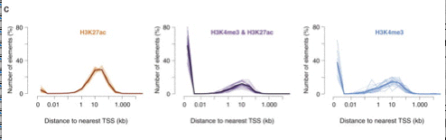
Distance to Nearest TSS for Enhancers/Promoters
Notes:
Figure S2C.

Slide 35
Number of Consensus Peaks for Each Species
Blue - H3K4me3
Orange - H3K27Ac
Nearly 3X as many H3K27Ac peaks
as H3K4me3 peaks
Notes:
Figure S1B.
Same colors used in all figures in the paper.
The acetylated K27 marks are show in orange, and the trimethylated K4 marks are in blue.

Slide 36
Evolution of Promoters and Enhancers
Notes:
Figure 2.

Slide 37
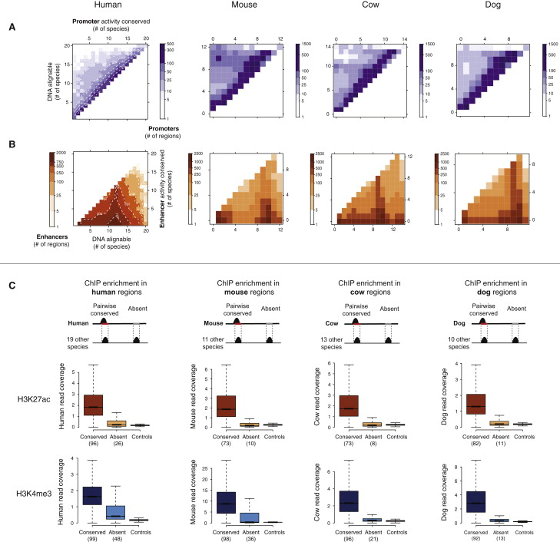
Figure S3

Slide 38
Figure 3
Notes:
FIgure 3.

Slide 39
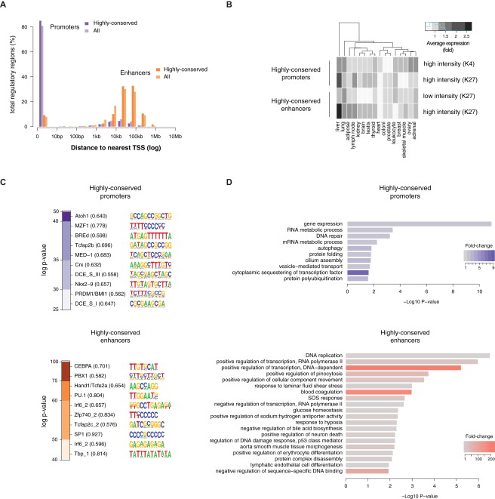
Figure S5

