Slide 1
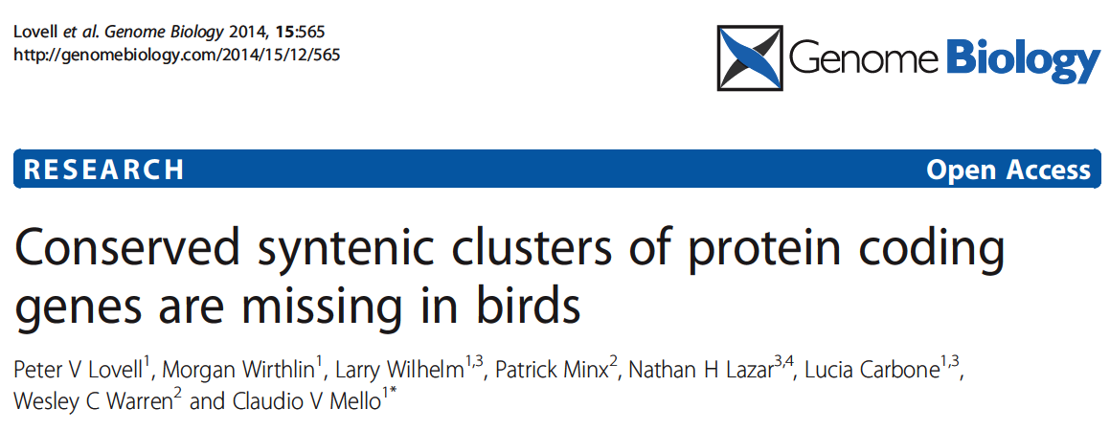
Maria Stalteri
Feb. 02, 2015

Slide 2
Introduction
Bird genomes are more compact
Loss of non-coding DNA
Compared to mammals:
    Less repetitive DNA
    Fewer pseudogenes
    Shorter introns
Also loss of protein-coding genes
    Chicken 15.5 K vs. 18.5 K lizard, frogs
Previous work (the zebra finch genome paper, Nature 2010):
    Chr alignment of 1-1 orthologs from represetative vertebrate species can be used to identify protein coding genes missing in birds
    Syntenic gene block on human chr X that includes Synapsin1 (SYN1) is missing in zebra fish, chicken, present in lizard
Apply systematically to entire genome of birds
More comprehensive picture of extent of gene losses in birds
Notes:
Bird genomes are more compact compared to other amniotes.
Speculation that this was due to higher rates of oxidative metabolism necessary for evolution of flight.
But evolution of compact genomes may have occurred before emergence of flighted birds.
Less repetitive DNA, fewer pseudogenes, shorter introns compared to mammals.
Ensembl 71: human 20.8K protein-coding genes, 18.6K anole lizard, 18.4K frogs
Birds are also known to have high rates of chromosomal rearrangements compared to other organisms – could have resulted in losses of syntenic groups of protein-coding genes.
Amniotes – clade of vertebrates that lay eggs on land, have specialised membranes around the egg – amnion, chorion, allantois.
(Reptiles, Birds, Mammals)
Anamniotes lay eggs in water, have tadpole stage. (Fish, Amphibians).
Ref to prev. Work:

Slide 3
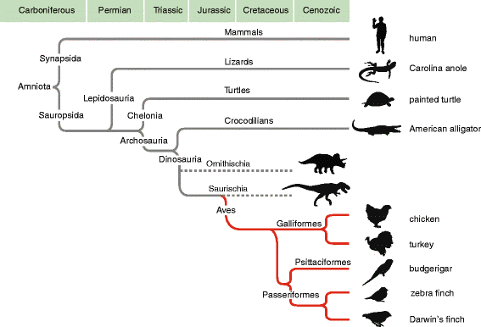
Phylogenetic Relationships Among Amniotes
Notes:
Phylogenetic Relationships Among the Major Amniote Lineages,
Showing the various vertebrate species used in this study.
Most of the work was done, as we will see later, on human, anole lizard and chicken, because these are the best annotated and assembled genomes presently available,
Using chicken as a model for birds, with contributions from zebra finch and other bird genomes,
Lizard is used because it is a non-avian descendant of dinosaurs, and the same for crocodilians, of which alligator is a representative.
(The red lines are birds.)
Genes that are shared by all organisms shown, but missing in birds,
ARE PRESUMED TO HAVE BEEN LOST IN NON-CROCODILIAN ARCHOSAUR, (POSSIBLY SAURISCHIAN),
ANCESTORS OF BIRDS.
So the top half of the tree have the genes, the dinosaurs are extinct so I don't know how you can tell what genes they may or ma not have had, and the bottom half of the tree are birds, so they don't have the genes.

Slide 4
Homologous Genes
Similarity attributable to descent from a common ancestor
Orthologs
    Genes in different species derived from an ancestral gene in the last common ancestor
Paralogs
    Homologous genes that arose by gene duplication
  http://www.ncbi.nlm.nih.gov/books/NBK21106/
Notes:
NCBI – can search HomoloGene database with the gene name, or Gene or Protein databases.
Or you can do nucleotide or protein blast with a protein or nucleotide sequence.
HomoloGene is an automated system for constructing putative homology groups from the complete
Gene sets of a wide range of eukaryotic species.
http://www.ncbi.nlm.nih.gov/guide/howto/find-homolog-gene/
A gene homology tool that compares nucleotide sequences between pairs of organisms in order to identify putative orthologs. Curated orthologs are incorporated from a variety of sources via the Gene database.
http://www.ncbi.nlm.nih.gov/homologene
HomoloGene is based on the proteins from the input organisms.
Sequences are compared using blastp,, matched up and put into groups.
Paralogs are identified by finding proteins that are closer within species than other species.

Slide 5
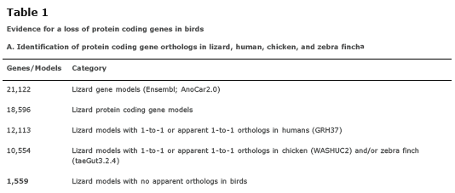
Orthologs in Lizard, Human, Chicken, Zebra Finch
Start with all lizard (Anolis carolinensis, green anole lizard) gene models in Ensembl 71
Chicken and zebra finch were the best assembled and curated avian genomes
Lizard/human orthologs
Lizard/chicken orthologs
1559 lizard protein coding gene models with no orthologs in birds
1559 potential candidates for missing genes in birds
Notes:
This is how they went about trying to do a genome-wide analysis of the missing genes in birds:
Start with the lizrd genome,
21K gene models in Ensembl 71
Take only protein coding genes, 18K

Slide 6
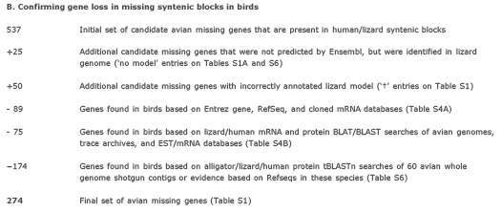
Narrowing Down List of Missing Genes in Birds
1559 candidate missing genes
537 cluster into ~100 conserved syntenic blocks in human/lizard
    Blocks are typically >80 Kb, can be confident that they are absent
~1000 occur as singletons throughout non-avian genomes OR are on unplaced segments in avian genome assemblies (Chr_Un)
    Not possible to establish orthology or synteny
Focus on the syntenic blocks
Notes:
Check tBLASTn.
Search Translated (t) Nucleotide (n) databases using a Protein query.
The 174 genes removed from the list had hits to avian genomes, but NOT to chicken.
These are not found in chicken GENOME or TRANSCRIPTOME.
BUT the aim was to identif genes that are missing in all birds and not just in chicken.

Slide 7

Final Count of Genes Missing in Birds

Slide 8
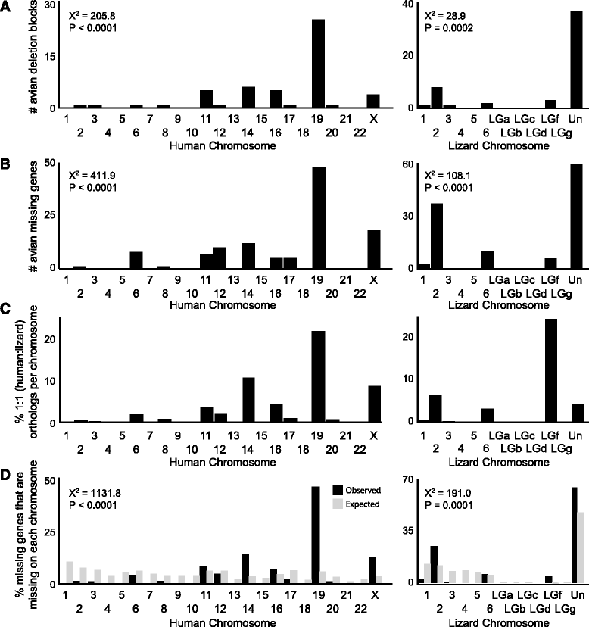
Distribution of Avian Missing Genes
Number of avian deletion blocks on human and lizard chromosomes
Number of avian missing genes on human and lizard chromosomes
Human chromosomes numbered 1 to 22 in order of decreasing size
Missing blocks not randomly distributed by chromosome size
Concentrated on human chr 19, lizard chr 2
Notes:
Human chromosomes are numbered in order of decreasing size, with 1 the largest and 22 the smallest.
Human chromosome 19 is supposed to be particularly gene-rich.
Note also that in lizard the majority of blocks and genes are on Chr_Un, obviously reflecting the current state of the lizard genome assembly.

Slide 9
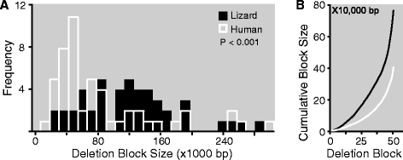
Total Size of Deletion Blocks in Human and Lizard
Average size of avian missing syntenic blocks is about twice as large in
lizard compared to human, 143 Kb vs 76 Kb
Cumulative size of missing blocks in lizard is 7.4 Mb vs 3.9 Mb in human
Species difference in block sizes is due to size difference in blocks on just
a few human chromosomes
Avg size of blocks on human chr 19: 150 Kb for lizard vs 85 Kb for human
90% of the missing blocks are located on just 5 chromosomes in human,
19 (54%), X, 11, 14, 16
Notes:
Histogram in Panel A shows the number of deletion blocks by size in human and lizard;
Size of blocks along x-axis versus how many blocks of each size.
Note that the human (white) has more smaller blocks, whereas the lizard (black) has more larger blocks.
Panel B shows the cumulative size of the deletion blocks in human compared to lizard.
There are about 50 syntenic blocks (of genes missing in birds).
Why are the syntenic blocks in lizard larger than those in humans?
Are intron sizes or intergenic DNA greater in lizard,
Is it because human chr 19 is more gene rich, and most of the blocks are in chr 19?

Slide 10
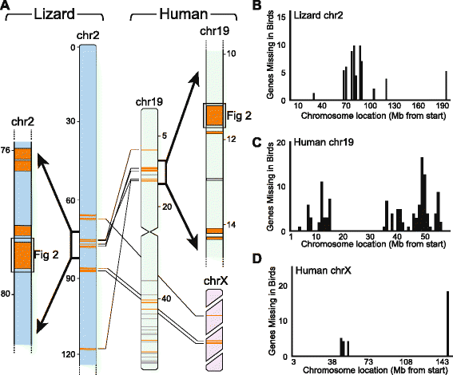
Avian Missing Gene Blocks on Lizard and Human Chromosomes
Notes:
Right hand side:
Chromosomal location of the avian missing syntenic blocks,
Along lizard chromosome 2,
Human chromosome 19, and
Human X chromosome.
Showing localisation to hot spots.
Left hand side:
Lizard chromosome 2,
Thin lines show location of syntenic blocks of orthologous genes on human chromosome 19 and the X chromosome.
Gray blocks on human chr 19 are on unplaced contigs in lizard.
Expanded view of a small region including the syntenic block shown in Figure 2, where the order of genes is shown.

Slide 11
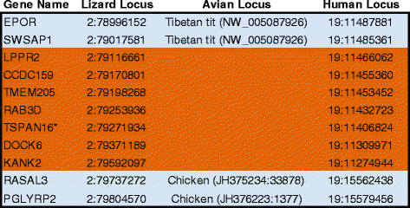
Example of Avian Missing Syntenic Block
Alignment of 1-1 orthologous genes in lizard, chicken, human
Based on chromosomal position in lizard
Lizard chr 2, human chr 19
Flanking genes are present in all species, incuding birds
Complete list of genes given in Supplementary Materials
Notes:
Tables S1A and S1B give list of the 274 genes in syntennic blocks and near syntenic blocks.

Slide 12
Exhaustive Search for Avian Missing Genes
To confirm that the genes are indeed missing in birds
Found and corrected misannotated gene predictions
Identified previously unknown orthologs and paralogs
Cross-species BLAT alignments (hits to paralogs)
Search of other databases - Entrez Gene, RefSeq, NCBI avian mRNAs
BLAT or Blast searches of avian genome assemblies (turkey, medium ground finch, budgerigar) and avian ESTs
tBLASTn searches of WGS databases
Search of chicken transcriptome databases
Manual curation of hits
Conservative approach - removed genes fom missing list if they had any avian hits that were reciprocal best hits with ortholog in non-avian species
Aim was to identify genes missing in all birds, not just chicken
Notes:
NCBI – can search HomoloGene database with the gene name, or Gene or Protein databases.
WGS = whole genome shotgun.
Aim was to identify genomic losses shared by all birds, not just in chicken.
So, 174 of the 537 genes were removed from the search because they were found in some avian genomes BUT
These 174 genes were not found in galGal4 genome or chicken transcriptome.
Or you can do nucleotide or protein blast with a protein or nucleotide sequence.
HomoloGene is an automated system for constructing putative homology groups from the complete
Gene sets of a wide range of eukaryotic species.
http://www.ncbi.nlm.nih.gov/guide/howto/find-homolog-gene/
A gene homology tool that compares nucleotide sequences between pairs of organisms in order to identify putative orthologs. Curated orthologs are incorporated from a variety of sources via the Gene database.
http://www.ncbi.nlm.nih.gov/homologene
HomoloGene is based on the proteins from the input organisms.
Sequences are compared using blastp,, matched up and put into groups.
Paralogs are identified by finding proteins that are closer within species than other species.

Slide 13
Avian Missing Genes Only Missing In Birds
Positive control (genes present in birds):
    91% of chicken/lizard orthologs present in alligator or crocodile
274 avian missing genes:
    86% of missing genes present in crocodilians (alligator or crocodile)
    94-95% present in Sarcopterygians (coelacanth, Xenopus)
    90% present in teleosts (zebra fish, fugu)
Loss of the 274 genes occurred only in birds
Loss occurred subsequent to split of dinosaurs/birds from crocodilians
Notes:
Positive control:
The genes present in birds:
Test that the genes present in human/lizard/chicken are present in crocodilians.
BLAT-alignments.

Slide 14
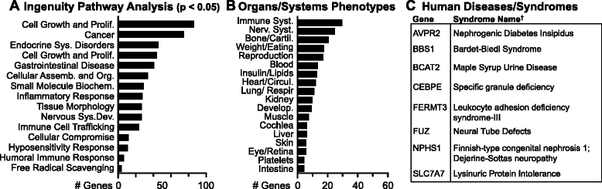
Functions of Avian Missing Genes I
Ingenuity Pathway Analysis
Functional enrichment categories related to:
  Diseases and Disorders
  Molecular and Cellular Functions
  Physiological System Devel. and Function
Ranked by number of genes
A range of biological function categories that are significantly enriched
Many of the missing genes participate in major cellular functions or are
implicated in severe human hereditary diseases and disorders
    Cell growth and proliferation
    X-linked mental retardation
    Immune function
    Nervous system development
Missing genes also enriched in canonical pathways that regulate the
functions of various organs and signaling systems
Notes:
What do the missing avian genes do? Functional enrichment analysis using Ingenuity Pathway Analysis.
Impact of the observed gene losses?
How do birds cope without the missing genes?
Obviously if genes are associated with features/functions missing in birds - teeth, hair, then not a problem,
But genes are associated with a wide range of basic biological functions

Slide 15
Functions of Avian Missing Genes II
B. Mouse Genome
Informatics (MGI)
C. Online Mendelian
Inheritance in Man
(OMIM)
MGI - phenotypes observed in mice on knockout of missing avian genes
Phenotypes caused by single gene or multiple gene knockouts
Organs/systems affected by knockout
98 genes associated with phenotypes affecting major organs/systems
~5% of genes associated with mouse phenotypes involving tissues or
functions that are absent in birds (hair, teeth, placenta, lactation)
43 genes associated with lethal phenotype in mice
OMIM - 32 genes associated with specific genetic disorders in humans
C - genes associated with human disorders also linked to lethal phenotypes
in mice
Notes:
About 5% of the missing genes are associated with mouse phenotypes involving tissues or functions that are
ABSENT IN BIRDS.
Since IPA analysis suggested that some genes were associated with severe hereditary diseases in humans,
Did further search in OMIM.

Slide 16
Permutation Analysis - MGI Phenotypes
To determine whether the associations with severe and/or lethal phenotypes in mice were unique to missing genes:
1000 independent permutations of 98 genes, i.e. 1000 gene lists, 1000 control gene sets
Retrieved MGI phenotypes associated with genes
Test for difference between number of phenotypes associated with missing gene set versus distribution of number of phenotypes associated with the 1000 controls
Compare number of genes associated with each phenotype in missing gene set versus distribution of the number of genes associated with each phenotype in control data sets, using BH correction for multiple testing
Notes:
See Additional file 4, Fig S3; Also Table S10B
P-value is the number of times you get a result equal to or more extreme than our data.
To determine whether the associations with severe or lethal phenotypes are unique to the missing genes or more generally associated with any comparably sized and organized sets of genes.
The 98 genes with lethal phenotype in mice.

Slide 17
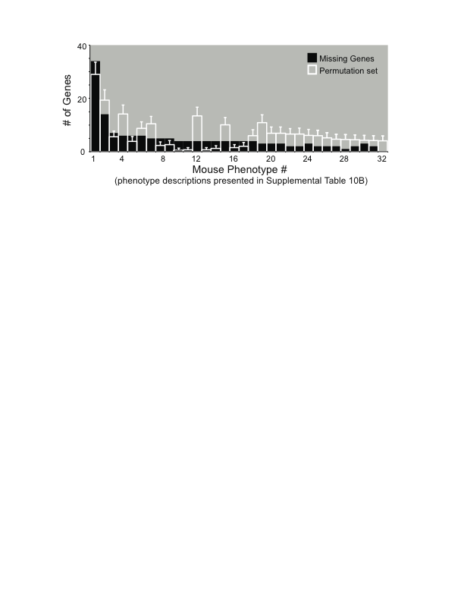
Results of Permutation Analysis
Number of genes associated with a mouse phenotype in the missing gene set is significantly smaller than would be expected based on analysis of the permutation datasets
Strong trend towards a greater association of genes with phenotypes associated with lethality in the permutation dataset compared to the avian missing gene set
Similar permutation analysis for the genes associated with OMIM disease terms
Hypothesis that gene losses associated with deleterious phenotypes would be less likely to be tolerated and so will be less frequent in the avian missing gene set than in the permutations of control gene sets
Missing gene set contained significantly fewer OMIM disease terms

Slide 18
How Do Birds Compensate for the Lost Genes
Blast2GO comparative functional enrichment analysis
Compare impact of loss of the avian missing genes against the genetic background of human, chicken and lizard
Identified the set of enriched GO terms associated with the missing genes compared to all protein coding genes for each species
GO term enrichments in a given organism reflect functions that are over-represented in the missing gene set compared to the rest of the genome, and thus are not functionally compensated within the genetic background
There were fewer overall statistically significant GO term enrichments in chicken (235) than in lizard (338) and human (294).
Group of genes with enriched GO terms in non-avian species (human, lizard), may represent genes whose losses are compensated in birds
Genome-wide screening for avian paralogs to identify possible sources of compensation for missing genes
Found examples where a close paralog may have provided compensation
Notes:
Figure 8A, Additional file 1, Table S3.
Synteny analysis, Figure 8C.
Phylogenetic analysis, Figure 8B.
Fig. 8D NCBI Conserved Domains Database
Check what OrthoMCL does, what is orthogroup classification.
Orthogroup is group of orthologous genes in extant species, descended from common ancestor.
OrthoMCL does protein Blast, reciprocal best hits to find orthologs, paralogs.
?multiple sequence alignments (MUSCLE), MCL stands for Markov Clustering ….
OrthoMCL helps to find orthologs, paralogs.

Slide 19
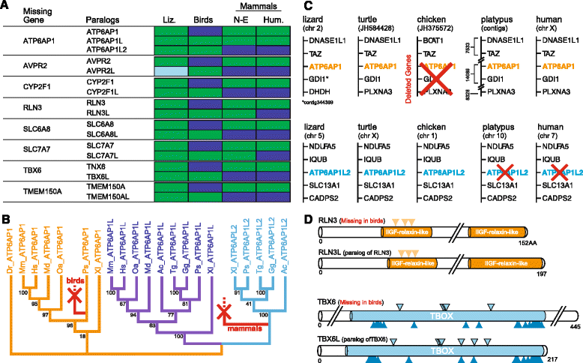
Paralogs of 8 Missing Avian Genes
Notes:
A.Summary of newly discovered paralogs of 8 avian missing genes.
And showing copies that have been independently lost in birds and mammals.
Green colored cells indicate gene is present, blue cells indicate gene is missing.
N-E, non-eutherian mammal, I.e. opossum (monodelphis domestica) and platypus
C. Synteny analysis of ATP6P1 and its paralog ATP6P1L2.
Can see the gene is missing in chicken, but the paralog is missing in human and platypus.
ATP6AP1 is associated with GO terms enriched in humans and lizards but not birds (implies compensated in birds).
Previously unidentified paralog is present in birds and lizard but missing in mammals, the other paralog is present in all tetrapods.
Analysis of sequence pairs or triads using NCBI's Conserved Domains Database.
Paralogs formed from ancestral duplication of genes in the missing gene list.
Structural or functional domans are conserved across paralogs.

Slide 20
Summary
Using comparative genomics, mainly comparing human/lizard/chicken/zebra finch genomes, found 274 genes missing in birds
Mainly in syntenic blocks in human and lizard
Associated with disease phenotypes in human, mouse
Only ~5% associated with functions missing in birds
Gene loss shown to be compensated by paralogs in some cases

Slide 23
Gene Orthology Assignment
From the zebra finch genome paper:
  The EnsemblCompara GeneTrees pipeline
  The OPTIC pipeline (Chris Ponting, Oxford, NAR, 2008)
BLAST to define homologies
Using information from:
  Sequence homology
  Phylogenetic trees
  Conservation of synteny
Homologous pairs downloaded from Ensembl Compara database (www.ensembl.org)
Notes:
Previous work - how orthologs were assigned, found.
OPTIC - Nucleic Acids Research, 2008. Database Issue.

Slide 24
Previous work - Procedure for finding orthologs
BLAT alignments
Blast search
Manual curation of hits
Conservative - removed genes fom missing list if there were any hits to avian genomes that were reciprocal best hits with ortholog in another species
Notes:
NCBI – can search HomoloGene database with the gene name, or Gene or Protein databases.
Or you can do nucleotide or protein blast with a protein or nucleotide sequence.
HomoloGene is an automated system for constructing putative homology groups from the complete
Gene sets of a wide range of eukaryotic species.
http://www.ncbi.nlm.nih.gov/guide/howto/find-homolog-gene/
A gene homology tool that compares nucleotide sequences between pairs of organisms in order to identify putative orthologs. Curated orthologs are incorporated from a variety of sources via the Gene database.
http://www.ncbi.nlm.nih.gov/homologene
HomoloGene is based on the proteins from the input organisms.
Sequences are compared using blastp,, matched up and put into groups.
Paralogs are identified by finding proteins that are closer within species than other species.

Slide 25
Gene Ontology (GO)
Structured, controlled vocabulary
Biological process
Cellular component
Molecular function
  http://geneontology.org/page/documentation
Notes:
NCBI – can search HomoloGene database with the gene name, or Gene or Protein databases.
Or you can do nucleotide or protein blast with a protein or nucleotide sequence.
HomoloGene is an automated system for constructing putative homology groups from the complete
Gene sets of a wide range of eukaryotic species.
http://www.ncbi.nlm.nih.gov/guide/howto/find-homolog-gene/
A gene homology tool that compares nucleotide sequences between pairs of organisms in order to identify putative orthologs. Curated orthologs are incorporated from a variety of sources via the Gene database.
http://www.ncbi.nlm.nih.gov/homologene
HomoloGene is based on the proteins from the input organisms.
Sequences are compared using blastp,, matched up and put into groups.
Paralogs are identified by finding proteins that are closer within species than other species.

Slide 26
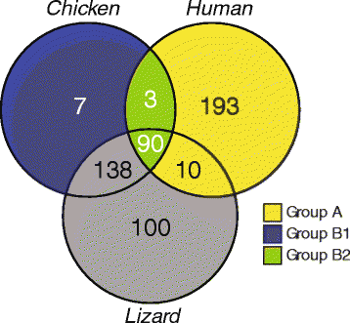
GO Term Enrichment - Number of Genes
A - enriched in non-avian species,
in human only or human/lizard

Slide 27
Identification of Paralogs
Lizard or human gene model with high BLAT score to one or more loci in zebra finch or chicken, where synteny did not match synteny of query gene or related gene family member in lizard
Avian locus might be previously unidentified paralog
  Determine synteny of avian region:
  Walking the chromosome/contig and documenting the order of genes immediately flanking the BLAT hit
    Used budgerigar or medium ground finch in cases where chicken or zebra finch genomes had gaps or unplaced segments
  Check if lizard genome might have paralogs, by BLAT alignment of the lizard query back to the lizard genome.
  For positive hits, examine the synteny in lizard, examine flanking genes in the lizard genome
  Identified novel, mostly unannotated genes in lizard
  Compared synteny of high scoring hit in avian lineages with syntenies of multiple hits in lizard
    Cases where the syntenies in birds matched those of the newly found paralogs in lizard

Slide 28
Further Identification of Paralogs
More comprehensive synteny and phylogenetic analysis based on presence/absence of paralogous gene pair across larger set of vertebrate genomes including opossum and platypus, and human
Reconstruct evolutionary history of paralogs
  Software PRANK, WebPrank server
  Multiple protein sequence alignment on the coding sequences of the paralogs
  Used alignments to construct Maximum Likelihood phylogenetic trees using PhyML
Analyzed each pair of paralogs using NCBI's Conserved Domains Database
  Visual comparison to identify conserved domains
  Dna and protein binding sites related to the established function of the gene
Notes:
Figure 8A, Additional file 1, Table S3.
Synteny analysis, Figure 8C.
Phylogenetic analysis, Figure 8B.
Fig. 8D NCBI Conserved Domains Database
Check what OrthoMCL does, what is orthogroup classification

Slide 29
Paralogs, part 3
Orthogroup classification using OrthoMCL
  Identify whether missing avian genes would have been members of a multi-gene orthogroup group
  Whether a possible paralog might be present in birds, but not lizards or humans
Assigned genes to OrthoMCL groups
  Missing gene set (439 genes using lizard/human protein sequences)
  13,101 chicken genes (Ensembl 71)
  All missing genes assigned except FEAR1
  Searched for OrthoMCL groups with a missing gene plus additional members
  Most of the paralogs previously found were present in same orthogroup as missing gene
    Independent confirmation
    Genes may provide functional compensation for the missing genes

Slide 30
Natural knockouts

Slide 31
Bird kidney function
Natural knockouts

Slide 32
Notes: Page 1
BLAT
- DNA or protein, for very similar sequences,
95% nucleotide, 80% protein;
Keeps index of genome in memory
run standalone (command line version)
- word size ? 11 for nucleotide, ? For protein
Blast2GO
Blastn, Blastx, followed by GO annotation
Protein motif identification by InterPro scan,
Also KEGG
Notes:
Amniotes – clade of vertebrates that lay eggs on land, have specialised membranes around the egg – amnion, chorion, allantois.
(Reptiles, Birds, Mammals)
Anamniotes lay eggs in water, have tadpole stage. (Fish, Amphibians).
Teleosts – infra-class of ray-finned fishes, means ‘complete bone.’
Most currently existing fishes.
Coelacanth - more related to tetrapods than to ray-finned fishes, a 'living fossil', previously thought to be extinct
Ratitite – ostrich
Anole lizard, pronounciation ?:
Carolina anole, Anolis carolinensis, also called green anole,
Primarily in southeastern United States. An arboreal (lives in treetops) lizard.
Chosen as a model reptile by the National Human Genome Research Institute (NHGRI) genome sequencing program.
Kingdom/Phylum/Class/Order/Family/Genus/Species

Slide 33
Notes: Page 2
Zebra finch genome. 2010.
Chicken and zebra finch lineages diverged about 100 million years ago.
Shared features – generally characteristic of birds
Constructed phylogenies of genes present in the last common ancestor of birds and mammals in order to address specific gene losses and expansions in the zebra finch lineage
Both chicken and zebra finch lack genes for various functions related to teeth and mammary glands, not surprisingly, as these are not present in birds
BUT BOTH ALSO LACK the gene for the neuronal protein synapsin 1 (SYN1)
Comparative analyses suggest that the loss of SYN1 and flanking genes probably occurred in an ancestor to modern birds, possibly within the dinosaur lineage
In mammals, up to half of genome consists of interspersed repeats derived from mobile elements, whereas in chicken this is only 8.5%, and 7.7% in zebra finch.
http://www.nature.com/nature/journal/v464/n7289/full/nature08819.html
Notes:
Previous work:
Nature 2010, The genome of a songbird.
The zebra finch genome. (Taeniopygia guttata).
Passeriformes is a large order of birds (Sparrows).
Zebra finch is also a model organism for human neuroscience.
Like other songbirds it communicates through learned vocalizations.
Comparison to chicken genome.
Similar but:
Many intrachromosomal rearrangements,
Number of long terminal repeat retrotransposons.
(Gene regulatory networks in the brain involved in song behaviour)
Zebra finch genome had 17.4K predicted protein-coding genes

Slide 34
Notes: Page 3
Ratites – diverse group of large flightless birds of infraclass Palaeognathae
Unlike other flightless birds, have no keel on their sternum
Ostrich
Latin ratis (raft)
Without this to anchor their wing muscles, they could not fly
Flightlessness evplved multiple times in different ratite lineages
Rhea, moa, kiwi, cassowary, emu , ostrich
Eutherian/non-eutherian
Eutherian means true beasts, includes placentals and non-placentals
Opossum, marsupials, monotremes are non-eutherian (metatherian)
Monotremes are mammals that lay eggs (platypus, echidna (spiny anteater)), as opposed to giving birth to live young like mammals and marsupials;
So platypus and opossum are non-eutherian;

Slide 35
Sections to do - Next to last:
Expanded curation and alignment searches
Chromosomal location of avian missing genes (done)
Missing genes in crocodilians and non-amniotes (done)
Paralogs (diagram)

Slide 36
Sections to do - Last one:
Bioinformatics and Functional Classification
MGI mutations in genes on missing list (done)
Permutation experiments (done)
    MGI phenotype classification
    OMIM disease classification
Comparative functional enrichment analysis
GO term enrichments

Slide 37
Birds descended from theropod dinosaurs
(theropod - Greek for 'beast feet')
Distinct characteristics – feathers, wings, ability to fly, toothless beak
Sauropsids (lizards, turtles,crocodiles)

Slide 38
Bird genomes completed
Genomic features unique to birds
Avian genomes more compact
Loss of noncoding DNA
  Less repetitive DNA
  Fewer pseudogenes
  Shorter introns
  Loss of protein coding genes
  Chicken coding genes 15K compared to

Slide 39
Human
Lizard (green anole, non-avian sauropsid)
Chicken, high quality genome assembly
Zebra finch
Painted turtle
Chicken and zebra finch were the best annotated bird genomes

Slide 41
Avian Missing Genes - Analysis of Chromosomal Location
To test whether the distribution of the avian missing gene blocks was significantly different from a uniform random distribution
  Contingency table analysis using a Chi-squared test for independence
  Largest chromosomes should contain largest proportion of deletions
Notes:
See frequency distributions in Fig. 3.

Slide 42
Search for missing avian genes in crocodilians
Evolutionary history of avian gene loss
BLAT-aligned the avian missing gene set (using lizard and human Ensembl CDSs) to alligator and crocodile genomes
Presence/absence determined by comparing total hits in alligator/crocodile with those in chicken
  Use alignment score and percent identity to separate hits to the orthologous human and lizard genes from hits to related gene family members that are also present in chicken
Criteria for considering genes present in crocodilians;
  Significant hit in alligator or crocodile but not to birds
  Gene had hits to both crocodilians and birds, but at least one of the crocodilian hits was of substantially higher score and percent identity than those to birds, and the hits to birds were shown to be hits to related family members or paralogs
Notes:
Because alligator/crocodile genome assemblies are not fully assembled/annotated.
Scaffolds are not long-enough for full-scale syntenic analysis.
Tables S3 and S5, paralogs.

Slide 43
Evolutionary history of missing genes, part 2

Slide 44
Evolutionary history of missing genes, part 3
To determine the extent to which the missing genes were present in the various vertebrate lineages:
  Sorted all the orthologs present in frog
  Identified cases where no ortholog was predicted
  Confirmed presence/absence of orthologs in the other vertebrate lineages
1. Present in coelacanth but not fish, so likely appeared in sarcopterygian
2. Present in coelacanth, frog and fish, likely present in ancestral teleost
Searched for cases where avian missing genes were specifically absent in frog, coelacanth or fish but present in the other species
Losses in fish confirmed by searching for orthologs in lamprey
For each species, and each set of gene losses,
  determined relative human and lizard chromosomal positions,
  and searched for cases where the losses were syntenic

Slide 45
Functions of Avian Missing Genes
Functional enrichment analysis using Ingenuity Pathway Analysis (A)
A range of biological function categories that are significantly enriched
Many of the missing genes participate in major cellular functions or are
implicated in severe human hereditary diseases and disorders
    Cell growth and proliferation
    X-linked mental retardation
    Immune function
    Nervous system development
Missing genes also enriched in canonical pathways that regulate the
functions of various organs and signaling systems
Notes:
What do the missing avian genes do?
Impact of the observed gene losses?
How do birds cope without the missing genes?
Obviously if genes are associated with features/functions missing in birds - teeth, hair, then not a problem,
But genes are associated with a wide range of basic biological functions

Slide 46
Acronyms
OMIM - Online Mendelian Inheritance in Man
MGI - Mouse Genome Informatics
Notes:
Non-eutherian mammals: opossum, platypus
Eutherian mammals: human

Slide 47
Results of Permutation Analysis
Number of genes associated with a mouse phenotype in the missing gene set is significantly smaller than would be expected based on analysis of the permutation datasets
Found a strong trend towards a greater association of genes with phenotypes associated with lethality in the permutation dataset compared to the avian missing gene set

Slide 48
OMIM Disease Terms
To determine whether the associations of missing genes with OMIM disease terms was greater or less than what would be expected by chance:
Analyzed the distribution of OMIM disease terms associated with the 1000 control gene sets
Test for statistical differences between number of genes associated with an OMIM disease term in the missing gene set versus the distribution of the numbers of disease terms associated with the 1000 control sets
Notes:
See Additional file 4, Fig S3;
Alpha (type I error, p-value) of 0.05 for the two-tailed permutation test

