Slide 1
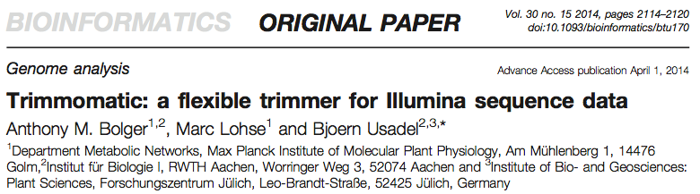
Maria Stalteri
Journal Club, 22/09/2014

Slide 2
Overview
    What Trimmomatic is
    What it does
    Trimming steps
    Advantages for paired end reads
    Adapter trimming
    Quality trimming
    Comparison to other tools

Slide 3
Trimmomatic
Preprocessing of NGS reads, Illumina
    Removing adapter sequences
    Removing low quality sequences
Pipeline – series of steps
Flexible – steps can be applied in any order, independently or in combination
Advantages for PE (paired end) reads

Slide 4
Commands – Simple Steps
CROP
HEADCROP
TRAILING
LEADING
MINLEN
AVGQUAL

Slide 5
More Complicated Steps
ILLUMINACLIP – adapter removal
    Simple mode
    Palindrome mode (Paired End)
Quality trimming
    SLIDINGWINDOW
    MAXINFO

Slide 6
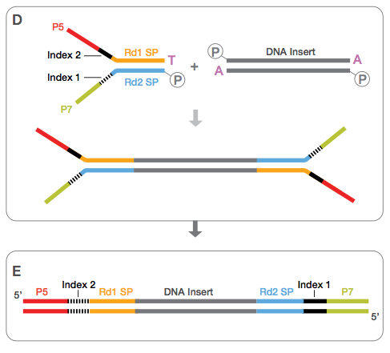
DNA Fragments and Illumina Adapters
http://www.illumina.com Pub. No. 770-2012-019
Notes:
http://www.illumina.com Pub. No. 770-2012-019, Data Sheet: TruSeq DNA Sample Prep Kits

Slide 7
Handling of Paired End Reads
Illumina paired end (PE) reads come in 2 files, R1.fastq (Forward) and R2.fastq (Reverse)
Programs that use PE reads require the R1 and R2 reads to be in the same order in the 2 files
But many programs that trim paired end reads produce files that become out of sync, where one read of a pair is deleted and the other one is not
One of the main advantages of Trimmomatic is that it produces 4 output files:
    R1_Paired.fastq
    R2_Paired.fastq
    R1_Unpaired.fastq
    R2_Unpaired.fastq

Slide 8
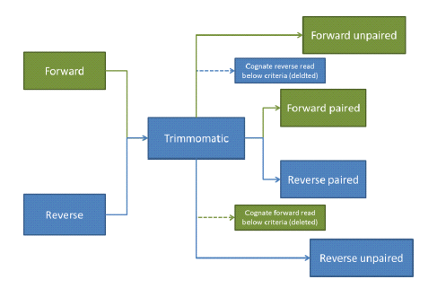
Flow of Reads in Trimmomatic Paired End Mode
http://www.usadellab.org/cms/uploads/supplementary/Trimmomatic/TrimmomaticManual_V0.32.pdf
Notes:
http://www.usadellab.org/cms/uploads/supplementary/Trimmomatic/TrimmomaticManual_V0.32.pdf

Slide 9
Adapter Trimming - ILLUMINACLIP
Simple Mode - for single end reads
Palindrome Mode – for PE reads

Slide 10
Scoring Method for Adapter Trimming
Seed and extend
Seed region (16 bp)
Mismatches allowed – set by user (0 -2)
Score for match (0.6)
Penalty for mismatch (Q/10)
Mismatch at high quality bases more heavily penalised
Threshold score – set by user
Need perfect match of 12 bases for score of 7,
Perfect match of 25 bp to get score of 15
Score has to reach threshold in order for match to adapter to be recognized and the adapter trimmed

Slide 11
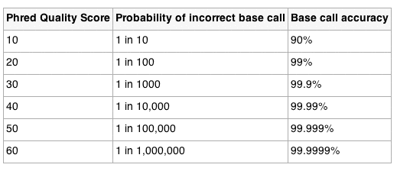

Base Qualities
http://en.wikipedia.org/wiki/Phred_quality_score
Notes:
http://en.wikipedia.org/wiki/Phred_quality_score
Base quality values are minus 10 times the log of the probability
Of the base call being incorrect.
Base qualities of 30 or 40 are very good qualities.
A base quality of 40 corresponds to a 1/10,000 probability of a base call being incorrect,
A base quality of 30 corresponds to a 1/1000 probability of a base call being incorrect.

Slide 12
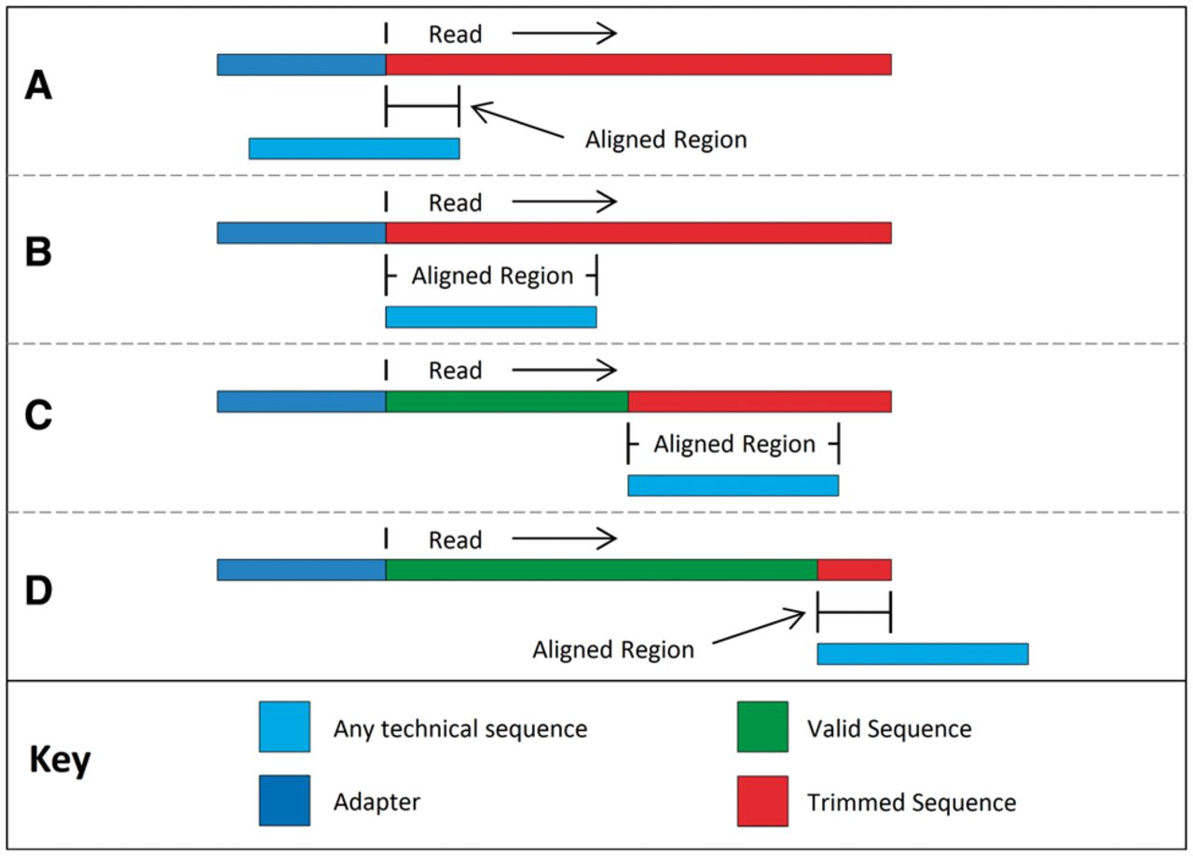

Putative sequence alignments as tested in simple mode.
Bolger A M et al. Bioinformatics 2014;30:2114-2120
© The Author 2014. Published by Oxford University Press.
Notes:
Putative sequence alignments as tested in simple mode. The alignment process begins with a partial overlap at the 5′ end of the read (A), increasing to a full-length 5′ overlap (B), followed by full overlaps at all positions (C) and finishes with a partial overlap at the 3′ end of the read (D). Note that the upstream ‘adapter’ sequence is for illustration only and is not part of the read or the aligned region

Slide 13
DNA Fragments and Illumina Adapters
http://www.illumina.com Pub. No. 770-2012-019
Notes:
http://www.illumina.com Pub. No. 770-2012-019, Data Sheet: TruSeq DNA Sample Prep Kits

Slide 14
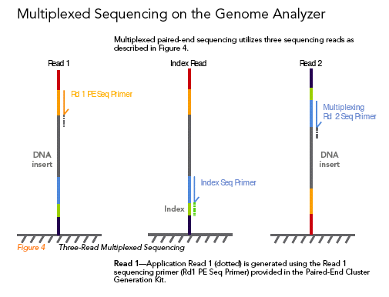
http://www.illumina.com Sequencing_MultiplexedSamples_1006655_RevA.pdf
Notes:
http://www.illumina.com Sequencing_MultiplexedSamples_1006655_RevA.pdf

Slide 15
Adapter Trimming – Palindrome Mode
If DNA insert is shorter than read length, you read into adapter sequence
Read1 and Read2 overlap
The overlapping parts are reverse complements
Trimmomatic uses this info when looking for adapters in PE reads

Slide 16
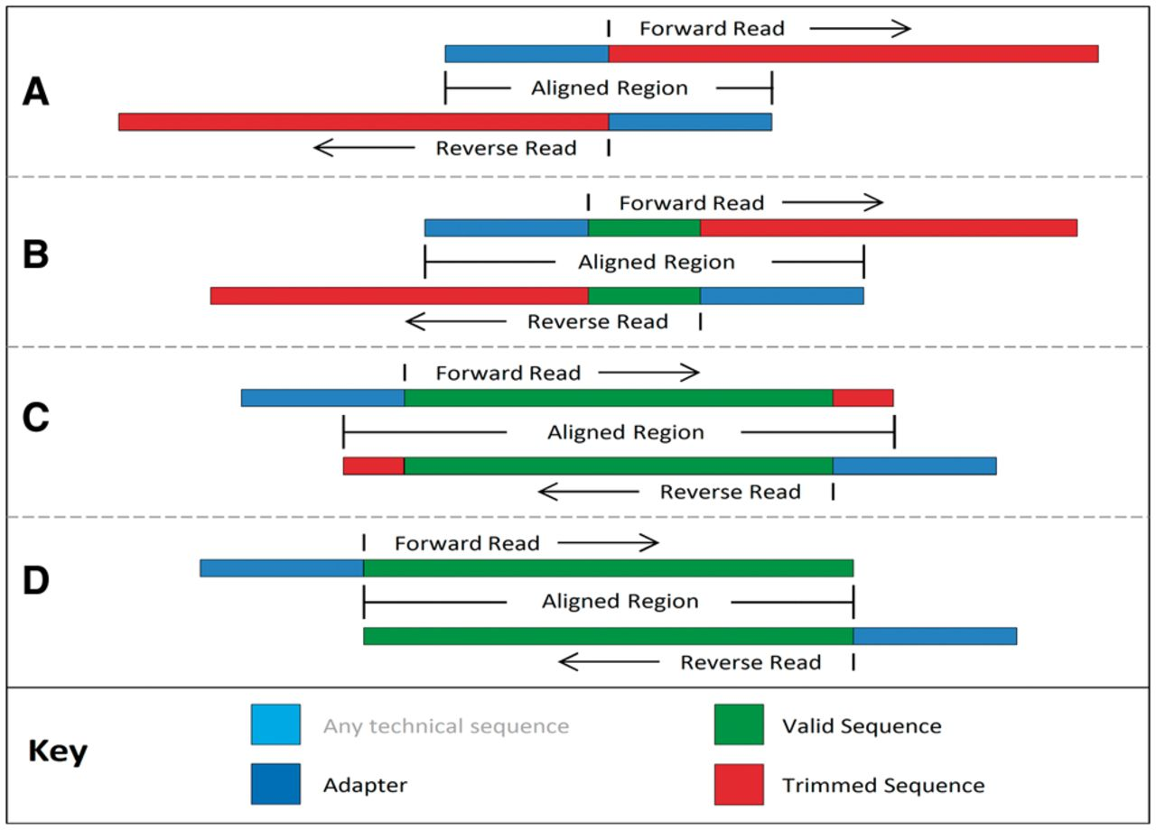
Putative sequence alignments as tested in palindrome mode.
Bolger A M et al. Bioinformatics 2014;30:2114-2120
© The Author 2014. Published by Oxford University Press.
Notes:
Putative sequence alignments as tested in palindrome mode. The alignment process begins with the adapters completely overlapping the reads (A) testing for immediate ‘read-through’, then proceeds by checking for later overlap (B), including partial adapter read-through (C), finishing when the overlap indicates no read-through into the adapters (D)‏

Slide 17
Quality Trimming
SLIDINGWINDOW
    Start at 5' end of read, and scan across the read
    Calculate avg quality of bases in window
    Window size usually 4 bases
    Cut remaining 3' end of read if avg quality of bases falls below threshold
MAXINFO
    Novel algorithm
    Score from combination of 3 factors determines trimming point
      Length threshold
      Coverage
      Error rate
Notes:
MAXINFO - The Maximum Information quality filtering algorithm is a novel approach based on the idea that
the incremental value of retaining additional bases in a read is related to the read length.
This approach has not been applied in any other existing tools.
Short Reads:
Short reads are not very useful because they could map to many places in a genome.
So, even at the risk of introducing errors, it is worth keeping some low quality bases in the 5'
end of the read, because longer reads are more useful.
Longer Reads:
However, beyond a certain read length, keeping bases that are low quality is not so useful, and may
even introduce errors. A moderately long read is nearly as useful as a full-length read in terms of mapping
uniquely to the genome. If a read can't be mapped uniquely because it maps to a repeat region,
keeping a few more bases is not likely to help.
So here the benefit of retaining additional bases must be balanced against the risk of introducing errors,
particularly since read quality typically drops (decreases) toward the 3' end of the read.
Because of this, it makes sense for the trimming process to become increasingly strict as it goes
from 5' to 3' along the read, rather than to apply a fixed quality threshold.
MAXINFO uses a combination of 3 factors to decide how much of each read should be retained.
Length threshold
2. Coverage
3. Error rate
Length threshold: A logistic curve was chosen to implement this scoring method.
Curve is flat at extreme values but has a steep transition around the user-specified
threshold point.
t is target length (user-specified threshold)
l (the letter ell) is the length for which a score is being calculated
2. Coverage - linear score based on sequence length.
For high-quality bases, a longer read contains more useful information
3. Error rate - the third factor models 'error rate'
uses the error probabilities from the read quality scores to determine the accumulated
likelihood of errors over the read
It takes the product of the probabilities that each base is correct
The overall formula for the Maximum Information alorithm seems to be the product of the scores for each of the 3 factors.
The MAXINFO algorithm determines the combined score of the 3 factors for each possible trimming position.
The best combined score determines how much of each read to trim.
This is illustrated in Figure 3.
The read is trimmed at the position that gives the max. combined score.
There is also another parameter in the formula, the user-specifies strictness, s, with values bet. 0 and 1.
The stictness controls the balance between the coverage factor (maximal for s=0, ell to the 1-s, 1-s is maximal for s=0) ,
And the error rate factor (maximal for s=1 (the error rate formula is raised to the power of s), whereas the coverae factor is raised to the power of 1-s.
Show the formulas.

Slide 18
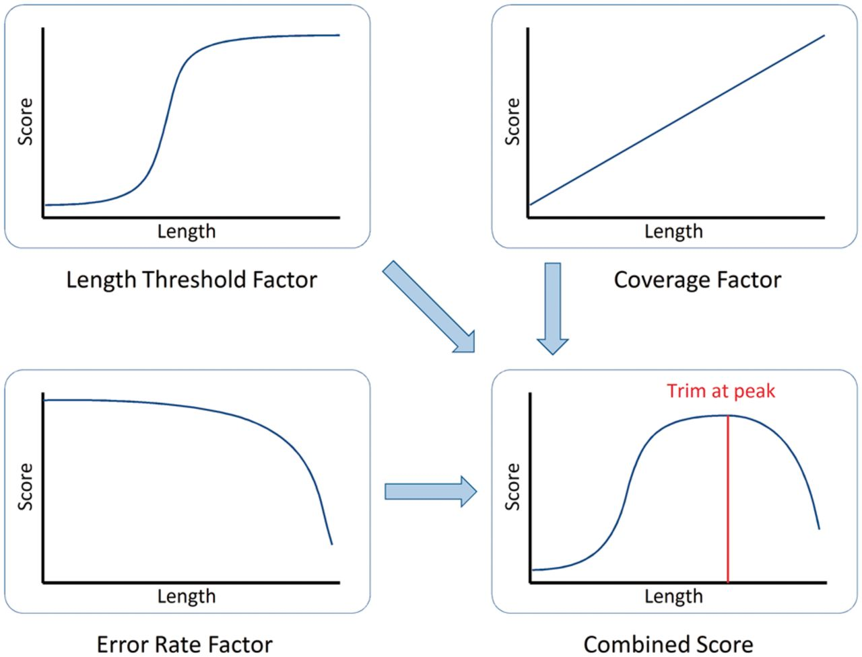
How Maximum Information mode combines uniqueness, coverage and error rate to determine the optimal trimming point.
Bolger A M et al. Bioinformatics 2014;30:2114-2120
© The Author 2014. Published by Oxford University Press.
Notes:
How Maximum Information mode combines uniqueness, coverage and error rate to determine the optimal trimming point

Slide 19
Comparing Trimmed vs Untrimmed Data
Advantages of preprocessing NGS reads
2 procedures
    Alignment to reference - uniquely aligned reads
      Tolerant vs. strict alignment
      Bowtie2
      BWA
    De novo assembly - N50
2 E.coli datasets from SRA
    Dataset 1 - high quality HiSeq data, 2X100 PE
    Dataset 2 - lower quality MiSeq data, 2X250 PE

Slide 20
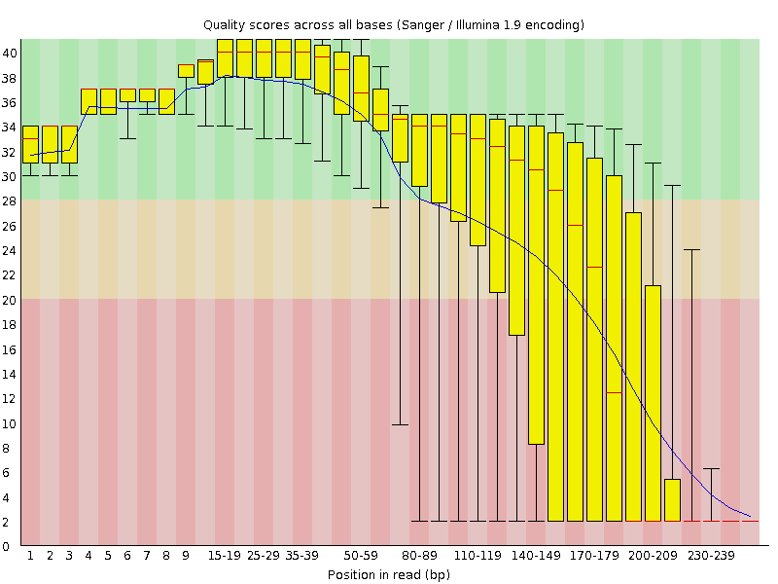
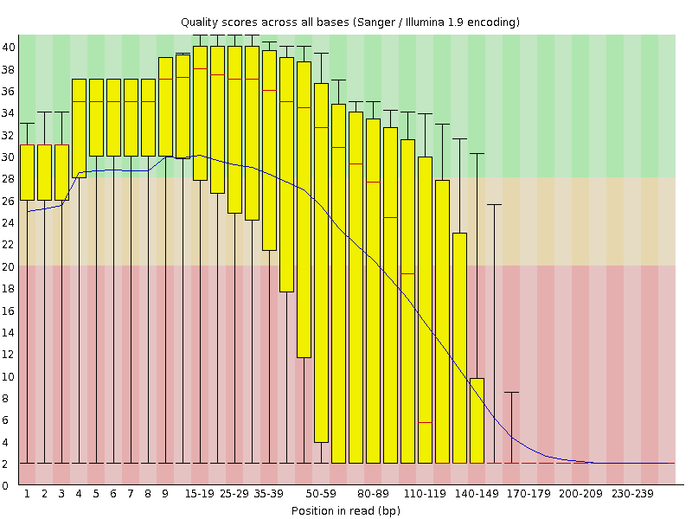
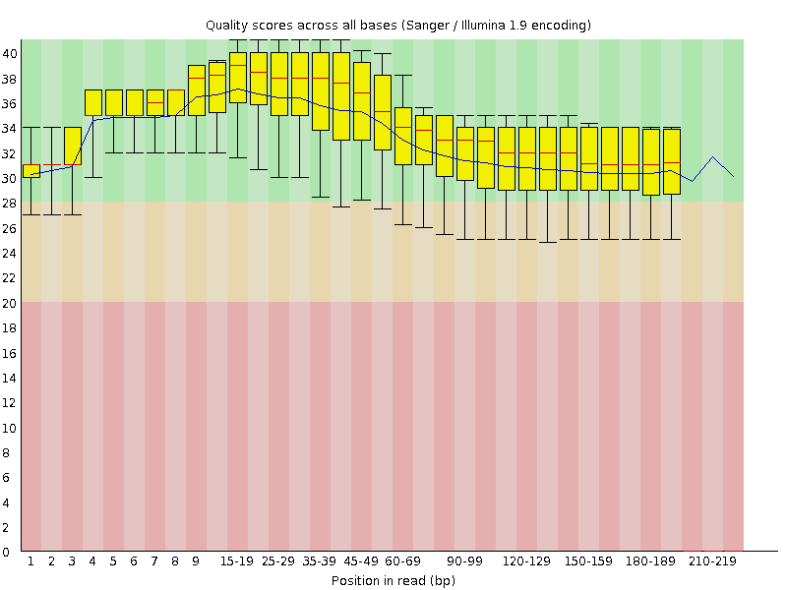
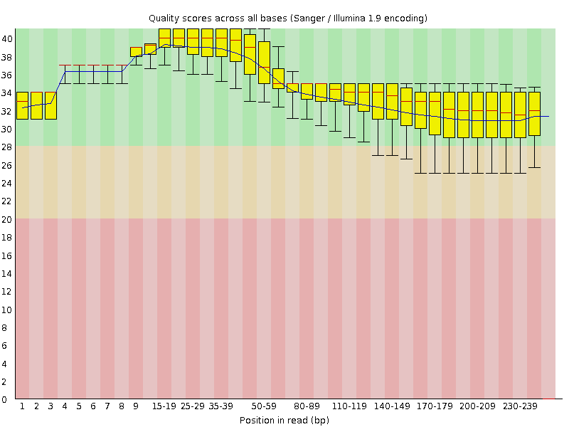
FastQC Quality Plots For Low Quality MiSeq Dataset
Bolger A M et al. Bioinformatics 2014;30:2114-2120, Trimmomatic-Sup.docx
Notes:
Bolger A M et al. Bioinformatics 2014;30:2114-2120, Trimmomatic-Sup.docx
FastQC Per base sequence quality plots for untrimmed data (R1 and R2), and Trimmomatic Max Info trimmed data (R1 and R2).
Dataset 2, the low quality dataset, is a 2X250 bp (PE) MiSeq run.
Dataset 1, the high quality dataset, is a 2X100 bp (PE) HiSeq run.
Both datasets were E.coli K-12 data from the SRA (Sequence Read Archive).
Base qualities go from 0 to 40, the plots go from the 5' end of the read to the 3' end of the read.
The reads are 250 bp long.
The yellow boxplots show the inter-quartile range for the base qualities.
You can see that the base qualities of the untrimmed data start falling toward the end of the read,
And that R2 is of lower quality than R1.

Slide 21
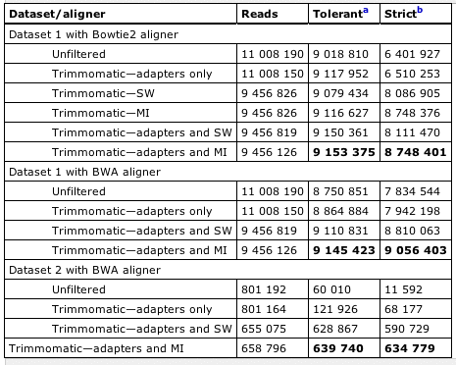
Table 1: Alignment of Raw Data and Trimmomatic Trimmed Data
Notes:
Table 1, main paper.

Slide 22
Comparison Against Other Software
six other programs:
    Fastx-Toolkit
    Cutadapt
    EA-Utils
    Reaper
    Scythe/Sickle
    Adapter Removal
alignment to reference with Bowtie2 and BWA
high quality dataset and lower quality dataset
stringent conditions and more tolerant conditions

Slide 23
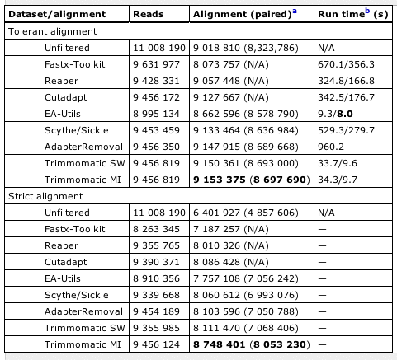
Table 2: Comparison of Trimmomatic With Other Tools
Bowtie2 Alignments of High Quality Dataset
Notes:
Table 2, Main paper.
Comparison of number of reads aligned by Bowtie2 for the HiSeq dataset - Comparing untrimmed raw data with data trimmed by Trimmomatic or various other tools.
Best results are shown in bold.
Best results are for Trimmomatic with Max Info quality filtering.

Slide 24
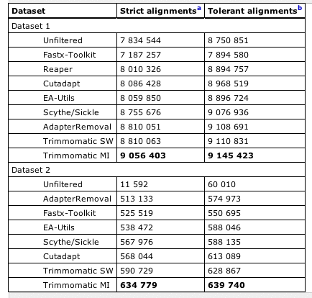
Table 3: Comparison of Trimmomatic With Other Tools
BWA Strict and Tolerant Alignments

Slide 25
Comparison Against Other Software - Results
Greater difference in results for strict alignments
Rankings are different for the low quality dataset
Quality trimming more important for low quality data
Trimmomatic with MI (Max Info) gave best results

Slide 26
Summary
Advantages for PE reads
Pair-aware palindrome mode adapter trimming
Max Info quality trimming gives best results
Performs well compared to other software

Slide 30
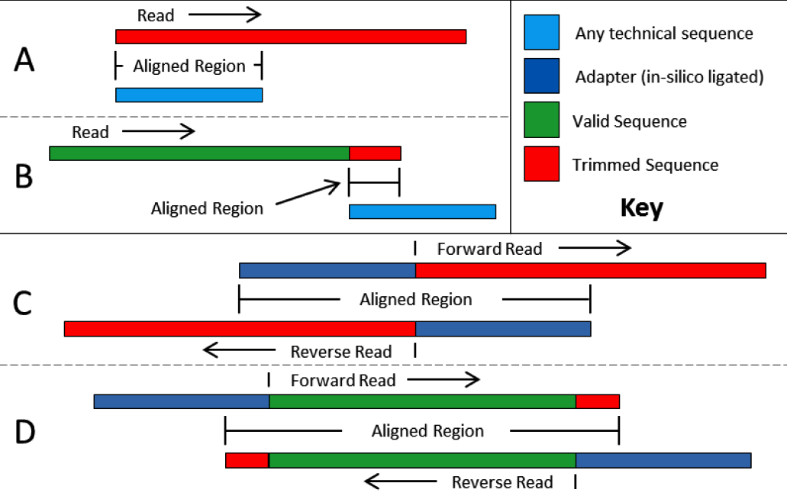
Adapter trimming – simple mode and palindrome mode
http://www.usadellab.org/cms/uploads/supplementary/Trimmomatic/TrimmomaticManual_V0.32.pdf
Notes:
http://www.usadellab.org/cms/uploads/supplementary/Trimmomatic/TrimmomaticManual_V0.32.pdf

Slide 31
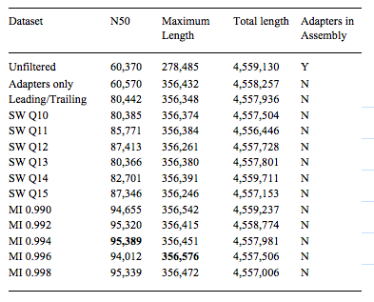
De Novo Assembly of HiSeq Dataset
Raw Data vs. Various Levels of Quality Filtering With Trimmomatic
Notes:
Bolger A M et al. Bioinformatics 2014;30:2114-2120, Trimmomatic-Sup.docx
Table 3, Supplementary information.
De novo assembly with velvet (k21).
HiSeq (high quality) dataset.
Raw data compared to various levels of quality filtering with Trimmomatic.
Best results for N50 and Max Contig Length are shown in bold.
Contig N50 increased by 58% (untrimmed data compared to best results with Trimmomatic Max Info).
Contig N50 is size of contig where 50% of the assembly is in larger contigs, if you list the contigs in an assembly by size, the N50 is the length of the contig where 50% of the assembly is in larer contigs.
Maximum length is the longest contig in the assembly.
Maximum contig length improved by about 28%.
The assembly with the untrimmed data contained a 34bp adapter sequence that was incorporated into the assembly.

Slide 32
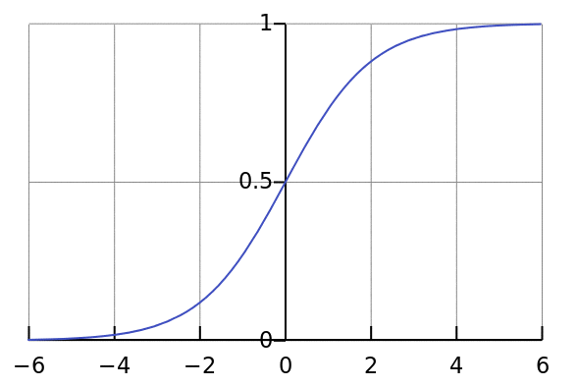
Logistic Function
Notes:
http://en.wikipedia.org/wiki/File:Logistic-curve.svg
http://en.wikipedia.org/wiki/Logistic_function, 20/09/2014

Slide 33

Logistic Function
Notes:
http://en.wikipedia.org/wiki/File:Logistic-curve.svg
http://en.wikipedia.org/wiki/Logistic_function, 20/09/2014

Slide 34
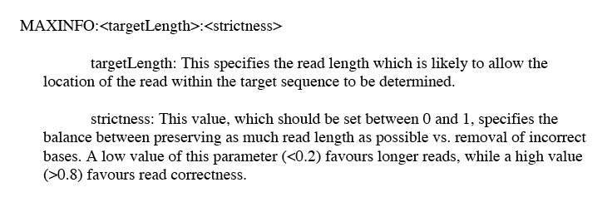
MAXINFO Quality Trimming Part I
Notes:
MAXINFO quality trimming:
Need to specify:
1. target length
2. Strictness
Target length: How do you know what is an appropriate target length?
The idea is presumably to find a read length that would map uniquely in the genome under consideration.
Strictness: value bet. 0 and 1.
Low value (<0.2) favors longer reads.
High value (>0.8) favors read correctness.
Leniency = 1 - strictness.
Strictness - balance between preserving as much read length as possible vs. removal of incorrect bases.

Slide 35
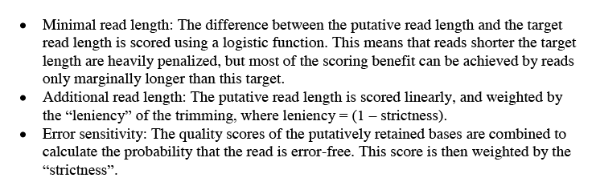
MAXINFO Quality Trimming Part II
Notes:
Miinimal read length is scored using a logistic function.
Logistic (logit) function is
What is the putative read length and target read length?
Target read length is specified as a parameter. Putative read length is presumably every read length being considered/scored.
Reads shorter than target read length are heavily penalised (because they wouldn't map uniquely), but most of the scoring benefit
Can be achieved by reads only slightly longer than the target length (it is obvioulsy quite important to get the target length parameter right - I guess this could be established by running bowtie, etc, with different target lengths and seeing how many reads align.)
Read length is scored linearly, and weighted by the leniency of the trimming, where leniency = (1 - strictness).
Values for leniency/strictness are between 0 and 1.
Error sensitivity: quality scores of retained bases are combined, score is then weighted by the strictness.

Slide 36
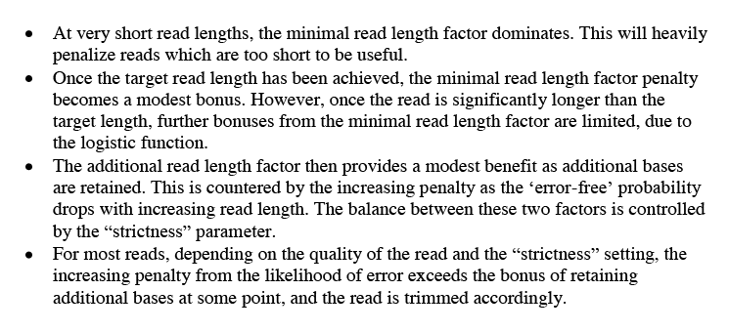
MAXINFO Quality Trimming Part III
Notes:
Minimal read length factor: This factor dominates for very short read lengths. Reads that are too short to be useful are heavily penalised.
Small bonus for reads longer than target read length.
No more bonus once reads are significantly longer than target length.
2. Additional read length factor:

Slide 37
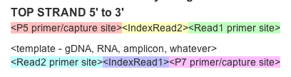
Illumina adapter/barcode/primer construct
P5/P7 primer/adapter – attach to flow cell
IndexRead1/2 – multiplex barcode
Read1/2 primer – sequencing primer
https://wikis.utexas.edu/display/GSAF/Illumina+-+all+flavors
Notes:
https://wikis.utexas.edu/display/GSAF/Illumina+-+all+flavors

Slide 38
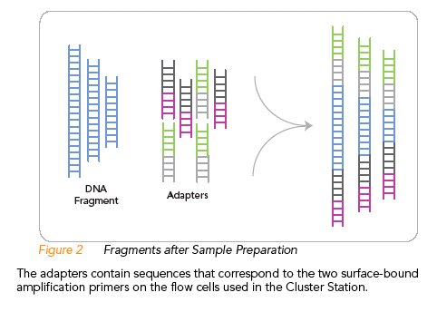
Illumina Sequencing – Fragmenting DNA and Adding Adapters
http://www.illumina.com 1003880_Paired-End_SequencingUserGuide_SamplePrepOnly.pdf
Notes:
http://www.illumina.com 1003880_Paired-End_SequencingUserGuide_SamplePrepOnly.pdf

Slide 39
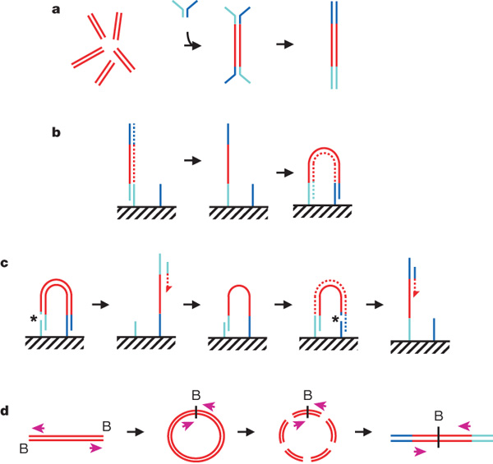

Preparation of samples.
DR Bentley et al. Nature 456, 53-59 (2008) doi:10.1038/nature07484
Notes:
DR Bentley et al. Nature 456, 53-59 (2008) doi:10.1038/nature07484

Slide 40
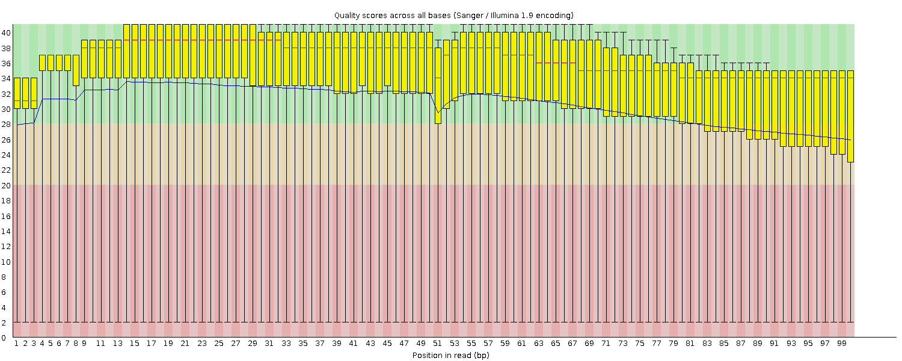

Slide 41
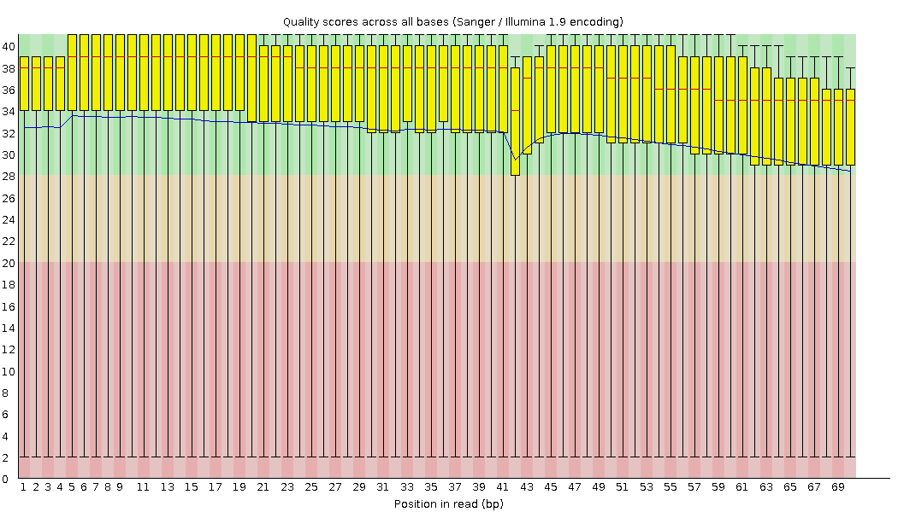

Slide 42
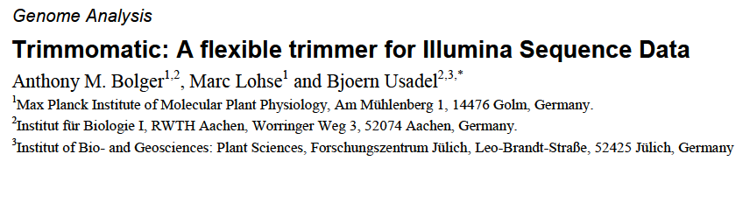
Maria Stalteri
Journal Club, 22/09/2014
Notes:
Bolger AM, Lohse M, Usadel B (2014)
Trimmomatic: A flexible trimmer for Illumina Sequence Data,
Bioinformatics, 30 (15): 2114-2120.

Slide 43
parameters
-phred33
-phred64
-t
PE or SE

Slide 44
Input/output filenames
-basein
-baseout

Slide 45
trimming steps
Pipeline – each step independently or in combination
Crop
Headcrop
Sliding window
Illumina clip

Slide 46
Commands pt2
MINLEN
SLIDINGWINDOW
MAXINFO
ILLUMINACLIP

Slide 47
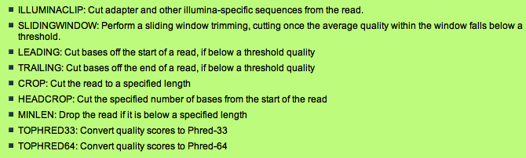

Slide 48
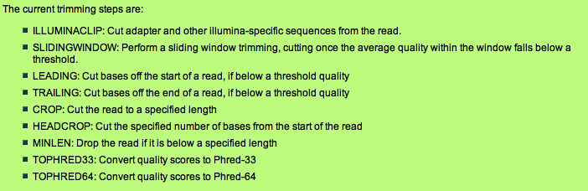

Slide 49
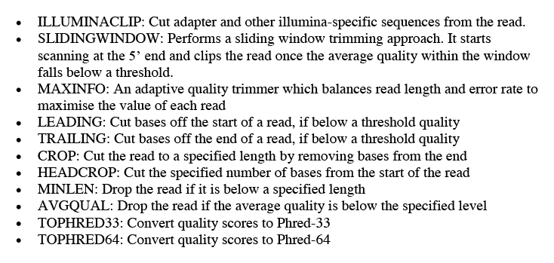
All Trimming Steps

Slide 50
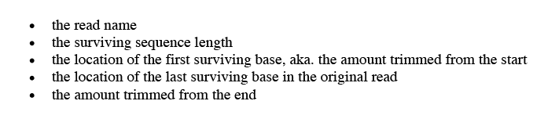
Trimmomatic Log File

Slide 51
The adapter.fasta files

Slide 52
List of slides, pt 1
1. Title
2. Overview
3. trimming steps
4. Quality trimming – sliding window vs max info
5. Base qualities
6. Scoring method for adapters
7. Pairing of reads in output
8. Log file
9. Illumina sequencing constructs -diagram
10. Adapter trimming – simple mode – diagram
11. Adapter trimming – palindrome mode - diagram
12. Results: alignment vs. De novo assembly
13. Summary
14. ? Fastqc plots of trimmed data before and after
15. written in java, can run multiple threads

Slide 53
Outline
5 min Intro
5 min explaining adapter trimming
5 min explaining MAXINFO quality trimming
5 min explaining results and comparison to other tools
Need to explain:
Base qualities
How Illumina adapter sequences end up at the 3' end
How base quality goes down toward end of read,
So why trimming is mainly from 3' end of read

