Slide 1
A Chicken GTF Combining UCSC and Ensembl Data
Maria Stalteri
November 03, 2014

Slide 2
Overview
Need for combined GTF
What is a GTF file
Previous work
Figuring out what final-comparator.pl does
Sorting out problems
Rewrite - series of filtering steps
Conclusions

Slide 3
Need for Combined GTF File
Need gtf file for annotation of ChIP-Seq and RNA-Seq data
Chicken genome is not complete, galGal4
    34 chromosomes
    16K scaffolds, 27K contigs (NCBI)¹
Ensembl vs UCSC gtf: more genes, better data?
But some genes are missing from Ensembl, are in UCSC
Find genes in UCSC gtf that are not in Ensembl gtf
Add the ucsc genes to the ensembl gtf
¹ http://www.ncbi.nlm.nih.gov/assembly/317958
Notes:
Assembly stats from NCBI,
http://www.ncbi.nlm.nih.gov/assembly/317958

Slide 4
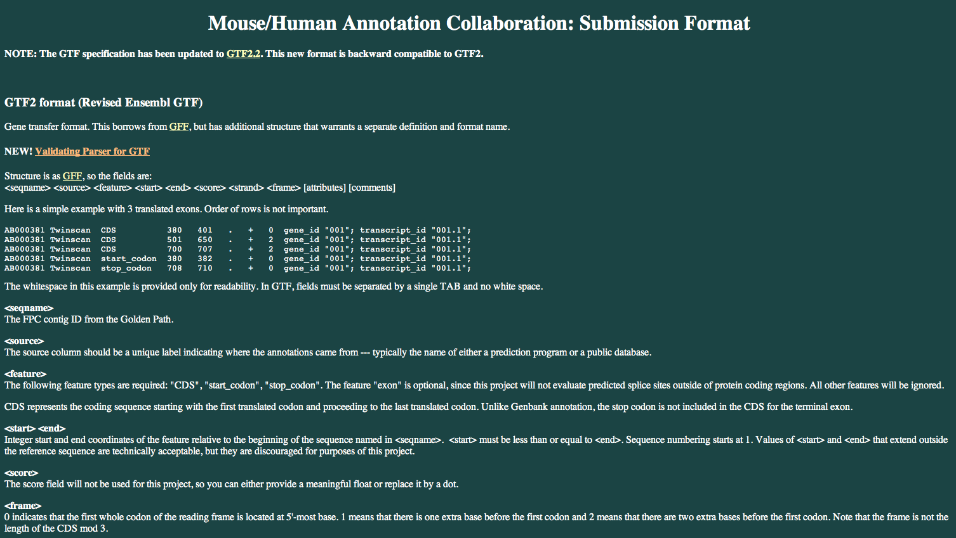
GTF Format Specification
http://mblab.wustl.edu/GTF2.html
http://mblab.wustl.edu/GTF22.html
http://www.ensembl.org/info/website/upload/gff.html
http://www.sanger.ac.uk/resources/software/gff/

Slide 5
Previous Work I
Gene info downloaded from ensembl (biomart) and ucsc
Files ensembl-in.txt (17108 lines), ucsc-in.txt (6909 lines)
File format: 6 columns
    chromosome
    start_coord
    end_coord
    strand
    gene_symbol
    gene_id
Different conventions between ucsc and ensembl
    chromosome names (starting with chr)
    strand names (+/- vs 1/-1)
    miRNA names
Perl script to compare the 2 files (final-comparator.pl)

Slide 6
Previous Work II
look through the different output files
decide which files represented genes to be added to the ensembl gtf
get the additional info for the genes to be added, from the ucsc gtf
change to ensembl gtf format,
add to the ensembl gtf
galGal4.Ensembl75.gtf 445,501 lines
UCSC gtf 128,756 lines
merged.ensembl75.ucsc.gtf 490,794 lines (+ ~45K lines, + ~10%)
Problems
  Peak callers prefer one format or the other
  Didn't work well with combined gtf
  Redundancy
    Added genes that were already present?

Slide 7
First Look at Final-comparator Script
Compares files ensembl-in.txt and ucsc-in.txt
28 comparisons, 12 possible output files
Output: 8 files/12 possible (4 cases no output)
  same-gene-strand-same-gene-partial-overlaps.txt
  same-gene-strand-same-gene-annotations.txt
  strand-same-gene-annotations.txt
  strand-same-gene-partial-overlaps.txt
  strand-specific-gene-annotations.txt
  strand-same-strand-perfect-matches.txt
  strand-specific-gene-partial-overlaps.txt
  same-gene-strand-same-strand-perfect-matches.txt

Slide 8
Final-comparator Output Files (translated)
same-gene-strand-same-gene-partial-overlaps.txt
same-gene-strand-same-gene-annotations.txt (gene-within-a-gene)
strand-same-gene-annotations.txt
strand-same-gene-partial-overlaps.txt
strand-specific-gene-annotations.txt (gene-within-a-gene, diff strand, diff sym)
strand-same-strand-perfect-matches.txt (same strand, diff gene symbol)
strand-specific-gene-partial-overlaps.txt (diff strand)
same-gene-strand-same-strand-perfect-matches.txt
Notes:
Some of the output file names were a bit confusing to me, so I had to sort out which output files came from which matches (obviously from reading the perl script),
Perfect matches and Partial Overlaps are self-explanatory.
Gene Annotations turned out to mean the Gene-Within-a-Gene type of matches,
And Strand-Specific turned out to mean matches on different strand.

Slide 9
Final-comparator Comparisons
3 types of matches (genomic coordinates)
    Perfect match (1)
    Gene-within-a-gene (2 possible orientations)
    Partial overlap (4)
4 conditions (for each of the 3 types of matches)
    Same strand, same gene symbol
    Same strand, diff gene symbol (synonyms)
    Diff strand, same gene symbol
    Diff strand, diff gene symbol (overlapping genes)
4 + 8 + 16 = 28 comparisons
4 + 4 + 4 = 12 output files
Notes:
OK, so going through the script I sorted out that it does 3 types of matches
Based on genomic coordinates:

Slide 10
Final-comparator Output Before Changes
  same-gene-strand-same-strand-perfect-matches.txt 23
  strand-same-strand-perfect-matches.txt 5
  same-gene-strand-same-gene-partial-overlaps.txt 3218
  same-gene-strand-same-gene-annotations.txt 1894
  strand-same-gene-annotations.txt 1064
  strand-same-gene-partial-overlaps.txt 1069
  strand-specific-gene-annotations.txt 423
  strand-specific-gene-partial-overlaps.txt 279
  --------------------------------------------------------------- -------
  Total 7975
  Lines in ucsc-in.txt 6909
Notes:
At least 1000 more matches than there were lines in the ucsc input file.
Note that the number of matches is greater than the number of lines in the ucsc file.
Lines can match more in more than one category of match, as all matches are independent.

Slide 11
Problems with final-comparator
Minor modifications to script (script was 795 lines long)
Partial overlaps - half of the matches didn't work
UCSC genomic coordinates - problem with matches
Missing values (no gene symbol in ensembl entries)
Windows line endings
Chromosome names
miRNA names
Order of comparisons - ensembl to ucsc vs ucsc to ensembl
Each match is completely independent of the others
Each ensembl line can match in more than one category
Synonyms - some genes can have several names

Slide 12
1. Minor Modifications to final-comparator.pl
Moved '#!/usr/bin/perl' to be the first line in the script
Removed variables that were declared or initialised but then never used by the script
Enabled running the script with 'use strict', use 'warnings'
Indented code for legibility
Changed the script so you have to give it the name of the input files as command-line parameters
    Was accidentally appending output to the ends of existing files
Still to do:
    Change the script so that it checks if the output files already exist, so as not to append output to files from a previous run
Notes:
The script used input files with a specific name,
So if you happened to start the script in the same directory as the input and output files,
It would start running and APPEND more lines of output to the existin output files,
Resulting in files with duplicated sections.

Slide 13
2. Partial Overlap Orientations v1
2
3
12
11
11
12
3
2
A
B
2
3
12
11
11
12
3
2
C
D
A: $entry2 < $entry11; $entry3 > $entry11; $entry3 <= $entry12;
B: $entry11 < $entry2; $entry11 > $entry3; $entry12 <= $entry3; X
C: $entry2 > $entry11; $entry12 > $entry2; $entry12 <= $entry3;
D: $entry11 > $entry2; $entry2 > $entry12; $entry3 <= $entry12; X
Notes:
This is the old code that didn't work, with the old (wrong) orientations for B and D.
The overlaps with numbers are FINE.
The ones with blunt ends on one side need checking, they may not be quite right. DONE.
They agree with the matches as written.
Actually, I think I should have 3 cases for each orientation, the 3rd case for each would be the gene-within-a-gene overlap.
The red and blue lines represent genomic coordinates from 2 databases, for genes being compared;
Say blue is ensembl, and red is ucsc;
We are interested in comparing the start and end coordinates from the gene in the blue database
To the coordinates of the gene in the red database.
Numbers along a chromosome, as in a genome browser;
Coordinates increase from left to right;

Slide 14
2. Partial Overlap Orientations v2
2
3
2
3
11
12
11
12
A
B
2
3
2
3
11
12
11
12
C
D
A: $entry2 < $entry11; $entry3 > $entry11; $entry3 <= $entry12;
B: $entry2 < $entry12; $entry3 > $entry12; $entry11 <= $entry2;
C: $entry2 > $entry11; $entry12 > $entry2; $entry12 <= $entry3;
D: $entry12 > $entry3; $entry3 > $entry11; $entry2 <= $entry11;
Notes:
This version: my coordinates overlap orientations AND my code. DONE.
(Note that there is a mirror plane between AC and BD EXCEPT for the labels on the starts and ends,
I think that is the difference between my matches working and the previous set not,
Because by definition $entry2 < $entry3 and $entry11 < $entry12, and if you try and change it to
$entry2 > $entry3 or $entry11 > $entry12 it will nevermatch, arithmetically impossible).
Actually, I think I should have 3 cases for each orientation, the 3rd case for each would be the gene-within-a-gene overlap.
The red and blue lines represent genomic coordinates from 2 databases, for genes being compared;
Say blue is ensembl, and red is ucsc;
We are interested in comparing the start and end coordinates from the gene in the blue database
To the coordinates of the gene in the red database.
Numbers along a chromosome, as in a genome browser;
Coordinates increase from left to right;

Slide 15
Genomic Coordinates on Minus Strand
Genomic coordinates are often given from 5' to 3' along the top strand¹
From left to right on a genome browser track
For genes on the minus strand this means that
    Start coordinate is the 3' end of the gene
    End coordinate is the 5' end of the gene
    Start coordinate < end coordinate
Check whether this convention is being used by checking the genes on the minus strand, and whether start_pos < end_pos
¹http://mblab.wustl.edu/GTF2.html
Notes:
I think this is what caused the problem where the partial overlaps code did not work in two of the cases.
Rotating the diagram so that in one case one gene extends further on the 5' end, and in the other case the gene extends further on the 3' end.
Except that when the enomic coordinates are given relative to the top (plus, forward) strand,
You can't do that,
And the start coordinate is always less than the end coordinate, you just don't know whether it's the 5' end or the 3' end.

Slide 16
2. Partial Overlap Orientations v3 – 9 Types
S1
E1
E1 = E2 Perfect Match
E1 > E2
E1 < E2
E1 = E2
E1 > E2 Gene-within-a-gene
E1 < E2
E1 = E2
E1 > E2
E1 < E2 Gene-within-a-gene
A. S1 = S2
S2
E2
S1
E1
S2
E2
S1
E1
S2
E2
B. S1 < S2
S1
E1
S2
E2
S1
E1
S2
E2
S1
E1
S2
E2
C. S1 > S2
S1
E1
S2
E2
S1
E1
S2
E2
S1
E1
S2
E2
Notes:
Actually, I think I should have 3 cases for each orientation, the 3rd case for each would be the gene-within-a-gene overlap.
The red and blue lines represent genomic coordinates from 2 databases, for genes being compared;
Say blue is ensembl, and red is ucsc;
We are interested in comparing the start and end coordinates from the gene in the blue database
To the coordinates of the gene in the red database.
Numbers along a chromosome, as in a genome browser;
Coordinates increase from left to right;

Slide 17
Results of Partial Overlap Matches
 | Same str Same sym | Same str Diff sym | Diff str Same sym | Diff str Diff sym
All 4 orientations | 3218 | 1069 | 0 | 279
a | 794 | 131 | 0 | 127
b | 0 | 0 | 0 | 0
c | 2424 | 938 | 0 | 152
d | 0 | 0 | 0 | 0
Totals a - d | 3218 | 1069 | 0 | 279
a | 794 | 131 | 0 | 127
b2 | 866 | 135 | 0 | 151
c | 2424 | 938 | 0 | 152
d2 | 521 | 94 | 0 | 126
Totals a - d2 | 4605 | 1298 | 0 | 556
Notes:
Note: This was the first change made, so this was BEFORE changing chr names or mirna names or ucsc coords.
There are 4 possible orientations for the partial overlaps matches, and to begin with the outputs from all the 4 different orientations were all going to the same file.
I changed the code so that the output of each match went to a different file,
Two of the matches had no output, because the matches didn’t work as coded.
After fixing the code so that the matches work properly, you see that you get lines matching each of the 4 possible orientations.
The table may be difficult to understand, but the important numbers are those in the first line, and the last line,
The numbers of matches before, and after fixing the code so it worked correctly.

Slide 18
3. UCSC Genomic Coordinates
Differ from coordinates used by nearly everyone else¹
Half open
Designed so that end_coord minus start_coord equals seq_length
Normally, seq_length = end_coord - start_coord + 1
Need to add 1 to ucsc start coordinate
Effect on final-comparator results: Before After²
Perfect Match same gene symbol 23 1032
Perfect Match diff gene symbol 5 755
Total perfect matches 28 1787
² Before changing miRNA names
¹ http://genomewiki.ucsc.edu/index.php/Coordinate_Transforms

Slide 19
4. Chromosome Names
UCSC uses 'chr' prefix
This had been removed, to comply with ensembl usage
OK for the main chromosomes
Names of the 13K+ contigs also different between UCSC and Ensembl
  chrUn_AADN03018430 AADN03018430.1
  chr1_AADN03009729_random AADN03009729.1
Found UCSC ucscToEnsembl conversion file for chromosome names
Wrote a short perl script to convert the UCSC chromosome and contig names to Ensembl format

Slide 20
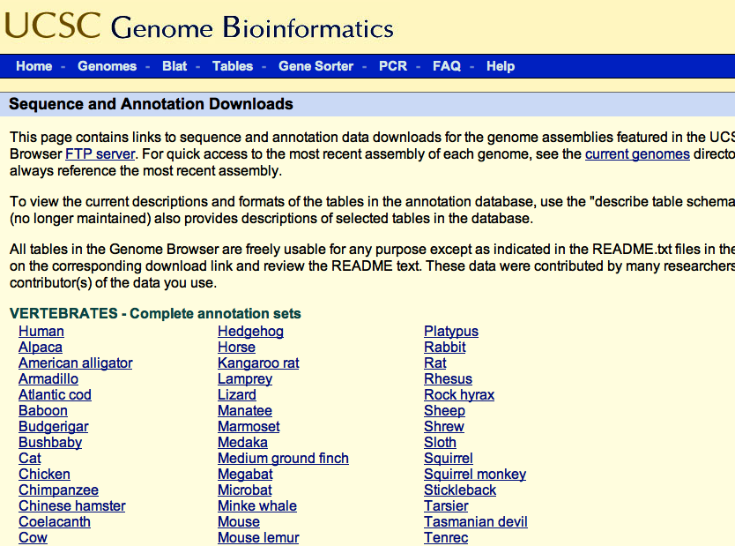
Genomes > Downloads > Genome Data
http://hgdownload.soe.ucsc.edu/downloads.html
Notes:
http://hgdownload.soe.ucsc.edu/downloads.html
From the UCSC Genome Browser Home Page
Select Genomes
Select Downloads
Drop Down Menu – Select Genome Data
Go to the UCSC Genome Browser Downloads Page,
And select Chicken

Slide 21
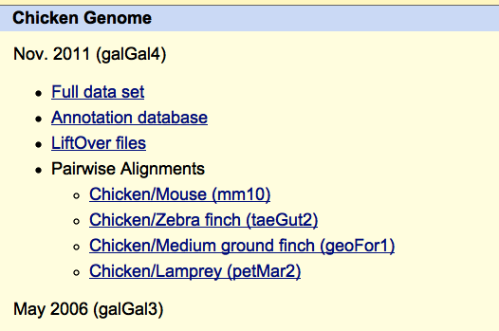
UCSC Genome Browser Annotation Files
http://hgdownload.soe.ucsc.edu/downloads.html#chicken
Notes:
http://hgdownload.soe.ucsc.edu/downloads.html#chicken
Click on ‘Annotation database’

Slide 22
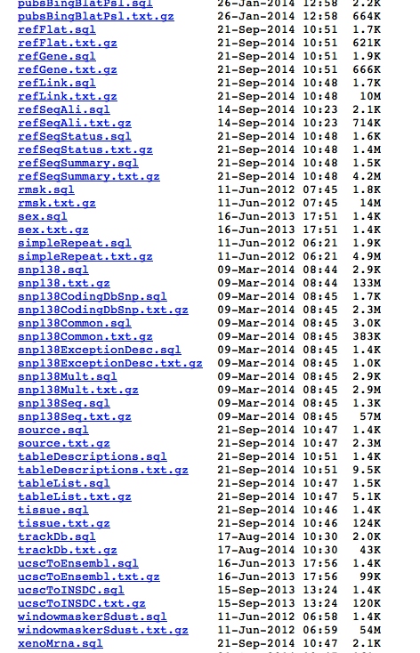
UCSCToEnsembl Chromosome Conversions
http://hgdownload.soe.ucsc.edu/goldenPath/galGal4/database/
Notes:
http://hgdownload.soe.ucsc.edu/goldenPath/galGal4/database/
The ucscToEnsembl.txt.gz file has conversions of all the chromosomes and contigs from ucsc format to ensembl format.

Slide 23
5. miRNA Names
Also differ between UCSC and Ensembl
UCSC uses 'MIR' prefix
Ensembl uses 'ggamir' prefix
Wrote a short perl script to convert UCSC miRNA names to Ensembl
668 ggamir entries in ensembl-in.txt
763 MIR entries in ucsc-in.txt
Not successful in all cases
    Names containing numbers and letters with hyphens
    ggamir135a-2
    MIR196-1, MIR122-2, MIRLET7I
Increased the number of matches in 'same gene symbol' categories

Slide 24
6. Entries With Missing Data
Many lines in Ensembl input file are missing gene symbol, column 5
final-comparator.pl extracts the data by splitting the lines on white space (tabs, spaces, new lines)
When there is a missing value, there are 2 tab characters in a row, one from the column before the missing value, and one from the column with the missing value
As a result the data from column 6 (Ensembl gene ID) gets extracted into the variable where the value from column 5 (gene symbol) should be
This results in the gene symbol from the UCSC file being compared against the Ensembl gene ID
Changed the code so it splits on tab characters only
Resulted in a new problem (\r in middle of line) when I swapped the order in which the ensembl and ucsc files are compared

Slide 25
7. Line Endings
\r carriage return
\n line feed
Old Mac (pre OS X) \r
Windows \r\n
OS X, Linux \n
Linux doesn't handle \r line endings well
$ od -c # one way of checking what line endings # you have
Solution: Wrote a short perl script to change the \r\n endings to \n
Notes:
The ucsc file had Windows line endings, probably because it had been edited and saved in Excel.
This didn't show as a problem until I decided to change the order in which the files were compared,
Using the ucsc file first.
This meant that the output files had the entries from the ucsc file first,
With the carriage return character in the middle of the lines,
And the output looked like the order of the columns had been rather scrambled.

Slide 26
8. Order of Comparing Input Files
Final-comparator takes each line from ensembl-in.txt file and compares to every line in the ucsc file
Since we want to find genes in ucsc that are not in ensembl, is it a better idea to go through the ucsc-in.txt file first?
For every line in the ucsc file, go through all the lines in the ensembl file
Switched order of reading input files, to read ucsc file first
Made no difference to the output obtained
Led to the idea of filtering out lines that have matched, so that they can't match in more than one category

Slide 27
9. compare_genes.pl
Rewrite of final-comparator using a filtering strategy
Only one type of match at a time
Do matches in a 'hierarchical' order
Best matches first
  Perfect match
    Same gene symbol, same strand
    Different gene symbol, same strand
  Partial overlap match
After each type of match remove ucsc lines that matched from the input for subsequent matches
This way a gene that matches in a 'higher quality' match, for example, perfect match of genomic coordinates, will not also match as partial overlap or other 'lower quality' match

Slide 28
Order of Matches
Same chromosome
  Same strand (matches 1 - 6)
    Perfect match (genomic coordinates)
      same gene symbol
      different gene symbol
    Partial overlap
      same gene symbol
    Gene-within-a-gene
      same gene symbol
      different gene symbol
    Partial overlap
      different gene symbol
  Different strand (matches 7 - 12)
    Same order as matches 1 - 6
Different chromosome (match 13)
      Same gene symbol

Slide 29
Results of Filtering
Number of Lines Matched Remaining
Same Strand (6909)
  Perfect Match, same gene symbol 1585 5324
  Perfect Match, diff gene symbol 241 5083
  Partial Overlaps, same gene symbol (4) 2851 2233
  Gene-within-a-gene, same gene symbol (2) 1382 852
  ------------------------------------------------------------------------------------------------------------------------------
  Gene-within-a-gene, diff gene symbol (2) 341 558
  Partial Overlaps, diff gene symbol (4) 324 249
Different Strand
  Perfect Match, same gene symbol 0 249
  Perfect Match, diff gene symbol 0 249
  Partial Overlaps, same gene symbol (4) 0 249
  Gene-within-a-gene, same gene symbol (2) 0 249
  Gene-within-a-gene, diff gene symbol (2) 16 235
  Partial Overlaps, diff gene symbol (4) 21 214
Differerent Chromosome
  Same gene symbol 26 189
Remaining: - 62 miRNA 127 other
Notes:
Th

Slide 30
Final-comparator output comparisons
  First Last¹ Filt.
  same-gene-strand-same-strand-perfect-matches.txt 23 1038 1585
  strand-same-strand-perfect-matches.txt 5 788 241
  same-gene-strand-same-gene-partial-overlaps.txt 3218 3862 2851
  same-gene-strand-same-gene-annotations.txt 1894 1379 1382
  strand-same-gene-annotations.txt 1064 1051 341
  strand-same-gene-partial-overlaps.txt 1069 616 324
  strand-specific-gene-annotations.txt 423 430 16
  strand-specific-gene-partial-overlaps.txt 279 585 21
  --------------------------------------------------------------- ------- ------ ------
  Total 7975 9749 6761
¹ Before changing miRNA names

Slide 31
Output Files Checked Manually
File (number of entries) Results expected
same_str_diff_sym_gene_within.txt (341) Synonyms
same_str_diff_sym_part_overlap.txt (324) Synonyms
diff_str_diff_sym_part_overlap.txt (21) Overlapping genes
diff_str_diff_sym_gene_within.txt (16) miRNAs
same_sym_diff_chr.txt (26) ?
Remaining unmatched miRNAs (62) miRNAs not in Ensembl
Other remaining unmatched genes (127) genes not in Ensembl
Notes:
I got Bozka, Maryam and Ramya to help with going through the output in these files to check
Whether the genes were synonyms or not, because I foundit difficult to check against the CGNC
File computationaly, and thought for the small numbers of genes involved, it would be easier to assess b eye whether the gene symbol is similar or not.
I haven't had a chance to have a look at the data yet.
Results are from compare_genes_v2_run7.

Slide 32
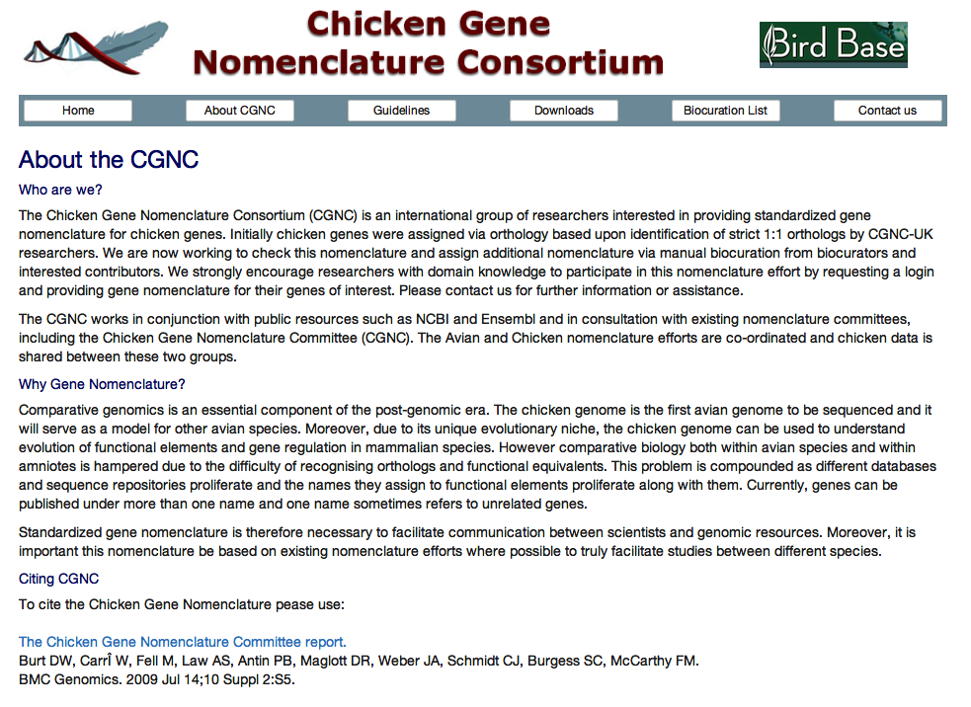
http://birdgenenames.org/cgnc/about
Notes:
http://birdgenenames.org/cgnc/about
The Chicken Gene Nomenclature Consortium Website
Standardized ‘official’ nomneclature for chicken.
Info about Gene Synonyms

Slide 33
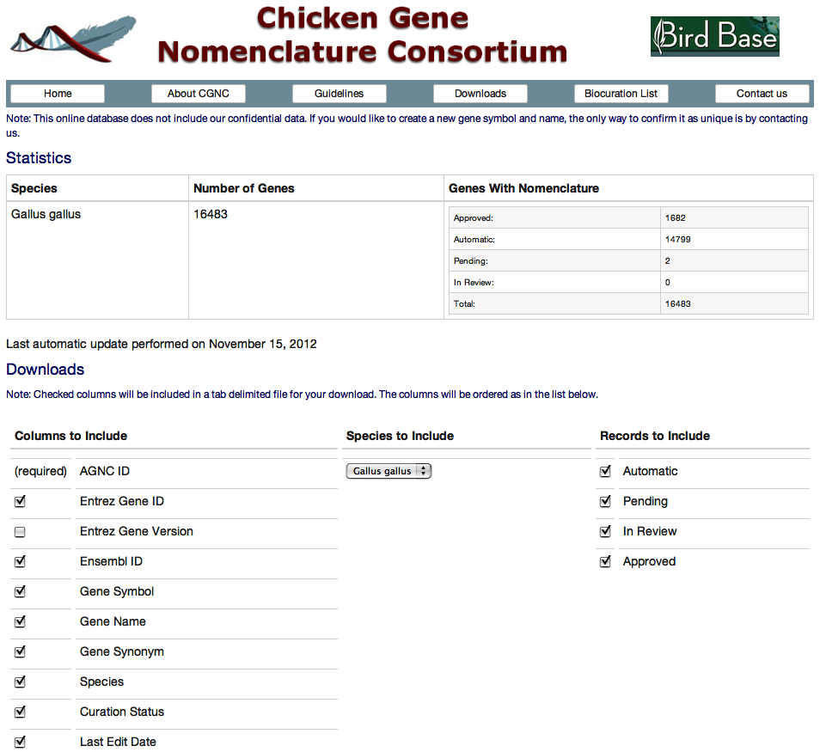
http://birdgenenames.org/cgnc/downloads.jsp
Notes:
http://birdgenenames.org/cgnc/downloads.jsp
Click boxes to download data.
Note the box marked Gene Synonym.

Slide 34
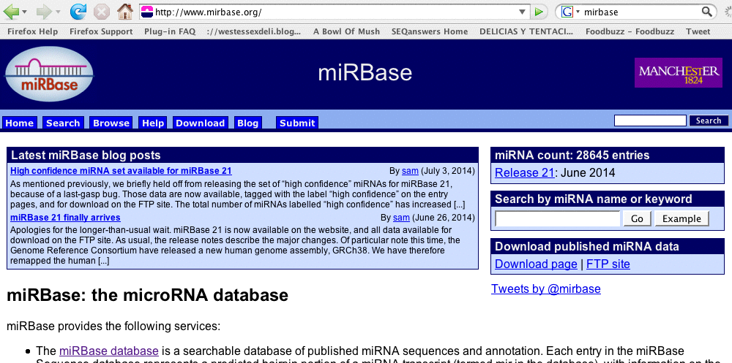
http://www.mirbase.org/
High and low quality databases
Number of sequencing reads supporting miRNA
To help decide whether to add certain miRNAs to gtf

Slide 35
Improvements
Reducing redundancy
Trying to make sure that genes added to the ensembl gtf are not already in ensembl
  Fixing problems with chromosome names and mirna names
    Increases the number of matches in 'same gene symbol' categories
  Filtering
    prevents genes that match to the same gene symbol in a higher level of match from matching again as overlaps on a different strand, etc
  Checking for synonyms (checked by hand)

Slide 36
Perl Scripts Written
Minor modifications to final-comparator.pl
Script to change UCSC chromosome names to ensembl format using the ucscToEnsembl file
Script to change UCSC miRNA names to ensembl format
Script to change line endings from Windows format to Linux
Script to filter the CGNC data for entries with synonyms
Rewrite of final-comparator as compare_genes.pl using filtering strategy

Slide 37
Problems Remaining
Partial overlap matches are still not quite right, need to be rewritten
Gene symbols are ambiguous, use identifiers instead
    RefSeq, Entrez Gene, Ensembl Gene/Transcript
UCSC data are transcripts, Ensembl data are genes
Will the different peak callers, etc. work with the combined gtf?

Slide 38
Acknowledgements
Stern Lab
  Mohsin Khan
  Bozka Palinkasova
Streit Lab
  Maryam Anwar
  Jingchen Chen
  Ramya Ranganathan
  Ravindra Prajapati

Slide 41
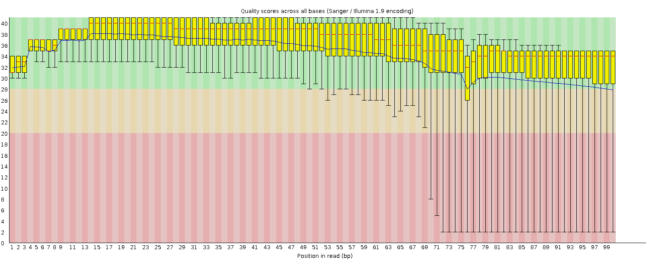
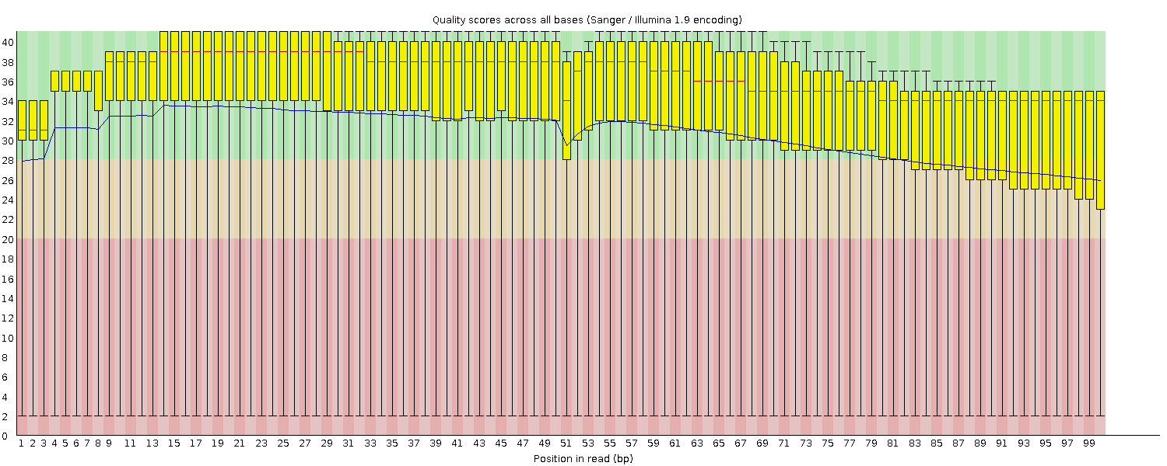
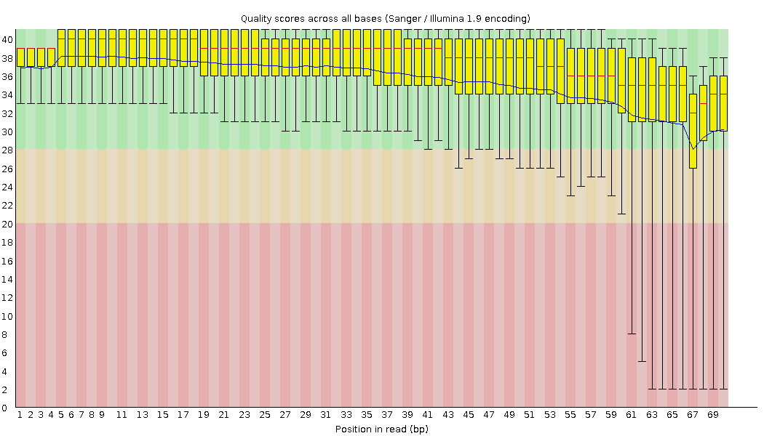
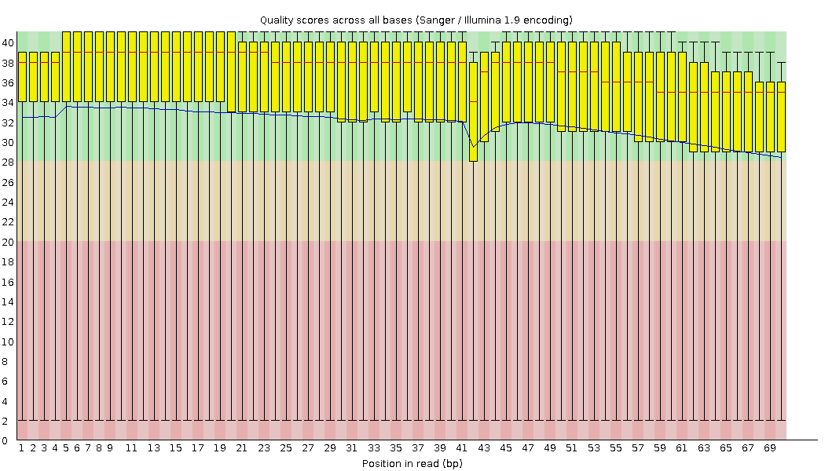
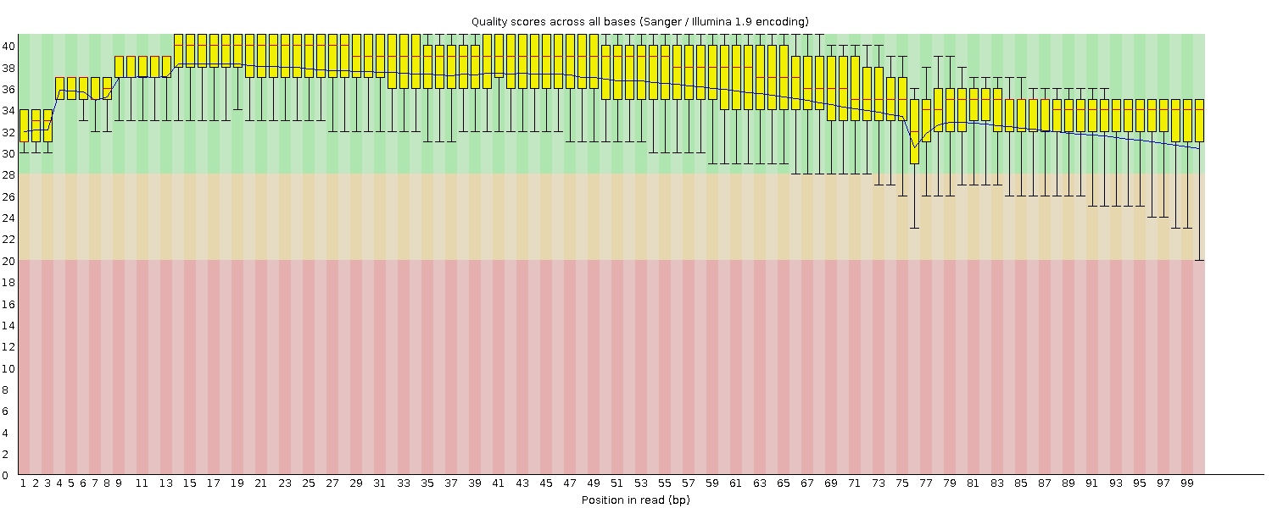
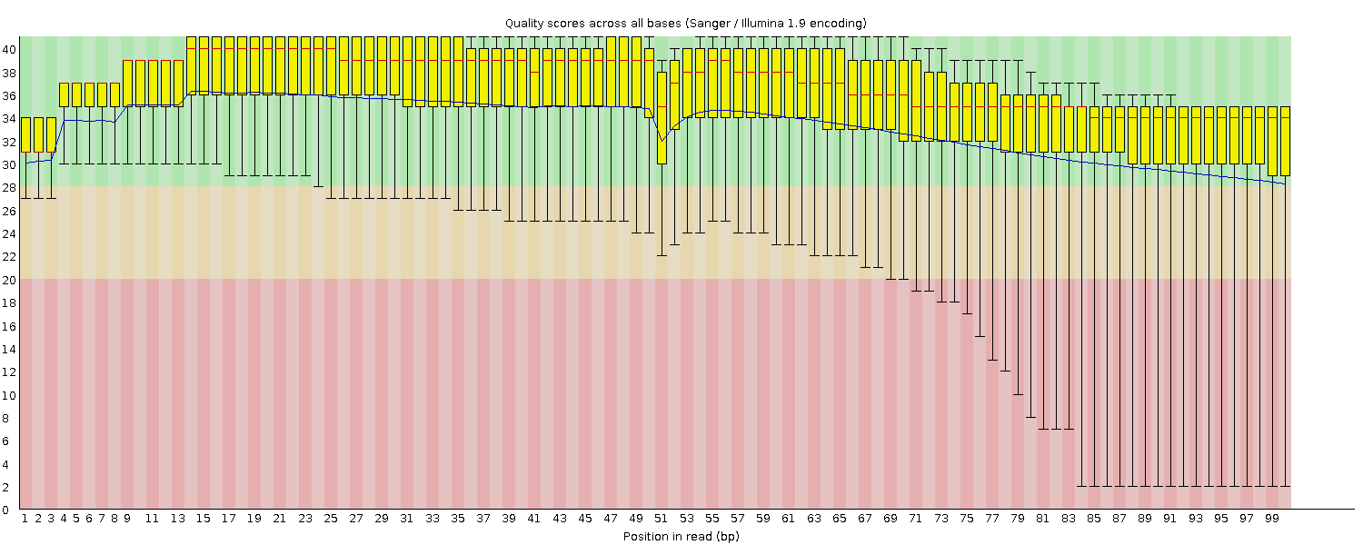
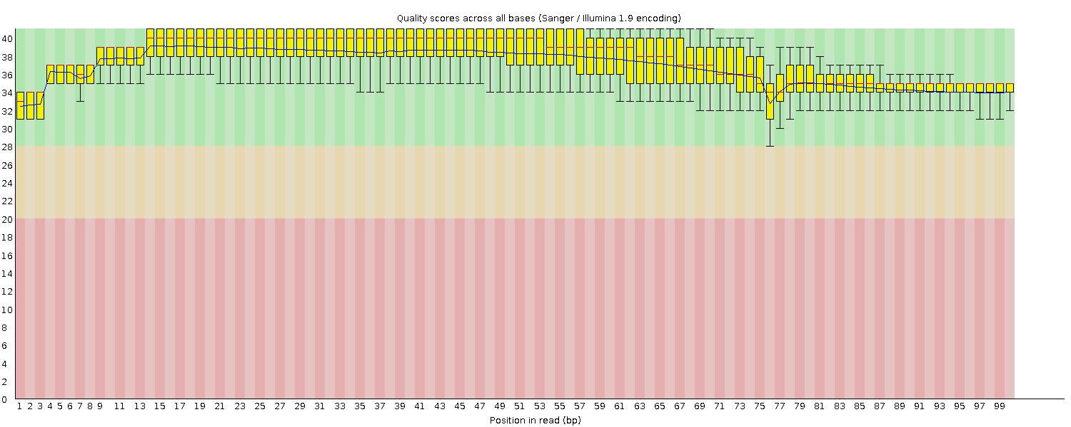
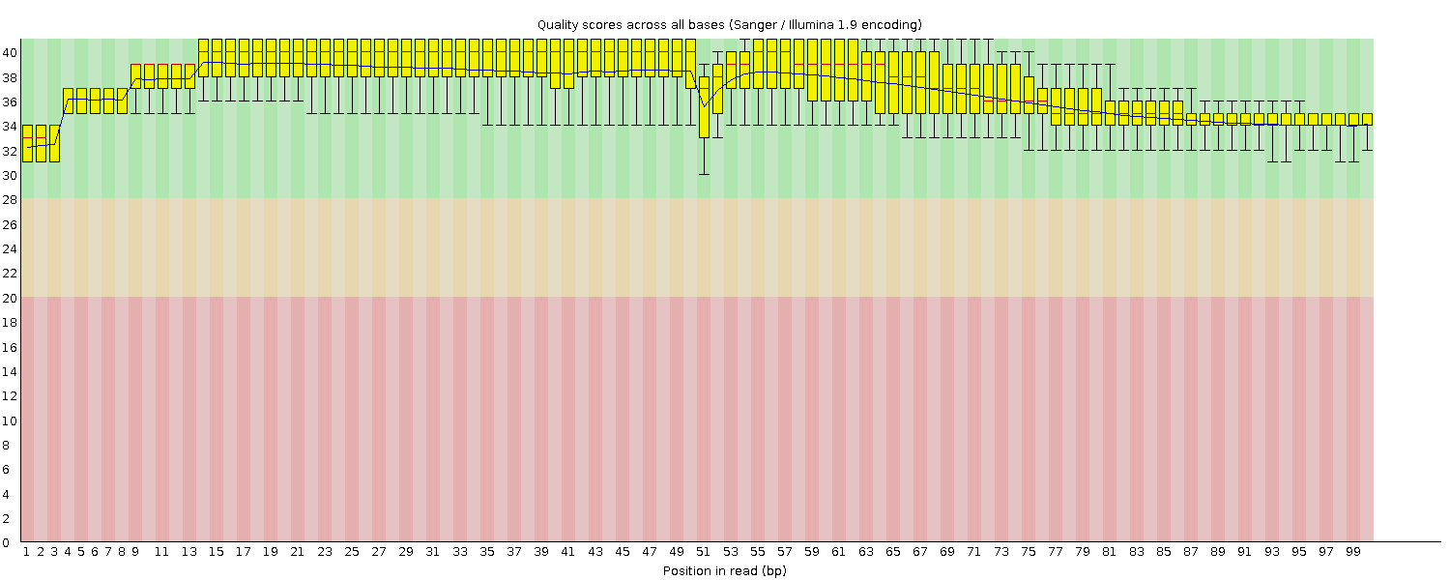
Sample 7D Reads, Before and After Trimming
Raw data
Fastx
Trimmomatic,
Adapters only
Trimmomatic,
Adapters and Quality

Slide 42
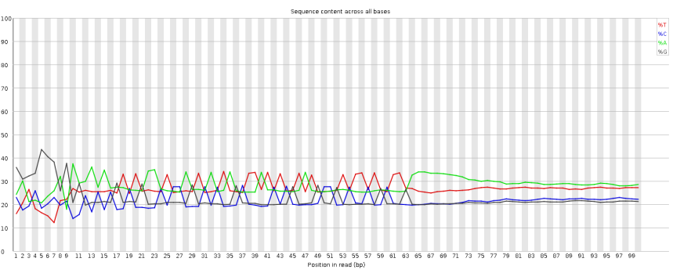
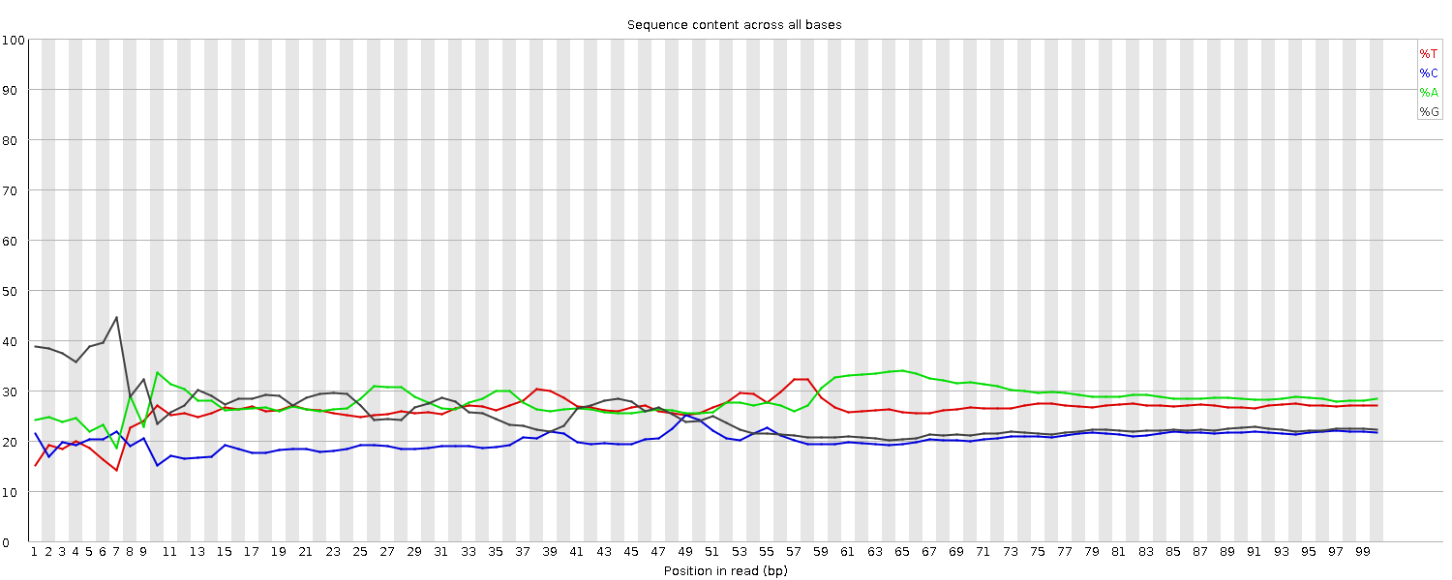
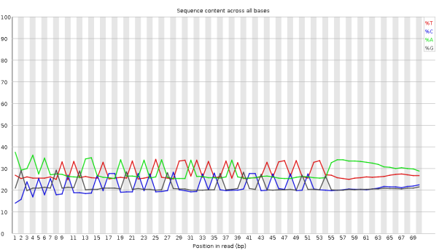
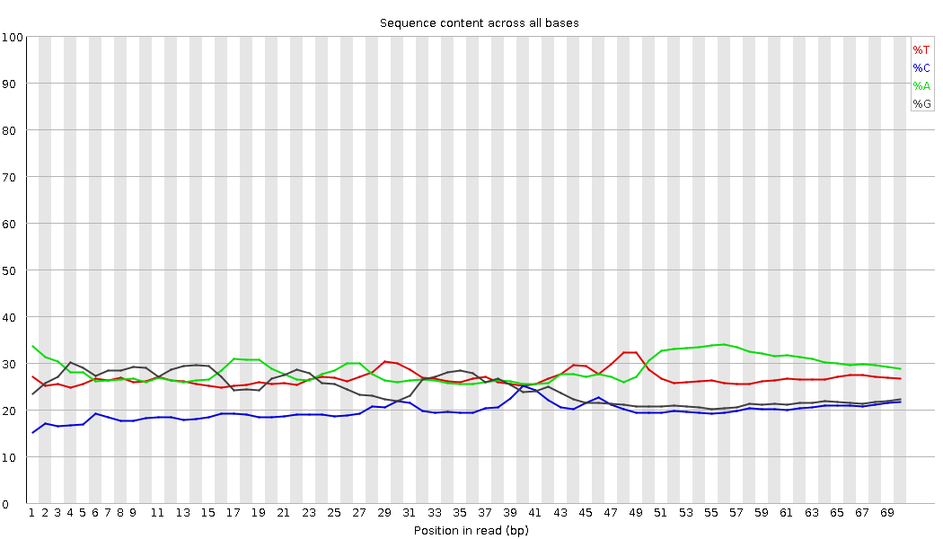
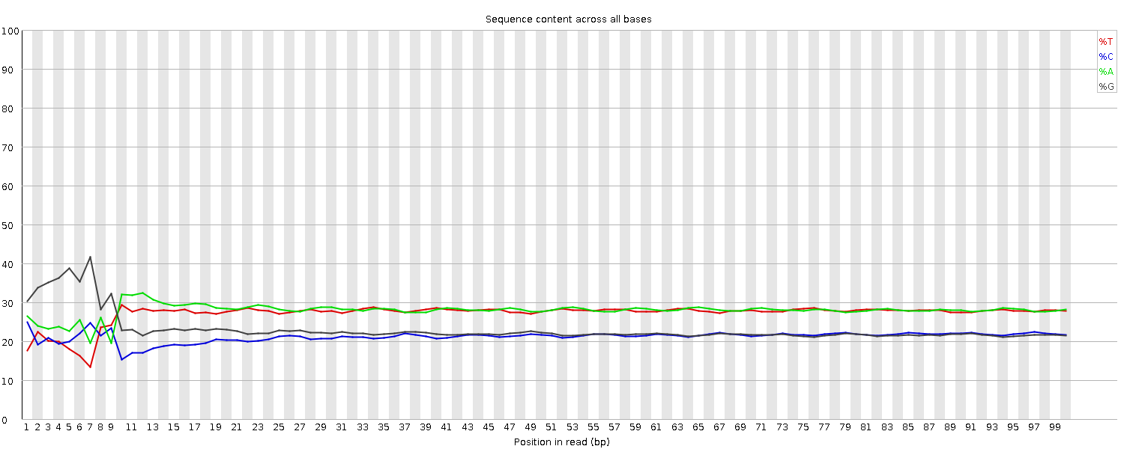
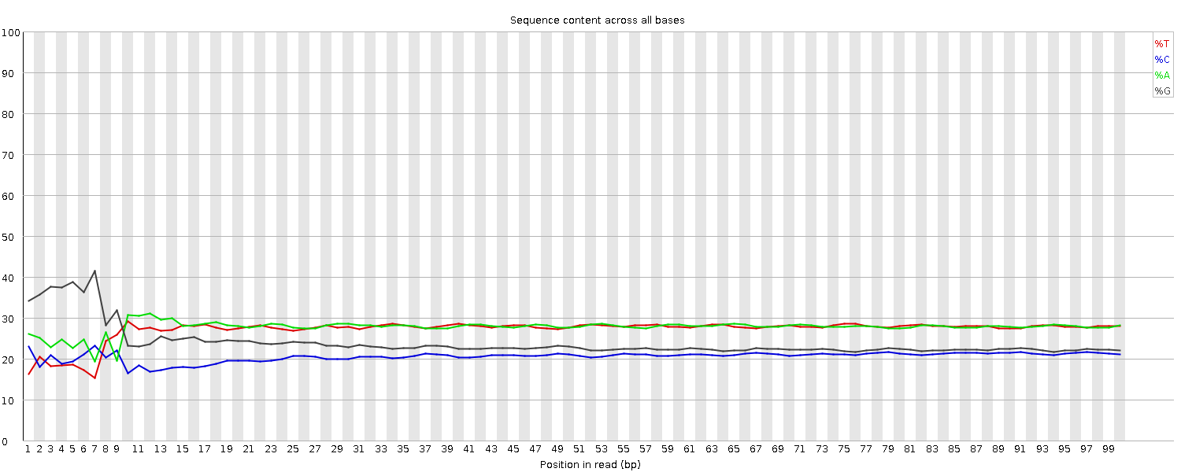
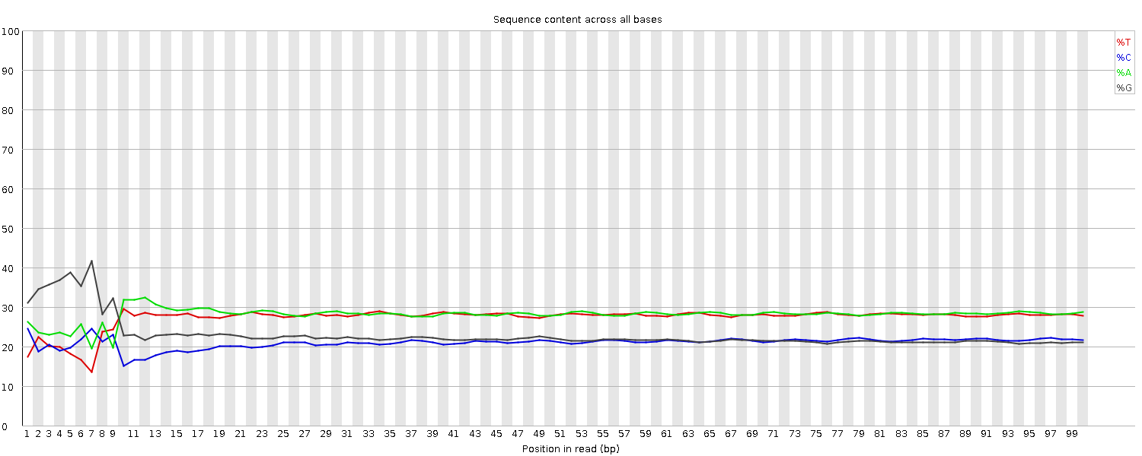
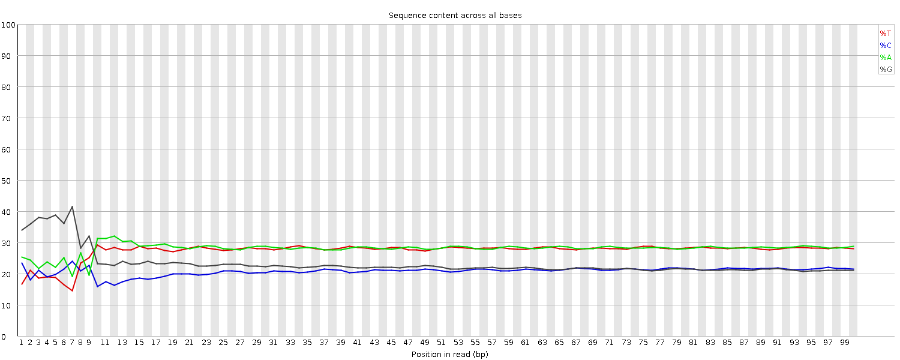
Sample 7D Reads, Per Base Sequence Content
Raw data
Fastx
Trimmomatic,
Adapters only
Trimmomatic,
Adapters and Quality

Slide 43
Partial Overlap Orientations

Slide 44
Gene-Within-a-Gene Overlap

Slide 45
2. Partial Overlap Orientations v3 – 9 Types
S1
E1
2
3
S2
E2
11
12
A
B
2
3
2
3
11
12
11
12
C
D
S1
E1
S2
E2
Notes:
Actually, I think I should have 3 cases for each orientation, the 3rd case for each would be the gene-within-a-gene overlap.
The red and blue lines represent genomic coordinates from 2 databases, for genes being compared;
Say blue is ensembl, and red is ucsc;
We are interested in comparing the start and end coordinates from the gene in the blue database
To the coordinates of the gene in the red database.
Numbers along a chromosome, as in a genome browser;
Coordinates increase from left to right;

Slide 46
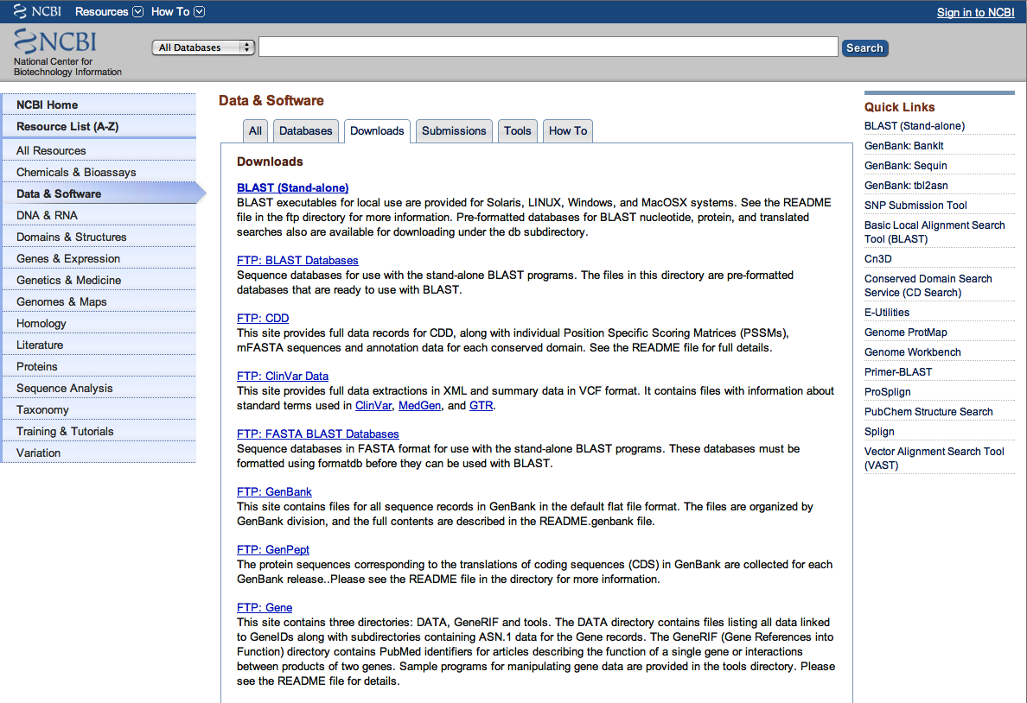
http://www.ncbi.nlm.nih.gov/guide/data-software/
Notes:
http://www.ncbi.nlm.nih.gov/guide/data-software/
NCBI Data and Software Downloads
From the Main NCBI page, select Data and Software,
Then from the Downloads section
select FTP:Gene
Data & Software > Downloads > FTP:Gene > DATA
ftp://ftp.ncbi.nlm.nih.gov/gene/DATA/
? What data did I get from here
gene2ensembl probably, haven’t used it yet;
gene2ensembl, gene2accession, gene2refseq

Slide 47
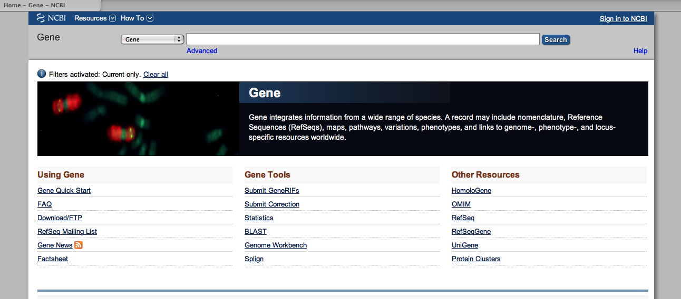
Notes:
http://www.ncbi.nlm.nih.gov/gene
Entrez Gene home page.
To position picture on slide, on the PC version of ppt, press ctrl and the up and down keys for fine control.

Slide 48
miRBase
http://www.mirbase.org/
High and low quality databases
Number of sequencing reads supporting miRNA
To help decide whether to add certain miRNAs to gtf

Slide 49
List of slides
Sorting out the matches
28 matches and 8 files/12 Possible files
X1. Line endings (\r vs \n)
X2. Matches when field is blank – gene sym in ensembl data
X3. Ucsc coordinates (+1 to start)
XResult – no of matching lines
X4.Left-right coordinates and matching
X5. Change chr names, for contigs
X6. Change mirna names, still many not matching
X7. Change order of comparison, ucsc first
X8. Filtering out lines that matched
9. Table of matches at each stage
10. Matches on different chromosome
11. CGNC – synonyms
X12. Final files to check by eye
13. mohsin’s document, idea that start codon and stop codon have something to do with TSS!

Slide 50
List of slides: To do no.2
XDrawing of partial overlap matches
draw the 9 possible overlaps, one of which
is the perfect match, and 2 are the ones we
considered as gene within a gene
XCoordinates on minus strand
XMirbase image
Final-comparator run22 switch, changed mirna names
Examples of problems – SOX3
Synonyms MSX1 and GHOX-7
obsolete records ZIC2, XR_, LOC; record witdrawn ???
PHF20
Keratin7 ENST?

Slide 51
List of slides: To do no.3
Going through the 386 ;Nanostring probes
64 not in ensembl, but about half are synonyms
List to add - about 12, some not on genome assembly,
Case studies of problems - ERNI, HAIRY1/HES4
2. Merged gtfs
Cufflinks gtf parser - old merged gtf,
new ens77 gtf plus one gene from igenomes or ucsc;
plus 7 genes from ucsc
3. Old gtf with fixed chromosome names
Ravindra's problems with easyRNASeq R (Bioconductor) package
INSDC chromosome names and lengths
Error suggests coordinates outside chromosome range

Slide 52
Genes added to merged gtf previously
KRT7 added to merged gtf
Present in more than one contig
Strand/location different for ucsc/ensembl

Slide 53
Final-comparator output
  same-gene-strand-same-gene-partial-overlaps.txt 3218
  same-gene-strand-same-gene-annotations.txt 1894
  strand-same-gene-annotations.txt 1064
  strand-same-gene-partial-overlaps.txt 1069
  strand-specific-gene-annotations.txt 423
  strand-same-strand-perfect-matches.txt 5
  strand-specific-gene-partial-overlaps.txt 279
  same-gene-strand-same-strand-perfect-matches.txt 23
  --------------------------------------------------------------- -------
  Total 7975
Lines in ucsc-in.txt 6909
Notes:
At least 1000 more matches than there were lines in the file of ucsc genes.

Slide 54
final-comparator vs compare_genes
  Before Final
  Changes (filter)
  same-gene-strand-same-strand-perfect-matches.txt 23 1585
  strand-same-strand-perfect-matches.txt 5 241
  same-gene-strand-same-gene-partial-overlaps.txt 3218 2851
  same-gene-strand-same-gene-annotations.txt 1894 1382
  strand-same-gene-annotations.txt 1064 341
  strand-same-gene-partial-overlaps.txt 1069 324
  strand-specific-gene-annotations.txt 423 16
  strand-specific-gene-partial-overlaps.txt 279 21
  --------------------------------------------------------------- ------- -------
  Total 7975 6761

Slide 55
UCSC Genomic Coordinates
Differ from coordinates used by nearly everyone else
Half open
Designed so that end_coord minus start_coord equals seq_length
Normally, seq_length = end_coord - start_coord + 1
Need to add 1 to ucsc start coordinate
Effect on final-comparator results: Before After¹ Final
Perfect Match same gene symbol 23 1032 1585
Perfect Match diff gene symbol 5 755 241
Total perfect matches 28 1787 1826
¹ Before changing miRNA names

Slide 56
Filtering Results
Number of Lines Matched Remaining
Same Strand (6909)
  Perfect Match, same gene symbol 1585 5324
  Perfect Match, diff gene symbol 241 5083
  Partial Overlaps, same gene symbol (4) 2851 2233
  Gene-within-a-gene, same gene symbol (2) 1382 852
  ----------------------------------------------------------
  Gene-within-a-gene, diff gene symbol (2) 341 558
  Partial Overlaps, diff gene symbol (4) 324 249
Different Strand
  Perfect Match, same gene symbol 0 249
  Perfect Match, diff gene symbol 0 249
  Partial Overlaps, same gene symbol (4) 0 249_x000f_
  Gene-within-a-gene, same gene symbol (2) 0 249
  Gene-within-a-gene, diff gene symbol (2) 16 235
  Partial Overlaps, diff gene symbol (4) 21 214
Differerent Chromosome
Notes:
Th

