Slide 1

ENDPOINT
API ARCHITECTURE & SERVICE DESIGN
POST /weather-recommendation
AI Weatherwise API
PIPELINE CORE
Turning raw weather conditions into clear summaries and practical outdoor advice
Validation → Gemini Reasoning → Mongo Persistence
Student Engineering Project · Node.js · Google Gemini · MongoDB
EXECUTION VERDICT
HTTP 200 OK · JSON Payload Verified
Notes:
Introduce AI Weatherwise as an automated backend service. It bridges raw atmospheric data points with natural-language generative advice, delivering structured, context-rich recommendations for end users.

Slide 2

PROJECT CONTRIBUTORS & OWNERSHIP
The team behind AI Weatherwise
Five core domains structured across backend engineering, integration, and quality assurance.
LEAD
BACKEND
RELIABILITY
TESTING
PRESENTATION
Mastani I
Priya Bharathi T
Sharmila V
Uzma Farheen J
Vishali M
Team leader and API integration oversight.
Node.js service logic and server pipeline.
Error handling routines and resilience paths.
Documentation, testing suites, and validation.
Architecture review and presentation design.
Collaborative engineering division: modular ownership enabled parallel development across routes, controllers, and verification.
02
Notes:
Acknowledge each team member's domain: Mastani directed integration, Priya implemented core server architecture, Sharmila constructed error flows, Uzma managed documentation and testing, and Vishali structured communications.

Slide 3
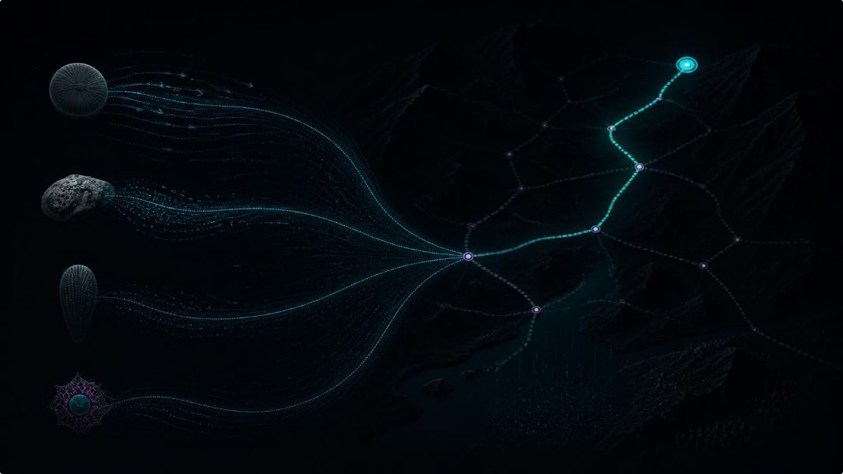
CORE SERVICE CONTRACT
The service has one job: make context usable
Raw weather values lack decision context until filtered, prompted, and protected behind an API boundary.
STAGE 01 · INGESTION
STAGE 02 · INTEGRITY
STAGE 03 · SYNTHESIS
STAGE 04 · SECURITY
Accept
Validate
Advise
Protect
Consumes structured weather data including temperature, rain chance, sky conditions, and wind metrics.
Enforces rigorous checks against required fields, valid primitive types, and physiologically plausible boundaries.
Synthesizes environmental factors through LLM prompting to return clear summaries and actionable clothing tips.
Isolates internal prompts, Gemini keys, and database connection strings safely behind server-side middleware.
03
Notes:
Explain the core responsibility: transforming raw measurements into daily human decisions. The pipeline enforces clean ingestion and strict input hygiene before any LLM invocation occurs.

Slide 4
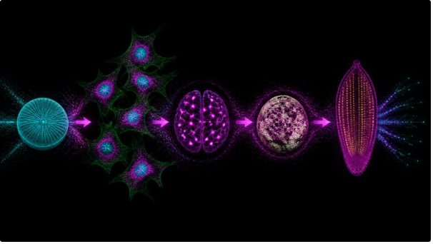
EXECUTION LIFECYCLE
Five steps connect the request to the recommendation
01
Send an HTTP POST request with weather details.
02
Check the data in Node.js.
03
Ask Google Gemini to create suggestions.
04
Save the request and advice in MongoDB.
05
Return the result as JSON with a status code.
04
Notes:
Trace the five-stage flow: send the HTTP POST request, check the data in Node.js, ask Google Gemini for suggestions, save the request and advice in MongoDB, and return JSON with a status code.

Slide 5

SUBSYSTEM DECOUPLING
The stack separates handling, intelligence and evidence
Distinct architectural layers guarantee isolation between network IO, AI inference, and durable logging.
HANDLING LAYER
INTELLIGENCE LAYER
EVIDENCE LAYER
VERIFICATION TOOL
Node.js + Express
Google Gemini
MongoDB
Postman
Processes sanitized inputs into nuanced natural-language summaries, gear suggestions, and activity advisories.
Maintains durable operational history, persisting request parameters, output logs, and service telemetry.
Executes manual and automated endpoint testing, verifying header formats, payload structures, and status codes.
Hosts the runtime server, manages HTTP lifecycle, validates inputs, and orchestrates API middleware flow.
Document Storage
Runtime & Routing
Gen AI Inference
Client Testing Rig
05
Notes:
Emphasize subsystem separation: Node.js guards network routing, Gemini contributes domain intelligence, MongoDB provides non-volatile audit records, and Postman verifies contract adherence.

Slide 6

ENGINEERING TIMELINE
Development moved from setup to reliability
Iterative engineering methodology progressing from dependency bootstrapping to verified system resiliency.
01
02
03
04
05
Environment Setup
Modularization
Logic & Security
Integration Testing
Hardening & Docs
Configured Node.js, Express, Google Gen AI SDK, MongoDB, and dotenv.
Isolated routes, controller handlers, prompt templates, and DB modules.
Refined prompt formatting and anchored secrets in environment variables.
Spawned local server instances and validated transactions via Postman.
Enhanced error handlers, drafted recovery logic, and completed API docs.
Milestone progression: decoupling prompt construction from controller routes ensured model parameters could be tuned without risking network stability.
06
Notes:
Describe development phases: initial dependency integration, separation of concerns into dedicated modules, securing credentials with dotenv, rigorous Postman verification, and hardening error boundaries.

Slide 7
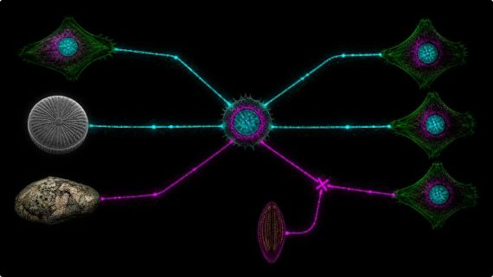
RESILIENCE & FAULT TOLERANCE
Good API behavior includes failure paths
Predictable HTTP status mapping prevents technical data leaks while keeping client integrations stable.
Status Code | Error Classification | Trigger Condition | Mitigation / Client Contract
400 | Bad Request | Missing, invalid or out-of-range weather data. | Reject invalid input.
500 | Internal Server Error | Unexpected server problems. | Logs support debugging.
503 | Service Unavailable | Gemini cannot respond. | Provide backup advice.
Timeouts, logs and backup advice help the service fail clearly without exposing technical details.
07
Notes:
Walk through the failure matrix: 400 Bad Request handles bad client input, 500 covers runtime exceptions without exposing stack traces, and 503 protects upstream AI timeouts with graceful degradation.

Slide 8

DATA GOVERNANCE & SECRET DEFENSE
Privacy is part of the architecture
Strict boundaries ensure zero credential leakage and prevent prompt injection from compromising persistence layers.
ISOLATION
ABSTRACTION
AUDITABILITY
Environment Secrets
Prompt Concealment
Isolated Logging
Gemini API credentials and MongoDB connection strings live strictly in root .env files, excluded from source control and invisible to client callers.
System instructions, temperature framing, and safety guidelines stay internal to the server controller. Users receive only the finalized advice string.
Request records and recovery traces persist in MongoDB for system observability, stripped of client secrets and secured behind private server credentials.
Zero Credential Exposure
Encapsulated Logic
Durable Observability
08
Notes:
Highlight privacy guarantees: .env isolation prevents API token theft, internal prompt structuring hides LLM parameters, and audit logging preserves observability without exposing user footprints.

Slide 9
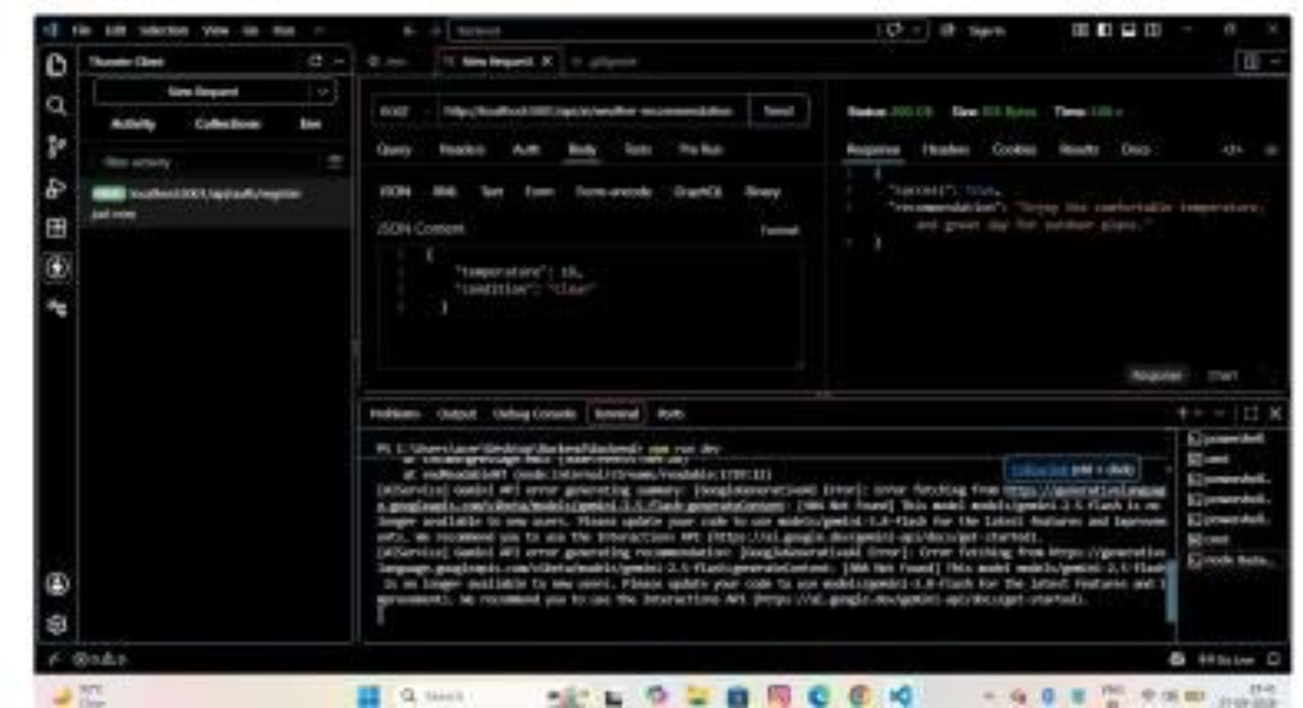
INTEGRATION VERIFICATION
The first test proved the core loop
ENDPOINT
INPUT
POST /weather-recommendation
Temperature 18°C, condition “clear”
RESULT
ADVICE
HTTP 200 OK
Outdoor and clothing suggestions
Fig 2. Postman test run confirming structured JSON response generation.
The example confirmed that the Node.js service and Gemini worked together for a structured request.
09

Slide 10

VERIFIED CAPABILITIES & ROADMAP
What the current version can and cannot claim
Clear distinction between proven production behaviors and necessary future validation milestones.
VERIFIED IN CURRENT BUILD
RECOGNIZED BOUNDARIES
IMMEDIATE MILESTONES
Working Capabilities
Current Limitations
Next Quality Steps
Structured JSON input consumption.
Schema validation and boundary checks.
Automated Google Gemini prompt pipeline.
HTTP 200 OK response with clean JSON structure.
Evidence limited to single baseline test (18°C, clear).
Lacks automated stress testing under severe weather extremes.
No high-concurrency rate-limit benchmarking.
Subject to upstream generative latency fluctuations.
Expand unit and integration suite across edge temperatures.
Implement cached fallback recommendations for 503 events.
Benchmark upstream Gemini token response latency.
Deploy automated CI/CD Postman collection testing.
10
Notes:
Conclude with an honest academic evaluation: the core loop is proven and operating cleanly, but broad field reliability requires extended test coverage across erratic conditions and resilient fallback caching.

