Slide 1
The Convex Optimization Approach to Regret
Minimization
Optimization in Machine Learning
CS 769
Harikrishna Shenoy- 22M0759
Suman Saurav Panda- 22M0783
Shashank Kate- 22M0756

Slide 2
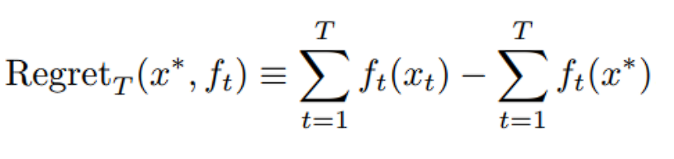
Regret Minimization :
Regret minimization is a concept in decision theory and game theory that involves minimizing the difference between the actual outcome of a decision and the best possible outcome that could have been achieved in hindsight.
In the context of portfolio management, regret minimization involves making investment decisions based on the potential future performance of assets rather than past performance.
The goal of regret minimization is to achieve the best possible outcome over time, even if individual decisions may not always result in the best possible outcome in the short term.

Slide 3
Portfolio management :
Portfolio management using regret minimization is an approach to portfolio optimization that focuses on minimizing the regret associated with investment decisions.
The basic idea is to make investment decisions based on the expected regret associated with each decision, rather than simply maximizing expected returns or minimizing expected risk.
By focusing on minimizing regret rather than maximizing returns, this approach can lead to more robust and resilient investment strategies, which may be better suited to the unpredictable and often volatile nature of financial markets.

Slide 4
Follow the Leader :
Follow the Leader (FTL) is a popular online learning algorithm which is a simple and intuitive algorithm that works by selecting the action that has performed the best in the past.
In the context of portfolio management, FTL can be used to make investment decisions by selecting the asset or portfolio that has performed the best in the past.
However, FTL has some drawbacks, such as being highly sensitive to outliers and not taking into account the overall risk of the portfolio. As a result, more sophisticated algorithms such as FTRL have been developed to overcome these limitations.

Slide 5
Follow the (Regularized) Leader :
FTRL (Follow-The-Regularized-Leader) is an online learning algorithm used for large-scale and sparse machine learning problems, particularly in the field of online advertising.
FTRL is an extension of the classic online learning algorithm, Follow-The-Leader (FTL), and includes additional regularization terms to prevent overfitting and improve generalization performance.

Slide 6
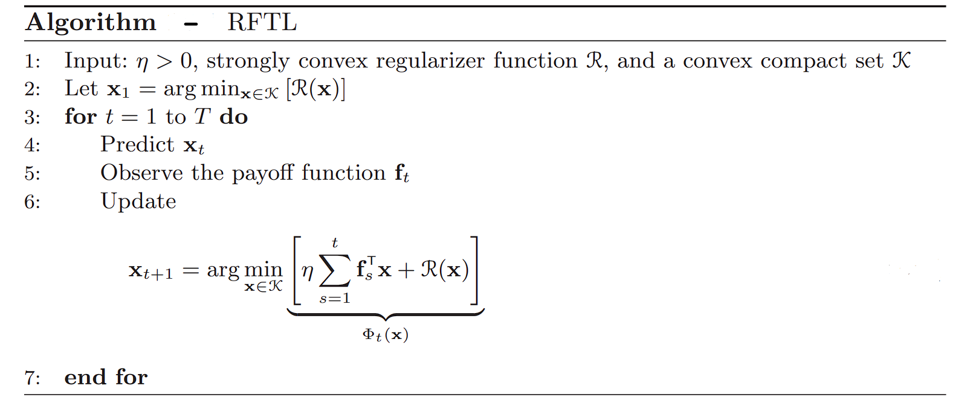

Slide 7
RDA : Regularized dual averaging
In RDA, the objective function is regularized with a convex penalty term that penalizes large parameter values.
RDA iteratively updates the parameters by taking a step in the direction of the negative gradient of the objective function, while also adding a regularization term that pulls the parameters towards zero.

Slide 8
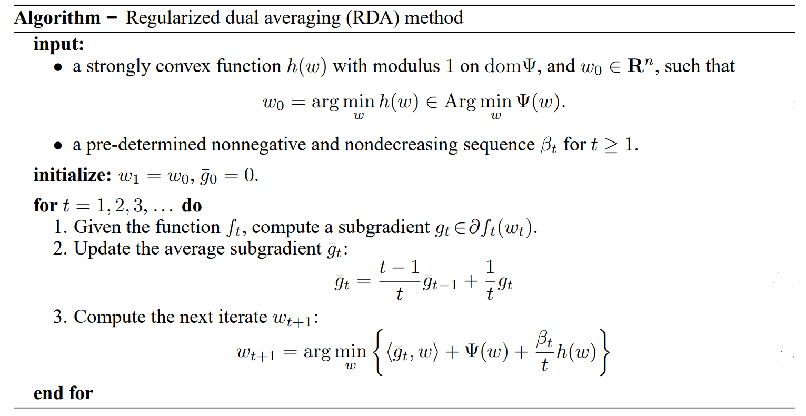

Slide 9
OPG : Online Proximal Gradient
The main idea behind OPG is to minimize a loss function with a proximal regularizer term that promotes sparsity in the solution.
It is particularly useful in online learning, where data arrives in a stream and the goal is to update the model with each new data point.
In OPG, the proximal operator is typically chosen to be the L1-norm of the solution, which promotes sparsity in the solution by shrinking the coefficients of less important features towards zero.

Slide 10
The OGD algorithm can be described by the following steps:
Initialize the current solution, x_{i}.
For each time step t:
Observe the loss function f_{t}(x_{t}), and the corresponding gradient g_{t}(x_{t}).
Take a step in the opposite direction of the gradient: x_{t+1} = x_{t}- η_{t} * g_{t}(x_{t}) , where η_{t}is the learning rate.
Repeat step 2 until convergence.
The OGD algorithm has a regret bound, which is a measure of how much worse the algorithm performs compared to the best solution in hindsight. The regret bound for the OGD algorithm is O(sqrt(T)), where T is the number of time steps. This means that the OGD algorithm can achieve a sublinear regret over time.

Slide 11
We performed experiments using following methods :
FTRL RDA
FTRL OGD
FTL OGD
FTRL RDA moving averages.
FTRL RDA exponential smoothing.

Slide 12
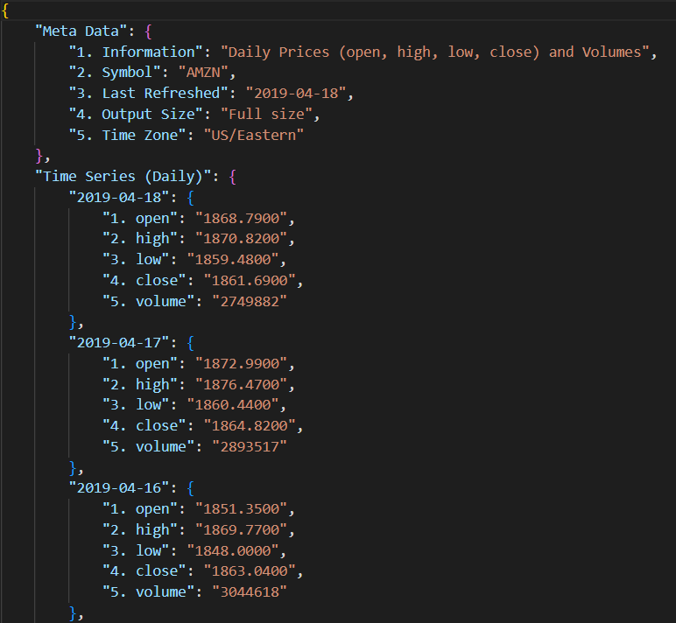
Sample data and processing
Daily Real Stock Json available from public API’s.
Opening and Closing price of each day was considered for calculating gain for Particular day.

Slide 13
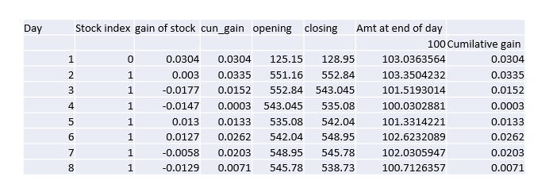
Sample data and processing
Sample calculation for cumulative gain at the end of each day.
Aim of experiments: To increase the cumulative gain at the end of 1000 days of investment, given we can strategize at the start of each day what stock to select based on output from FTRL.

Slide 14
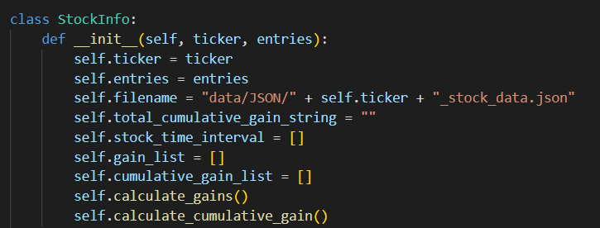
Stocks Used :
stock_set_increasing = Apple, Google, Amazon, Intel, Microsoft.
stock_set_big = Apple, Google, Amazon, Intel, Microsoft, Twitter, Altaba, General_electric, Fitbit, Tesla, Qualcomm, Sony, cisco, Activision, Xilinx.

Slide 15
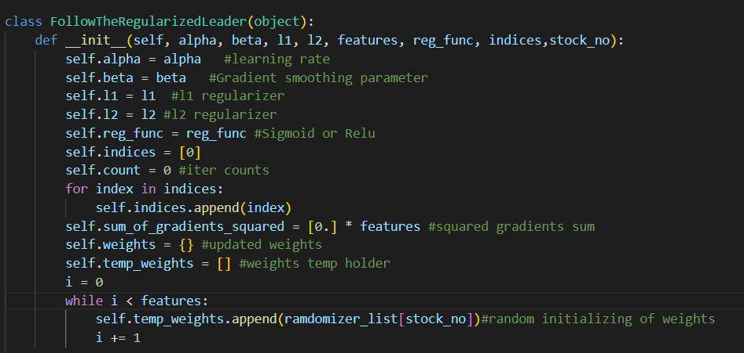
FTRL Class parameters

Slide 16
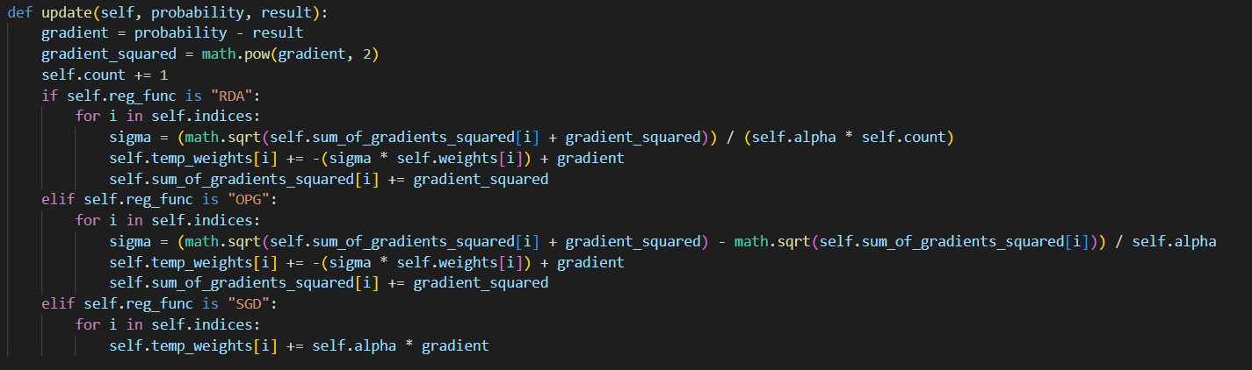
Update rule with momentum+Adaptive/ Vanilla

Slide 17
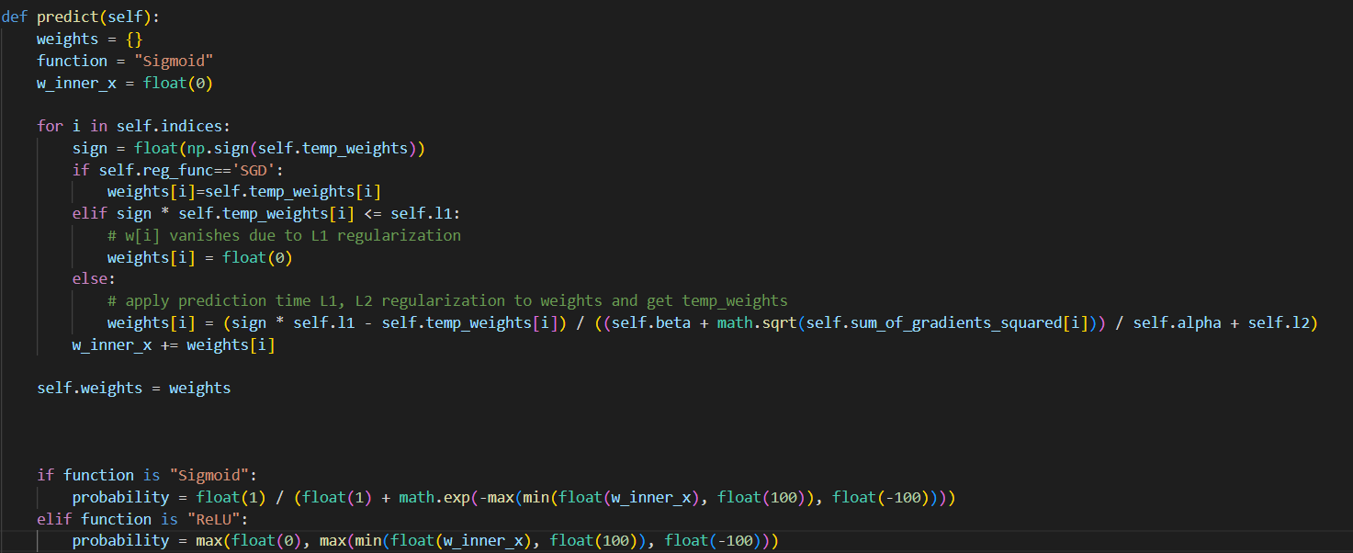
Prediction function

Slide 18
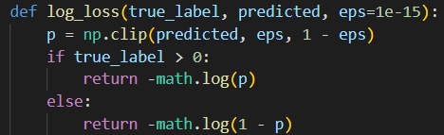
Loss function

Slide 19
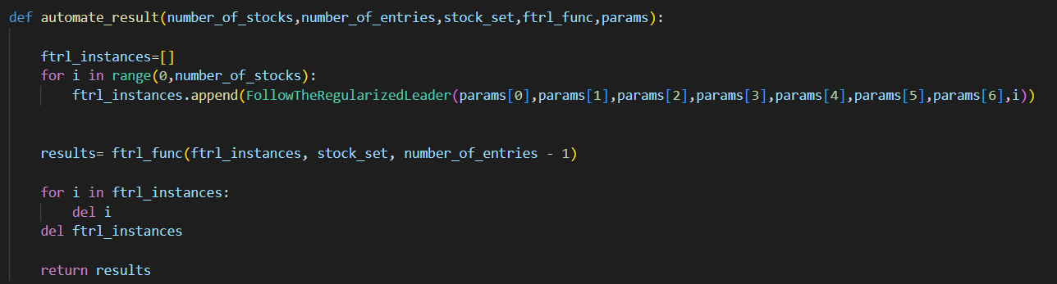
Result automation

Slide 20
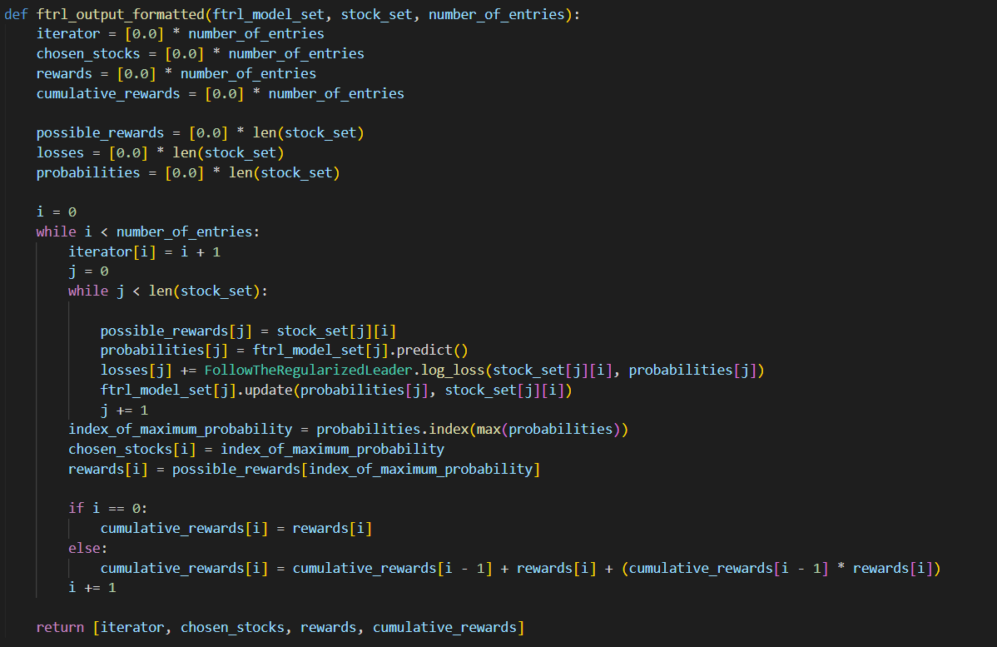
Putting it all together for prediction(FTRL standard)

Slide 21
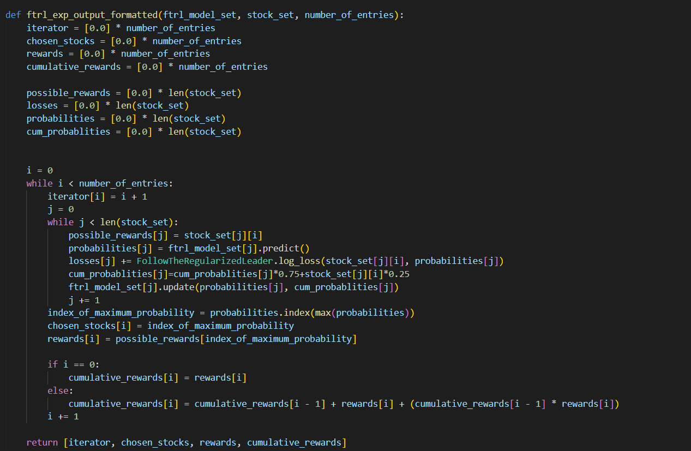
Extension FTRL Exponential smoothening

Slide 22
Extension FTRL Exponential smoothening

Slide 23
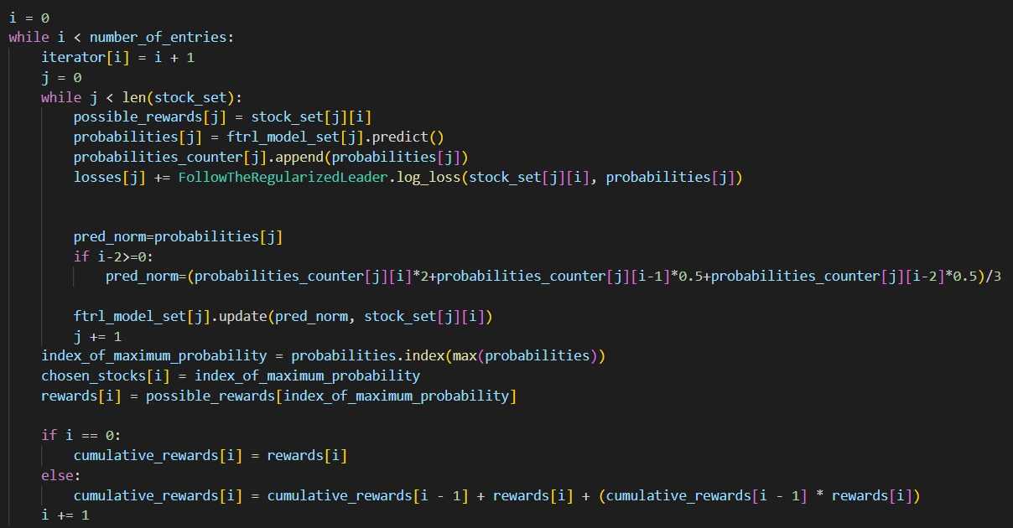
Extension FTRL moving average

Slide 24
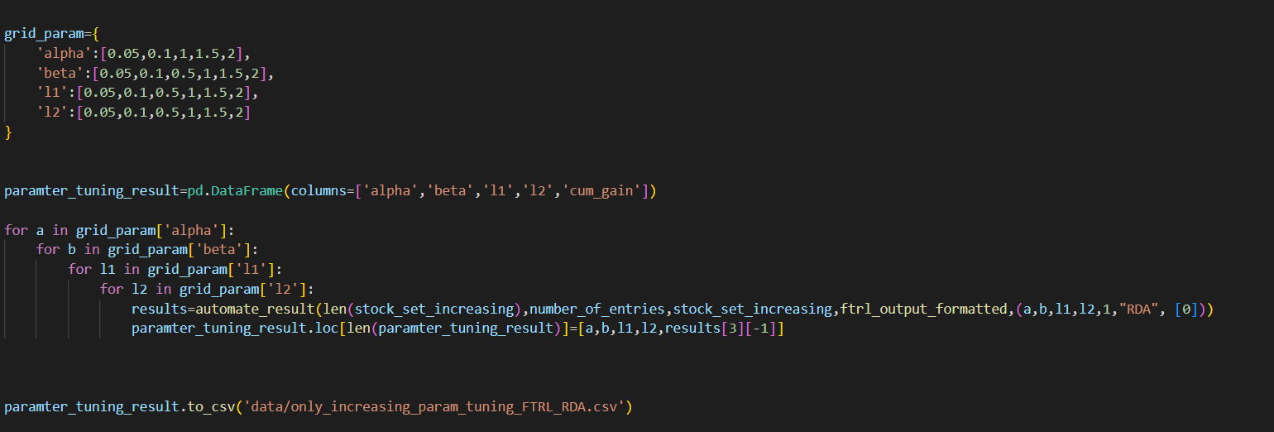
Tuning the parameters

Slide 25
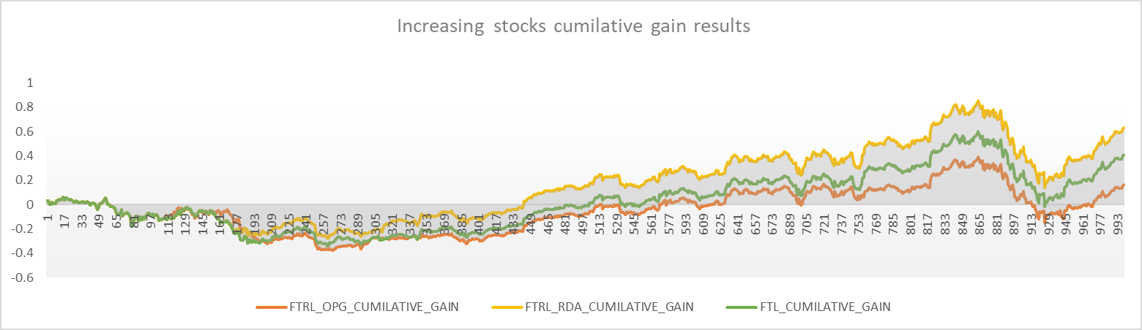
Results :Trends for cumulative gain
FTRL RDA is giving best results with cumulative gain of around 65% at the end of 1000 days.

Slide 26
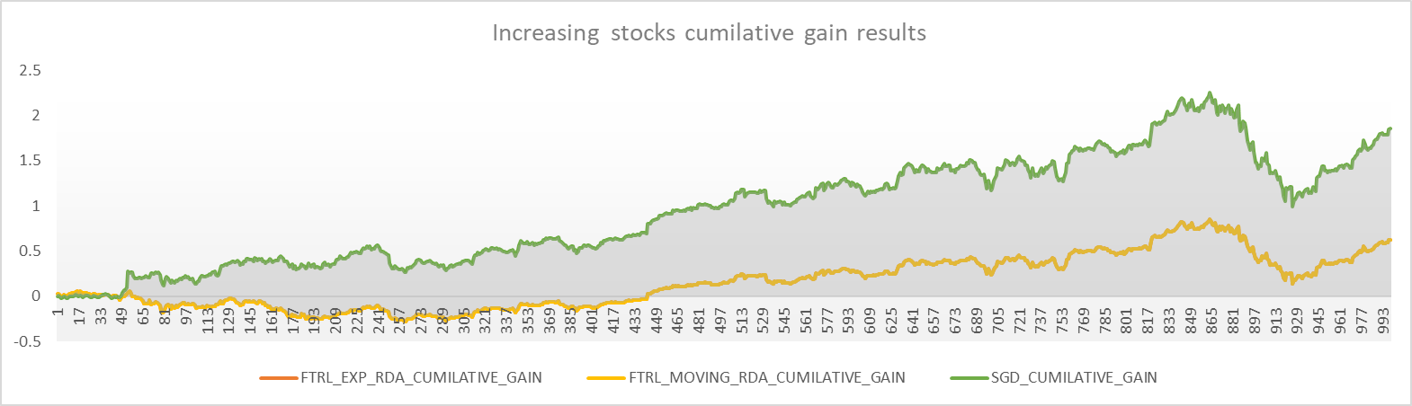
Results :Trends for cumulative gain
FTRL SGD is giving best results with cumulative gain of around 150% at the end of 1000 days.
FTRL RDA and moving average variant are giving the same trends i.e they are selecting the same stocks.

Slide 27
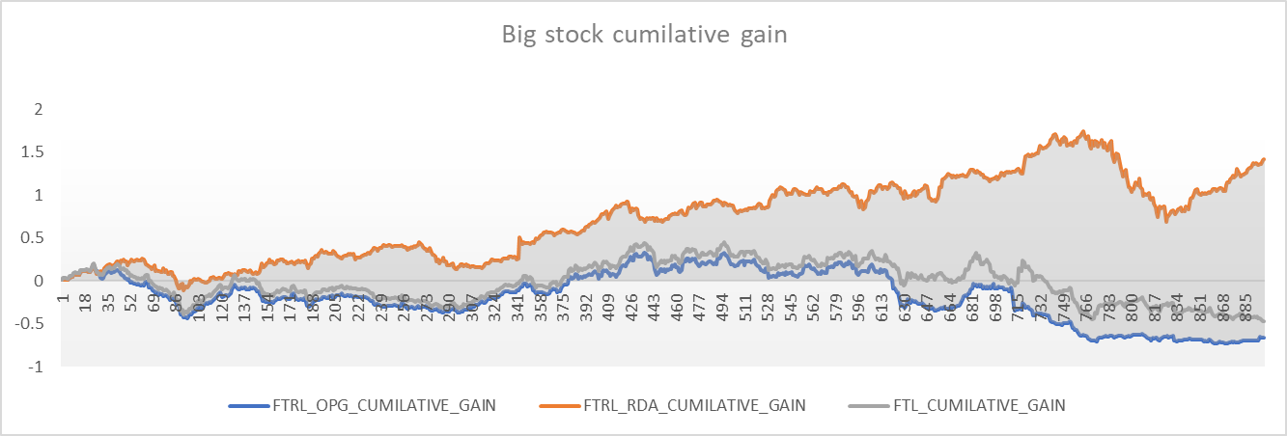
Results :Trends for cumulative gain
FTRL RDA is giving best results with cumulative gain of around 130% at the end of 1000 days for Big Stock set.

Slide 28
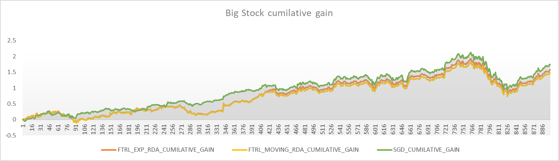
Results :Trends for cumulative gain
SGD and FTRL RDA are giving very close results in Big Sets.

Slide 29
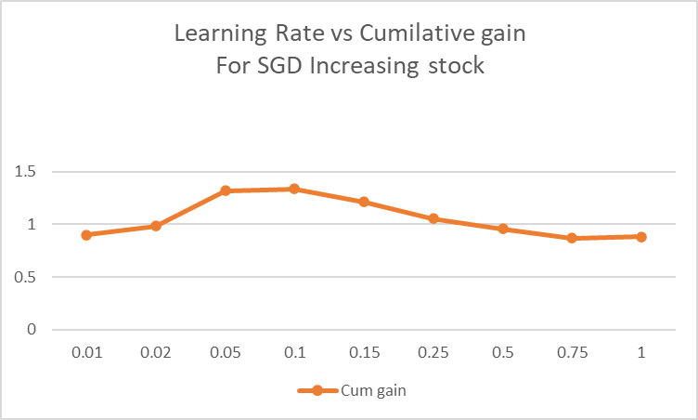
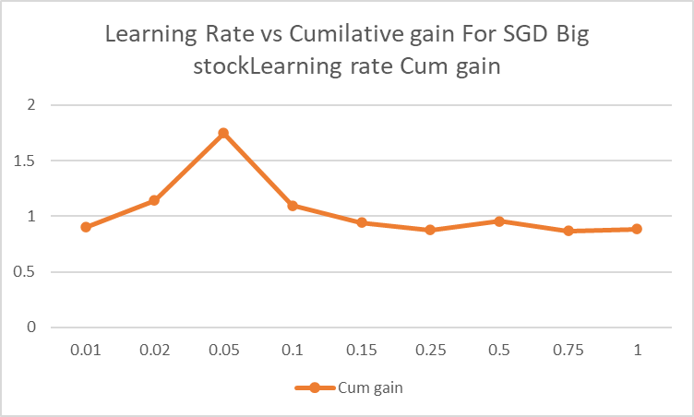
Results :Hyperparameter effects on SGD

Slide 30
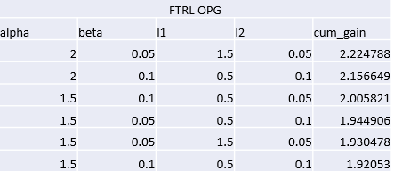
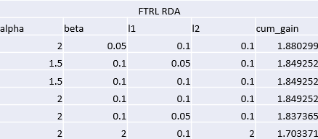
Results :Hyperparameter effects on SGD

Slide 31
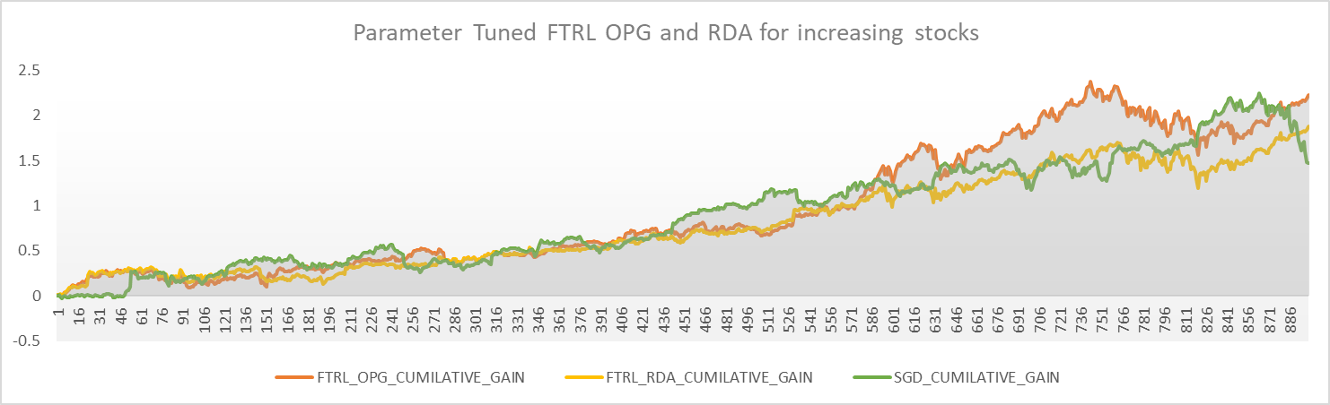
Results :Hyperparameter effects on SGD
OPG and RDA improved upon SGD after Hyper parameter Tuning

Slide 32
References :
https://marinballu.github.io/papers/OCO_Ballu19.pdf
https://courses.cs.washington.edu/courses/cse599s/14sp/scribes/
DATA source : https://www.alphavantage.co/
OPG and RDA : https://arxiv.org/pdf/1803.11521.pdf

