Slide 1

Toward Real-Time Planning in Games
Jeff Orkin
Monolith Productions

Slide 2
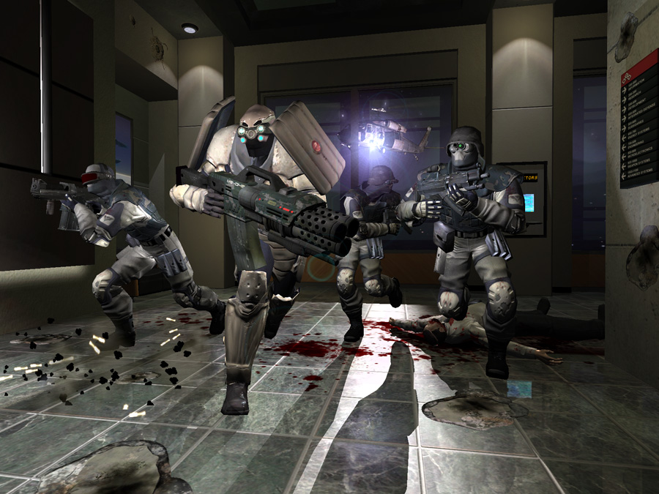
F.E.A.R.

Slide 3
Agenda
What
Why
How

Slide 4
Agenda
What do we mean by planning?
Why use planning in games?
How can we use planning in practice?

Slide 5
What do we mean by “planning?”

Slide 6
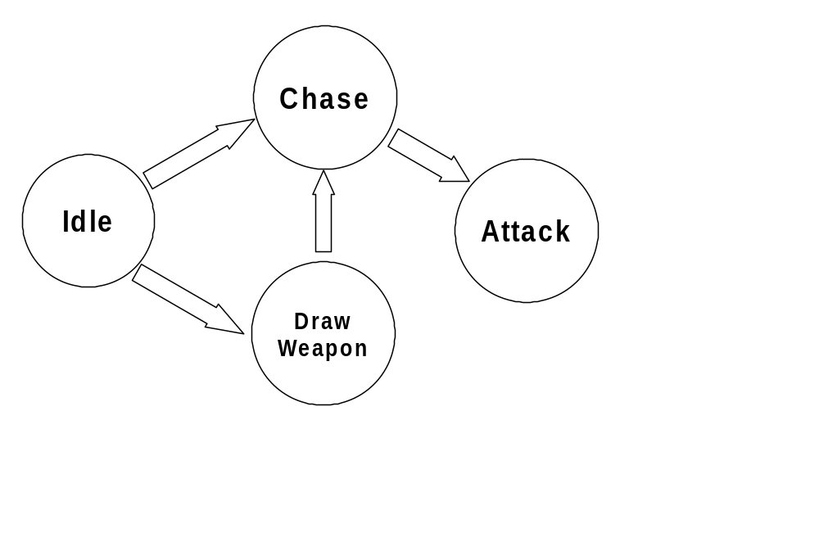
Typical Game AI

Slide 7
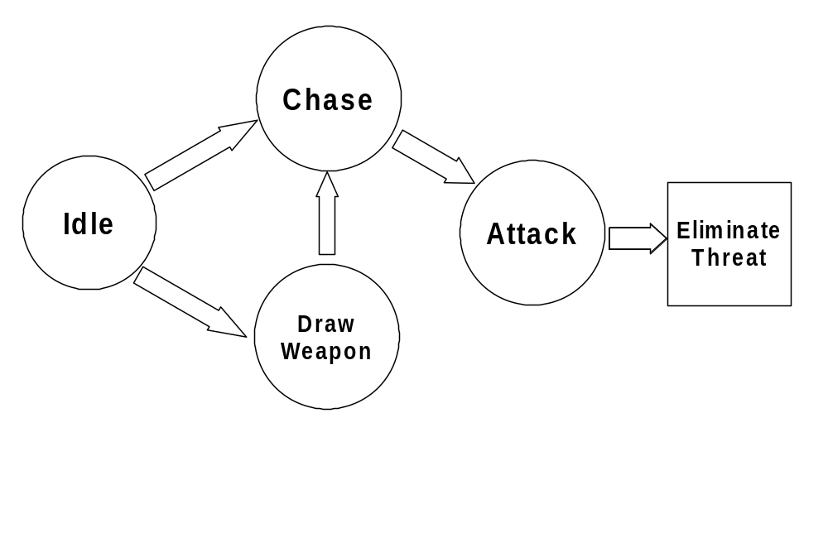
Goal-Oriented Planning

Slide 8
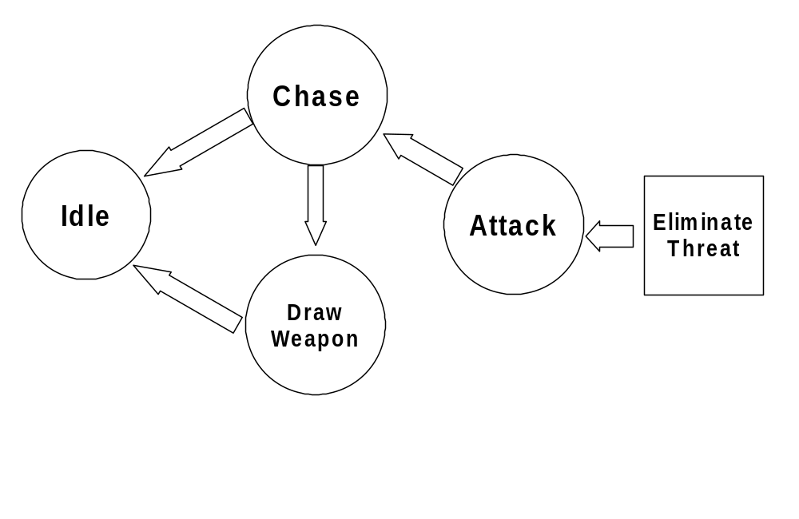
Regressive Planning

Slide 9
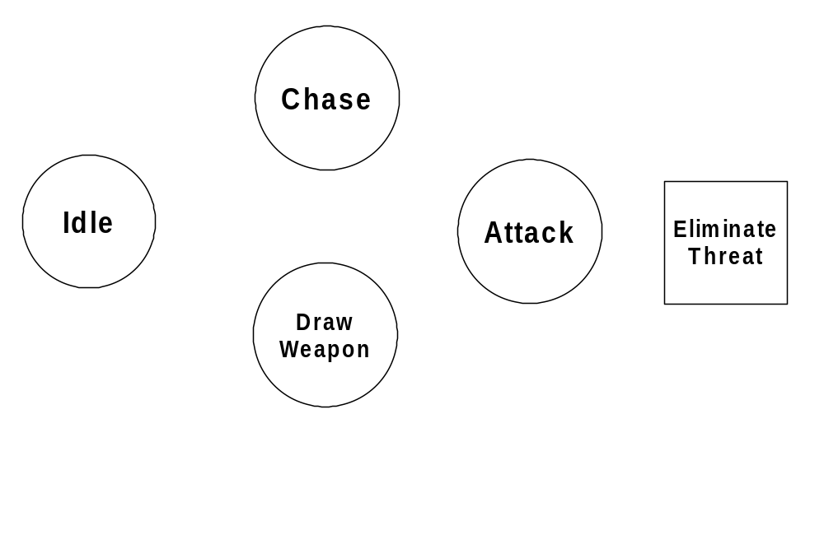
Dynamic Planning

Slide 10
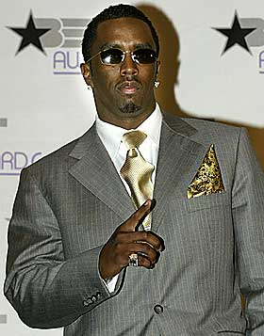
P.Diddy

Slide 11
P.D.D.L.
Planning Domain Definition Language
Goals
  Desired state
Actions
  Preconditions
  Effects

Slide 12
PDDL
Goal:
  (define (problem get-paid)
  (:domain briefcase-world)
  (:init (place home) (place office)
  (object p) (object d) (object b)
  (at B home) (at P home) (at D home) (in P))
  (:goal (and (at B office) (at D office) (at P home))))

Slide 13
PDDL
Action:
  (:action put-in
  :parameters (?x - physob ?l - location)
  :precondition (not (= ?x B))
  :effect (when (and (at ?x ?l) (at B ?l))
  (in ?x)) )
Other actions: take-out, move

Slide 14
PDDL
Modular
  Goals
  Actions
Decoupled Modules Related by symbols
  World State
  Preconditions
  Effects
Applied PDDL’s structure to C++ toolkit in game code.

Slide 15
Why use planning in games?

Slide 16
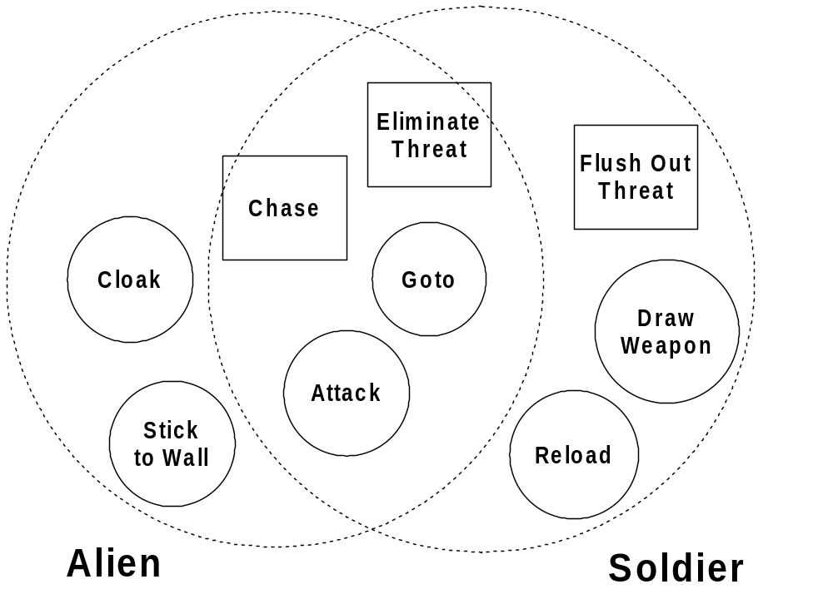
Sharing Behavior between NPCs

Slide 17
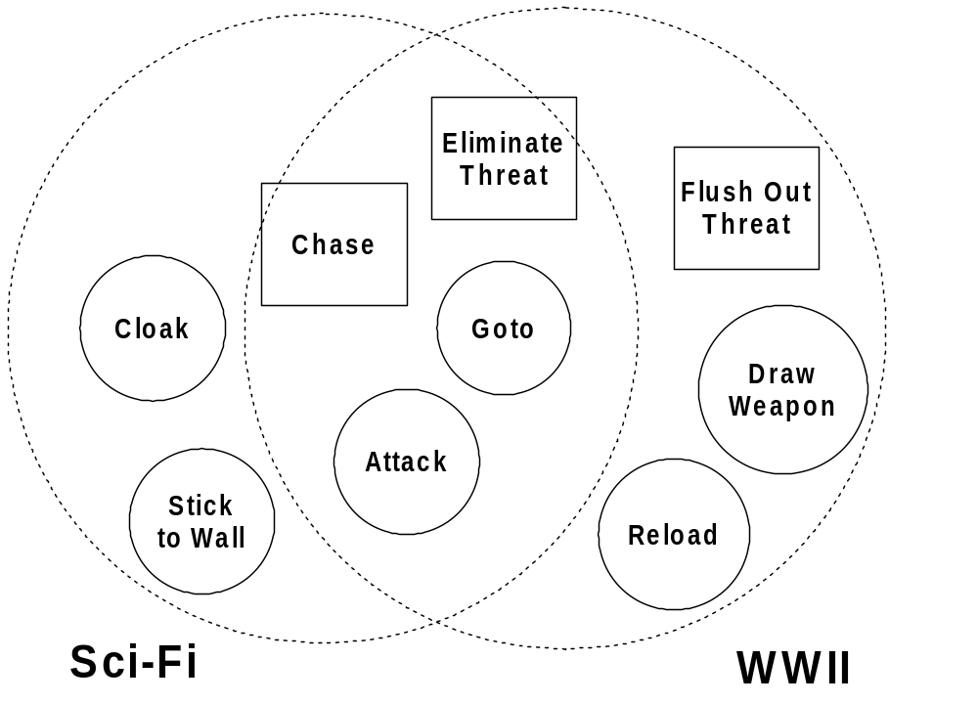
Sharing Behavior between Projects

Slide 18
Sharing Behavior: Data Points
7 Character types in FEAR
62 Actions
41 Actions shared between projects
20 Actions shared between characters in FEAR
35 Goals
21 Goals shared between projects
21 Goals shared between characters in FEAR

Slide 19
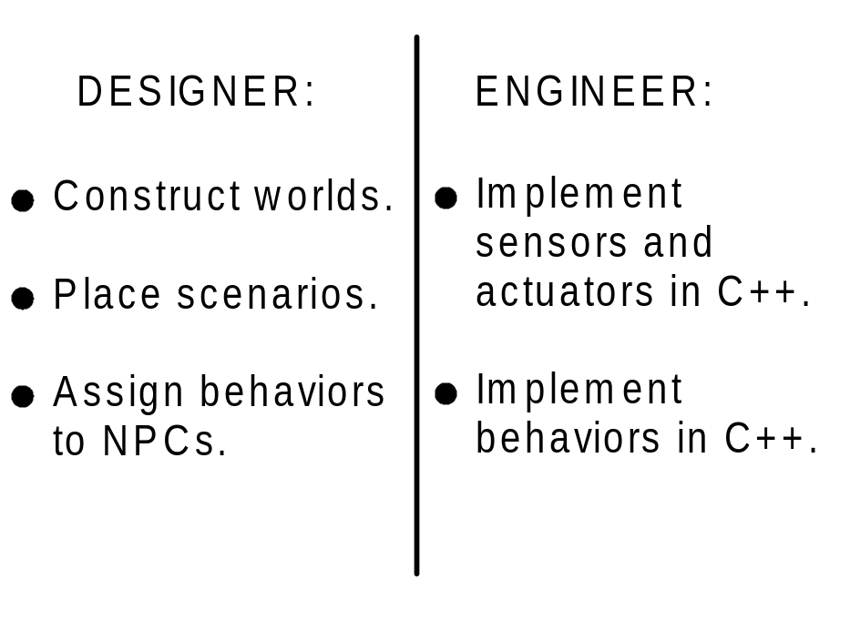
Workflow
Division of Labor:

Slide 20
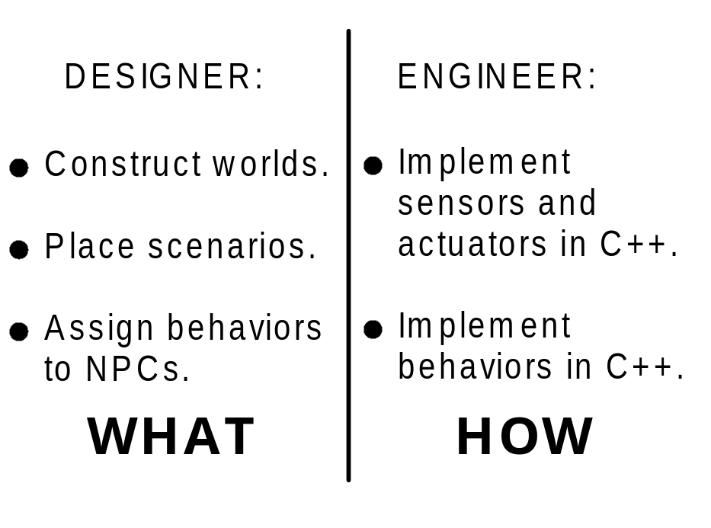
Workflow
Division of Labor:

Slide 21
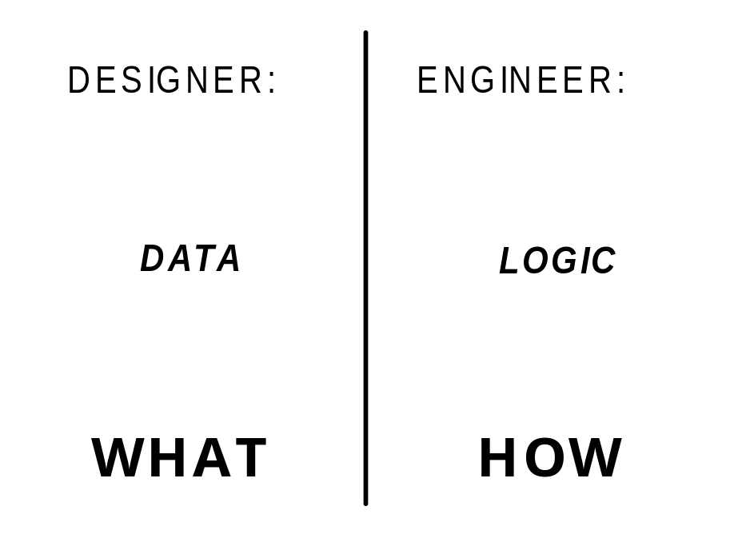
Workflow
Division of Labor:

Slide 22
The Best Day of
My Professional Life

Slide 23
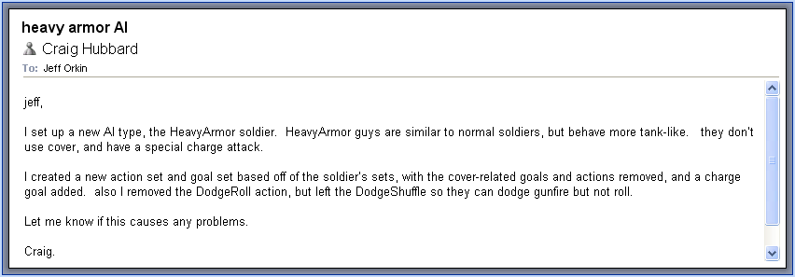
Workflow

Slide 24
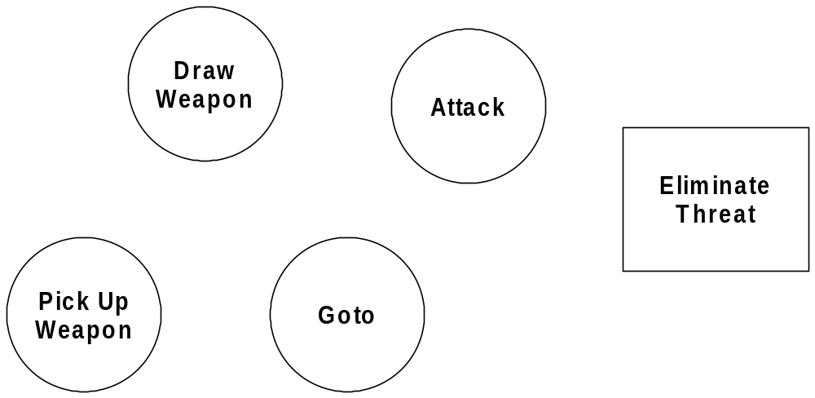
Robust Behavior

Slide 25
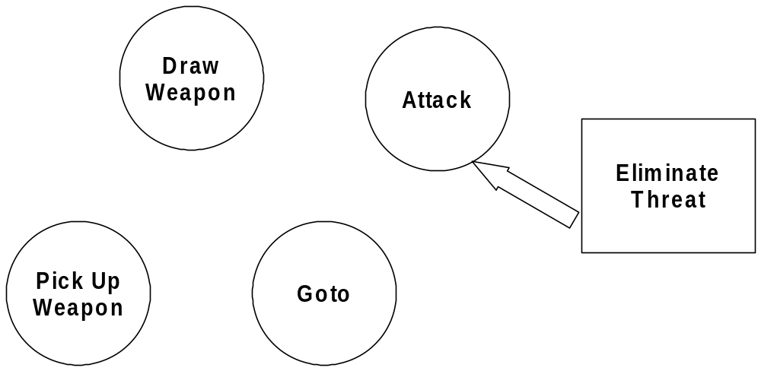
Robust Behavior

Slide 26
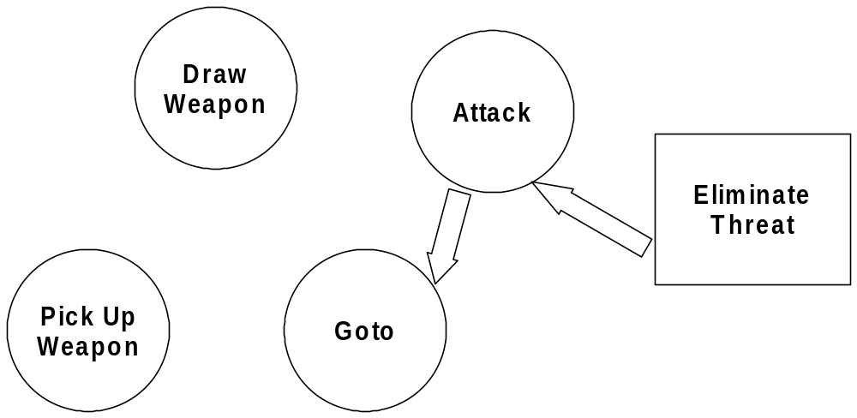
Robust Behavior

Slide 27
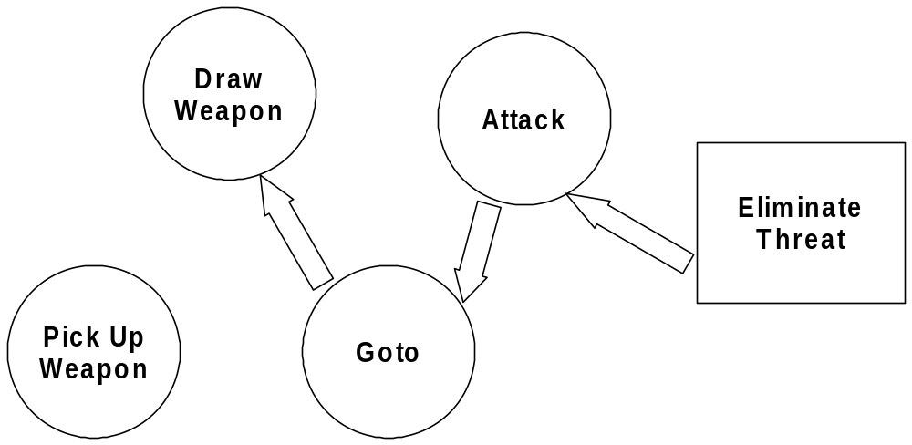
Robust Behavior

Slide 28
Robust Behavior

Slide 29
Robust Behavior

Slide 30
Robust Behavior

Slide 31
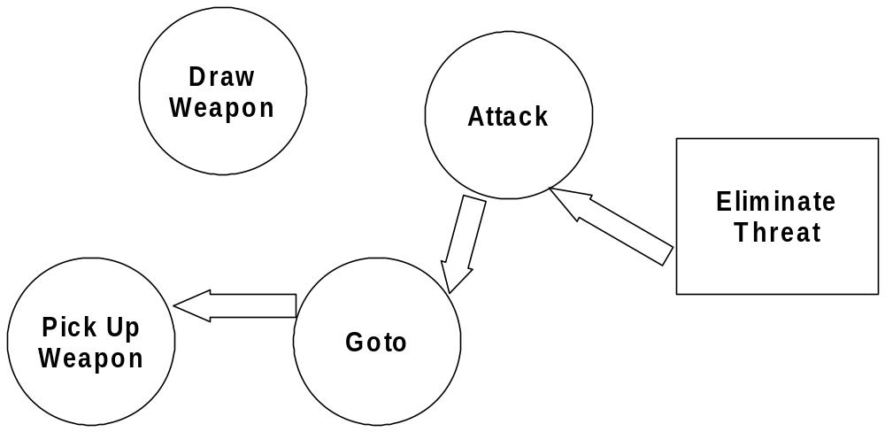
Robust Behavior

Slide 32
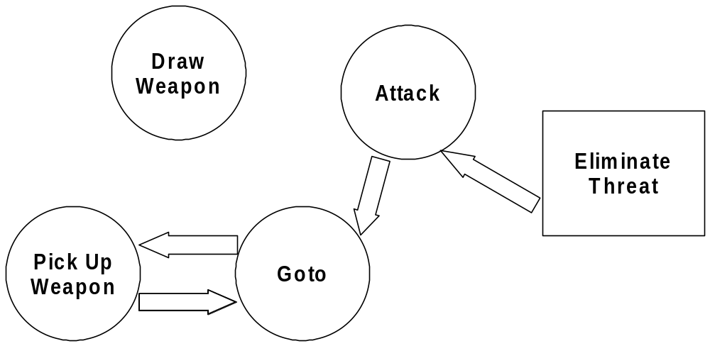
Robust Behavior

Slide 33
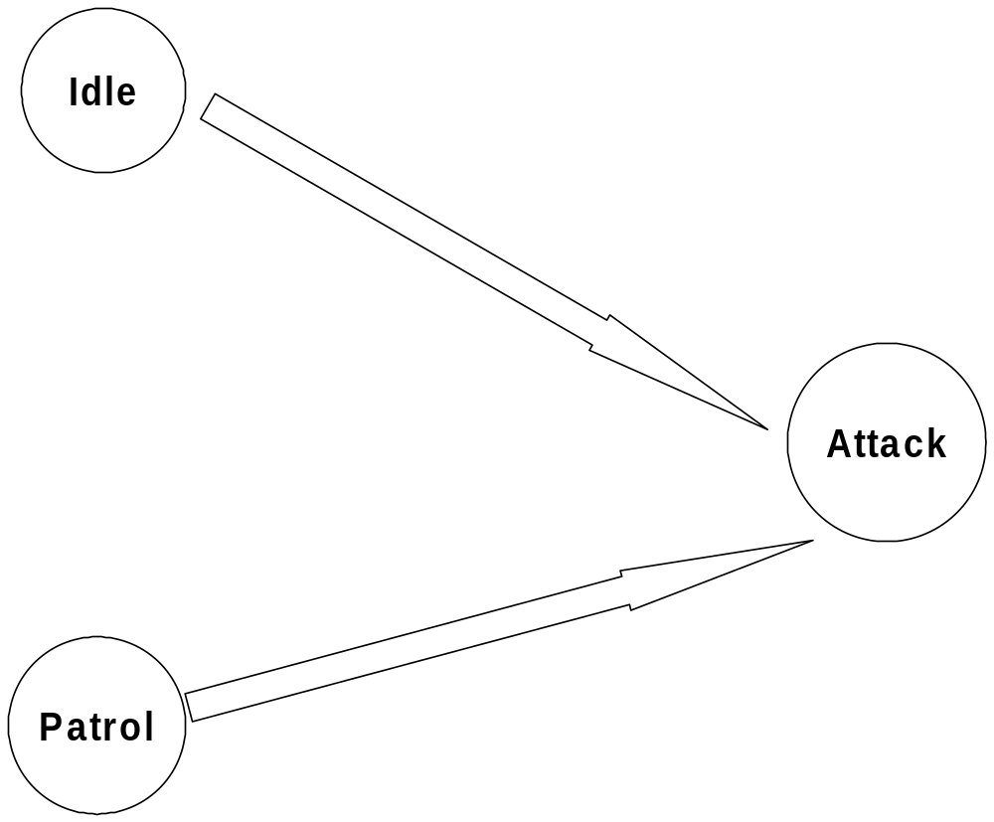
Maintenance

Slide 34
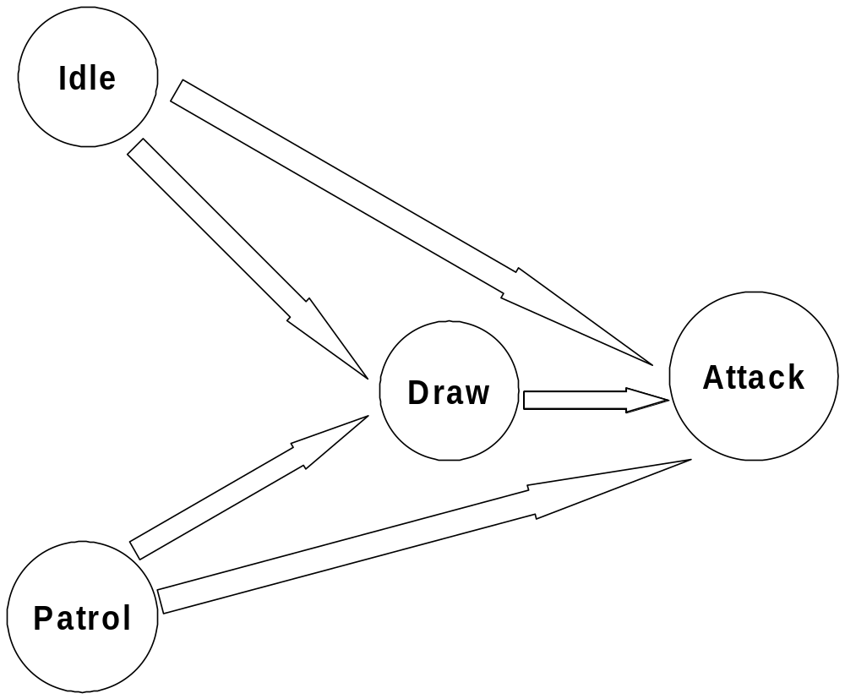
Maintenance

Slide 35
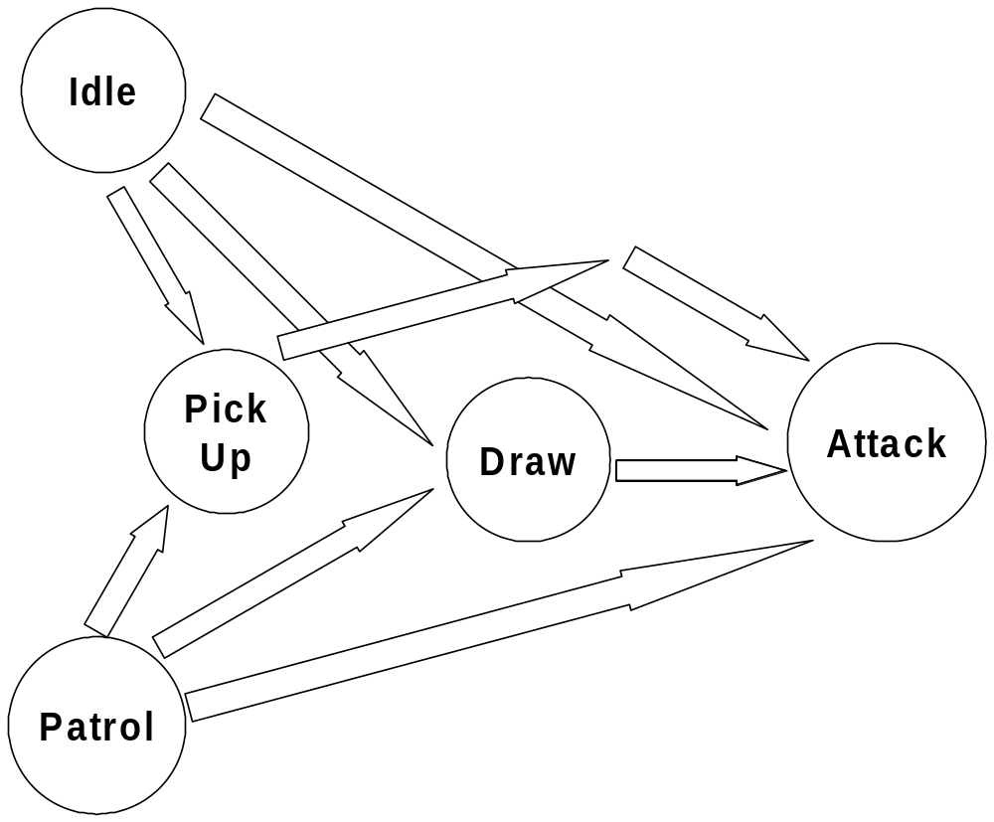
Maintenance

Slide 36

Maintenance

Slide 37
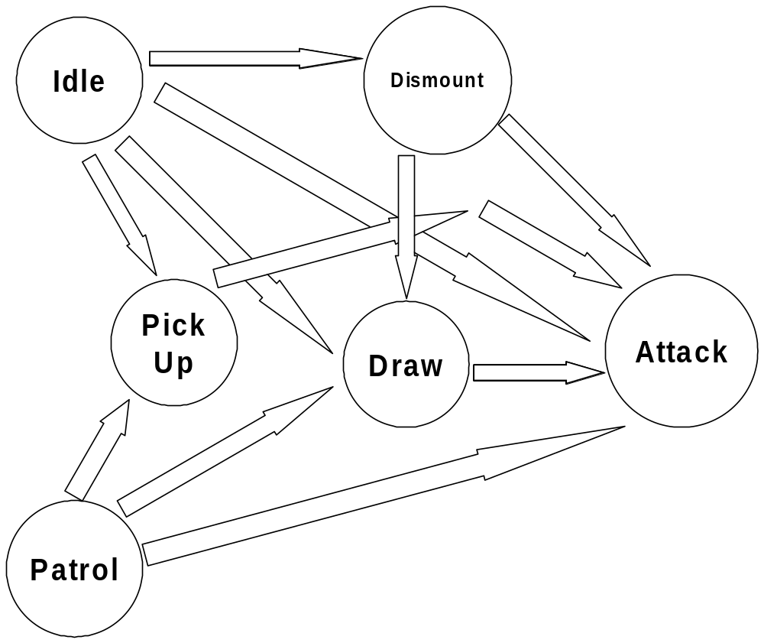
Maintenance

Slide 38
How can we use planning in practice?

Slide 39
How can we use planning in practice?
Symbols
Plan Formulation
Planning Frequency
Plan Granularity

Slide 40
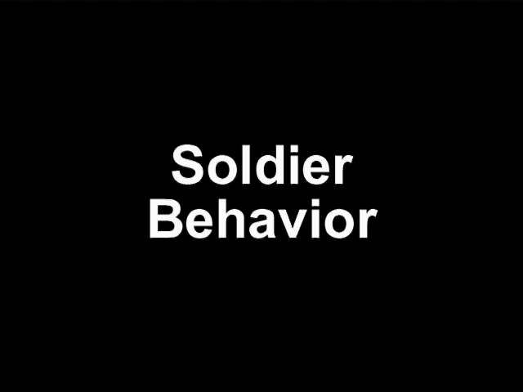
F.E.A.R. Demo

Slide 41
Symbols
Key-Value pairs
Enumerated keys
  kKey_WeaponLoaded
  kKey_AtPosition
Values – union of types
  bool
  int
  float
  enum
  etc…

Slide 42
Symbols
Array of Key-Value pairs represents:
  State of world
  Goal satisfaction conditions
  Action preconditions
  Action effects

Slide 43
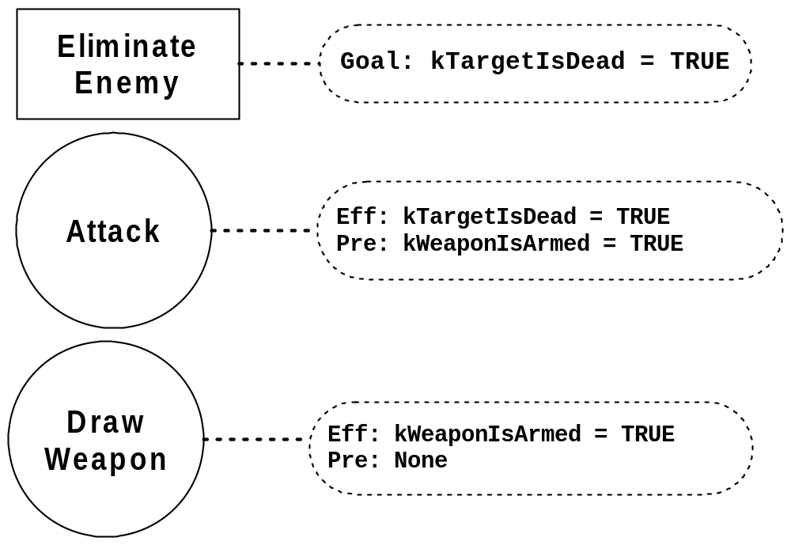
Symbols

Slide 44
Plan Formulation
A* search for sequence of actions
  Action is neighbor if effect satisfies an existing precondition.
  Actions hashed by effect.
  Heuristic: minimize number of unsatisfied preconditions.

Slide 45
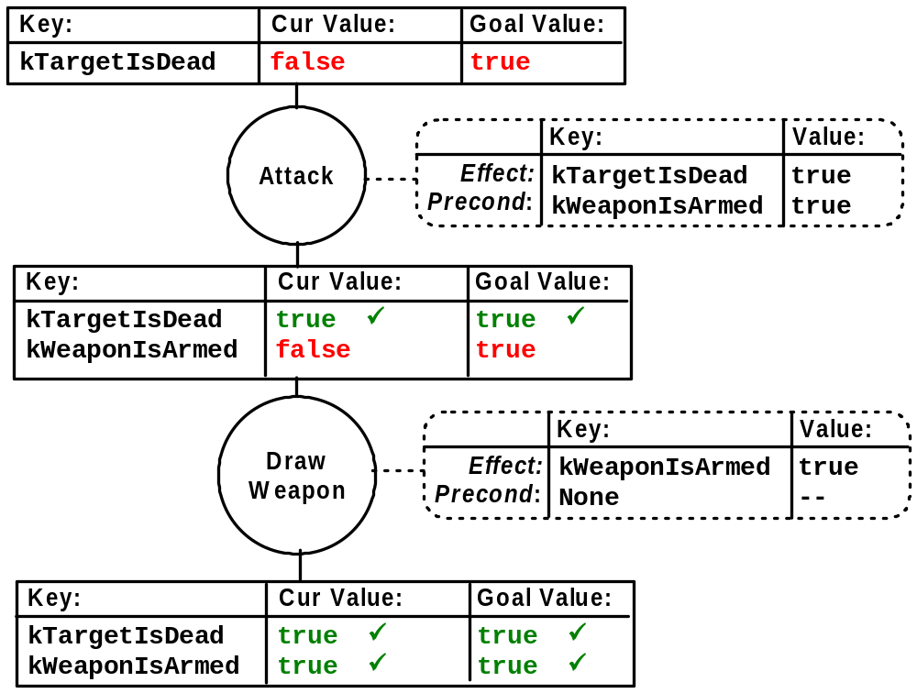

Slide 46
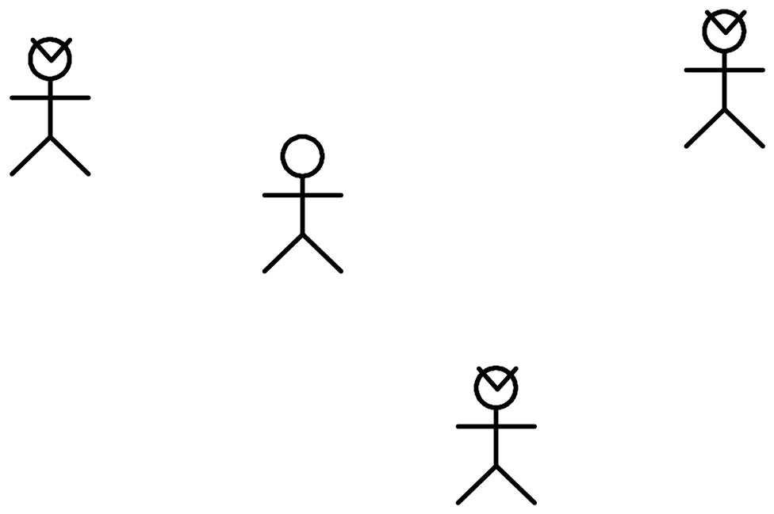
Symbolic Representation Strategies

Slide 47
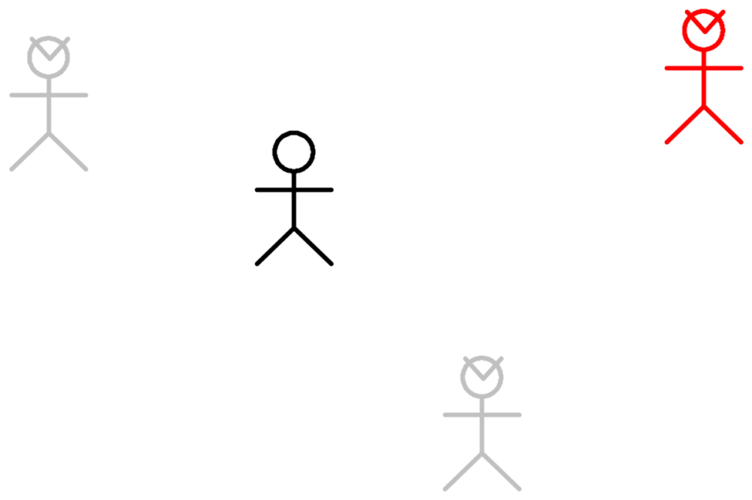
Symbolic Representation Strategies
Agent-centric representation.

Slide 48
Symbolic Representation Strategies
Agent-centric representation
  Subsystem handles target selection.
  Less symbols to evaluate during plan formulation.

Slide 49
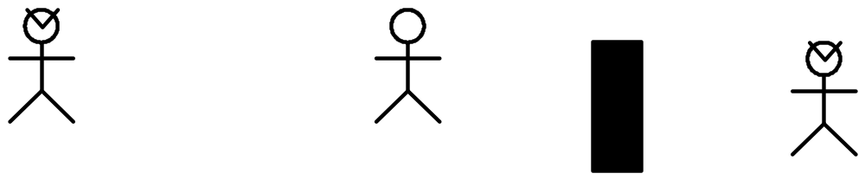
Symbolic Representation Strategies

Slide 50
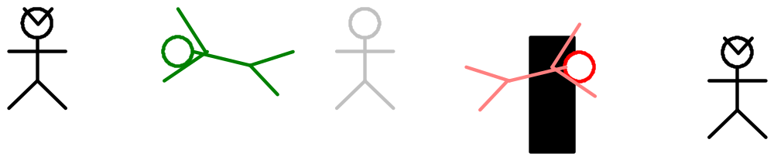
Symbolic Representation Strategies
Context preconditions.

Slide 51
Symbolic Representation Strategies
Context preconditions
  aka Filter conditions.
  Alternative to symbolic preconditions.
  Test precondition(s) with arbitrary piece(s) of code.
  Prune search tree.
Symbolic preconditions are only used when we want the planner to find a preceding action.

Slide 52
Planning Frequency
Do NOT plan every frame!
Plan may last seconds or minutes.
Only re-plan when:
  Goal changes.
  Action invalidated.
  Target changes.

Slide 53
Planning Frequency
Action duration:
  Finite (e.g. ReloadWeapon)
  Variable (e.g. Goto)
  Infinite (e.g. Attack)

Slide 54
Planning Frequency
Action invalidation:
  Out of ammo.
  Target dead.
  Path obstructed.

Slide 55
Planning Granularity
Fine grained:
  Look at target
  Walk in range of target
  Turn toward target
  Move right hand to holster
  Unholster weapon
  Raise right hand
  Aim weapon
  Fire weapon
  Move left hand to weapon
  Reload weapon

Slide 56
Planning Granularity
Course grained:
  Defeat player

Slide 57
Planning Granularity
Happy medium:
  Goto target
  Draw weapon
  Attack
  Reload
Subsystems handle details:
  Animation
  NPC movement & rotation
  Target selection & aiming

Slide 58
Take-Away
Use planning in games!
Minimize number of symbols with agent-centric representation.
Prune search with context preconditions.
Only re-plan when necessary.
Delegate details to sub-systems.

Slide 59
Questions?
Jeff Orkin
Monolith Productions
http://www.jorkin.com

