Slide 1

Agent Architecture Considerations for Real-Time Planning in Games
Jeff Orkin
Monolith Productions

Slide 2
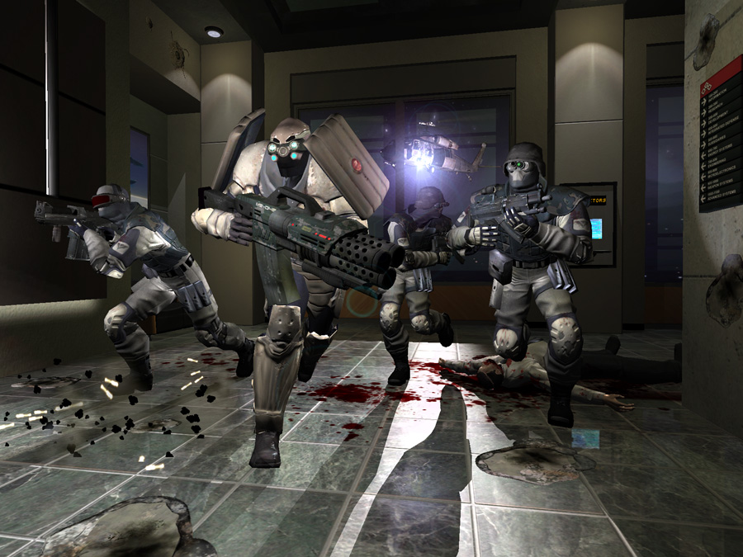
F.E.A.R.

Slide 3
Agenda
Motivation
Problems
Solutions
Was it worth it?

Slide 4
Agenda
Motivation – Why plan?
Problems – Performance!
Solutions – Agent architecture
Was it worth it?

Slide 5
Why plan in real-time?

Slide 6


Goal-Oriented Behavior

Slide 7
Goal-Oriented Behavior
Problems:
Managing dependencies
Sharing behaviors

Slide 8
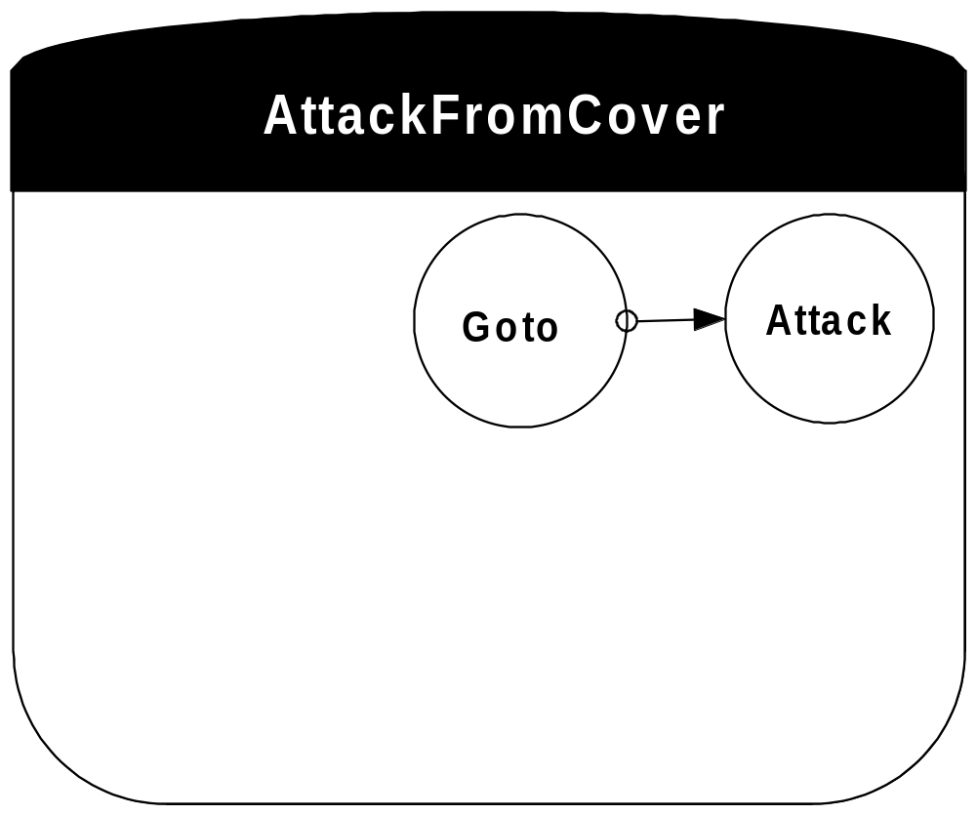
Problem: Dependencies

Slide 9
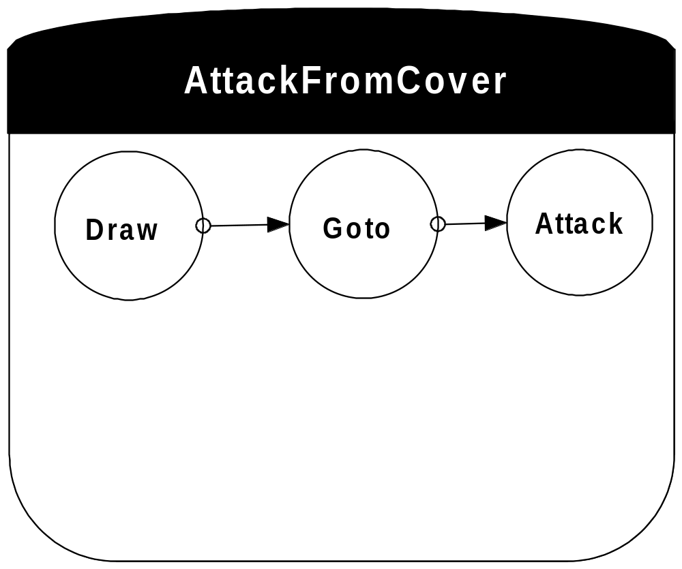
Problem: Dependencies

Slide 10
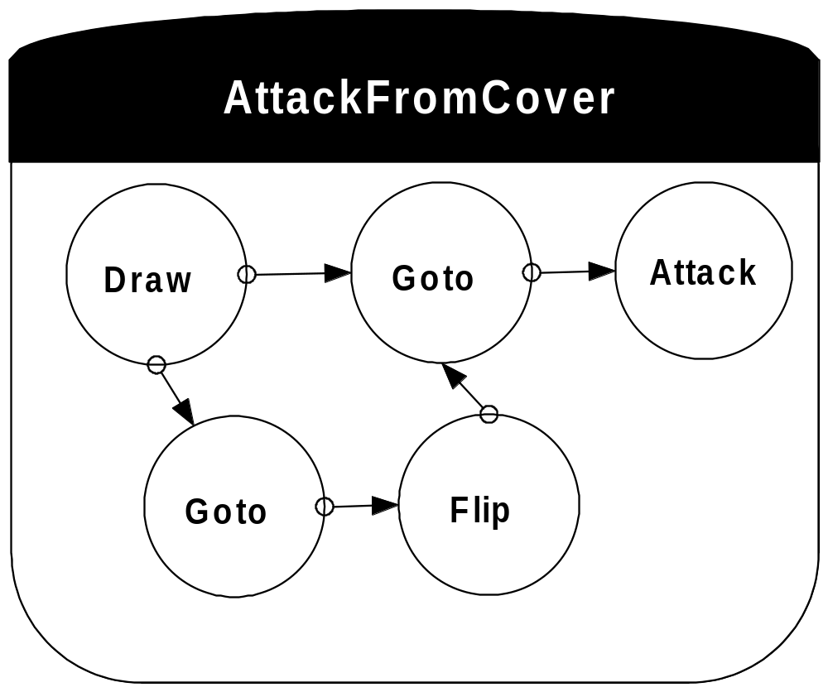
Problem: Dependencies

Slide 11
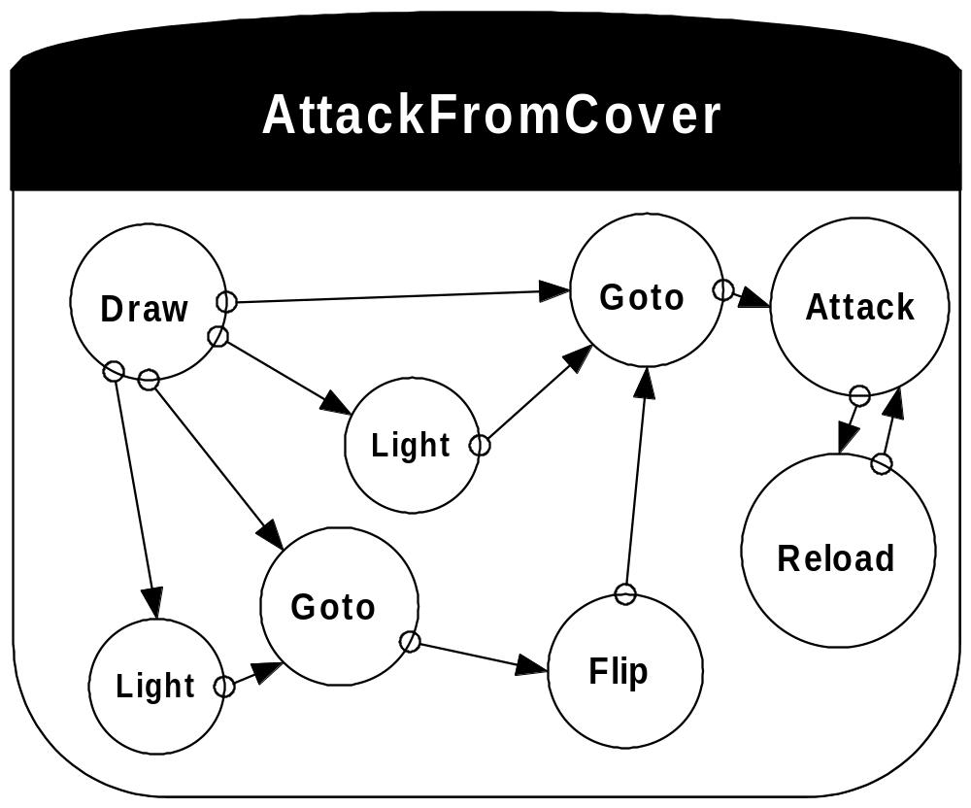
Problem: Dependencies

Slide 12
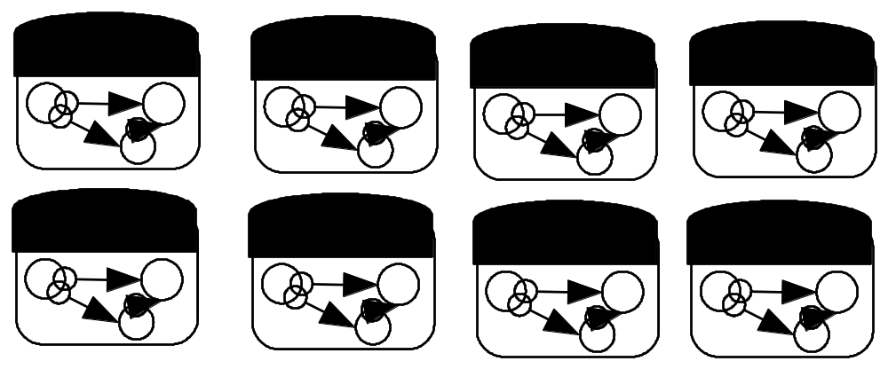
Problem: Dependencies

Slide 13
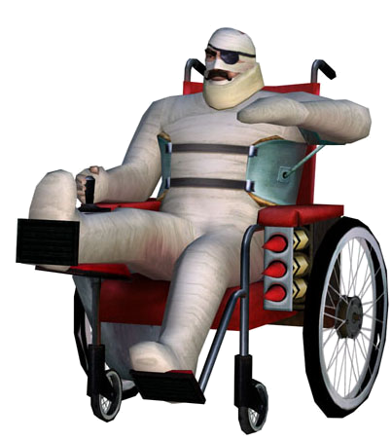
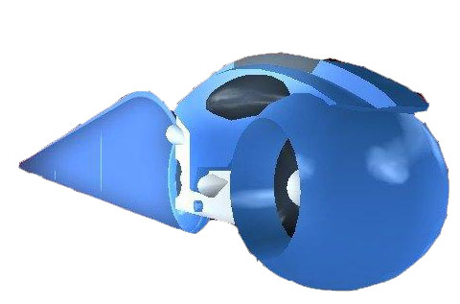
Problem: Sharing
No One Lives Forever 2
TRON 2.0

Slide 14
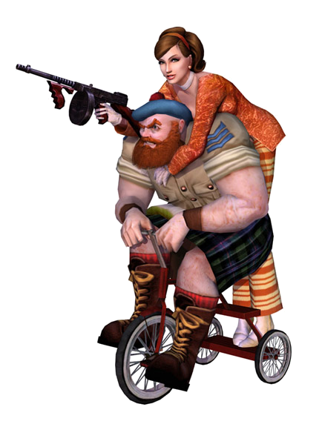
Problem: Sharing
No One Lives Forever 2
TRON 2.0

Slide 15
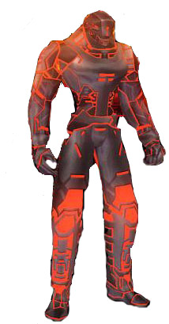
Problem: Sharing
No One Lives Forever 2
TRON 2.0

Slide 16
P.D.D.L.
Planning Domain Definition Language
Goals
  Desired state
Actions
  Preconditions
  Effects

Slide 17
P.D.D.L.
Goal:
  (define (problem get-paid)
  (:domain briefcase-world)
  (:init (place home) (place office)
  (object p) (object d) (object b)
  (at B home) (at P home) (at D home) (in P))
  (:goal (and (at B office) (at D office) (at P home))))

Slide 18
P.D.D.L.
Action:
  (:action put-in
  :parameters (?x - physob ?l - location)
  :precondition (not (= ?x B))
  :effect (when (and (at ?x ?l) (at B ?l))
  (in ?x)) )
Other actions: take-out, move

Slide 19
P.D.D.L.
Modular
  Goals
  Actions
Decoupled Modules Related by symbols
  World State
  Preconditions
  Effects
Applied PDDL’s structure to C++ toolkit in game code.

Slide 20

Monolith Productions
Management

Slide 21
How to Plan in Real-Time and Keep Your Job
Jeff Orkin
Monolith Productions

Slide 22
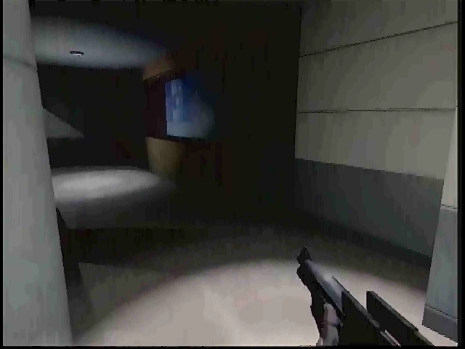

Slide 23
The Plan
Goal: KillEnemy
Plan:
Goto (couch)
UseObject (couch)
Goto (coverNode)
AttackFromCover

Slide 24
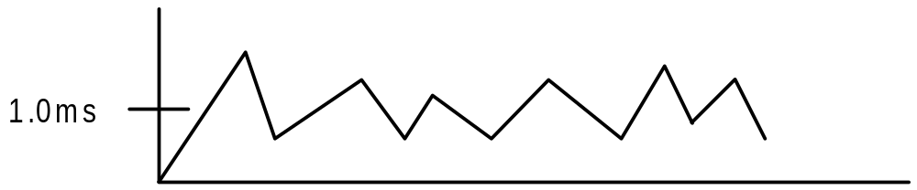
AI Performance Guideline: 1.0ms / frame

Slide 25
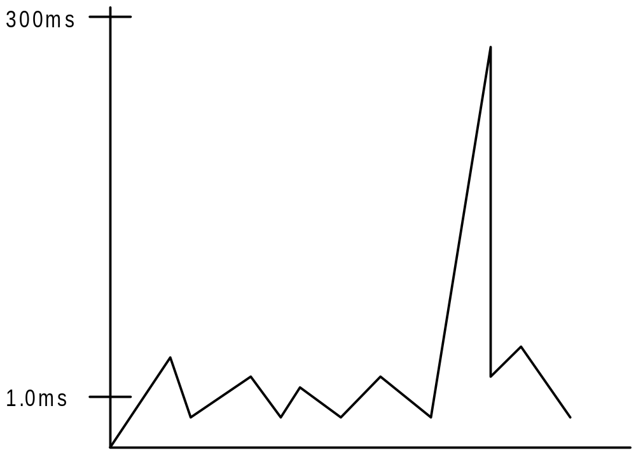
AI Performance: Off the Chart!

Slide 26
AI Performance: Off the Chart!
Preconditions:
Visibility

Slide 27
AI Performance: Off the Chart!
Preconditions:
Visibility
Pathfinding

Slide 28
AI Performance: Off the Chart!
Preconditions:
Visibility
Pathfinding
Tactical Position Validity

Slide 29
Solution
Re-consider Agent Architecture
Distributed processing
Caching

Slide 30
Solution
Re-consider Agent Architecture
Distributed processing
Caching
Inspiration:
MIT Media Lab’s C4
Robotics

Slide 31
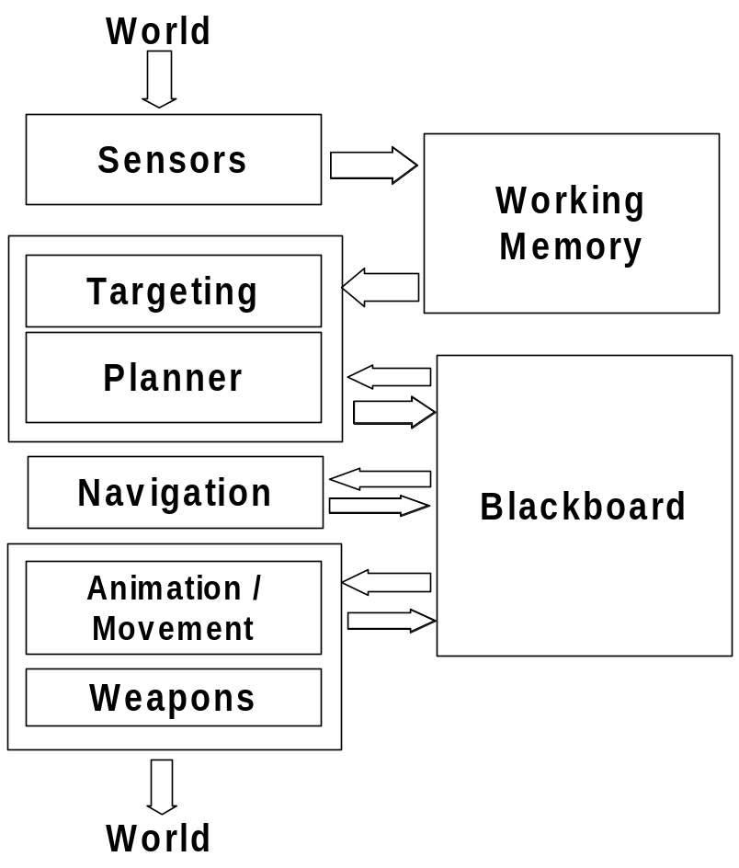
Solution

Slide 32
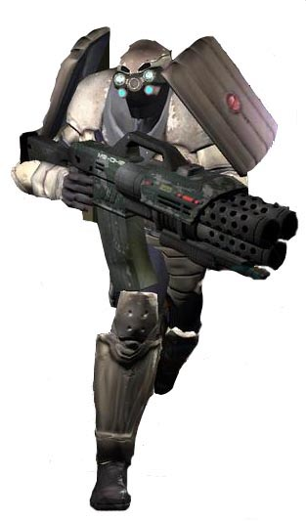
What is a soldier?

Slide 33
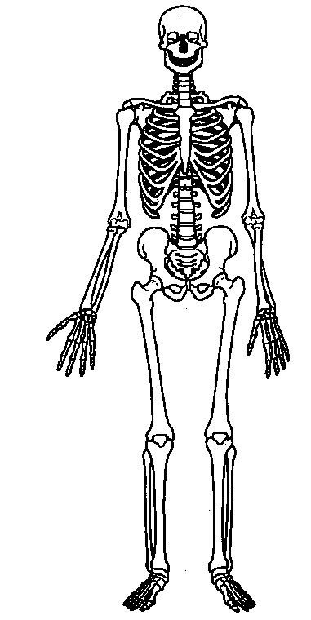
What is a soldier?

Slide 34
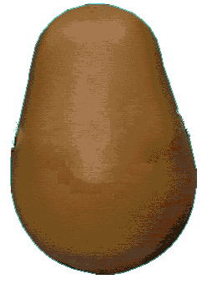
What is a soldier?

Slide 35

What is a soldier?
Sensors:
See

Slide 36


What is a soldier?
Sensors:
See
Hear

Slide 37

What is a soldier?
Sensors:
See
Hear
Feel pain

Slide 38


What is a soldier?
Subsystems:
Navigate / Move

Slide 39

What is a soldier?
Subsystems:
Navigate / Move
Attention Selection (Targeting)

Slide 40

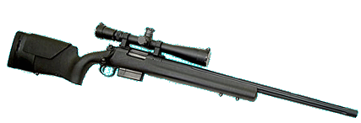
What is a soldier?
Subsystems:
Navigate / Move
Attention Selection (Targeting)
Weapons

Slide 41
Distributed Processing with Sensors
Pseudo-parallel
Amortize precondition processing across many frames
Allow incremental processing

Slide 42
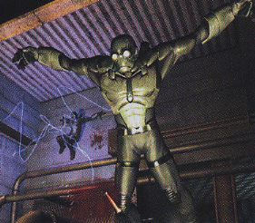
Distributed Processing with Sensors
More than Vision, Hearing, Touch
Tactical analysis
Internal desires

Slide 43
Distributed Processing with Sensors
Update:
  Every frame
  Periodic Polling
  Event-driven
Limit total number of expensive sensor updates per frame.

Slide 44
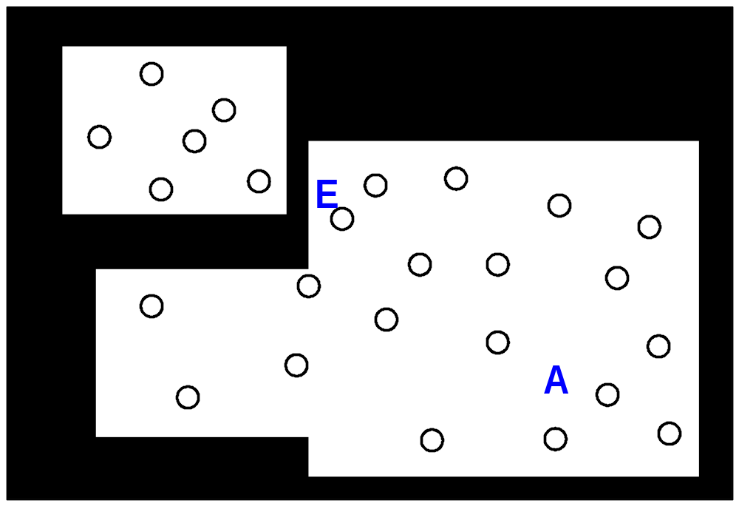
Sensor Example: CoverNode Sensor
Update 3 times / second

Slide 45
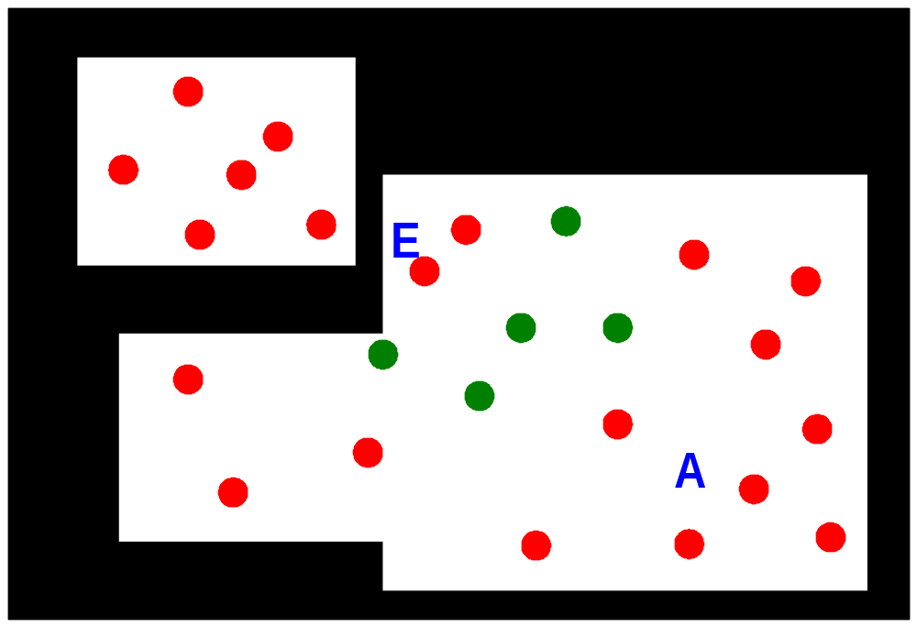
Sensor Example: Cover Node Sensor
Update 3 times / second

Slide 46
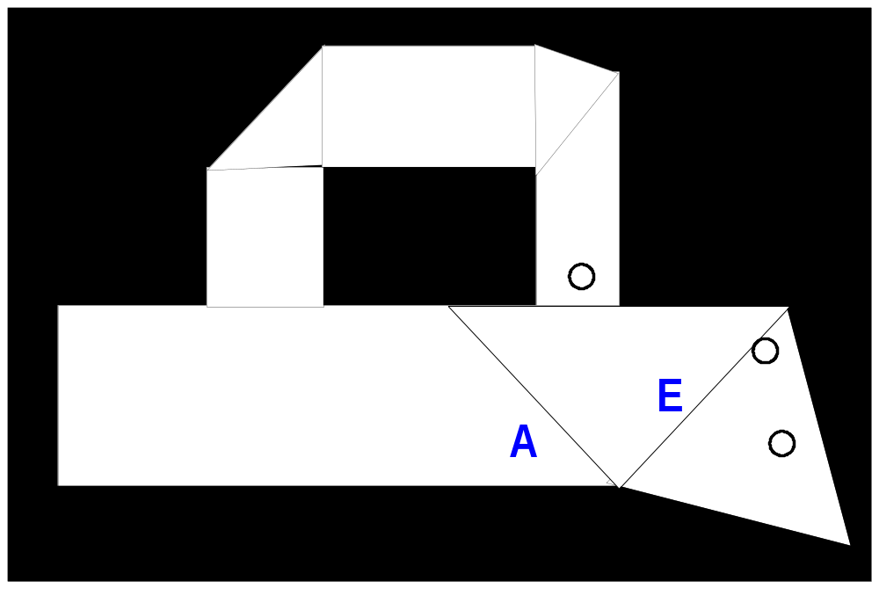
Sensor Example: PassTarget Sensor
Incremental update

Slide 47

Sensor Example: PassTarget Sensor
Incremental update

Slide 48
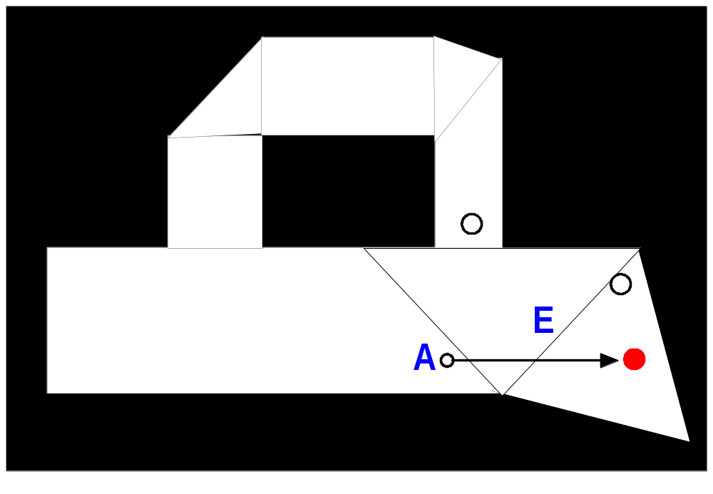
Sensor Example: PassTarget Sensor
Incremental update

Slide 49

Sensor Example: PassTarget Sensor
Incremental update

Slide 50

Sensor Example: PassTarget Sensor
Incremental update

Slide 51
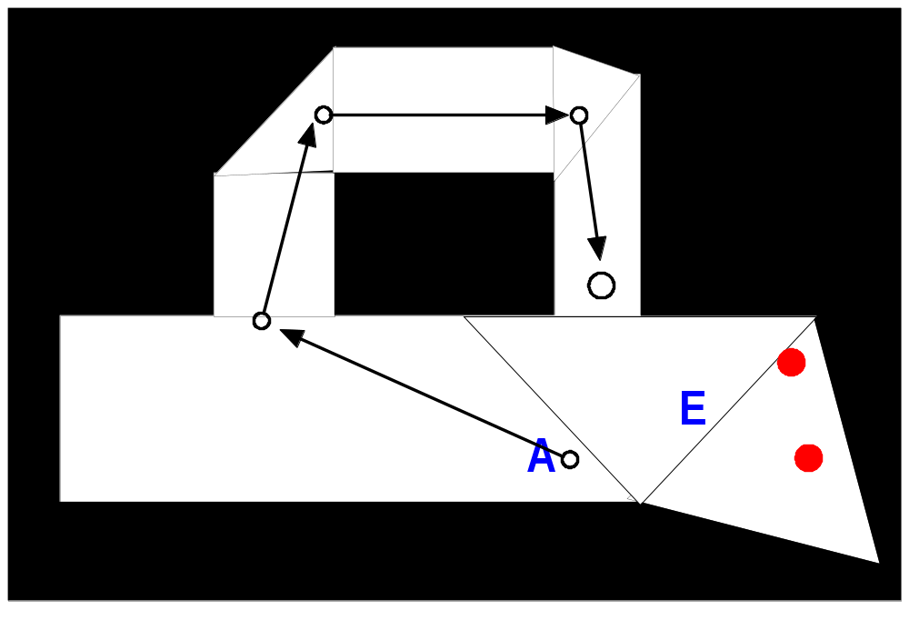
Sensor Example: PassTarget Sensor
Incremental update

Slide 52
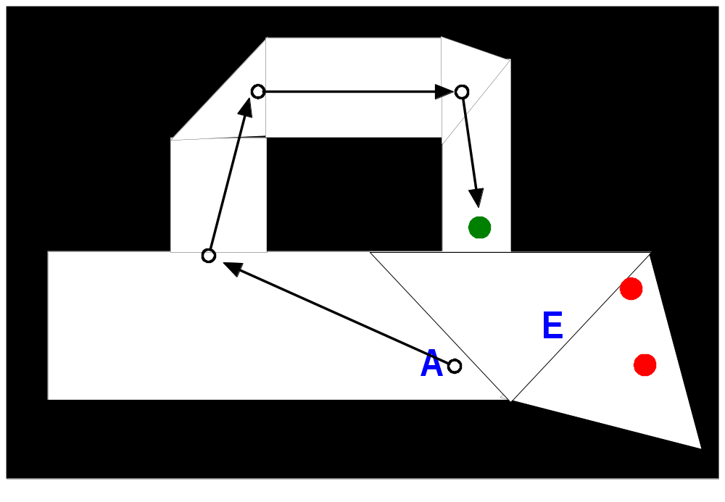
Sensor Example: PassTarget Sensor
Incremental update

Slide 53
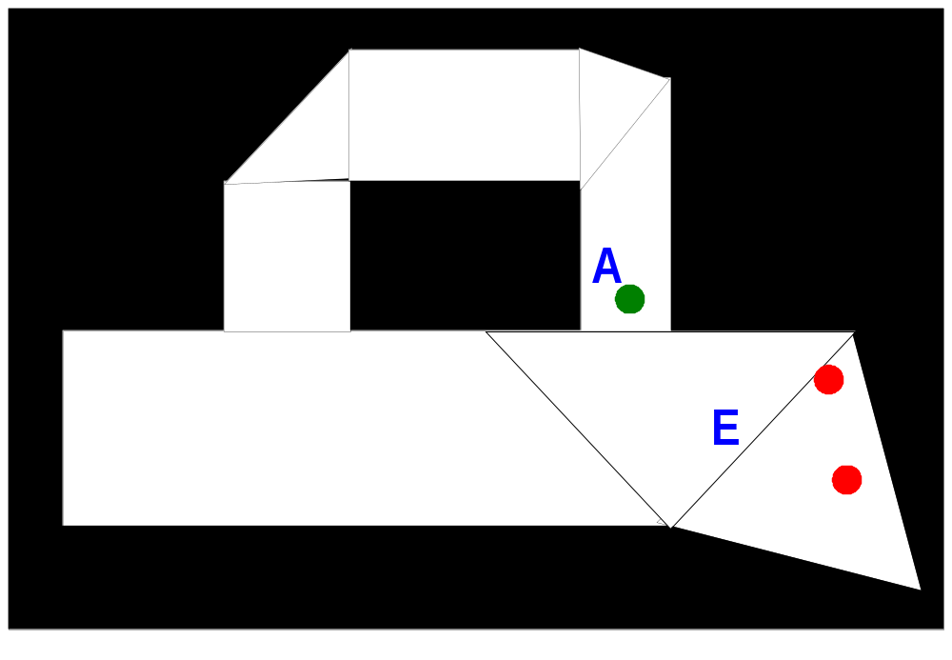
Sensor Example: PassTarget Sensor
Incremental update

Slide 54
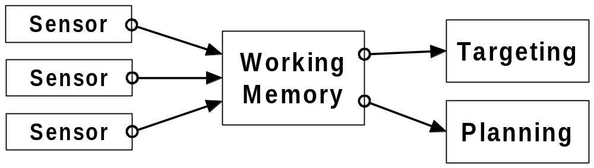
Caching

Slide 55
Caching: WorkingMemoryFacts
Facts are really beliefs
Common representation of all knowledge:
  Character
  Object
  Node
  Disturbance
  Task
  PathInfo
  Desire

Slide 56
Caching: WorkingMemoryFacts
WorkingMemoryFact
{
Attribute<Vector3D> Position
Attribute<Vector3D> Direction
Attribute<StimulusType> Stimulus
Attribute<HANDLE> Object
Attribute<DesireType> Desire
// 16 attributes total...
}

Slide 57
Caching: WorkingMemoryFacts
Attribute<Type>
{
Type Value
float fConfidence
}

Slide 58
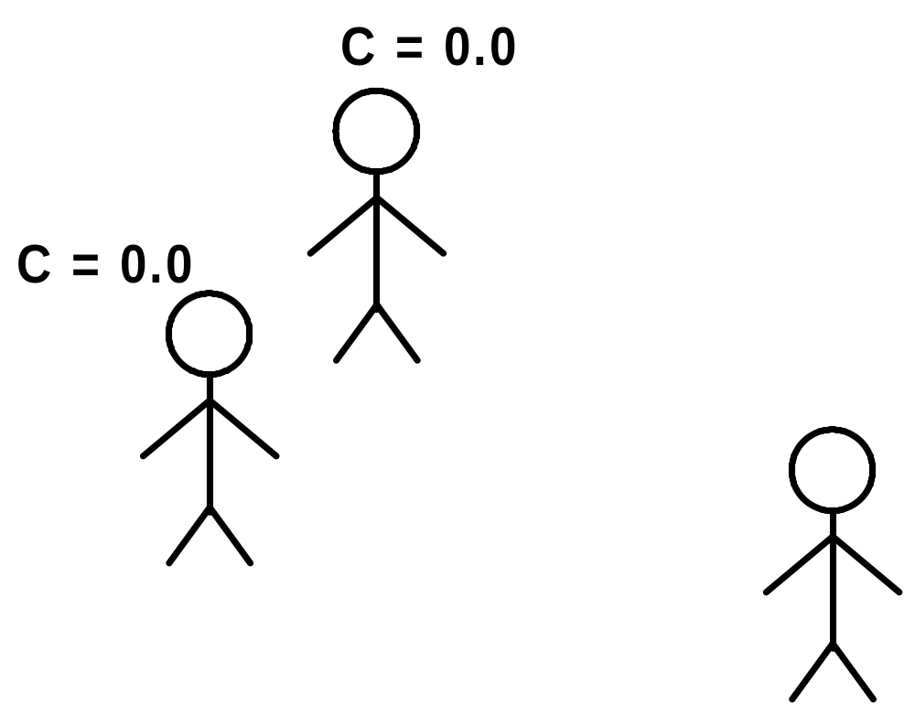
Caching: WorkingMemoryFacts
SeeEnemy Sensor: Stimulus Confidence

Slide 59
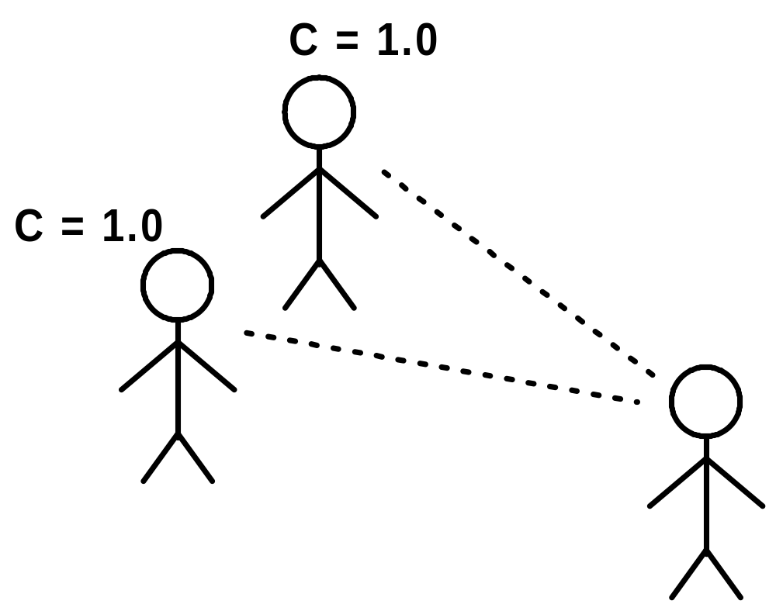
Caching: WorkingMemoryFacts
SeeEnemy Sensor: Stimulus Confidence

Slide 60
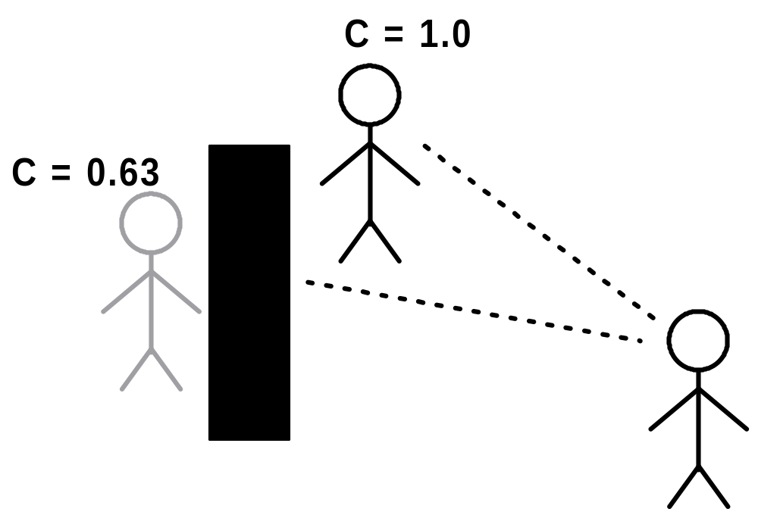
Caching: WorkingMemoryFacts
SeeEnemy Sensor: Stimulus Confidence

Slide 61
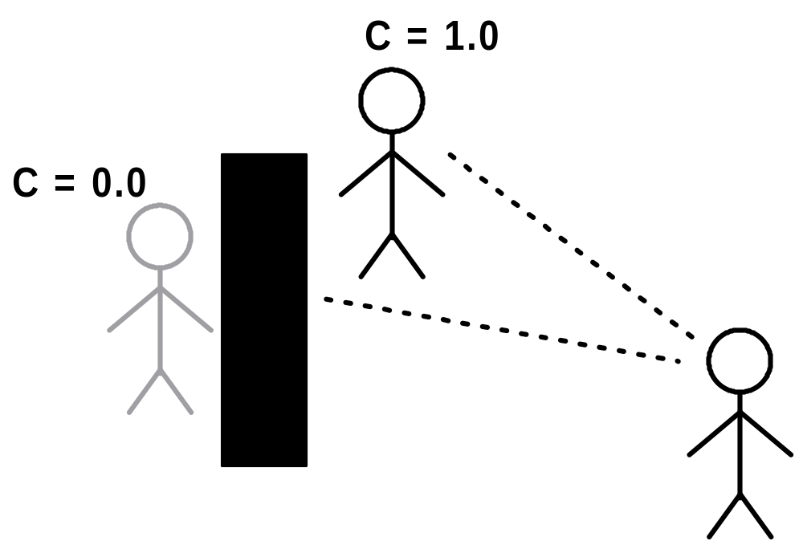
Caching: WorkingMemoryFacts
SeeEnemy Sensor: Stimulus Confidence

Slide 62
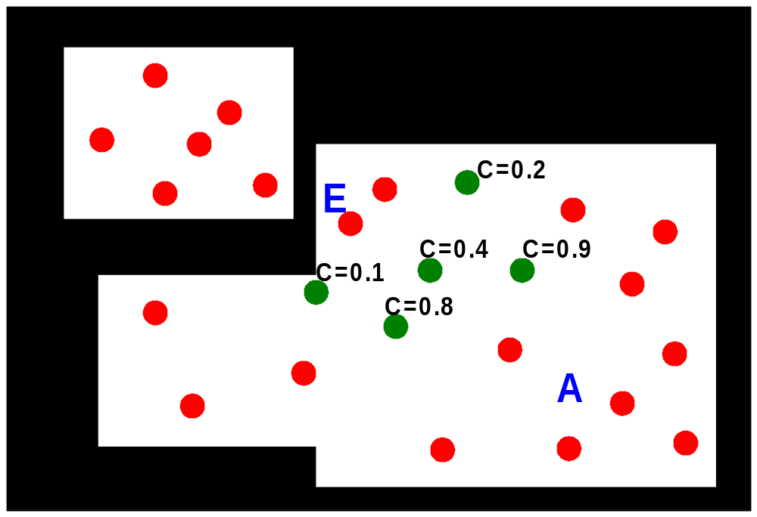
Caching: WorkingMemoryFacts
CoverNode Sensor: Position Confidence

Slide 63
The Planning Process

Slide 64
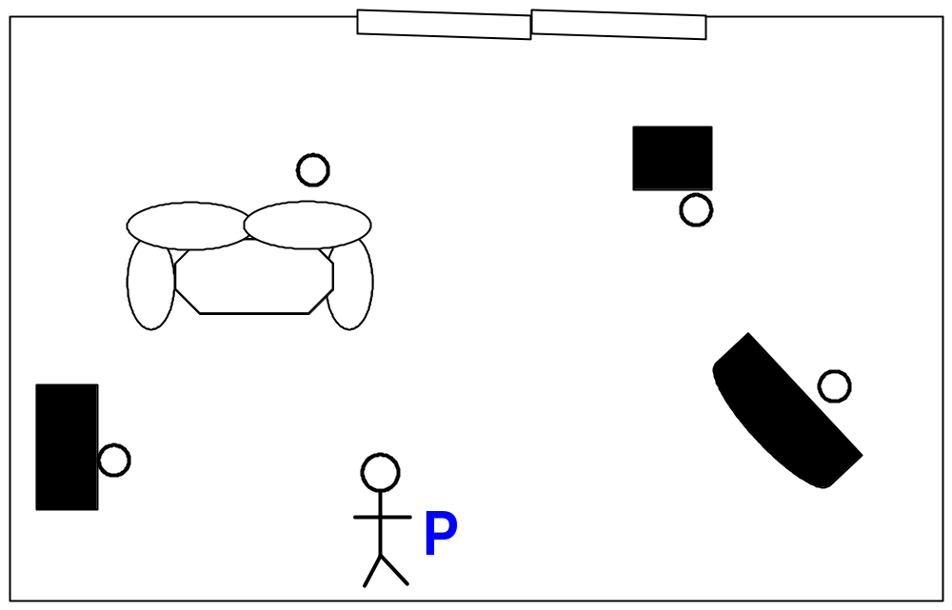
The Planning Process

Slide 65
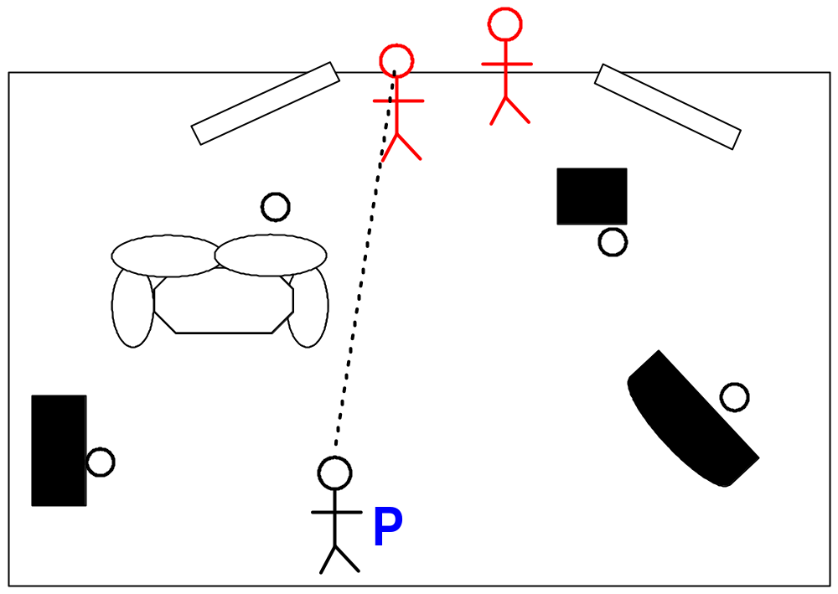
The Planning Process

Slide 66
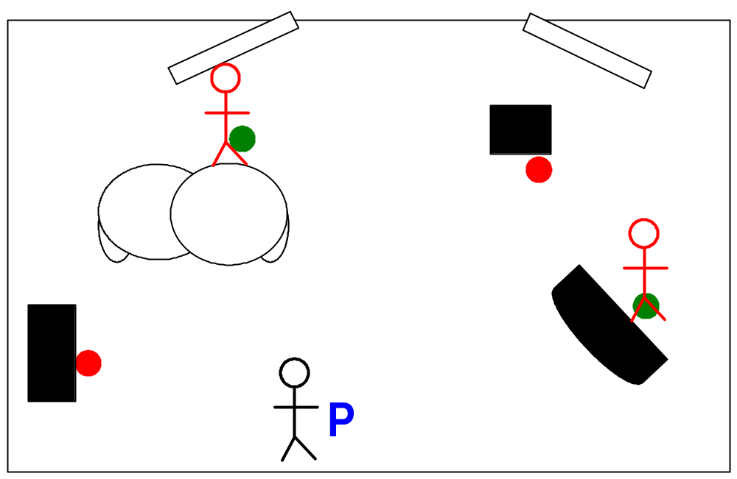
The Planning Process

Slide 67
The Plan
Goal: KillEnemy
Plan:
Goto (couch)
UseObject (couch)
Goto (coverNode)
AttackFromCover

Slide 68

The Plan
Plan:
Goto (couch)
UseObject (couch)
Goto (coverNode)
AttackFromCover
Goal: KillEnemy

Slide 69
The Planning Process
Goal: KillEnemy
Satisfaction: ???

Slide 70
Planning Process: Symbols
Simple representation of World State:
Array of symbols
Fixed number of symbols
Symbol = Key, Value pair
Union of 4 byte values (int, float, HANDLE, etc)

Slide 71
Planning Process: Symbols
Simple representation of agent’s World State:
Array of symbols
Fixed number of symbols
Symbol = Key, Value pair
Union of 4 byte values (int, float, HANDLE, etc)
Examples:
kWeaponArmed = TRUE
kUsedObject = hSomeObject

Slide 72
Planning Process: Symbols
Goal: KillEnemy
Satisfaction: kTargetIsDead = TRUE

Slide 73
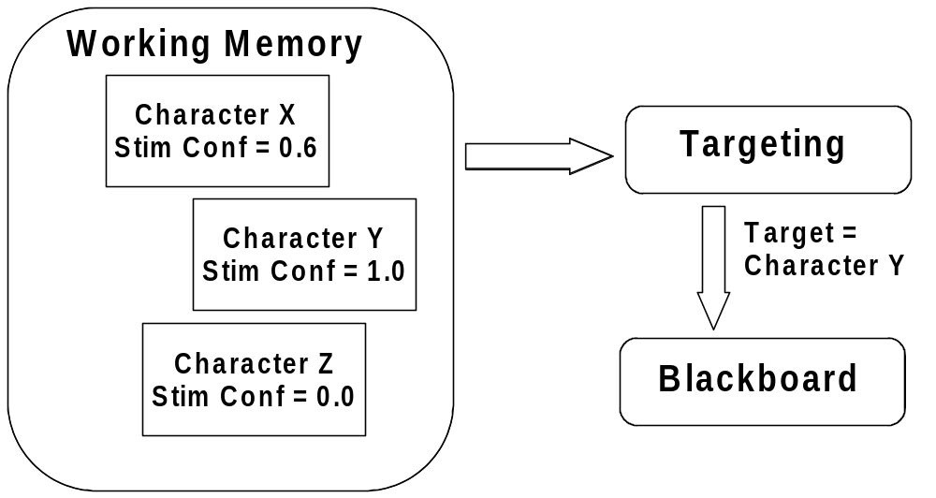
Planning Process: Symbols
Agent-centric representation

Slide 74
Planning Process: Symbols
Agent-centric representation
  kTargetIsDead
  Subsystem handles target selection.
  Select from Character Facts in WorkingMemory.
  Less symbols to evaluate during plan formulation.

Slide 75
The Plan
Plan:
Goto (couch)
UseObject (couch)
Goto (coverNode)
AttackFromCover
Goal: KillEnemy

Slide 76
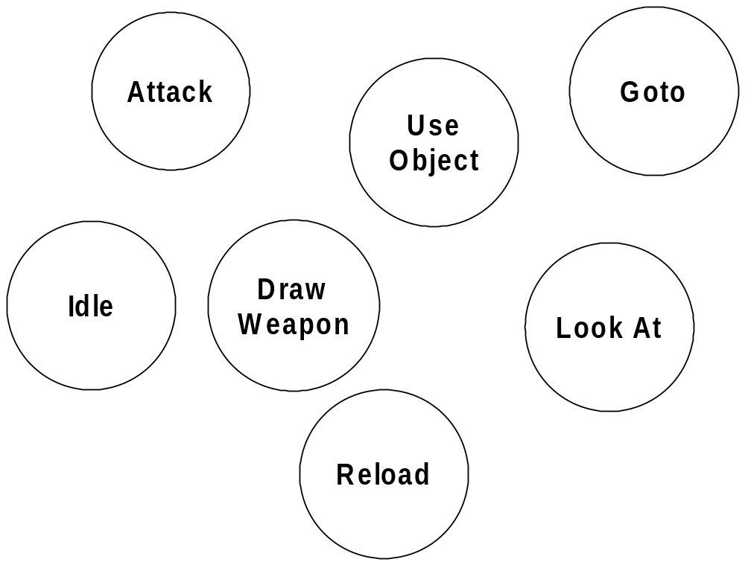
Planning Process: Actions

Slide 77
Planning Process: Actions
Action Preconditions & Effects:
Represented with same array of symbols
Value may be constant or variable

Slide 78
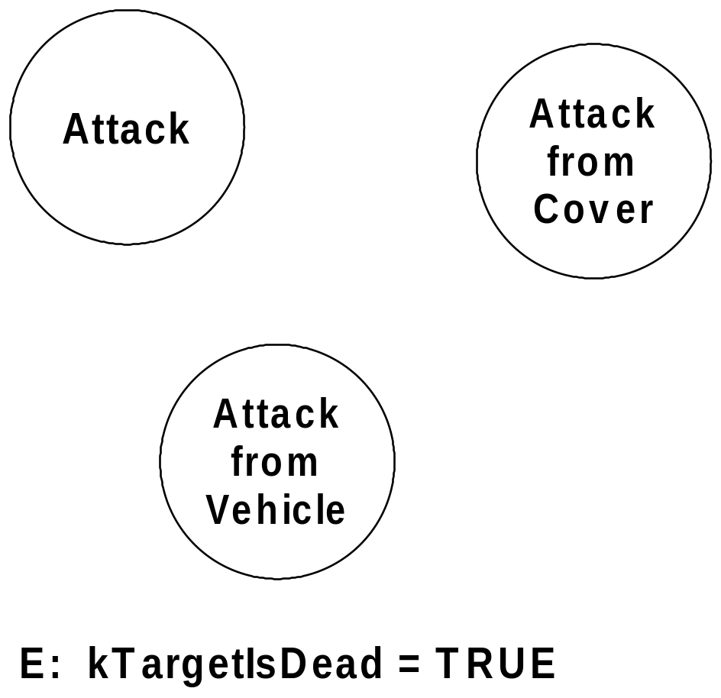
Planning Process: Actions

Slide 79
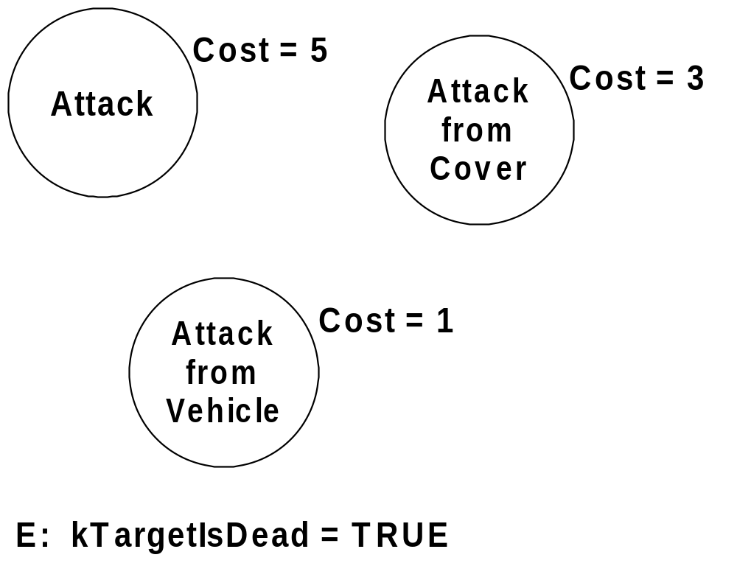
Planning Process: Actions

Slide 80
Planning Process: Context Preconditions
Context preconditions
Filter function of arbitrary code
  Am I riding a vehicle?
  Does a path exist?
  Is object visible?
  Is valid cover available?
Symbolic preconditions are only used when we want the planner to chain a preceding action.

Slide 81
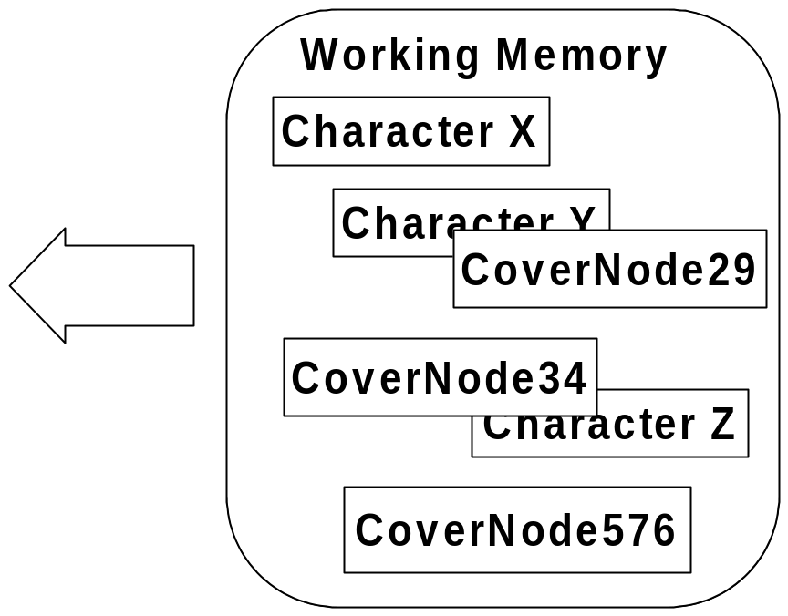
Planning Process: Context Preconditions
A: AttackFromCover
bool ValidateContextPreconditions()
{
// Is target visible?
...
// Does a valid node
// exist?
}

Slide 82
Planning Process: Context Preconditions
Query Q
Q.Type = kFact_Node
Q.Node = kNode_Cover
Fact* pFact = FindFactMax( Q, kAtt_Position )
Finds the WMFact with highest confidence in some attribute.
If returns NULL, no valid cover exists.

Slide 83
The Plan
Plan:
Goto (couch)
UseObject (couch)
Goto (coverNode)
AttackFromCover
Goal: KillEnemy

Slide 84

Planning Process: Variables
G: KillEnemy
  S: kTargetIsDead = TRUE
A: AttackFromCover
  E: kTargetIsDead = TRUE

Slide 85
Planning Process: Variables
G: KillEnemy
  S: kTargetIsDead = TRUE
A: AttackFromCover
  E: kTargetIsDead = TRUE
  P: kWeaponArmed = TRUE
  kWeaponLoaded = TRUE
  kAtObject = ???

Slide 86
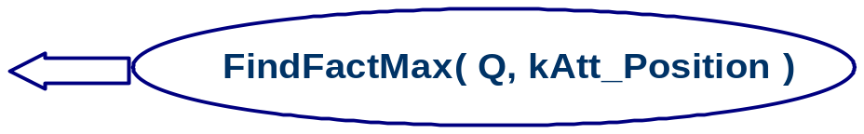
Planning Process: Variables
A: AttackFromCover
  E: kTargetIsDead = TRUE
  P: kWeaponArmed = TRUE
  kWeaponLoaded = TRUE
  kAtObject =

Slide 87

Planning Process: Variables
A: Goto
  E: kAtObject =

Slide 88
Planning Process: Variables
A: AttackFromCover
  P: kAtObject =
A: Goto
  E: kAtObject =

Slide 89
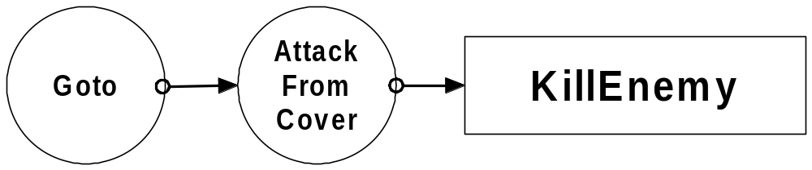
Planning Process: Variables

Slide 90
The Plan
Plan:
Goto (couch)
UseObject (couch)
Goto (coverNode)
AttackFromCover
Goal: KillEnemy

Slide 91
Planning Process: Variables
A: Goto
  E: kAtObject =

Slide 92
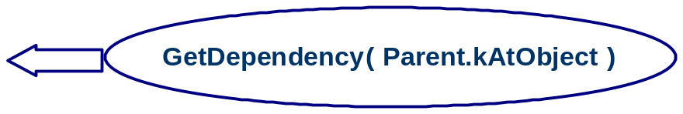
Planning Process: Variables
A: Goto
  E: kAtObject =
  P: kUsedObject =

Slide 93
The Plan
Plan:
Goto (couch)
UseObject (couch)
Goto (coverNode)
AttackFromCover
Goal: KillEnemy

Slide 94
Was It Worth It?

Slide 95
Was It Worth It?
Did we handle?
Managing dependencies √
Sharing behaviors √
Additional benefit:
Replanning

Slide 96
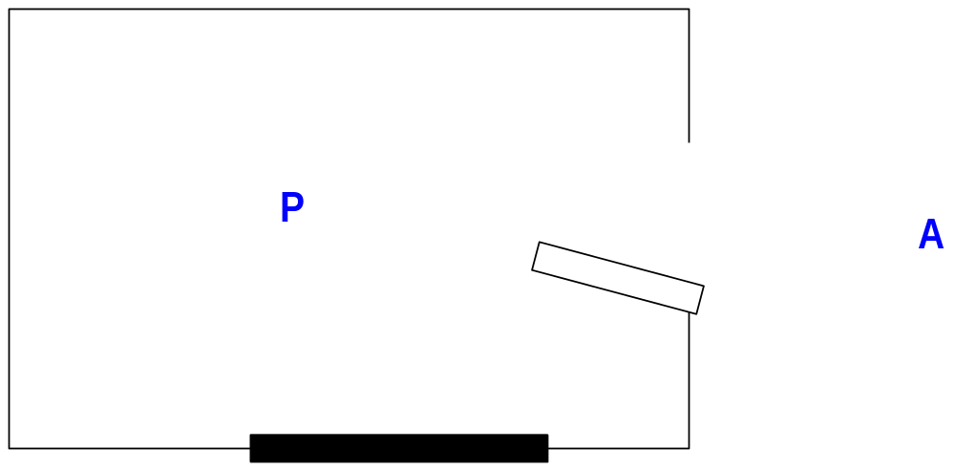
Replanning

Slide 97
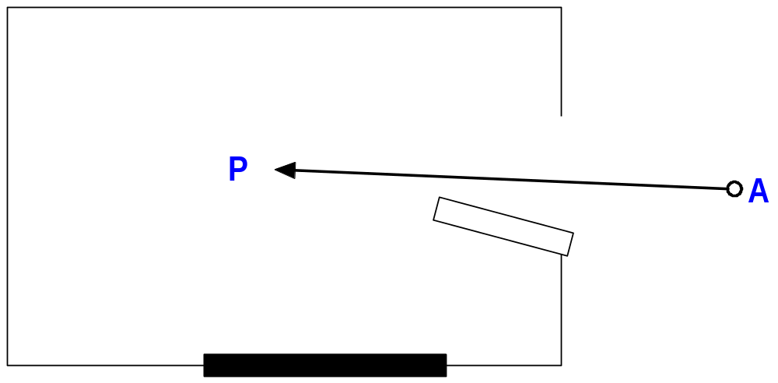
Replanning

Slide 98
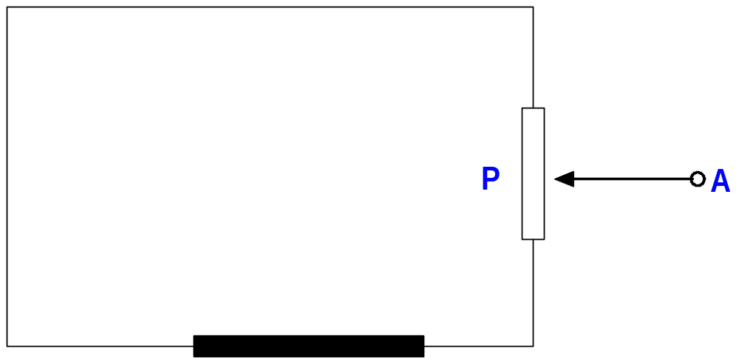
Replanning

Slide 99
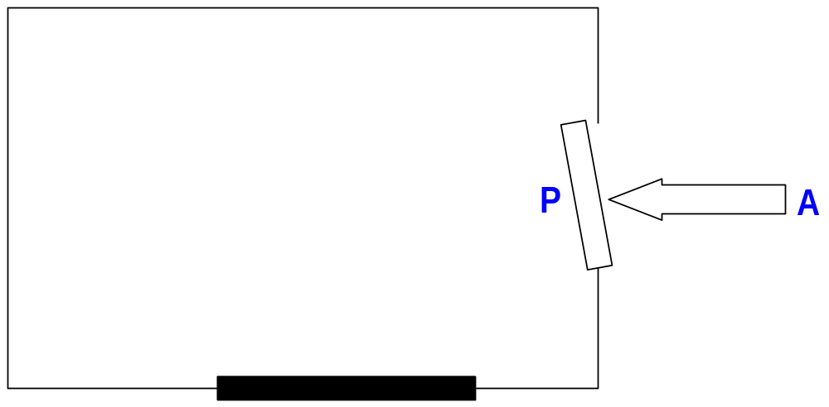
Replanning

Slide 100
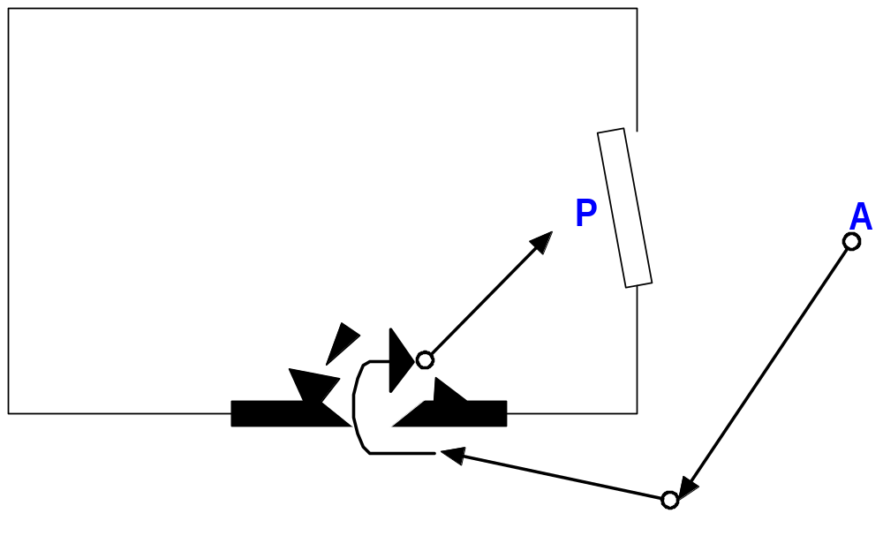
Replanning

Slide 101
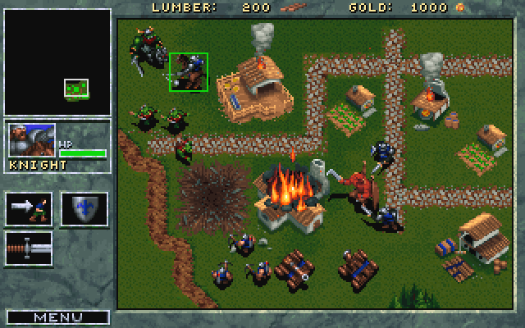
Parting Thoughts
Warcraft (1994)

Slide 102
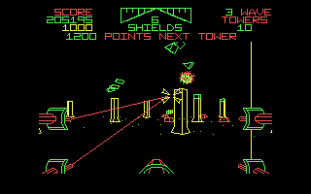
Parting Thoughts
Star Wars (1987)

Slide 103

Parting Thoughts
F.E.A.R. (2005)

Slide 104
Parting Thoughts
2D 3D
Pre-rendered Real-time rendered
graphics graphics

Slide 105
Parting Thoughts
Scripts, FSMs Planning
Pre-rendered Real-time simulated
reasoning & behavior reasoning & behavior
What new types of gameplay are possible?!

Slide 106
Questions?
Jeff Orkin
Monolith Productions
http://www.jorkin.com

