Slide 1
Behavior Trees: Three Ways of Cultivating Game AI
Alex J. Champandard
AiGameDev.com
Michael Dawe
Big Huge Games
David Hernandez-Cerpa
LucasArts

Slide 2
Behavior Trees APPLIED!
Halo 3 & ODST
[PROTOTYPE]
Spore
GTA: Chinatown Wars
The Bourne Conspiracy
SWAT 4, Bioshock
Dark Sector
…

Slide 3
FEATURES
BTs are a framework for game AI.
BTs model character behaviors extremely well.
BTs are simple, yet extremely customizable.

Slide 4
OVERVIEW
Behavior
Behavior
Behavior
Behavior
Behavior
Behavior
Behavior
Action
Action
Action
Action
Action

Slide 5
Agenda
Building Blocks
Design Patterns
Script Integration
Debugging
Discussion

Slide 6
Building BLOCKS
Behavior Trees Part 1, David

Slide 7
Node Types
Priority
Child nodes are evaluated in order until one validates
Sequential
First child is validated and executed
When it is finished, the next one is validated
Stochastic
All children are validated
A random node is selected among the valid ones
Notes:
Introduce the three basic node types

Slide 8
Behavior Tree Update
Root
Combat
Idle
Melee
Ranged
Use Computer
Patrol
Flee
Attack
Weapon 1
Weapon 2
Weapon 3
Notes:
Go over a validation step introducing how the different node types work:
* Grey: priority node.
* Red: stochastic node.
* Blue: sequential node.
Behaviors checked for validation are marked in yellow. Behaviors that have validated and are running are marked in green.
At the beginning the combat branch doesn’t validate. After a first activation, the first node in the sequence is finished and the next one is validated and activated.
While the Look node is running, another validation happens and the combat branch becomes valid. Then the stochastic node is validated, one of its children selected. Because Root is a priority node, the current branch is interrupted and the new one is started.

Slide 9
Event-Driven Behaviors
Root
Incoming Projectile
Combat
Idle
Evade
Melee
Ranged
Use Computer
Patrol
Flee
Attack
Weapon 1
Weapon 2
Weapon 3
Stimulus types
Disabled by event
Autodisabled
Notes:
Introduce the stimulus as a regular behavior that is disabled by default (marked in red). Usually used to unblock parts of the behavior tree.
An event from the engine activates the behavior. The behavior is now marked in black and is validated during the validation step. It validates and it is executed.
Then the two ways of disabling stimuli are introduced:
* Disabled by event. The stimulus is disabled by another event from the engine. That stops the branch.
* Autodisabled. The branch stops when the behavior that is under the stimulus is finished.

Slide 10
Dynamic Behaviors
Dynamic behaviors support
Level specific content
Patrols
Initial setups
Story driven events
DLC
Behaviors are added to actors in the level (enticers)
When a NPC uses the actor, it attaches the behavior to the tree
Notes:
Introduce the necessity of dynamic behaviors and how are they authored.

Slide 11
Dynamic Behaviors
Root
Combat
Idle
Melee
Ranged
Use Computer
Patrol
Flee
Attack
Weapon 1
Weapon 2
Weapon 3
Notes:
The idle behaviors disappear to have just one behavior that looks for enticers to do stuff while the NPC is idle

Slide 12
Dynamic Behaviors
Root
Combat
STIdle
Melee
Ranged
Flee
Attack
Weapon 1
Weapon 2
Weapon 3

Slide 13
Dynamic Behaviors
Validate
Look for enticers
Update
Move to enticer
Wait for other NPCs
Subscribe
Attach new behavior to the tree
Wait for behavior to finish
Unsubscribe
Remove behavior from the tree
Root
STIdle
Use Computer
Notes:
The enticing process is introduced.

Slide 14
Design PATTERNS
Behavior Trees Part 2, Alex

Slide 15
IN THE NEXT 10 MINUTES, FIND OUT...
What’s the biggest problem developers face working with behavior trees and scaling up?

Slide 16
IN THE NEXT 10 MINUTES, FIND OUT...
When should you build your BT like a HFSM, and what happens if you do?

Slide 17
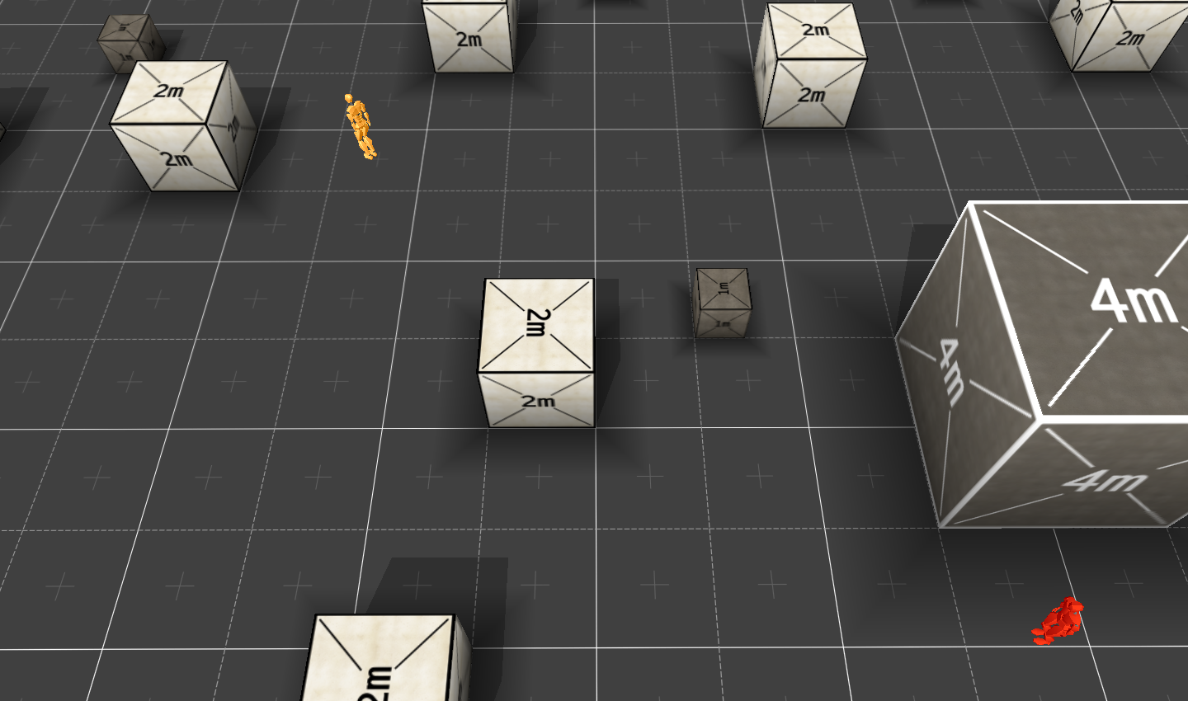

Slide 19
MOVING
COVER
MOVING
COVER

Slide 22
BLACKBOARD
COVER
MOVING
STANDING
CROUCHING

Slide 23
RunToTarget
PeakAtThreat
SneakToCover

Slide 24
RunToTarget
BLACKBOARD
COVER
MOVING
STANDING
CROUCHING

Slide 25
SneakToCover

Slide 26
BLACKBOARD
COVER
MOVING
STANDING
CROUCHING

Slide 27
BT DESIGN Take AWAY
Decouple your BT from the problem at hand, for example using a blackboard.
Build purposeful behaviors as sequences of short goal-directed actions.
Be careful with “state-like” behaviors that keep running.
Leverage the power of the tree search!

Slide 28
SCRIPT INTEGRATION
Behavior Trees Part 3, Michael

Slide 29
Script Integration
Behavior trees are all about flexibility
Selector choice!
Reuseable goals!
Rapid iteration is a key goal
Bigger games, more actors, individualized behaviors
Need to quickly change in response to prototyping and playtest
Separate the algorithm from the behaviors
Notes:
Alex & David: This is my segue slide; something to tie together what you guys talk about to the scripting section and how it all relates to how awesome BTs are. I can change it depending on what your slides look like and the specifics of what you’ll be discussing.
Script Integration
How scripts create trees
How trees are called from script
Scripted behaviors

Slide 30
Flexibility from script
Lua at BHG, but could be any language
What you’ll need:
Scripting language integration
Calling script from code and vice versa
Really nice to have:
Designers comfortable with scripting
You will need support time (more on that later)
Script debugging
Notes:
By “scripting language integration” I mean calling script from code and vice versa.

Slide 31
C++
Lua
Behavior Interface
Behavior Tree
Behavior
Gather
What behaviors want to run?
Precondition
Type/precondition results
.
.
.
Type
Behavior
Calls to on_exit, on_enter, behavior
Behavior
Run
Behavior
on_enter
on_exit
Notes:
Animated slide to illustrate duties of code/script as pertains to trees. In this picture

Slide 32
Creating a behavior script
Behaviors have a common structure
Precondition
Behavior
Optional components
Type (priority, sequential, random)
on_enter, on_exit
Whatever else you decide your behaviors need
In Lua, these can be known function names in a table

Slide 33
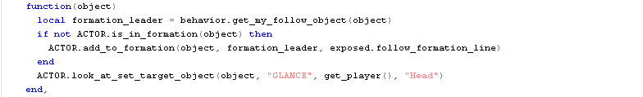
Behavior script
Notes:
Example script with important, illustrative parts

Slide 34
Creating a tree with behavior scripts
First implementation: Scripts that create behavior trees
Lua functions to add, remove, insert behaviors from an existing tree
add_behavior(tree, behavior)
Great flexibility, but hard to conceptualize
Creating trees in script was difficult to grasp
Especially when trying to reuse trees you didn’t write
Notes:
First implementation, difficulties

Slide 35
Behavior tree tool
External .NET app to manage trees and behaviors
Easy to create new behaviors or reuse existing ones
Statistics on commonly used behaviors
Search for behavior/tree by name or usage

Slide 36
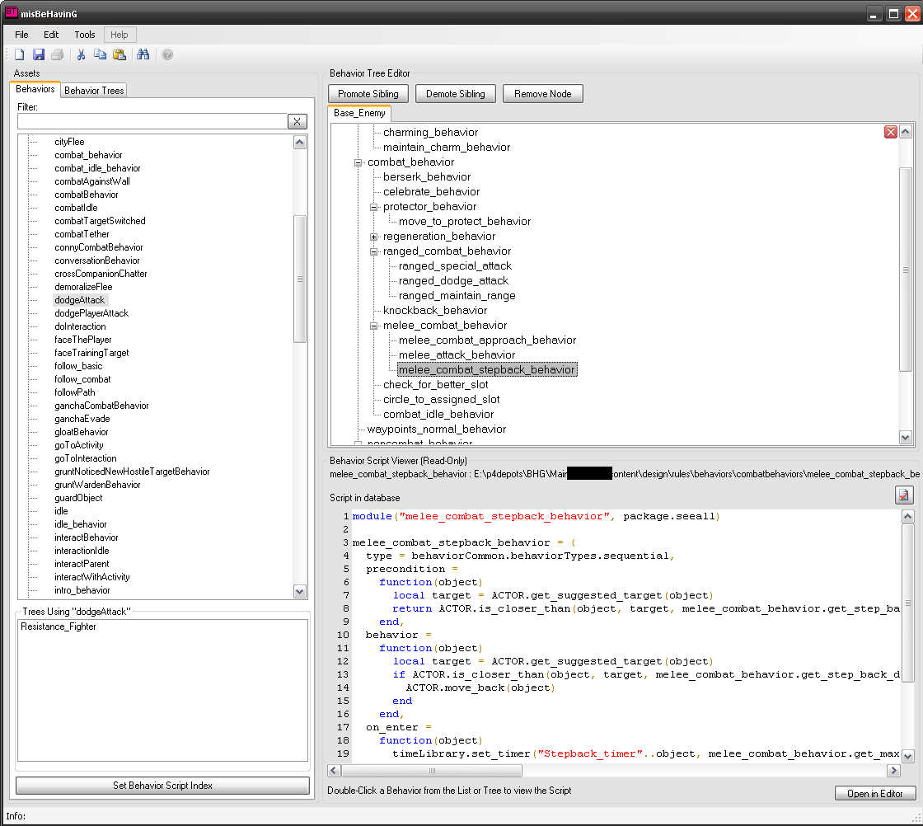
Behavior tree tool

Slide 37
Benefits of using script
Designers write behaviors so you don’t have to
Currently 63 unique behaviors in our game
I wrote 7
Lots of time back for other tasks
Faster implementation and iteration
No rebuilding code
Can reload scripts while the game runs
Need prep for this; flush behaviors, cached names, pointers?
Notes:
Emphasis on quick revision times, no matter who’s writing the behaviors

Slide 38
Common questions
Performance-related
“Isn’t scripting slow?”
“How do you stay under CPU budget?”
Behavior creation-related
“Are designers scripting well?”
“What if my designers aren’t scripters?”

Slide 39
Keeping script fast
Don’t let it be slow!
BHG limits lua to integer math
Prevent mid-frame garbage collection
Limit scripting to where it makes sense
AI loop is not in script
No trig in script!
Anything “complicated enough” done in code
Could put behaviors to code for performance
…but maybe not
Notes:
AI loop: We don’t put the main algorithm in script, so it doesn’t control when behaviors (or any other AI processing) happens. In fact, by keeping most of the control in
We thought we’d have to start doing this script-to-code transition when we started, but even now we’re running well under CPU budget, so we might not have to. It’s important to note that this architecture’s strength is its flexibility! By separating the algorithm from the behaviors we can mix and match code/script without problems.

Slide 40
Designer scripting
Good enough is great!
Does take code support time
~10% of my time debugging for designers
~10% on function requests (trig, &c.)
Watch for things that should be done in code
Strength in speed! Don’t stifle creativity
Plan on reviewing trees and behaviors periodically
Notes:
Our designers are awesome, and picked this up right quick, but the point here is getting the behaviors how you want them to look quickly and then polish. Even if your designers haven’t done scripting before, it’s not the point. It’s fantastic if they can, and they’ll learn quickly, but one of the greatest parts of this for us was letting designers prototype while we developed other features.

Slide 41
DEBUGGING
Behavior Trees Part 4, David

Slide 42
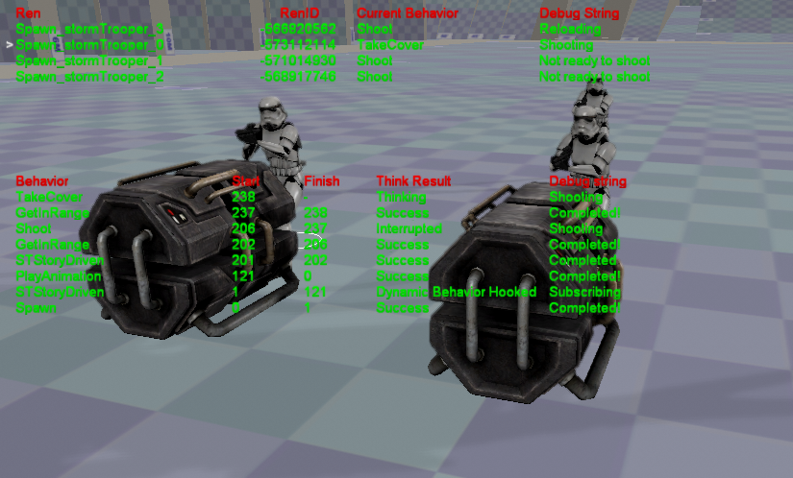
Debugging
Notes:
A screenshot of the debugger. Comment the different types of information.

Slide 43
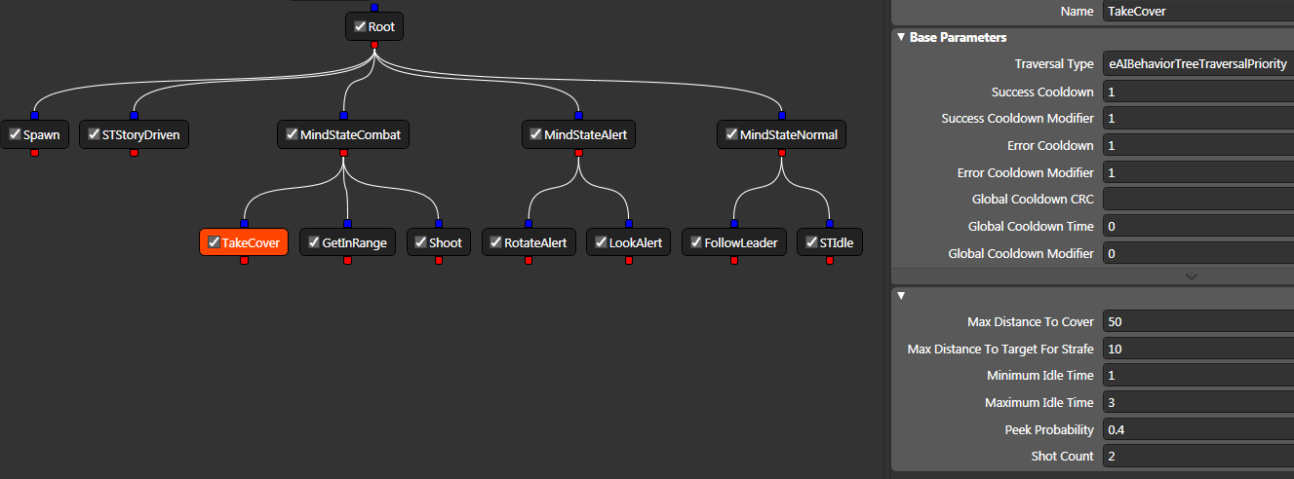
Debugging
Notes:
This is our editing tool that also connects to the game and allows us to dynamically tweak behaviors’ parameters.

Slide 44
Behavior Trees: Three Ways of Cultivating Game AI
Alex J. Champandard
AiGameDev.com
Michael Dawe
Big Huge Games
David Hernandez-Cerpa
LucasArts

