Slide 1
Characters & Social Games
Michael Mateas
michaelm@cs.ucsc.edu
eis.soe.ucsc.edu/
AI Summit: GDC 2010

Slide 2
The character performance hierarchy
Long Term Goals
Personality
Social Behavior
Group Tasks
Action Selection
Sequencing
Path planning
Reactive actions
Animation Control

Slide 3
Character design space
Individuality
Physical & Social
Dynamics
Visual
Concreteness

Slide 4
Character design space
Individuality
Heavy Rain
Physical & Social
Dynamics
Visual
Concreteness

Slide 5
Character design space
Individuality
Mass Effect (physical medium, social low)
Physical & Social
Dynamics
Visual
Concreteness

Slide 6
Character design space
Individuality
Sims 3
Physical & Social
Dynamics
Visual
Concreteness

Slide 7
Character design space
Individuality
Façade
(social/communicative high, physical low)
Physical & Social
Dynamics
Visual
Concreteness

Slide 8
Zoomed in social behaviors
Focus of this talk is zoomed-in social behavior
This means
  Interactions with dramatic potential
  Detailed dialog
  Detailed, playable social space

Slide 9
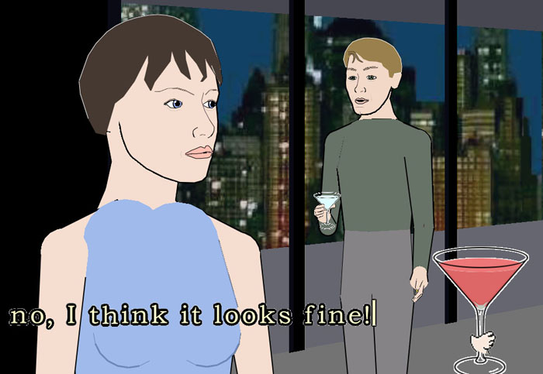
Façade

Slide 10
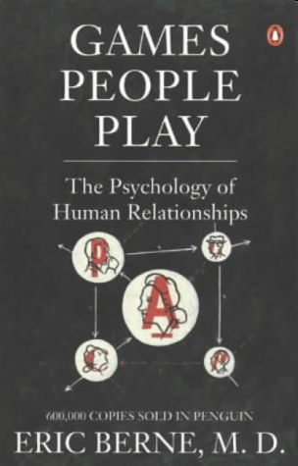

Slide 11
Façade’s social games
Affinity game
  Player must take sides in character disagreements
Hot-button game
  Player can push character hot-buttons (e.g. sex, marriage) to provoke responses
Therapy game
  Player can increase characters’ understanding of their problems
Tension
  Not a game, but dramatic tension increases over time and is influenced by player actions (e.g. pushing character hot-buttons can accelerate the tension)

Slide 12
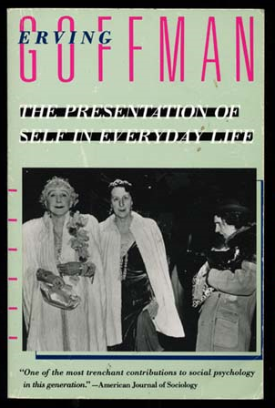

Explicitly modeling social games
+
+
=
Models of social games

Slide 13
Definition of social game
A pattern of multi-agent interactions whose function is to modify the social state existing within and across the participants.
Allows for agents to reason and perform in a social way to manipulate social state (includes social norm following)
Interactivity – selection of game, current social state, and realization details influence oucome
Notes:
Social Game: a pattern of multi-agent interactions whose function is to modify the social state existing within and across the participants.

Slide 14
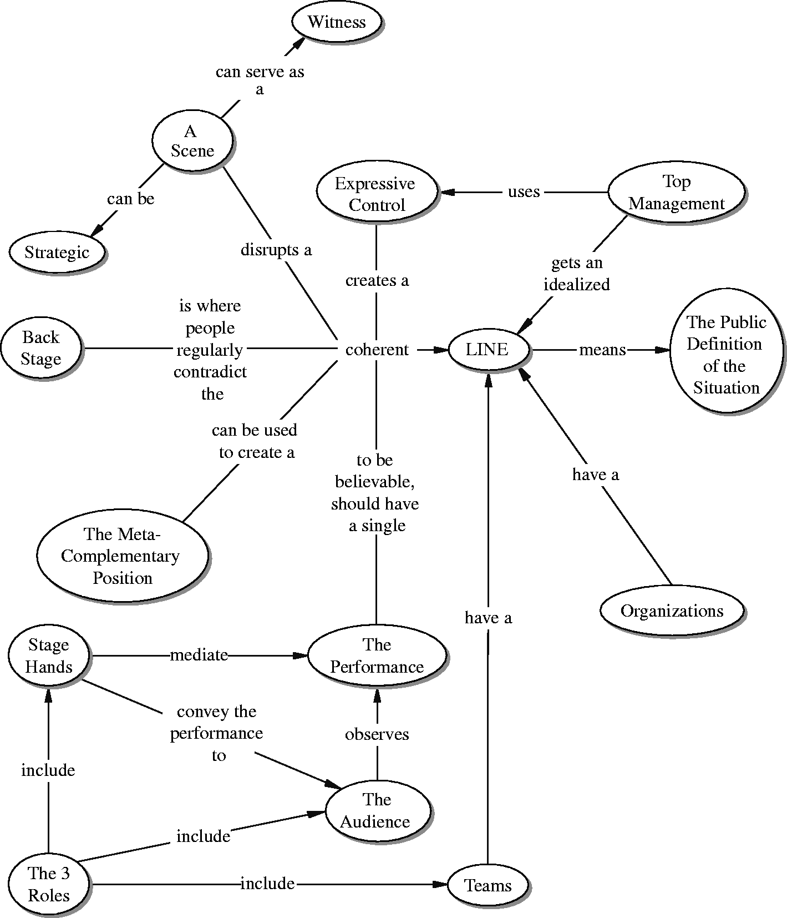
Dramaturgical analysis
Sociological tool for exploring reasons for behavior
Impression management
  Self-presentation
Setting, stage, role, team, front/back stage, props, audience, etc.

Slide 15

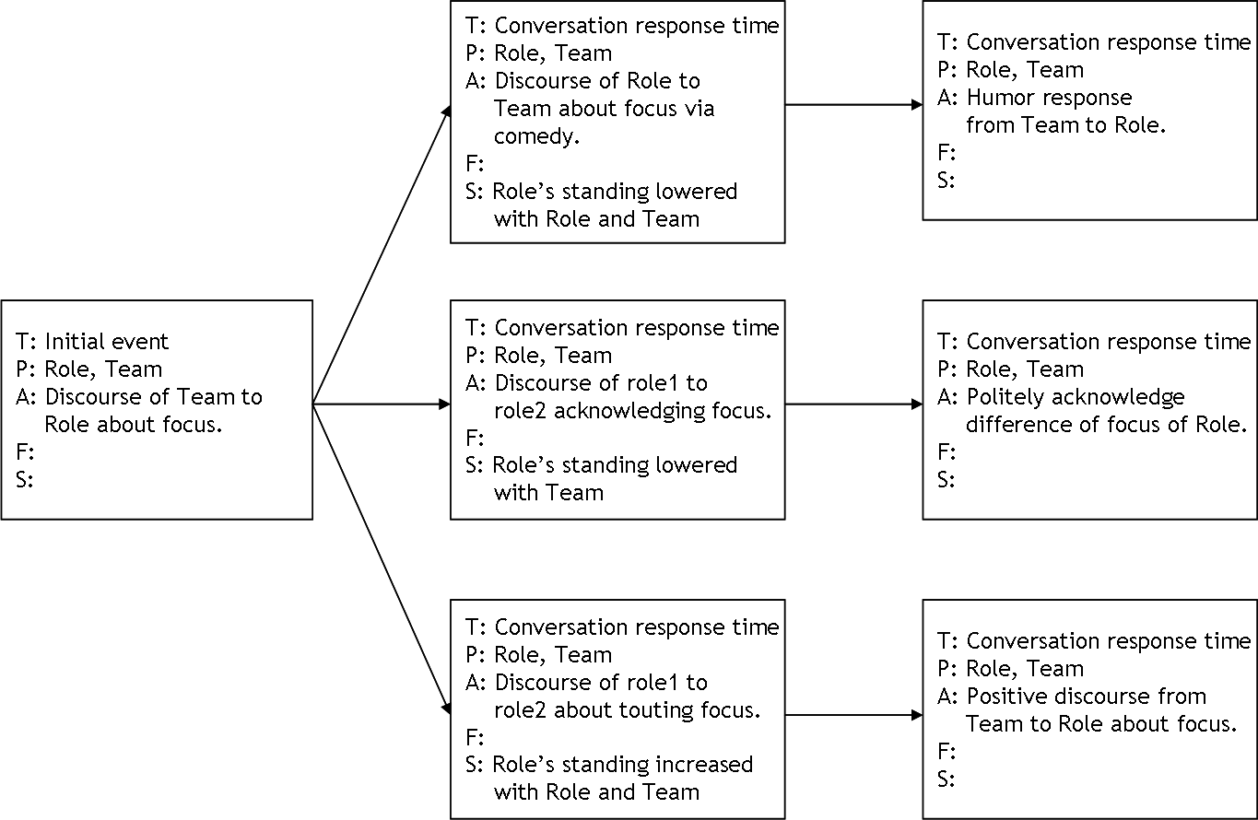
Analyze media to find social games
Notes:
Goffman’s Dramaturgical analysis provides a method to capture normal interaction patterns.
To create dramatically interesting base of social games for our model, we applied dramaturgical analysis to the HBO show Sex and the City. We used sex in the city because the volume knob turned up to 11!
This study gave us an idea as to what the basic structure of social games needed to be and how personality specific variation looked.

Slide 16
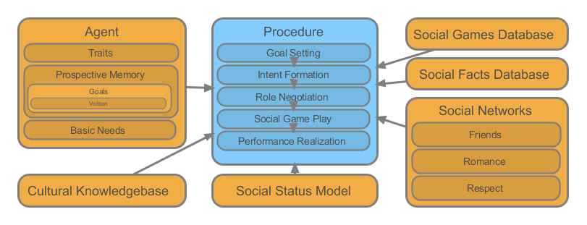
Architecture

Slide 17
Social networks
Our most primitive social state is captured by weighted edges in social network graphs
  Each node is a character in the space
  Each edge weight is the strength of the “affinity” that a character feels towards another
We have three networks
  Relationship: How much you like someone as a person (e.g. friends)
  Romance: Interest in romantic endeavors (e.g. dating)
  Cool: Respect for another.

Slide 18
Social status
Social status consists of higher-level social status that builds on the primitive social networks
Inference rules chain from social networks to status
Dating(x,y) :- Rom(x,y) > 70 ^ Rom(y,x) > 70
Fighting(x, y) :- Enemy(x, y) ^ [NegativeAct(x,y)]
Fighting(x, y) :- Enemy(x, y) ^ [NegativeAct(x,z)] ^ Friends(y,z)
Fighting(x, y) :- Enemy(x, y) ^ [NegativeAct(x,z)] ^ Dating(y,z)

Slide 19
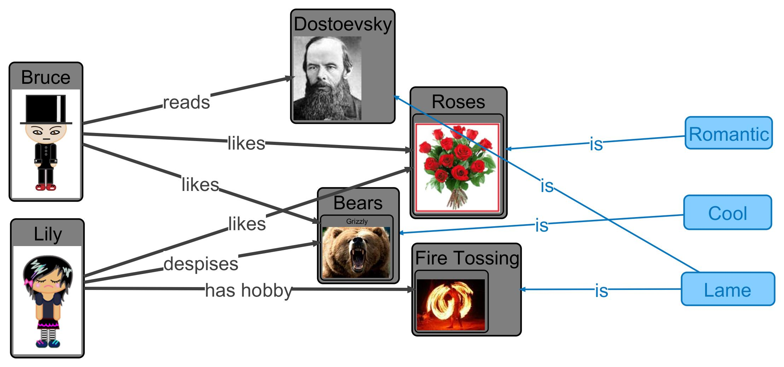
Cultural knowledge base

Slide 20
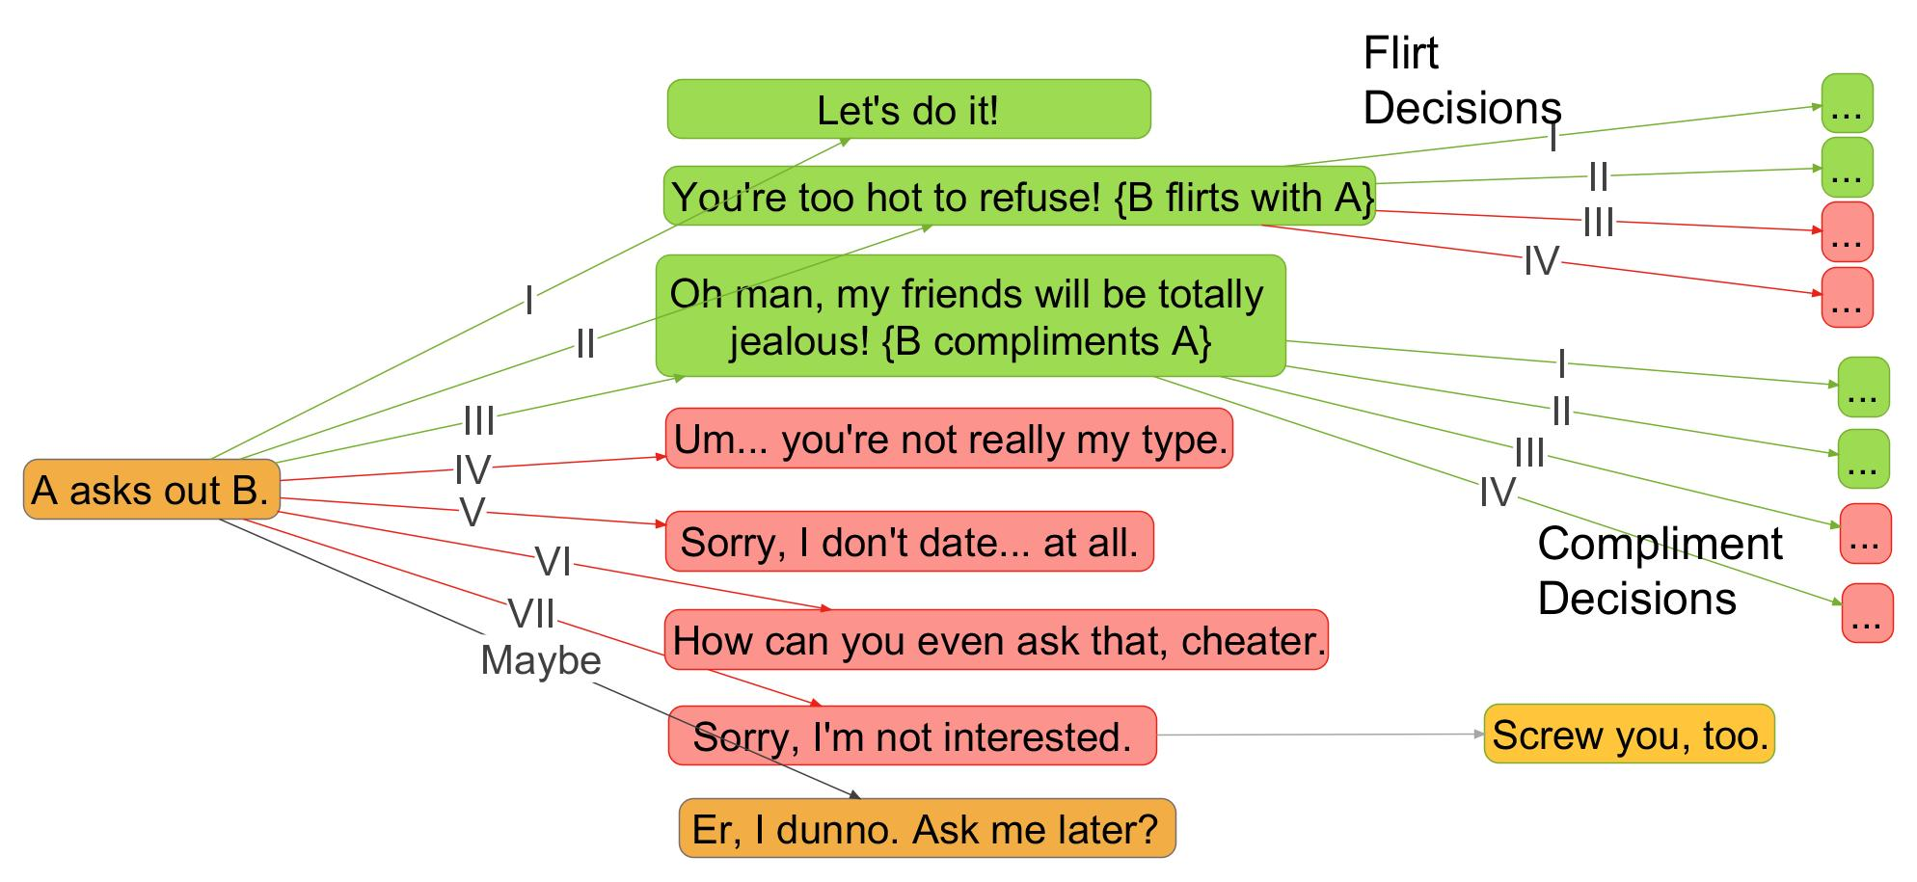
Social game example – “Ask Out”
For all friends f of B: avg(romantic(f,A)) > neutral → III
For all friends f of B: avg(cool(f,A)) > neutral → III
(rom(B,A) – threshold(Dating, rom)) < 0 → VII
trait(A, sex_magnet) → II (modifier high)
trait(B, desperate) → I (modifier medium)
…

Slide 21
Social facts database
Class | Word | A | B
1 | dating | Kat | Rob
2 | dating | Rob | Kat
4 | friends | Kat | Miri
4 | friends | Miri | Kat
6 | broke up | Miri | Ed
6 | broke up | Ed | Miri
2 | took pass at | Rob | Ed
2 | desires reconnect | Ed | Miri
7 | dissed | Kat | Rob
7 | insulted | Ed | Rob
8 | fake story | Rob | Ed
11 | spied on | Kat | Rob
Entry
Goal (chain back to status rule)
Specific game and path
Cultural knowledge used
Social facts used
Dialog templates with parameters
expressiveintelligencestudio
UC Santa Cruz

Slide 22
Take home
Social games are a useful abstraction level for adding social dynamics to characters
Holy grail of highly concrete, socially and physically dynamic, highly realized characters is still far way
  For next several years, physical abstraction will be key for highly realized dynamic characters
  I realize this doesn’t help AAA, but can incrementally add social dynamics

