Slide 1
Effective Use of
OpenMP in Games
Pete Isensee
Lead Developer
Xbox Advanced Technology Group
Notes:
Description: Harnessing the power of multiple processors is a new challenge for game programmers, and one that’s likely to be more and more important as the number of multi-CPU gaming systems grows. One technology that allows developers to use multiple CPUs without all the hassle of spawning threads and synchronizing data is OpenMP. OpenMP is a portable, industry-standard API for C/C++ that supports parallel programming. Although OpenMP has been primarily targeted at high-end supercomputers in the past, it’s now available in the Intel compiler, gcc, and Visual Studio 2005. This talk gives a brief introduction to OpenMP, and then dives into ways that games can really take advantage of this technology to improve performance. We cover common errors, portability issues, and debugging.
Takeaway: In order to get the performance they crave, more and more gamers are buying gaming machines with hyperthreading or multiple CPUs. Future game consoles are likely to have multiple processors as well – harnessing the full power of this silicon is a new challenge for game programmers. OpenMP is a flexible, portable technique for programmers to have in their tool chest. OpenMP allows developers to really take advantage of the gaming systems of the future.
Intended Audience and Prerequisites: This presentation is designed for C++ programmers writing games for any multi-threaded platform. The talk assumes basic knowledge of multi-threading programming issues like synchronization and deadlocks, but does not assume the programmer has used OpenMP.

Slide 2
Agenda
Why OpenMP
Examples
How it really works
Performance, common problems, debugging and more
Best practices

Slide 3
Today: Games & Multithreading
Few current game platforms have multiple-core architectures
Multithreading pain often not worth performance gain
Most games are single-threaded (or mostly single-threaded)

Slide 4
The Future of CPUs
CPU design factors: die size, frequency, power, features, yield
Historically, MIPS valued over watts
Vendors have hit the “power wall”
Architectures changing to adjust
  Simpler (e.g. in order instead of OOO)
  Multiple cores
Notes:
CPU vendors facing a conundrum: power increases exponentially as frequency goes up

Slide 5
Two Things are Certain
Future game platforms will have multi-core architectures
  PCs
  Game consoles
Games wanting to maximize performance will be multithreaded

Slide 6
Addressing the Problem
Ignore it: write unthreaded code
Use an MT-enabled language
Use MT middleware
Thread libraries (e.g. Pthreads)
Write OS-specific MT code
Lock-free programming
OpenMP

Slide 7

OpenMP Defined
Interface for parallelizing code
  Portable
  Scalable
  High-level
  Flexible
  Standardized
  Performance-oriented
Assumes shared-memory model
Notes:
Open Multi-Processing
From spec: “A model for parallel programming that allows a program to be portable across shared-memory architectures from different vendors.”

Slide 8
Brief Backgrounder
10-year history
Created primarily for research and supercomputing communities
Some relevant game compilers
  Intel C++ 8.1
  Microsoft Visual Studio 2005
  GCC (see GOMP)
Notes:
Announced 1997 (8 years); really in the making since 94
Initially Fortran (1997), then C/C++ (1998)
Jointly defined by IBM, DEC, Cray, Silicon Graphics, small compiler shops
Version 2.0 in 2002: stable, proven
Look for omp.h header

Slide 9
OpenMP for C/C++
Directives activate OpenMP
  #pragma omp <directive> [clauses]
  Define parallelizable sections
  Ignored if compiler doesn’t grok OMP
APIs
  Configuration (e.g. # threads)
  Synchronization primitives

Slide 10
Canonical Example
for( i=1; i < n; ++i )
b[i] = (a[i] + a[i-1]) / 2.0;
a
0.1
2.1
4.3
0.7
0.1
5.2
8.8
0.2
...
1.1
3.2
2.5
0.4
2.7
6.7
4.5
...
b
0.0
0.0
0.0
0.0
0.0
0.0
0.0
0.0
Notes:
Straight from Appendix A of the spec
a, b double-precision, i int
every computation is order-independent

Slide 11
Thread Teams
#pragma omp parallel for
for( i=1; i < n; ++i )
b[i] = (a[i] + a[i-1]) / 2.0;
a
0.1
2.1
4.3
0.7
0.1
5.2
8.8
0.2
...
b
0.0
1.1
3.2
2.5
0.4
2.7
6.7
4.5
...
0.0
0.0
0.0
0.0
0.0
0.0
0.0
Thread0
Thread1
Notes:
Assume OMP implementation uses team of 2 threads by default
#pragma applies only to the statement following
In theory, performance of this loop would almost double

Slide 12
Performance Measurements
Compiler: Visual C++ 2005 derivative
Max threads/team: 2
Hardware
  Dual core 2.0 GHz PowerPC G5
  64K L1, 512K L2
  FSB: 8GB/s per core
  512 MB

Slide 13
Performance of Example
#pragma omp parallel for
for( i=1; i < n; ++i )
b[i] = (a[i] + a[i-1]) / 2.0;
Performance on test hardware
  n = 1,000,000
  1.6X faster
  OpenMP library/code added 55K
Notes:
One line of code
Cross platform
Works fine on non-OMP platforms
Readable

Slide 14
Compare with Windows Threads
DWORD ThreadFn( VOID* pData ) { // Primary function
for( int i = pData->Start; i < pData->Stop; ++i )
b[i] = (a[i] + a[i-1]) / 2.0;
return 0; }
for( int i=0; i < n; ++i ) // Create thread team
hTeam[i] = CreateThread( 0, 0, ThreadFn, pDataN, 0, 0 );
// Wait for completion
WaitForMultipleObjects( n, hTeam, TRUE, INFINITE );
for( int i=0; i < n; ++i ) // Clean up
CloseHandle( hTeam[i] );
Notes:
Doesn’t include all the code: e.g. ThreadSetIdealProcessor to set affinity

Slide 15
Performance of Native Threads
n = 1,000,000
1.6X faster
Same performance as OpenMP
  But 10X more code to write
  Not cross platform
  Doesn’t scale
Which would you choose?
Notes:
Totally unreadable
Doesn’t work on non-Windows platforms
Positive side: Thread code added 2.5K

Slide 16
What’s the Catch?
Performance gains depend on n and the work in the loop
Usage restricted
  Simple for loops
  Parallel code sections
Operations must be order-independent
Notes:
As the genie in Aladdin says: there are some caveats, provisos, addendums, and quid pro quos
3 potential drawbacks

Slide 17
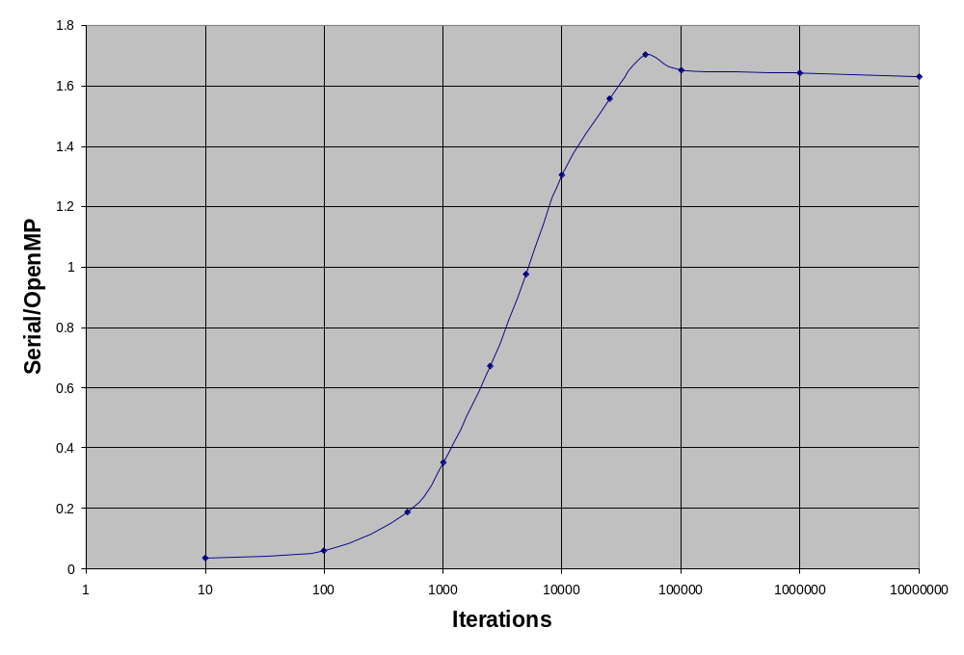
How Large n?
n = 5000
Notes:
N refers to original example
Overhead: initializing, allocating per-thread data, kicking off threads, waiting for completion
N different for every OMP loop

Slide 18
for Loop Restrictions
Let’s try parallelizing an STL loop
  #pragma omp parallel for
  for( itr i = v.begin(); i != v.end(); ++i )
  // ...
OpenMP limitations
  i must be an integer
  Initialization expression: i = invariant
  Compare with invariant
  Logical comparison only: <,<=,>,>=
  Increment: ++, --, +=, -=, +/- invariant
  No breaks allowed
Notes:
Compiler: initialization has improper form, termination test has improper form, increment has improper form
i is not an integer
invariants don’t change during the loop
can’t change i in the body of the loop

Slide 19
Independent Calculations
This is evil:
  #pragma omp parallel for
  for( i=1; i < n; ++i )
  a[i] = a[i-1] * 0.5;
a
4.0
2.0
3.0
1.0
Oh no!
Should be 0.5
a
4.0
2.0
2.0
1.0
3.0
1.5
1.0
Thread0
Thread1

Slide 20
You Bear the Burden
Verify performance gain
Loops must be order-independent
  Compiler cannot usually help you
  Validate results
    Assertions or other checks
Be able to toggle OpenMP
  Set thread teams to max 1
  #ifdef USE_OPENMP
  #pragma omp parallel for
  #endif
Notes:
Follow Abrash’s advice: verify the improvement
Ask yourself: loop run backwards? in non-discrete chunks? in any order?

Slide 21
Configuration APIs
#include <omp.h>
// examples
int n = omp_get_num_threads();
omp_set_num_threads( 4 );
int c = omp_get_num_procs();
omp_set_dynamic( 16 );
Notes:
Half the APIs control OpenMP configuration

Slide 22
OMP Synchronization APIs
OpenMP name | Wraps Windows:
omp_lock_t | CRITICAL_SECTION
omp_init_lock | InitializeCriticalSection
omp_destroy_lock | DeleteCriticalSection
omp_set_lock | EnterCriticalSection
omp_unset_lock | LeaveCriticalSection
omp_test_lock | TryEnterCriticalSection
Notes:
Use if you’re writing cross-platform code.
In Visual C++, basically as efficient as raw crit sec

Slide 23
Synchronization Example
omp_lock_t lk;
omp_init_lock( &lk );
#pragma omp parallel
{
int id = omp_get_thread_num();
omp_set_lock( &lk );
printf( “Thread %d”, id );
omp_unset_lock( &lk );
}
omp_destroy_lock( &lk );
Notes:
Discuss omp parallel
If we didn’t have the lock, multiple threads could call printf simultaneously: bad
Thread 0
Thread 1

Slide 24
OpenMP: Unplugged
Compiler checks OpenMP conformance
Injects code for #pragma omp blocks
Debugging runtime checks for deadlocks
Thread team created at app startup
Per-thread data allocated when #pragma entered
Work divided into coherent chunks

Slide 25
Debugging
Thread debugging is hard
OpenMP → black box
  Presents even more challenges
Much depends on compiler/IDE
Visual Studio 2005
  Allows breakpoints in parallel sections
  omp_get_thread_num() to get thread ID
Notes:
Thread definition: something that behaves absolutely unpredictably and differently each time I try to debug it.

Slide 26
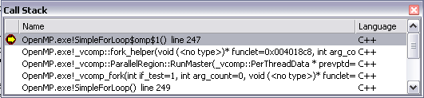
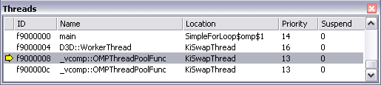
VS Debugging Example
#pragma omp parallel for
for( i=1; i < n; ++i )
b[i] = (a[i] + a[i-1]) / 2.0; // breakpoint
Notes:
Breakpoint
See the code that’s been auto generated
See the two threads in the team

Slide 27
OpenMP Sections
Executing concurrent functions
  #pragma omp parallel sections
  {
  #pragma omp section
  Xaxis();
  #pragma omp section
  Yaxis();
  #pragma omp section
  Zaxis();
  }
Notes:
All functions must be order-independent
Synch access to any global data
Useful in small bottleneck functions, not main game loop

Slide 28
Common Problems
Parallelizing STL loops
Parallelizing pointer-chasing loops
The early-out problem
Scheduling unpredictable work

Slide 29
STL Loops
For STL vector/deque
  #pragma omp parallel for
  for( size_type i = 0; i < v.size(); ++i )
  // use v[i]
In theory, possible to write parallelized STL algorithms
  // examples
  omp::transform( v.begin(), v.end(), w.begin(), tfx );
  omp::accumulate( v.begin(), v.end(), 0 );
In practice, it’s a Hard Problem

Slide 30
Pointer-chasing loops
Single: executed by only 1 thread
Nowait: removes implied barrier
Looping over a linked list:
  #pragma omp parallel
  for( p = list; p != NULL; p = p->next )
  #pragma omp single nowait
  process( p ); // efficient if mucho work here
Notes:
Two new clauses
Threads basically leapfrog
Can be useful for pointer chasing loops if work unit is large

Slide 31
Early out
The problem
  #pragma omp parallel for
  for( int i = 0; i < n; ++i )
  if( FindPath( i ) ) break;
Solutions
  May be faster to process all paths anyway
  Process in multiple chunks
Notes:
Compiler: Jump out of OpenMP structured block not allowed

Slide 32
Scheduling unpredictable work
The problem
  #pragma omp parallel for
  for( int i = 0; i < n; ++i )
  f( i ); // f takes variable time
Solution
  #pragma omp parallel for schedule(dynamic)
  for( int i = 0; i < n; ++i )
  f( i ); // f takes variable time
Notes:
If f() takes invariant time, all threads finish about the same time
If f() is variable, some threads may finish early
They could be doing useful work!
Dynamic: use available threads rather than statically assigning a selected range

Slide 33
When to choose OpenMP
Platform is multi-core
Profiling shows a need: 1 core is pegged
Inner loops where:
  N or loop work is significantly large
  Processing is order-independent
  Loops follow OpenMP canonical form
Cross-platform important
Last-minute optimizations
Notes:
What have we learned?
When applied to the right problem, yields great results

Slide 34
Game Applications
Particle systems
Skinning
Collision detection
Simulations (e.g. pathfinding)
Transforms (e.g. vertex transforms)
Signal processing
Procedural synthesis (e.g. clouds, trees)
Fractals
Notes:
Real game: #pragma omp gave a further 7% speedup

Slide 35
Getting Your Feet Wet
Add #pragma omp
Inform your build tools
  Set compiler flag; e.g. /openmp
  Link with library; e.g. vcomp[d].lib
Verify compiler support
  #ifdef _OPENMP
  printf( “OpenMP enabled” );
  #endif
Include omp.h to use any structs/APIs
  #include <omp.h>
Notes:
It’s not enough simply to add the pragmas

Slide 36
Best Practices
RTFM: Read the spec
Use OMP only where you need it
Understand when it’s useful
Measure performance
Validate results in debug mode
Be able to turn it off
Notes:
Spec: <100 pages

Slide 37
Questions
Me: pkisensee@msn.com
This presentation: gdconf.com

Slide 38
References
OpenMP
  www.openmp.org
The Free Lunch Is Over
  www.gotw.ca/publications/concurrency-ddj.htm
Designing for Power
  ftp://download.intel.com/technology/silicon/power/download/design4power05.pdf
No Exponential Is Forever
  ftp://download.intel.com/research/silicon/Gordon_Moore_ISSCC_021003.pdf
Why Threads Are a Bad Idea
  home.pacbell.net/ouster/threads.pdf
Adaptive Parallel STL
  parasol.tamu.edu/compilers/research/STAPL/
Parallel STL
  www.extreme.indiana.edu/hpc++/docs/overview/class-lib/PSTL
GOMP
  gcc.gnu.org/projects/gomp

