Slide 1
name
“iphone 4”
“iphone 5”
“iphone 6”
“iphone 7”
0B
0B
name_ptr
0B
name_ptr
0B
name_ptr
4B
4B
value
4B
value
4B
value
8B
next
8B
next
8B
next
8B
0
CB
0
CB
prev
CB
prev
CB
prev
first(global variable)

Slide 2
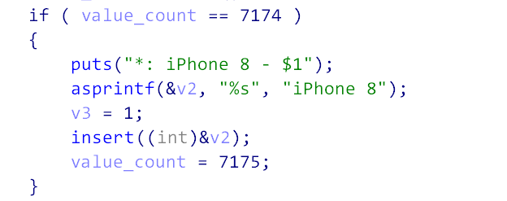
name
“iphone 4”
“iphone 5”
“iphone 6”
“iphone 7”
esp
0B
0B
name_ptr
0B
name_ptr
18B
name_ptr
4B
4B
value
4B
value
1CB
1
8B
next
8B
next
8B
next
20B
0
CB
0
CB
prev
CB
prev
24B
prev
...
...
38h
ebp
first(global variable)
stack

Slide 3
XXX
esp
...
XXX
XXX
BBB
XXX
...
AAA
XXX
ebp
ebp
ebp
XXX
add(retq)
add(retq)
esp
...
...
esp
...
...
...
...
ebp
ebp
ebp
ebp
ebp
before checkout()
in checkout()
after checkout()
before cart()

Slide 4
XXX
esp
...
XXX
XXX
DDD
XXX
...
CCC
XXX
ebp
ebp
ebp
XXX
add(retq)
add(retq)
esp
...
...
esp
...
...
...
...
ebp
ebp
ebp
ebp
ebp
before checkout()
in checkout()
after cart()
other func can change this data
so maybe can leak information of link

Slide 5
name
“iphone 4”
“iphone 5”
“iphone 6”
“iphone 7”
esp
0B
0B
name_ptr
0B
name_ptr
18B
name_ptr
4B
4B
value
4B
value
1CB
atoi_got
8B
next
8B
next
8B
next
20B
0
CB
0
CB
prev
CB
prev
24B
prev
...
...
38h
ebp
first(global variable)
stack
cart() will print each value
we can get libc address!

Slide 6
next? emmm...double link? Wonderful! Unlink may be sucessful!
esp
esp
call delete
(cur->prev)->next = cur->next
(cur->next)->prev = cur->prev
(atoi_got-8)+8 = system_addr
(sys_addr)+12 = atoi_got
atoi_got = system_addr
sys_add + 12 = atoi_got
18B
name_ptr
18B
name_ptr
1CB
1
1CB
1
20B
0
20B
atoi_got - 8
24B
prev
24B
system_addr
...
...
...
...
38h
ebp
38h
ebp
stack
stack
system_addr + 12 : Unwrittable!!!!

Slide 7
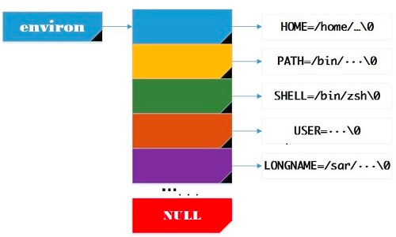
Unlink not work, using environ
esp
18B
name_ptr
1CB
environ real address
AAA
20B
0
...
24B
prev
...
...
...
...
38h
ebp
stack

Slide 8
Unlink not work, using environ
stack
...
...
...
...
esp
BBB
old ebp
18B
name_ptr
...
retq
1CB
environ real address
AAA
...
...
20B
0
...
...
...
24B
prev
...
AAA
...
...
...
...
...
...
38h
ebp
stack
1. cal() print AAA
2. using gdb get (BBB-AAA)
3. we can get BBB, that is cal() stack base
4. by assembly code, we can get all function stack base

Slide 9
What we can do is just unlink...
esp
esp
call delete
(atoi_got + 0x22) + 12 = del_ebp - 8
(del_ebp - 8) + 8 = atoi_got + 0x22
atoi_got + 0x2C = del_ebp - 8
del_ebp = atoi_got + 0x22
18B
name_ptr
18B
name_ptr
1CB
1
1CB
1
20B
0
20B
atoi_got + 0x22
24B
prev
24B
del_ebp - 8
...
...
...
...
38h
ebp
38h
ebp
stack
stack

Slide 10
XXX
XXX
leave ret(del func)
下面回到主函数继续输入choice
my_read(&choice, 0x15u)
switch( atoi( &choice) )
XXX
ebp
atoi_got + 0x22
retq
...
...

Slide 11
ebp-0x22
choice
atoi_got
ebp-0x20
...
...
leave ret(del func)
下面回到主函数继续输入choice
my_read(&choice, 0x15u)
switch( atoi( &choice) )
ebp-0x0E
...
ebp-0x0C
cookie
ebp-0x0A
...
...
ebp-0x04
...
ebp-0x02
...
ebp
...
atoi_got + 0x22

Slide 12
ebp-0x22
system
atoi_got
ebp-0x20
...
||sh
leave ret(del func)
下面回到主函数继续输入choice
my_read(&choice, 0x15u)
switch( atoi( &choice) )
ebp-0x0E
...
ebp-0x0C
cookie
ebp-0x0A
...
...
ebp-0x04
...
ebp-0x02
...
ebp
...
atoi_got + 0x22

Slide 13
ebp-0x22
system
atoi_got
ebp-0x20
...
||sh
leave ret(del func)
下面回到主函数继续输入choice
my_read(&choice, 0x15u)
switch( atoi( &choice) )
ebp-0x0E
...
ebp-0x0C
cookie
ebp-0x0A
...
...
ebp-0x04
...
ebp-0x02
...
相当于执行 system(“system||sh”)
ebp
...
atoi_got + 0x22

