Slide 1
fp
IO_FILE
vtable_ptr
finish
overflow
...

Slide 2
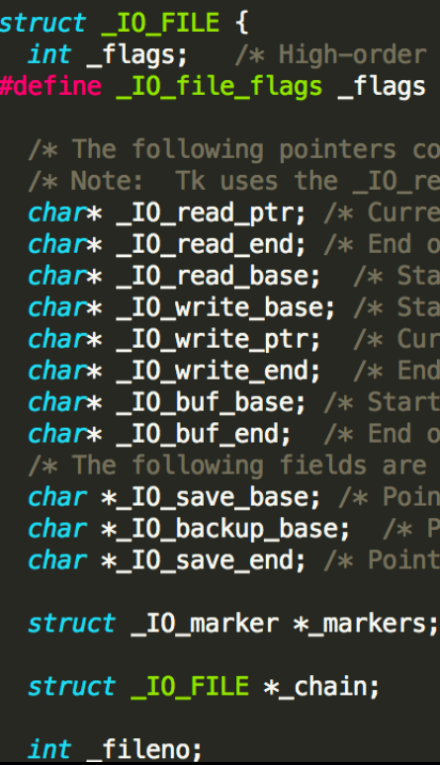
fp
IO_FILE
vtable_ptr
finish
overflow
...

Slide 3
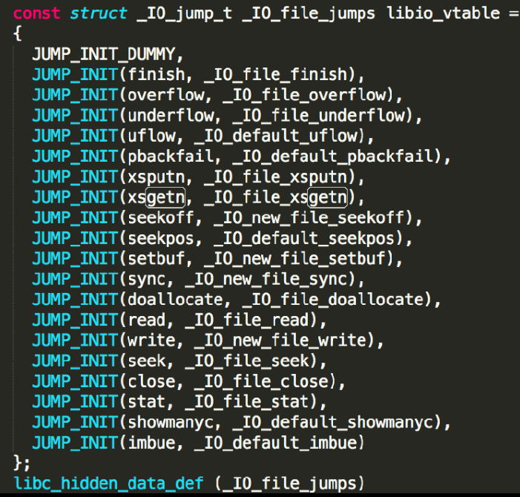
fp
IO_FILE
vtable_ptr
finish
overflow
...

Slide 4
fp
IO_FILE
fclose() 步骤
利用IO_FILE.flag和其他一些东西
如果符合条件，就执行vtable.finish(fp)
这题我没有深究
flag不变就可以执行vtable.finish(fp)
具体作用以后再研究
vtable_ptr
finish
overflow
...

Slide 5
aaaa
name
aaaa
fp
...
IO_FILE
aaaa
vtable_ptr
this_addr + 0x4
func in vtable
flag: 0xffff7fff
||sh
0000
...
0000
最终执行finish(fp)
等于 system(“0xffff7fff||sh”)
this_addr + 0x4
finish: system
...

