Slide 1
Swap absorption
SWAP
+ CP
How _swap_absorption.py moves two-qubit gates next to routing SWAPs, and what changed in the CommutationChecker
Qiskit transpiler · written for readers who do not know Qiskit · October 2026
Notes:
Title. This deck explains one transpiler pass, _AbsorbIntoSwaps, and the small CommutationChecker repair it relies on. No prior Qiskit knowledge is assumed: the first section explains circuits, SWAPs, the transpiler pipeline and commutation in plain terms.

Slide 2
What this deck covers
1
Background
2
The idea
3
The code
4
The checker change
Circuits, qubit wires and gates
Why routing inserts SWAPs
The transpiler as a pipeline of passes
What it means for two gates to commute
Why a gate next to a SWAP is cheaper to compile
A worked example, before and after
The three rules every move obeys
Pauli letters: the commutation model
Every class, function, record and constant in _swap_absorption.py
The planner's four stages traced on one running example, then the rewrite
What CommutationChecker is
The defect in check_commutation_entries and its repair
The new Rust binding, its contract, files and tests
How to read it. Diagrams carry the explanation; the text around them names the exact functions and variables so you can open the source alongside. Monospace names such as _find_moves are identifiers in the code. Everything in the module is private (leading underscore) except the public CommutationChecker.check_commutation_entries method.
Notes:
Four parts. Readers who already know Qiskit can skip the background section. Every class, function, record and constant in the module gets its own description in part three; the planner is traced stage by stage on one running example whose values were produced by running the code.

Slide 3
Background: circuits, SWAPs, passes and commutation
Part 1
Notes:
Four slides of background. Each one introduces exactly the vocabulary the later slides use.

Slide 4
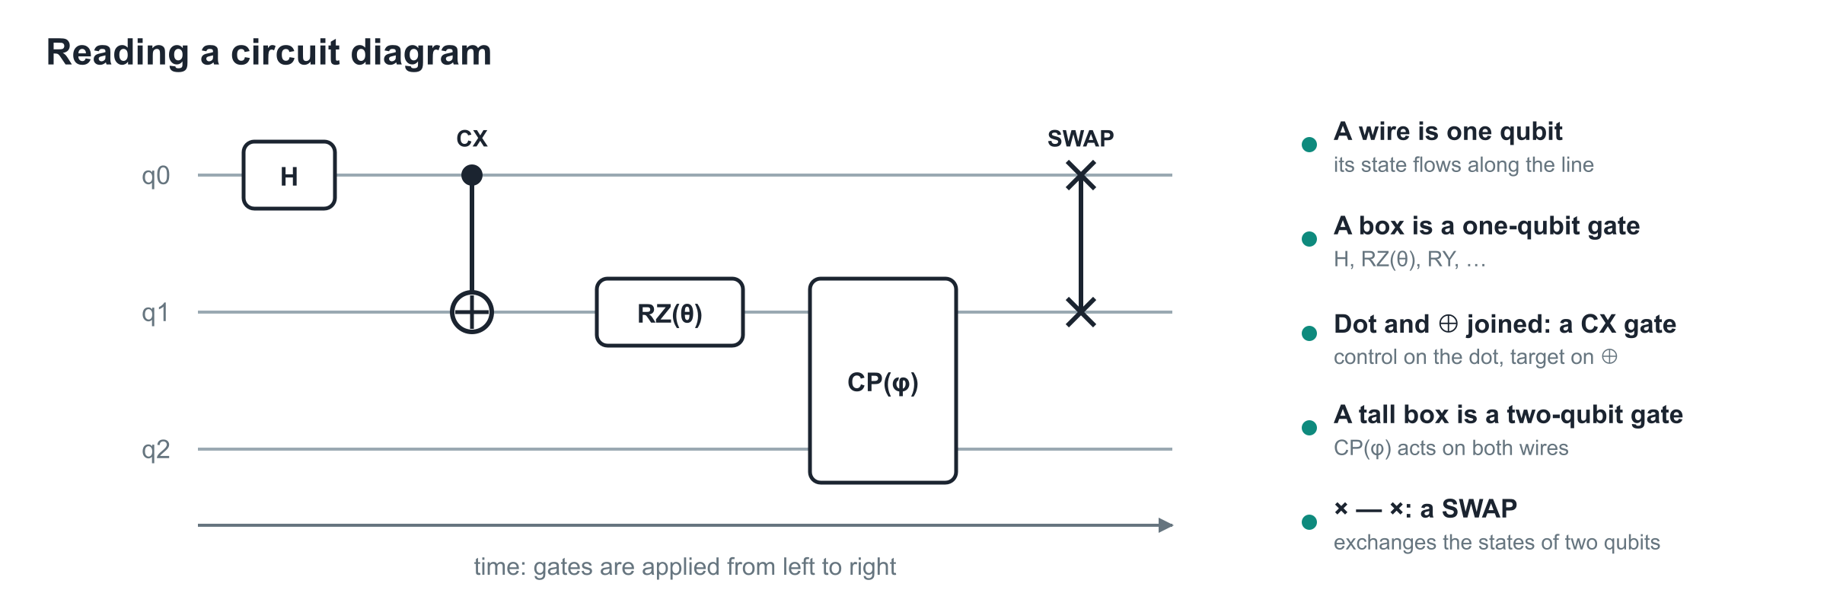
A circuit is a timeline of gates on qubit wires
Vocabulary used later
In Qiskit
A gate's qubits are its arguments, written in order: CX(control, target).
A one-qubit gate like RZ(θ) takes an angle parameter θ.
A QuantumCircuit is the user-facing object. The transpiler works on a DAGCircuit, a graph of the same gates.
Each gate becomes a DAGOpNode; node.qargs lists its qubits in order.
Notes:
Read the diagram left to right. Each horizontal line is a qubit. Boxes are one-qubit gates. Two-qubit gates connect two wires. The SWAP symbol exchanges the states of its two wires. The pass we study only ever touches two-qubit gates and SWAPs on the same pair of wires.

Slide 5
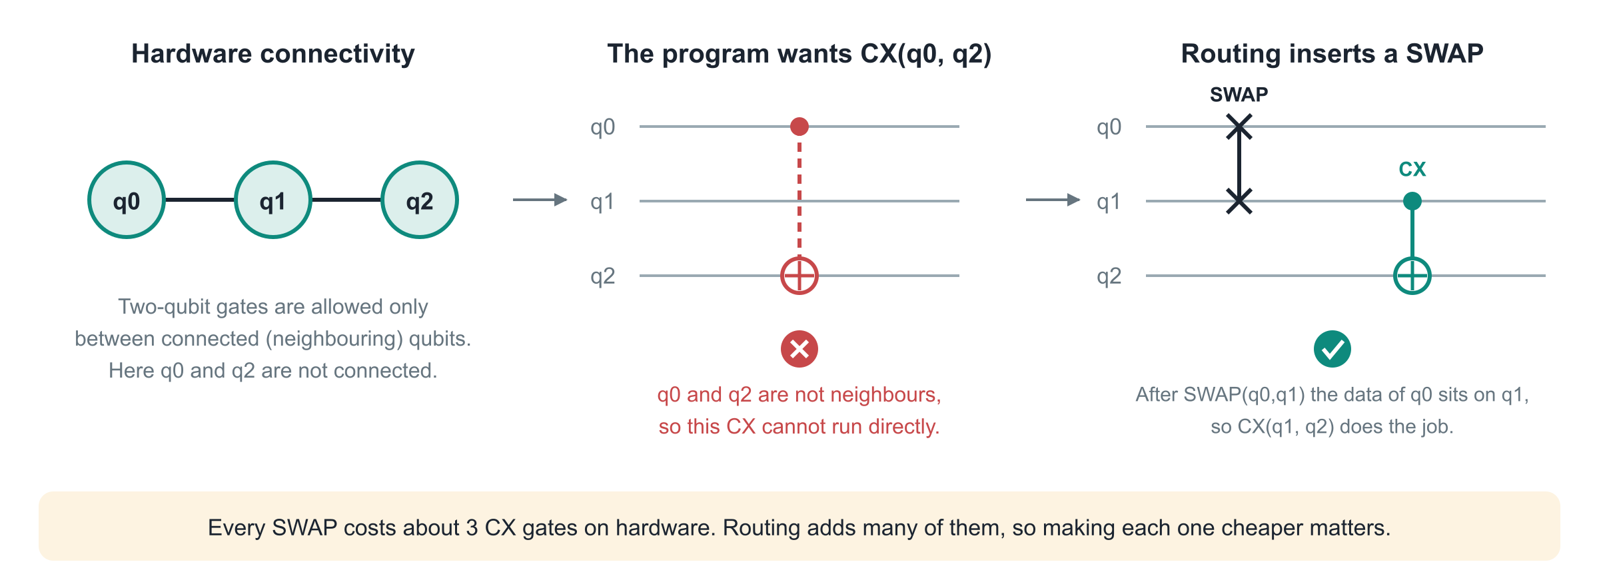
Hardware connectivity forces routing SWAPs
A SWAP that routing inserted is just an ordinary standard swap gate in the circuit. The pass finds such gates by name; it does not care who inserted them.
Notes:
Real devices only allow two-qubit gates between physically connected qubits. The routing stage inserts SWAPs to bring interacting qubits next to each other. Each SWAP costs three CX gates, so routed circuits are dominated by SWAP cost. The pass tries to make some of those SWAPs cheaper.

Slide 6
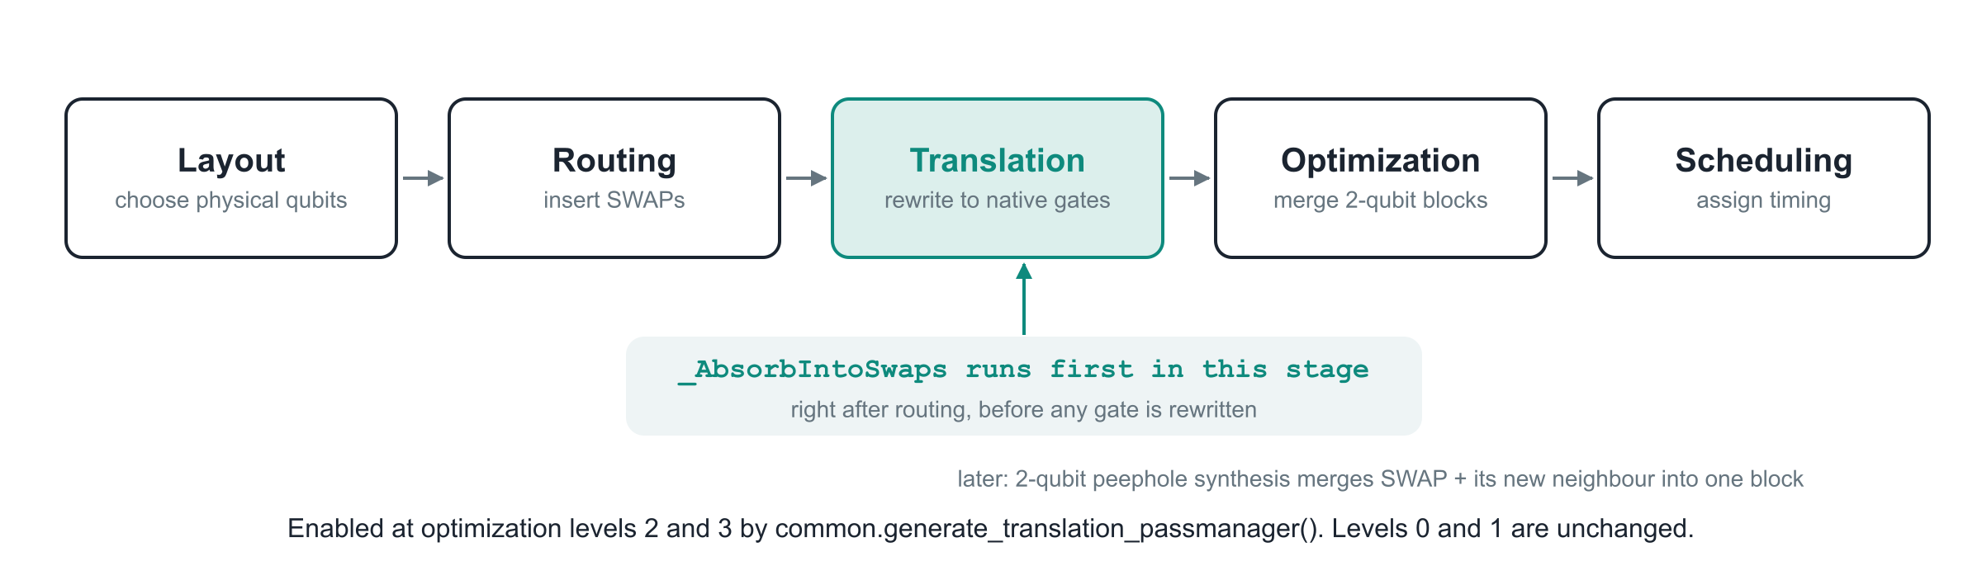
The transpiler is a pipeline of passes
A pass
Why this spot in the pipeline
Where it is wired in
A class with a run(dag) method that receives the circuit as a DAGCircuit and returns one.
_AbsorbIntoSwaps is a TransformationPass: it may rewrite gates but never changes the layout.
Routing has just produced the SWAPs. Translation has not yet decomposed anything, so the standard gate names are still visible.
The later 2-qubit peephole synthesis will merge each SWAP with its new neighbour.
common.generate_translation_passmanager() adds the pass when optimization_level is 2 or 3.
Levels 0 and 1 and the default None are unchanged. Provider plugins calling the helper inherit the behaviour.
Notes:
The transpiler runs a sequence of passes. Each pass is a function from DAGCircuit to DAGCircuit. The absorption pass is prepended to the translation stage at optimization levels 2 and 3 by generate_translation_passmanager in common.py. Both built-in translation plugins, translator and synthesis, go through that helper.

Slide 7
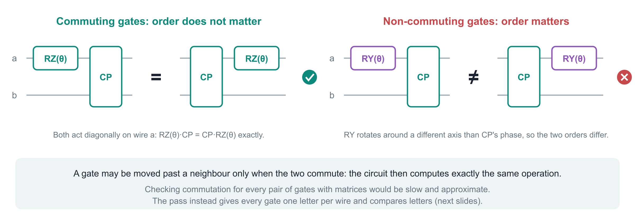
Commuting gates can change order safely
Exact commutation is what the pass needs: the rewritten circuit must compute precisely the same unitary, including its global phase, not merely something close to it.
Notes:
Two gates commute when applying them in either order gives the same operation. Only then may one be moved past the other. RZ and CP commute: both act as diagonal phases on the shared wire. RY and CP do not. The pass never calls a general commutation routine per pair; it uses one letter per wire, explained in part 3.

Slide 8
The idea: put a two-qubit gate right next to its SWAP
Part 2
Notes:
Why adjacency pays, a worked example, and the rules every move obeys.

Slide 9
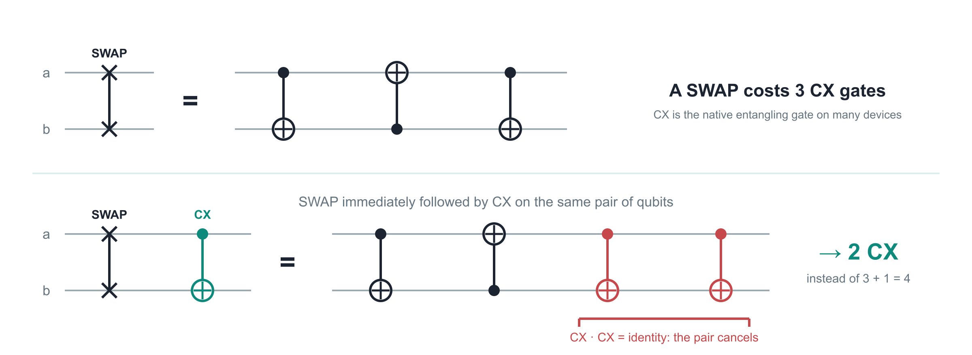
Why adjacency pays: SWAP + CX costs 2 CX instead of 4
In general
References
Any two-qubit gate adjacent to a SWAP on the same pair can be synthesized with it as one block. The pass only arranges adjacency; synthesis happens later.
[1] Liu, Li, Zhou. Not All SWAPs Have the Same Cost. arXiv:2205.10596
[2] Lao, Browne. 2QAN. arXiv:2108.02099
Notes:
A SWAP decomposes into three CX gates. If a CX on the same pair immediately follows, two equal CX gates meet and cancel, leaving two. The same kind of saving appears for other two-qubit gates once the SWAP and its neighbour are synthesized together as one block. The idea comes from Liu, Li and Zhou, arXiv:2205.10596, and from the 2QAN compiler, arXiv:2108.02099.

Slide 10
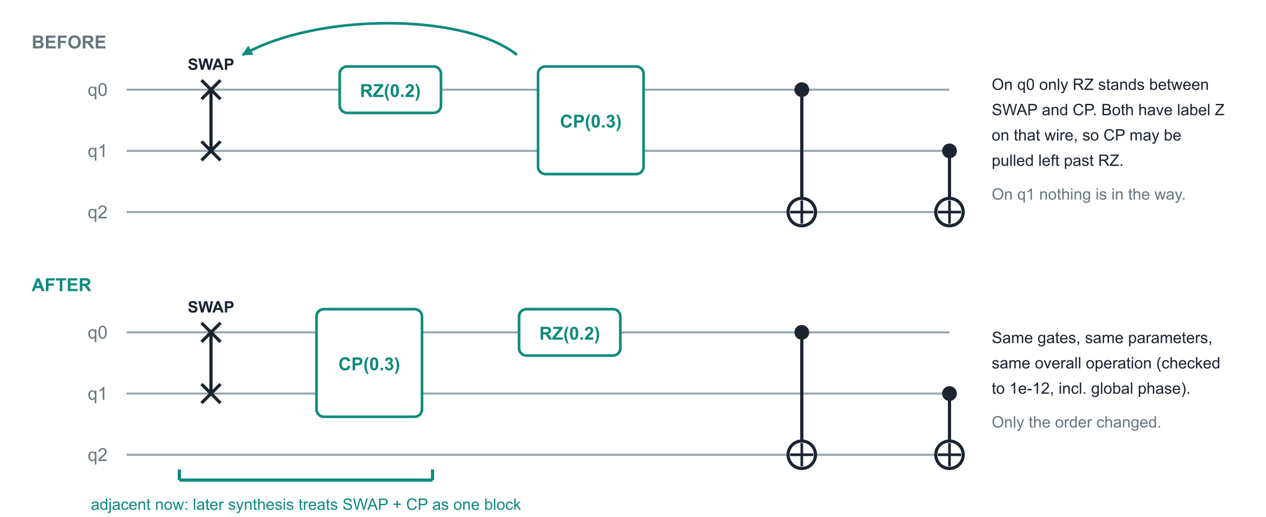
The pass in one example
from qiskit import QuantumCircuit
from qiskit.converters import circuit_to_dag, dag_to_circuit
from qiskit.transpiler.preset_passmanagers._swap_absorption import _AbsorbIntoSwaps
qc = QuantumCircuit(3); qc.swap(0, 1); qc.rz(0.2, 0); qc.cp(0.3, 0, 1); qc.cx(0, 2); qc.cx(1, 2)
out = dag_to_circuit(_AbsorbIntoSwaps().run(circuit_to_dag(qc))) # order now: swap, cp, rz, cx, cx · Operator(out) == Operator(qc)
Replace RZ(0.2) with RY(1e-6) and nothing moves: Y and Z letters differ, however small the angle. Replace it with a barrier and nothing moves either.
Notes:
Run on this checkout: the pass moves CP next to the SWAP, pulling it left past RZ. Operator equality holds to 1e-12 without allowing a global-phase difference. The gate counts are unchanged; the benefit appears when the later synthesis merges SWAP and CP.

Slide 11
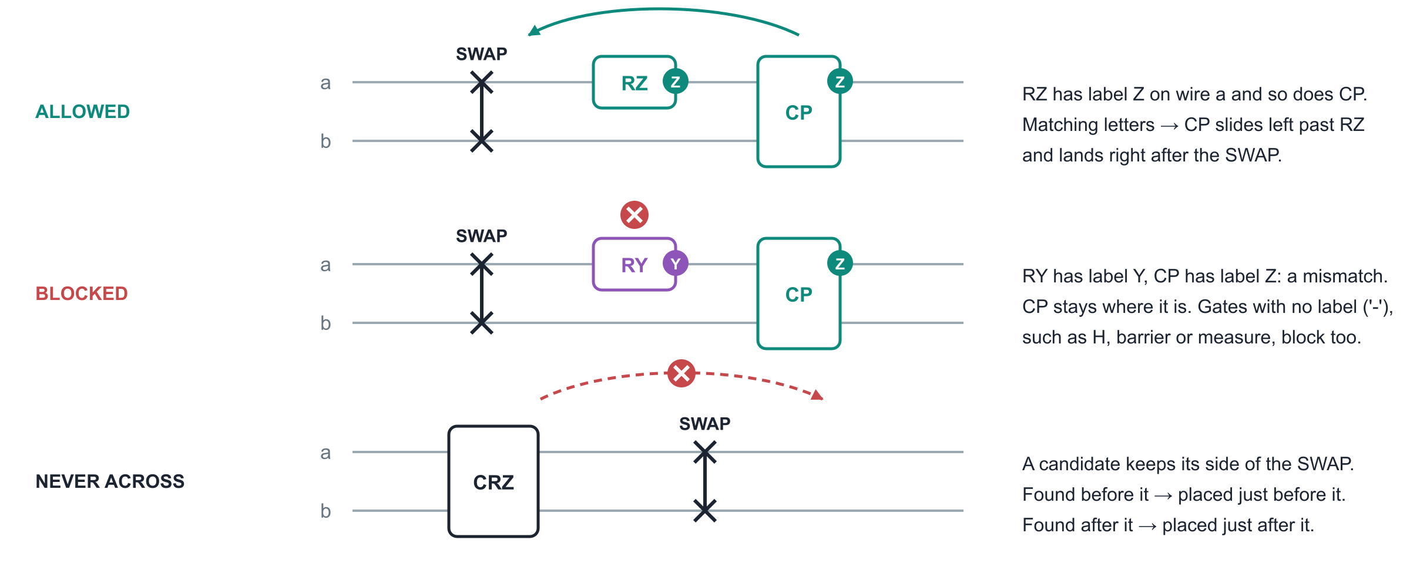
Three rules every move obeys
Only two-qubit gates on exactly the SWAP's pair of qubits are candidates. One-qubit gates can be crossed but are never moved themselves.
Notes:
Rule one: only cross gates whose letter on the shared wire matches the candidate's letter. Rule two: a wall, that is a mismatched letter or a gate with no letter, stops the move. Rule three: a candidate never crosses the SWAP; it ends on the side it started from. This matters for asymmetric gates such as CRZ, which do not commute with a SWAP on their pair.

Slide 12
What the pass deliberately does not do
No SWAP is deleted
No synthesis, no layout change
Never across a SWAP
The pass keeps every SWAP and every gate with its parameters. It only reorders. Gate counts are unchanged until later synthesis merges blocks.
It never builds matrices for the circuit, never picks routes, never changes the layout. Its whole output is better placement.
A candidate may approach a SWAP but never jump over it. Asymmetric gates like CRZ(a,b) do not commute with SWAP(a,b).
No control flow
Conservative by design
At most one new partner per SWAP
Control-flow blocks (if, while, for) are not entered. Barriers, measurements and resets are walls.
RXX and RYY on the same pair commute, but their letters differ (XX vs YY), so no move. RY(0) keeps the Y letter: angles are never inspected.
Each run picks at most one candidate for each SWAP that does not already touch a same-pair gate. Greedy, deterministic, no global search.
Notes:
These boundaries keep the pass simple and exactly correct. The conservative cases are rejections of moves that would be legal mathematically but are not covered by the per-wire letters.

Slide 13
The commutation model: one Pauli letter per wire
Part 3a
Notes:
Before the function tour, the model everything rests on: each supported gate receives one letter per qubit, and letters are compared instead of matrices.

Slide 14
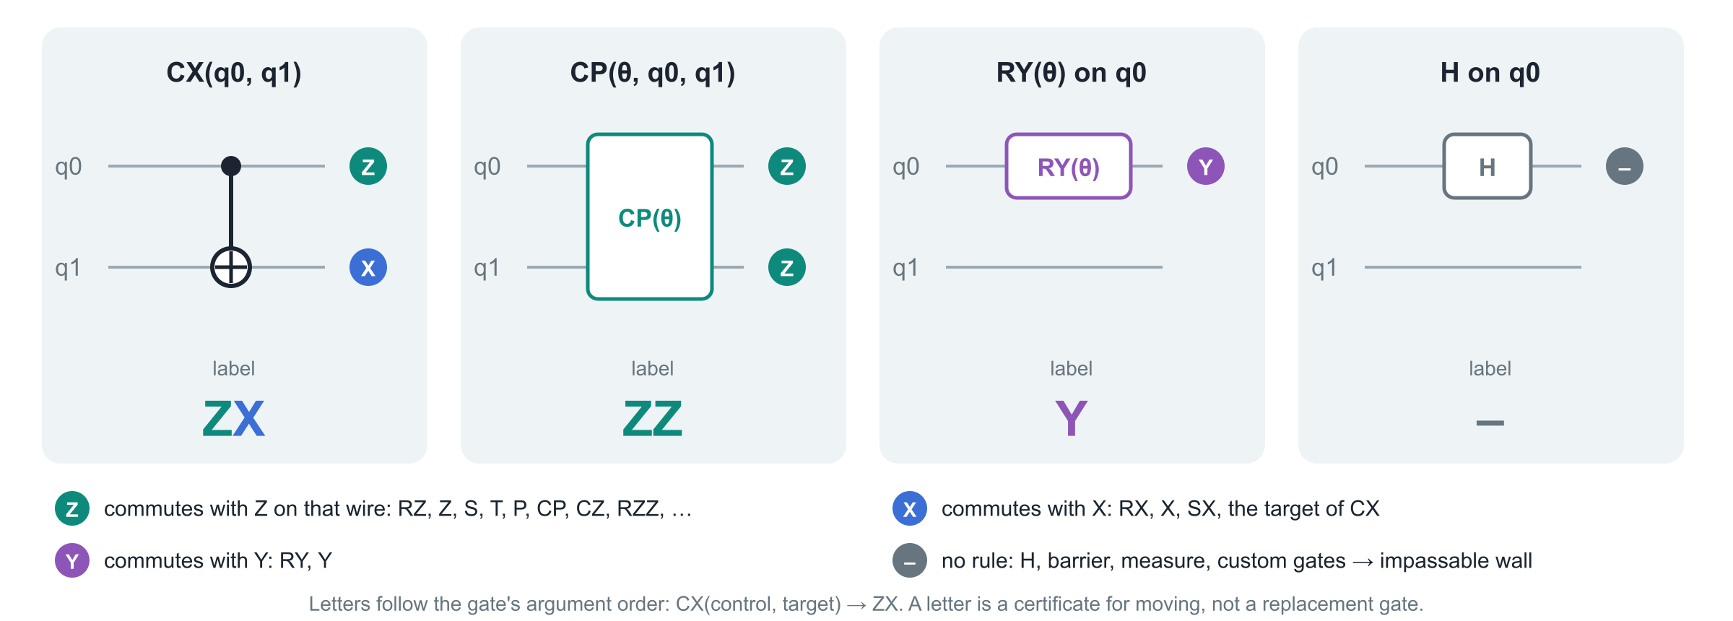
One Pauli letter per wire
The string follows node.qargs order, not Qiskit's Pauli-string convention. RZX(a, b) is 'ZX': Z on its first argument, X on its second.
Notes:
X, Y and Z are the three Pauli operators. A gate gets letter Z on a wire when it commutes with Z on that wire, which is the case for every gate diagonal in the computational basis. CX commutes with Z on its control and X on its target, hence ZX. A dash means no usable rule. The letters are a certificate for moving; no gate is ever replaced by a Pauli.

Slide 15
Why matching letters guarantee exact commutation
1
Same letter on a shared wire
2
Fix every shared wire
3
Therefore they commute exactly
Both gates commute with that Pauli, so both are block diagonal in its eigenbasis on that wire.
Example: RZ and CP both commute with Z on wire a.
Inside each eigenspace the two gates act only on their private qubits, which are disjoint.
Operations on disjoint qubits always commute.
No tolerance, no approximation, global phase preserved.
The rewritten circuit is the same unitary.
The rule the planner applies: a candidate may cross a unit when, on every wire they share, the unit's letter equals the candidate's letter on that wire, and neither letter is '-'. Gates on wires the candidate does not touch are irrelevant.
Sufficient, not necessary
Angles are never inspected
RXX and RYY on one pair commute, but XX and YY differ letter by letter, so the move is refused. That is accepted.
RY(0) is the identity, yet it keeps letter Y and blocks a Z candidate. Parameter-independent rules are the point.
Notes:
The argument is simple linear algebra and needs no numerics. Two gates that each commute with the same Pauli on a shared wire are both block diagonal in that Pauli's eigenbasis. Fix the eigenvalue on every shared wire and the remaining actions live on disjoint private qubits, which always commute. So the gates commute exactly, global phase included. The rule is sufficient, not necessary: it misses some commuting pairs on purpose.

Slide 16
The 27 supported gate families
Standard gate names | Letters | Why
rz, z, s, sdg, t, tdg, p, u1 | Z | Diagonal one-qubit gates: functions of Z
rx, x, sx, sxdg | X | Functions of X
ry, y | Y | Functions of Y
cz, cp, crz, cu1, cs, csdg, rzz | ZZ | Diagonal two-qubit gates
cx, crx, csx, rzx | ZX | Z on the first argument, X on the second
rxx | XX | X on both arguments
ryy | YY | Y on both arguments
Two extra ZZ forms
A genuine two-qubit UnitaryGate whose matrix has every off-diagonal entry exactly zero (1e-13 is enough to reject).
A recognised CX(a,b); D(b); CX(a,b) block with D a Z-letter gate, e.g. CX; RZ; CX = RZZ.
Only genuine standard gates
node.is_standard_gate() must be true and the name must be in the allowlist.
A custom Gate named 'cx', or an open-control CX, gets '-'.
Extra entries in the commutation table do not enlarge this set: the allowlist is checked before any lookup, so new table coverage can never enable new moves by accident.
Movable versus crossable
Two-qubit entries can be moved next to a SWAP.
One-qubit entries are only ever crossed.
Notes:
The allowlist _SUPPORTED_GATES holds exactly these 27 standard-gate names: 14 one-qubit and 13 two-qubit. The table doubles as the finite specification checked by test_standard_wire_labels. Two more forms get ZZ without being in the list: an exactly diagonal two-qubit UnitaryGate, and the CX-D-CX pattern recognised by _group_nodes in the planner.

Slide 17
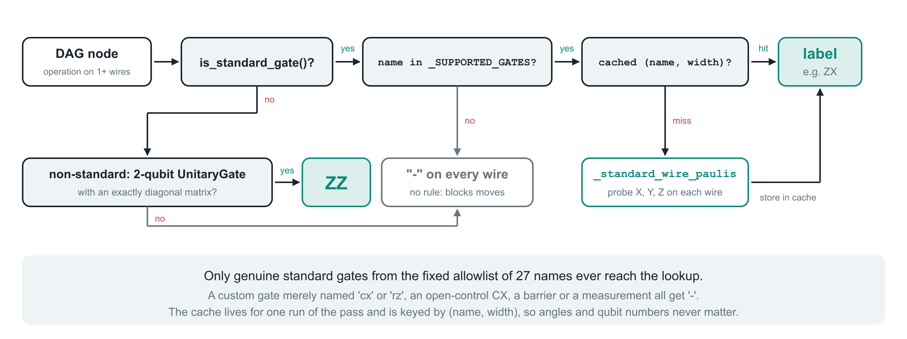
How a node gets its letters: _wire_paulis
def _wire_paulis(node: DAGOpNode, cache: dict | None = None) -> str:
# returns one letter per qubit of node; '-' means no rule
# standard gate -> allowlist -> cache[(name, width)] -> _standard_wire_paulis(op, width)
# UnitaryGate, 2 qubits, exactly diagonal -> 'ZZ' anything else -> '-' * width
Notes:
_wire_paulis(node, cache) is the classification boundary. It returns a string of length len(node.qargs). Standard gates go through the allowlist and the per-run cache before _standard_wire_paulis runs any lookup. The only non-standard operation it understands is an exactly diagonal two-qubit UnitaryGate. Everything else, including H, measure, barrier, reset, control flow and custom gates, gets dashes. The cache dictionary is created inside _group_nodes, so it lives for exactly one run of the pass.

Slide 18
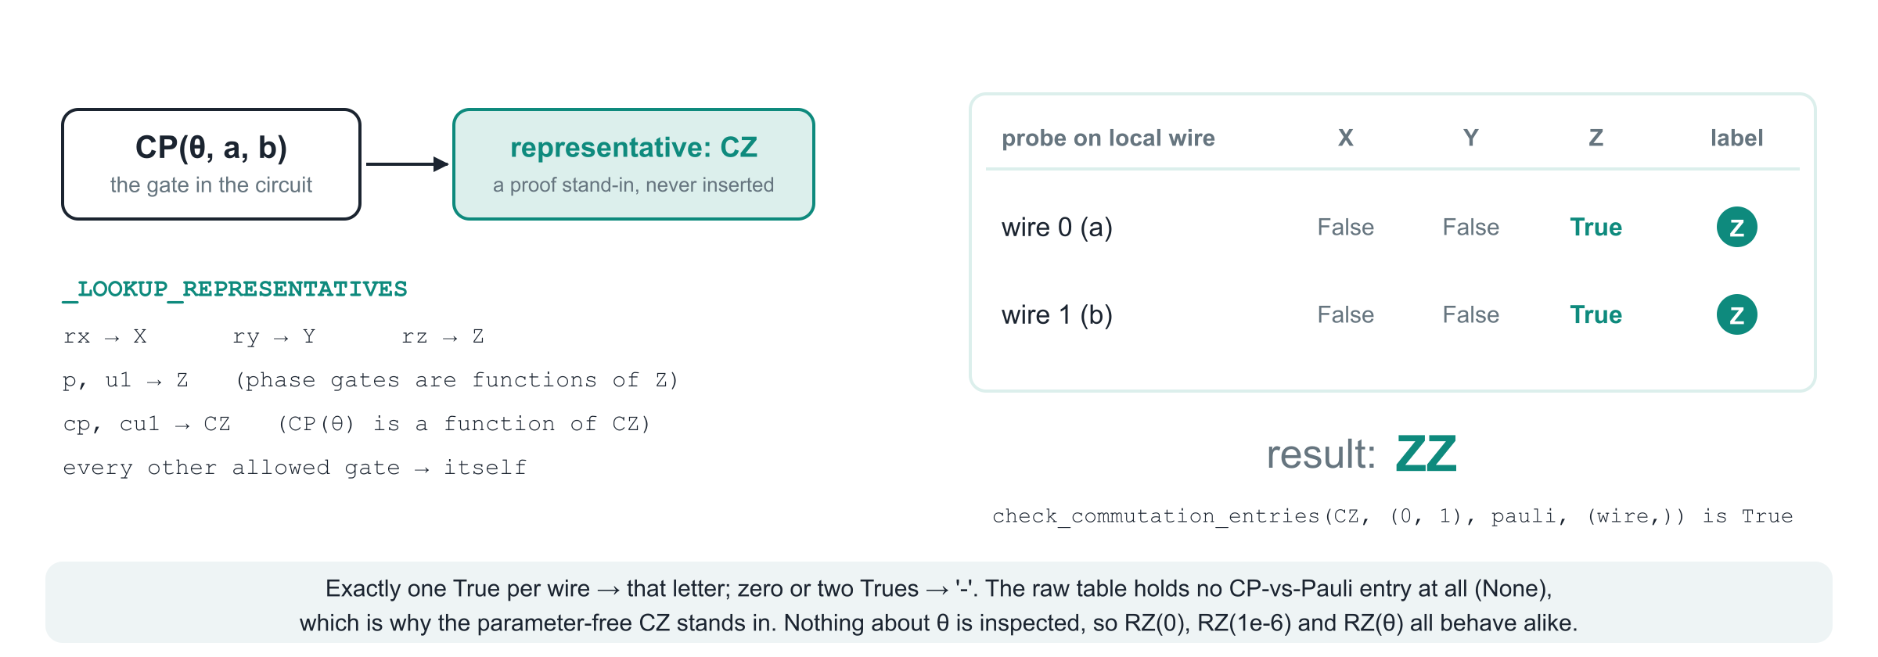
The three constants and the probe: _standard_wire_paulis
_SUPPORTED_GATES
_PAULI_PROBES
_LOOKUP_REPRESENTATIVES
frozenset of the 27 names. Checked before any lookup, so table coverage alone can never admit a new gate.
(('X', XGate()), ('Y', YGate()), ('Z', ZGate())): the three questions asked on every local wire.
rx→X, ry→Y, rz→Z, p/u1→Z, cp/cu1→CZ. Parameter-free stand-ins for the proof query; never inserted into the circuit.
Notes:
_standard_wire_paulis(op, width) assumes the caller already verified standard identity and allowlist membership. It picks a representative from _LOOKUP_REPRESENTATIVES, falling back to the gate itself, then asks the session checker three questions per wire, one per entry of _PAULI_PROBES. A wire gets a letter only when exactly one probe answers True. The raw table has no CP entry, which is why CZ stands in: CP(θ) is a function of CZ, so anything commuting with CZ commutes with CP.

Slide 19
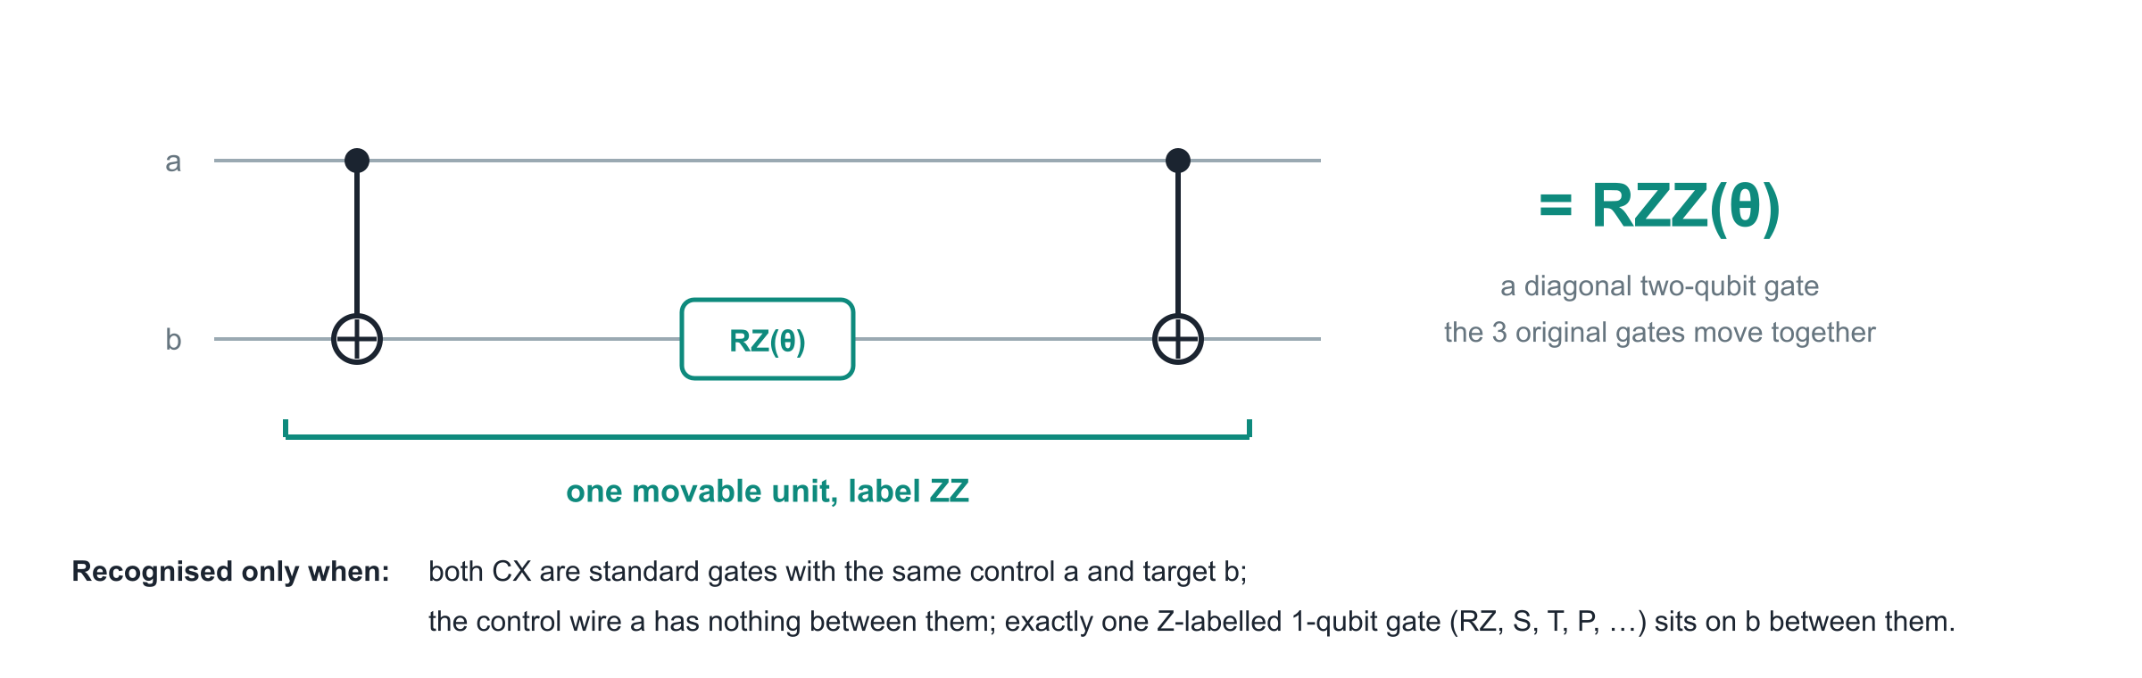
The compound unit: CX, D, CX counts as one ZZ gate
Exact conditions checked in the code
Why it matters
First CX: standard, letters ZX. Next node on the target wire: a one-qubit node with letter Z. Next node after that on the target: a standard CX with the same (control, target). The control wire's next node after the first CX must be that same closing CX.
Routed circuits from Hamiltonian simulation and QAOA are full of CX-RZ-CX blocks. Treating them as one diagonal unit lets the pass pull a whole block next to a SWAP instead of only its outer CX.
Notes:
_group_nodes, stage 2 of the planner, recognises CX(a,b); D(b); CX(a,b) with D a Z-letter one-qubit gate. Conjugating Z on the target by CX gives Z tensor Z, so the block is a function of ZZ: a diagonal two-qubit gate such as RZZ. The three original nodes share one unit id, carry the letters ZZ, and are moved together. Nothing is replaced by an RZZ gate. The running example in part 3b contains exactly such a block.

Slide 20
Inside _swap_absorption.py: every class and function
Part 3b
Notes:
A map of the module first, then the entry point, the planner's four stages traced on one running example (a diagram slide and a code slide for each), the rewrite, and the records and helper types.

Slide 21
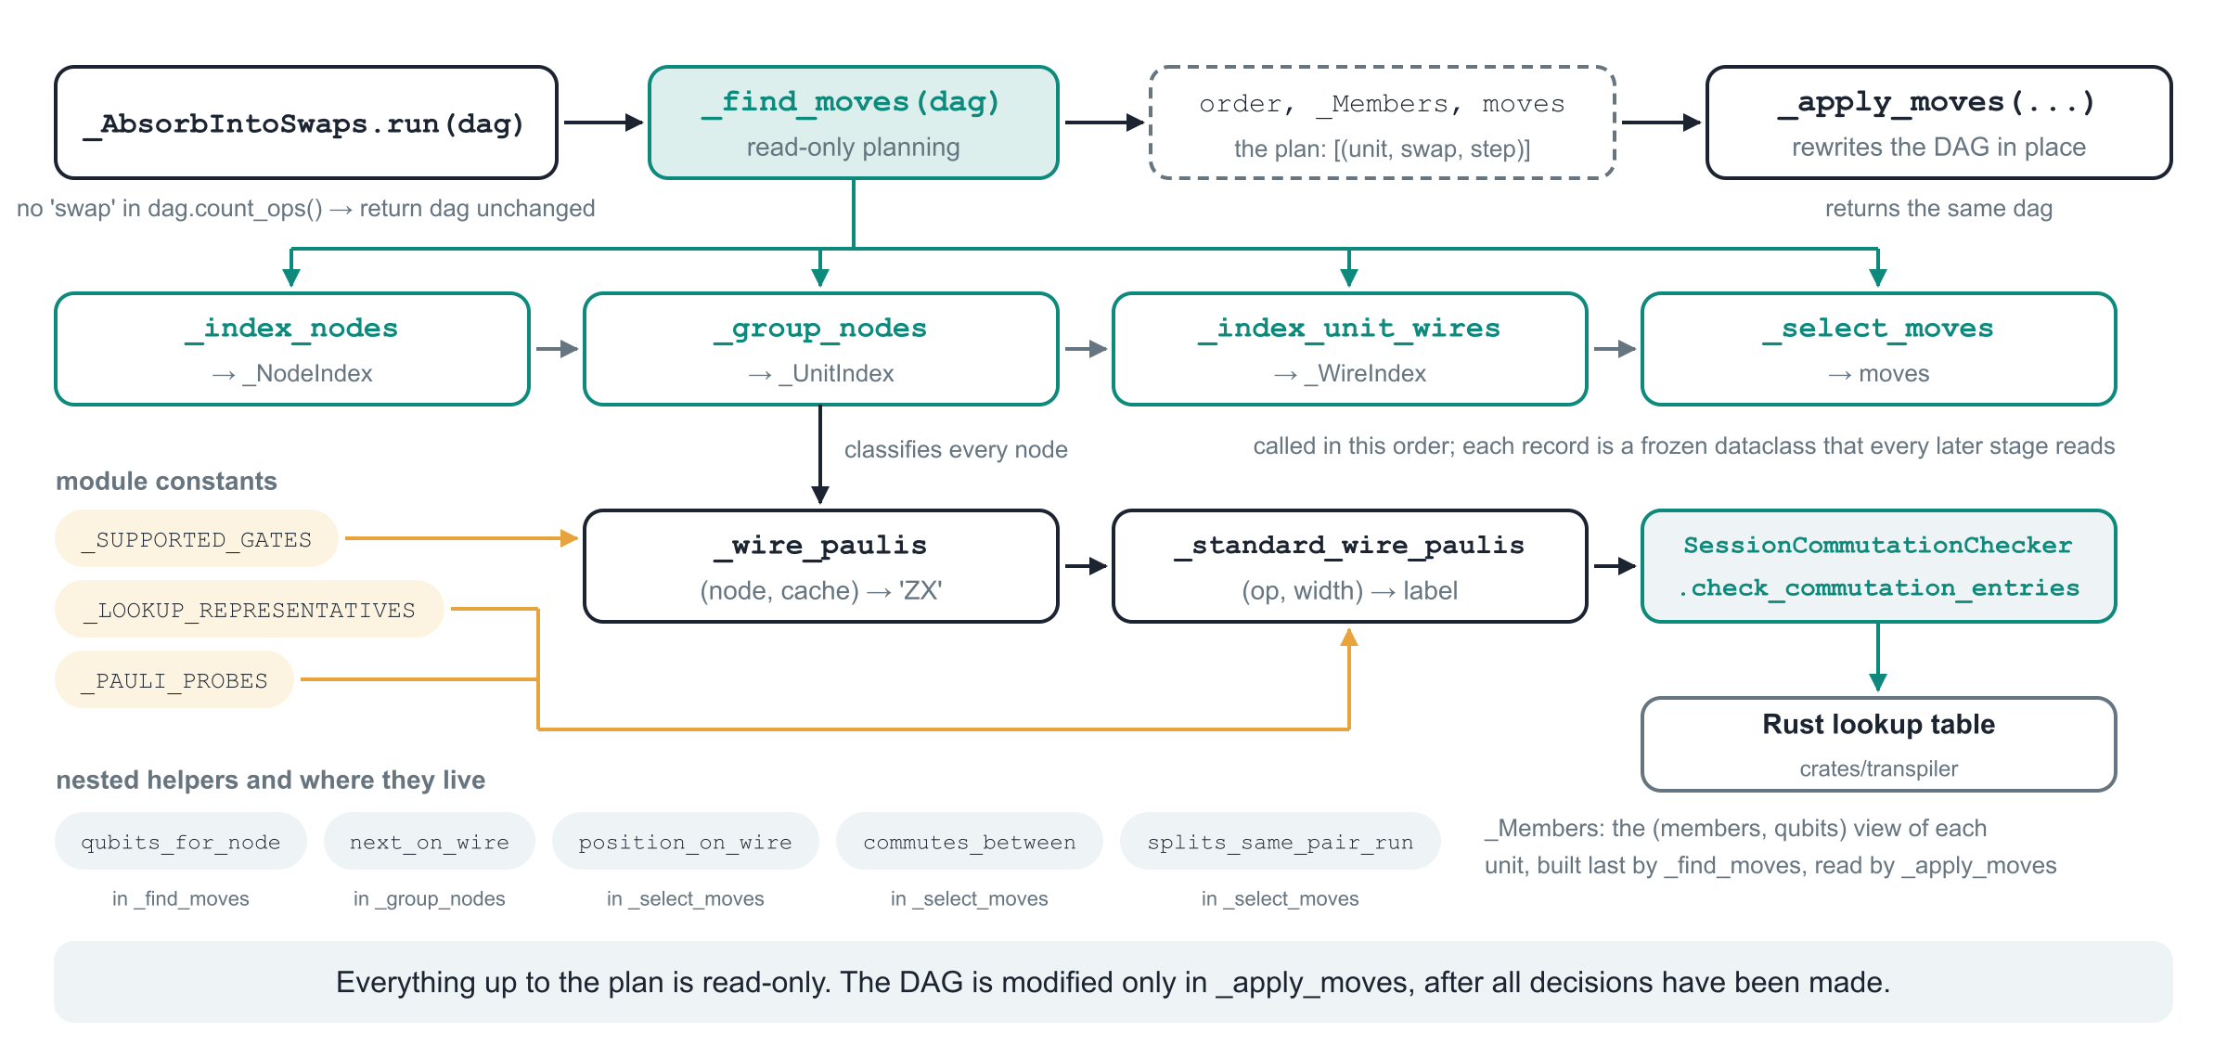
Module map: who calls whom
Three public-facing facts for newcomers: the pass has no constructor options; it never recurses into control-flow blocks; it mutates and returns the DAG it was given.
Notes:
run checks for a swap, plans with _find_moves, then rewrites with _apply_moves. _find_moves is now a thin pipeline: _index_nodes, _group_nodes, _index_unit_wires and _select_moves each return a frozen record that the next stage reads. _group_nodes classifies nodes through _wire_paulis and _standard_wire_paulis, which is the only place that talks to the commutation checker. The constants feed the classification. The nested helpers moved into the stage that needs them. _Members is the compact view of units that _apply_moves reads.

Slide 22
_AbsorbIntoSwaps.run: the entry point
class _AbsorbIntoSwaps(TransformationPass):
"""Move a two-qubit interaction next to a ``swap``
on the same qubit pair."""
def run(self, dag: DAGCircuit) -> DAGCircuit:
if "swap" not in dag.count_ops(recurse=False):
return dag
order, units, moves = _find_moves(dag)
return (_apply_moves(dag, order, units, moves)
if moves else dag)
1
Fast exit
No operation named swap at the top level → return the DAG untouched. Control-flow bodies are not searched (recurse=False).
2
Plan
_find_moves(dag) returns the topological node list, a _Members view of the units, and the list of (unit, swap, step) moves. Read-only.
For readers new to Qiskit passes
TransformationPass: a pass that may change the circuit but must keep the layout. The pass manager wires run(dag) into the pipeline.
DAGCircuit: Qiskit's graph form of a circuit. dag.count_ops() counts gates by name; topological_op_nodes() lists gates in dependency order.
No state is kept between runs: the only cache is the letter cache created inside _group_nodes for one call.
3
Rewrite
_apply_moves removes the chosen units and re-inserts each one glued to its SWAP. Returns the same DAG object.
Notes:
The class derives from TransformationPass, so the pass manager calls run with the DAG. The count_ops check is only a fast exit by name; genuine SWAP detection later also requires is_standard_gate. _find_moves builds the complete plan without touching the DAG; _apply_moves runs only if the plan is non-empty.

Slide 23
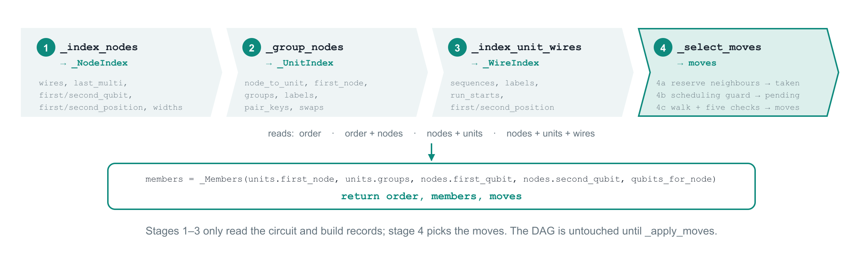
_find_moves: four stages and three records
def _find_moves(dag: DAGCircuit):
order = list(dag.topological_op_nodes())
qubit_index = {qubit: index for index, qubit in enumerate(dag.qubits)}
nodes = _index_nodes(order, qubit_index, dag.num_qubits()) # stage 1
units = _group_nodes(order, nodes) # stage 2
wires = _index_unit_wires(nodes, units) # stage 3
moves = _select_moves(nodes, units, wires) # stage 4
def qubits_for_node(node):
return [qubit_index[qubit] for qubit in order[node].qargs]
members = _Members(units.first_node, units.groups,
nodes.first_qubit, nodes.second_qubit, qubits_for_node)
return order, members, moves
Return value | Meaning
order | list[DAGOpNode] in topological order; every node index refers to it
members | _Members: units[u] gives (member node indices, qubit index set)
moves | list of (unit, swap, step): step = +1 found after the SWAP, −1 before
Notes:
_find_moves(dag) is fourteen lines. It lists the DAG's operations in topological order, numbers the qubits, and calls the four stage functions in turn: _index_nodes returns a _NodeIndex, _group_nodes a _UnitIndex, _index_unit_wires a _WireIndex, and _select_moves the list of moves. Each record is a frozen dataclass with slots, so a later stage can only read what an earlier one built. Finally it wraps the pieces _apply_moves needs into a _Members view and returns (order, members, moves). The step in each move records on which side of the SWAP the candidate was found: +1 after, −1 before. It is the search direction, not a travel direction. The next slide introduces the running example on which every stage is traced.

Slide 24
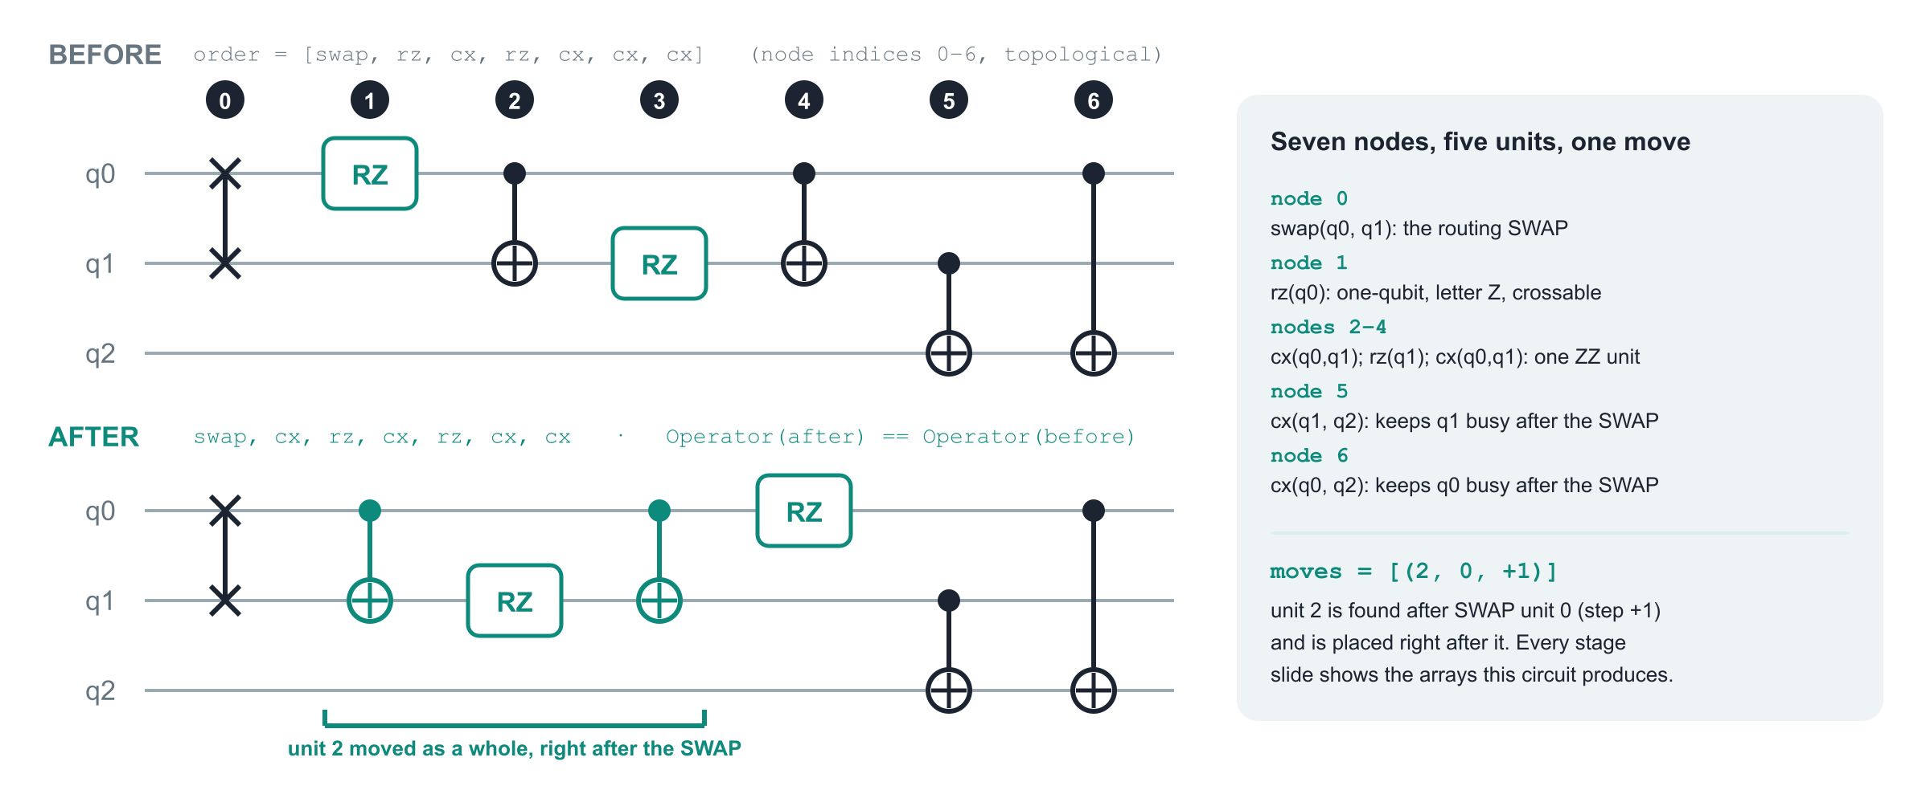
The running example used on every stage slide
qc = QuantumCircuit(3); qc.swap(0, 1); qc.rz(0.2, 0); qc.cx(0, 1); qc.rz(0.5, 1); qc.cx(0, 1); qc.cx(1, 2); qc.cx(0, 2)
order, members, moves = _find_moves(circuit_to_dag(qc)) # moves == [(2, 0, 1)]
Notes:
One small circuit is traced through all four stages. Three qubits; seven operations in topological order: a SWAP on q0 and q1, an RZ on q0, a CX-RZ-CX block on (q0, q1), then CX(q1, q2) and CX(q0, q2). Node numbers are indices into order. The CX-RZ-CX block will become one ZZ unit; the two trailing CX gates keep both of the SWAP's wires busy so the scheduling guard lets the SWAP through. The pass finds exactly one move, (2, 0, +1): unit 2 is found after SWAP unit 0 and is placed right after it. The AFTER circuit was produced by running the pass on this checkout; the operators of the two circuits are equal. Every array printed on the following slides was produced by calling the stage functions on this circuit.

Slide 25
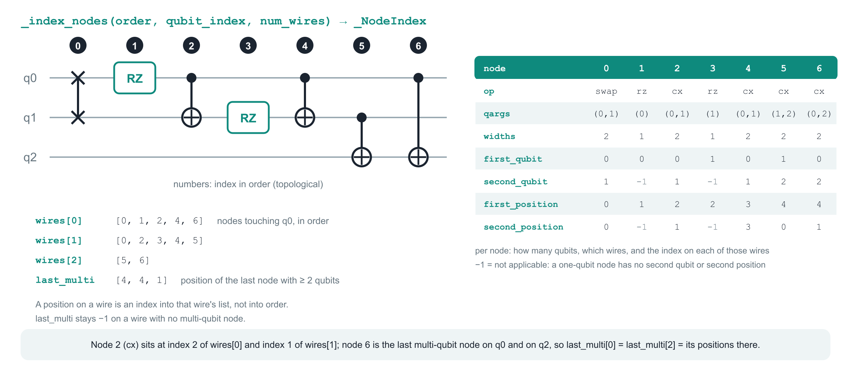
Stage 1 · _index_nodes: what it builds
Positions are per wire. Node 3 (rz on q1) has first_position 2 because two nodes, 0 and 2, precede it on wires[1]; its second_qubit and second_position stay −1.
Notes:
Stage 1 walks the topological order once and records where every node sits. The output is a _NodeIndex with seven fields. wires lists, per qubit, the node indices on that wire in order; a node's position on a wire is its index in that list, which is not its index in order. For one- and two-qubit nodes the first_qubit, second_qubit, first_position and second_position arrays hold the qubits and those positions; entries that do not apply stay −1. widths holds the number of qubits of every node. last_multi records, per wire, the position of the last node with two or more qubits, which the scheduling guard reads in stage 4. In the running example node 2, the first CX, is at position 2 on q0 and position 1 on q1; node 6 is the last multi-qubit node on both q0 and q2.

Slide 26
Stage 1 · _index_nodes: how it works
def _index_nodes(order, qubit_index, num_wires: int) -> _NodeIndex:
wires = [[] for _ in range(num_wires)]
last_multi = [-1] * num_wires
... # first_qubit, second_qubit, first_position, second_position:
... # [-1] per node; widths: [0] per node
for node, op_node in enumerate(order):
qubits = op_node.qargs
width = len(qubits)
widths[node] = width
if width == 1:
qubit = qubit_index[qubits[0]]
wire = wires[qubit]
first_qubit[node] = qubit
first_position[node] = len(wire)
wire.append(node)
elif width == 2:
qubit_a = qubit_index[qubits[0]]
qubit_b = qubit_index[qubits[1]]
wire_a = wires[qubit_a]
wire_b = wires[qubit_b]
first_qubit[node] = qubit_a
second_qubit[node] = qubit_b
first_position[node] = last_multi[qubit_a] = len(wire_a)
second_position[node] = last_multi[qubit_b] = len(wire_b)
wire_a.append(node)
wire_b.append(node)
else:
for qubit in qubits:
wire = wires[qubit_index[qubit]]
if width > 1:
last_multi[qubit_index[qubit]] = len(wire)
wire.append(node)
return _NodeIndex(wires, last_multi, first_qubit, second_qubit,
first_position, second_position, widths)
Step by step
1. One pass over order
Node i is visited with its qargs. qubit_index maps each Qubit object to its integer wire number, so everything after this works on small integers.
2. Width 1: one wire
The qubit goes into first_qubit[i]; the position is the wire's current length, stored in first_position[i] before the node is appended to wires[q].
3. Width 2: two wires and last_multi
Both qubits and both positions are stored in argument order (first = qargs[0]). The same assignment updates last_multi on both wires, so after the loop it holds the position of the last multi-qubit node on each wire.
4. Any other width
A barrier on three qubits, a measure, a reset or a control-flow block is appended to every wire it touches and bumps last_multi when it has more than one qubit, but gets no first/second entries: they stay −1 and the node can never be a candidate.
5. What this buys
Every later question is an O(1) lookup: 'what follows this node on wire q' is wires[q][position + 1], and 'is there multi-qubit work after the SWAP' is a comparison with last_multi[q].
Notes:
The code shown is the function body with the five array initialisations elided. Note that positions are assigned before the append, so the first node on a wire has position 0. The else branch handles widths 0 and 3 or more: such nodes still occupy their wires, which is what makes a barrier a wall, and still count as multi-qubit work for last_multi when they touch more than one qubit. A measurement has one qubit and one clbit; its qargs has length 1, so it takes the width-1 branch and gets a position, but _wire_paulis later gives it '-'. Nothing here looks at gate names.

Slide 27
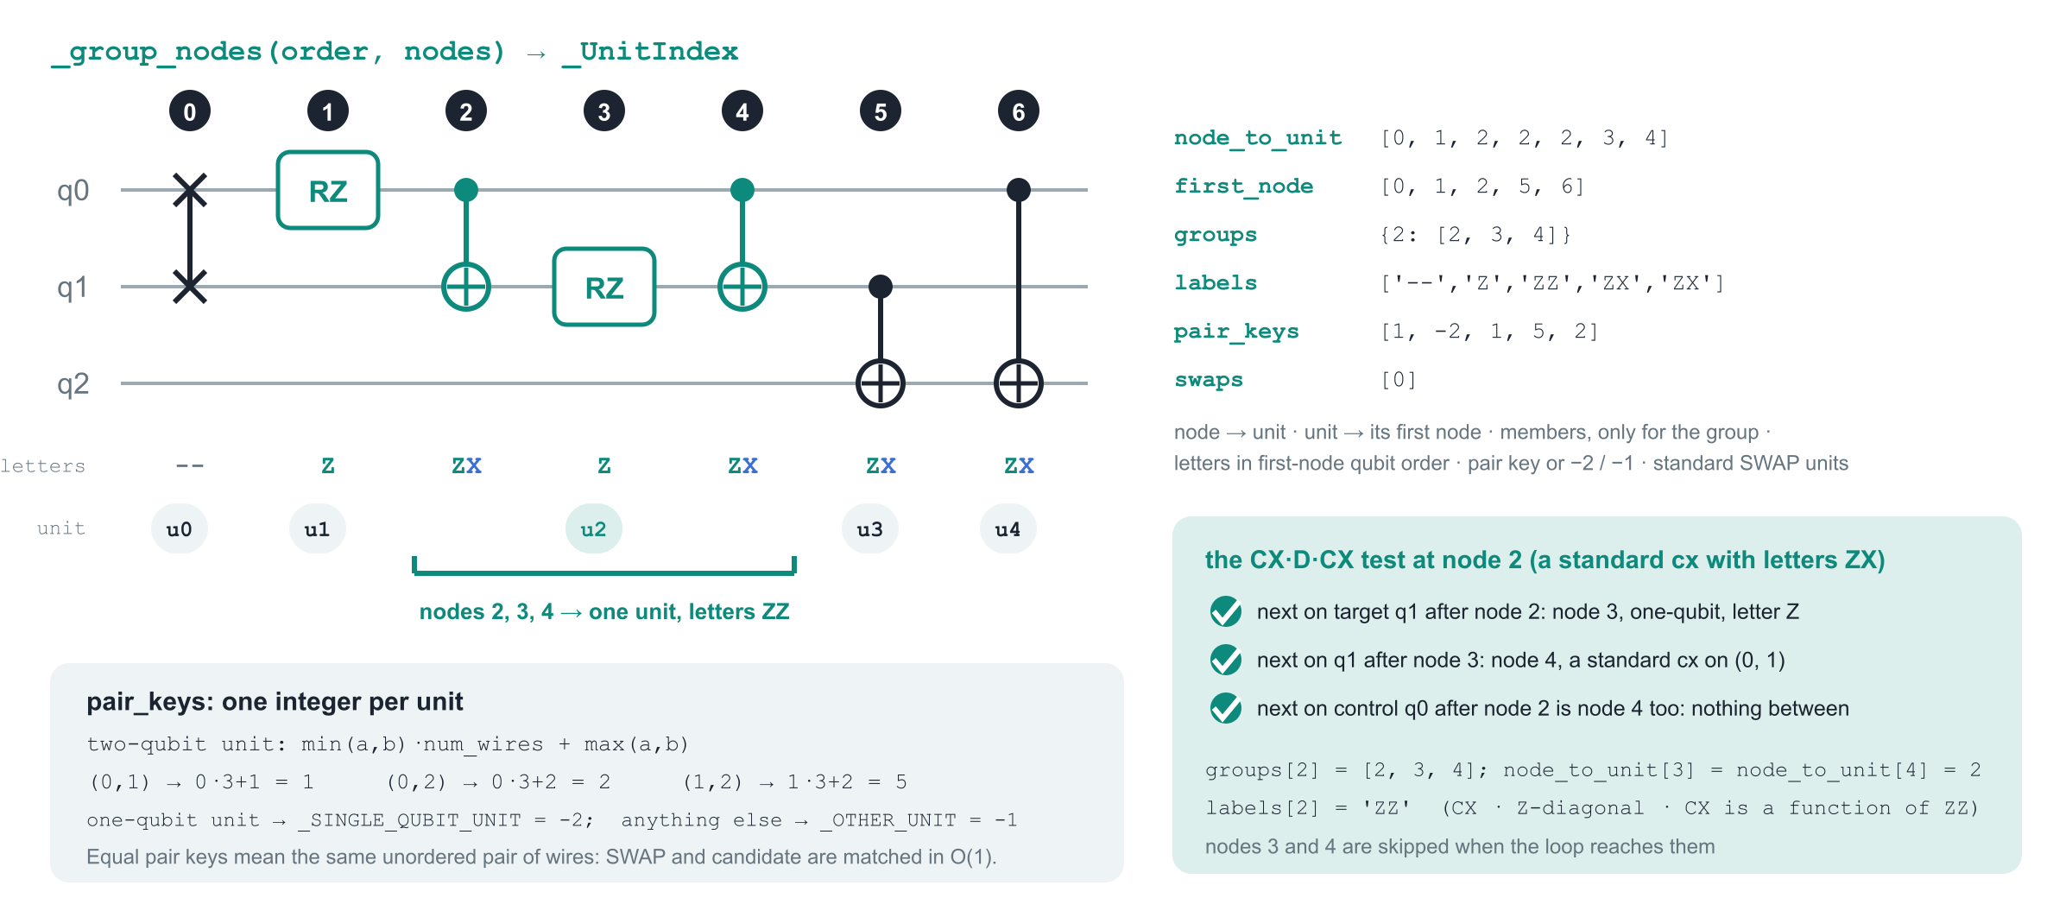
Stage 2 · _group_nodes: what it builds
Letters are per node here; stage 3 splits a unit's two letters between its two wires. The pair key ignores argument order, so cx(1, 0) and swap(0, 1) share key 1.
Notes:
Stage 2 turns nodes into units. Every node becomes its own unit except a recognised CX-D-CX triple, which becomes one unit of three nodes. Units are numbered densely in the topological order of their first nodes. The _UnitIndex record holds node_to_unit (node → unit), first_node (unit → first node), groups (members, only for the three-node units), labels (the letters of the unit in the qubit order of its first node), pair_keys and swaps. In the running example _wire_paulis gives '--' to the swap, 'Z' to each rz and 'ZX' to each cx. Node 2 passes the CX-D-CX test with nodes 3 and 4, so units are [0], [1], [2, 3, 4], [5], [6]; the group gets labels ZZ. The pair key of a two-qubit unit encodes its unordered qubit pair as min·num_wires + max: 1 for (0, 1), 2 for (0, 2), 5 for (1, 2). One-qubit units get −2 and anything else −1; these two constants are _SINGLE_QUBIT_UNIT and _OTHER_UNIT. swaps = [0] lists the only genuine standard swap.

Slide 28
Stage 2 · _group_nodes: how it works
def _group_nodes(order, nodes: _NodeIndex) -> _UnitIndex:
cache = {}
... # next_on_wire(qubit, position) -> the node after that position, or None
... # node_to_unit = [-1] * len(order); the five output collections start empty
for node, op_node in enumerate(order):
if node_to_unit[node] >= 0:
continue
width = nodes.widths[node]
label = _wire_paulis(op_node, cache)
unit = len(first_node)
if label == "ZX" and op_node.name == "cx" and op_node.is_standard_gate():
control, target = nodes.first_qubit[node], nodes.second_qubit[node]
middle = next_on_wire(target, nodes.second_position[node])
if (middle is not None
and _wire_paulis(order[middle], cache) == "Z"
and (last := next_on_wire(target, nodes.first_position[middle])) is not None
and order[last].name == "cx" and order[last].is_standard_gate()
and nodes.first_qubit[last] == control
and nodes.second_qubit[last] == target
and nodes.widths[last] == 2
and next_on_wire(control, nodes.first_position[node]) == last):
groups[unit] = [node, middle, last]
node_to_unit[middle] = node_to_unit[last] = unit
label = "ZZ"
node_to_unit[node] = unit
first_node.append(node)
labels.append(label)
if width == 2:
qubit_a, qubit_b = nodes.first_qubit[node], nodes.second_qubit[node]
pair_keys.append(qubit_a * num_wires + qubit_b if qubit_a < qubit_b
else qubit_b * num_wires + qubit_a)
if op_node.name == "swap" and op_node.is_standard_gate():
swaps.append(unit)
else:
pair_keys.append(_SINGLE_QUBIT_UNIT if width == 1 else _OTHER_UNIT)
return _UnitIndex(node_to_unit, first_node, groups, labels, pair_keys, swaps)
Step by step
1. Skip members of an earlier group
node_to_unit starts at −1. A node the CX·D·CX test already claimed (nodes 3 and 4 here) is skipped and never becomes a unit of its own.
2. Classify through the cache
_wire_paulis(node, cache) returns the letters; the cache maps (name, width) to them, so the checker is consulted once per gate kind per run.
3. The CX·D·CX test
Only a standard cx with letters ZX starts it. Next on the target: a one-qubit Z node; next after it on the target: a standard cx with the same control and target; next on the control after the first cx: that same closing cx. On success the three nodes share the unit, groups records them, and the letters become ZZ.
4. Record the unit
first_node, labels and pair_keys get one entry per unit: key min·num_wires + max for two-qubit units, −2 for one-qubit units, −1 otherwise. A genuine standard swap also joins swaps.
5. Why units
From here on the planner reasons about units: a candidate is a unit, a wall is a unit, and a group's three nodes move together.
Notes:
The condition is shown reformatted on fewer lines; it is otherwise the source. Two initialisation lines are elided. Note the asymmetry of the test: the middle node is looked for on the target wire only, because D acts on the target. The letters of a unit follow the qubit order of its first node: cx(0, 1) is ZX with Z on q0. A cx(1, 0) would be ZX with Z on q1, and that is what stage 3 uses when it splits the letters per wire. The cache is a plain dict created here, so it lives exactly one run of the pass.

Slide 29
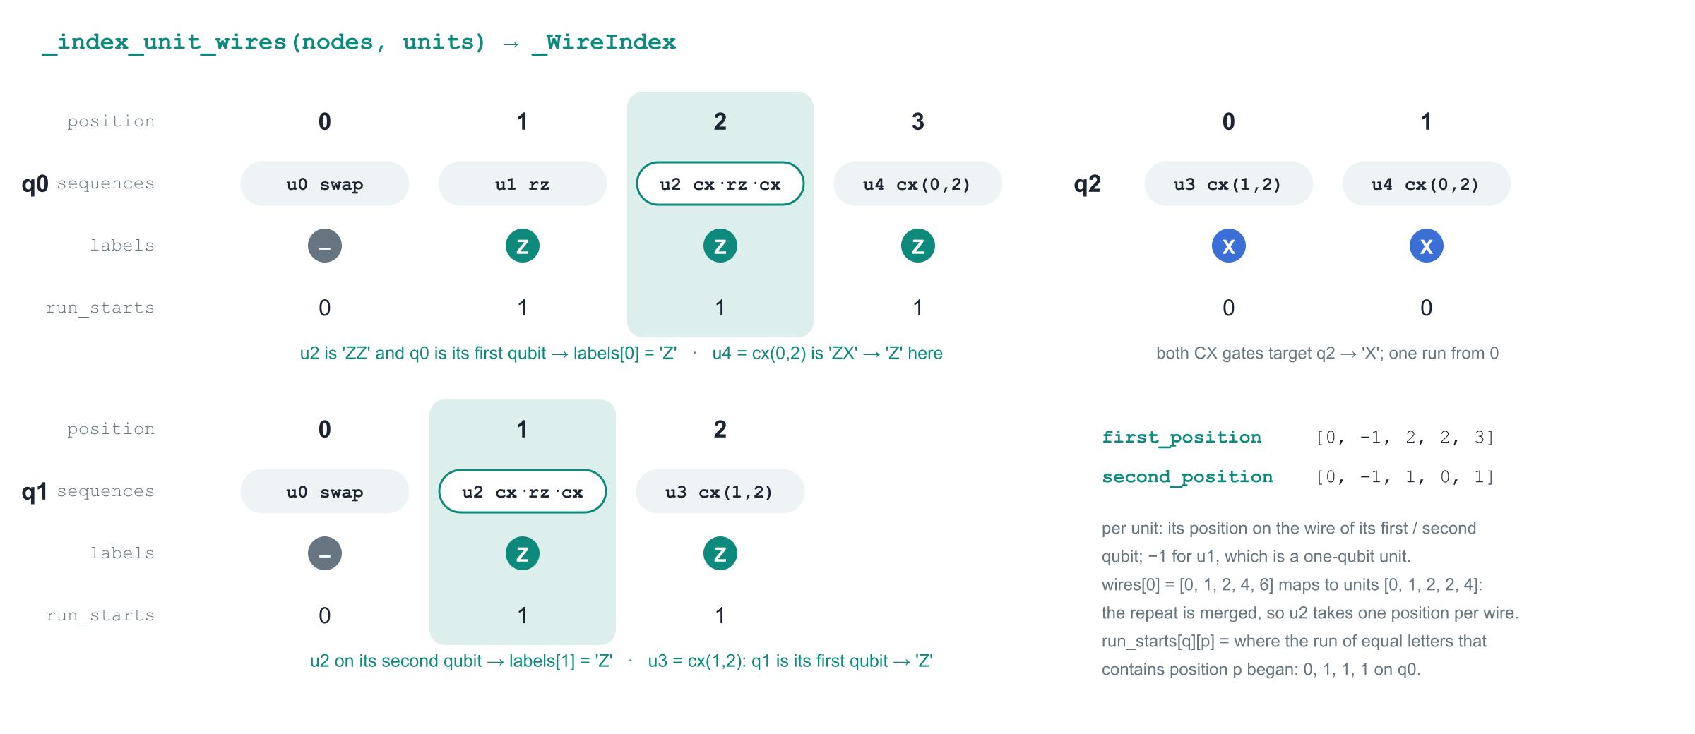
Stage 3 · _index_unit_wires: what it builds
Positions here count merged units, not nodes. The SWAP's own letter is '-', so it starts a run of its own.
Notes:
Stage 3 re-reads every wire in terms of units and prepares the data for constant-time commutation checks. For each qubit, sequences holds the unit ids along the wire with consecutive repeats merged: on q0 the node list [0, 1, 2, 4, 6] maps to units [0, 1, 2, 2, 4], so unit 2 occupies a single position. labels holds the letter each unit carries on this particular wire: a two-qubit unit contributes its first letter on the wire of its first qubit and its second letter on the other wire, so cx(0, 2), which is ZX, contributes Z on q0 and X on q2. run_starts records for every position where the current run of equal letters began; on q0 the letters are '-', Z, Z, Z and the run starts are 0, 1, 1, 1. The per-unit first_position and second_position arrays give a unit's position on the wire of its first and second qubit; stage 4 reads them through position_on_wire.

Slide 30
Stage 3 · _index_unit_wires: how it works
def _index_unit_wires(nodes: _NodeIndex, units: _UnitIndex) -> _WireIndex:
num_units = len(units.first_node)
first_position = [-1] * num_units
second_position = [-1] * num_units
... # sequences, wire_labels, run_starts = [], [], []
for qubit, wire in enumerate(nodes.wires):
... # sequence, labels, starts = [], [], []
previous_unit = -1
for node in wire:
unit = units.node_to_unit[node]
if unit == previous_unit:
continue
previous_unit = unit
position = len(sequence)
label = units.labels[unit]
head = units.first_node[unit]
if units.pair_keys[unit] >= 0:
if nodes.first_qubit[head] == qubit:
first_position[unit] = position
label = label[0]
else:
second_position[unit] = position
label = label[1]
else:
label = label[0] if label else "-"
starts.append(starts[-1] if position and labels[-1] == label
else position)
sequence.append(unit)
labels.append(label)
sequences.append(sequence)
wire_labels.append(labels)
run_starts.append(starts)
return _WireIndex(sequences, wire_labels, run_starts,
first_position, second_position)
Step by step
1. Walk each wire, merging repeats
The node list of a wire is mapped node by node to units. A unit equal to the previous one is skipped, which is how the three nodes of a CX·D·CX group collapse into one position on each of their two wires.
2. Pick the letter for this wire
A two-qubit unit (pair key ≥ 0) contributes label[0] if this wire is its first qubit, else label[1], and its position is stored in first_position or second_position accordingly. A one-qubit unit contributes its only letter; a wider or empty unit contributes '-'.
3. Extend or start a run
If the letter equals the previous position's letter, the run start is inherited; otherwise the run starts at this position. One linear scan, no nested loops.
4. Three parallel lists per wire
sequences (unit ids), labels (one letter per position) and run_starts (one index per position) always have the same length, so a position indexes all three.
5. What this buys
'Do all units strictly between A and B carry letter P on this wire?' becomes two reads: the letter next to B and the run start there. commutes_between (later slide) is that check.
Notes:
Two initialisation lines are elided. The important subtlety is which letter a unit contributes: the unit's letters are stored in the qubit order of its first node, so the first letter belongs to the wire of first_qubit[head]. For the group unit this is the control of the first cx. A wider unit such as a barrier has letters '---' and contributes '-' on every wire; an empty label (a zero-qubit operation) also becomes '-'. The SWAP itself has '--' and so contributes '-' on both wires: it is a wall for every other SWAP's search, which is one of the ways 'never across a SWAP' is enforced.

Slide 31
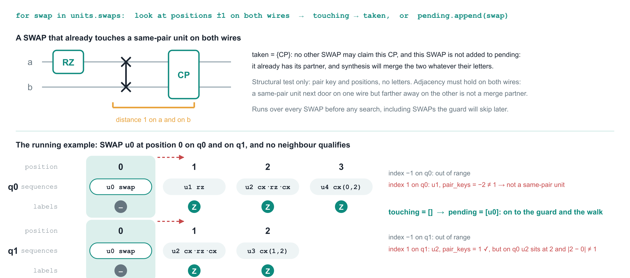
Stage 4a · reserve the neighbours a SWAP already has
Reserving first protects existing partners and stops two SWAPs from claiming one unit: nothing in taken is selected in 4c.
Notes:
_select_moves has three phases, 4a, 4b and 4c. Phase 4a runs over every SWAP unit before any move is chosen. For each SWAP it looks at the positions just before and just after it on both wires. A neighbour counts as touching when it has the SWAP's pair key and sits at distance one on both wires: same-pair adjacency on only one wire is not adjacency, because synthesis cannot merge the two through a gate that sits between them on the other wire. Touching units are put into the set taken, and the SWAP is finished: it already has a partner. A SWAP with no touching unit goes to the list pending. Letters play no role here; any same-pair neighbour is reserved, even one the pass could never move. In the running example the only same-pair unit, u2, is adjacent to the SWAP on q1 but two positions away on q0, so pending = [u0].

Slide 32
Stage 4a · the reserve loop: how it works
def _select_moves(nodes: _NodeIndex, units: _UnitIndex, wires: _WireIndex):
def position_on_wire(qubit, unit):
if nodes.first_qubit[units.first_node[unit]] == qubit:
return wires.first_position[unit]
return wires.second_position[unit]
... # commutes_between and splits_same_pair_run: see their own slides
taken = set()
pending = []
for swap in units.swaps:
pair_key = units.pair_keys[swap]
head = units.first_node[swap]
qubit_a, qubit_b = nodes.first_qubit[head], nodes.second_qubit[head]
touching = []
for qubit, at in ((qubit_a, wires.first_position[swap]),
(qubit_b, wires.second_position[swap])):
sequence = wires.sequences[qubit]
for index in (at - 1, at + 1):
if (0 <= index < len(sequence)
and units.pair_keys[unit := sequence[index]] == pair_key
and abs(position_on_wire(qubit_a, unit)
- wires.first_position[swap]) == 1
and abs(position_on_wire(qubit_b, unit)
- wires.second_position[swap]) == 1):
touching.append(unit)
if touching:
taken.update(touching)
else:
pending.append(swap)
Step by step
1. position_on_wire
Given a wire and a unit, returns the unit's merged position on that wire: first_position if the wire is the unit's first qubit, else second_position. Every distance below is measured with it.
2. Every SWAP, in order
units.swaps lists only genuine standard swaps, numbered in topological order. For each one the loop fetches its pair key and its two qubits from its first node.
3. Four candidate slots
On wire a the positions at − 1 and at + 1, and the same on wire b. A slot is only considered when it is inside the wire.
4. The touching test
The unit in the slot must have the SWAP's pair key, and its distance from the SWAP must be exactly 1 on wire a and on wire b. The second and third conditions catch a same-pair unit that is next door on one wire but not on the other.
5. taken or pending
Touching units are added to taken; a SWAP without any goes to pending. Only pending SWAPs reach the guard and the walk, and nothing in taken can be chosen later.
Notes:
The two helper functions that the walk uses are elided here and shown on their own slides. Observe that the same unit can appear in touching twice, once from each wire; taken is a set, so that is harmless. A SWAP whose partner is reserved never gets a second partner in this run: at most one new neighbour per SWAP is a design rule, and existing neighbours count. The loop uses merged unit positions from _WireIndex, so the three nodes of a CX·D·CX group count as one neighbour at one distance.

Slide 33
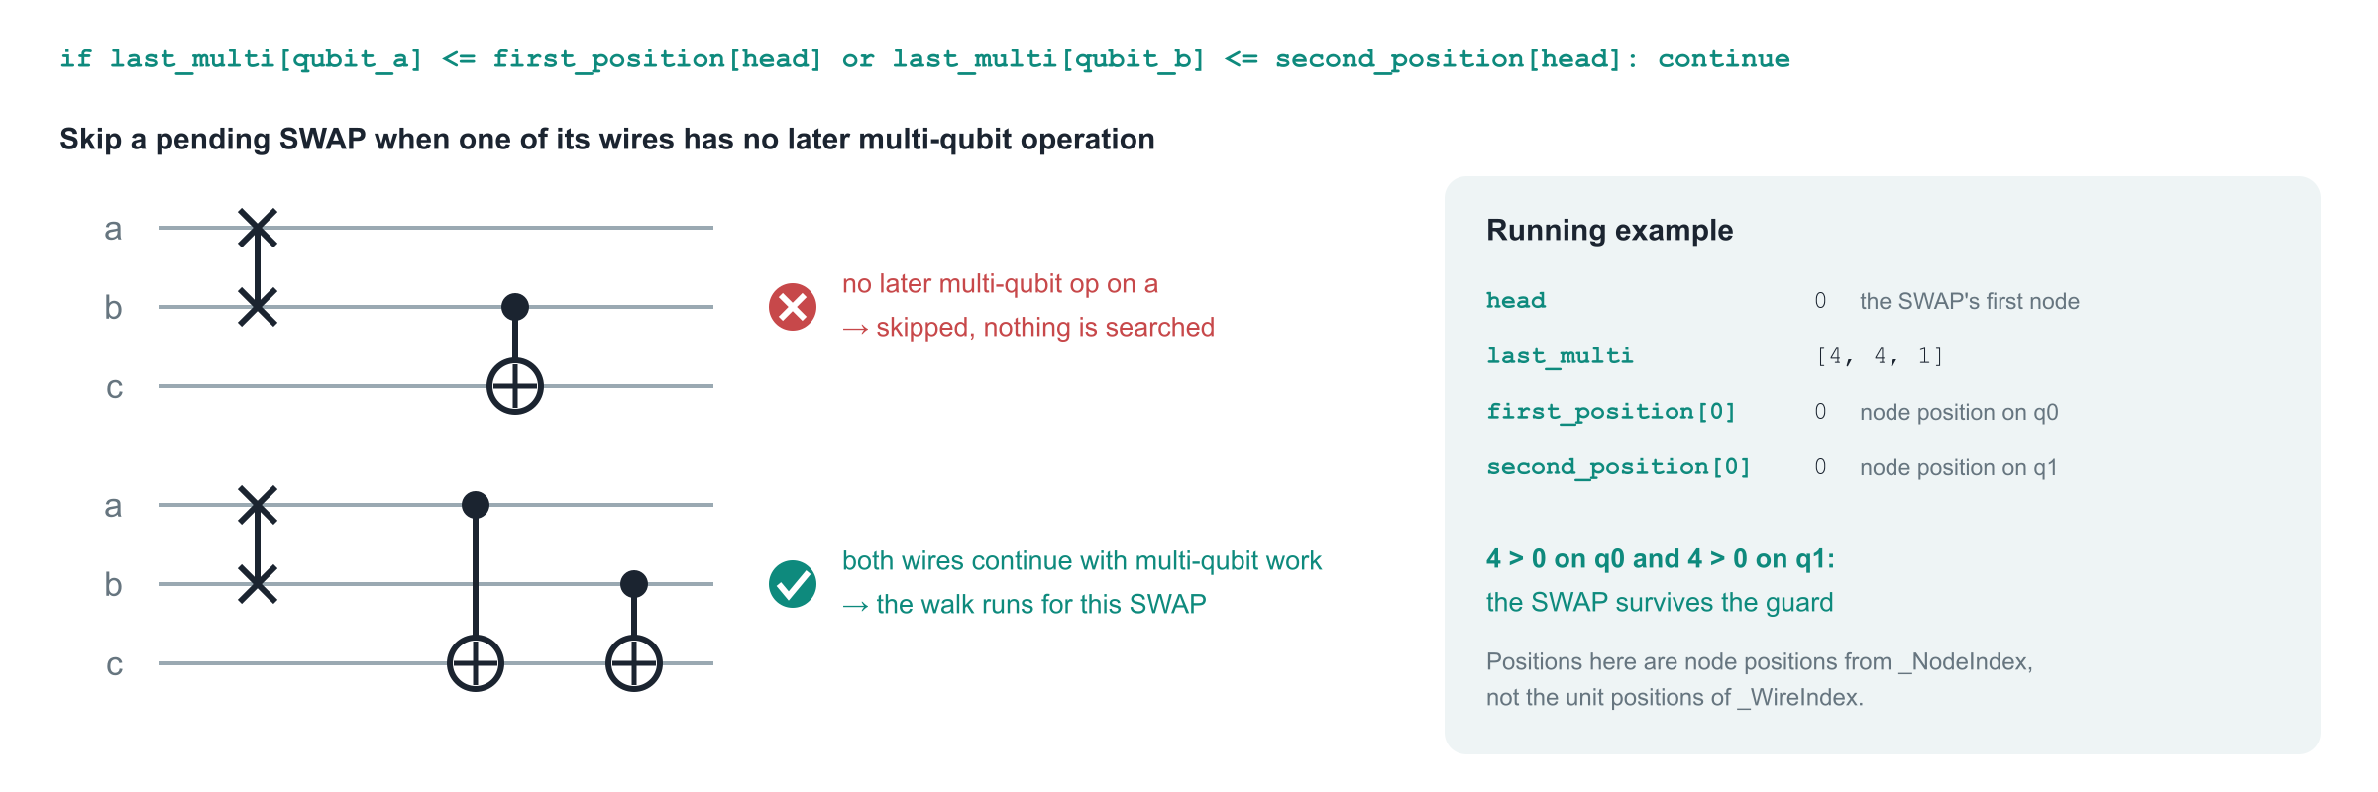
Stage 4b · _select_moves: the scheduling guard
Why: profit, not correctness
Details worth knowing
A merged SWAP + unit block ends in single-qubit gates. On a wire that is otherwise idle to the end of the circuit, an as-late-as-possible schedule would stretch that idle time, so such SWAPs are left alone.
The guard reads the original circuit, before any move. A later same-pair interaction satisfies it on both wires. It runs only for pending SWAPs. A single-qubit gate after the SWAP does not count: last_multi ignores width-1 nodes.
Notes:
Phase 4b is one condition at the top of the loop over pending SWAPs. head is the SWAP's node; the guard compares last_multi of each of its wires with the SWAP's node position on that wire. If either wire has no multi-qubit node after the SWAP, continue: no search happens for this SWAP. The reason is profit rather than correctness. Once synthesis merges a SWAP with its partner into one block, the block ends with single-qubit gates on both wires. If one wire is idle from there to the end of the circuit, an as-late-as-possible schedule pushes those single-qubit gates to the end and stretches the idle time. Barriers count as multi-qubit work because they fence the schedule; a measurement does not. In the running example last_multi is [4, 4, 1] and the SWAP sits at node position 0 on both wires, so it survives.

Slide 34
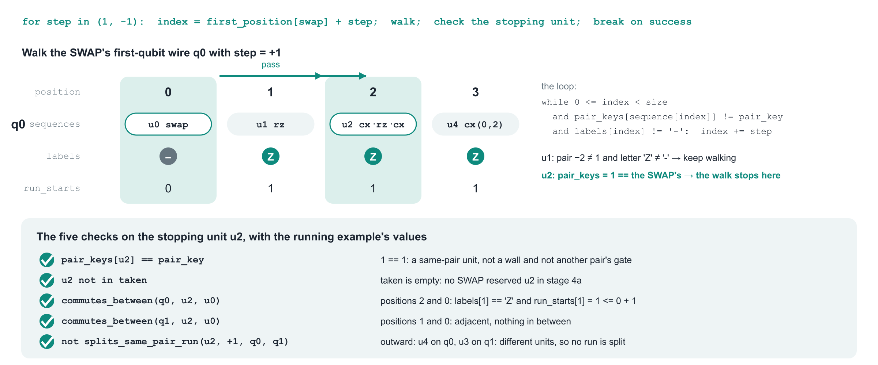
Stage 4c · _select_moves: the walk, on the running example
taken.add(u2); moves.append((2, 0, +1)); break. The step records that the unit was found after the SWAP; _apply_moves will place it right after it.
Notes:
Phase 4c looks for one new partner per pending SWAP. Only the SWAP's first-qubit wire is walked; the second wire is consulted by the checks. With step = +1 the index starts right after the SWAP and advances while the unit there belongs to another pair and its letter is not '-': such units are candidates for crossing, not for moving. The walk stops at the first same-pair unit, at the first wall, or when it runs off the wire. In the running example the walk on q0 passes u1 (rz, pair key −2, letter Z) and stops at u2, whose pair key equals the SWAP's. The stopping unit is accepted only if all five checks hold: same pair key, not in taken, commutes_between on q0, commutes_between on q1, and not splits_same_pair_run. All five pass with the values shown, so the move (2, 0, +1) is recorded, u2 is added to taken, and the break ends the search for this SWAP without trying step = −1.

Slide 35
Stage 4c · the walk: how it works
moves = []
for swap in pending:
head = units.first_node[swap]
qubit_a, qubit_b = nodes.first_qubit[head], nodes.second_qubit[head]
if (nodes.last_multi[qubit_a] <= nodes.first_position[head]
or nodes.last_multi[qubit_b] <= nodes.second_position[head]):
continue # 4b: the scheduling guard
pair_key = units.pair_keys[swap]
sequence = wires.sequences[qubit_a]
labels = wires.labels[qubit_a]
size = len(sequence)
# Search the SWAP's first-qubit wire, preferring a later candidate.
for step in (1, -1):
index = wires.first_position[swap] + step
while (0 <= index < size
and units.pair_keys[sequence[index]] != pair_key
and labels[index] != "-"):
index += step
if not 0 <= index < size:
continue
unit = sequence[index]
if (units.pair_keys[unit] == pair_key
and unit not in taken
and commutes_between(qubit_a, unit, swap)
and commutes_between(qubit_b, unit, swap)
and not splits_same_pair_run(unit, step, qubit_a, qubit_b)):
taken.add(unit)
moves.append((unit, swap, step))
break
return moves
Step by step
1. Only pending SWAPs, after the guard
The loop body starts with the 4b condition; a SWAP that fails it is skipped with continue before any wire is read.
2. Walk wire a, later side first
index starts at the SWAP's position plus step. The while loop advances past units of other pairs whose letter is not '-'. It halts at a same-pair unit, at a wall ('-'), or past the end of the wire; in the last case the direction is given up.
3. Five checks on the stopping unit
It must carry the SWAP's pair key (so a wall fails here), must not be in taken, must pass commutes_between on wire a and on wire b, and must not split a same-pair run. The walk never looks past a unit that fails.
4. Record and stop
On success the unit joins taken, (unit, swap, step) joins moves, and break leaves the direction loop: step = −1 is only tried when step = +1 produced no move.
5. What the result means
moves pairs each unit with its SWAP and the side it was found on. Candidates stay on their side of the SWAP, so a unit found after the SWAP is placed right after it and never crosses it.
Notes:
The code is the verbatim remainder of _select_moves. Two properties follow directly from it. Determinism: pending SWAPs are visited in topological order, the later side is tried first, and the walk stops at the first same-pair unit, so the plan depends only on the circuit. One partner per SWAP: break ends the search after the first accepted unit. The walk reads only the first wire's labels, which is safe because commutes_between is then evaluated on both wires: a wall on wire b that the walk never saw still rejects the candidate.

Slide 36
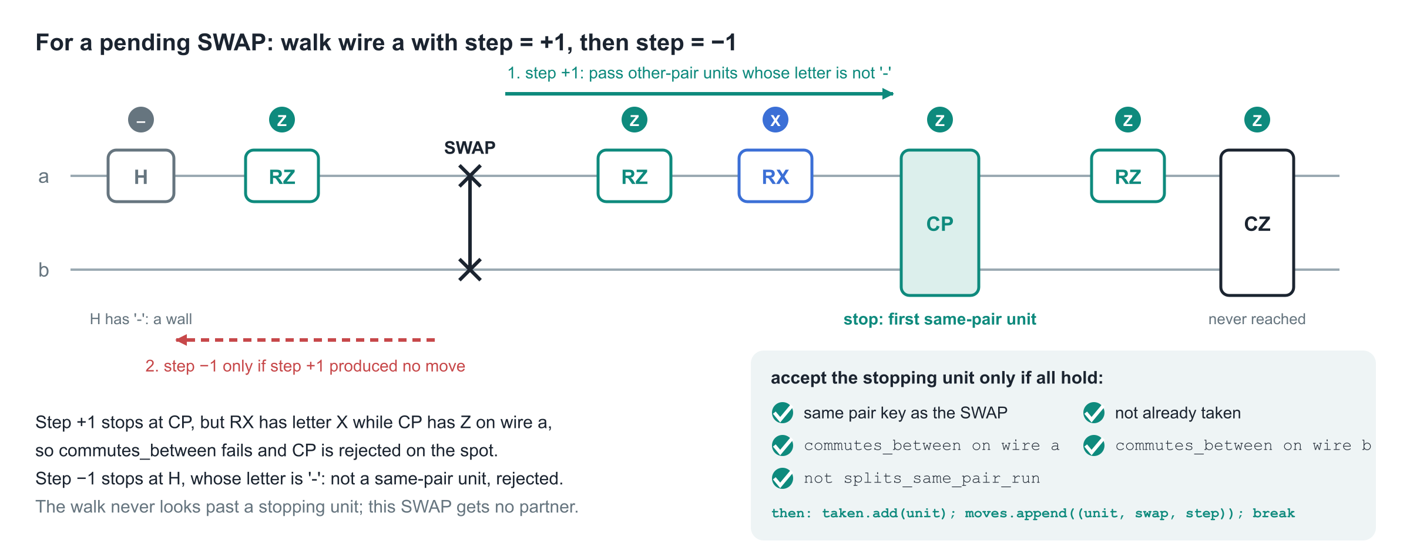
Stage 4c · a walk that finds nothing
Why stop at the first same-pair unit
Why walls end the walk
Moving CZ next to the SWAP would carry it across CP, a same-pair unit that cannot be reordered with it in general. The first same-pair unit is the only one that can reach the SWAP.
A unit with letter '-' on wire a, such as H, a barrier or a measurement, cannot be crossed by anything, so no candidate beyond it could ever reach the SWAP.
Notes:
A SWAP that survives the guard can still end with no partner. Here the walk with step +1 passes RZ and RX, both of other pairs with letters that are not '-', and stops at CP. CP has the right pair key, but RX carries letter X while CP carries Z on wire a, so commutes_between fails and CP is rejected on the spot. The walk does not look further in that direction, even though CZ later on would also be a same-pair unit. Step −1 then stops at H, whose letter is '-': it is not a same-pair unit, so the first check fails. This SWAP gets no partner in this run.

Slide 37
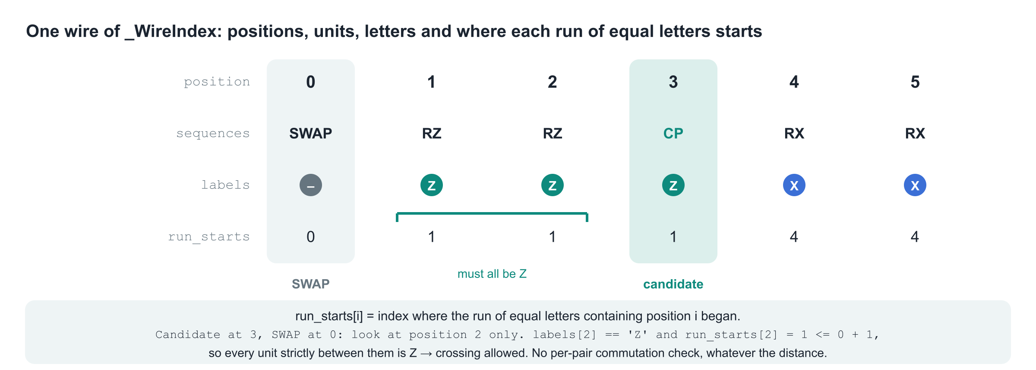
commutes_between: the constant-time interval check
def commutes_between(qubit, unit, swap):
unit_position = position_on_wire(qubit, unit)
swap_position = position_on_wire(qubit, swap)
low, high = ((unit_position, swap_position) if unit_position < swap_position
else (swap_position, unit_position))
labels = wires.labels[qubit]
pauli = labels[unit_position]
if pauli == "-":
return False
return high - low <= 1 or (
labels[high - 1] == pauli and wires.run_starts[qubit][high - 1] <= low + 1)
Why it is O(1)
Stage 3 precomputed run_starts, so the check reads two array entries whatever the distance. The walk is called once per SWAP and direction, and this check twice per stopping unit, so the search cost is dominated by the walk itself, not by commutation tests.
Notes:
commutes_between(qubit, unit, swap) answers, for one wire, whether the candidate may cross everything strictly between itself and the SWAP. It takes the two merged positions from position_on_wire, orders them, and reads the candidate's letter on that wire; a '-' refuses at once. If the two are adjacent the interval is empty and the answer is True. Otherwise only the position next to the SWAP on the candidate's side, high − 1, is inspected: its letter must equal the candidate's, and the run of equal letters containing it must have started no later than low + 1, the first position inside the interval. Then every unit strictly between them carries the candidate's letter. The SWAP's own position is never part of the interval, which is how a candidate can approach a SWAP without having to commute with it.

Slide 38
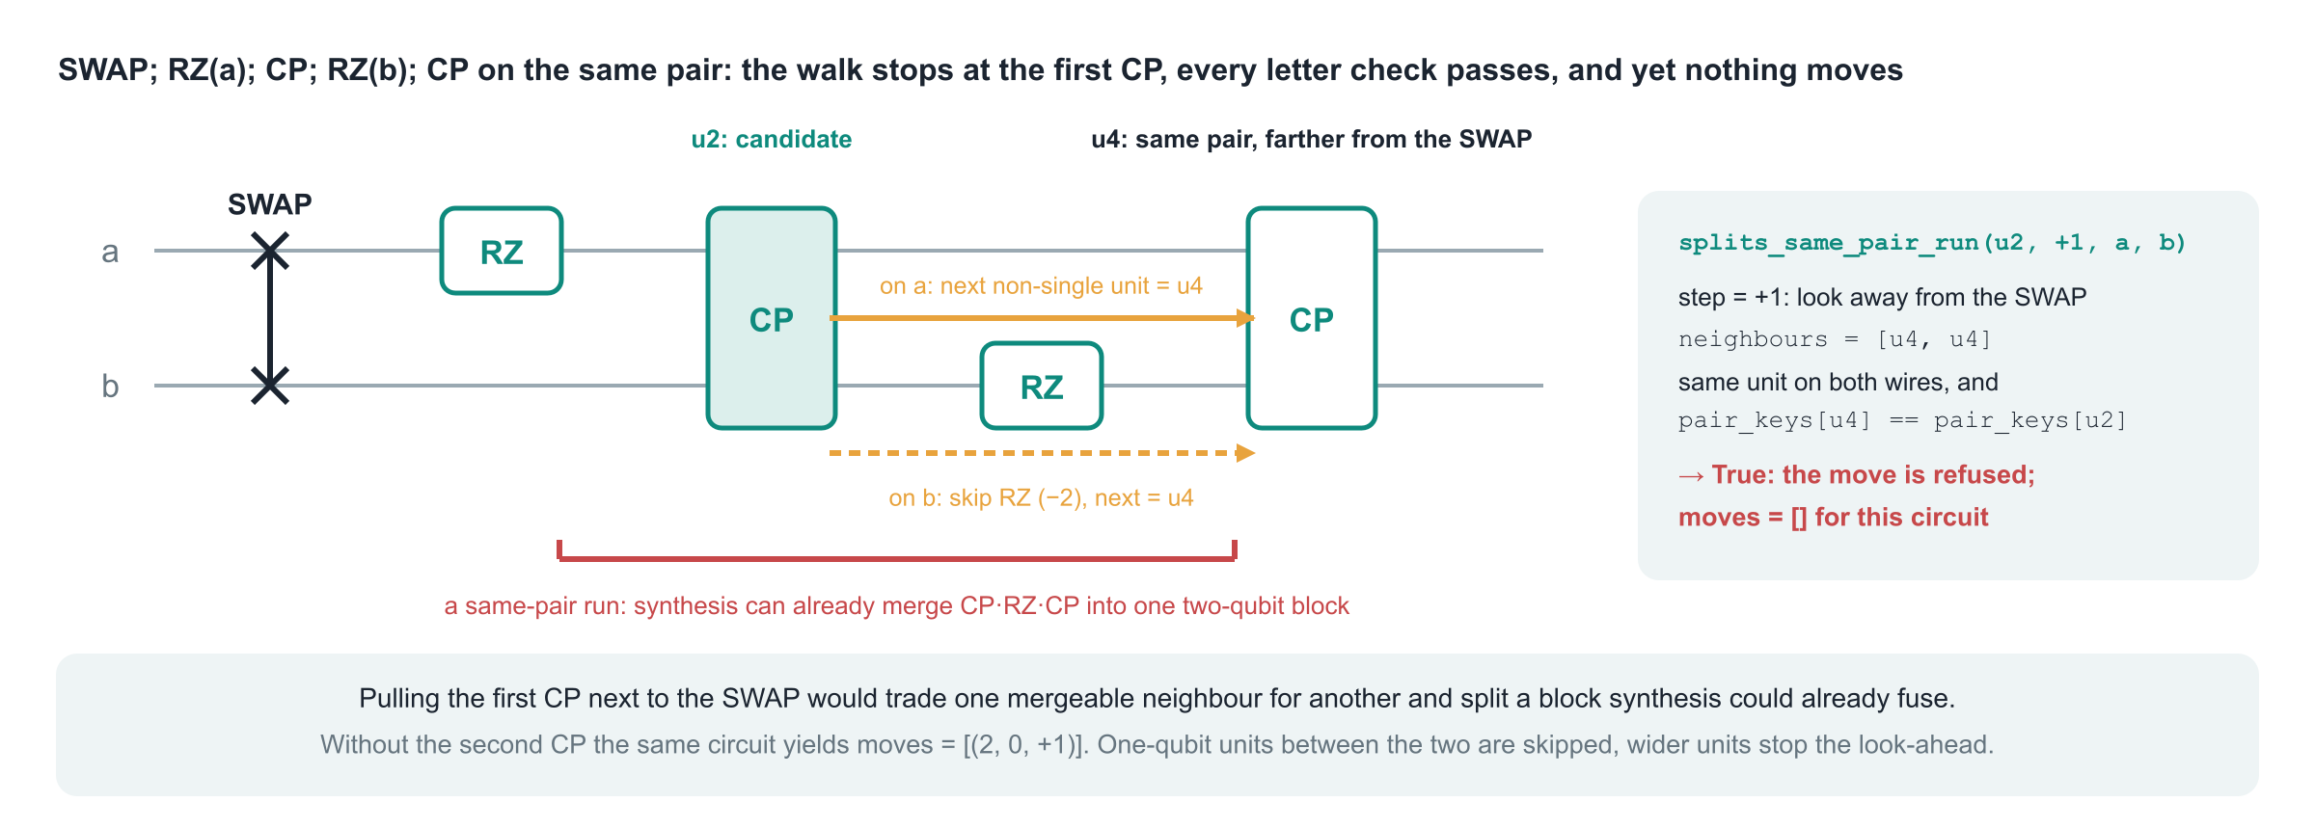
splits_same_pair_run: do not break up a run of same-pair work
def splits_same_pair_run(unit, step, qubit_a, qubit_b):
neighbours = []
for qubit in (qubit_a, qubit_b):
sequence = wires.sequences[qubit]
index = position_on_wire(qubit, unit) + step
while (0 <= index < len(sequence)
and units.pair_keys[sequence[index]] == _SINGLE_QUBIT_UNIT):
index += step
neighbours.append(sequence[index] if 0 <= index < len(sequence) else None)
return (neighbours[0] is not None and neighbours[0] == neighbours[1]
and units.pair_keys[neighbours[0]] == units.pair_keys[unit])
Reading the arguments
step is the walk direction, so unit + step is 'farther from the SWAP'. Only _SINGLE_QUBIT_UNIT (−2) units are skipped: a barrier (−1) or another pair's gate stops the look-ahead and the answer is False.
Notes:
splits_same_pair_run(unit, step, qubit_a, qubit_b) is the last check. It looks outward from the candidate, away from the SWAP, on both of its wires, skipping one-qubit units, and returns True when the next unit on both wires is the same unit and that unit has the candidate's pair key. Then the candidate already belongs to a run of two-qubit work on its pair, separated only by one-qubit gates, which the later synthesis can already merge into one block; pulling it to the SWAP would trade one mergeable neighbour for another and split that block. In the example the walk stops at the first CP and every letter check passes, yet the pass refuses the move and leaves the circuit unchanged. Without the second CP the same circuit yields the move. Wider units stop the look-ahead, because they are not skipped and have a different key.

Slide 39
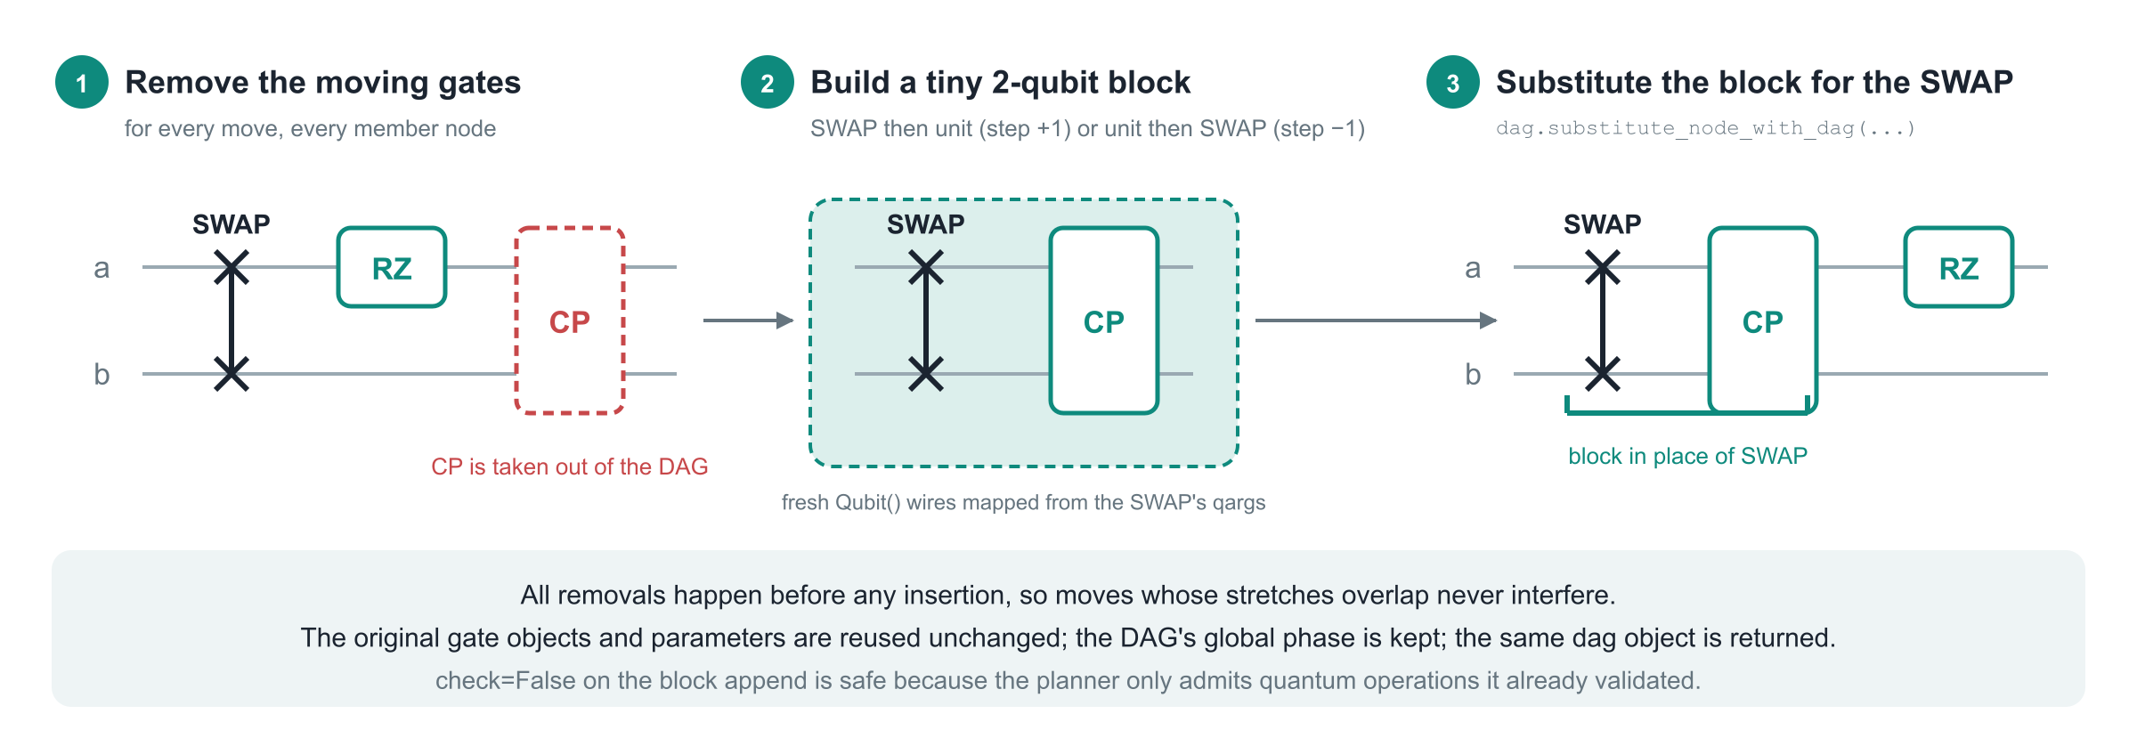
_apply_moves: rewriting the DAG
for unit, _, _ in moves: # 1. remove all members first
for member in units[unit][0]: dag.remove_op_node(order[member])
for unit, swap, step in moves: # 2. build a 2-qubit block in the right order
block = DAGCircuit(); block.add_qubits(qubits := [Qubit(), Qubit()]); wire_map = dict(zip(swap_node.qargs, qubits))
...; dag.substitute_node_with_dag(swap_node, block, wires=qubits) # 3. replace the SWAP node by the block
Notes:
_apply_moves(dag, order, units, moves) first removes every member node of every chosen unit, then for each move builds a two-qubit DAGCircuit with fresh Qubit objects, maps the SWAP's ordered qargs onto them, appends SWAP then members for step +1 or members then SWAP for step −1, and substitutes that block for the SWAP node. Removing everything first makes overlapping stretches safe. For the running example the block is swap, cx, rz, cx on the SWAP's two wires, and the three removed nodes reappear inside it in their original order.

Slide 40
The three index records
_NodeIndex | per node, from stage 1
wires | per qubit: node indices on that wire, in order
last_multi | per qubit: position of the last node with ≥ 2 qubits, or −1
first_qubit | index of the node's first qubit, or −1
second_qubit | index of its second qubit (two-qubit nodes only)
first_position | its index in wires[first_qubit]
second_position | its index in wires[second_qubit]
widths | number of qubits
_UnitIndex | per unit, from stage 2
node_to_unit | per node: its unit id
first_node | node index of the unit's first node
groups | unit → [first, middle, last], CX·D·CX units only
labels | letters, in the first node's qubit order
pair_keys | unordered pair key, or −2 (one-qubit) / −1 (other)
swaps | unit ids of genuine standard SWAPs, in order
_WireIndex | per wire or unit, from stage 3
sequences | per qubit: unit ids along the wire, repeats merged
labels | per qubit: the letter each unit carries on this wire
run_starts | per qubit and position: where the run of equal letters began
first_position | per unit: position on the wire of its first qubit, or −1
second_position | per unit: position on the wire of its second qubit
How to read an index
A node index refers to order; a unit index refers to first_node; a qubit index refers to dag.qubits. A position is an index into one wire's list.
_NodeIndex positions count nodes on a wire (the scheduling guard uses them). _WireIndex positions count merged units (every other stage-4 check uses them).
frozen=True makes the records read-only after construction; slots=True keeps them compact. Nothing downstream mutates what an earlier stage built.
Notes:
The three records are frozen dataclasses with slots. Each stage returns one and later stages can only read it, so the data flow is visible in the signatures. The field names say what an index means: entries of _NodeIndex are per node, entries of _UnitIndex per unit, and _WireIndex holds per-wire lists of units. The two kinds of first/second position are easy to confuse: _NodeIndex positions count nodes on a wire, _WireIndex positions count merged units on a wire. The scheduling guard uses the former, every other check in stage 4 the latter.

Slide 41
_Members, the helper functions and the performance picture
_Members | Role and source
first | unit id → index in order of its first node (units.first_node)
groups | unit id → the three node indices of a CX·D·CX unit (units.groups)
q0, q1 | node index → first / second qubit index, or −1 (nodes.first_qubit, nodes.second_qubit)
qargs | callback returning all qubit indices of a node (qubits_for_node)
__len__() | number of units
__getitem__(unit) | (members, qubits): node indices and a frozenset of qubit indices
Helper | Lives in | Purpose
qubits_for_node(node) | _find_moves | all qubit indices of order[node]; passed to _Members as qargs
next_on_wire(qubit, position) | _group_nodes | node after that position on the wire, or None; used by the CX·D·CX test
position_on_wire(qubit, unit) | _select_moves | the unit's merged position on that wire (first_position or second_position)
commutes_between(qubit, unit, swap) | _select_moves | constant-time check that every unit between them carries the candidate's letter
splits_same_pair_run(unit, step, qubit_a, qubit_b) | _select_moves | True when moving would detach the unit from a same-pair unit beyond it
Performance picture
Stages 1 to 3 are linear in the number of nodes and qubit incidences. commutes_between is O(1) thanks to run_starts; the walk and splits_same_pair_run still scan wire segments.
Letters are looked up once per (name, width) per run: covering all 27 families costs 14×3 + 13×6 = 120 raw probes, regardless of how many gates or angles the circuit has.
Exactly diagonal custom unitaries take the matrix-inspection branch and are not cached by name.
Notes:
_Members is a tiny view object with __slots__ that lets _apply_moves translate a unit id into its node indices and qubit set without storing a full tuple per unit; _find_moves builds it from fields of the records. The nested helpers now live in the stage that uses them: qubits_for_node in _find_moves, next_on_wire in _group_nodes, and position_on_wire, commutes_between and splits_same_pair_run in _select_moves.

Slide 42
The CommutationChecker change
Part 4
Notes:
What the checker is, what was broken, what the repair looks like, and the contract the swap pass relies on.

Slide 43
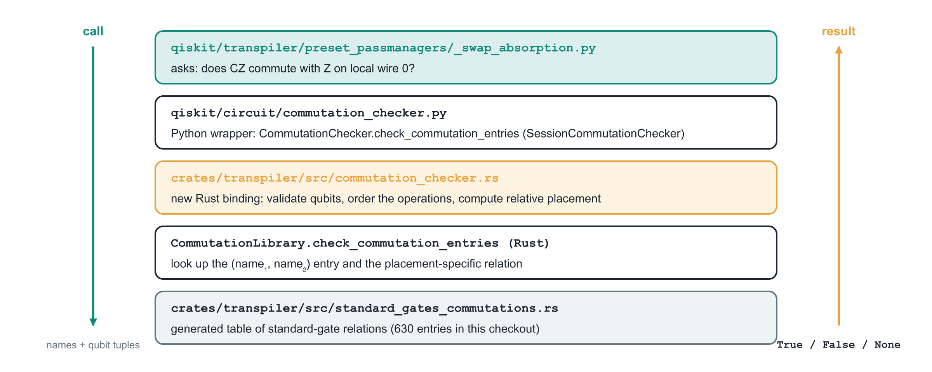
What the CommutationChecker is
Three Python APIs on the class
The instance the pass uses
commute(...) → bool and commute_nodes(...) → bool are the general decisions, unchanged. check_commutation_entries(...) → bool | None is the raw table read, repaired here.
SessionCommutationChecker (commutation_library.py) wraps get_standard_commutation_checker(), so its table is populated. A bare CommutationChecker() has an empty table and answers None.
Notes:
CommutationChecker is Qiskit's general oracle for 'do these two operations commute?'. Its Python class wraps a Rust object that owns a generated table of standard-gate relations. The general commute() path combines table lookups with rotation normalization and matrix comparison under a tolerance. The swap pass needs none of that: it only needs to read the table. That read path is check_commutation_entries, and it was broken.

Slide 44
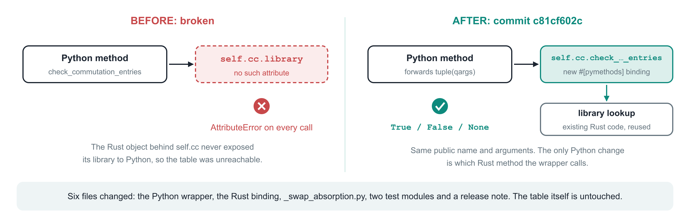
The defect and the repair
# before
return self.cc.library.check_commutation_entries(
first_op, first_qargs, second_op, second_qargs)
# AttributeError: no attribute 'library'
# after
return self.cc.check_commutation_entries(
first_op, tuple(first_qargs),
second_op, tuple(second_qargs))
Notes:
The public method already existed but forwarded to self.cc.library, an attribute the Rust object never exposed, so every call raised AttributeError. Commit c81cf602c adds a #[pymethods] binding named check_commutation_entries on the Rust CommutationChecker and makes the Python wrapper call it with tuple qargs. Name and positional arguments are unchanged; the docstring now spells out the contract.

Slide 45
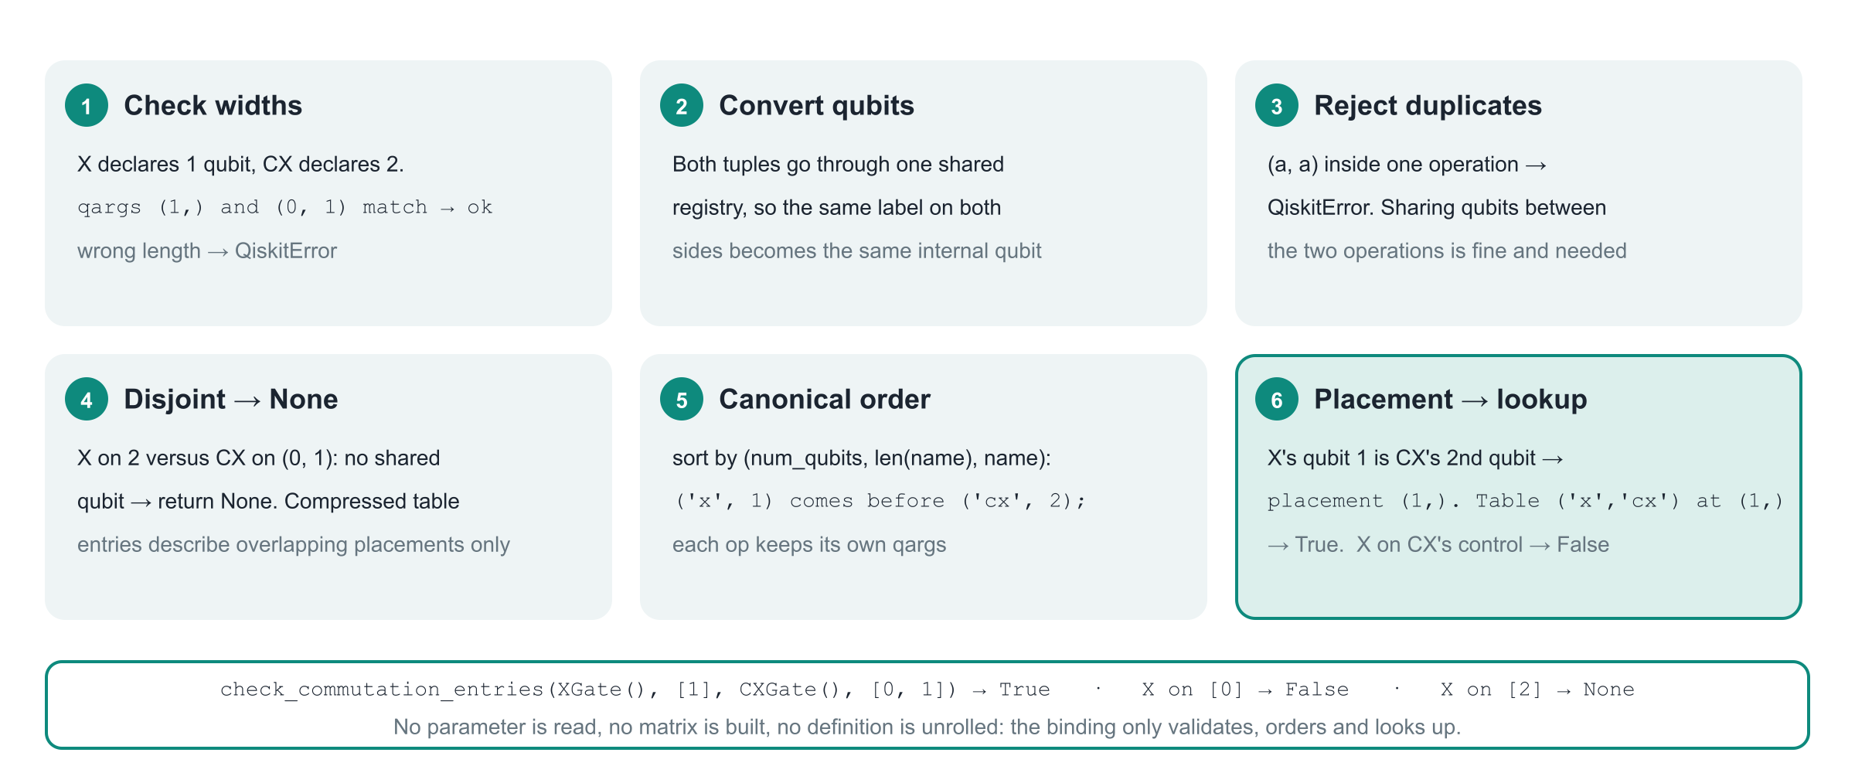
Inside the new Rust binding
Relative placement lists, for each qubit of the canonical first operation, its position in the second, or None. X(b) against CX(a,b) has placement (1,); X(a) has (0,).
Notes:
The binding returns PyResult<Option<bool>>, which Python sees as True, False, None or an exception. It validates widths, converts both qubit tuples through one shared registry so shared labels become shared qubits, rejects duplicates inside one operation, returns None for disjoint placements, orders the two operations by (num_qubits, len(name), name) carrying their qargs along, computes the relative placement and calls the existing CommutationLibrary lookup. Nothing else is evaluated.

Slide 46
The contract of check_commutation_entries
Result | Meaning
True | The table stores a positive relation for this name pair and placement.
False | The table stores a negative relation. For a parameterized family this does not rule out commutation at special angles.
None | No applicable entry, the table is empty, or the two operations share no qubit.
QiskitError | A qubit sequence has the wrong length for its operation, or repeats a qubit. Qubits shared between the operations are fine.
from qiskit.circuit.commutation_library import (
SessionCommutationChecker as checker)
from qiskit.circuit.library import (
CXGate, CPhaseGate, XGate, ZGate)
lookup = checker.check_commutation_entries
lookup(ZGate(), [0], CXGate(), [0, 1]) # True
lookup(XGate(), [1], CXGate(), [0, 1]) # True
lookup(XGate(), [0], CXGate(), [0, 1]) # False
lookup(XGate(), [2], CXGate(), [0, 1]) # None
lookup(ZGate(), [0], CPhaseGate(0.3), [0, 1]) # None
What the raw lookup deliberately does not do
It never reads parameter values, never maps rotations to generators, never applies the checker's gates filter, never unrolls a definition and never builds a matrix.
It does not authenticate names: a custom gate called 'x' gets the standard 'x' entry. That is why the swap pass checks is_standard_gate() first.
Explicitly supplied tables must use the canonical key order; reversed keys are not searched. Calling with the operations reversed is fine because inputs are canonicalized.
Notes:
Three results and two exceptions. True and False report what the configured table stores for these names and this placement. None means no applicable entry, an empty table, or disjoint placements. QiskitError is raised for a wrong number of qubits or a duplicate qubit inside one operation. The examples were run on this checkout.

Slide 47
Why not just call commute()?
Question | commute(...) | check_commutation_entries(...)
Reads parameter values? | Yes: rotation normalization, near-identity acceptance | Never
Uses matrices or tolerances? | Yes, with a 1e-12 floor and matrix_max_num_qubits | Never
Applies the gates filter? | Yes | No
Result | bool; False may mean 'not commuting' or 'not checked' | True / False / None, as stored in the table
Disjoint qubits | Commute | None: compressed entries describe overlaps only
RY(1e-6) versus Z | May be accepted as identity | False for the whole family: the move is blocked
The swap pass only trusts 'is True'
Not a universal exactness oracle
Both False and None simply mean 'no letter for this axis'. Zero or several positive axes on a wire give '-'. No approximate fallback exists.
The table is generated numerically. Exactness here rests on the 27 admitted families and their algebraic identities, not on the table alone.
Notes:
commute() is the right tool for general optimization passes, but the swap pass needs parameter-independent certificates. The general path normalizes rotations and accepts near-identity rotations before the matrix-size limit applies, and its tolerance has a floor of 1e-12. A tiny RY must block a Z candidate; only the raw table gives that answer. Two constraints decided the design: the exported Python StandardGateCommutations dictionary lacks the crx and crz probe entries this pass needs, and a table lookup is a certificate only for the finite, mathematically justified families on the allowlist.

Slide 48
Files changed and how they are tested
File | Change
qiskit/circuit/commutation_checker.py | Repaired forwarding, Sequence[Qubit | int] annotations, documented contract
crates/transpiler/src/commutation_checker.rs | New Python-callable binding: validation, disjoint handling, canonical order, library lookup
qiskit/transpiler/preset_passmanagers/_swap_absorption.py | Hard-coded _WIRE_PAULIS table replaced by allowlist + probes + representatives + per-run cache; later refactored (ab28929ff) into four stage functions and three index records, behaviour unchanged
test/python/circuit/test_commutation_checker.py | TestCommutationTableLookup: placements, missing/disjoint, no fallback, invalid qubits, custom tables, no rotation normalization
test/python/transpiler/test_swap_absorption.py | Labels, exactness, unsupported operations, per-run lookup cache, movement, preset integration
releasenotes/notes/fix-commutation-table-lookup-….yaml | Release note for the repaired API
PYTHONPATH=. python -m unittest \
test.python.circuit.test_commutation_checker \
test.python.transpiler.test_swap_absorption
Tests worth opening first
test_standard_wire_labels: the 27 letters for every angle and qubit order.
test_lookup_cache_per_run: lookups happen only in preprocessing and never via commute().
Notes:
The integration commit touched six files. The Rust standard table and the exported Python dictionary were not modified; the repaired binding simply exposes the existing table. Tests pin the 27 labels as a finite specification, exercise exactness with operator comparisons, and check that unsupported gates never reach the lookup. A later commit, ab28929ff, refactored _swap_absorption.py for readability only: the planner became four stage functions handing over three frozen records, with descriptive names in place of the old q0/p0/ukey arrays. The 43 tests of test_swap_absorption pass unchanged on it.

Slide 49
Summary
1
What
2
Where
3
Why it is safe
_AbsorbIntoSwaps moves one two-qubit gate (or a CX-D-CX block) next to a routing SWAP on the same pair, so later synthesis compiles both as one block. SWAP + CX becomes 2 CX instead of 4.
First pass of the translation stage at optimization levels 2 and 3. Plans with _find_moves in four stages (_index_nodes, _group_nodes, _index_unit_wires, _select_moves), rewrites with _apply_moves, never crosses a SWAP, never enters control flow.
One Pauli letter per wire. Equal letters on every shared wire give exact commutation, global phase included. 27 standard families, diagonal unitaries, the CX-D-CX block.
4
What changed in the checker
5
Known limits
check_commutation_entries used to raise AttributeError. A new Rust binding validates, canonicalizes and reads the configured table, returning True, False or None. The swap pass derives its letters from it through parameter-free representatives, once per gate kind per run.
Greedy, one new partner per SWAP, no global search. Some commuting pairs (RXX vs RYY) are refused. Angles never inspected, so RY(0) still blocks. No guarantee a chosen move reduces gate count; the scheduling guard only avoids the obvious losses.
Notes:
One pass, one small repair. The pass moves a two-qubit gate next to a SWAP on the same pair, using per-wire Pauli letters derived from the checker's table. The checker repair makes the raw table readable from Python again. Both are conservative by design.

Slide 50
Where to look next
Source
qiskit/transpiler/preset_passmanagers/_swap_absorption.py the pass itself, about 510 lines after the readability refactor
qiskit/transpiler/preset_passmanagers/common.py generate_translation_passmanager() adds the pass at levels 2 and 3
qiskit/circuit/commutation_checker.py the Python wrapper and its documented contract
crates/transpiler/src/commutation_checker.rs the Rust binding check_commutation_entries
Tests and notes
test/python/transpiler/test_swap_absorption.py
test/python/circuit/test_commutation_checker.py
design/swap_absorption_implementation_guide.md the same material in prose
design/old/Swap_Absorption_CommutationChecker_Plan.md the design plan the change implemented
Background reading
Liu, Li, Zhou. Not All SWAPs Have the Same Cost: A Case for Optimization-Aware Qubit Routing. arXiv:2205.10596
Lao, Browne. 2QAN: A quantum compiler for 2-local qubit Hamiltonian simulation algorithms. arXiv:2108.02099
Deck rebuilt 26 October 2026 from commit ab28929ff (the _swap_absorption.py readability refactor). Diagrams are SVG files next to this deck.
Notes:
Closing. Point people to the module and to the two test files; the implementation guide in design/ carries the same material in prose.

