Slide 1
Project-Stardate

Slide 2
Significance
Stardate is modern & efficient.
Stardate can be used on the Earth & space also, without time calculation.
Stardate has a unique time & date pattern which never depends on your location.
By using stardate, One time will run all over the world & space without calculating the time for each region.

Slide 3
One Time, One Stardate
Stardate focuses on simplicity & “how many times left”.
Stardate is simple and efficient time format for computing devices.

Slide 4
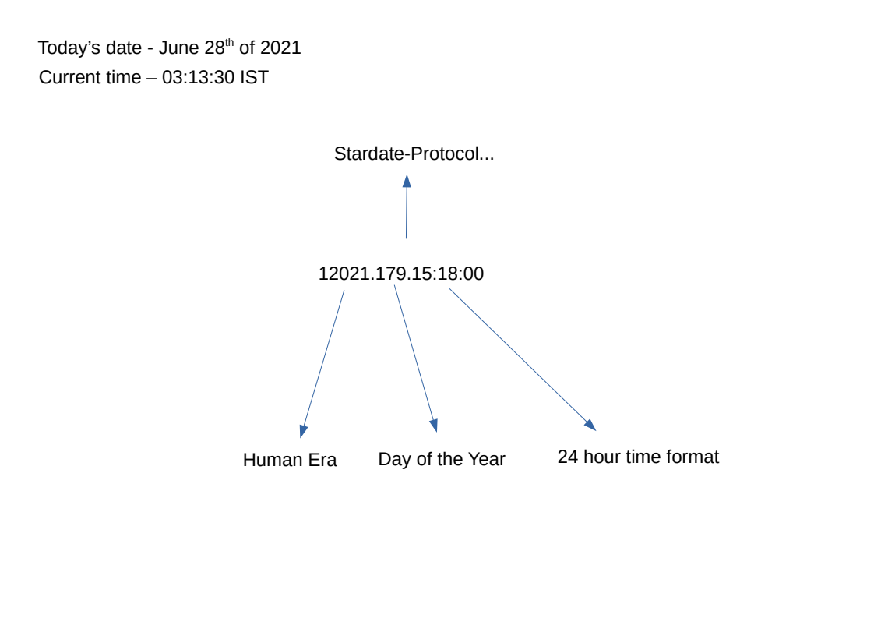
Stardate-Protocol

