Slide 1
IB logo
x
Dashboard
Notification Bell Icon
user@email.com
My Account
Active Projects
First Name Last Name
Title
Organization Name
Email Address
Phone (Office)
Phone (Mobile)
Fax
Address
+ Add a Picture (Stock Headshot Photo for users without pictures)
Completed Projects
All editable except for email address
Security
Current Password
New Password
New Password
[Change Password]

Slide 2
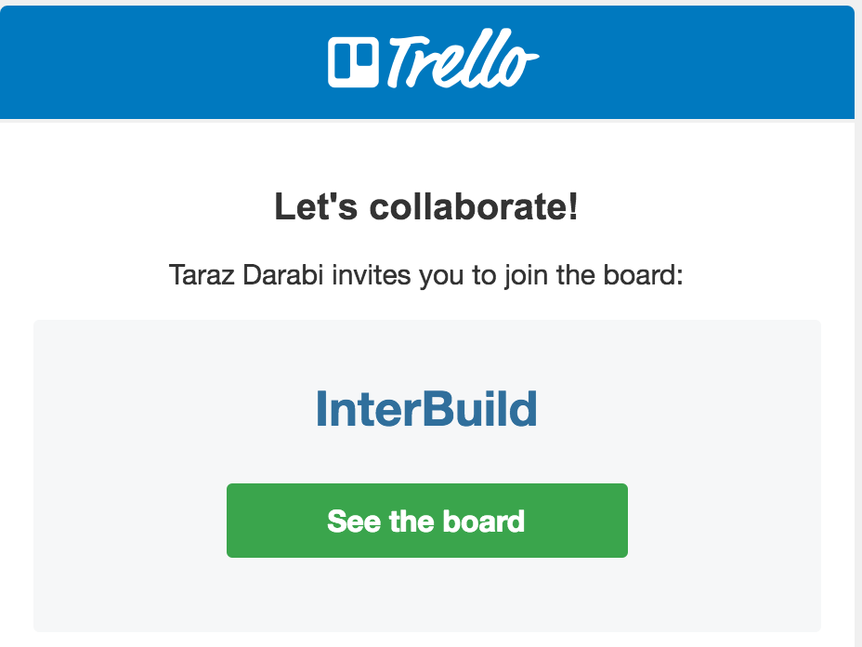
Email Invite
Subject Line: (User Name) invited you to join Project “XYZ” on InterBuild
IB Logo
project
XYZ
project

Slide 3
IB logo
Sign Up - InterBuild
Already have an account? Log In
First Name Last Name (Pre-populated)*
Email Address (Pre-populated)*
Organization Name (Pre-populated)*
Title
Phone (Office)*
Phone (Mobile)* (one of either Office/Mobile required)
Fax
Address*
+ Add a Picture (Stock Headshot Photo for users without pictures)
Password
Confirm Password
[Change Password]
All editable except for email address
*Denotes required

