Slide 1

Telecom Customer Churn Analysis
Uncovering why customers leave — and how to keep them.

Slide 2

Introduction to the Project
7,043 Customers
Total customers analyzed in this study
Objective
Identify the key reasons behind customer churn
Goal
Improve customer retention and business revenue
Industry
Telecom sector

Slide 3




Tools & Technologies Used
Python & Pandas
SQL & MySQL
Data manipulation and statistical analysis
Querying and managing customer datasets
Matplotlib & Seaborn
Jupyter Notebook
Visualizing churn patterns and trends
Interactive analysis and reporting environment

Slide 4
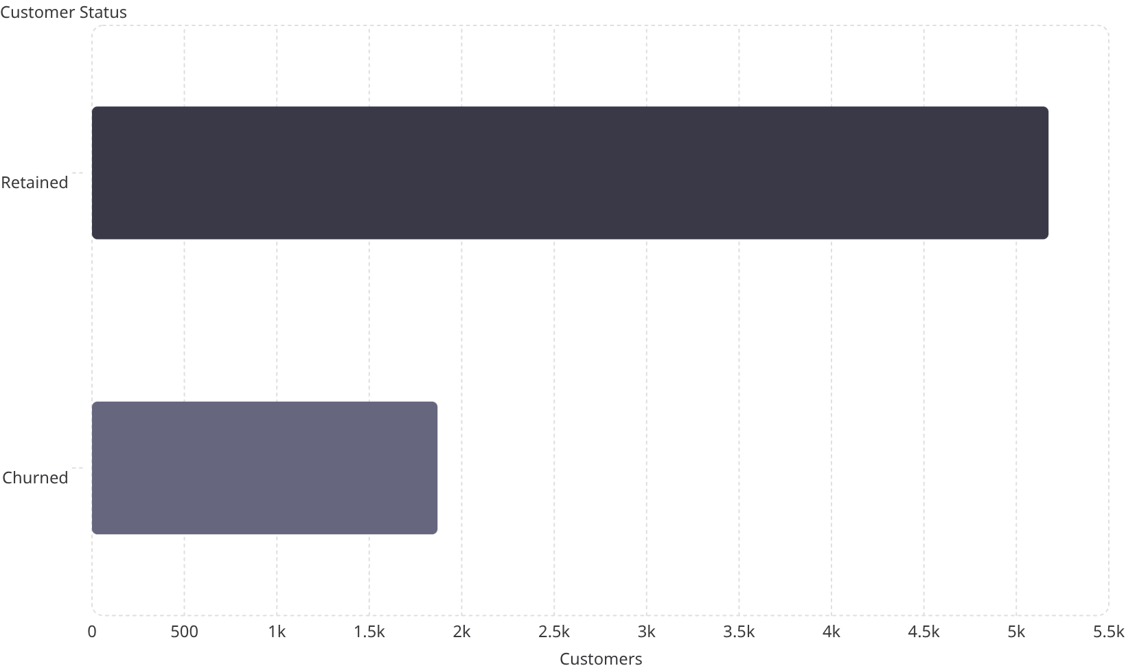
Q1: Overall Customer Churn Rate
Key Findings
26.5% churn rate — approximately 1 in 4 customers leaves the company, causing significant revenue loss.
Reducing churn by just 5% can significantly increase profits
Retention costs less than acquiring new customers
Improved retention drives long-term growth

Slide 5
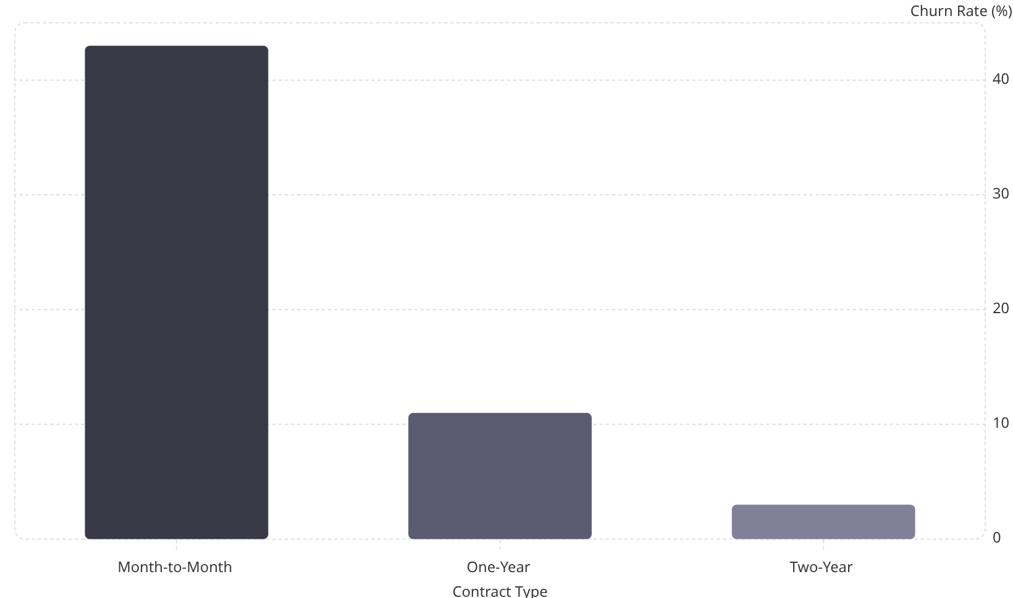
Q2: Contract Type & Churn
Key Insights
Month-to-month customers are the highest-risk group. Long-term contracts dramatically improve loyalty — two-year plans see only ~3% churn.
Recommendations
Offer discounts on yearly subscriptions
Introduce loyalty rewards for long-term users
Promote annual plans aggressively

Slide 6
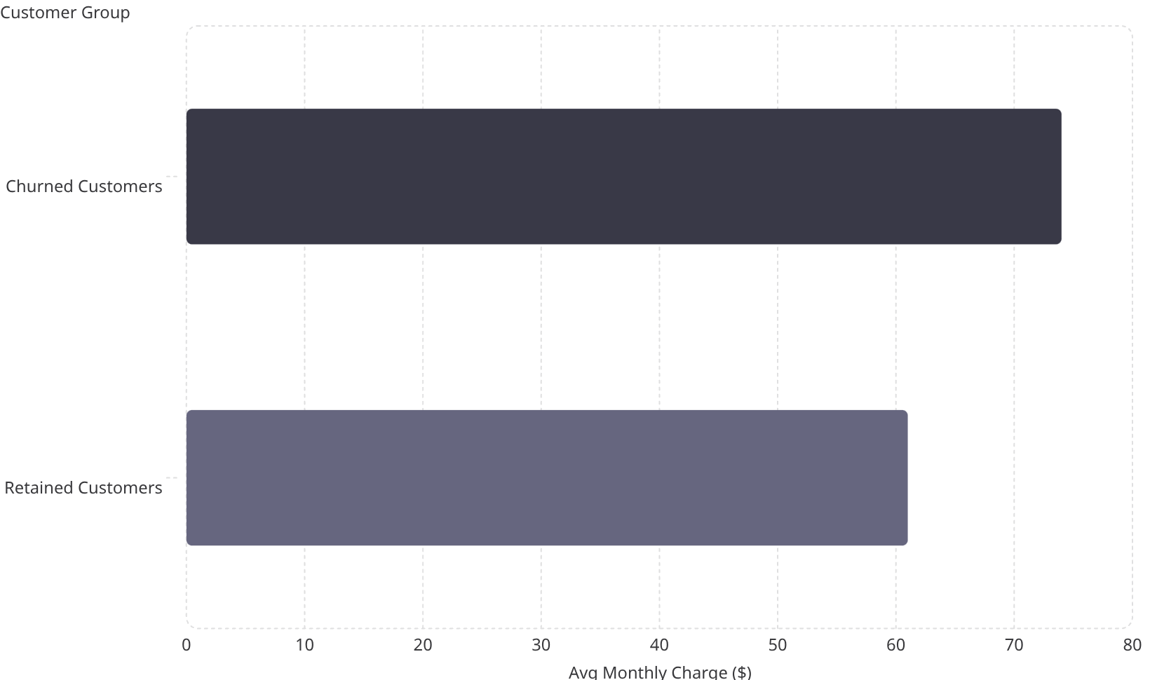
Q3: Monthly Charges & Churn
Key Insights
Higher-paying customers churn more frequently — $74 avg vs. $61 for retained customers. Expensive plans increase churn probability when customers don't perceive enough value.
Recommendations
Offer personalized discounts
Improve premium service quality
Introduce affordable bundled plans

Slide 7
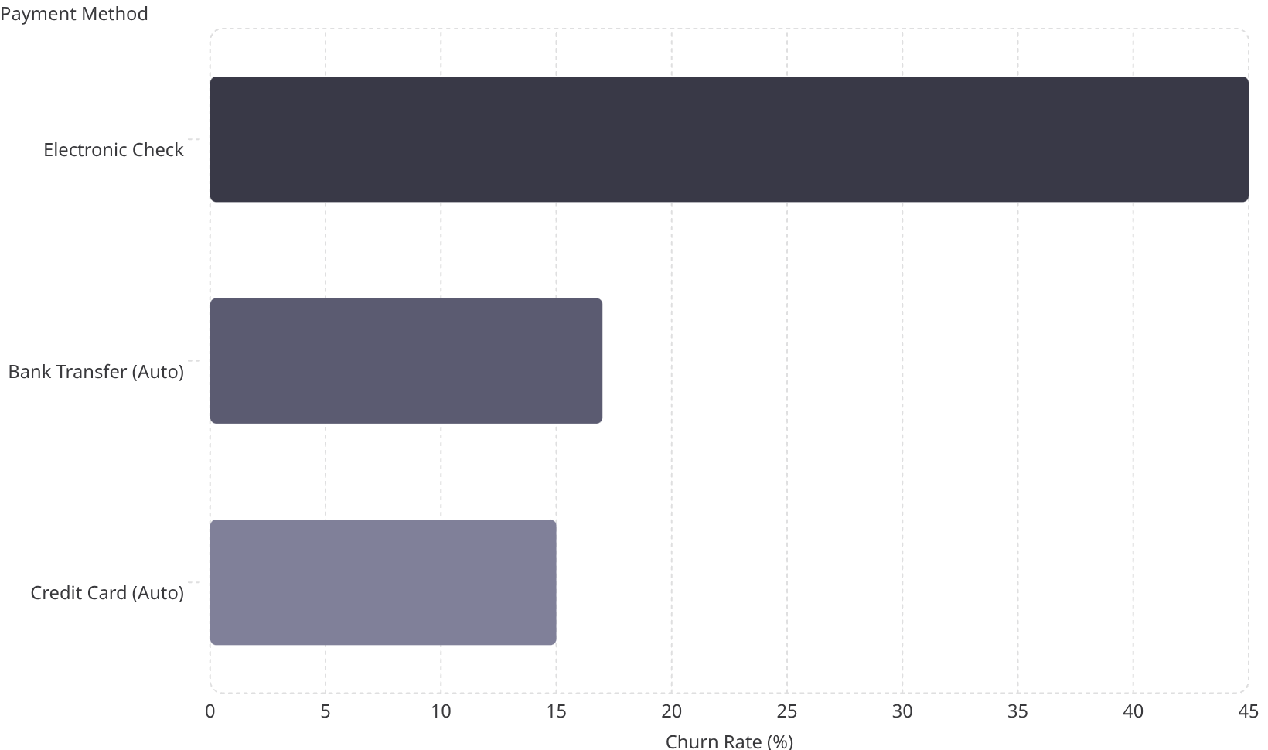
Q4: Payment Method & Churn
Key Insights
Electronic check users have the highest churn rate at ~45%. Automatic payment users are significantly more loyal, suggesting payment experience directly affects retention.
Recommendations
Encourage automatic payments
Offer cashback for auto-pay setup
Improve digital payment experience

Slide 8
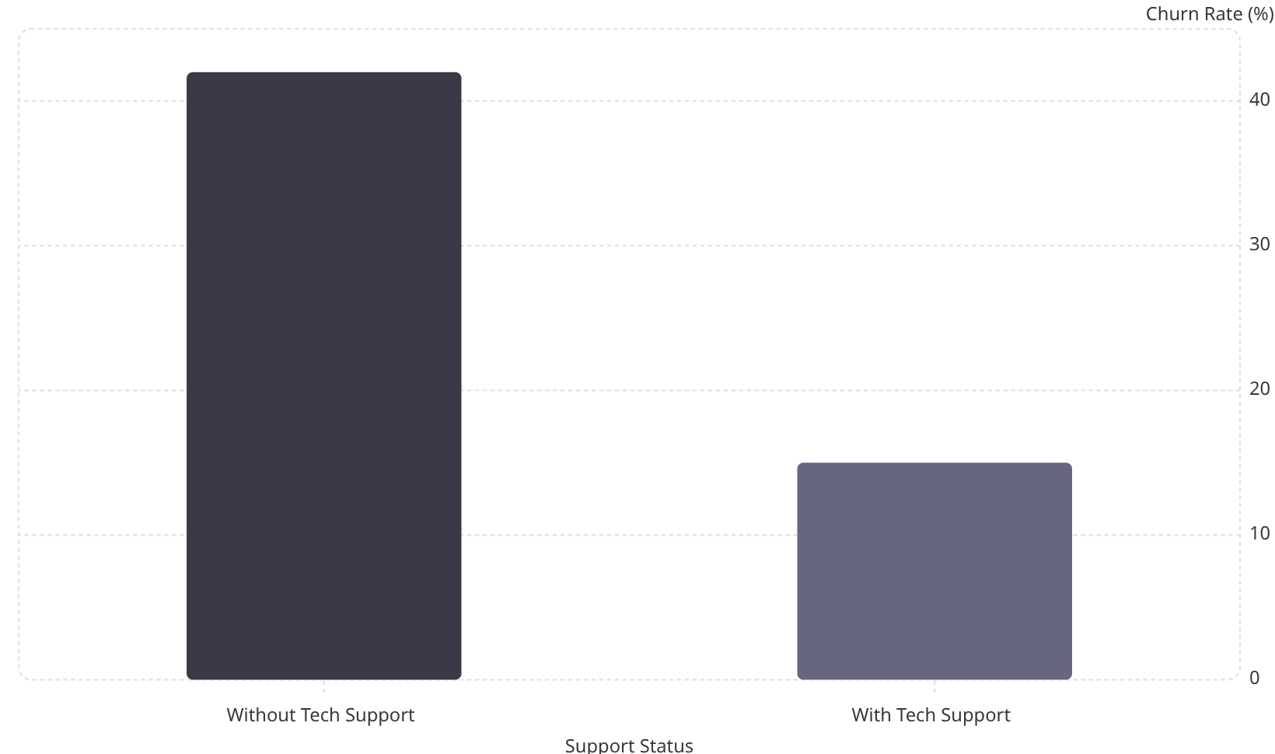
Q5: Technical Support & Churn
Key Insights
Technical support dramatically reduces churn — from 42% to 15%. Support services increase customer trust and customers value quick problem resolution.
Recommendations
Offer free tech support trials
Improve customer service response time
Promote support features to users

Slide 9

Overall Project Findings
Pricing & Contracts
Month-to-month customers are the most vulnerable segment. Long-term contracts significantly reduce churn.
Payment Methods
Electronic check users churn at ~45%; automatic payments improve loyalty.
Technical Support
Support services reduce churn from 42% to 15%, building customer trust.
Data-Driven Decisions
Targeted strategies on pricing, contracts, and support can reduce churn and increase revenue.

Slide 10

Final Conclusion
1
Analysis Complete
Successfully analyzed telecom customer churn using Python and SQL across 7,043 customers.
2
Key Factors Identified
Contract type, monthly charges, payment method, and technical support are the primary drivers of customer loss.
3
Actionable Strategies
Recommended business strategies to reduce churn by improving customer experience and retention.
4
Skills Demonstrated
Practical data analysis and business problem-solving applied to a real-world telecom challenge.

