Slide 1

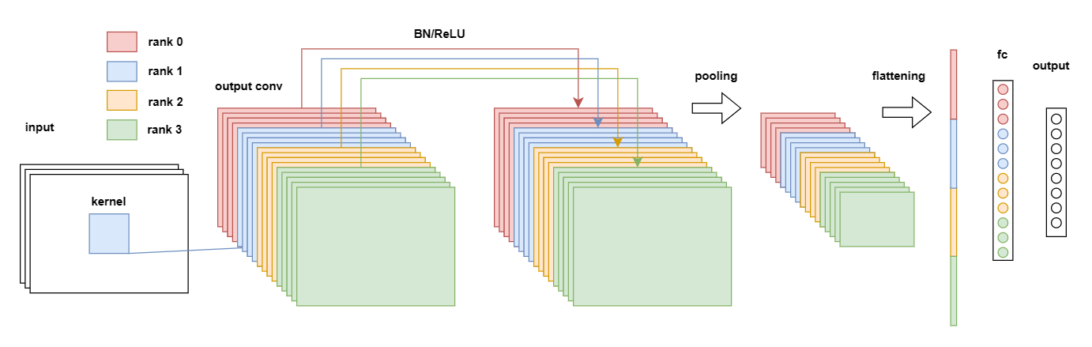
Towards efficient and parallel
neural network ensembles
Muhammed Öz | Master‘s Thesis | Advisor: Markus Götz
04.10.2023

Slide 2
Motivation
Lottery ticket hypothesis:
„Dense, randomly-initialized, feed-forward networks contain subnetworks (winning tickets) that – when trained in isolation - can reach test accuracy comparable to the original network in a similar number of iterations.“
Model capacity is not utilized perfectly
→ Better solutions possible
→ Small models are viable
Goal:
Find winning tickets using multiple, diverse models!
https://doi.org/10.48550/arXiv.1803.03635

Slide 3
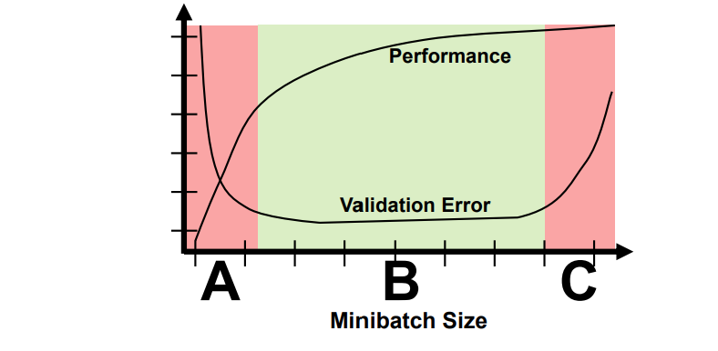
Motivation
Issues with SGD
Stochastic gradient descent (SGD) suffers from large minibatch effects
Parallel SGD only reaches at best sequential accuracy
Use parallel methods to find better solutions for the same architecture!
Research Questions:
Can particle swarm optimization (PSO) find them?
Can ensembles be combined into one model to find them?
[1802.09941] Demystifying Parallel and Distributed Deep Learning: An In-Depth Concurrency Analysis (arxiv.org)

Slide 4
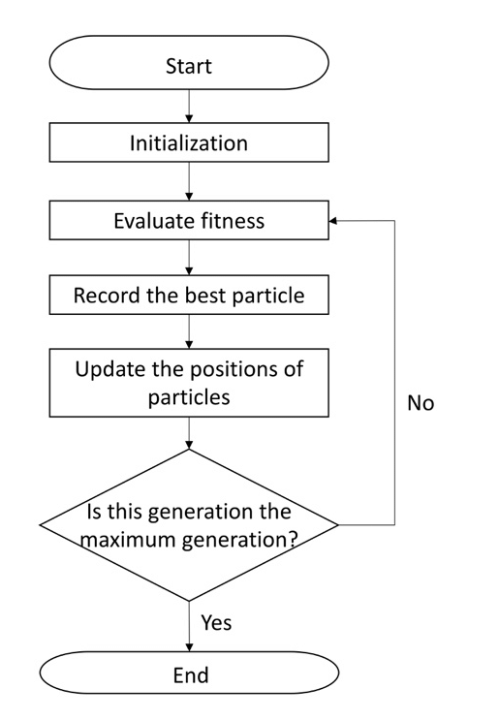
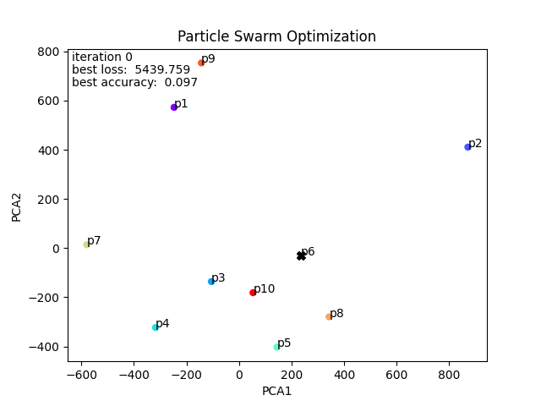
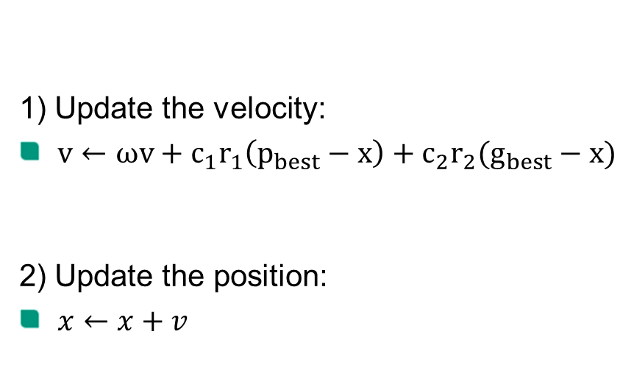

Particle swarm optimization
1) Update the velocity:
$v←ωv+c_{1}r_{1}\left(p_{best}−x\right)+c_{2}r_{2}(g_{best}−x)$
2) Update the position:
$x←x+v$
For each particle repeat T times:
inertia cognitive pull social pull
Flowchart of the particle swarm optimization. | Download Scientific Diagram (researchgate.net)

Slide 5
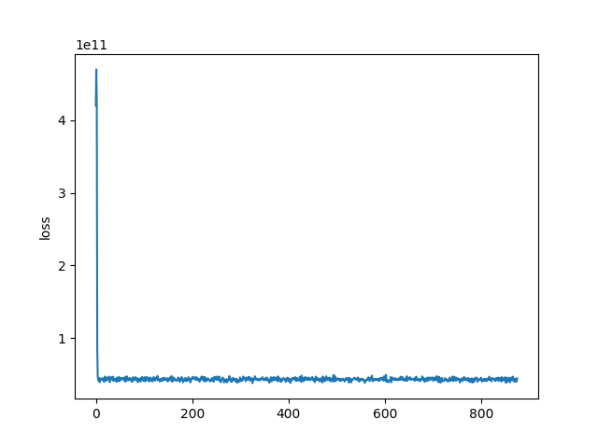
Initial attempt
Cifar-10 dataset
AlexNet
(CIFAR-10 and CIFAR-100 datasets (toronto.edu))
(https://doi.org/10.1145/3065386)
using torch-pso (torch-pso · PyPI)
Accuracy does not improve

Slide 6





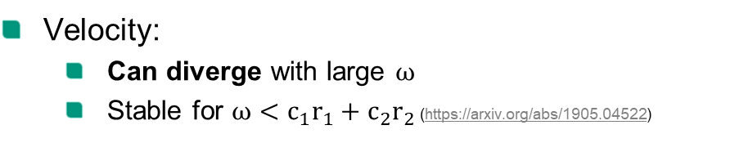


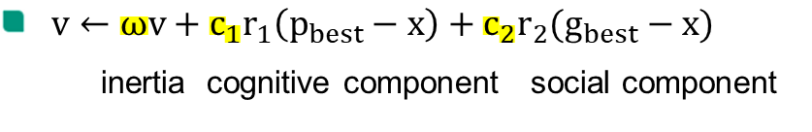
What goes wrong?
$v←ωv+c_{1}r_{1}\left(p_{best}−x\right)+c_{2}r_{2}(g_{best}−x)$
inertia cognitive component social component
Particle initialization:
Random init in [-1,1] → high initial loss
Kaiming He init (1502.01852v1.pdf (arxiv.org))
Velocity:
Can diverge with large $ω$
Stable for $ω<c_{1}r_{1}+c_{2}r_{2}$ (https://arxiv.org/abs/1905.04522)
Fitness function evaluation:
Sample size important
Tradeoff: Speed vs. accuracy
Flowchart of the particle swarm optimization. | Download Scientific Diagram (researchgate.net)

Slide 7
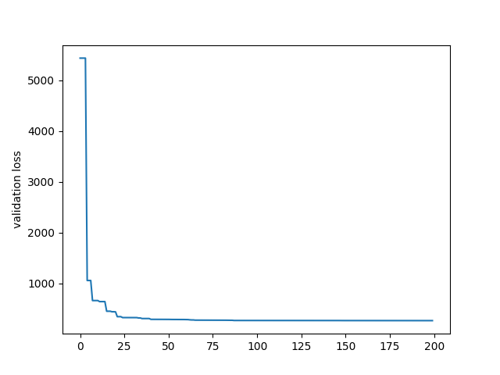
New attempt
Cifar-10 dataset
(CIFAR-10 and CIFAR-100 datasets (toronto.edu))
Small ANN
2 hidden layers with 512 neurons
Better but particles converge to a suboptimal solution
→ winning ticket not found
Possible explanations:
Not directed enough
Search space too small

Slide 8
Possible extensions: Search space and directed search
Hybrid optimizers
Random perturbations and opposite directions¹
Include genetic algorithms²
Use PSO only for…
Initial solutions³
Improvements⁴
Include gradients (PSO-PS⁵, PSO-BP-CD⁶, PSO-CNN⁷)
→ Use gradients for directed search
1: A hybrid algorithm for artificial neural network training – ScienceDirect
2: GA and PSO hybrid algorithm for ANN training with application in Medical Diagnosis | IEEE Conference Publication | IEEE Xplore
3: A Novel Parameter-Optimized Recurrent Attention Network for Pipeline Leakage Detection | IEEE Journals & Magazine | IEEE Xplore
4: PARTICLE SWARM OPTIMIZATION (PSO) FOR TRAINING OPTIMIZATION ON CONVOLUTIONAL NEURAL NETWORK (CNN) | Jurnal Ilmu Komputer dan Informasi (ui.ac.id)
5: PSO-PS:Parameter Synchronization with Particle Swarm Optimization for Distributed Training of Deep Neural Networks | IEEE Conference Publication | IEEE Xplore
6: [2202.01943] PSO-PINN: Physics-Informed Neural Networks Trained with Particle Swarm Optimization (arxiv.org)
7: PSO-Convolutional Neural Networks With Heterogeneous Learning Rate | IEEE Journals & Magazine | IEEE Xplore

Slide 9
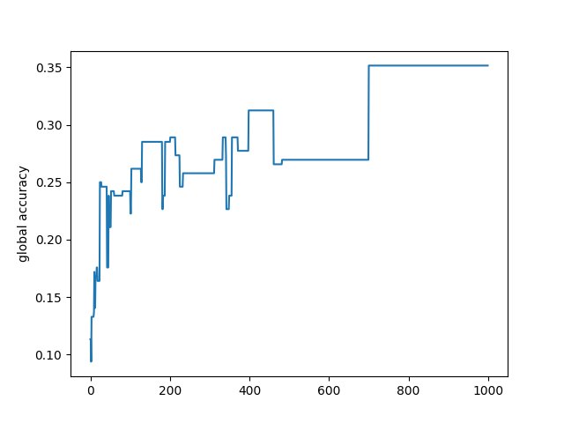

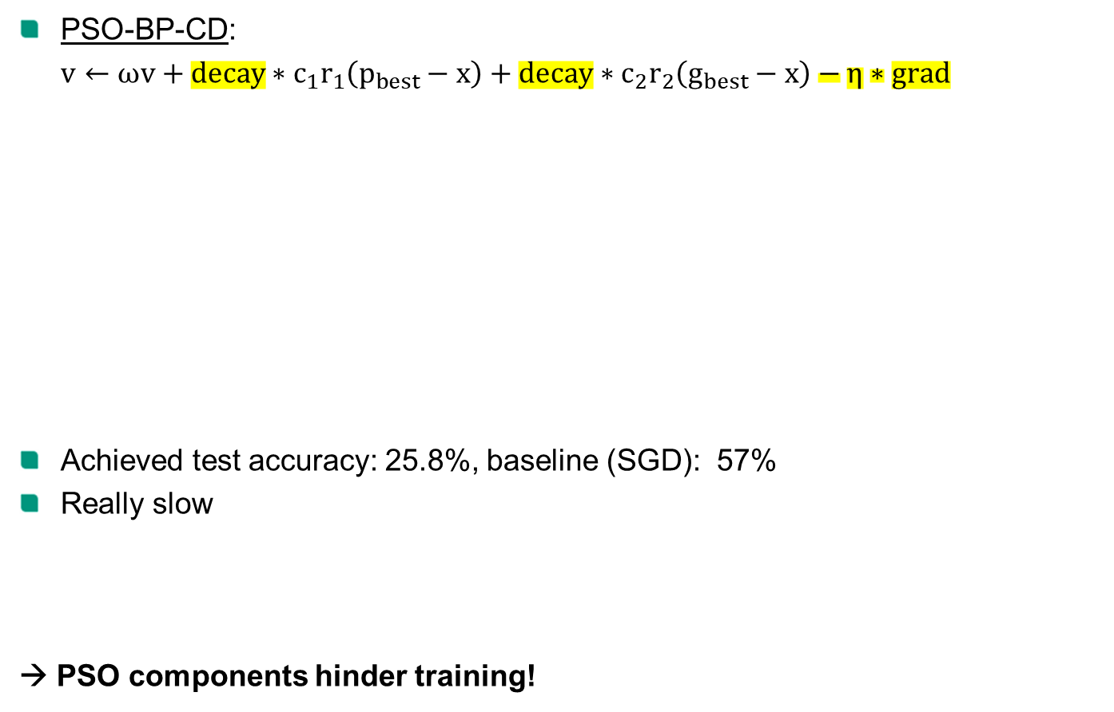
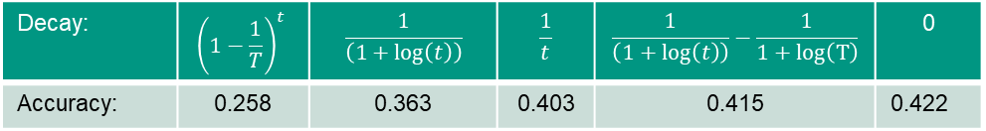
Including gradients
PSO-BP-CD:
$v←ωv+{decay∗c}_{1}r_{1}\left(p_{best}−x\right)+{decay∗c}_{2}r_{2}\left(g_{best}−x\right)−η∗grad$
Achieved test accuracy: 25.8%, baseline (SGD): 57%
Really slow
→ PSO components hinder training!
20 particles
1000 iterations
Disjoint subsets
Linear decay with factor ${\left(1−\frac{1}{T}\right)}^{t}$
for iteration t
Decay: | $${\left(1−\frac{1}{T}\right)}^{t}$$ | $$\frac{1}{\left(1+\log\left(t\right)\right)}$$ | $$\frac{1}{t}$$ | $$\frac{1}{\left(1+\log\left(t\right)\right)}−\frac{1}{1+log\left(T\right)}$$ | 0
Accuracy: | 0.258 | 0.363 | 0.403 | 0.415 | 0.422

Slide 10

Including gradients
cognitive pull
social pull
PSO-BP-CD:
PSO-BP-CD:
$$v←ωv+{decay∗c}_{1}r_{1}\left(p_{best}−x\right)+{decay∗c}_{2}r_{2}\left(g_{best}−x\right)−η∗grad$$
Why does PSO hinder training?
Hypothesis:
Overestimation of $g_{best}$
Experiment: compare fitness evaluation with different sample sizes → no change
New hypothesis:
Information loss from social pull
Data is not shared
Experiment:
Social pull worse than no communication
Experiment:
Adding particles does not increase accuracy or lower training time.
Information is lost
Possible fix: Average pull
component: | social | social+cognitive | none | averaging
accuracy: | 0.405 | 0.415 | 0.422 | 0.57

Slide 11
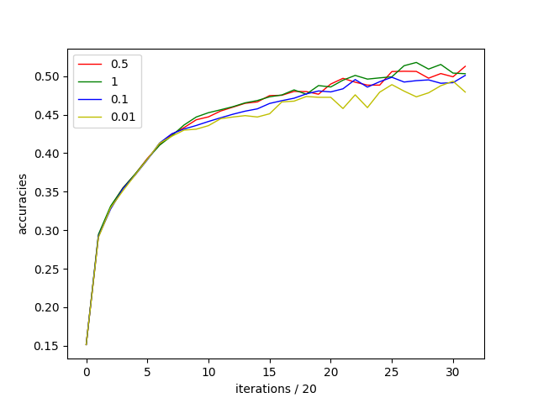
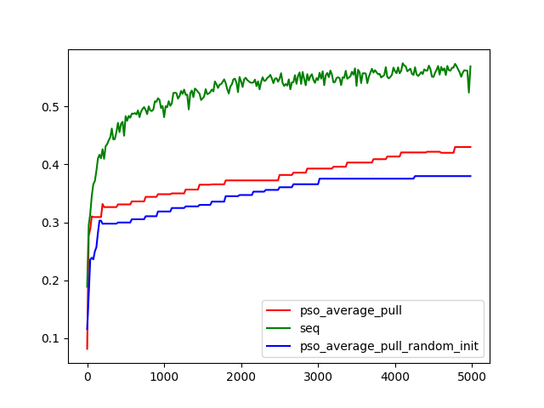

Average pull
Goal: Use all samples
Average Pull:
4 local SGD-updates, then $x←x+ν∗\left(averageParticle−x\right)$
PSO - Average Pull:
$v←ωv+{decay∗c}_{1}r_{1}\left(p_{best}−x\right)+{decay∗c}_{2}r_{2}\left(g_{best}−x\right)−η∗grad$
$$+ν∗(averageParticle−x)$$
Average Pull with a large local batch size of 2048
PSO – Average Pull
Insight 1: Slightly worse, slightly less scalable than synchronous SGD
Insight 2: Can still be used to increase ensemble diversity, even with different initialisations!
Insight 3: Does not fix information forgetting problem. → Drop social pull!

Slide 12

Ensembles
$$v←ωv+{decay∗c}_{1}r_{1}\left(p_{best}−x\right)+{decay∗c}_{2}r_{2}\left(g_{best}−x\right)−η∗grad$$
$$c_{1}=c_{2}=0$$
$$v←ωv−η∗grad$$
→ Ensemble of particles using SGD independently
How to extract winning tickets?

Slide 13
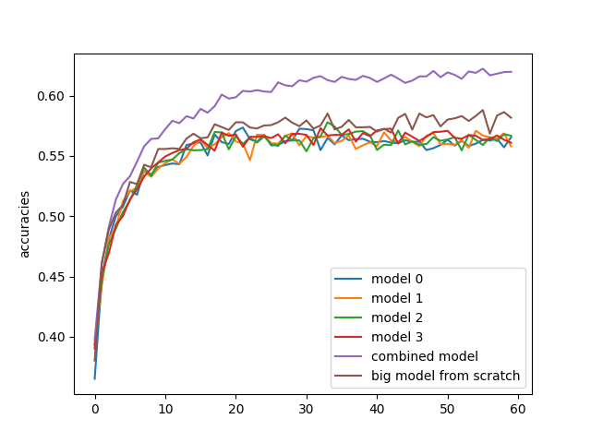
Ensembles
Do not select particles, combine them!
“Ensemble learning methods train multiple base learners and combine their predictions to obtain improved performance and better generalization ability than the individual base learners”
→ Ensemble outperforms large model
10.3390/electronics10192347

Slide 14
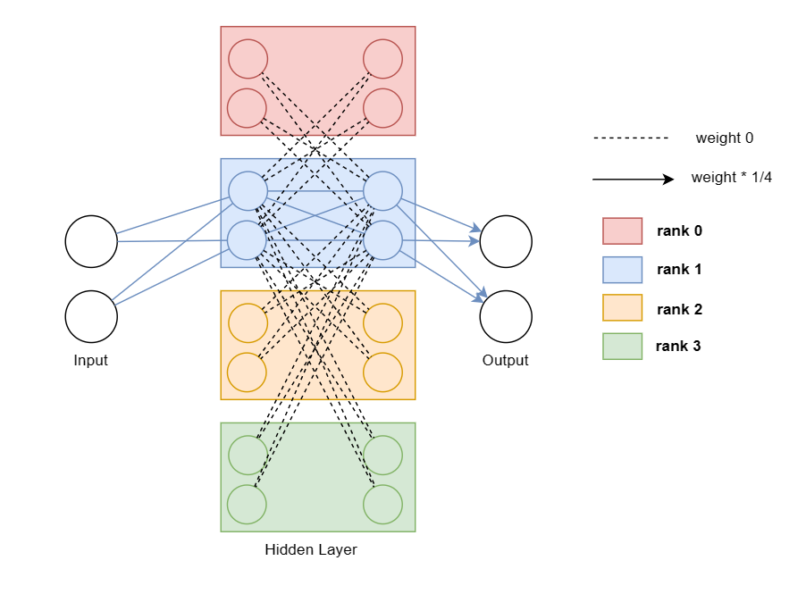
Concatenation pruning
Proposed algorithm: Concatenation pruning
Train with different seeds and all data
Combine models via concatenation
Prune layerwise via magnitude pruning
Finetune

Slide 15
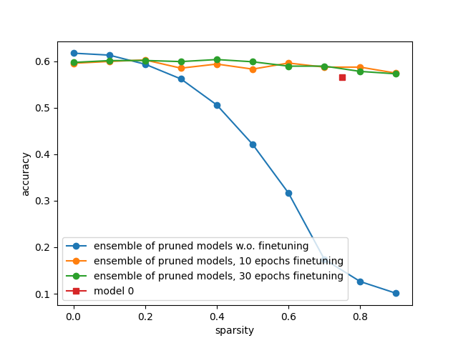
Concatenation pruning - experiments
Proposed algorithm: Concatenation pruning
Train with different seeds and all data
Combine models via concatenation
Prune layerwise via magnitude pruning
Finetune
Some results:
Recovering ensemble accuracy possible
Pruning/combing - order irrelevant!
Prune first for memory
Only needs a few epochs finetuning
Works well on shallow networks
E.g. <= 5 layers, e.g. LeNet
Struggles with deeper networks
E.g. 7 layers, e.g. VGG-11
https://doi.org/10.48550/arXiv.2301.04275
LeNet / VGG:
https://doi.org/10.48550/arXiv.1409.1556

Slide 16
Summary
Standard PSO:
Search space not large enough
Needs special treatment:
Careful with random velocities coupled with large inertia
Fitness evaluation expensive, tradeoff: accuracy vs. efficiency
PSO with gradients:
Information loss from social pull
→ Scales badly
Only reaches SGD-accuracy
Average Pull:
Scalability slightly worse than synchronous SGD
Can be used even with different initializations and low pull factors to increase diversity
Does not fix information loss problem
Concatenation Pruning:
Train – Prune – Combine – Finetune
Prune first for memory
Only 2 epochs finetuning
Works for shallow networks

Slide 17
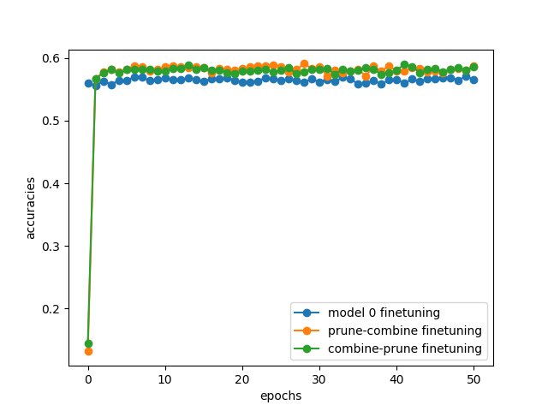
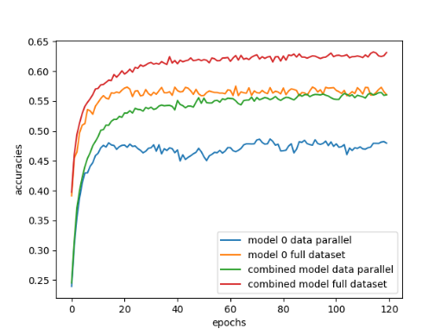
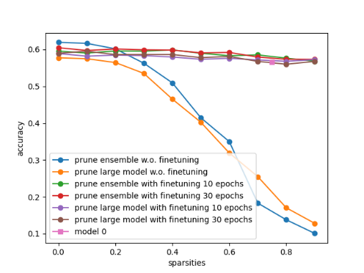
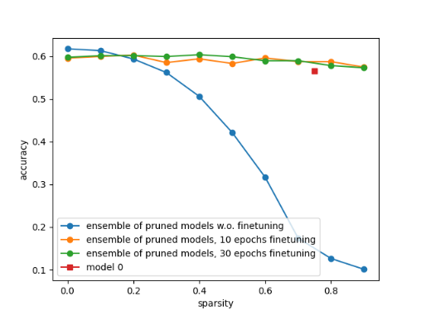
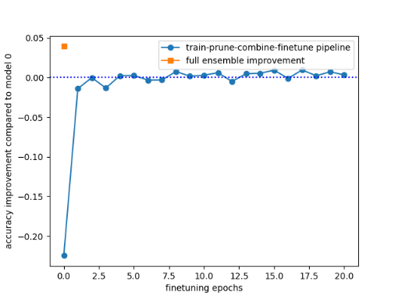
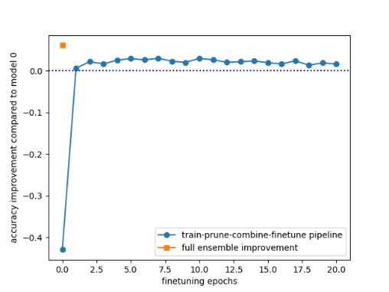
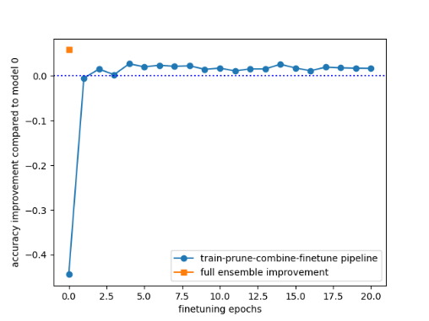
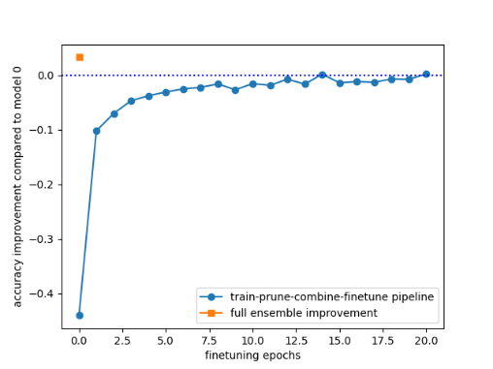
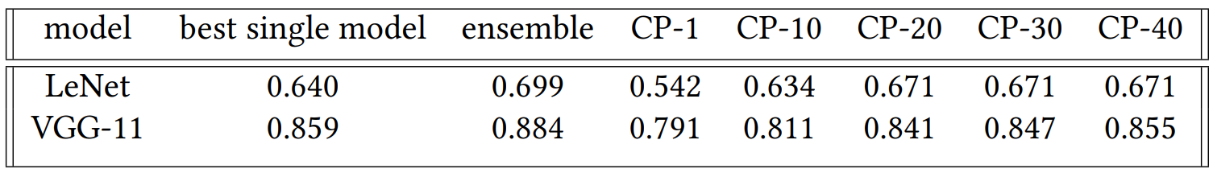
Backup slide
finetuning
data-parallel
first combine
first prune
1*128, 3*512, 5*512, 7*64

Slide 18
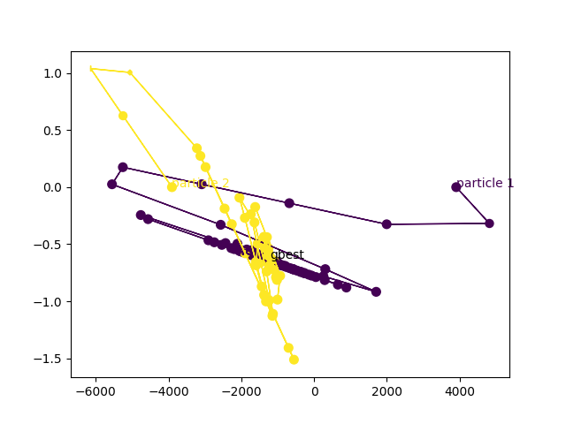
Backup slide

