Slide 1
KernelLeakGuard
Hybrid Static Analysis and Runtime Verification of Memory Leaks in Linux Kernel Early-Exit Paths
Om Gunjan Gupta (24BIT0316) · Abhishek Kumar Singh (24BIT0309) · Aarav Jain (24BIT0023)
Guide: Dr. Arivuselvan K, Associate Professor, SCORE
BITE303P Operating Systems Lab · Fall 2026-27 · VIT Vellore

Slide 2
The problem: leaks on early-exit paths
• Kernel code checks every operation and bails out early with an error code.
• Each early exit must undo everything done so far; a missing kfree() leaks memory until reboot (no garbage collector, no process exit).
• These paths run only when an allocation or device operation fails, so ordinary testing almost never executes them.
• Static tools report candidates, but many are safe: ownership moves to lists, callers, callbacks.
int initialize(void)
{
char *a = kmalloc(100, GFP_KERNEL);
if (!a)
return -ENOMEM;
char *b = kmalloc(200, GFP_KERNEL);
if (!b)
return -ENOMEM; // a leaks
...
kfree(b);
kfree(a);
return 0;
}
Leaks only when the second kmalloc() fails
KernelLeakGuard · BITE303P Operating Systems Lab
2

Slide 3
Why it matters
120
weekly
0
previously unknown early-exit leaks found
in Linux by MLEE (USENIX ATC 2021)
kmemleak reports filed by syzbot,
Google's kernel fuzzing service
times an error path runs in a normal
test run that never fails an allocation
• Impact: memory pressure, degraded performance, instability; an attacker who can trigger the failure repeatedly can exhaust kernel memory (denial of service).
• Gap: static warnings are not proof; dynamic tools only see the paths they happen to execute and give a backtrace without the root cause.
KernelLeakGuard · BITE303P Operating Systems Lab
3

Slide 4
Objectives
• Detect missing releases on early-exit paths with an LLVM-based static analyser (alias, ownership-transfer, interprocedural and path-correlation analysis).
• Predict, for each warning, the failing call that leads onto the leaking path.
• Build an isolated QEMU/KVM test kernel with kmemleak and per-task fault injection.
• Automatically inject the predicted failure and decide confirmed / not reproduced / inconclusive from kernel evidence.
• Evaluate on a benchmark with ground truth: static vs hybrid vs dynamic-only, ablation.
• Deliver a CLI and a dashboard with source context, evidence and suggested fixes.
KernelLeakGuard · BITE303P Operating Systems Lab
4

Slide 5
Literature survey
Work | Technique | Strength | Limitation
MLEE (ATC'21) | LLVM IR, early-exit vs normal path | 120 new kernel leaks | static only, manual triage
Hector (DSN'13) | compare error paths | no specification needed | false positives
K-MELD (NDSS'21) | ownership reasoning | custom allocators | static only
HERO (Sec'21) | precise function pairing | many confirmed bugs | no runtime evidence
FIFUZZ (Sec'20) | context-sensitive fault injection | deep error paths | crashes, not leaks
syzkaller + kmemleak | fuzzing + fail-nth + kmemleak | real evidence | only reached paths, no root cause
KernelLeakGuard · BITE303P Operating Systems Lab
5

Slide 6
Research gap and our idea
• Static detectors cover all paths but every warning needs manual triage.
• Dynamic tools give evidence only for executed paths, without saying which exit forgot what.
• No surveyed system uses the static analysis to drive targeted fault injection per warning and feeds kernel evidence back into the verdict.
static warning ──► predicted failing call ──► fail exactly that call in a VM ──► kmemleak
│
confirmed / not reproduced / inconclusive + reproduction + backtrace ◄─────┘
KernelLeakGuard · BITE303P Operating Systems Lab
6

Slide 7
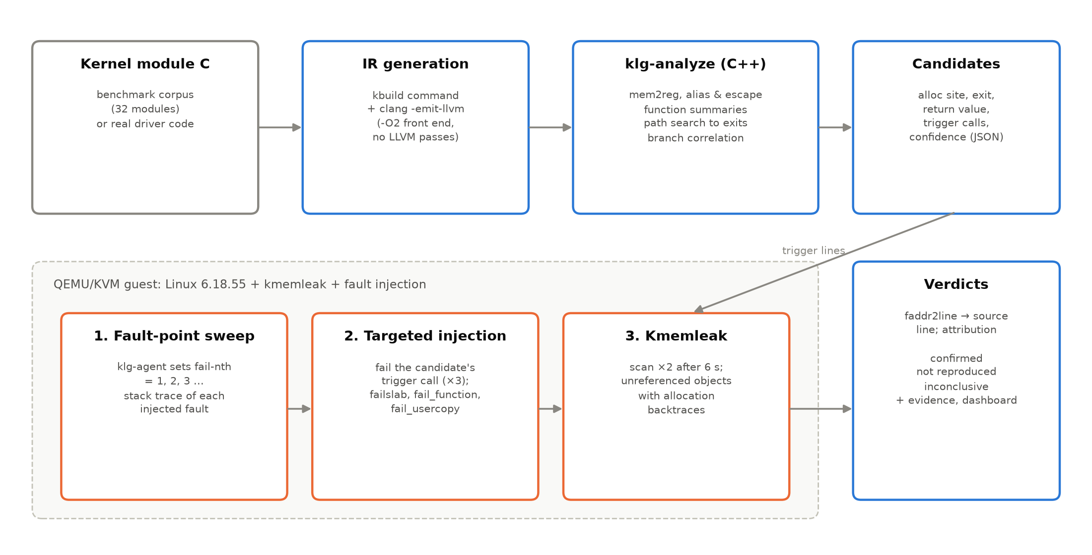
System architecture
KernelLeakGuard · BITE303P Operating Systems Lab
7

Slide 8
Static analyser (klg-analyze, C++ / LLVM 21)
• IR: re-run each module's kbuild command with -emit-llvm; mem2reg; fold configuration stubs.
• Aliases: casts, GEPs, PHIs, and fields of local structs/arrays.
• Handled = kfree & friends, or ownership transfer (store to non-local memory, return, capturing call).
• Summaries: frees / captures / returns each parameter; allocation wrappers.
• Path search: DFS to every return, skip the alloc-failed edge and contradictory branches (correlation), loops ×2.
• Report: exit, returned errno, failing trigger calls, confidence.
{
"function": "sensor_setup",
"allocator": "kmalloc",
"alloc": {"line": 32},
"exit": {"line": 54},
"return_value": "-ENOMEM",
"triggers": [
{"callee": "kasprintf",
"line": 38}],
"confidence": "high"
}
KernelLeakGuard · BITE303P Operating Systems Lab
8

Slide 9
Runtime verifier (QEMU/KVM guest, Linux 6.18.55)
• Fault-point sweep: klg-agent writes N to /proc/thread-self/fail-nth (N = 1, 2, 3 ...) and runs the routine; the stack trace of each injected fault gives N → source line.
• Targeted injection: for each warning, inject the N that fails its trigger call, 3 times (failslab, fail_function via ftrace kprobes, fail_usercopy).
• Kmemleak: wait 6 s, scan twice; attribute each unreferenced object by its allocation backtrace (faddr2line) or, for unloaded init code, by allocation size.
• Trustworthy evidence: no stale pointer copies: page-allocator stacks, KSTACK_ERASE, no task-stack scanning, init_on_alloc / init_on_free for slab memory.
• Speed: a guest boots in ~2 s; both VM runs take about 3 min.
KernelLeakGuard · BITE303P Operating Systems Lab
9

Slide 10
Operating-system concepts in the project
Concept | Where
Memory management | slab allocator, kmalloc caches, vmalloc, ownership, kmemleak mark & scan
Error handling / faults | errno propagation, goto cleanup, failslab / fail_function / fail_usercopy
Processes & system calls | per-task fault state (fail-nth), task stacks, write / finit_module / pread
Device management | loadable modules, misc devices, platform drivers, devm memory
Synchronisation | mutex-protected lists, RCU deferred free, kref reference counting
Virtualisation | QEMU + KVM, virtio-9p sharing, initramfs boot
Performance analysis | analysis time, VM time, executions, precision / recall
KernelLeakGuard · BITE303P Operating Systems Lab
10

Slide 11
Benchmark corpus (dataset)
32
17
42
kernel modules
(17 leaky, 15 leak-free)
leaking allocation sites
safe allocation sites
• Patterns from real kernel bugs: wrong goto label, copy_from_user failure, loops, wrappers, registration failures, conditional allocation, kmem_cache, vmalloc.
• Tricky safe code: list ownership, caller-owned fields, devm, kref, RCU, factories, correlated conditions, rollback loops.
• Ground truth in the source: every allocation is annotated /* GT:LEAK */ or /* GT:SAFE */.
KernelLeakGuard · BITE303P Operating Systems Lab
11

Slide 12
Implementation and module division
Member | Modules
Om Gunjan Gupta (24BIT0316) | Static analyser (C++/LLVM): IR preparation, alias/escape, summaries, path search
Abhishek Kumar Singh (24BIT0309) | Guest kernel & VM, klg-agent fault-injection driver (C), kmemleak protocol
Aarav Jain (24BIT0023) | Corpus & ground truth, Python verifier & evaluation, Streamlit dashboard
• C++17 + LLVM/Clang 21 · C (static) · Python 3 · Linux 6.18.55 LTS · QEMU/KVM on WSL2
• Single command: python3 -m klg all → build, analyse, verify in VM, evaluate
KernelLeakGuard · BITE303P Operating Systems Lab
12

Slide 13
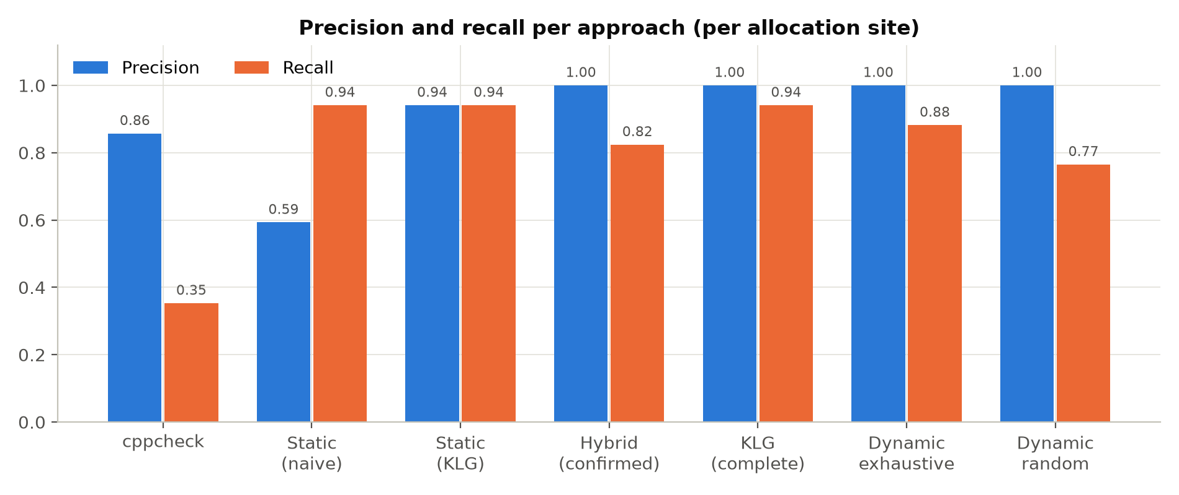
Results: detection quality
Approach | TP | FP | FN | Prec. | Rec.
cppcheck 2.19 | 6 | 1 | 11 | 0.86 | 0.35
Static, naive | 16 | 11 | 1 | 0.59 | 0.94
Static, KLG | 16 | 1 | 1 | 0.94 | 0.94
Hybrid (confirmed) | 14 | 0 | 3 | 1.00 | 0.82
KLG complete | 16 | 0 | 1 | 1.00 | 0.94
Dynamic, exhaustive | 15 | 0 | 2 | 1.00 | 0.88
Dynamic, random | 13 | 0 | 4 | 1.00 | 0.77
KernelLeakGuard: 16 of 17 leaks, no false positive; every confirmed leak has kernel evidence.
KernelLeakGuard · BITE303P Operating Systems Lab
13

Slide 14
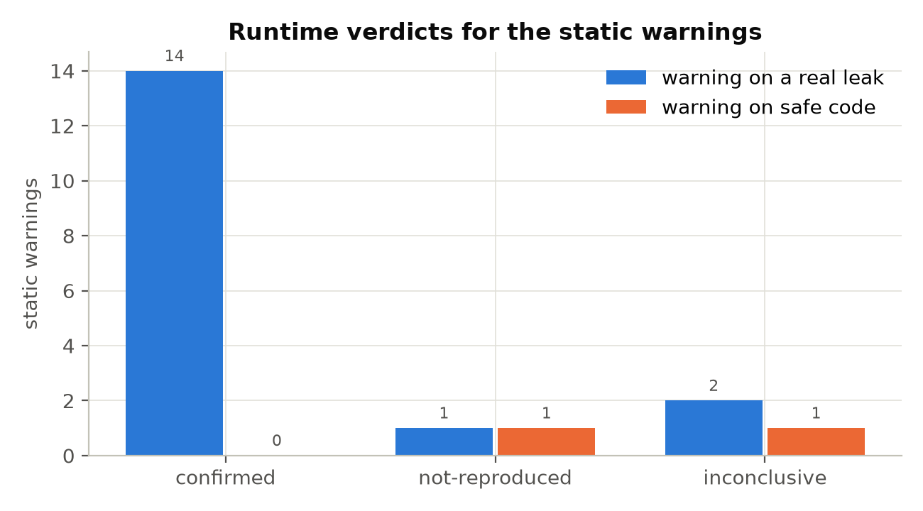
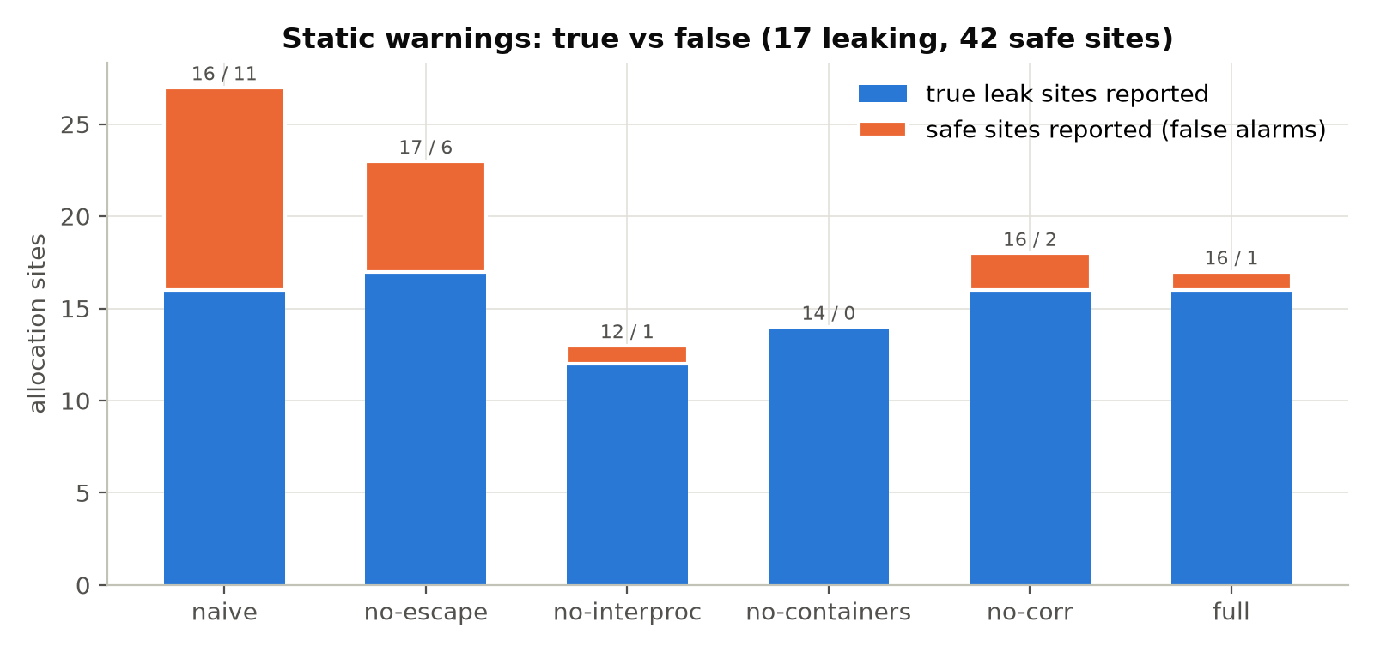
Runtime verdicts and ablation
• 14 confirmed, 2 not reproduced, 3 inconclusive — no false confirmation
• Without ownership transfer: precision 0.74; naive: 11 false alarms
KernelLeakGuard · BITE303P Operating Systems Lab
14

Slide 15
Real Linux 6.18.55 kernel code
• Static: 39 hardware-free modules, 6376 functions, 590 allocation sites → 115 warnings
• Runtime (VM): 15 representative modules, 6156 fault points of module init exercised
• Manual review: all 13 high-confidence warnings read in the source are false positives (ERR_PTR returns, error codes in variables, list ownership) — none confirmed at runtime; most are in mount/ioctl code that init-time testing does not reach
• Sweep observation: 1 leak report (erofs init: kmem_cache name strings) — root cause under analysis, likely slab error path
• Crash found: reproducible kernel crash while loading null_blk under allocation failure (bdev_release reads freed module memory) — root cause still to be analysed
• Lesson: static precision drops on real code; runtime verification keeps reports clean
KernelLeakGuard · BITE303P Operating Systems Lab
15

Slide 16
Case study: klg_l02 — wrong goto label
tx = kmalloc(TX_SIZE, GFP_KERNEL); // 32
if (!tx) {
ret = -ENOMEM;
goto err_rx;
}
name = kasprintf(GFP_KERNEL, ...); // 38
if (!name) {
ret = -ENOMEM;
goto err_rx; // BUG: err_tx
}
...
err_tx:
kfree(tx);
err_rx:
kfree(rx);
return ret;
• Static: kmalloc at 32 leaks when returning -ENOMEM; trigger kasprintf (38).
• Sweep: fault #5 fails sensor_setup+0x5f/0xb0.
• Confirm: injected 3×, kmemleak: 3 unreferenced objects allocated at line 32.
• Verdict: confirmed. Fix: goto err_tx.
KernelLeakGuard · BITE303P Operating Systems Lab
16

Slide 17
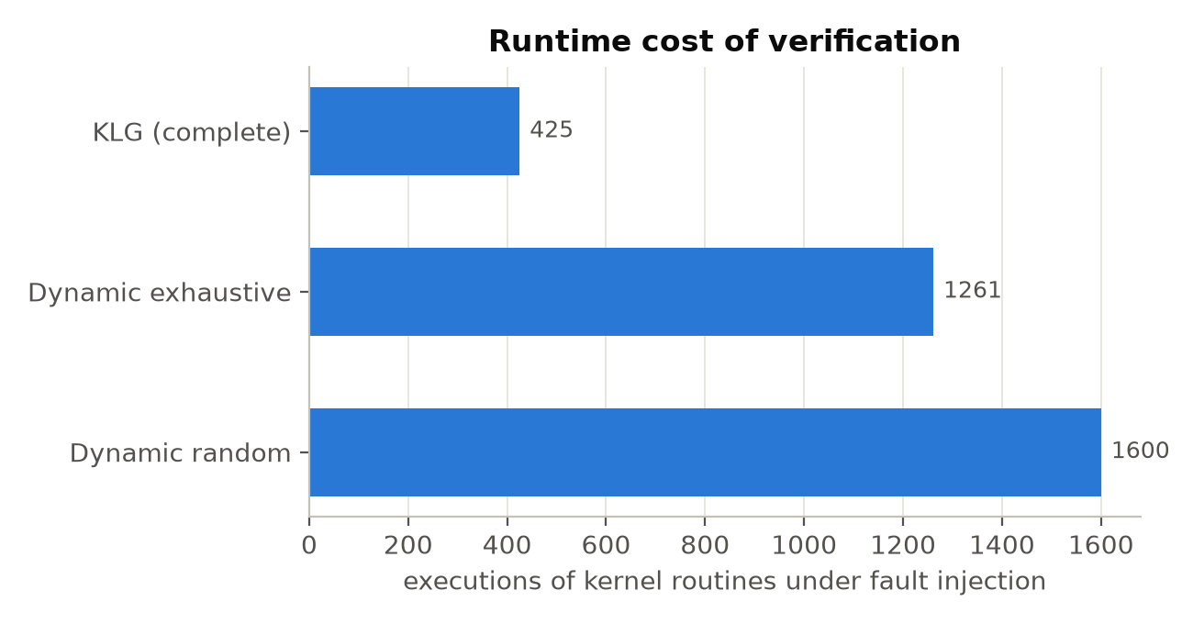
Performance
• Static analysis: 27 ms for 32 modules
• Mapping + confirmation VM runs: 50 s + 78 s
• KernelLeakGuard: 425 executions in total (module-filtered sweep + confirmation) vs 1261 exhaustive
• Fix patches: 13 of 14 validated (compile, re-analysis, VM re-run)
• Hardware: laptop, Ryzen 7, 15 GB, WSL2 + KVM
KernelLeakGuard · BITE303P Operating Systems Lab
17

Slide 18
Demonstration
cd ~/KernelLeakGuard
python3 -m klg all
python3 -m klg show
.venv/bin/streamlit run dashboard/app.py
# → http://localhost:8501
• Pipeline: build → analyse → VM sweep → targeted injection → kmemleak → verdicts
• Dashboard: findings with verdicts; source with allocation / failing call / exit highlighted; kmemleak backtraces; evaluation charts
• Live: introduce a bug in a module, rerun, watch it get confirmed
KernelLeakGuard · BITE303P Operating Systems Lab
18

Slide 19
Conclusion and future work
• Static analysis finds early-exit leaks with F1 0.94 (naive: 0.73).
• Targeted fault injection + kmemleak confirms them with evidence; precision 1.00.
• Complete tool: 16/17 leaks, 0 false positives, validated fix patches for 13/14.
• Predicting the failing call + module-filtered injection: cheaper than blind injection.
• kmemleak must be protected from stale pointer copies (stacks, reused slab memory).
Future work
• Field-sensitive heap ownership (nested leaks)
• Real kernel code: 39 hardware-free modules already built into the guest
• Reproduce MLEE's historical leaks
• Loop-counter reasoning; patches for shared error labels
• CI integration (KernelCI)
KernelLeakGuard · BITE303P Operating Systems Lab
19

Slide 20
Thank you
Questions?
Om Gunjan Gupta · Abhishek Kumar Singh · Aarav Jain

