Slide 1
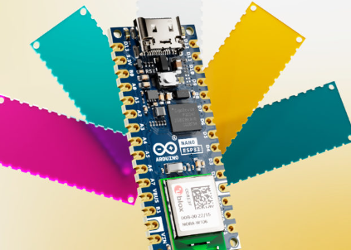
INTRODUCTION TO ESP32 HARDWARE-RELATED PROGRAMMING ENVIRONMENT
EXPLORING THE HARDWARE FRONTIER - A JOURNEY INTO PROGRAMMING ENVIRONMENTS FOR MICROCONTROLLER MASTERY

Slide 2
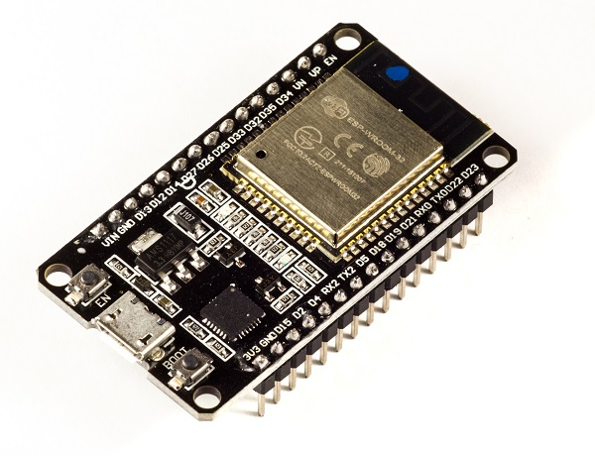
INTRODUCTION TO ESP32
ESP32 is the SoC (System on Chip) microcontroller which has gained massive popularity recently. Whether the popularity of ESP32 grew because of the growth of IoT or whether IoT grew because of the introduction of ESP32 is debatable. If you know 10 people who have been part of the firmware development for any IoT device, chances are that 7−8 of them would have worked on ESP32 at some point. So what is the hype all about? Why has ESP32 become so popular so quickly? Let's find out. Before we delve into the actual reasons for the popularity of ESP32, let's take a look at some of its important specifications. The specs listed below belong to the ESP32 WROOM 32 variant.
Integrated Crystal− 40 MHz
Module Interfaces− UART, SPI, I2C, PWM, ADC, DAC, GPIO, pulse counter, capacitive touch sensor
Integrated SPI flash− 4 MB, ROM− 448 KB (for booting and core functions)
SRAM− 520 KB , Integrated Connectivity Protocols− WiFi, Bluetooth, BLE
On−chip sensor− Hall sensor, Operating temperature range− −40 − 85 degrees Celsius
Operating Voltage− 3.3V, Operating Current− 80 mA (average)

Slide 3
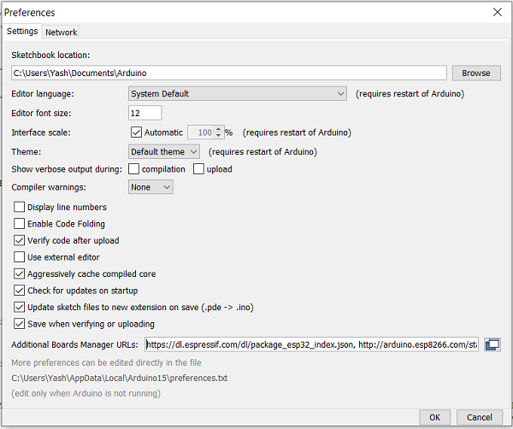
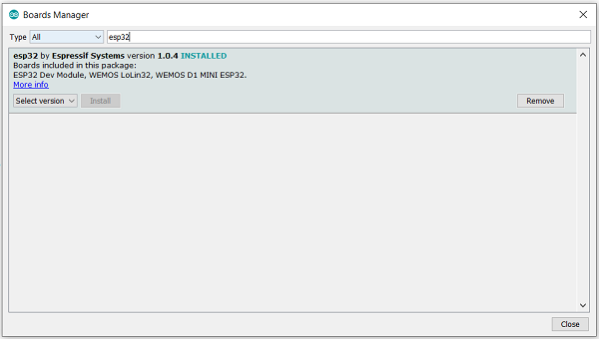
INSTALLATION STEPS
Now, to install the ESP32 board in the Arduino IDE, you need to follow the below steps −
Make sure you have Arduino IDE (preferably the latest version) installed on your machine
Open Arduino and go to File −> Preferences
In the Additional Boards Manager URL, enter
https://dl.espressif.com/dl/package_esp32_index.json
In case you have an existing JSON file's URL in the preferences (this is likely if you've installed ESP8266, stm32duino, or any such additional board in the IDE), you can just append the above path to the existing path, using a comma. An example is shown below, for ESP8266 and ESP32 boards −
http://arduino.esp8266.com/stable/package_esp8266com_index.json, https://dl.espre

Slide 4
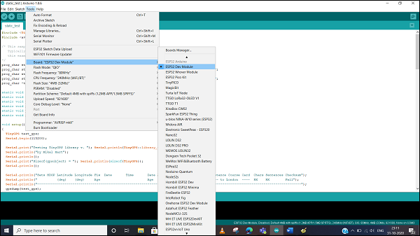
Go to Tools −> Board−> Boards Manager. A pop−up would open up. Search for ESP32 and install the esp32 by Espressif Systems board. The image below shows the board already installed because I had installed the board before preparing this tutorial.
Verifying the Installation
Once your ESP32 board has been installed, you can verify the installation by going to Tools −> Boards. You can see a whole bunch of boards under the ESP32 Arduino section. Choose the board of your choice. If you are not sure which board best represents the one you have, you can choose ESP32 Dev Module.

Slide 5
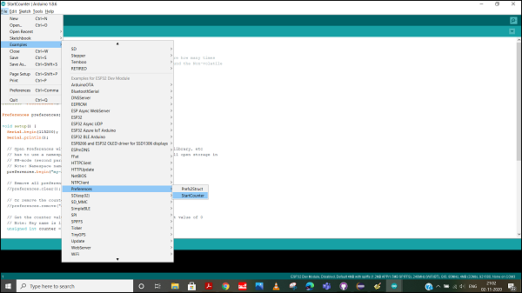
Next, connect your board to your machine using the USB Cable. You should see an additional COM Port under Tools−> Port. Select that additional port. In case you see multiple ports, you can disconnect the USB and see which port disappeared. That port corresponds to ESP32.
Once the port is identified, pick any one example sketch from File −> Examples. We will choose the StartCounter example from File −> Examples −> Preferences −> StartCounter.
Open that sketch, compile it and flash it into the ESP32 by clicking on the Upload button (the right arrow button, besides the Compile button).

Slide 6
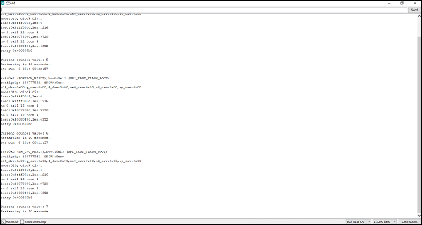
Serial Monitor
Then open the Serial Monitor using Tools −> Serial Monitor, or simply by pressing Ctrl + Shift + M on your keyboard. You should see the counter value getting incremented after every ESP32 restart.
Congratulations!! You've set up the environment for working with ESP32.

Slide 7
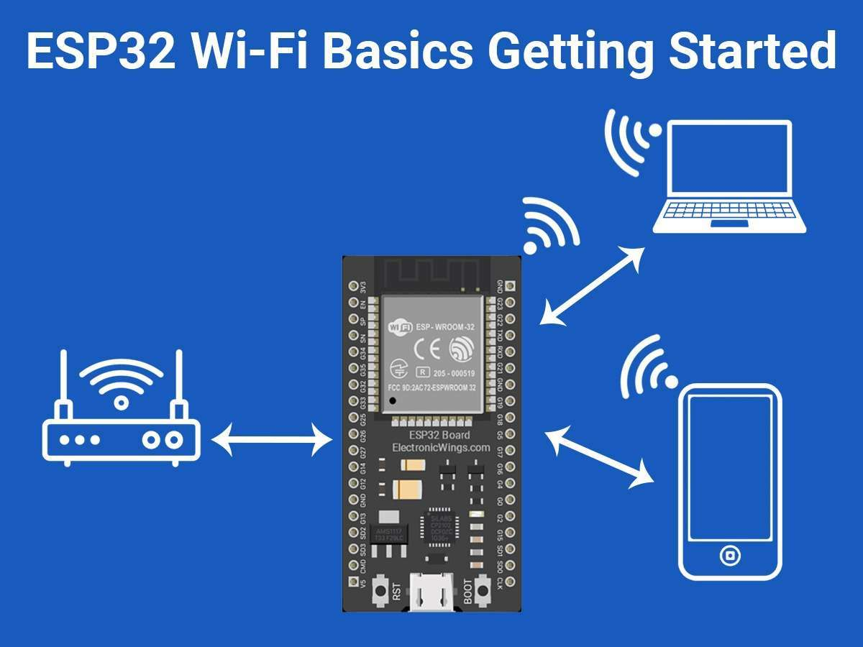

Slide 8
WIFI ON ESP32
The availability of a WiFi stack is one of the main differentiators between ESP32 and other microcontrollers. This chapter will give you a brief overview of the various WiFi modes available on ESP32. Subsequent chapters cover the transmission of data of WiFi using HTTP, HTTPS, and MQTT. There are 3 primary modes in which the WiFi can be configured on ESP32:
Station Mode − This is like the WiFi client mode. The ESP32 connects to an available WiFi field which in turn is connected to your internet. This is exactly similar to connecting your mobile phone to an available WiFi network.
Access Point Mode − This is equivalent to turning on the hotspot on your mobile phone so that other devices can connect to it. Similarly, ESP32 creates a WiFi field around itself that other devices can connect to. ESP32, however, does not have internet access by itself. Therefore, with this mode, you can generally display only a couple of webpages hardcoded into ESP32's memory. This mode is generally used to perform device setup during installation. Say you are taking your ESP32 to an unknown client site whose WiFi credentials you don't know beforehand. You will program the ESP32 to start operation in the Access Point mode. As soon as your mobile phone connects to the WiFi field created by ESP32, a page can open up (Captive Portal) and it will prompt you to enter WiFi credentials. Once you enter those credentials, the ESP32, will switch to station mode and try to connect to the available WiFi network using the credentials provided.
Combined AP-STA mode − As you might have guessed, in this mode, ESP32 is connected to an existing WiFi network and at the same time it is creating its own field, which other devices can connect to.
Most of the time, you will be using the ESP32 in the station mode. In all the 3 subsequent chapters as well, we will be using the ESP32 in the station mode. However, you should know about the AP mode as well and you are encouraged to explore examples of the AP mode yourself.

Slide 9
TRANSMITTING DATA OVER BLUETOOTH CLASSIC
Bluetooth using ESP32. Arduino has a dedicated BluetoothSerial library for ESP32 that makes transmitting data over Bluetooth as simple as transmitting data to the Serial monitor. We will look at how to create a Bluetooth field around the ESP32, connect our smartphone to that field, and communicate with the ESP32.
Code Walkthrough
We will be using an example code for this chapter. You can find it in File −> Examples −> BluetoothSerial −>SerialToSerialBT. It can also be found on GitHub.
We begin with the inclusion of the BluetoothSerial library.
#include <BluetoothSerial.h>
The next few lines of code are a bit irrelevant if you haven't messed around with your ESP32. They check if Bluetooth is configured enabled, and throw up a warning if it is not. Bluetooth config is enabled by default on your ESP32, so you may as well comment out these lines if you have used your ESP32 strictly with the Arduino IDE. The make menuconfig which the error message refers to is actually accessed through ESP−IDF and not through Arduino IDE. So, the bottom line is, don't worry about these lines.
Next, we define the BluetoothSerial object.
BluetoothSerial SerialBT;
Within setup, we will begin the Bluetooth field around our ESP32 using the SerialBT.begin() function. This function takes an argument, the name of your Bluetooth device (ESP32 in this case). This is the name that will be shown when you scan for Bluetooth networks on your cell phone.

Slide 10
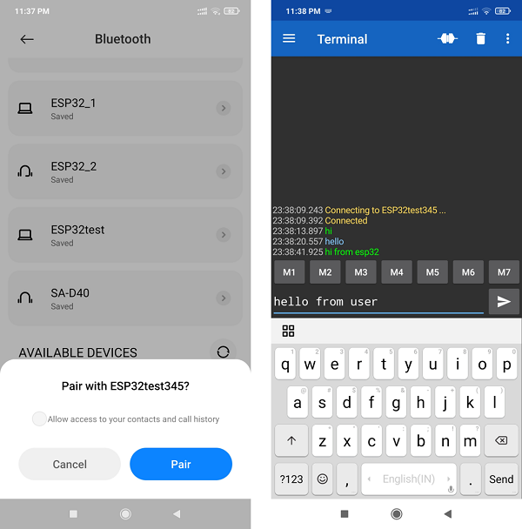
void setup() {
Serial.begin(115200);
SerialBT.begin("ESP32test"); //Bluetooth device name
Serial.println("The device started, now you can pair it with bluetooth!");
}
void loop() {
if (Serial.available()) {
SerialBT.write(Serial.read());
}
if (SerialBT.available()) {
Serial.write(SerialBT.read());
}

Slide 11
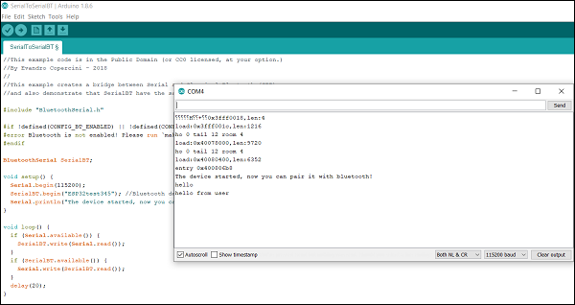
Corresponding view of Arduino Serial Terminal
Congratulations. You've communicated with your ESP32 using BlueTooth. Go ahead and explore the other examples that come along with the BluetoothSerial library.
Note − You may be tempted to use WiFi and Bluetooth simultaneously on ESP32. This is not recommended. While ESP32 has separate stacks for WiFi and Bluetooth, they share a common radio antenna. Therefore, the behavior of the module when both the stacks are trying to access the antenna becomes unpredictable. It is recommended that only one stack accesses the antenna at a time.

Slide 12
PERFORMING OVER-THE-AIR UPDATE OF ESP32 FIRMWARE
The process is quite simple. The device first downloads the new firmware in chunks and stores it in a separate area of the memory. Let's call this area the 'OTA space'. Let's call the area of the memory where the current code or the application code is stored as the 'Application space'. Once the entire firmware has been downloaded and verified, the device bootloader swings into action. Consider the bootloader as a code written in a separate area of the memory (let's call it the 'Bootloader space'), whose sole purpose is to load the correct code in the Application space every time the device restarts.
Thus, every time the device restarts, the code in the Bootloader space gets executed first. Most of the time, it simply passes control to the code in the Application space. However, after downloading the newer firmware, when the device restarts, the bootloader will notice that a newer application code is available. So it will flash that newer code from the OTA space into the Application space and then give control to the code in the Application space. The result will be that the device firmware will be upgraded.
Now, digressing a bit, the bootloader can also flash the factory reset code from the 'Factory Reset space' to the Application space, if the Application code is corrupted, or a factory reset command is sent. Also, often, the OTA code and the factory reset codes are stored on external storage devices like an SD Card or an external EEPROM or FLASH chip, if the microcontroller doesn't have enough space. However, in the case of ESP32, the OTA code can be stored in the microcontroller's memory itself.

Slide 13
We will be using an example code for this chapter. You can find it in File −> Examples −> Update −> AWS_S3_OTA_Update. It can also be found on GitHub.
This is one of the very detailed examples available for ESP32 on Arduino. The author of this sketch has even provided the expected Serial Monitor output of the sketch in comments. So while much of the code will be self−explanatory through the comments, we'll walk over the broad idea and also cover the important details. This code makes use of the Update library which, like many other libraries, makes working with ESP32 very easy, while keeping the rigorous work under−the−hood.
In this specific example, the author has kept the binary file of the new firmware in an AWS S3 bucket. Providing a detailed overview of AWS S3 is beyond the scope of this chapter, but very broadly, S3 (Simple Storage Service) is a cloud storage service provided by Amazon Web Services (AWS). Think of it like Google Drive. You upload files to your drive and share a link with people to share it. Similarly, you can upload a file to S3 and access it via a link. S3 is much more popular because a lot of other AWS services can interface seamlessly with it. Getting started with AWS S3 will be easy. You can get help from several resources available through a quick Google search. In the comments at the beginning of the sketch as well, a few steps to get started are mentioned.

Slide 14
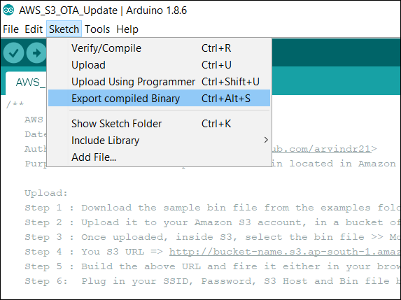
OTA PROCESS
An important recommendation to note is that you should use your own binary file for this code. The comments at the top of the sketch suggest that you can use the same binary file that the author has used. However, downloading a binary compiled on another machine/ another version of Arduino IDE has been known to cause errors sometimes in the OTA process. Also, using your own binary will make your learning more 'complete'. You can export the binary of any ESP32 sketch by going to Sketch −> Export Compiled Binary. The binary (.bin) file gets saved in the same folder in which your Arduino (.ino) file is saved.

Slide 15
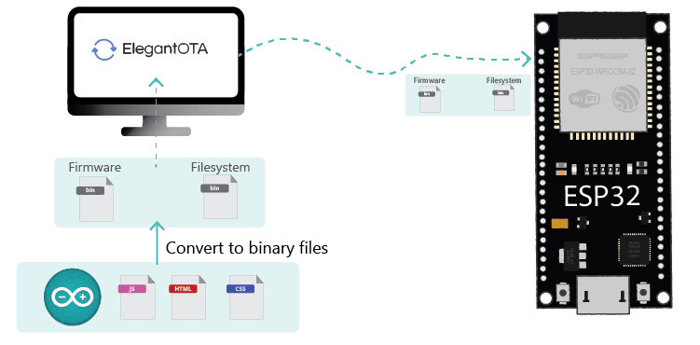

Slide 16
Once your binary is saved, you just need to upload it to S3 and add the link to the bucket and address of the binary file in your code. The binary you save should have some print statement to indicate that it is different from the code you flash in the ESP32. A statement like "Hello from S3" maybe. Also, don't keep the S3 bucket link and bin address in the code as it is.
Alright! Enough talk! Let's begin the walkthrough now. We will begin by including the WiFi and Update libraries.
#include <WiFi.h>
#include <Update.h>
Next, we define a few variables, constants, and also the WiFiClient object. Remember to add your own WiFi credentials and S3 credentials.

Slide 17
WiFiClient client;
// Variables to validate
// response from S3
long contentLength = 0;
bool isValidContentType = false;
// Your SSID and PSWD that the chip needs
// to connect to
const char* SSID = "YOUR−SSID";
const char* PSWD = "YOUR−SSID−PSWD";
// S3 Bucket Config
String host = "bucket−name.s3.ap−south−1.amazonaws.com"; // Host => bucket−name.s3.region.amazonaws.com
\

Slide 18
int port = 80; // Non https. For HTTPS 443. As of today, HTTPS doesn't work.
String bin = "/sketch−name.ino.bin"; // bin file name with a slash in front.
Next, a helper function getHeaderValue() has been defined, which basically is used to check the value of a particular header. For example, if we get the header "Content-Length: 40" and it is stored in a String called headers, getHeaderValue(headers,"Content−Length: ") will return 40.
// Utility to extract header value from headers
String getHeaderValue(String header, String headerName) {
return header.substring(strlen(headerName.c_str()));
}
Next, the main function execOTA(), which performs the OTA. This function has the entire logic related to the OTA. If you look at the Setup, we simply connect to the WiFi and call the execOTA() function.

Slide 19
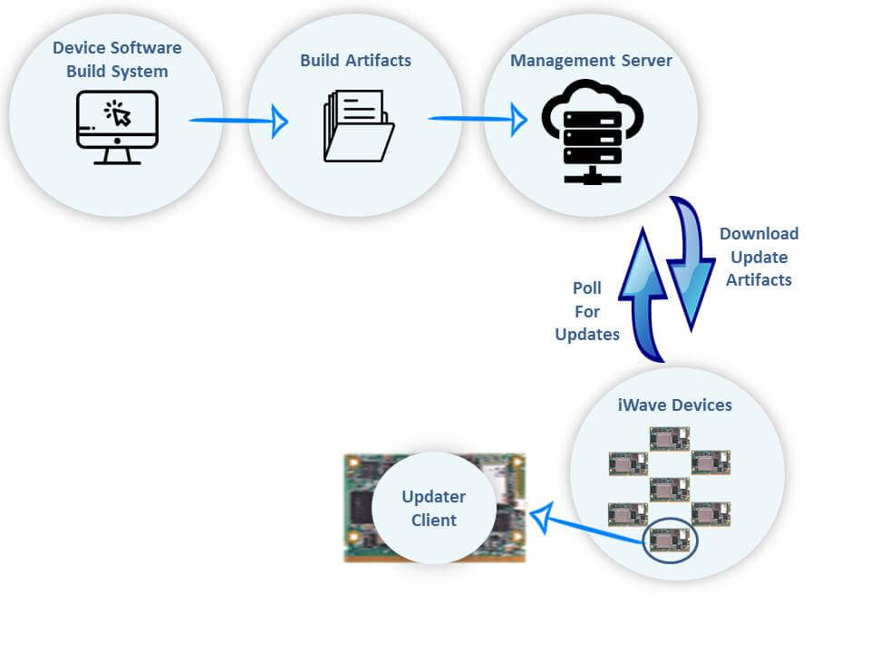
So you would have understood that understanding the execOTA function means understanding this entire code. Therefore, let's begin the walkthrough of that function.
We begin by connecting to our host, which is the S3 bucket in this case. Once connected, we fetch the bin file from the bucket, using a GET request (refer to the HTTP tutorial for more information on GET requests)
void execOTA() {
Serial.println("Connecting to: " + String(host));
// Connect to S3
if (client.connect(host.c_str(), port)) {
// Connection Succeed.
// Fecthing the bin
Serial.println("Fetching Bin: " + String(bin));
// Get the contents of the bin file
client.print(String("GET ") + bin + " HTTP/1.1\r\n" +
"Host: " + host + "\r\n" +
"Cache-Control: no-cache\r\n" +
"Connection: close\r\n\r\n");
Next, we wait for the client to get connected. We give a maximum of 5 seconds for the connection to get established, otherwise we say that the connection has timed out and return.

Slide 20
unsigned long timeout = millis();
while (client.available() == 0) {
if (millis() - timeout > 5000) {
Serial.println("Client Timeout !");
client.stop();
return;
}
}
Assuming that the code has not returned in the previous step, we have a successful connection established. The expected response from the server is provided in the comments. We begin by parsing that response. The response is read line by line, and each new line is stored in a variable called line. We specifically check for the following 3 things −
If the response status code is 200 (OK)
What is the Content-Length
Whether the content type is application/octet-stream (this is the type expected for a binary file)

Slide 21
APPLICATIONS OF ESP32
Now that you are fairly familiar with ESP32, let's look at its application. This is a chapter where I feel I need not tell you much. After going through the various chapters in this tutorial, you would have started forming ideas in your head. You would have already created a rough list of applications where you could use ESP32. And the good news is that most of the applications you've listed are feasible.
However, ESP32 is more feasible for some applications than others. In this chapter, my focus will be on making you understand the factors you should consider when deciding whether to use ESP32 for an application or not. Please note that this chapter is production focused, i.e., when we are talking of a scale of thousands or lakhs of devices. If you have a requirement of a handful of devices and ESP32 can serve them, just simply go ahead and use ESP32 without a second thought. Also, for prototyping/ establishing Proof of Concept (PoC), you can use ESP32 without any hesitation.
One of the major advantages of ESP32 is the presence of inbuilt WiFi and Bluetooth stacks and hardware. Therefore, ESP32 will be your choice of microcontroller in a static application where good WiFi connectivity is guaranteed, say an environment monitoring application in, say, a laboratory. The presence of WiFi stack on the module itself means you will have saved money on an additional networking module. However, if you use ESP32 in an asset tracking application, where it keeps moving around, you will have to rely on a GSM or LTE module for connectivity to the server (because you will not be guaranteed WiFi availability). In such a scenario, ESP32 loses the competitive advantage, and you may be better off using a cheaper microcontroller that can serve your purpose.

Slide 22
APPLICATIONS OF ESP32
The presence of two cores again makes ESP32 your choice of microcontroller for processing-heavy applications like those receiving data at a very high baud rate and requiring the data processing and transmission to run on separate cores. Several such applications can be found in Industrial IoT. But for a very light application, where you don't even require secure communication, a microcontroller having modest specs may prove to be more useful. After all, what is the use of having (and effectively paying for) two cores, when you can make do with one?
Another factor to consider is the number of GPIOs and peripherals. ESP32 has 3 UART channels. If you have an application where you need more than 3 UART channels, you may have to look for another microcontroller. Similarly, ESP32 has 34 programmable GPIOs which are more than sufficient for most applications. However, if your application does require more GPIOs, you may have to switch to another microcontroller
ESP32's 1.5 MB of default SPIFFS provides you with more storage onboard the microcontroller than most other microcontrollers. If your storage requirements are within 1.5 MB, ESP32 saves you the cost of an external SD Card or Flash Chip. ESP32 does wear-leveling within SPIFFS by itself, saving you a lot of development efforts as well. However, if your storage requirements are not met by ESP32, again, the competitive advantage disappears.
ESP32's 520 KB of RAM is also more than sufficient for most applications. It is only for very heavy applications like image/video processing where this proves to be a bottleneck.
To summarize, ESP32 has specs that are good enough to accommodate most of your applications. When scaling up production, you need to just make sure that the specs are not an overkill for you. In other words, if you can get the desired output with modest specs, you may be better off using a cheaper microcontroller and save money. These savings become significant when your production numbers increase by orders of magnitude. However, production aside, ESP32 is definitely the ideal microcontroller for prototyping and establishing the PoC.

Slide 23
Arduino C/C++
Arduino C/C++ is the programming language used for writing code that runs on Arduino microcontrollers. It is essentially a variant of the C and C++ programming languages with additional libraries and conventions to make it user-friendly for hobbyists and beginners in the field of electronics.
Explanation:
Language Roots: Arduino C/C++ is rooted in the standard C and C++ languages, which are powerful and widely used in software development. Arduino simplifies and abstracts certain aspects to make programming microcontrollers more accessible.
API for Microcontrollers: The Arduino platform provides an extensive set of libraries and functions that abstract the intricacies of low-level hardware interactions. These libraries simplify common tasks such as reading analog or digital inputs, controlling output pins, and interfacing with various sensors and actuators.
Event-Driven Model: Arduino programs generally follow an event-driven model, with the setup() function being executed once at the beginning to set up initial configurations, and the loop() function running continuously in a loop. This structure simplifies the organization of code, especially for beginners.

Slide 24
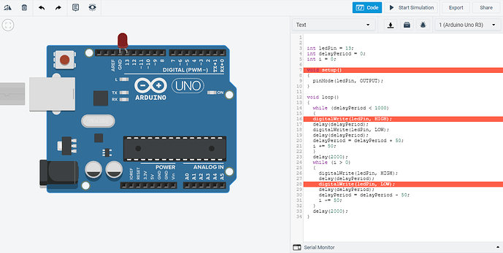
EXAMPLE:
// Example Arduino C/C++ code to blink an LED
void setup() {
pinMode(13, OUTPUT); // Set pin 13 as output
}
void loop() {
digitalWrite(13, HIGH); // Turn on the built-in LED
delay(1000); // Wait for 1 second
digitalWrite(13, LOW); // Turn off the built-in LED
delay(1000); // Wait for 1 second
}

Slide 25
In this example, the code initializes pin 13 as an output, then repeatedly turns an LED on and off at one-second intervals.
4. Purpose:
Education and Learning: Arduino C/C++ is designed with education in mind, especially for those new to programming and electronics. Its simplicity and ease of use make it an excellent starting point for beginners to learn the fundamentals of coding and hardware interaction.
Prototyping and Rapid Development: The language is optimized for rapid prototyping and experimentation. It allows users to quickly implement and test ideas without the need for extensive low-level programming.
Cross-disciplinary Projects: Arduino is widely used in various disciplines, including art, design, and engineering. Its simplicity and versatility make it a preferred choice for cross-disciplinary projects where both software and hardware components are involved.

Slide 26
Advantages:
Abstraction of Complexity: Arduino C/C++ abstracts complex hardware operations, providing high-level functions that simplify tasks like reading analog values, controlling servos, and communicating over serial. This abstraction makes it more accessible to beginners.
Community and Documentation: Arduino has a large and active community. Users can benefit from a wealth of online resources, including tutorials, forums, and example projects. The extensive documentation helps users understand the functionalities of libraries and functions.
Open Source Philosophy: Arduino follows an open-source philosophy. Both the hardware and software aspects of Arduino are open source, encouraging collaboration, sharing of knowledge, and modification of designs to meet specific project requirements.
Extensibility: Users can extend the functionality of Arduino by creating and sharing their own libraries. This extensibility allows for a wide range of applications and compatibility with various sensors, actuators, and communication modules.
In conclusion, Arduino C/C++ serves as a bridge between the complexity of microcontroller programming and the accessibility required for educational and prototyping purposes. Its roots in C and C++ provide a solid foundation for learning, experimenting, and creating diverse projects within the Arduino ecosystem.

Slide 27
Thank You..

