Slide 1
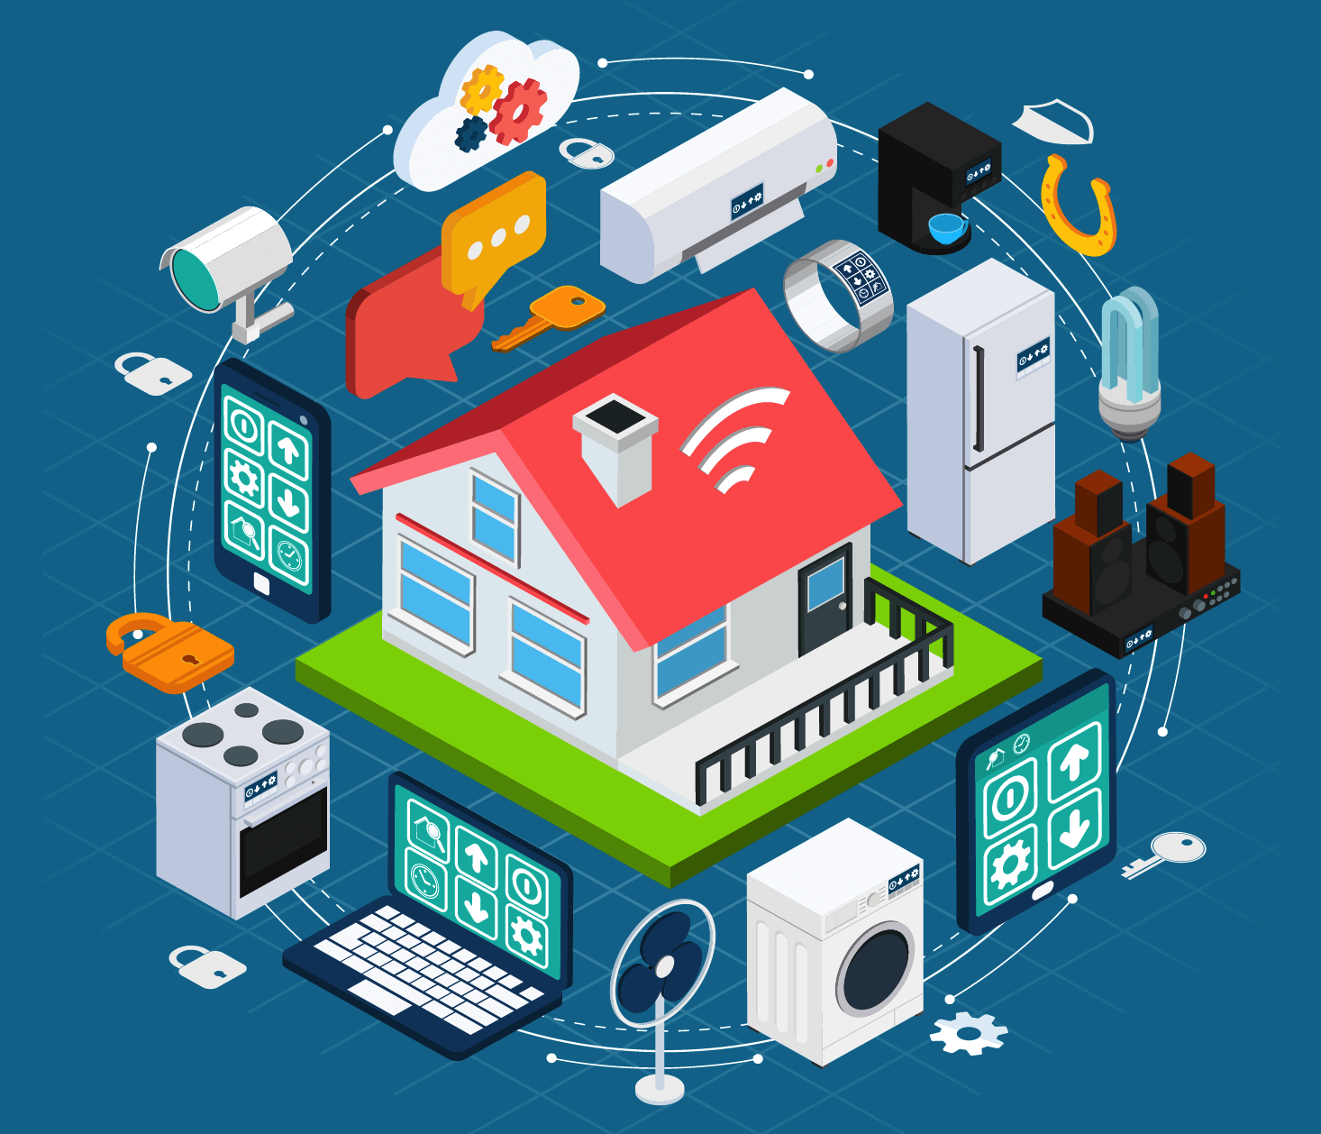
“IoT”
Internet Of Things

Slide 2
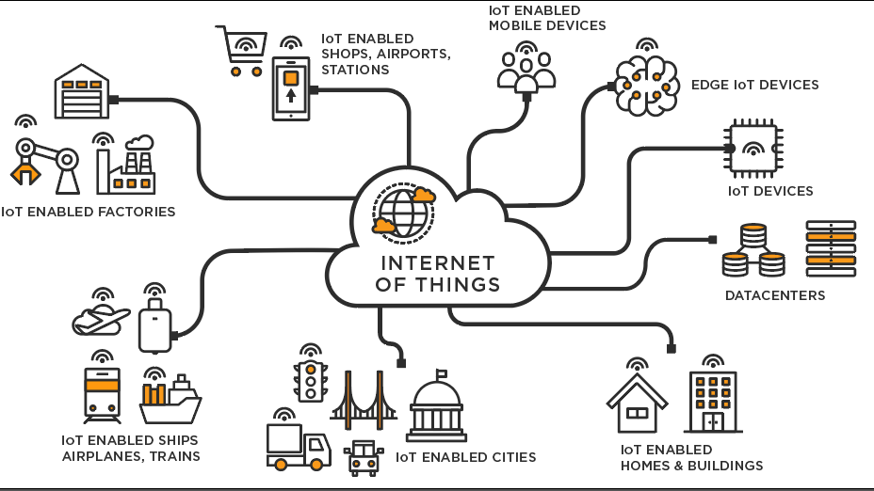
"What is IoT?"
"When you Google 'what is IoT,' many answers are unnecessarily technical."
"The Internet of Things (IoT) is a system of interrelated computing devices, mechanical and digital machines, objects, animals, or people that are provided with unique identifiers and the ability to transfer data over a network without requiring human-to-human or human-to-computer interaction."

Slide 3
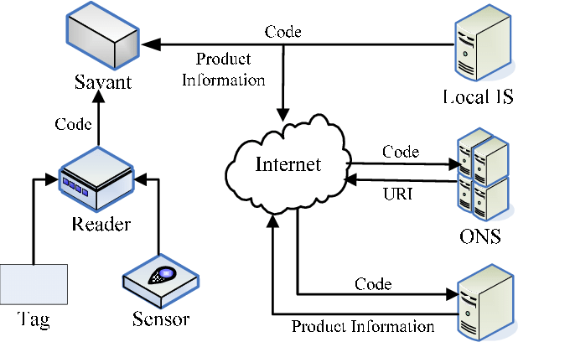
"A Simple, Non-Technical Explanation"
"IoT and The Internet of Things used interchangeably."
"Avoid saying 'the IoT' to sound knowledgeable."

Slide 4
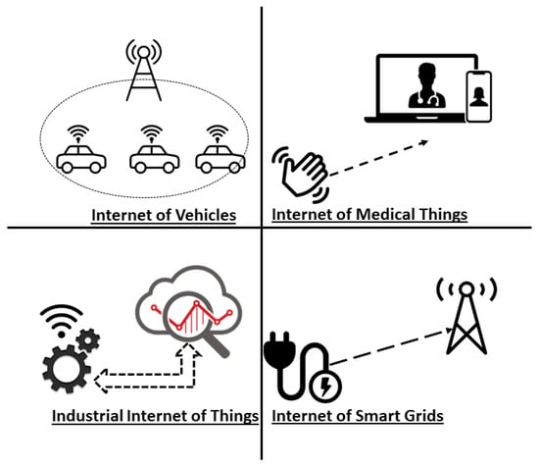
"Connecting the Physical World"
"IoT is connecting all physical places and things to the internet."
"It means taking all the physical places and things in the world and connecting them to the internet."

Slide 5
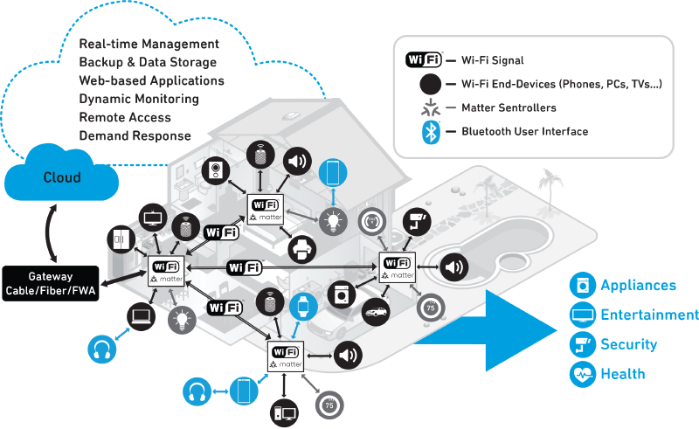
"Why IoT Matters“?
"Connected things can send and/or receive information, making them 'smart.'"
"When something is connected to the internet, it can send information or receive information, or both."

Slide 6
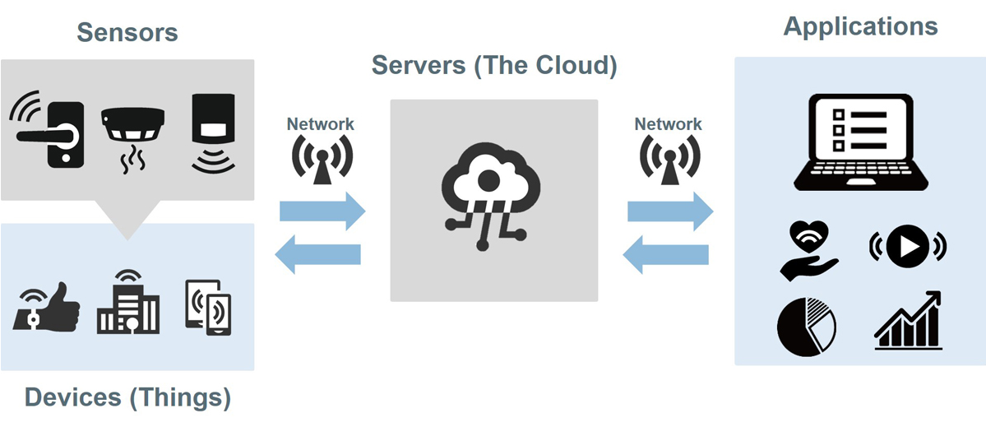
"Categories in IoT"
Things that collect information and then send it."
Things that receive information and then act on it."
Things that do both."

Slide 7
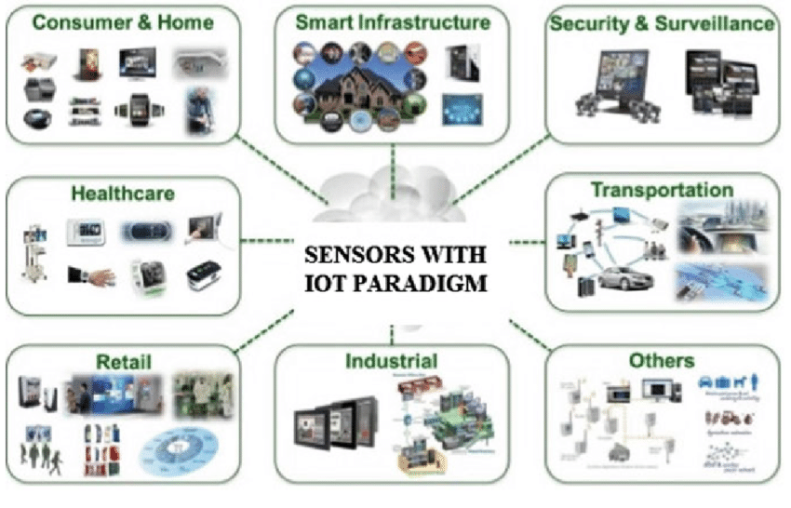
"Collecting and Sending Information"
"Examples of sensors: temperature, motion, moisture, air quality, light."
"Sensors, along with a connection, allow us to automatically collect information from the environment for more intelligent decisions."

Slide 8
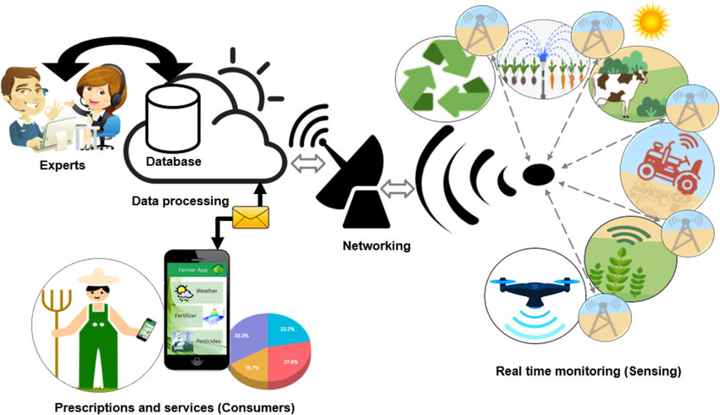
"Receiving and Acting on Information"
Printer printing a document, car doors opening."
"Real power arises when things can collect information, send it, receive information, and act on it."

Slide 9
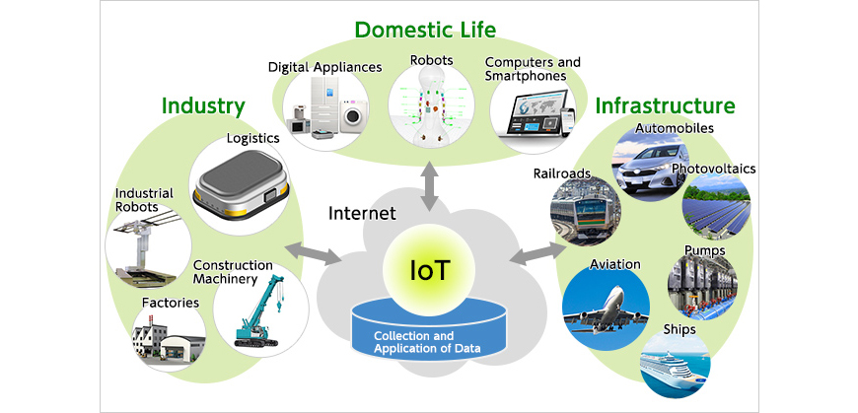
"Doing Both: The Goal of an IoT System"
Example: "Farming - Irrigation system automatically adjusts based on soil moisture and weather conditions."
"The goal is to have things that can collect information and send it, but also receive information and act on it."

Slide 10
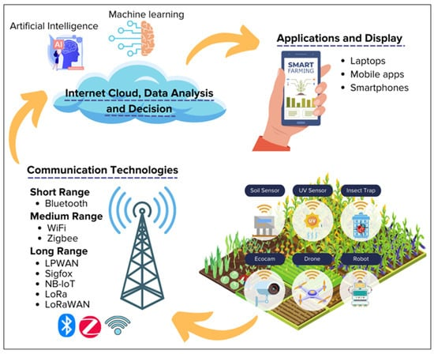
"Beyond Farming: IoT Applications"
“Agriculture is just one of many applications of IoT."
"With numerous sensors and algorithms, IoT can revolutionize various fields, helping to feed the world."

Slide 11
Thank You

