Slide 1

Essentials of Electronics Design
From Ohm's Law to EasyEDA
Comprehensive Curriculum

Slide 2
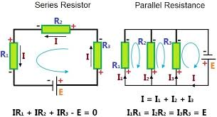
Importance of Circuit Analysis
Foundation of Electronics Engineering:
Circuit analysis, rooted in electrical engineering principles, focuses on ensuring that selected components can handle the anticipated voltages and currents in a circuit. It involves mathematical analysis to calculate unknown elements like voltage or current, typically after simplifying the circuit.
To perform a circuit analysis, you'll need the following tools:
Circuit Schematics:
Understand the circuit's schematics, visualizing it on paper.
Draw a comprehensive circuit diagram, including all components.
Resistor Simplification:
Simplify resistors into a single equivalent resistor.
Combine resistors in series or parallel into one value.

Slide 3
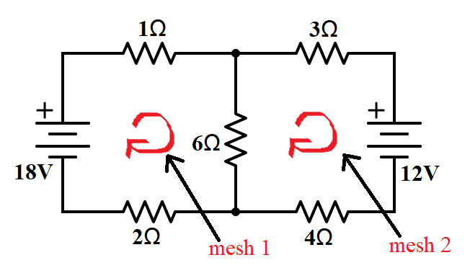
Importance of Circuit Analysis
Fundamental Equations and Laws of Physics:
Familiarize yourself with fundamental equations and laws governing physics.
Ohm’s law
Power / energy definitions and equations
Understand the relationships involving voltage, current, and resistance.
Measurement Tools (Real-life Applications):
In real-life applications, utilize a voltmeter and an ammeter.
Measure voltage and current to obtain initial values for further calculations.

Slide 4
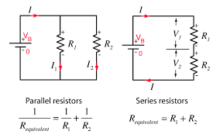
Using Circuit Analysis Tools
In circuit analysis, various tools play a crucial role in understanding and evaluating electronic systems. Here's a brief overview of two essential tools:
1. Circuit Schematics:
Definition: A circuit schematic, often called a circuit diagram, is a visual representation of a circuit, displaying its connections and components.
Purpose: Engineers use circuit schematics to plan circuits before physical implementation, helping in the identification of necessary components.
Representation: Components are depicted by symbols, connected by vertical and horizontal lines indicating conductors.
2. Resistor Simplification:
Definition: Resistor simplification involves condensing multiple resistors within a circuit to a single equivalent resistor.
Method:
Start with the resistor farthest from the main circuit.
Replace groups of resistors in a loop with a single resistor, considering series or parallel connections.
Repeat until only one resistor remains in the circuit.
Analogy: Analogous to simplifying fractions in mathematics, this process aids in streamlining circuit analysis.

Slide 5
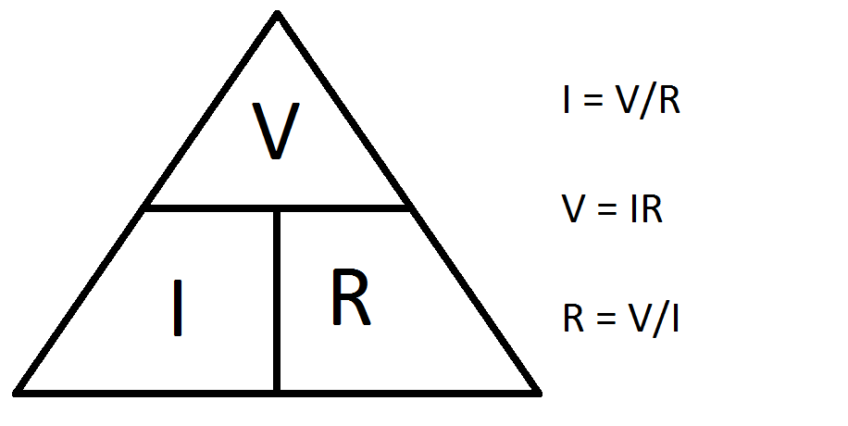
Fundamental Equations in Circuit Analysis
In circuit analysis, understanding fundamental equations is crucial for evaluating ideal circuits. Here are key equations to remember:
1. Ohm's Law:
Equation: V=I⋅R
Explanation: Ohm's law relates voltage (V), current (I), and resistance (R), allowing calculation of resistance at a specific point in a circuit.
2. Power in a Resistor:
Equation: P=I^2⋅R
Explanation: This equation determines the power (P) in watts, considering current (I) and resistance (R).

Slide 6
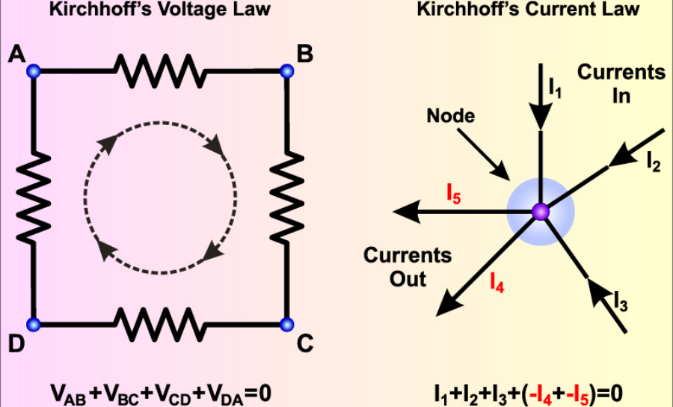
Kirchhoff's Laws:
Kirchhoff's Laws:
3. Kirchhoff's Current Law:
Statement: The total current entering a circuit equals the total current leaving the circuit.
Mathematical Expression: ∑in=∑out∑in​=∑out​
Application: Used for calculating current in branches of a parallel circuit.
4. Kirchhoff's Voltage Law:
Statement: The sum of potential differences in a loop equals zero.
Mathematical Expression: ∑loop=∑Vloop​=0
Explanation: Describes the distribution of total voltage within a circuit loop.
Understanding these fundamental equations and laws forms the basis for effective circuit analysis.

Slide 7
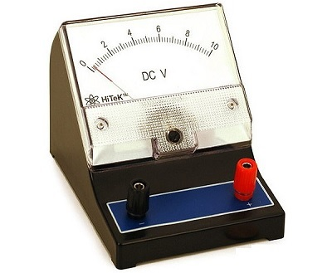
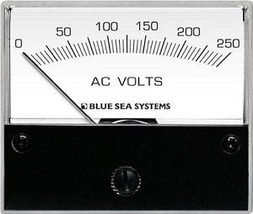
Basic Measuring Instruments in Electrical Circuits
In the realm of electrical circuits, measuring instruments are indispensable for assessing critical quantities. Two fundamental tools, voltmeters and ammeters, play a pivotal role in this domain. Here's a concise exploration:
Types of Basic Measuring Instruments:
Voltmeters:
Definition: A voltmeter gauges the voltage across any two points within an electric circuit.
Units: Voltage is measured in volts (V), and the instrument takes the form of a meter.
Varieties:
DC Voltmeters: Gauge direct current (DC) voltage.
AC Voltmeters: Assess alternating current (AC) voltage.
Example: An analogy could be a thermometer measuring temperature, where the DC voltmeter is akin to measuring a constant temperature, and the AC voltmeter is like measuring temperature variations.

Slide 8
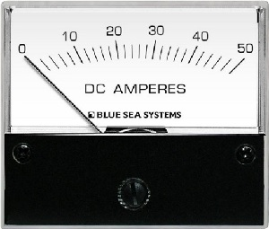
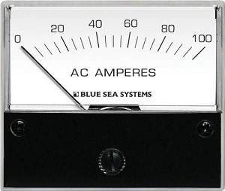
Basic Measuring Instruments in Electrical Circuits
Ammeters:
Definition: An ammeter quantifies the flow of current through any two points in an electric circuit.
Unit: Current is quantified in amperes (A), and the instrument adopts the structure of a meter.
Varieties:
DC Ammeters: Evaluate direct current (DC) current.
AC Ammeters: Assess alternating current (AC) current.
Example: Think of an ammeter like a flowmeter in a pipeline, where the DC ammeter measures a steady flow, and the AC ammeter measures fluctuations in the flow.

Slide 9
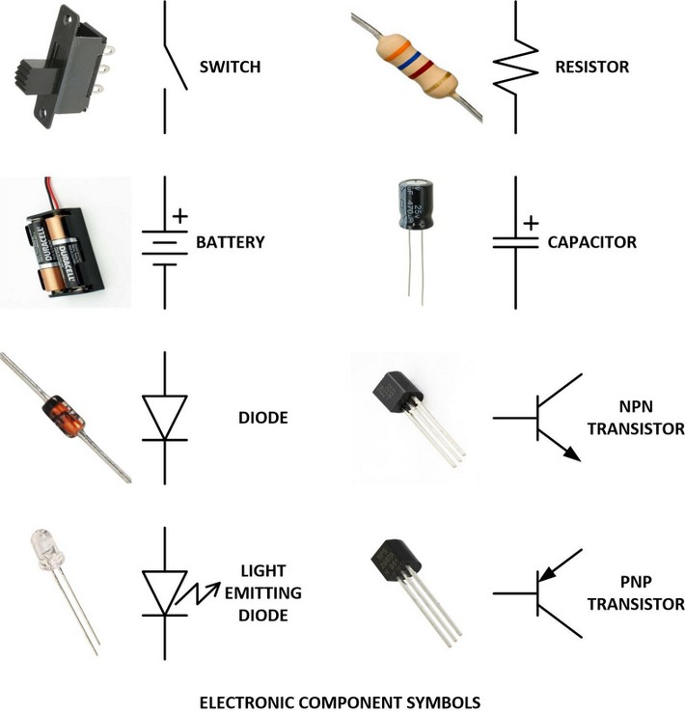
Electronics Components

Slide 10
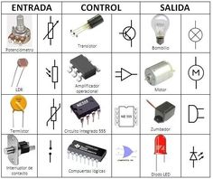
Electronics Components

Slide 11
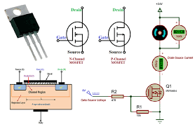
MOSFET BASICS
What Is a MOSFET?
Metal Oxide Silicon Field Effect Transistors commonly known as MOSFETs are electronic devices used to switch or amplify voltages in circuits. It is a voltage controlled device and is constructed by three terminals. The terminals of MOSFET are named as follows:
Source
Gate
Drain
Body

Slide 12
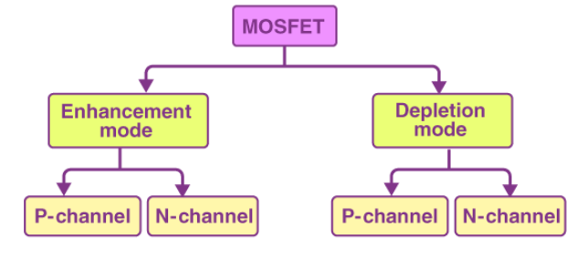
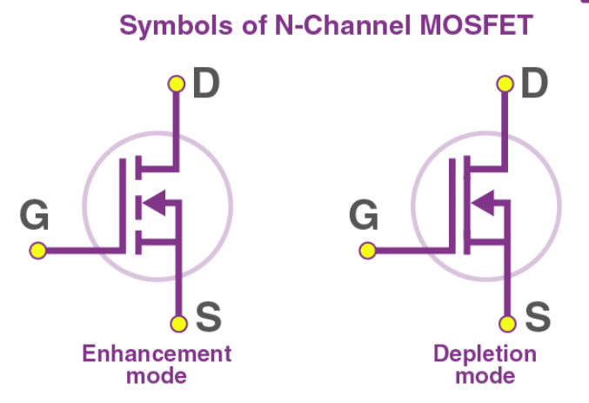
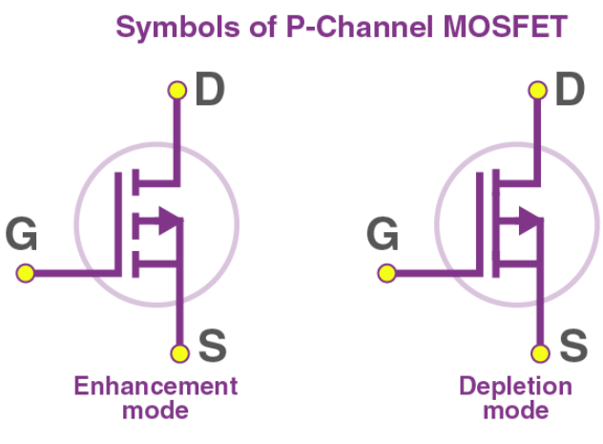
MOSFET Types
The classification of MOSFET based on the construction and the material used is given below in the flowchart.
MOSFETs are of two classes: Enhancement mode and depletion mode. Each class is available as n-channel or p-channel; hence overall they tally up to four types of MOSFETs.
Depletion Mode
When there is no voltage across the gate terminal, the channel shows maximum conductance. When the voltage across the gate terminal is either positive or negative, then the channel conductivity decreases.
Enhancement Mode
When there is no voltage across the gate terminal, then the device does not conduct. When there is the maximum voltage across the gate terminal, then the device shows enhanced conductivity.
The N-channel MOSFETs are abbreviated as NMOS and are symbolically represented as shown in the figure

Slide 13
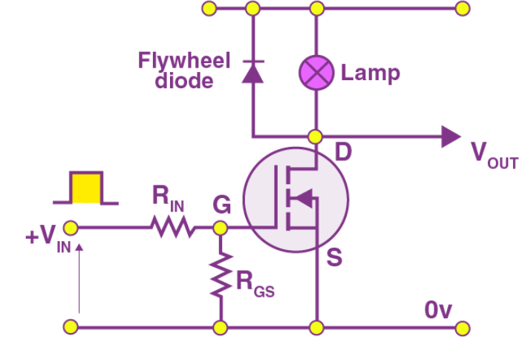
OPERATING REGIONS OF MOSFET
A MOSFET is seen to exhibit three operating regions. Here, we will discuss those regions.
Cut-Off Region
The cut-off region is a region in which there will be no conduction and as a result, the MOSFET will be OFF. In this condition, MOSFET behaves like an open switch.
Ohmic Region
The ohmic region is a region where the current (I_{DS})increases with an increase in the value of V_{DS}. When MOSFETs are made to operate in this region, they are used as amplifiers.
Saturation Region
In the saturation region, the MOSFETs have their I_{DS} constant in spite of an increase in V_{DS} and occurs once V_{DS} exceeds the value of pinch-off voltage V_{P}. Under this condition, the device will act like a closed switch through which a saturated value of I_{DS} flows. As a result, this operating region is chosen whenever MOSFETs are required to perform switching operations.
MOSFET as a Switch
MOSFETs are commonly used as switches. The circuit below shows the configuration of MOSFET when it is used as a switch.

Slide 14
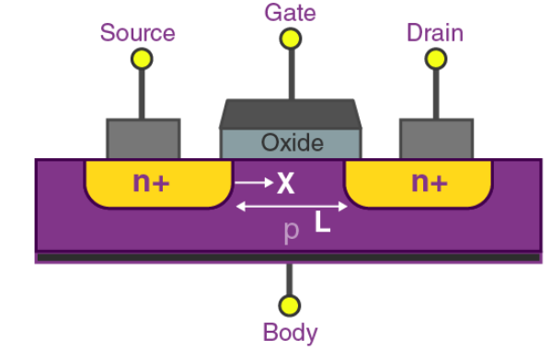
MOSFET CONSTRUCTION
The circuit of MOSFET is typically represented as follows:
The p-type semiconductor forms the base of the MOSFET.
The two types of the base are highly doped with an n-type impurity which is marked as n+ in the diagram.
From the heavily doped regions of the base, the terminals source and drain originate.
The layer of the substrate is coated with a layer of silicon dioxide for insulation.
A thin insulated metallic plate is kept on top of the silicon dioxide and it acts as a capacitor.
The gate terminal is brought out from the thin metallic plate.
A DC circuit is then formed by connecting a voltage source between these two n-type regions.

Slide 15
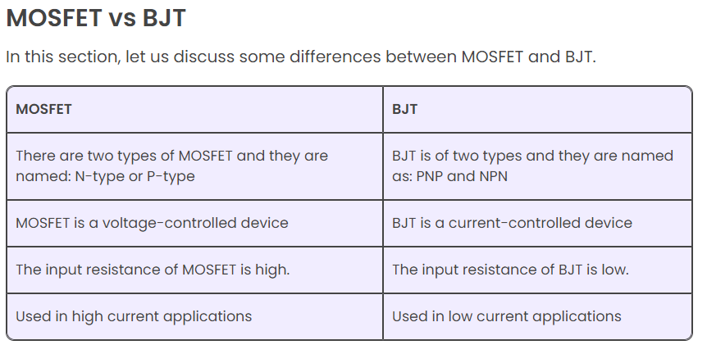
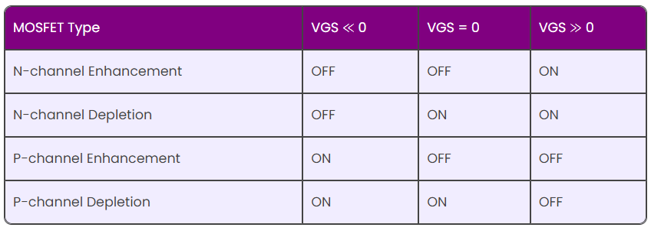
MOSFET APPLICATIONS
Radiofrequency applications use MOSFET amplifiers extensively.
MOSFET behaves as a passive circuit element.
Power MOSFETs can be used to regulate DC motors.
MOSFETs are used in the design of the chopper circuit.
Advantages of MOSFET
MOSFETs operate at greater efficiency at lower voltages.
Absence of gate current results in high input impedance producing high switching speed.
Disadvantages of MOSFET
MOSFETs are vulnerable to damage by electrostatic charges due to the thin oxide layer.
Overload voltages make MOSFETs unstable.

Slide 16
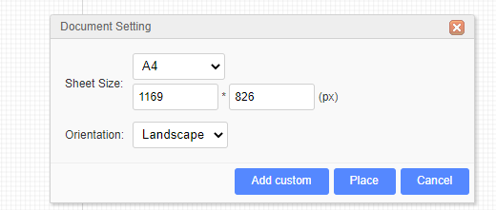
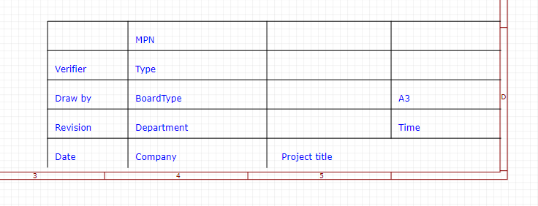
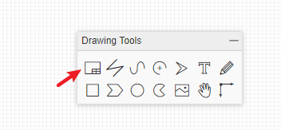
Custom Sheet
EasyEDA supports the schematic diagram drawing frame required by custom. At present, custom drawings need to be placed manually, and automatic reference of custom drawings is not supported when creating new schematic diagram.
How to create:
Click the “Sheet Setting” button at “Drawing Tool”.
Click “Add Custom” button.
It will create a new symbol editor, you can edit the table by line as you want.

Slide 17
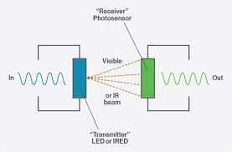
Understanding Optocouplers in Electronics
Optocouplers
Definition: An optocoupler or optoelectronic coupler is an electronic component that basically acts as an interface between the two separate circuits with different voltage levels. Optocouplers are common component by which electrical isolation can be supplied between the input and output source. It is a 6 pin device and can have any number of photodetectors.
Here, a beam of light emitted by a light source exists as an only contact between input and output. Due to this, we can have an insulation resistance of megaohms between the two circuits. In high voltage applications where the voltage difference between the two circuits differs by several thousand volts, such isolation is favourable. The use of all such electronic isolators lies in all that conditions where the signal is to pass between two isolated circuits

Slide 18
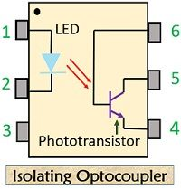
What is an isolated circuit?
Isolated circuits are the circuits which do not have a common conductor in between them and proper isolation is maintained.
As we are already aware of the fact that the information signal highly contains noise and additional distortions in it which can be beyond the tolerance limit of the logic circuit at the output end during transmission. Optical couplers can be used to work on both ac and dc high voltages.
Construction of an Optocoupler
An optocoupler mainly consists of an infrared LED and a photosensitive device that detects the emitted infrared beam. The semiconductor photosensitive device can be a photodiode, phototransistor, a Darlington pair, SCR or TRIAC.
Let’s have a look at the basic diagram of an Optocoupler:

Slide 19
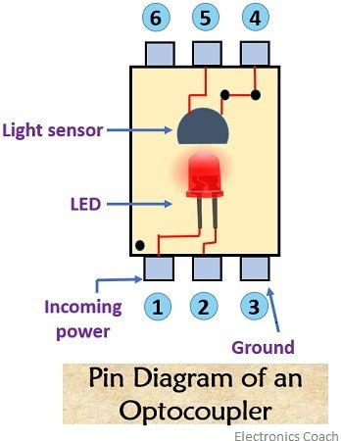
Construction of an Optocoupler
The infrared LED and the device that are light sensitive is packed in a single package. The LED is kept on the input side and the light-sensitive material is placed on the output side. A resistance is connected at the beginning of the circuit which is used to limit the current and the other resistance is connected between the supply voltage and the collector terminal.
Before proceeding further let’s see the pin description of an optocoupler:
Pin 1: Anode
Pin 2: Cathode
Pin 3: Ground
Pin 4: Emitter
Pin 5: Collector
Pin 6: Base
The base terminal of the phototransistor is externally available. A single phototransistor is used at the output stage of a simple isolating optocoupler.

Slide 20
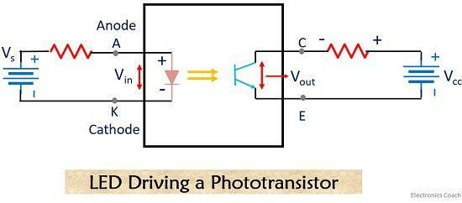
Working Of an Optocoupler
An Optocoupler is a combination of LED and a Photo-diode packed in a single package. As we can see in the below-shown circuit diagram, when a high voltage appears across the input side of the Optocoupler, a current start to flow through the LED.
Basic circuit of optocoupler
Due to this current LED will emit light. This emitted light when falls on a phototransistor cause a current to flow through the same. The current flowing through the phototransistor is directly proportional to the supplied input voltage. An input resistance placed at the beginning of the circuit will decrease the amount of current flowing through the LED if its value is increased. As the LED glows due to this current, hence, when current will be low so as the light intensity of LED.
As we have already discussed earlier the intensity of emitted light by the LED will be equal to the corresponding current flowing through the phototransistor. This means that the low-intensity light emitted by the LED will cause a low-level current to flow through the phototransistor. Thus a changing voltage is generated across the collector-emitter terminal of the transistor.
In this way, an incoming signal from the input circuit is coupled to the output circuit.

Slide 21
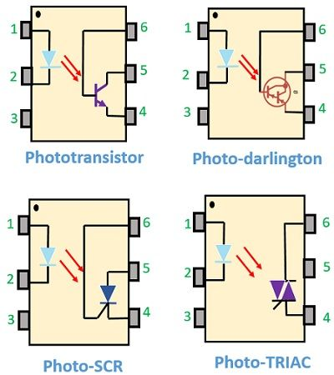
Types of Optocoupler
For the use in DC circuits, photo-transistor and photo-Darlington devices are majorly used. In the case of AC, powered circuits photo-SCR and photo-TRIAC are used.
There exist some other forms of source-sensor configurations like LED-LASER, LED-photodiode, reflective optocoupler, slotted optocoupler etc.
Advantages
Optocouplers allow easy interfacing with logic circuits.
Electrical isolation provides circuit protection.
It allows wideband signal transmission.
It is small in size and lightweight device.
Disadvantages
The operational speed of Optocouplers is low.
In case of a very high power signal, the possibility of signal coupling may arise.

Slide 22
Types of Opto Coupler
Applications
It is used in high power inverters.
It is used in high power choppers.
In AC to DC converters optocouplers are widely used.
The layout of an optocoupler depends basically upon the isolation voltage. To have the appropriate breakdown voltage the optical channel is made as thin as possible

Slide 23
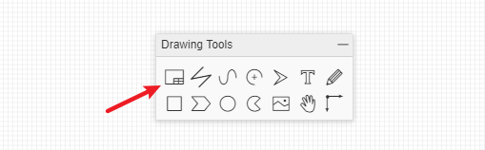
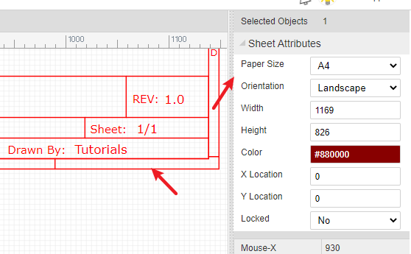
EASYEDA TOOL
Sheet Setting
It is now possible to add design notes to the frame and the frame selection, for example A4, which can assist in aligning and improve the look of printed schematics and PCB designs.
Click the frame/drawing/document button like in the image below
And you can edit the blue text when you’ve selected the text attributes or double clicked it.
The bottom right zone can be selected and dragged or the frame can be dragged and deleted.
When you’ve selected the bottom right zone, you can edit the sheet attributes:

Slide 24
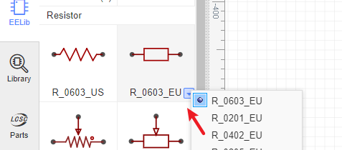
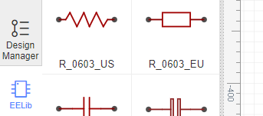
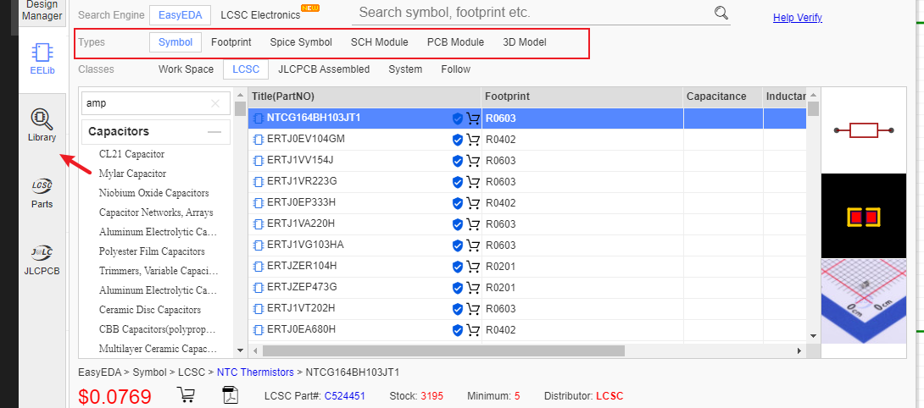
Commonly Library
That contains ready made symbols for a wide range of components and which can be simulated.
Many of these components have optional US and EU style symbols, we split them, so you can select those you like. Click on the drop down list or right click to popup the context menu, it contains many footprints or parameters. EasyEDA will remember your choices for the next time.Don’t forget to use Filter to locate a component fastly. For example, you just need to type 0603 to find all of resistors.
EasyEDA provide a lot of libraries, you can find them at “Left-hand Panel - Library”, hotkey “SHIFT+F”, at here you can search library from LCSC, system, user contributed etc.

Slide 25
EASYEDA CLASSES
Symbol: Schematic symbols
Spice Symbol: Symbols for spice simlation
Footprint: PCB footprints, PCB pattern.
SCH Modules: Schematic modules, a part of the circuit design. It can not assign the PCB module, doesn’t like the schematic Symbol can assign the footprint . when it be placed on the schematic, it will be separated.
PCB Modules: As like as Schematic modules.
3D Model: It is bind with footprint via “3D Model Manager”.
Simply type your part number or symbol’s name to Search. before searching, you must choose the “Type” first.
and then click the “Table of contents” to open the categories list to choose your components.
from there you can scroll up and down to browse parts from each category.
If you know the component’s name
Suppose you want to find the MAX232 (which converts signals from an RS-232 serial port to signals suitable for use in TTL compatible digital logic circuits). Simply type Max232 into the Search box and press Enter.

Slide 26
Classes
Work Space: It include your personal parts and your teams’ parts.
LCSC: EasyEDA online part store LCSC.com parts(Officail Parts). It will add new libraries everyday
LCSC Assembled: JLCPCB Assembled parts. All JLCPCB assembly parts will contain a SMT icon, that means this part can be JLCPCB assemble.
System: EasyEDA system parts, it comes from open source libraries, such as Kicad libraries, company public libraries, user contributions.
Follow: If you follow a user at EasyEDA(You can follow a user at him/her user page), you can view and use his/her libraries.
User Contributed: When you searching a part, maybe you can find it at this class. At EasyEDA, all libraries are public. the detail you can refer at: Contribute
We add an “JLCPCB Assembled” Components option of the Parts, It’s easy to choose which component can be assembled by JLCPCB. Yes, JLCPCB will provide the assembly service. the more information please refer at: How to order a SMT order

Slide 27
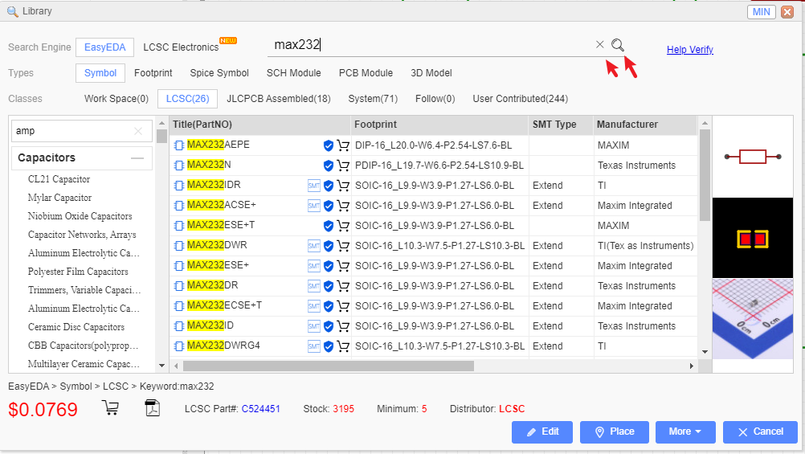
EASYEDA CLASSES

Slide 28
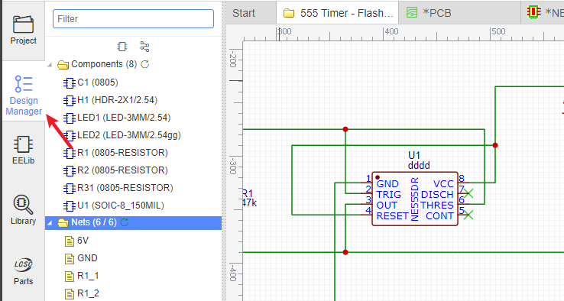
Easyeda Nets
With large schematics it can be hard to find the components quickly. Sometimes, you may make a mistake such as wiring to a wrong component pin. So you need a tool to help you out. Design Manager is just the tool.
Just press the CTRL+D hotkey to open the Design Manager.
or click it via on the left navigation panel:

Slide 29
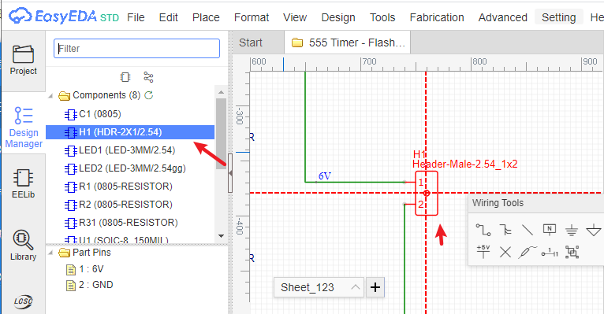
Easyeda Nets
Nets: Lists all the nets in this schematic. A net must connect at least two Pins, or the net name will be marked as a red error. When click the net name, the canvas wire will highlight and being large, when you click the empty space to unhighlight:

Slide 30
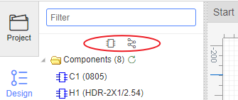
Components
Filter: You can find your components or net name easily: for example, if you want to find all capacitances, you just need to type C;
Components: Lists all the components in this schematic. Clicking on a Component item highlights that component and pans it to the center of the window.

Slide 31
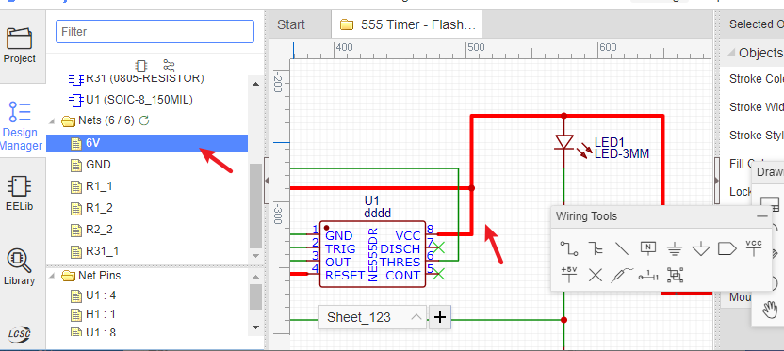
EASYEDA NETS
When you click the net name, you will see the tip at the bottom-left corner.
Net warning: It will show a prompt exclamation point icon.When multiple netlabels on one wire, please check whether if it is correct or just connected by mistake. You need to click this net and find it out. If your netflag or netlabel only connect one pin, it will show warning.

Slide 32
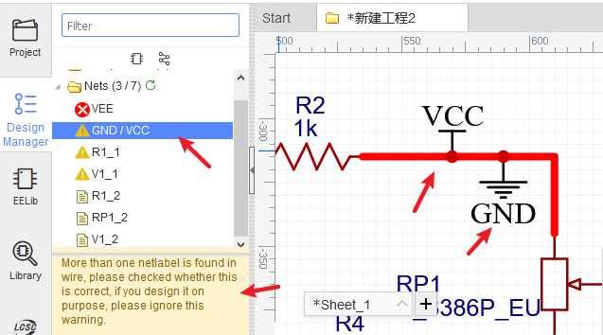
Net Label
The part’s pin doesn’t place the netlabel, or doesn’t connect other pins, or doesn’t place No Connect Flag. A completed net must connects two and more pins, so that, you need to modify your net connection. If you don’t need to use this pin, please place a No Connect Flag on the pin.

Slide 33
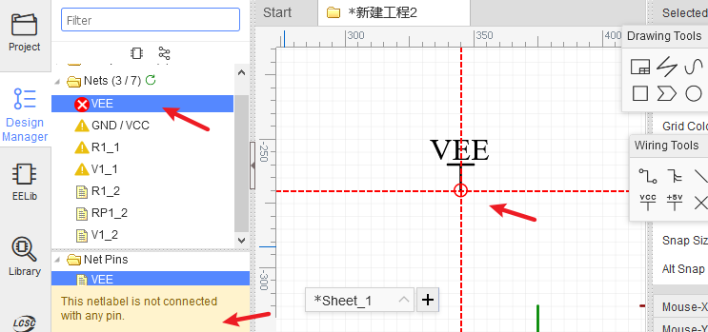
Net Label
Net error: Prompts a red error icon.
When Netlabel haven’t connected any pins

Slide 34
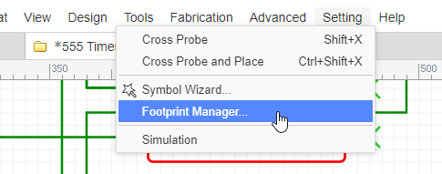
Want to batch modify components? Can’t identify the corresponding relationship between component pins and footprint pins? Don’t worry, EasyEDA can do this. There are two ways to open the footprint manager: Click top menu, via: Top Menu - Tools - Footprint Manager
FOOTPRINT MANAGER
Click the footprint input box of custom attributes when you’ve selected a component:

Slide 35
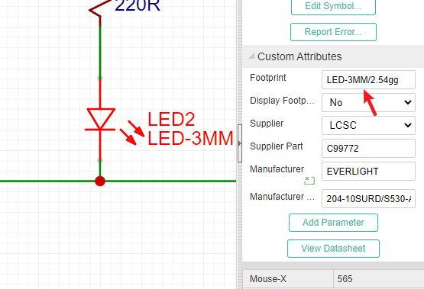
Footprints
EasyEDA's Footprint Manager instantly checks and alerts with a red background if a part's footprint is missing, nonexistent in EasyEDA Libraries, or if there's a mismatch between the part's pins and the footprint's pads.

Slide 36
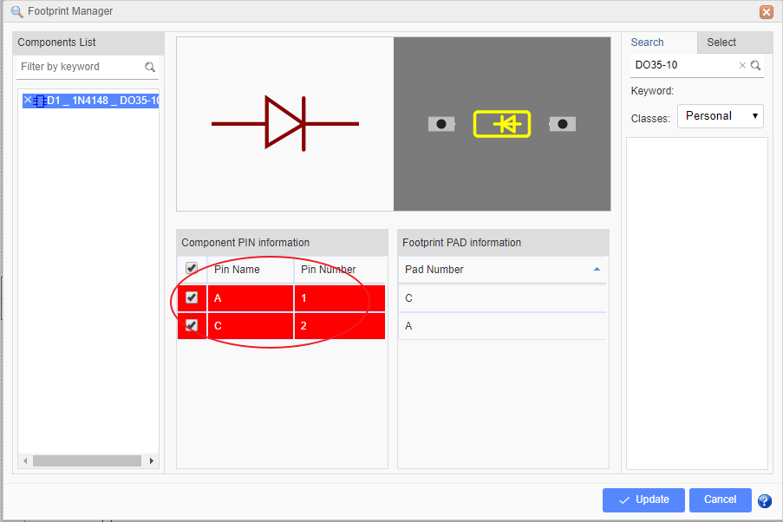
Footprint
In order to solve this:
method 1: change part’s pin number from 1 and 2 to A and C.
method 2: change footprint’s pad number as 1 and 2. That needs the footprint is created by you. And you can’t change the Pad number in footprint manager, you need to find out the footprint at “Library > Footprints > Work Space”, and then edit it.
method 3: find an other footprint and update.

Slide 37
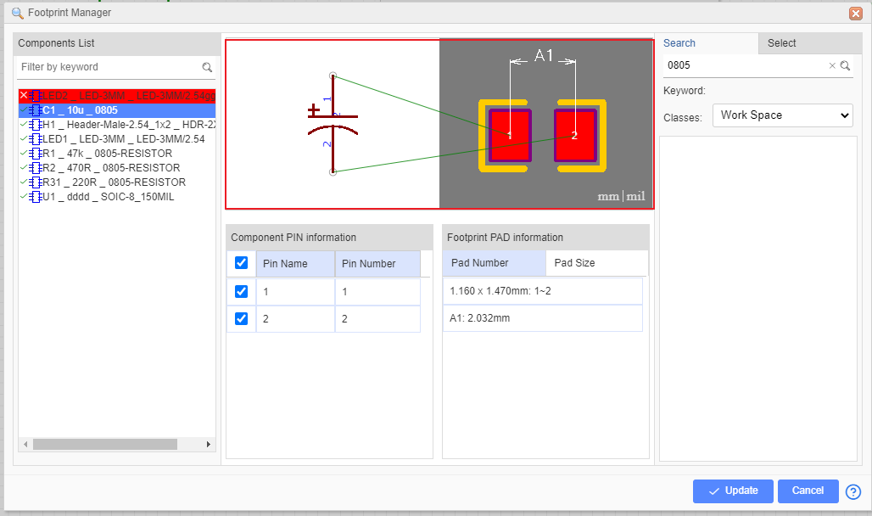
PCB PAD
In the preview area, you can zoom in, zoom out and pan with mouse scroll button.

Slide 38
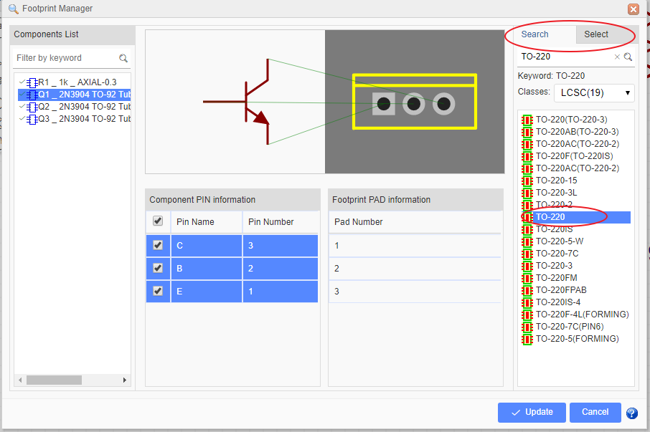
PCB PAD
Component PIN Information: And you can modify component’s pin map information in here.
PCB PAD Information:
Pad Number: You can check the footprint’s pad number, but you can’t modify it. when you select the component on the left side, it shows component’s footprint pad number, if you selected a footprint which is searched or selected from the classes, it will show the selected footprint’s pad number.
Pad Size: You can check the footprint’s pads size and distance, it same as “Check Dimension” tool of footprint editor. Click the preview area unit text to change size unit.

Slide 39
FOOTPRINT
Update footprint
If you want to change the footprint, for example, select a component such as Q1, from TO-92 TO TO-220, you just need to click in the footprint input box. EasyEDA will popup the footprint manager dialog. You can follow the instructions.
Type TO-220 into the search box and search, Or change to Select tab,
Select the classes you want and select TO-220 footprint,
Verify it in the preview box,
then press the Update button.
After that you will find you have changed the footprint to TO-220.
Note:
To ensure that you use a footprint type that is already in the EasyEDA library, it is recommended that you use this technique to change component footprints rather than just typing a footprint name directly into the footprint text input box.because of the footprint manager will add the footprint’s global unique ID into the schematic when the footprint updating.

Slide 40
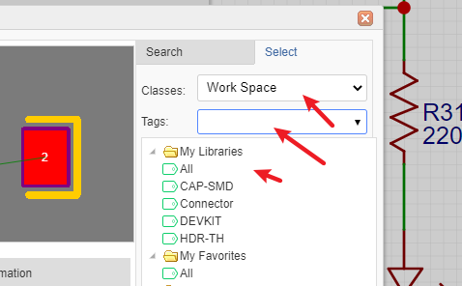
Update in Batch If you want to batch modify components’ footprints, In the footprint manager dialog, you can press CTRL + click or SHIFT + select to select the components, and then select the footprint to update. In schematic canvas, you can frame select the commponents as you want, and then click the “footprint” attribute input box at the right-hand property panel. To use your own footprints, you can select Work Space under the Select tab.

Slide 41
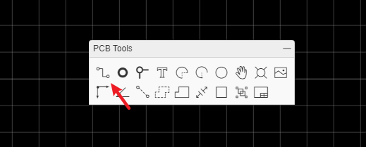
PCB TOOLS
PCB tools provide many function to fulfill your PCB design requirement.
Such as: Track, Pad, Via, Text, Arc, Circle, Move, Hole, Image, Canvas Origin, Connect Pad to Pad, Copper Area, Solid Region, Measure/Dimension, Rect, Group/Ungroup. etc. Track
In the schematic editor, we use Wire or the W Hotkey to connect Pins, in a similar way in the PCB editor, we use Track to connect Pads. Track allows you to draw PCB tracks and can be found on the PCB Tools palette or using the W Hotkey (not T: see above!).

Slide 42
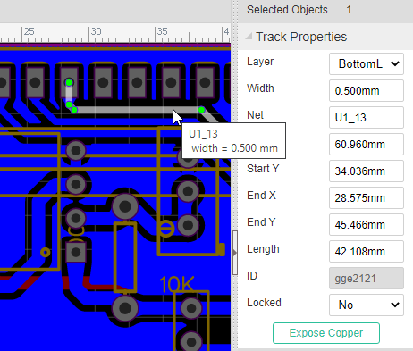
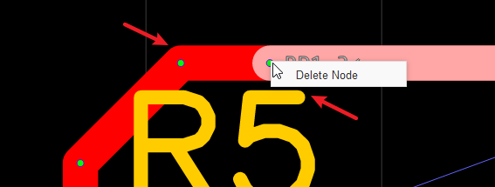
Track
When a track is selected, you can find its Length attribute in the right panel.
If you want to create solder mask for the track, you can click the “Expose Copper” button at the right-hand property panel.
When click the track, you will see the nodes, you can drag it or right-click delete it. when select the point to point separated tracks, you can convert them as Solid Region or continus track at right-click menu.
The more information of routing, please refer at PCB: Route Tracks

Slide 43
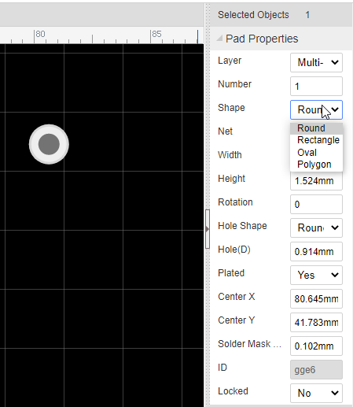
PAD
You can add pads using the Pads button from the Footprint Tools palette or using the P hotkey.
After selecting one of the pads, you can view and adjust its attributes in the right hand Properties panel.

Slide 44
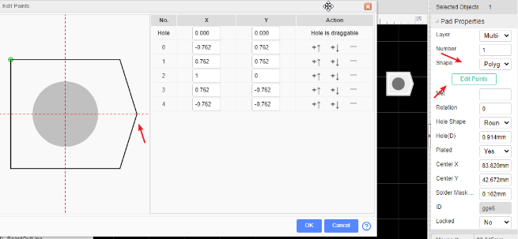
Number: Remembering the pin numbers you set in the schematic symbol in your Schematic Lib: to connect those schematic symbol pins to the pads in your PCB footprint, the pad numbers you set here in the Footprint footprint must be the same.
Shape: Round , Rectangular , Oval and Polygon.
EasyEDA supports four shapes: Round , Rectangular , OVAL and POLYGON.
OVAL PAD will give your more space.
POLYGON PAD will let you to create some strange pad.
Like in the image below, you can edit the PADs points when you select a POLYGON PAD

Slide 45
Layer: If the pads are part of a SMD footprint, you can set it to Top layer or Bottom layer. For through hole components you should set it to Multi-Layer. If it setting as mult-layer, it will connect with all copper layers.
Net: You don’t need to enter anything here because at present this footprint is not connected to anything in a circuit.
Width and Height: When the shape is set to Round, Width will equal Height.
Rotation: Here you can set the Pad’s rotation as you want.
Hole(D): This is the drill hole diameter for a through hole pad. For a SMD Pad, set its layer to TopLayer or BottomLayer.
Hole Shape: Round and Slot. When it is set as a slot, the Gerber is generated through the stitching of multiple drill holes in the corresponding position. If your hole is round, please do not set it as a slot, so as to avoid the overlapping error of holes during the production of DFM detection.

Slide 46
Easyeda Layers
Center-X and Center-Y: using these two attributes, you can set the pad’s position with more precision, compared to using the mouse.
Plated： Yes or No. When you set it as No, this pad Inner wall do not metallization.
Paste Mask Expansion: For single layer pad. This property affects the size of the tin area on the plate of the steel mesh. If you want to set a pad that is not open in the steel mesh, you can set the value to be negative, which is usually larger than the diagonal of the pad.
Solder Mask Expansion： This property affects the size of the green oil area cover on the pad. If you want to set a pad not open covered with green oil, you can set the value to be negative, the value is usually set larger than the diagonal of the pad.

Slide 47


And you can select a track/Solid Region, right-click it and convert to a pad.
Via
When you want to lay a multilayer PCB, you need to add Vias for nets getting through layer and layer.
Place a Via on a Track
When placing a via on a track, the track will be cut to two segments, and the via net will follow track’s net. Placing two vias on a tracks, you will get three segments, then you can change one segment to other layer id, or remove one of them.

Slide 48

Place Multiple Vias
Click the copper area outline, click the “Add/Remove Vias” button. this feature needs the same net copper areas on two and more layers in the same time, the cross area will add the vias.

Slide 49

Notice:
EasyEDA only support the through via for all layers, doesn’t support the buried/blind via.
Text
You can add more fonts from your computer or download free fonts: http://www.fontspace.com/.
if you need Japanese or Korean you can use Google Noto fonts
The editor including fonts are: (NotoSansCJKsc-DemiLight)[https://github.com/googlefonts/noto-cjk/blob/main/Sans/OTF/SimplifiedChinese/NotoSansCJKsc-DemiLight.otf] (NotoSerifCJKsc-Medium)[https://github.com/googlefonts/noto-cjk/blob/main/Serif/OTF/SimplifiedChinese/NotoSerifCJKsc-Medium.otf]

Slide 50

Select the text, then you can find a Font-family attribute on the right panel like in the image below.

Slide 51


Click the add button, then choose the font, the font file must be ttf or otf.
So you can add any fonts by yourself. EasyEDA doesn’t cache the font on our server, so if you close the editor, you need to add the font again by yourself.
Note: If you use the other font, the LineWidth attribute is useless, because it will be automatically set by changing the Height.
Arc
You can draw many Arcs with different sizes, it’s easy to create a pretty cool PCB as you like.

Slide 52



Circle
You can draw a circle in PCB. If you want to draw a circle at TopLayer or BottomLayer, please use Arc.
Move
This option is same as schematic’s drag.
Hole
There were lots of users that didn’t know how to use PAD or VIA as a HOLE, they asked EasyEDA for help, so EasyEDA added a HOLE TOOL in the PCB toolbar.

Slide 53


Copper Area
Sometimes you will want to fill in or flood an area with copper. Usually this copper area will be connected to a net such as GND or a supply rail. You can draw the outline of a flood using the Copper Area button from the PCB Tools palette.
When selecting a copper area, you can find its attributes from the right hand Properties panels.

Slide 54


Solid Region
EasyEDA has added a new tool Solid Region for PCB design
This is a very useful, quick way to connect Pads. You can draw a Solid Region to include all of these pads with same net name, then set the region to the same net name as the pads. It is like Copper Area but easier to use for small areas. To use Solid Region like this, set the Type attribute (in the right hand Properties panel) to Solid.

Slide 55

Measure/Dimension
Making and adding measurements is useful in PCB design. EasyEDA provides two methods to do this.
Dimension tool in the PCB Tools palette: This tool can show three units on the canvas, milliliter, inch and millimeter.
When you click one side of the dimension on the PCB, you can drag it for any directions or change its length.
Measure a distance using Hotkey M, Or Via: Top Menu > Edit > Measure Distance, then click the two points which you would like to measure.

Slide 56

Tips:
It’s unit follows canvas’s units.
You can disable the snap option to measure at the canvas property panel.

