Slide 1
Circuit Analysis, Instrument Measurement & Tool

Slide 2
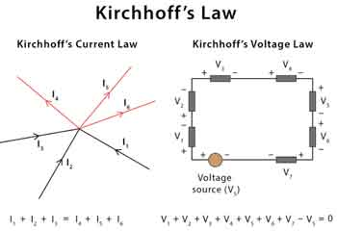
Circuit Analysis:
Basic Circuit Concepts:
Ohm's Law (V = I * R): Ohm's Law is a fundamental principle stating that the voltage (V) across a resistor is equal to the product of the current (I) flowing through it and the resistance (R) of the resistor. It serves as a cornerstone for understanding and calculating relationships within electrical circuits.
Kirchhoff's Laws (KVL and KCL): Kirchhoff's Voltage Law (KVL) asserts that the sum of voltages in any closed loop of a circuit is equal to the sum of the electromotive forces in that loop. Kirchhoff's Current Law (KCL) states that the total current entering a junction in a circuit is equal to the total current leaving the junction, ensuring the conservation of electric charge.
Series and Parallel Circuits: Circuits can be configured in series or parallel. In series circuits, components are connected end-to-end, while in parallel circuits, components share two common points. Understanding these configurations is crucial for analyzing and designing circuits with different characteristics.

Slide 3
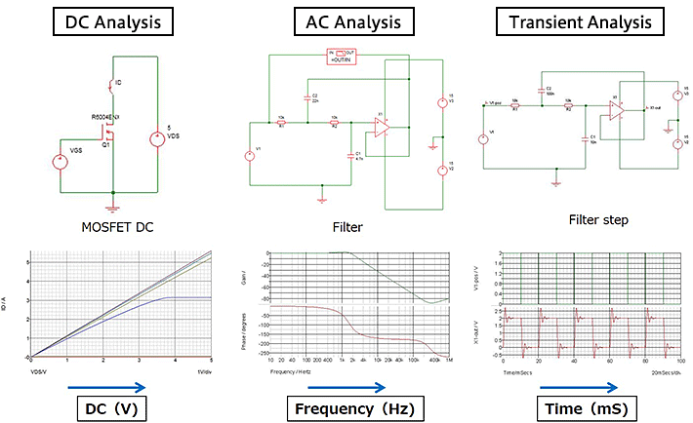
DC Circuit Analysis:
Node Voltage and Mesh Current Analysis: Techniques used to analyze and solve DC circuits by assigning variables to node voltages and mesh currents, simplifying complex circuits into systems of linear equations.
Thevenin and Norton Theorems: Thevenin's Theorem allows the simplification of complex circuits into an equivalent voltage source and series resistance, while Norton's Theorem uses a current source and parallel resistance. These theorems facilitate circuit simplification and analysis.
DC Circuit Transient Analysis: Examines the behavior of circuits during transient conditions, such as the response to sudden changes in voltage or current. Essential for understanding circuit dynamics during switching events.

Slide 4
AC Circuit Analysis:
Phasors and Complex Impedance: Phasors are a graphical representation of sinusoidal waveforms, simplifying AC circuit analysis. Complex impedance is an extension of resistance to AC circuits, considering both resistance and reactance.
AC Power Analysis: Involves the calculation of real (active) and reactive power in AC circuits, with considerations for power factor. Power analysis is crucial for efficient energy transfer.
Resonance in AC Circuits: Investigates the phenomenon of resonance, where the impedance of a circuit is minimized, resulting in maximum current flow. Important in applications like tuning circuits.

Slide 5
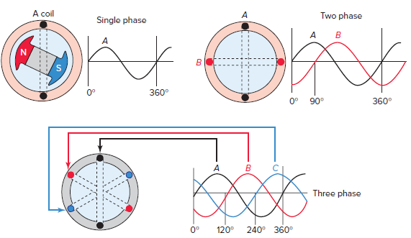
Three-Phase Circuits:
Three-Phase Power Calculation: Involves understanding and calculating power in three-phase systems, which are common in industrial and power distribution settings.
Delta and Wye (Star) Configurations: Describes the two primary configurations for connecting three-phase loads, providing flexibility in designing and connecting electrical systems.
Power Factor Correction: Techniques to

Slide 6
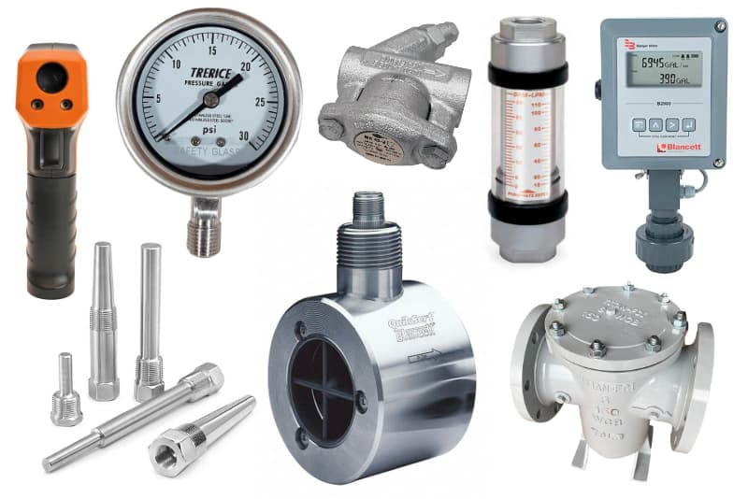
Instrument Measurement
Accuracy, Precision, and Resolution: Parameters defining the quality of measurements. Accuracy is the closeness to the true value, precision is the repeatability of measurements, and resolution is the smallest change detectable.
Calibration and Traceability: Ensuring instruments provide accurate readings by comparing them to known standards. Traceability establishes a documented path to a standard reference.
Error Analysis: Evaluating and minimizing errors in measurements, considering both systematic and random errors.

Slide 7
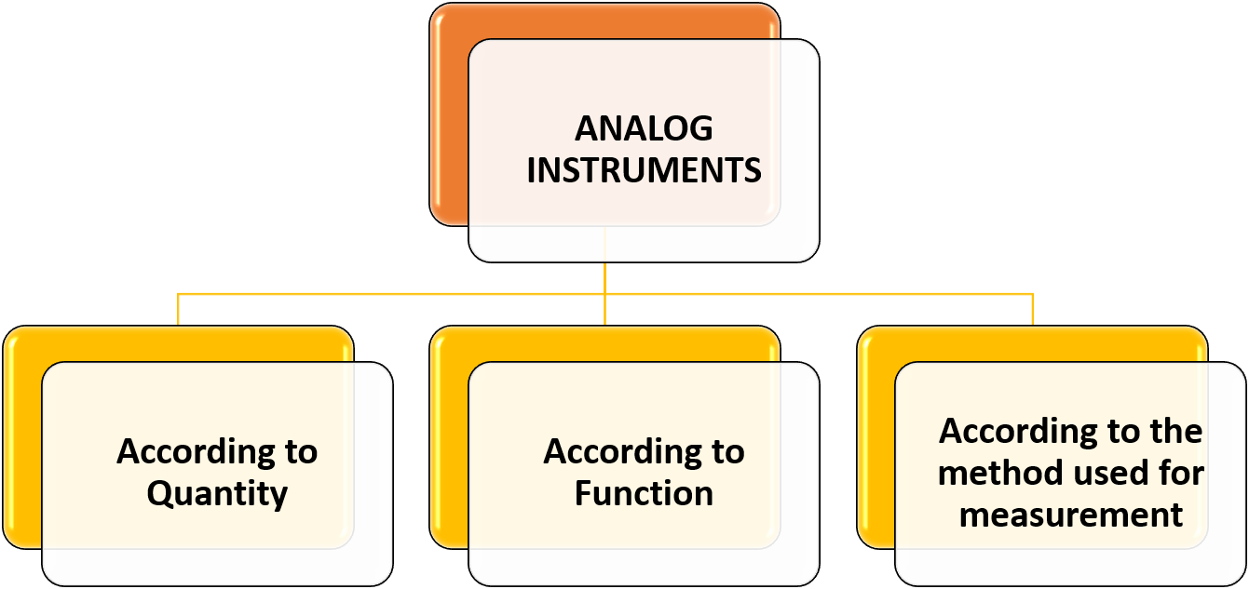
Analog and Digital Instruments:
Analog Voltmeters and Ammeters: Instruments measuring voltage and current with analog displays, providing continuous readings.
Digital Multimeters: Instruments that measure multiple electrical properties, such as voltage, current, and resistance, with digital displays for precise readings.
Oscilloscope Basics: An instrument for visualizing electrical signals over time, crucial for analyzing waveforms and transient behavior.

Slide 8
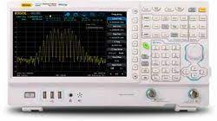
Signal Generators and Analyzers:
Function Generators: Produce waveforms for testing and calibrating electronic circuits.
Spectrum Analyzers: Analyze the frequency content of signals, useful for understanding the frequency distribution in electronic systems.
Frequency Counters: Measure the frequency of a periodic signal, aiding in frequency-based analysis.

Slide 9
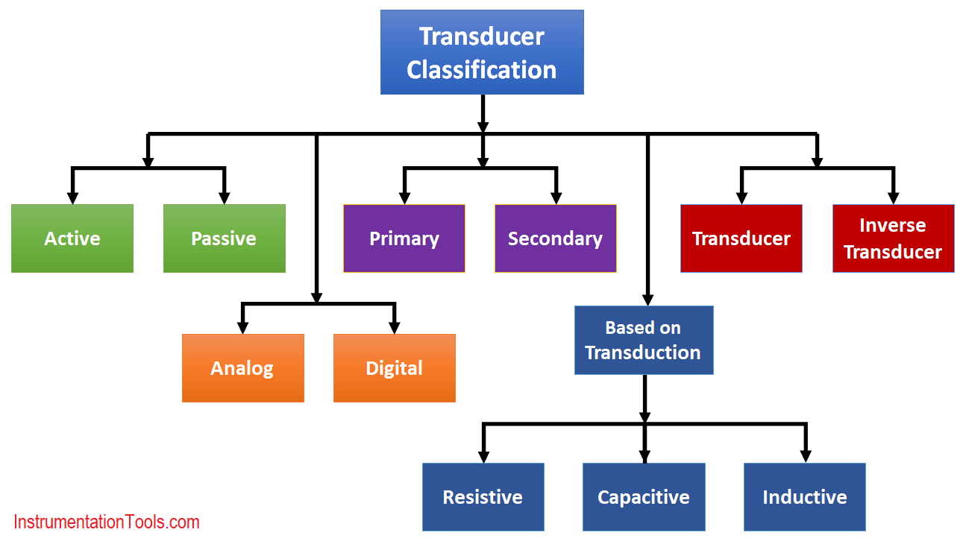
Sensor and Transducer Measurements:
Temperature, Pressure, and Strain Measurements: Techniques for measuring physical parameters using sensors and transducers.
Signal Conditioning: Preprocessing signals to improve their quality, often involving amplification, filtering, or modulation.
Data Acquisition Systems: Collect and process data from various sensors and instruments, crucial for monitoring and control applications.

Slide 10
Tools:
Electronic Tools:
Soldering Iron and Soldering Techniques: Essential for connecting components on circuit boards through soldering.
Breadboards and Prototyping: Platforms for building and testing electronic circuits without permanent soldering.
Oscilloscopes and Signal Generators: Instruments for visualizing and generating electronic signals, aiding in circuit analysis and testing.
Power Tools:
Power Supplies: Provide a stable source of electrical power for testing and operating electronic circuits.
Variable Power Sources: Allow adjustment of voltage and current levels for specific testing requirements.
Bench Power Supplies: Fixed or variable power supplies integrated into workbenches for convenience.

Slide 11
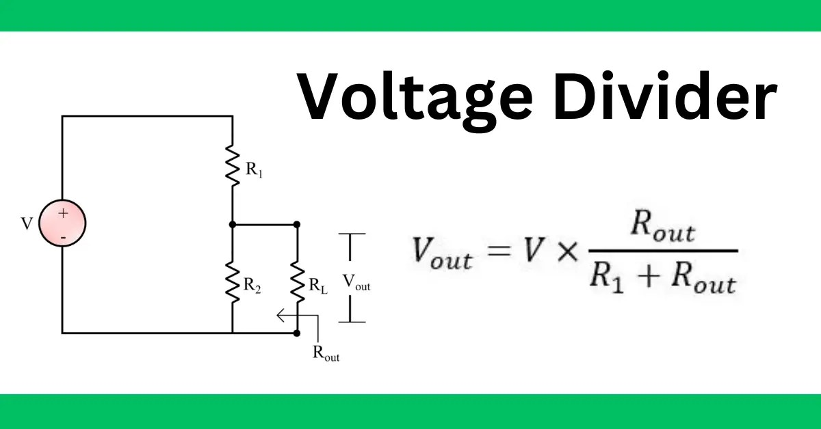
Ohm's Law & Voltage Divider :
Ohm's Law, expressed as V = I * R, is a fundamental principle in electrical engineering. It establishes the relationship between voltage (V), current (I), and resistance (R) in a circuit. According to Ohm's Law, the voltage across a resistor is equal to the product of the current flowing through it and its resistance. This law serves as a foundational concept in circuit analysis, helping engineers calculate and understand the behavior of electrical circuits.
A voltage divider is a simple circuit arrangement involving two resistors in series. It is commonly used to obtain a fraction of the input voltage at a specific point in the circuit. The output voltage is determined by the ratio of the two resistors. This circuit is valuable for creating reference voltages, biasing transistors, or providing specific voltage levels within a circuit.

Slide 12
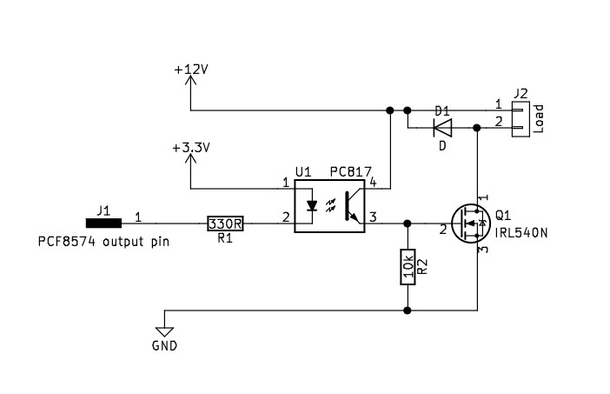
Opto-coupler, LED-driver, BJT-MOSFET switch design:
Opto-coupler: An opto-coupler (optocoupler or optical isolator) is a component that electrically separates input and output circuits using light. It consists of a light-emitting diode (LED) and a photodetector. Opto-couplers are often used to isolate high-voltage and low-voltage sections of a circuit.
LED-driver: An LED driver is a device that provides the necessary current and voltage to power LEDs efficiently. LED drivers ensure stable and controlled operation, preventing damage to the LEDs. They are crucial for applications where precise control of the LED's brightness is required.
BJT-MOSFET switch design: This involves designing a circuit that utilizes either a Bipolar Junction Transistor (BJT) or a Metal-Oxide-Semiconductor Field-Effect Transistor (MOSFET) as a switch. This design is common in digital electronics, allowing for efficient control of current flow through a load.

Slide 13
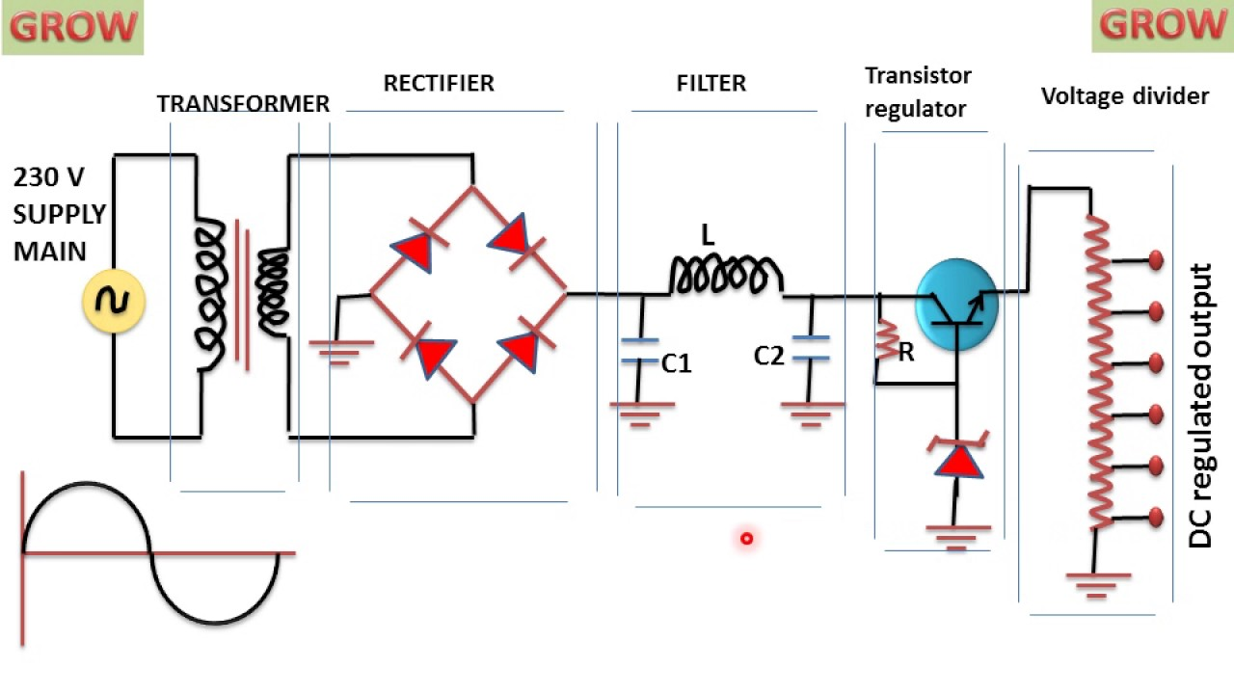
Voltage Regulators and Power Supply:
Voltage Regulators: Voltage regulators are components or circuits that maintain a constant output voltage despite variations in the input voltage or load conditions. They are vital for providing stable power to electronic devices and preventing voltage fluctuations.
Power Supply: Power supplies are systems that deliver electrical power to electronic devices. They may include voltage regulators, transformers, rectifiers, and filters to ensure a consistent and clean power source for various components in a circuit.

Slide 14
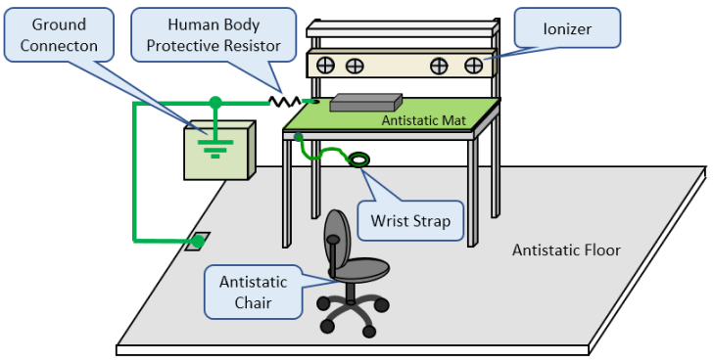
ESD (Electrostatic Discharge):
ESD is the sudden flow of electricity between two electrically charged objects caused by contact, an electrical short, or dielectric breakdown. It can damage electronic components. ESD protection measures, such as using antistatic materials, grounding, and implementing protective devices like diodes, are crucial in electronic design to prevent ESD-related failures.

Slide 15
Do's/Don'ts of Schematic Design:
No voltage mixing or crossing 3.3V input from 5V input or vice versa: Avoid connecting different voltage levels directly to prevent damage. Use level-shifting circuits or appropriate interfaces.
Never drive zero LED, etc.: Ensure that LEDs and other components have a minimum voltage or current to operate correctly.
Separate voltage sources for different components: Keep different voltage domains isolated to prevent interference and ensure proper functioning.
Pull-up / pull-down resistors for default state: Use pull-up or pull-down resistors to establish default states in digital circuits, preventing undefined or floating states.
Startup relay off conditions: Implement circuits to ensure a controlled startup sequence, preventing issues like inrush current or unexpected behaviors.
Glitch protection: Incorporate components or design techniques to protect against glitches, transient voltages, or noise in the circuit, ensuring reliable operation.

Slide 16
Thank You

