Slide 1
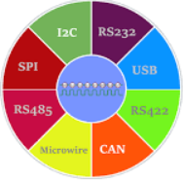
COMMUNICATION & PROTOCOLS
"Navigating the Web of Connection:
Exploring Communication and Protocols"

Slide 2
COMMUNICATION PROTOCOLS
A communication protocol is a set of guidelines used in telecommunications that permits information to be transmitted between two or more entities of a communication system using any modification of a physical quantity. These guidelines or standards specify the language, grammar, and synchronization of communication as well as potential error-recovery techniques. Protocols can be implemented with software, hardware, or both.
Systems that communicate employ well-defined formats, or protocols, to exchange messages. Every message has a precise meaning that is meant to elicit a reaction from a set of potential replies that have been predetermined for that specific scenario. Usually, the behaviour that is stated is independent of the implementation method. The parties concerned must agree on communication protocols. A protocol may be transformed into a technical standard in order to get to a consensus. There is a close analogy between protocols and programming languages: protocols are to communications what programming languages are to computations. A programming language describes the same for computations.
On the other hand, communicating systems must have a shared transmission means to communicate with one another because there is no shared memory. Transmission is not always dependable, and various systems may run different operating systems and/or hardware.

Slide 3
The protocol software modules interface with an operating system framework on the machine to implement a networking protocol. The operating system's networking features are implemented by this framework. The OSI model and the TCP/IP model are the most well-known frameworks.
Layering was a successful design strategy for operating systems and compilers at the time the Internet was built, and since communications protocols and programming languages are comparable, layering was also used to the protocols.
The protocols can be arranged based on functionality in groups, for instance there is a group of transport protocols. The functionalities are mapped onto the layers, each layer solving a distinct class of problems relating to, for instance: application-, transport-, internet- and network interface-functions. To transmit a message, a protocol has to be selected from each layer, so some sort of multiplexing/demultiplexing takes place. The selection of the next protocol is accomplished by extending the message with a protocol selector for each layer.

Slide 4
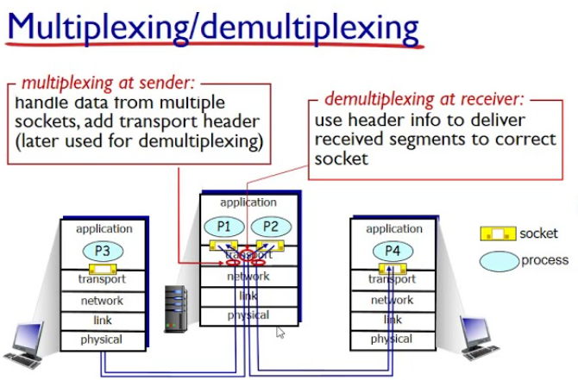

Slide 5
FUNDAMENTAL PROTOCOLS REQUIRED
On communicative systems, messages are delivered and received to establish communications. For this reason, protocols ought to outline the guidelines for transmission. Most of the following should be addressed in general:
formats for exchanging data. Bitstrings of digital messages are exchanged. Bitstrings are separated into fields, and each field contains data pertinent to the protocol. The bitstring is conceptually separated into the header section and the data portion. The fields in the header area are more pertinent to the protocol since the actual message is stored in the data region. Bitstrings that exceed the maximum transmission unit (MTU) are broken up into manageable chunks.
Address translation. Protocols may occasionally need to map one scheme's addresses to another scheme's addresses. For example, to convert an Ethernet hardware address from a logical IP address that the application specifies. We call this mapping of addresses.
routing. Messages must be forwarded on behalf of the sender via intermediary systems along the path to the intended recipient or recipients when systems are not directly connected. Routers are used to connect the networks on the Internet. We refer to this method of network connection as internetworking.
It is imperative to identify transmission problems on networks that cannot ensure flawless performance. A typical technique adds the data area's CRCs at the end of packets so that the recipient may identify discrepancies brought on by mistakes.

Slide 6
Data loss due to timeouts and repeated attempts. There could be network packet loss or significant delays. To deal with this, certain protocols allow a sender to anticipate receiving an acknowledgement from the recipient that the message was received correctly within a specified time frame. The sender has to retransmit the packet after a timeout, assuming it was not received. The number of retransmissions is limited because there is no impact from retransmissions in the event of a permanently damaged link. Retry limit exceeding is regarded as a mistake.
If transmissions can only happen in one direction at a time, like on half-duplex lines, then the direction of information flow needs to be handled.This is known as Media Access Control. Arrangements have to be made to accommodate the case when two parties want to gain control at the same time.
Sequence control. We have seen that long bitstrings are divided in pieces, and then sent on the network individually. The pieces may get lost or delayed or take different routes to their destination on some types of networks. As a result pieces may arrive out of sequence. Retransmissions can result in duplicate pieces. By marking the pieces with sequence information at the sender, the receiver can determine what was lost or duplicated, ask for necessary retransmissions and reassemble the original message.
Flow control is needed when the sender transmits faster than the receiver or intermediate network equipment can process the transmissions. Flow control can be implemented by messaging from receiver to sender.
Getting the data across a network is only part of the problem for a protocol. The data received has to be evaluated in the context of the progress of the conversation, so a protocol has to specify rules describing the context. These kind of rules are said to express the syntax of the communications. Other rules determine whether the data is meaningful for the context in which the exchange takes place. These kind of rules are said to express the semantics of the communications.

Slide 7
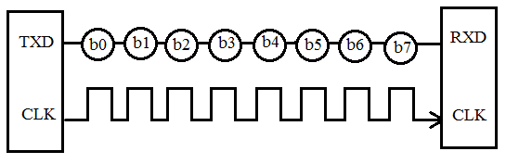
Exploring Serial & Wireless Communication Protocols
Serial Communication Protocols
Before starting with Serial Communication Protocols, Let’s break the terminology in three parts. The communication is very well known terminology which involves the exchange of information between two or more mediums. In embedded systems, the communication means the exchange of data between two microcontrollers in the form of bits. This exchange of data bits in microcontroller is done by some set of defined rules known as communication protocols. Now if the data is sent in series i.e. one after the other then the communication protocol is known as Serial Communication Protocol. More specifically, the data bits are transmitted one at a time in sequential manner over the data bus or communication channel in Serial Communication.
There are different types of data transfer available in the digital electronics such as serial communication and parallel communication. Similarly the protocols are divided into two types such as Serial Communication Protocol and Parallel Communication Protocols. Examples of Parallel Communication Protocols are ISA, ATA, SCSI, PCI and IEEE-488. Similarly there are several examples of Serial Communication Protocols such as CAN, ETHERNET, I2C, SPI, RS232, USB, 1-Wire, and SATA etc.

Slide 8
TYPES OF COMMUNICATION PROTOCOLS
The different types of Serial Communication Protocols will be discussed. Serial communication is the most widely used approach to transfer information between data processing peripherals. Every electronics device whether it is Personal Computer (PC) or Mobile runs on serial communication. The protocol is the secure and reliable form of communication having a set of rules addressed by the source host (sender) and destination host (receiver) similar to parallel communication.
The different types of Serial Communication Protocols will be discussed. Serial communication is the most widely used approach to transfer information between data processing peripherals. Every electronics device whether it is Personal Computer (PC) or Mobile runs on serial communication. The protocol is the secure and reliable form of communication having a set of rules addressed by the source host (sender) and destination host (receiver) similar to parallel communication.

Slide 9
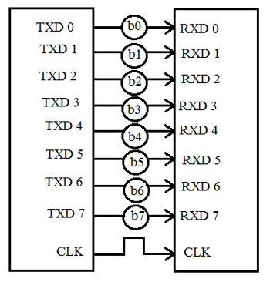
Modes in Serial Communication
Transmission Modes in Serial Communication
As already said above that in serial communication data is sent in the form of bits i.e. binary pulses and it is well known that, binary one represents the logic HIGH and zero represents the logic LOW. There are several types of serial communication depending on the type of transmission mode and data transfer. The transmission modes are classified as Simplex, Half Duplex and Full Duplex.
Simplex Method:
In simplex method either of the medium i.e sender or receiver can be active at a time. So if the sender is transmitting the data then receiver can only accept and vice versa. So simplex method is one-way communication technique. The well-known examples of simplex method are Television and Radio.
Half Duplex Method:
In half duplex method both sender and receiver can be active but not at the same time. So if the sender is transmitting then receiver can accept but cannot send and similarly vice versa. The well-known examples of the half duplex is the internet where the user sends a request for a data and the gets it from server.

Slide 10
Modes in Serial Communication
FULL DUPLEX METHOD:
In full duplex method, both receiver and transmitter can send data to each other at the same time. The well-known example is mobile phone.
Apart from this, for appropriate data transmission, the clock plays important role and it is one of the primary source. Malfunction of the clock results in unexpected data transmission even sometimes data loss. So, the clock synchronisation becomes very important when using serial communication.
CLOCK SYNCHRONIZATION:
The clock is different for serial devices and it is classified in two type viz. Synchronous Serial Interface and Asynchronous Serial Interface.
SYNCHRONOUS SERIAL INTERFACE:
It is a point-to-point connection from a master to slave. In this type of interface, all the devices use single CPU bus to share data and clock. The data transmission becomes faster with same bus to share clock and data. Also there is no mismatch in baud rate in this interface. In transmitter side, there is a shift of the data onto serial line providing the clock as a separate signal as there is no start, stop and parity bits are added to data. In receiver side, the data is being extract using the clock provided by the transmitter and converts the serial data back to the parallel form. The well-known examples are I2C and SPI.

Slide 11
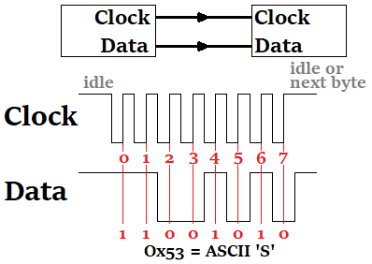
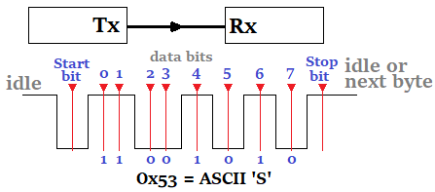
Modes in Serial Communication
ASYNCHRONOUS SERIAL INTERFACE:
In asynchronous Serial Interface, the external clock signal is absent. The Asynchronous Serial Interfaces can be seen in mostly in long distance applications and are a perfect fit for the stable communication. In asynchronous Serial Interface the absence of external Clock Source makes it rely on several parameters such as Data Flow Control, Error Control, Baud Rate Control, Transmission Control and Reception Control. On the transmitter side, there is a shifting of parallel data onto the serial line using its own clock. Also it adds the start, stop and parity check bits. On the receiver side, the receiver extracts the data using its own clock and convert the serial data back to the parallel form after stripping off the start, stop, and parity bits. The well-known examples are RS-232, RS-422 and RS-485.

Slide 12
Other Terms Related to Serial Communication
Apart from Clock Synchronization there are certain things to remember when transferring data serially such as Baud Rate, Data bit selection (Framing), Synchronisation and error checking. Let’s discuss these terms in brief.
Baud Rate: Baud rate is rate at which the data is transferred between the transmitter and receiver in the form of bits per second (bps). The most commonly used baud rate is 9600. But there are other selection of baud rate such as 1200, 2400, 4800, 57600, 115200. The more the baud rate will be fats the data will be transferred at a time. Also for the data communication the baud rate has to be same for both transmitter and receiver.
Framing: Framing is referred to the number of data bits to be sent from transmitter to receiver. The number of data bits differs in case of application. Most of the application uses 8 bits as the standard data bits but it can be selected as 5, 6 or 7 bits also.

Slide 13
Other Terms Related to Serial Communication
Synchronisation: Synchronization Bits are important to select a chunk of data. It tells the start and end of the data bits. The transmitter will set start and stop bits to the data frame and the receiver will identify it accordingly and do the further processing.
Error Control: The error control plays an important role while serial communication as there are many factors which affects and adds the noise in the serial communication. To get rid of this error the parity bits are used where parity will check for even and odd parity. So if the data frame contains the even number of 1’s then it is known as even parity and the parity bit in the register is set to 1. Similarly if the data frame contains odd number of 1’s then it is known as odd parity and clears the odd parity bit in the register.
Protocol is just like a common language that system uses to understand the data. As described above, the serial communication protocol is divided into types i.e. Synchronous and Asynchronous.

Slide 14
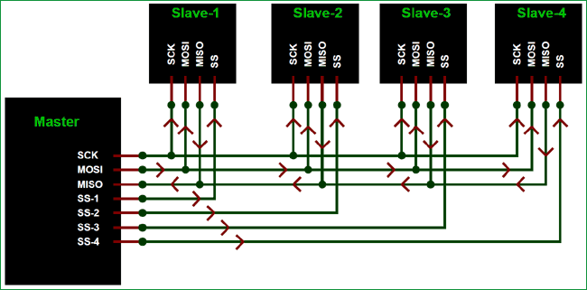
SPI Protocol
The Serial Peripheral Interface (SPI) is a synchronous interface which allows several SPI microcontrollers to be interconnected. In SPI, separate wires are required for data and clock line. Also the clock is not included in the data stream and must be furnished as a separate signal. The SPI may be configured either as master or as a slave. The four basic SPI signals (MISO, MOSI, SCK and SS), Vcc and Ground are the part of data communication. So it needs 6 wires to send and receive data from slave or master. Theoretically, the SPI can have unlimited number of slaves. The data communication is configured in SPI registers. The SPI can deliver up to 10Mbps of speed and is ideal for high speed data communication.

Slide 15
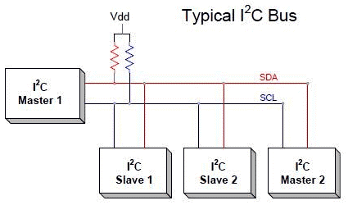
I2C SERIAL COMMUNICATION
Inter integrated circuit (I2C) two-line communication between different ICs or modules where two lines are SDA (Serial Data Line) and SCL (Serial Clock Line). Both the lines must be connected to a positive supply using a pull up resistor. I2C can deliver speed up to 400Kbps and it uses 10 bit or 7 bit addressing system to target a specific device on the i2c bus so it can connect up to 1024 devices. It has limited length communication and is ideal for onboard communication. I2C networks are easy to setup since it uses only two wires and new devices can simply be connected to the two common I2C bus lines. Same like SPI, microcontroller generally have I2C pins to connect any I2C device:

Slide 16
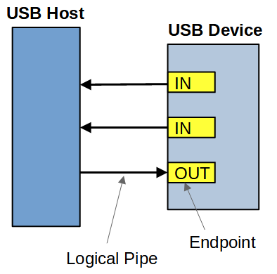
USB & CAN
USB
USB (Universal Serial Bus) is widely protocol with different versions and speeds. A maximum of 127 peripherals can be connected to a single USB host controller. USB acts as "plug and play" device. The USB are used in almost devices such as keyboards, printers, media devices, cameras, scanners and mouse. It is designed for easy installation, faster data rated, less cabling and hot swapping. It has replaced the bulkier and slower serial and parallel ports. USB uses differential signalling to reduce interference and allow high-speed transmission over a long distance.
A differential bus is built with two wire, one of represents the transmitted data and the other its complement. The idea is that the 'average' voltage on the wires does not carry any information, resulting in less interference. In USB, the devices are allowed to draw a certain amount of power without asking the host. USB uses only two wires to for data transfer and are faster than the serial and parallel interface. USB versions supports different speeds such as 1.5Mbps (USB v1.0), 480 Mbps (USB2.0), 5Gbps (USB v3.0). Length of individual USB cable can reach up to 5 meters without a hub and 40 meters with hub.

Slide 17
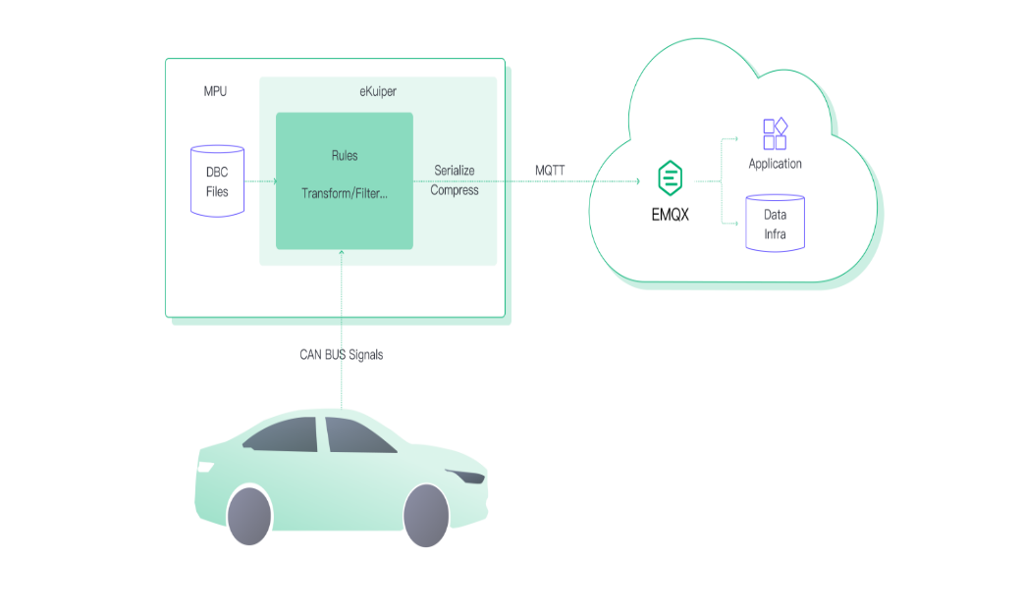
USB & CAN
Control Area Network (CAN) bus is a serial communication protocol that allows devices to exchange data in a reliable and efficient way. It is widely used in vehicles, working like a nervous system to connect ECUs in the vehicle.
CAN bus was originally designed for automotive applications by Bosch in the 1980s. It is a multi-master, multi-slave, half-duplex, and fault-tolerant protocol that fits well with the requirements of automotive applications. It is simple, low-cost, and reliable and can be used in harsh environments. The CAN bus provides one point of entry for all the ECUs in the vehicle, which makes it easy to connect and diagnose.
CAN bus data can provide valuable insights into the performance and status of the connected devices. However, collecting and processing CAN bus data can be challenging due to the high data rate, low bandwidth, and variable network conditions.

Slide 18
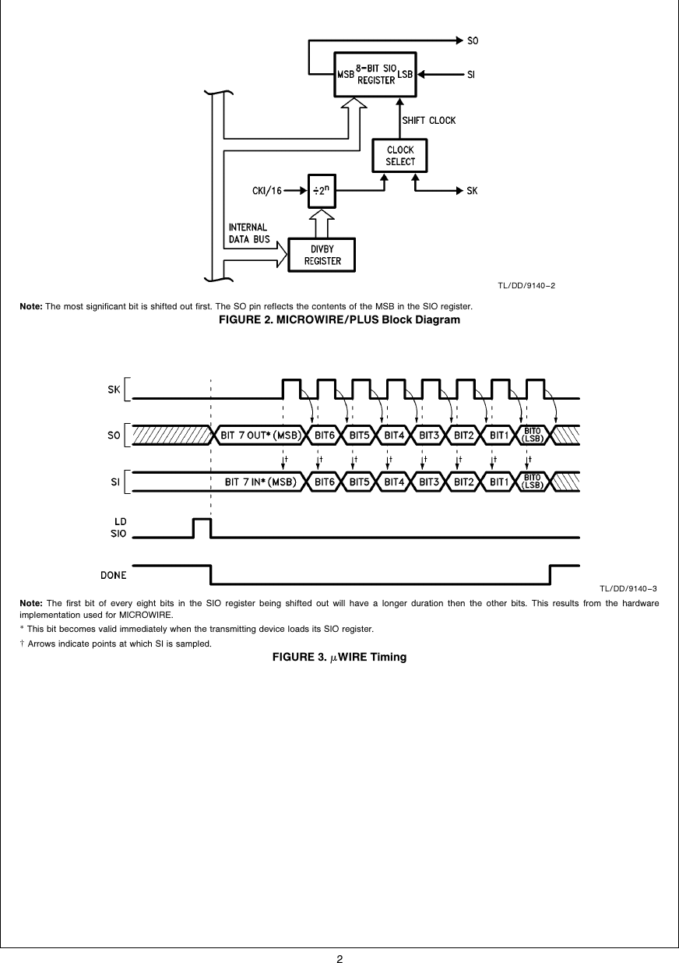
MICROWIRE & ASYNCHRONOUS SERIAL PROTOCOLS
Microwire
MICROWIRE is a 3Mbps [full-duplex] serial 3-wire interface essentially a subset of the SPI interface. Microwire is a serial I/O port on microcontrollers, so the Microwire bus will also be found on EEPROMs and other Peripheral chips. The 3 lines are SI (Serial Input), SO (SerialOutput) and SK(Serial Clock). The Serial Input (SI) line to the microcontroller, SO is the serial output line, and SK is the serial clock line. Data is shifted out on the falling edge of SK, and is valued on the rising edge. SI is shifted in on the rising edge of SK. An additional bus enhancement to MICROWIRE is called MICROWIRE/Plus. The main difference between the two buses seems to be that MICROWIRE/Plus architecture within the microcontroller is more complex. It supports speeds up to 3Mbps.

Slide 19
ASYNCHRONOUS SERIAL PROTOCOLS
The asynchronous type of serial protocols are very essential when it comes to longer distance reliable data transfer. Asynchronous communication does not require a timing clock that is common to both devices. Each device independently listens and sends digital pulses that represent bits of data at an agreed-upon rate. Asynchronous serial communication is sometimes referred to as Transistor-Transistor Logic (TTL) serial, where the high voltage level is logic 1, and the low voltage equates to logic 0. Almost every microcontroller on the market today has at least one Universal Asynchronous Receiver-Transmitter (UART) for serial communication. The examples are RS232, RS422, RS485 etc.
RS232
The RS232 (Recommended Standard 232) is very common protocol used to connect different peripherals such as Monitors, CNCs etc. The RS232 comes in male and female connectors. The RS232 is point-to-point topology with maximum one device connected and covers distance up to 15 meters at 9600 bps. Information on the RS-232 interface is transmitted digitally by logical 0 and 1. The logical "1" (MARK) corresponds to a voltage in the range from -3 to -15 V. The logical "0" (SPACE) corresponds to a voltage in the range from +3 to +15 V. It comes in DB9 connector which has 9 pinouts such as TxD, RxD, RTS, CTS, DTR, DSR, DCD, GND.

Slide 20
RS422 & RS485
RS422
The RS422 is similar to RS232 which allows to simultaneously send and receive messages on separate lines but uses a differential signal for this. In the RS-422 network, there can only be one transmitting device and up to 10 receiving devices. The data transfer speed in RS-422 depends on the distance and can vary from 10 kbps (1200 meters) to 10 Mbps (10 meters). The RS-422 line is 4 wires for data transmission (2 twisted wires for transmission and 2 twisted wires for receiving) and one common GND ground wire. The voltage on the data lines can be in the range from -6 V to +6 V. The logical difference between A and B is greater than +0.2 V. Logical 1 corresponds to the difference between A and B less than -0.2 V. The RS-422 standard does not define a specific type of connector, usually it can be a terminal block or a DB9 connector.
RS485
Since RS485 uses multi-point topology, it is most used in the industries and are industry preferred protocol. RS422 can connect 32 line drivers and 32 receivers in a differential configurations but with the help of additional repeaters and signal amplifiers up to 256 devices. The RS-485 does not define a specific type of connector, but it is often a terminal block or a DB9 connector. The speed of operation also depends on the length of the line and can reach 10 Mbit / s at 10 meters. The voltage on the lines is in the range from -7 V to +12 V. There are two types of RS-485 such as half duplex mode RS-485 with 2 contacts and full duplex mode RS-485 with 4 contacts. To learn more about using RS485 with other microcontrollers.

Slide 21
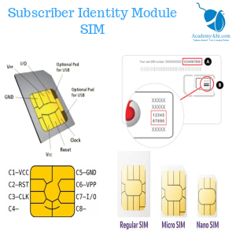
Subscriber Identity Module
SIM (SUBSCRIBER IDENTITY MODULE):
Purpose: Authentication and identification of mobile subscribers on a cellular network.
USES:
Authenticates the user on the network, allowing access to voice and data services.
Stores subscriber information, including contacts and text messages.
Examples:
Used in mobile phones, tablets, and other cellular devices.
Essential for secure and authorized access to cellular networks.

Slide 22
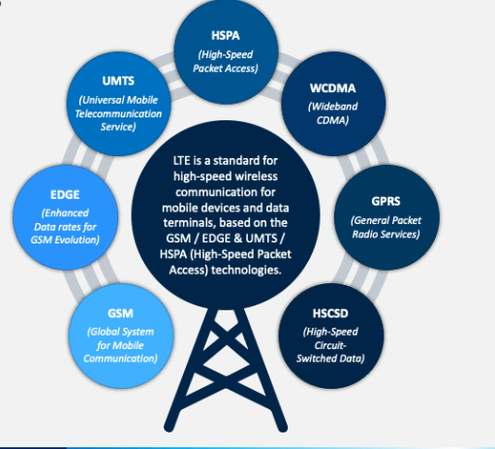
LONG-TERM EVOLUTION
LTE (LONG-TERM EVOLUTION):
Purpose: High-speed wireless communication for mobile devices.
USES:
Enables fast internet access and data transfer on mobile devices.
Supports multimedia streaming, online gaming, and other high-bandwidth applications.
EXAMPLES:
Utilized in smartphones, tablets, mobile hotspots, and other devices for high-speed mobile internet access.
Critical for 4G LTE networks that provide improved data transfer speeds compared to previous generations.

Slide 23
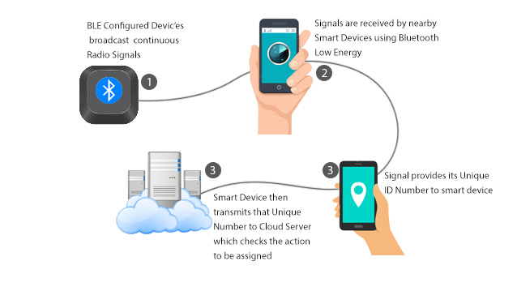
BLUETOOTH LOW ENERGY
BLE (BLUETOOTH LOW ENERGY):
Purpose: Efficient wireless communication with low power consumption for short-range connections.
USES:
Connects and exchanges data between devices in proximity.
Ideal for IoT devices, wearables, and applications with periodic data exchange.
EXAMPLES:
Fitness trackers, smartwatches, health monitoring devices.
Smart home devices like door locks, light bulbs, and sensors.

Slide 24
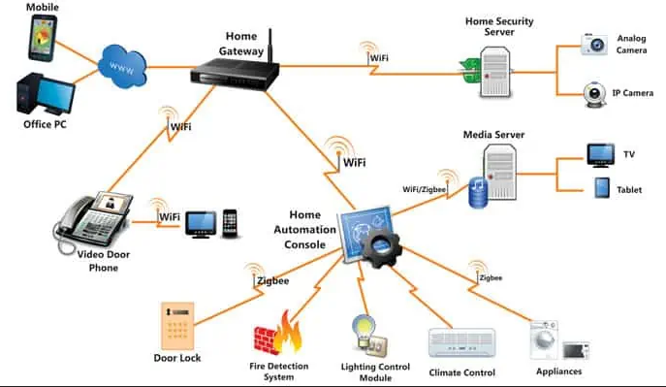
ZIGBEE
Purpose:
Low-power, short-range wireless communication for IoT devices in a mesh network.
USES:
Creates a mesh network for connecting and controlling smart devices.
Suitable for applications where low data rate and low power consumption are essential.
EXAMPLES:
Home automation systems controlling lights, thermostats, and smart plugs.
Industrial applications for monitoring and controlling sensors in a wireless mesh.

Slide 25
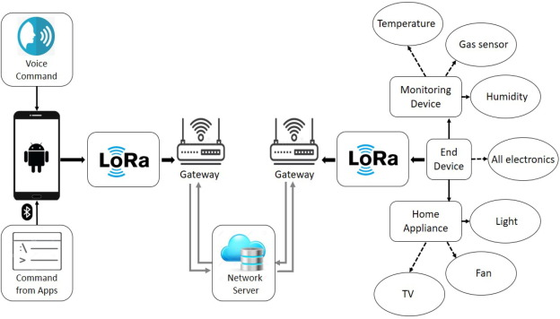
LONG RANGE
Purpose:
Long-range, low-power wireless communication for IoT applications.
Uses:
Connects devices over long distances with minimal power consumption.
Ideal for applications requiring intermittent, low-data-rate communication.
Examples:
Agricultural sensors for monitoring soil conditions and crop health.
Smart city applications, such as monitoring parking spaces and waste bins.

Slide 26
Thank You..

