Slide 1
INTERNET OF THINGS “IoT”

Slide 2
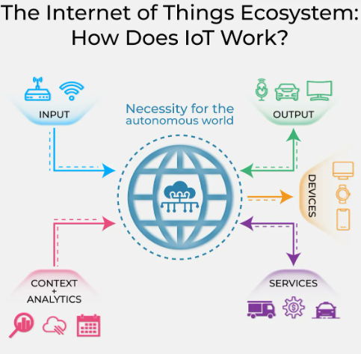
What is IoT ?
The Internet of Things (IoT) refers to a network of interconnected physical devices or "things" that are embedded with sensors, software, and other technologies to collect and exchange data over the internet. These devices can range from everyday objects like household appliances, wearable devices, and industrial machines to more sophisticated components in smart cities and advanced industrial systems.
The key idea behind IoT is to enable these devices to communicate with each other, share information, and perform tasks autonomously or with minimal human intervention. This connectivity allows for the creation of intelligent systems and applications that can enhance efficiency, automation, and overall functionality in various aspects of life, such as healthcare, transportation, agriculture, and home automation.
IoT has the potential to revolutionize industries and improve the quality of life by providing real-time data, enabling better decision-making, and fostering new levels of automation and control. However, it also raises concerns related to privacy, security, and the management of massive amounts of data generated by these interconnected devices

Slide 3

How does IoT work?
Internet of Things platform
An IoT platform manages device connectivity. It can be a software suite or a cloud service. The purpose of an IoT platform is to manage and monitor hardware, software, processing abilities, and application layers.
Sensor technologies
IoT sensors, sometimes called smart sensors, convert real-world variables into data that devices can interpret and share. Many different types of sensors exist. For example, temperature sensors detect heat and convert temperature changes into data. Motion sensors detect movement by monitoring ultrasonic waves and triggering a desired action when those waves are interrupted.
Unique identifiers
The core concept of the IoT is communication among devices and users. Unique identifiers (UIDs) establish the context of a device within the larger network to enable this communication. Identifiers are patterns, like numeric or alphanumeric strings. One example of a UID that you might be familiar with is an internet protocol (IP) address. They can identify a single device (instance identifier) or the class to which that device belongs (type identifier).
Internet connectivity
Sensors can connect to cloud platforms and other devices through a host of network protocols for the internet. This enables communication between devices.
Artificial intelligence (AI) and machine learning
Natural language processing (NLP) in IoT devices makes it easier for users to input information and interact with devices. One common example of an IoT device that utilizes NLP technology is the Amazon Alexa. Machine learning also enhances the analytical capabilities of IoT devices.
Edge computing
Edge computing is a computing framework. It aims to conserve resources and speed up response time by moving computational resources like data storage closer to the data source. The IoT accomplishes this by utilizing edge devices like IoT gateways.

Slide 4
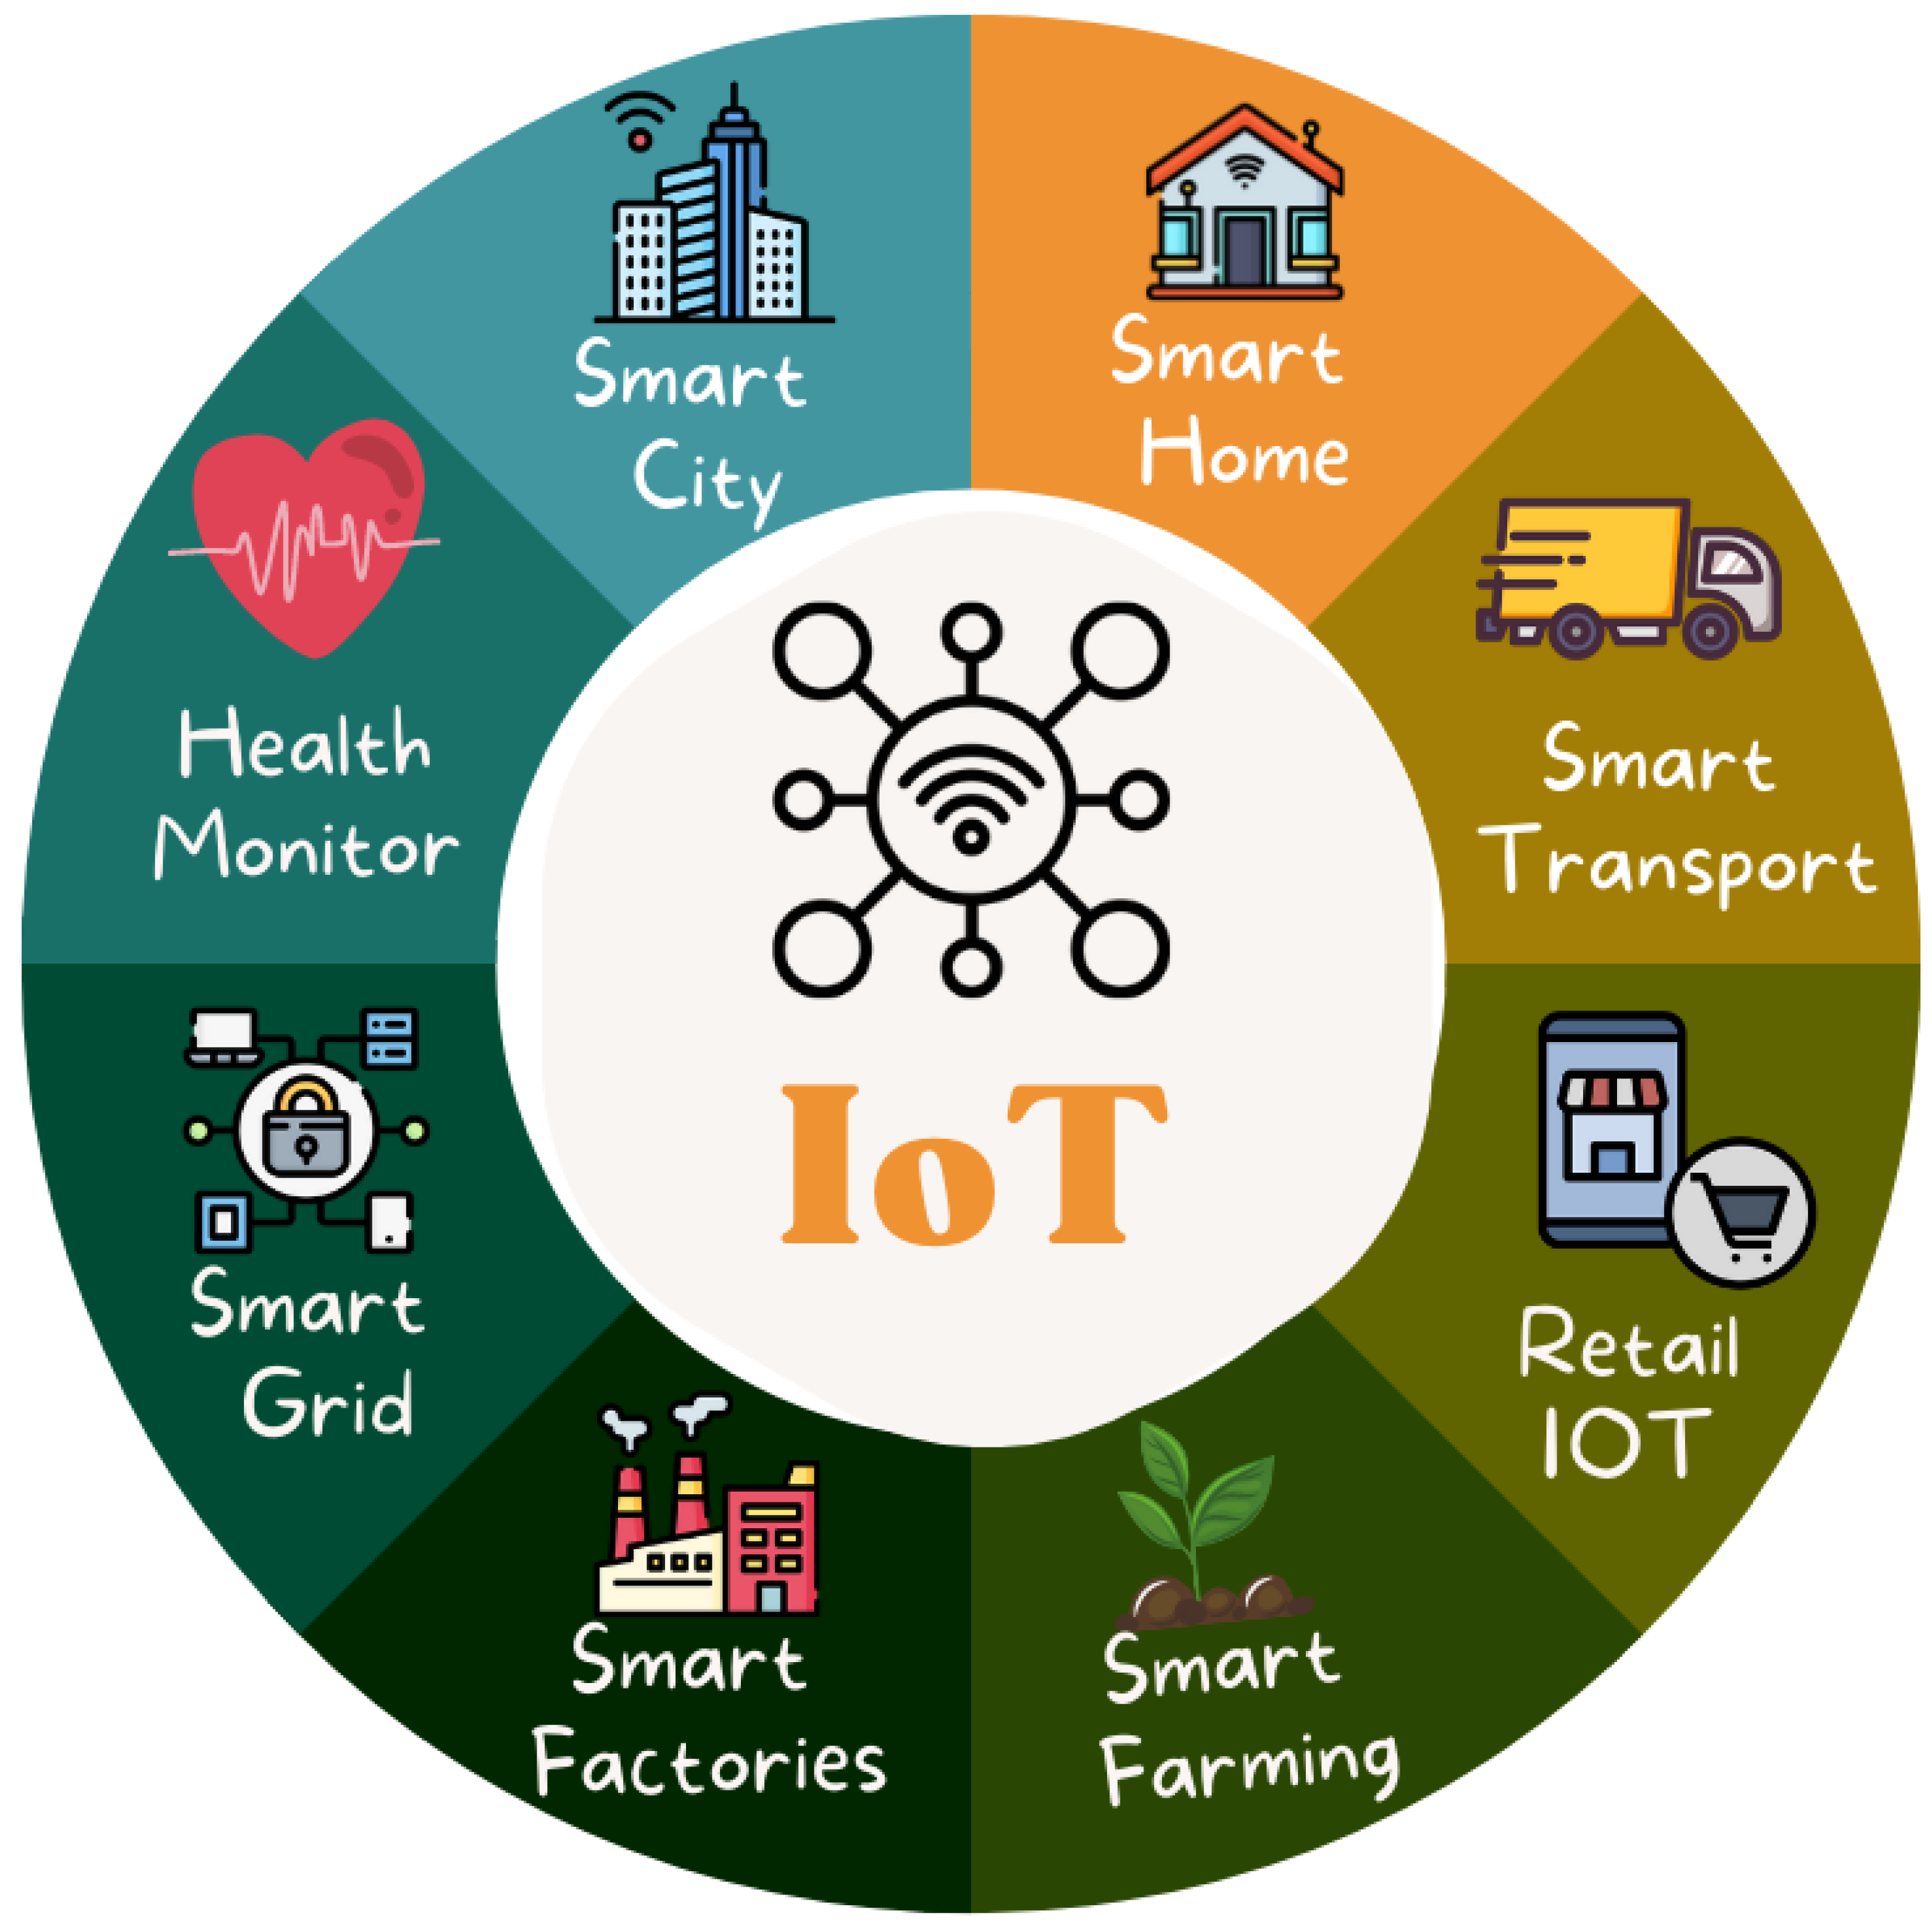
Applications Of IoT
Smart Home Automation:
IoT devices such as smart thermostats, lighting systems, security cameras, and connected appliances enable homeowners to automate and control various aspects of their homes remotely.
Healthcare Monitoring:
Wearable devices equipped with sensors can monitor vital signs, track physical activity, and send real-time health data to healthcare professionals, providing timely insights and improving patient care.
Industrial Internet (Industry 4.0):
IoT is extensively used in industries for predictive maintenance, asset tracking, and process optimization. Connected sensors on machines and equipment enable proactive maintenance, reducing downtime and improving efficiency.
Smart Cities:
IoT contributes to the development of smart cities by integrating sensors and data analytics into urban infrastructure. This includes smart traffic management, waste management, energy-efficient street lighting, and environmental monitoring.
Agricultural Monitoring:
IoT devices, such as soil sensors and drones, help farmers monitor crop conditions, manage irrigation more efficiently, and optimize farming practices for increased yield and sustainability.
Retail and Inventory Management:
Retailers use IoT for inventory tracking, supply chain optimization, and enhancing the overall shopping experience through technologies like smart shelves and connected beacons.

Slide 5
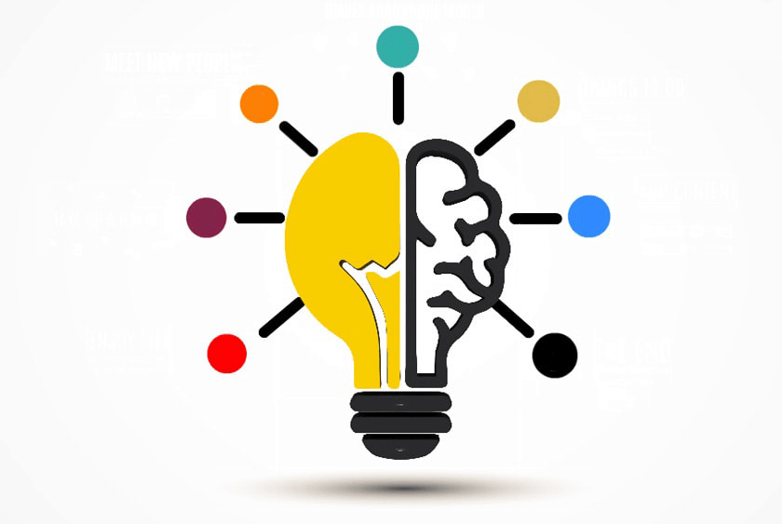
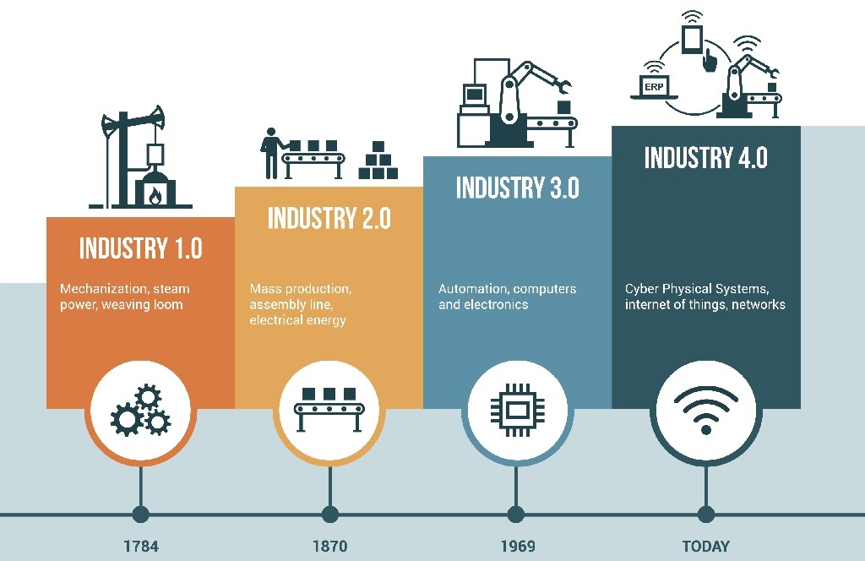
Applications Of IoT
Environmental Monitoring:
IoT sensors are deployed for monitoring and collecting data on environmental conditions, including air and water quality, to support sustainable practices and early detection of environmental issues.
Connected Vehicles:
IoT is integrated into vehicles for real-time monitoring, predictive maintenance, and enhancing safety. Connected cars can communicate with each other and with traffic infrastructure to improve traffic flow and reduce accidents.
Energy Management:
Smart meters, sensors, and connected devices help optimize energy consumption in homes, businesses, and industries, contributing to energy efficiency and cost savings.
Supply Chain Visibility:
IoT is used to track and monitor goods throughout the supply chain. This provides real-time visibility, improves logistics, and helps prevent issues such as theft or spoilage.
Asset Tracking:
Companies use IoT to track the location and condition of valuable assets, equipment, and inventory, leading to better asset management and increased operational efficiency.

Slide 6

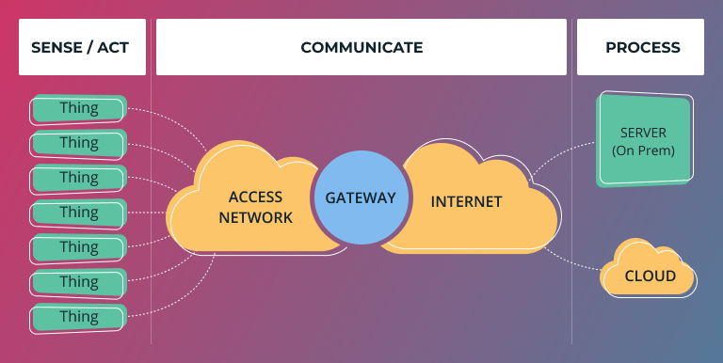
RISKS
The Internet of Things (IoT) introduces specific risks and challenges due to the interconnected nature of devices and the massive amounts of data they generate. Some of the key risks associated with IoT include:
Security Risks:
IoT devices may become targets for cyberattacks, leading to unauthorized access, data breaches, or manipulation of device functionalities. Insecure communication channels, weak authentication, and inadequate encryption can contribute to security vulnerabilities.
Privacy Concerns:
The extensive data collection capabilities of IoT devices raise privacy concerns. Personal and sensitive information may be collected without proper consent, leading to potential misuse or unauthorized access to individuals' data.
Data Integrity and Quality:
Ensuring the accuracy and reliability of data generated by IoT devices is crucial. Malfunctions, errors, or intentional manipulation of data can lead to incorrect conclusions and decisions.
Lack of Standardization:
The absence of standardized protocols and security measures across IoT devices can create interoperability issues and make it challenging to implement consistent security practices. This lack of standardization may hinder the overall security of IoT ecosystems.

Slide 7
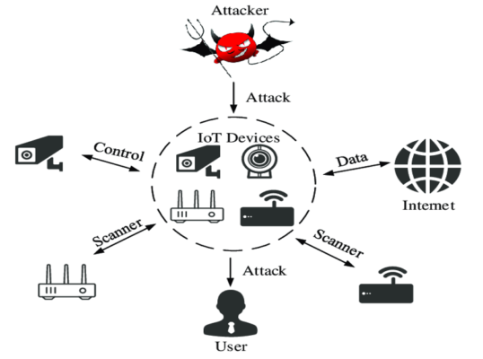
RISKS
Device Management and Maintenance:
Managing a large number of diverse IoT devices can be complex. Issues such as firmware updates, patch management, and device maintenance become critical to address vulnerabilities and ensure the ongoing security of the devices.
Network Vulnerabilities:
The communication networks connecting IoT devices are susceptible to various attacks, including denial-of-service (DoS) attacks. A compromised network can disrupt the functionality of IoT devices and compromise data integrity.
Supply Chain Risks:
The global supply chain for IoT components and devices introduces potential risks related to the security of the supply chain. Malicious actors may exploit vulnerabilities in the supply chain to compromise the integrity of IoT devices.
Regulatory Compliance:
Compliance with data protection and privacy regulations is a significant concern in the IoT space. Non-compliance may lead to legal consequences and reputational damage for organizations deploying IoT solutions.
Physical Security Risks:
Physical tampering with IoT devices can pose risks, especially in critical infrastructure and industrial applications. Adequate physical security measures are necessary to prevent unauthorized access or manipulation.
Scalability Challenges:
As IoT ecosystems grow in scale, managing the security of a large number of devices becomes more challenging. Ensuring consistent security practices and updates across a vast network of devices requires careful planning.

Slide 8
Features of IOT :
The most important features of IoT on which it works are connectivity, analyzing, integrating, active engagement, and many more. Some of them are listed below:
Connectivity :
Connectivity refers to establish a proper connection between all the things of IoT to IoT platform it may be server or cloud. After connecting the IoT devices, it needs a high speed messaging between the devices and cloud to enable reliable, secure and bi-directional communication.
Analyzing :
After connecting all the relevant things, it comes to real-time analyzing the data collected and use them to build effective business intelligence. If we have a good insight into data gathered from all these things, then we call our system has a smart system.
Integrating :
IoT integrating the various models to improve the user experience as well.
Artificial Intelligence :
IoT makes things smart and enhances life through the use of data. For example, if we have a coffee machine whose beans have going to end, then the coffee machine itself order the coffee beans of your choice from the retailer.
Sensing :
The sensor devices used in IoT technologies detect and measure any change in the environment and report on their status. IoT technology brings passive networks to active networks. Without sensors, there could not hold an effective or true IoT environment.
Active Engagement :
IoT makes the connected technology, product, or services to active engagement between each other.
Endpoint Management :
It is important to be the endpoint management of all the IoT system otherwise, it makes the complete failure of the system. For example, if a coffee machine itself order the coffee beans when it goes to end but what happens when it orders the beans from a retailer and we are not present at home for a few days, it leads to the failure of the IoT system. So, there must be a need for endpoint management.

Slide 9
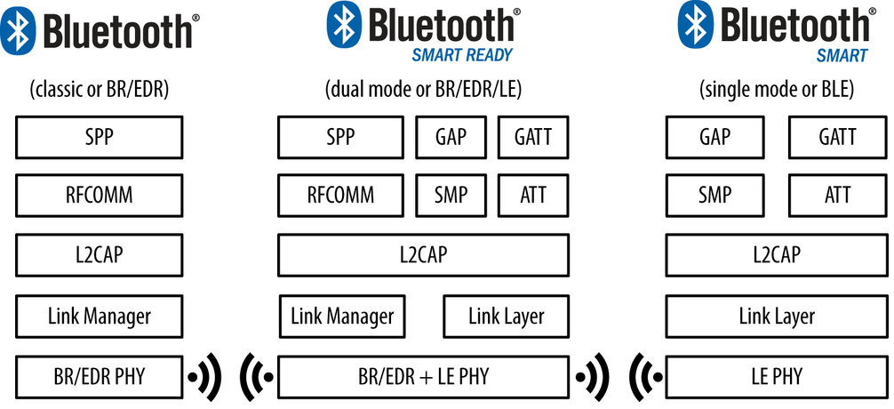
IoT Data Link Communication Protocol
The IoT Data Link communication protocol provides service to the Network Layer. There are various protocols and standard technologies specified by the different organization for data link protocols.
Bluetooth
Bluetooth is a short-range wireless communication network over a radio frequency. Bluetooth is mostly integrated into smartphones and mobile devices. The Bluetooth communication network works within 2.4 ISM band frequencies with data rate up to 3Mbps.
There are three categories of Bluetooth technology:
Bluetooth Classic
Bluetooth Low Energy
Bluetooth Smart Ready
The features of Bluetooth 5.0 version is introduced as Bluetooth 5 which have been developed entirely for the Internet of Things.

Slide 10
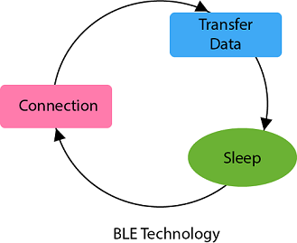
Properties of Bluetooth network :
Standard: Bluetooth 4.2
Frequency: 2.4GHz
Range: 50-150m
Data transfer rates: 3Mbps
Advantages of Bluetooth network
It is wireless.
It is cheap.
It is easy to install.
It is free to use if the device is installed with it.
Disadvantages of Bluetooth network
It is a short-range communication network.
It connects only two devices at a time.
Bluetooth Low Energy
Bluetooth low energy (BLE) is a short-range communication network protocol with PHY (physical layer) and MAC (Medium Access Control) layer. It is designed for low-power devices which uses less data. BLE always remain in sleep mode except when the connection between devices is initiated and data transmission occurs, due to this it conserves power of the device. Bluetooth low energy follows the master/slave architecture and offers two types of frames that are adverting and data frames. Slave node sent the advertising frame to discover one or more dedicated advertisement channels. Master nodes sense this advertisement channels to find slaves and connect them.

Slide 11
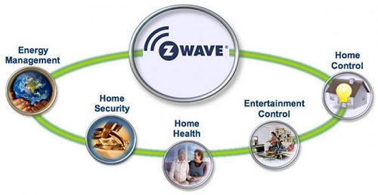
Z-Wave :
Z-Wave is a wireless communication protocol with the frequency of 900MHz. The ranges of Z-Wave lies between 30 meters to 100 meters with the data transfer rate of 100kbps so that it is suitable for small messages in IoT applications for home automation. This communication protocol operates on mesh network architecture with one and several secondary controllers
Properties of Z-Wave protocol
Standard: Z-Wave Alliance ZAD12837 / ITU-T G.9959
Frequency: 908.42GHz
Range: 30-100m
Data transfer rate: 100kbps
Advantages of Z-Wave protocol
Low power consumption
Remote or local control
Simple installation
Interoperability
Application of Z-Wave protocol
Smart product and IoT based application
Energy saving
Home security

Slide 12
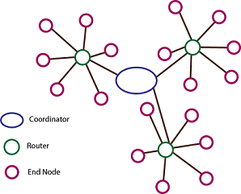
ZigBee Smart Energy :
ZigBee is a low power, low data rate wireless personal area network communication protocol. It is mostly used in home automation and industrial settings. Since ZigBee is a low power communication protocol, the IoT power devices used with ZigBee technology. The ZigBee communication protocol is based on the IEEE 802.15.4 standard operating at the 2.4GHz frequency. The ZigBee protocol supports star, cluster or wireless mesh technology topology.
ZigBee uses the following devices in its network:
Zigbee Coordinator
Zigbee End Device
Zigbee Router
Properties of ZigBee protocol :
Standard: ZigBee 3.0 based on IEEE802.15.4
Frequency: 2.4GHz
Range: 10-100m
Data transfer rate: 250kbps

Slide 13
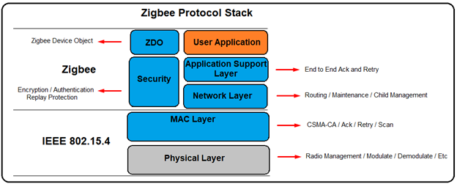
ZigBee protocol
Advantages of ZigBee protocol
Wireless
Mesh networking
Direct communication
Low power consumption
Disadvantages of ZigBee protocol
Costly
Works with low speed within a small distance
Application of ZigBee protocol
Commercial and residential control
Personal and healthcare
Home networking
Industrial control and management
Consumer electronics

Slide 14
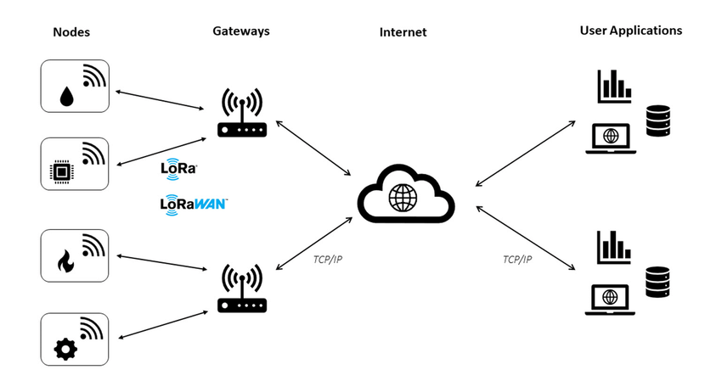
LoRaWAN :
LoRaWAN refers to Long Rage Wide Area Network which is a wide area network protocol. It is an optimized low-power consumption protocol design to support large-scale public networks with millions of low-power devices. A single operator operates the LoRaWAN. The LoRaWAN network is a bi-directional communication for IoT application with low cost, mobility, and security.
Properties of LoRaWAN protocol
Standard: LoRaWAN
Frequency: Various
Range: 2-5km (urban environment), 15km (suburban environment)
Data Rates: 0.3-50 kbps.

Slide 15
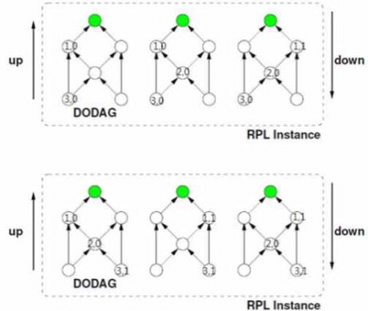
IoT Network Layer Protocols
The network layer is divided into two sublayers: routing layer which handles the transfer of packets from source to destination, and an encapsulation layer that forms the packets.
RPL Protocol :
RPL stands for Routing Protocol for Low-Power and Lossy Network. It is a distance-vector protocol that supports a varity of Data Link Protocols. RPL builds a Destination Oriented Directed Acyclic Graph (DODAG) which has only one route from each leaf node to the root. All the traffic in this DODAG is routed through the root. Initially, each node sends a DODAG Information Object (DIO) announcing them self as a root. This information travels in the network, and complete DODAG is gradually built. When a new node wants to join the network, it sends a DODAG Information Solicitation (DIS) request and root responds back with a DAO Acknowledgment (DAO-ACK) confirming the join.
CORPL Protocol :
CORPL protocol is the extension of the RPL protocol, which is termed as cognitive RPL. This network protocol is designed for cognitive networks and uses DODAG topology. CORPL protocol makes two new modifications in the RPL protocol. It uses opportunistic forwarding to forward a packet between the nodes. Each node of CORPL protocol keeps the information of forwarding set rather than parents only maintaining it. Each node updates its changes to its neighbor using DIO messages. On the basis of this updated message, each node frequently updates its neighbor for constant forwarder set.

Slide 16
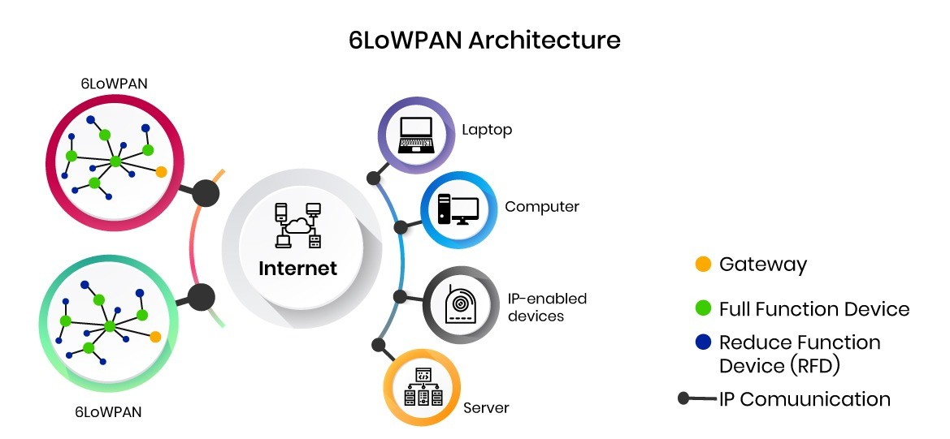
6LoWPAN
6LoWPAN
The 6LoWPAN protocol refers to IPv6 Low Power Personal Area Network which uses a lightweight IP-based communication to travel over low data rate networks. It has limited processing ability to transfer information wirelessly using an internet protocol. So, it is mainly used for home and building automation. The 6LoWPAN protocol operates only within the 2.4 GHz frequency range with 250 kbps transfer rate. It has a maximum length of 128-bit header packets.
6LowPAN Security Measure
Security is a major issue for 6LowPAN communication Protocol. There are several attacks issues at the security level of 6LoWPAN which aim is to direct destruction of the network. Since it is the combination of two systems, so, there is a possibility of attack from two sides that targets all the layer of the 6LoWPAN stack (Physical layer, Data link layer, Adaptation layer, Network layer, Transport layer, Application layer).
Properties of 6LowPAN protocol
Standard: RFC6282
Frequency: Used over a variety of other networking media including Bluetooth Smart (2.4GHz) or ZigBee or low-power RF (sub-1GHz)
Range: NA
Data Rates: NA

Slide 17
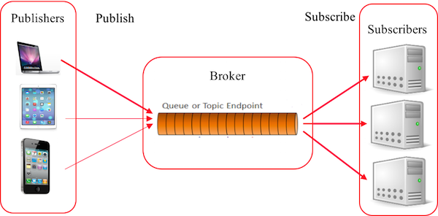
IoT Session Layer Protocols
The session layer protocols review standards and protocols for message passing. Different standardization organizations introduce the IoT session layer protocols. There are different types of session layer protocol available with different functionality and range. MQTT and CoAP provide these needs through small message sizes, message management, and lightweight message overhead.
MQTT (Message Queue Telemetry Transport)
MQTT (Message Queue Telemetry Transport) is a messaging protocol which was introduced by IBM in 1999. It was initially built for monitoring sensor node and faraway tracking in IoT. Its suits are small, cheap, low-memory and low-power devices. MQTT provides embedded connectivity between applications and middleware in one side and another side it connects networks and communicators.
MQTT protocol is based on publish/subscribe architecture. The publish/subscribe architecture consists of three major components: publishers, subscribers, and a broker. According to IoT point of view, publishers are lightweight sensor devices that send their data to connected broker and goes back to sleep whenever possible. Subscribers are applications, which are interested in a certain topic or sensory data, so they are connected to brokers to be informed whenever new data are received. The broker receives the sensory data and filters them in different topics and sends them to subscribers according to interest in the topics.

Slide 18
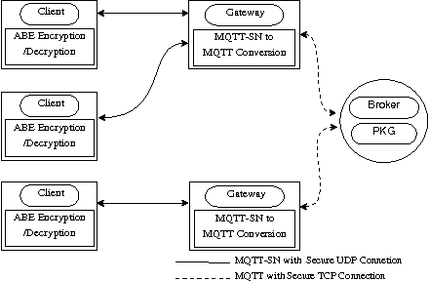
SMQTT (Secure Message Queue Telemetry Transport)
SMQTT (Secure Message Queue Telemetry Transport) is an extension of MQTT protocol which uses encryption based on lightweight attribute encryption. The main advantage of this encryption is that it has a broadcast encryption feature. In this features, one message is encrypted and delivered to multiple other nodes. The process of message transfer and receiving consists of four major stages:
Setup: In this phase, the publishers and subscribers register themselves to the broker and get a secret master key.
Encryption: When the data is published to broker, it is encrypted by broker.
Publish: The broker publishes the encrypted message to the subscribers.
Decryption: Finally the received message is decrypted by subscribers with the same master key.

Slide 19
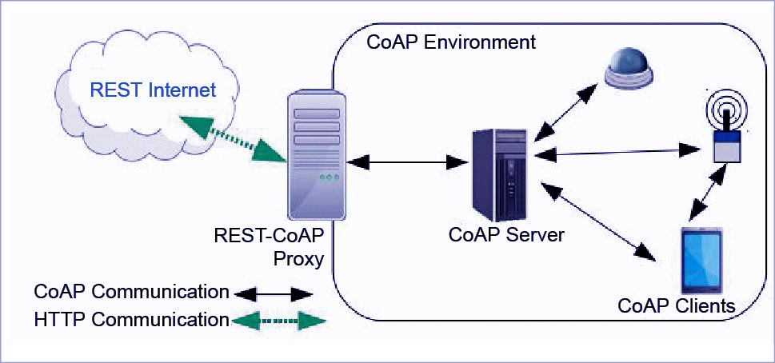
CoAP
CoAP (Constrained Application Protocol) is a session layer protocol that provides the RESTful (HTTP) interface between HTTP client and server. It is designed by IETF Constrained RESTful Environment (CoRE) working group. It is designed to use devices on the same constrained network between devices and general nodes on the Internet. CoAP enables low-power sensors to use RESTful services while meeting their low power constraints. This protocol is specially built for IoT systems primarily based on HTTP protocols.
This network is used within the limited network or in a constrained environment. The whole architecture of CoAP consists of CoAP client, CoAP server, REST CoAP proxy, and REST internet.
The data is sent from CoAP clients (such as smartphones, RFID sensors, etc.) to the CoAP server and the same message is routed to REST CoAP proxy. The REST CoAP proxy interacts outside the CoAP environment and uploads the data over REST internet.

Slide 20
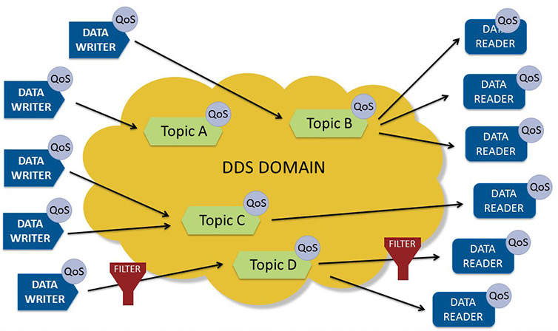
DDS
DDS (Data Distribution Service) is a middleware (sometimes called machine-to-machine (M2M)) communication protocol. It is implemented by the Object Management Group (OMG) standard for the real-time system with high speed and high-performance, scalable, dependable, and interoperable data exchange. This communication protocol is based on a publish-subscribe pattern for sending and receiving data, events, and commands among the nodes.
The DDS protocol has two main layers:
Data-Centric Publish-Subscribe (DCPS):
This layer delivers the information to subscribers.
Data-Local Reconstruction Layer (DLRL): This layer provides an interface to DCPS functionalities, permitting the sharing of distributed data amongst IoT enabled objects.

Slide 21
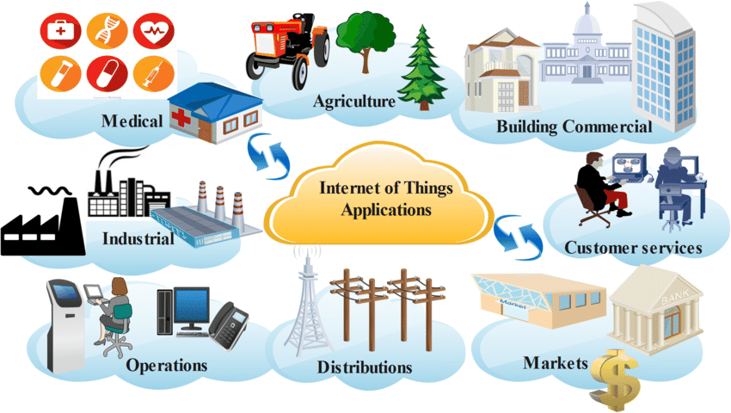
Internet of Things Innovative examples
You likely use IoT devices every day. The list below outlines a few IoT devices that you may be familiar with:
Smart home devices. Smart devices are interactive electronics that use wireless connections to understand user instructions. To an extent, smart home devices like thermostats and home security systems can work autonomously to assist with daily tasks. For example, you may program your smart thermostat to adjust automatically to a cooler setting before you arrive home from work. Or, you may receive a security camera notification to inform you that someone is at the door when you are not home.
Wearable technologies. One of the most common Internet of Things examples is smartwatches. Wearable IoT technology like Fitbits and Apple Watches connect to other devices (like your smartphone) to share data. They typically also connect to the internet to track GPS locations.
Personal medical devices. Personal medical devices like pacemakers are also IoT devices. Remote medical devices can help monitor and share a patient's vital signs or detect early signs of health issues for fast intervention.
Autonomous vehicles. Self-driving cars and other connected vehicles rely on the internet to share real-time information. Sensors throughout the vehicle help map its surroundings, transmit camera footage, and respond to traffic signals.

Slide 22
Thank You

