Slide 1
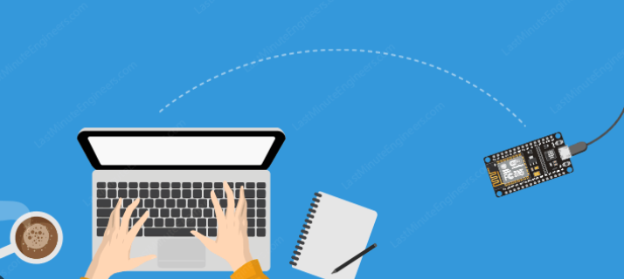
Introduction to ESP32

Slide 2
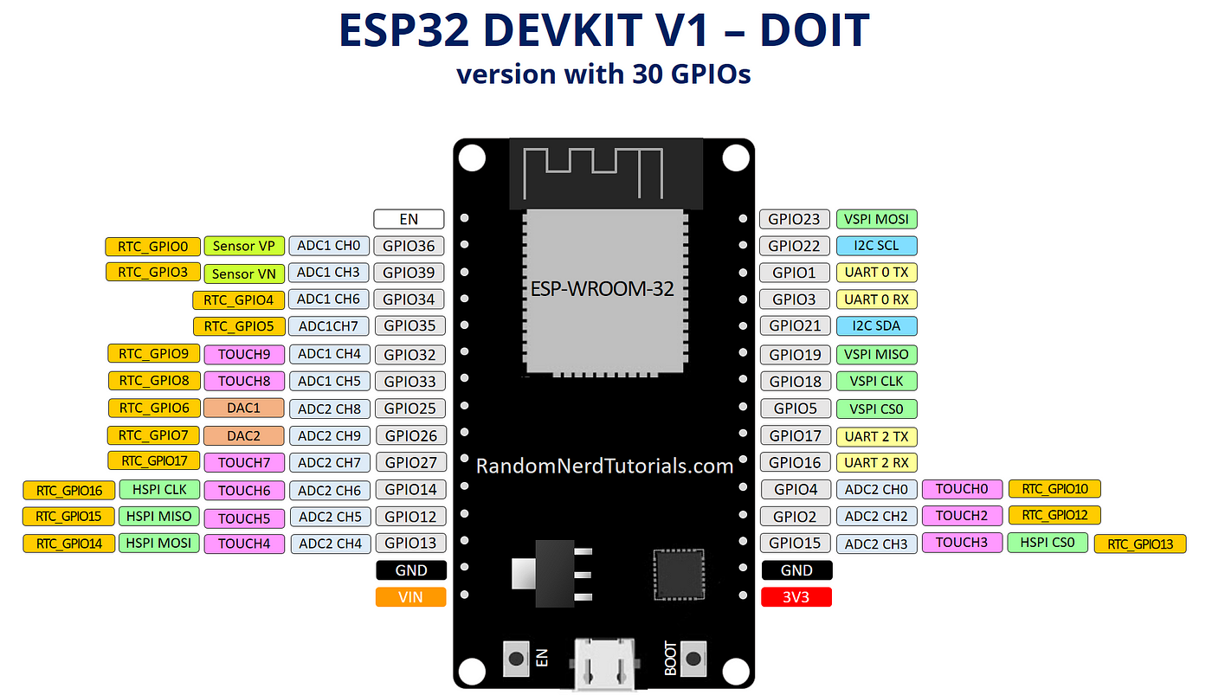
Introduction
The ESP32 is a powerful and versatile microcontroller that has gained popularity in the field of embedded systems and IoT (Internet of Things) applications. Developed by Espressif Systems, the ESP32 is known for its dual-core processing capabilities, built-in Wi-Fi and Bluetooth connectivity, and a rich set of peripherals. In this introduction, let's focus on the hardware-related programming environment for ESP32.

Slide 3
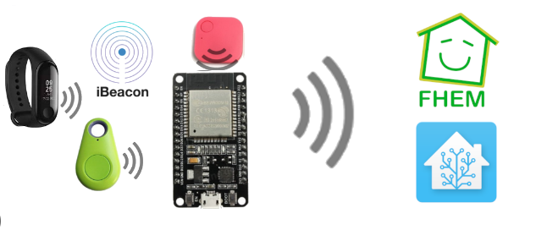
Hardware Overview:
Microcontroller Unit (MCU): The ESP32 is equipped with a dual-core Xtensa LX6 microprocessor, providing more processing power compared to single-core MCUs. This allows for efficient multitasking and handling of complex applications.
Memory:
Flash Memory: ESP32 comes with built-in Flash memory for program storage. It's used to store the firmware and application code.
RAM: The ESP32 has both internal and external RAM. Internal RAM is used for data and stack, while external RAM can be added for more storage.
Wireless Connectivity:
Wi-Fi: The ESP32 supports 802.11 b/g/n Wi-Fi, making it suitable for IoT applications that require internet connectivity.
Bluetooth: It features Bluetooth Classic (BT) and Bluetooth Low Energy (BLE) support, expanding its range of applications.

Slide 4
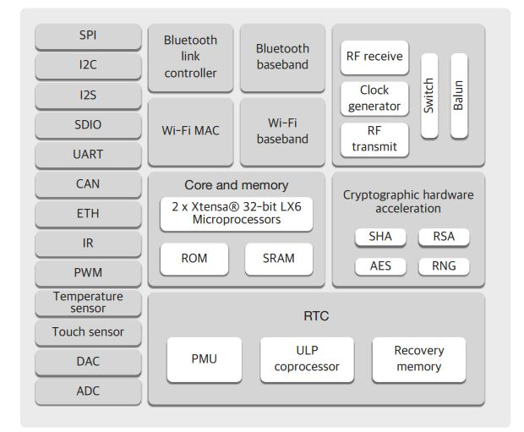
HARDWARE
Peripherals:
GPIO (General Purpose Input/Output): ESP32 provides a multitude of GPIO pins that can be configured for various purposes, such as digital input/output, PWM, or communication interfaces.
I2C, SPI, UART: Standard communication protocols for interfacing with sensors, displays, and other peripherals.
ADC (Analog-to-Digital Converter): Enables the ESP32 to read analog signals from sensors.
Power Management:
The ESP32 supports various low-power modes, making it suitable for battery-operated devices and energy-efficient applications.

Slide 5
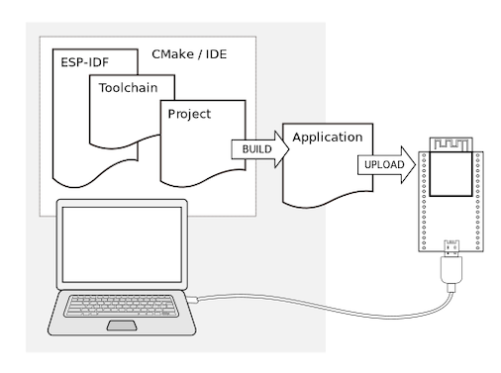
Programming Environment
Arduino IDE:
The Arduino IDE can be used to program the ESP32. Espressif provides the necessary board support package (BSP) that integrates with the Arduino IDE.
Arduino code for ESP32 is written in C/C++ with a simple and easy-to-use syntax.
Espressif IDF (IoT Development Framework):
For more advanced users, the Espressif IDF provides a comprehensive set of tools and libraries for ESP32 development.
It offers greater control over hardware features and low-level functionalities.
PlatformIO:
An alternative to the Arduino IDE is PlatformIO, which is an open-source ecosystem for IoT development. It supports the ESP32 and provides a more integrated development experience.

Slide 6
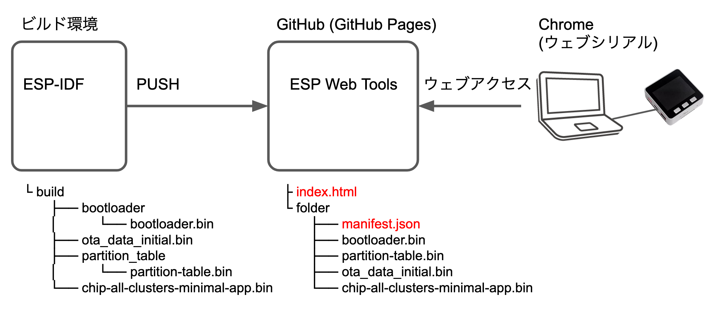
Getting Started
Installation:
Install the necessary drivers and tools for your development environment.
Set up the Arduino IDE or choose an alternative like PlatformIO.
Selecting the Board:
Choose the ESP32 board variant in your IDE.
Configure settings such as flash frequency, upload speed, and upload the boot loader.
Writing Code:
Start writing your code using the provided libraries and functions.
Leverage the extensive ESP32 community for support and libraries.

Slide 7
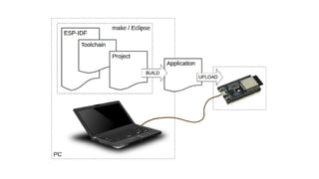
Getting Started
Uploading Code:
Connect your ESP32 to your computer and upload your code using a USB-to-Serial interface or through onboard USB if available.
Debugging and Monitoring:
Use debugging tools available in your IDE or utilize the serial monitor for debugging information.
In summary, the ESP32 offers a powerful hardware platform with built-in wireless capabilities, making it an excellent choice for a wide range of IoT applications. Whether using the Arduino IDE or Espressif IDF, developers can leverage the rich feature set of the ESP32 for creating innovative and connected projects.

Slide 8
Thank You.

