Slide 1


My Work Between
September 2021 and June 2023
Balázs PÁL^{1,2}
¹Department of Physics of Complex Systems, Eötvös Loránd University
²Heavy-ion Research Group, Wigner Research Centre for Physics
Eötvös Loránd University, Doctoral School of Physics
Astronomy and Space Physics Doctoral Program
Complex Exam – June 13, 2023

Slide 2
I. Cosmological Simulations
As part of István Csabai’s research group
@ Eötvös Loránd University
In cooperation with the
Wigner Research Centre for Physics
Supervised by István Csabai & Gergely Gábor Barnaföldi

Slide 3
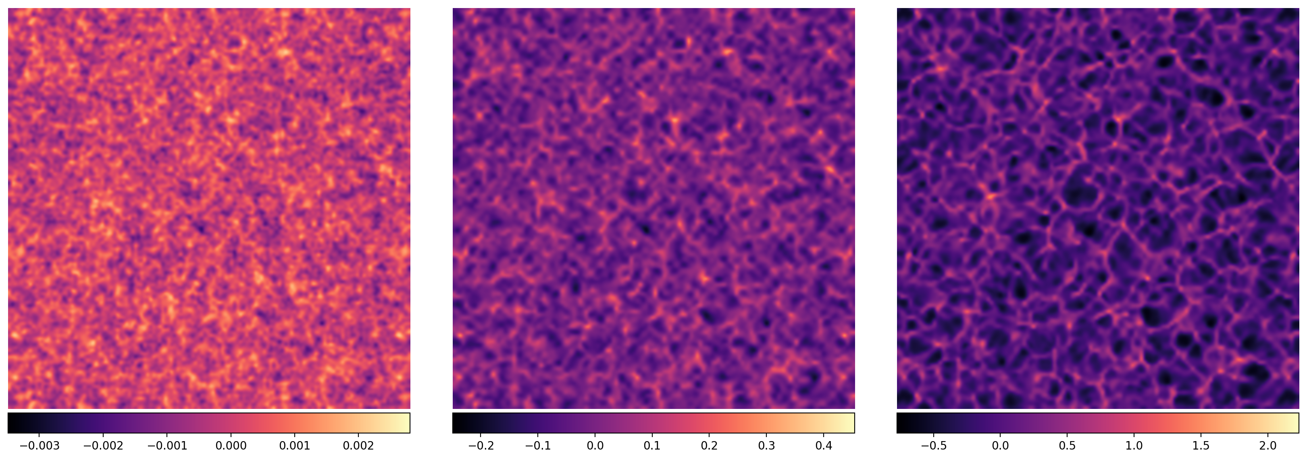
EinsteinToolkit + FLRWSolver
Fig. 1. Bicubic interpolation of a 7.8125 Mpc/h thick slice of the density field in a cosmological GR simulation with a boxsize of 1000 Mpc/h showing a) the initial conditions, b) an intermittent snapshot, c) and the end of the simulation at z = 0. The initial conditions were generated using the FLRWSolver¹ and was evolved using the EinsteinToolkit².
a) b) c)
¹: Hayley McPearson et al. (https://github.com/hayleyjm/FLRWSolver_public)
²: www.einstein-online.info

Slide 4
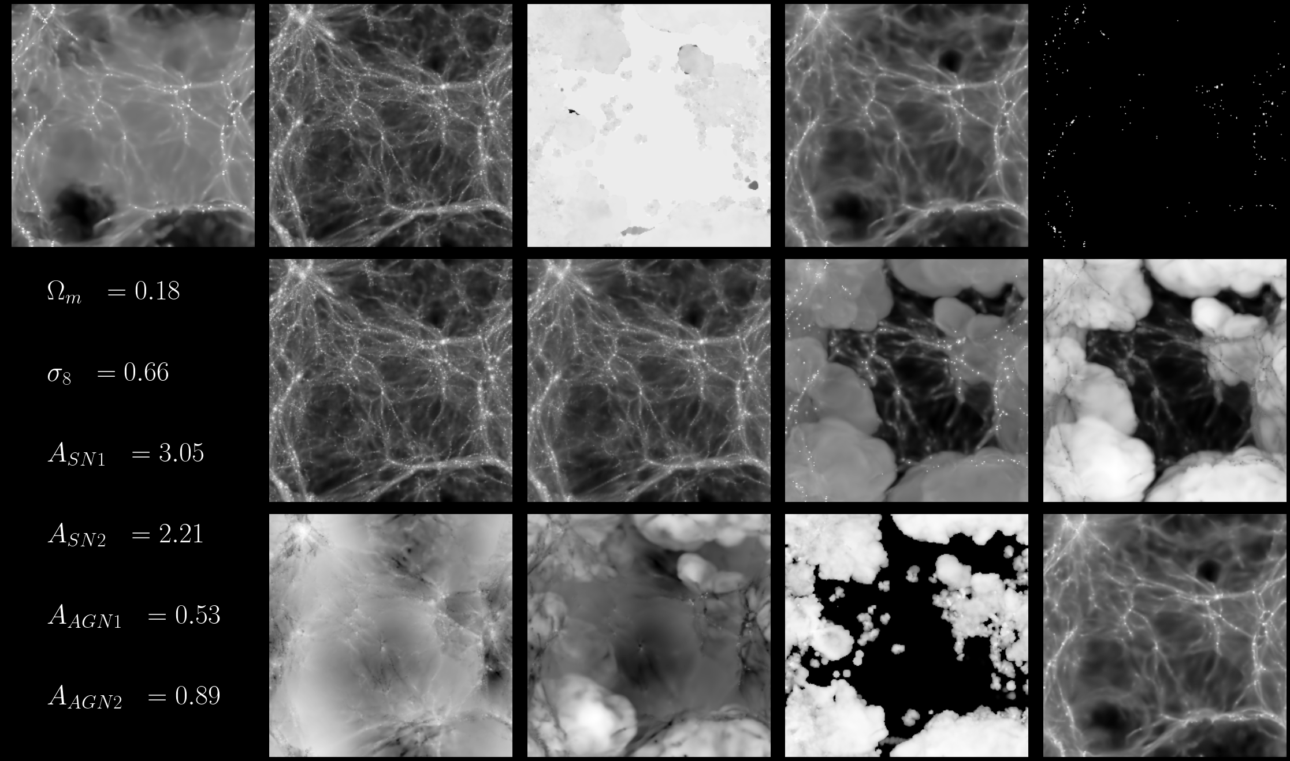
CAMELS – Connecting ML and simulations
Fig. 2. A sample of the 12+1 fields of a single simulation in the CAMELS dataset. The fields here represent the same physical slice in the simulation. The 6 target labels attached to the simulation are shown in the bottom left corner.

Slide 5
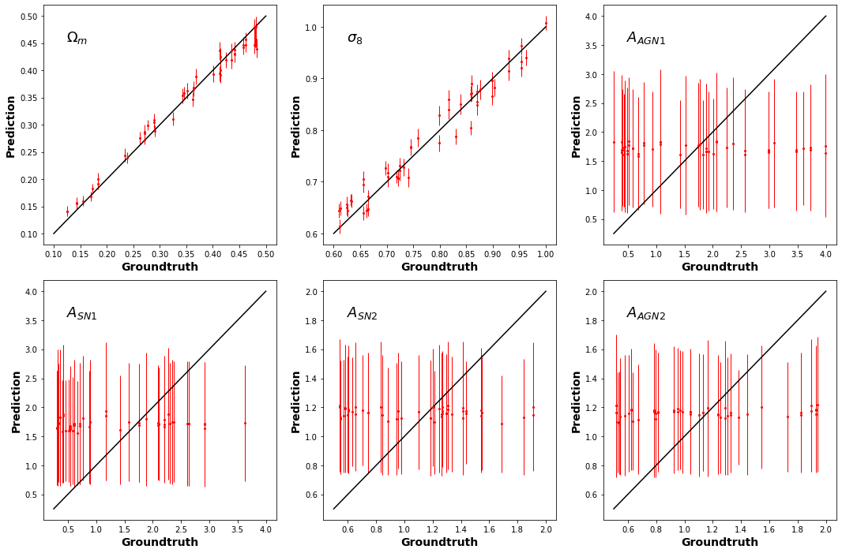
CAMELS – Connecting ML and simulations
Fig. 3. Predictions compared to labels after training an ML model on the MCDM fields.
A simple deep CNN model were separately trained on each sets of the 12+1 fields in the dataset. The goal was to accurately predict the Ωm and σ8 values, while omitting the astrophysical effects as much as possible. The figure here shows that it was successful for the MCDM fields.

Slide 6

II. Galactic Archaeology
As part of the PFS Galactic Archaeology Research Group
@ Johns Hopkins University, Baltimore, MD
Supervised by László Dobos

Slide 7
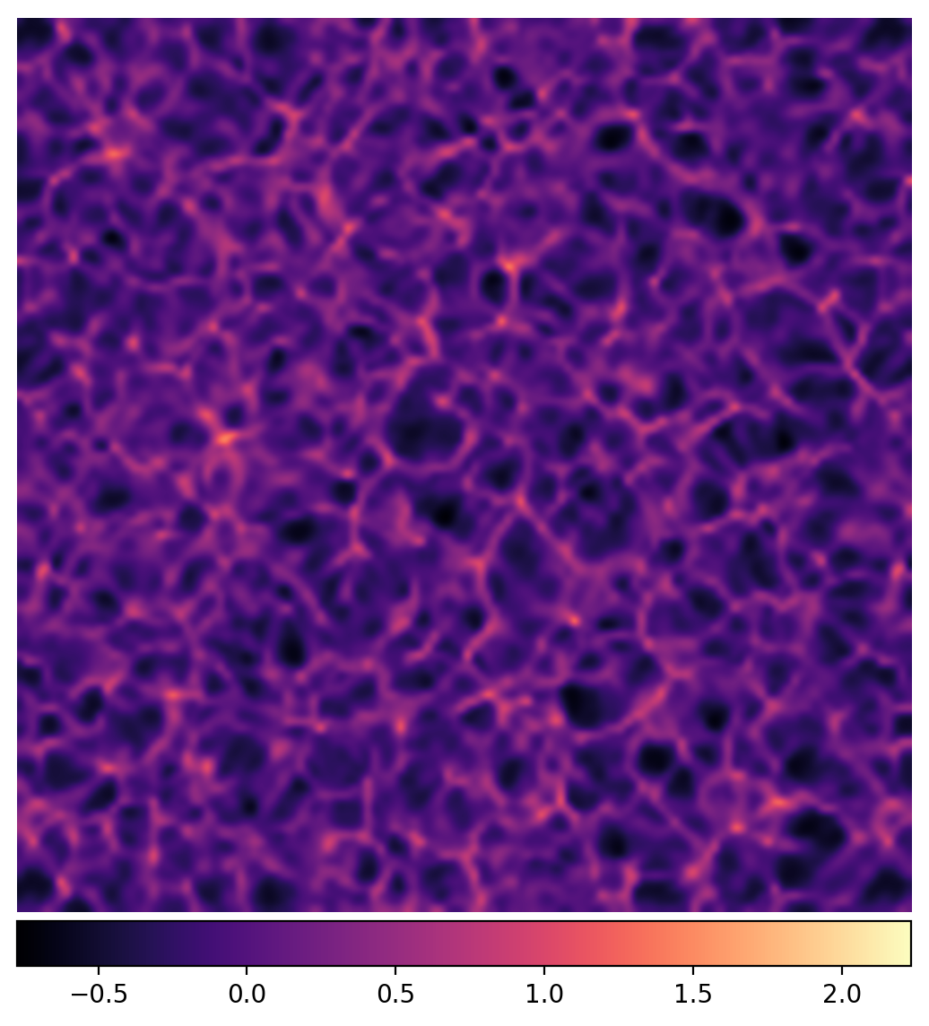
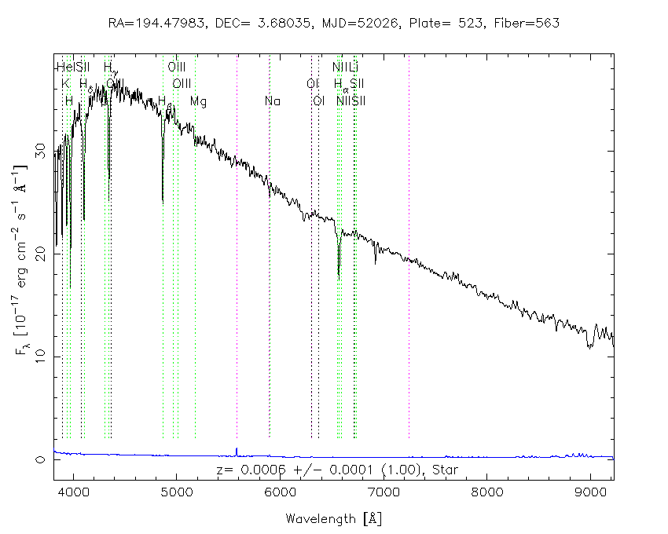
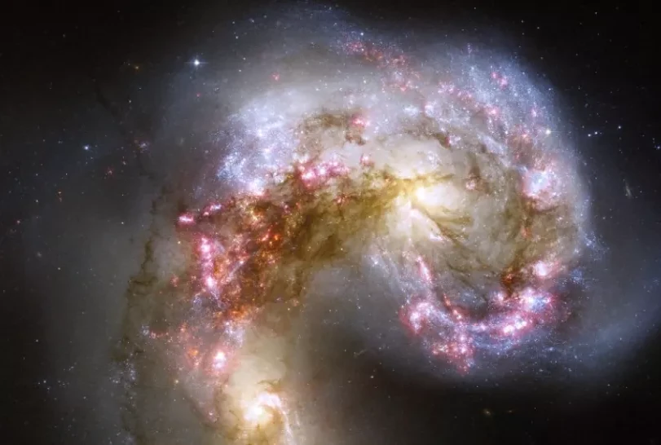
Galactic Archaeology and the Subaru PFS
Source: NASA, ESA, and the Hubble Heritage Team (STScI/AURA)-ESA/Hubble Collaboration
Source: Sloan Digital Sky Survey / SkyServer
General relativistic cosmological simulation using the BSSN formalism – Own work
1. Stellar attributes
2. Galactic evolution
3. Cosmological implications

Slide 8
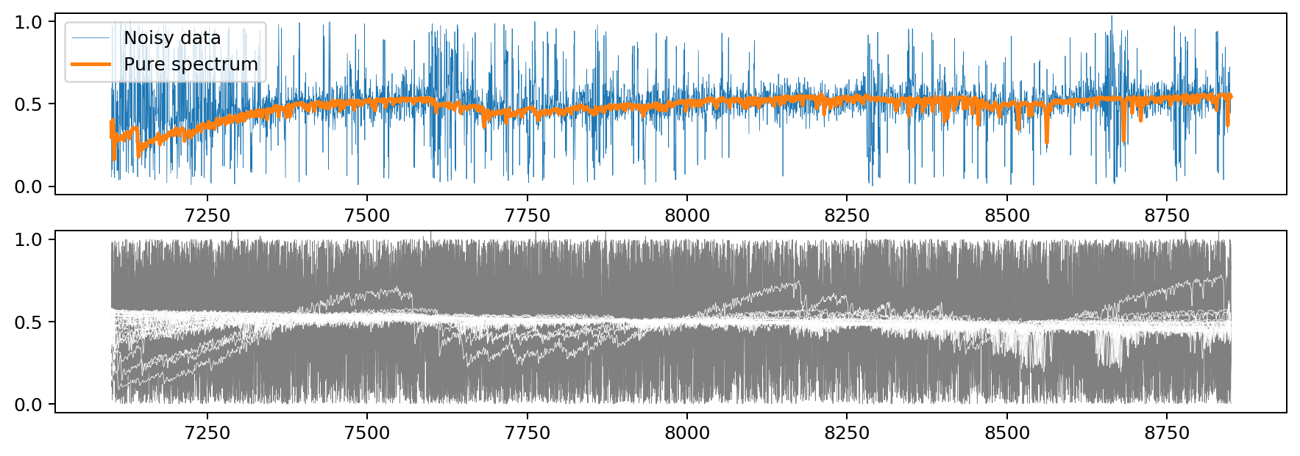
Example synthetic spectra
Fig. 4. Example of a single, artificially generated stellar spectrum with noise (blue line) and without noise (orange line) added (top panel). For additional visual clues about the dataset, a training batch of noisy (grey area) and noiseless (white area) spectra are also shown here (bottom panel).

Slide 9
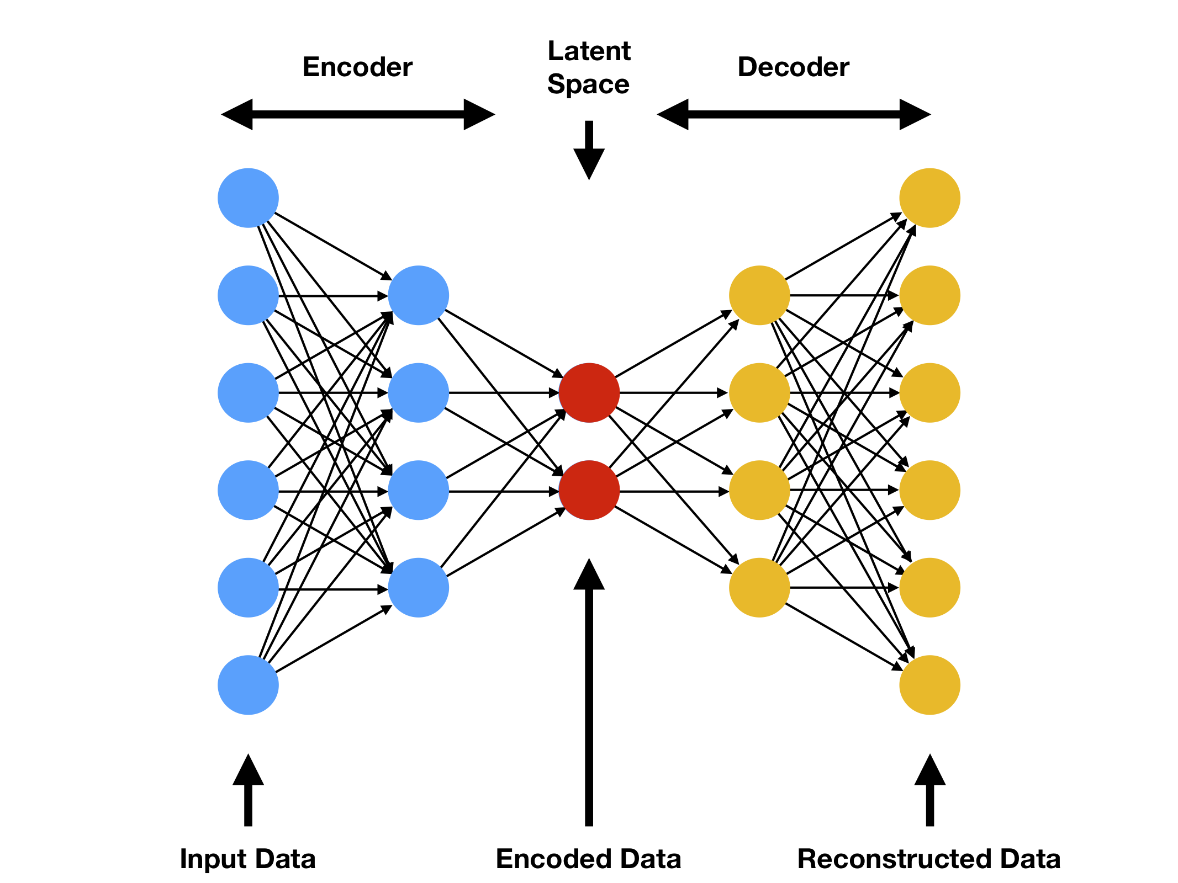
Structure of the base autoencoder
Dense Autoencoder
Dimensions
  Input/output: 4096
  Latent space: < 4096
Encoder and the Decoder
  4+4 layers
  Same amount of neurons
  No batch normalization
  No dropout layers
Source: Mahony, Niall O., et al. "Representation learning for fine-grained change detection." Sensors 21.13 (2021): 4486.

Slide 10
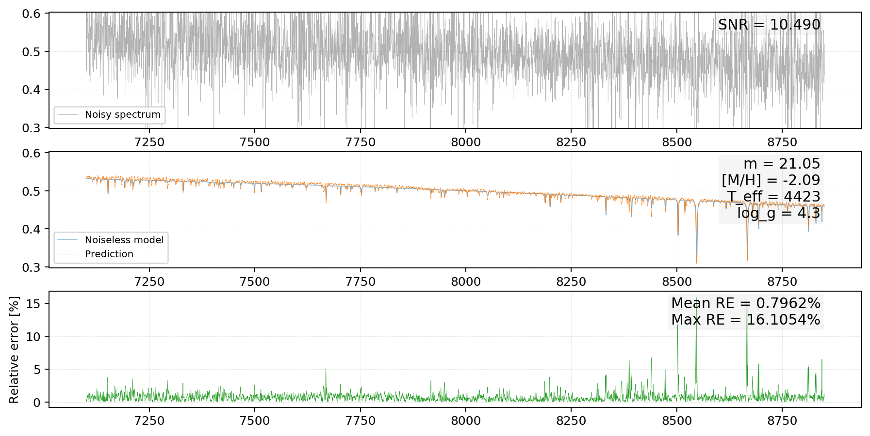
Example for denoising
Fig. 5. A single noisy spectrum (top panel); a comparison between the groundtruth and the prediction of the trained autoencoder model (center panel); and the relative error between the groundtruth and the prediction (bottom panel).

Slide 11
III. Unraveling Crypto-assets
Co-authoring with Tamás Pál
@ Eötvös Loránd University
Economic regimes and regime changes – November 26, 2021

Slide 12
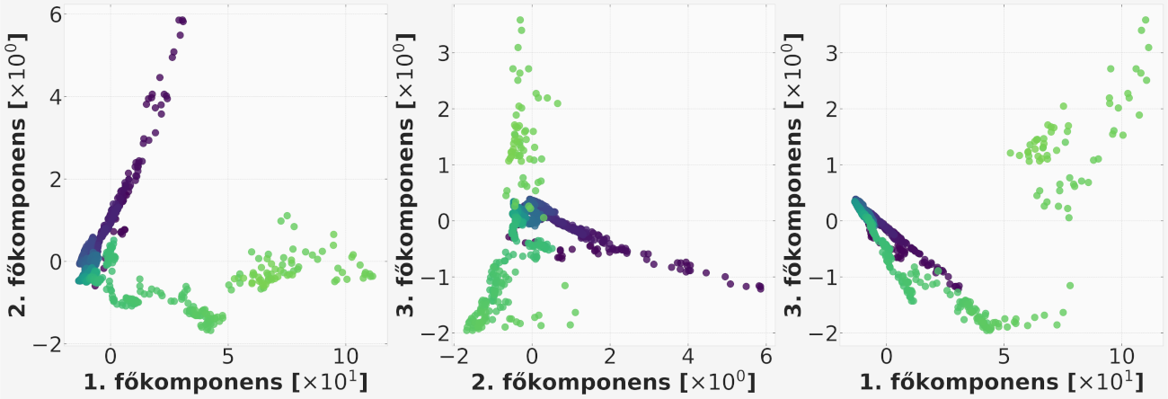
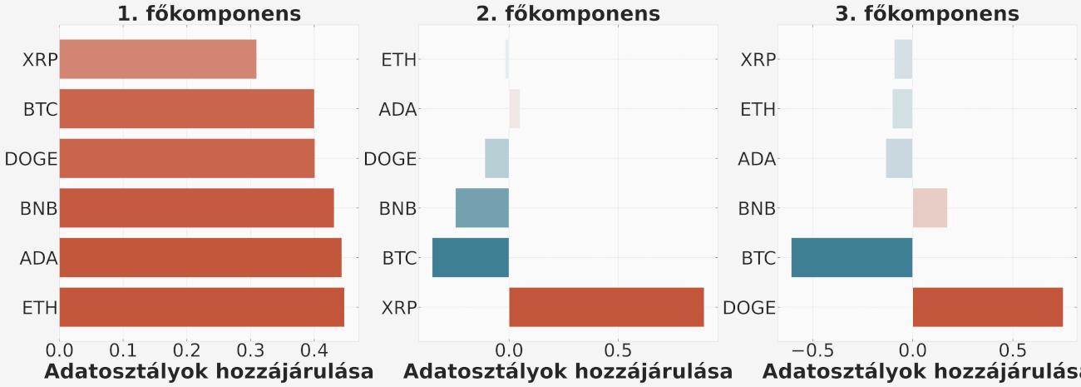
Results of Principal Component Analysis
Fig. 6. (on the right) Data are projected onto the first three principal components, with a color gradient indicating the temporal progression from dark to light. Each axis operates on a unique scale, as denoted by the respective labels. Dominating the variance, the 1st principal component is an order of magnitude larger than the subsequent two.
Fig. 7. (on the left) The individual contributions of data points from each crypto-asset to the three principal components are depicted. Although the differences are small, the crypto-assets ETH and ADA seems to be the main drivers of price fluctuations. On the other hand, the 2nd and 3rd principal components tell a story about specific, influential events in the crypto world, eg. the race between BTC and XRP, as well as Elon Musk’s internet campaign to promote the Dogecoin (DOGE).

Slide 13
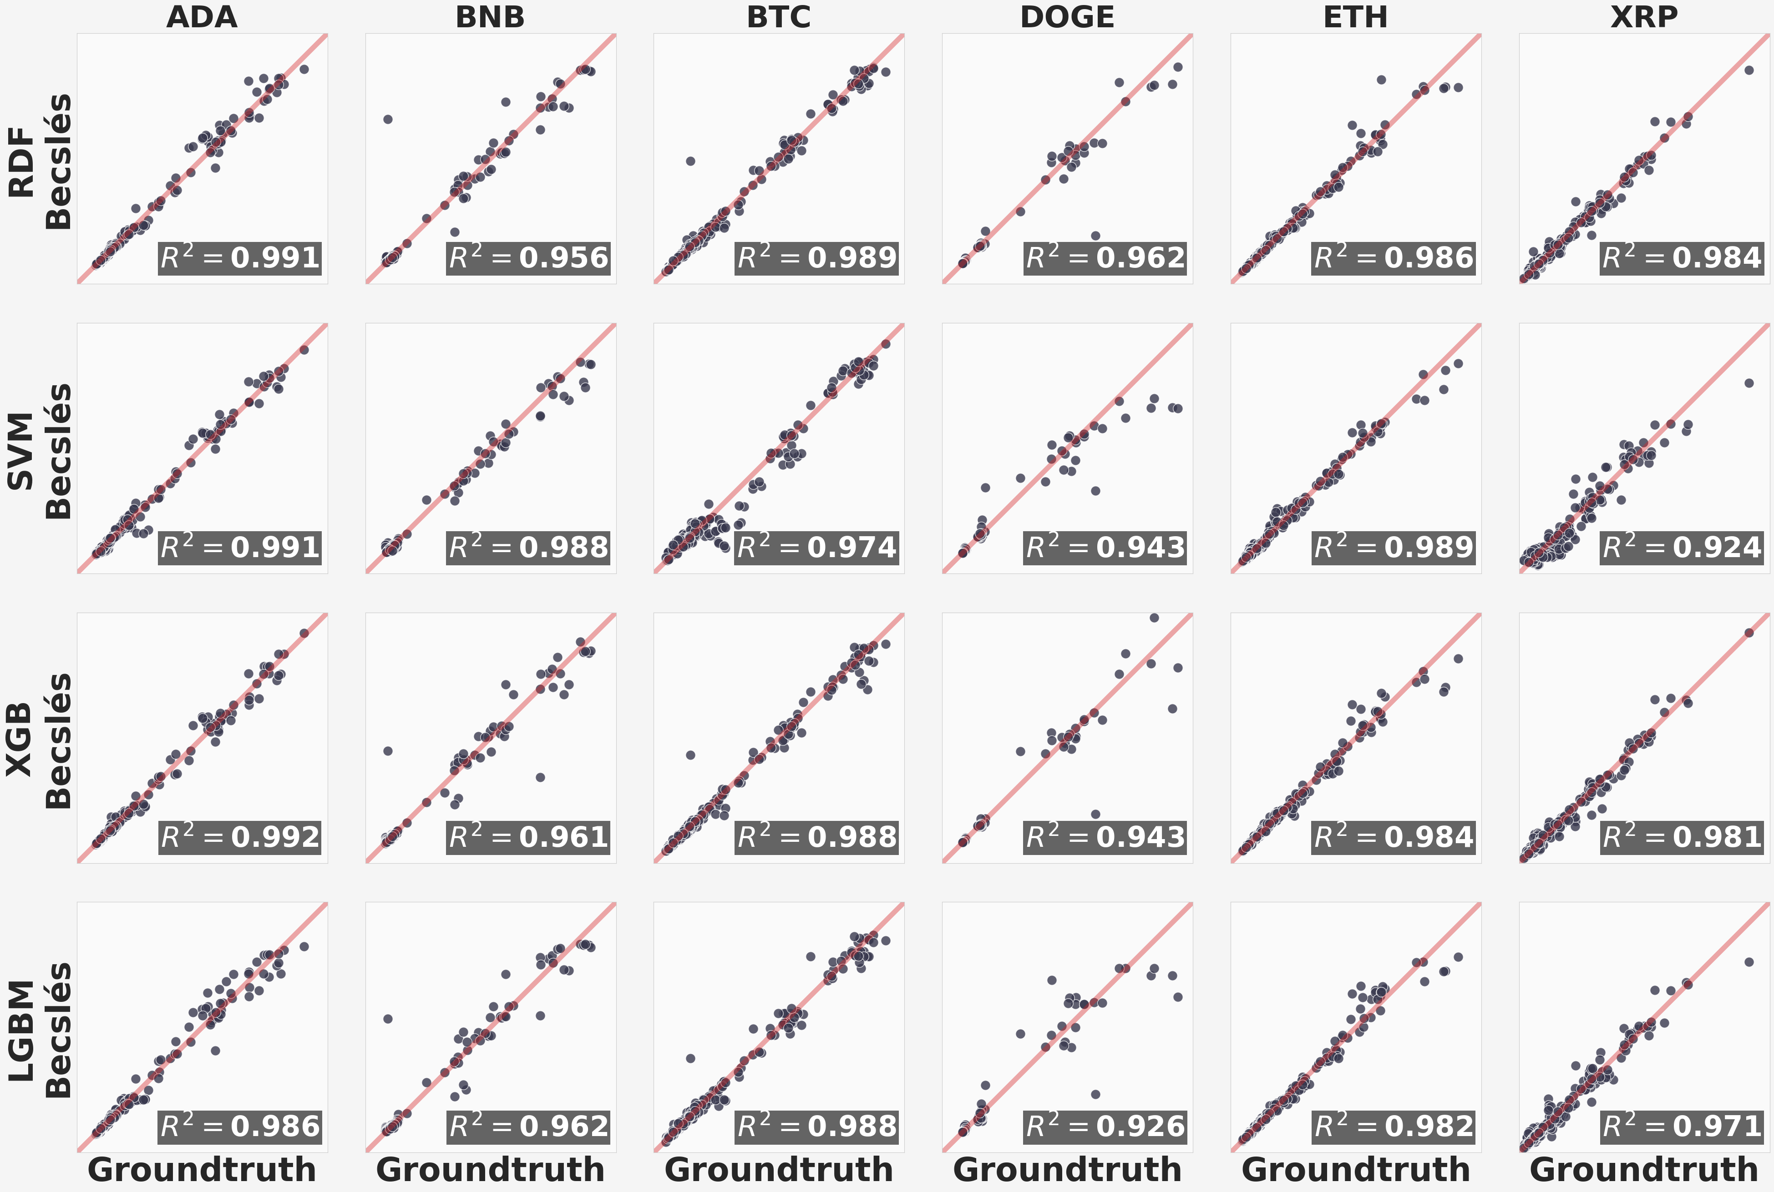
Results of other supervised ML methods
Fig. 8. Each subplot within the 4×6 grid represents the predictive performance of a specific machine learning model (Random Forest, SVM, XGBoost, LightGBM) for a particular crypto-asset. The plots depict the correlation between the predicted values and the actual values. Root Mean Square Error (RMSE), displayed in the lower right corner of each subplot, serves as the accuracy metric for the predictions. Analysis shows that the crypto-asset ADA shows the highest predicative power, while DOGE is the worst one.

Slide 14

IV. SARS-CoV-2 Reconstruction
Co-authoring with Ákos Gellért¹, Oz Kilim², Anikó Mentes² and István Csabai²
@ ¹Veterinary Medical Research Institute and ²Eötvös Loránd University
In cooperation with the
Wigner Research Centre for Physics

Slide 15

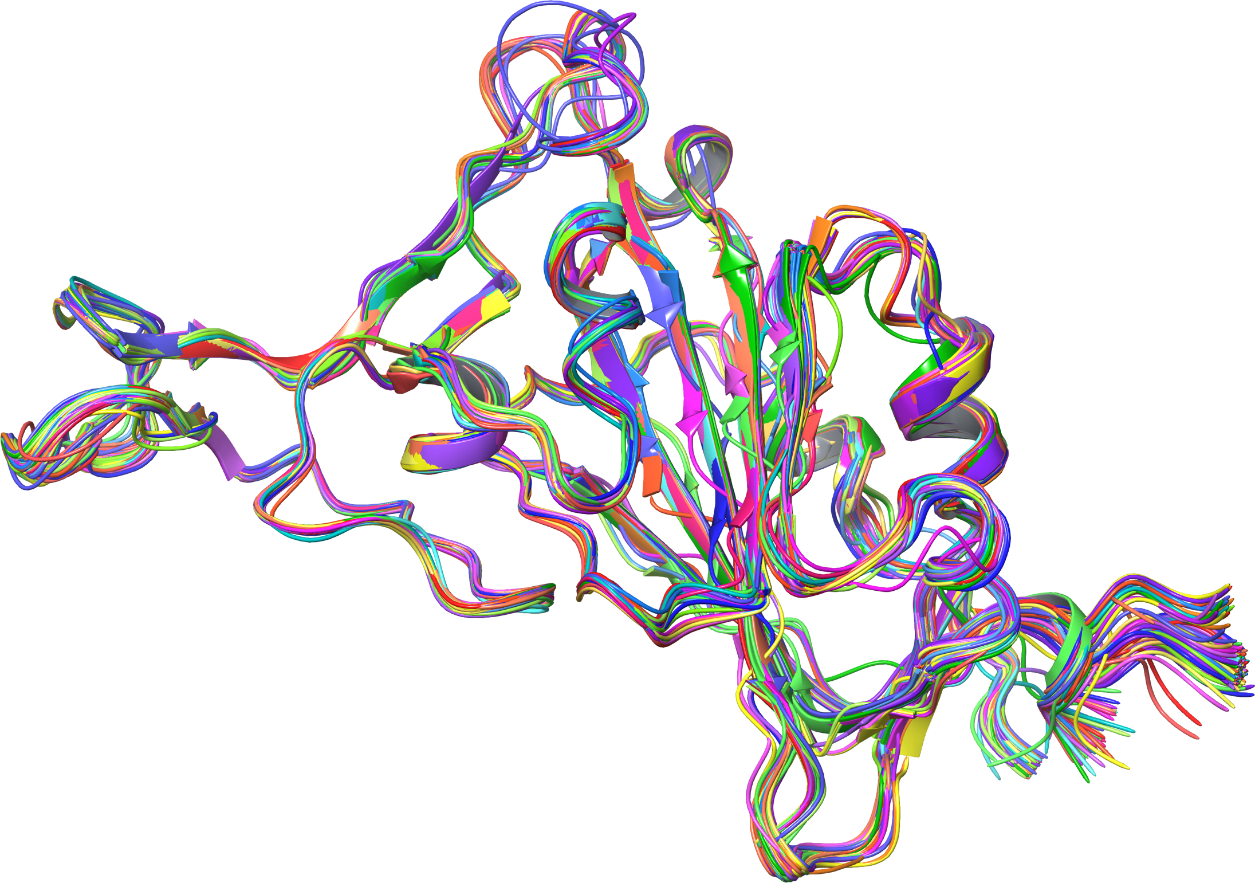
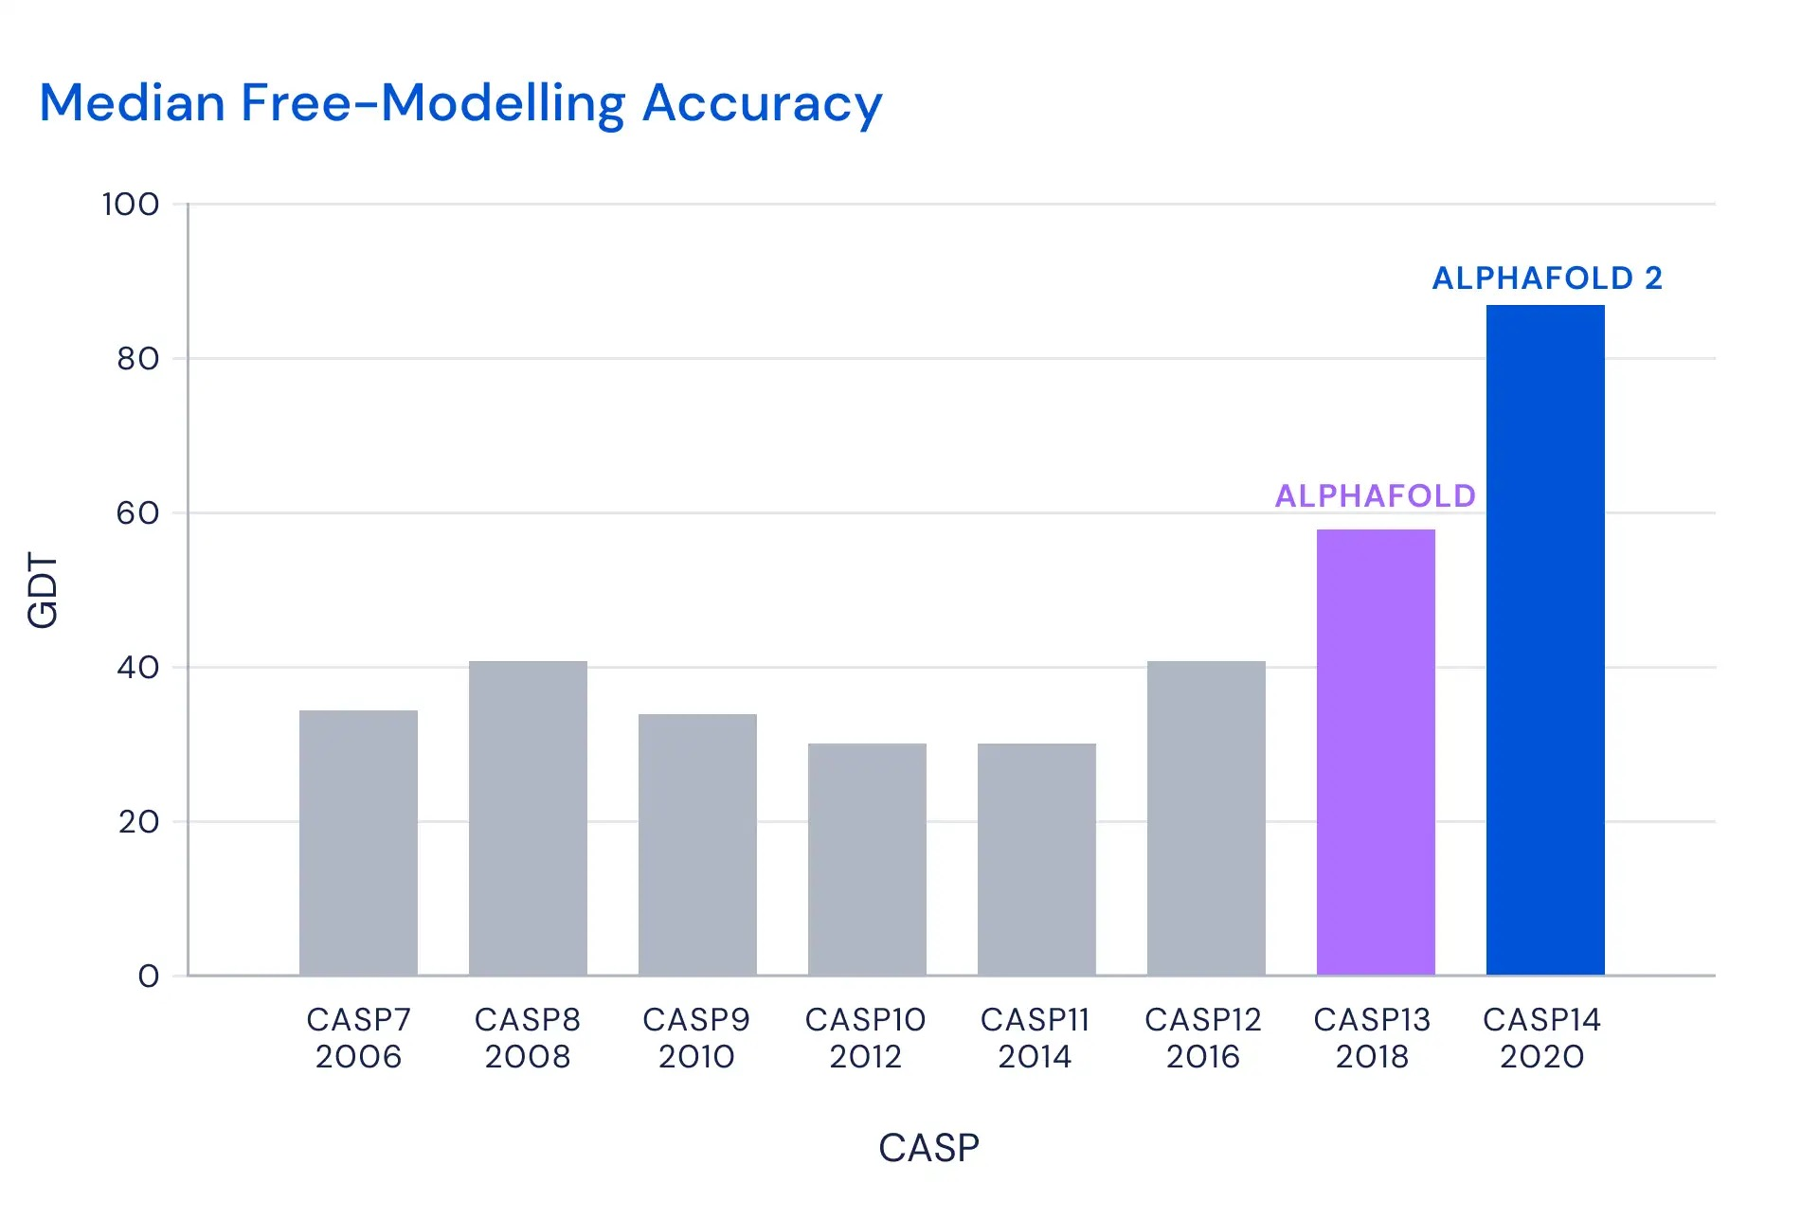
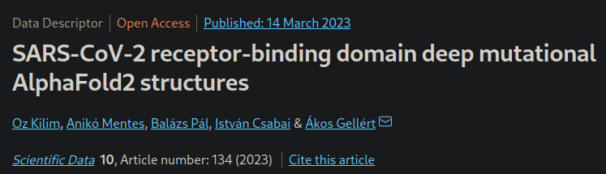
AlphaFold2 in COVID research
3D protein structure
Arbitrary chain of amino acids
VLLYTNEDKGTNFQDRMLGWTVKGKWTWHYIEIGVFQMIVQWNDTQAIKMQHECFQQRQHRHLYTWEENTCSAFMCGYYMLSPPWPACDVRIGWLRALVRNVHSSLWHWINASTAPSNHLGMALMMYYNCMQPFIIEKQGFERQVDCKID

Slide 16
Conferences, Lectures, Presentations

Slide 17
Conferences, lectures, presentations
Presentations given at conferences
Lectures given at other occasions
Economic regimes and regime changes – November 26, 2021
XIII. GPU Day(s) – May 15-16, 2023
ELTE MÁSZ Workshop Seminar – December 10, 2021
ELTE GTK Department of Comparative Economics Research Seminar – June 2, 2022
Wigner RCP IPNP Seminar – July 29, 2022
Lecture about Data Science and its applications – BGE KVIK – April 26, 2023
Lecturer on courses at ELTE
Modern Computational Methods in Physics 1 – 2022, 2023
Modern Computational Methods in Physics 2 – 2021
Scientific Modeling Computer Laboratory – 2023
Data Mining and Machine Learning – 2022 (only at laboratory courses)

Slide 18
Courses Taken

Slide 19
Courses taken during the PhD program
2nd Semester
3rd Semester (from abroad)
Advanced infomation technology in astronomy II. (FIZ/5/008) by Emese Forgácsné Dajka
Data mining in astronomy (FIZ/5/006) by István Csabai
Solar physics (FIZ/5/057) by Kristóf Petrovay
The structure of compact stars (FIZ/5/025) by Gergely Gábor Barnaföldi
Radio astronomy I. (FIZ/5/009) by Krisztina Gabányi & Sándor Frey
Space weather and space climate (FIZ/5/059) by Kristóf Petrovay
4th Semester
Radio astronomy II. (FIZ/5/010) by Krisztina Gabányi & Sándor Frey
Linear and nonlinear MHD waves (FIZ/5/054) by Róbert von Fáy-Siebenbürgen

Slide 20
Thank you for your attention!

