Slide 1

CAMELS Multifield Dataset
Balázs Pál
2022, Eötvös Loránd University

Slide 2
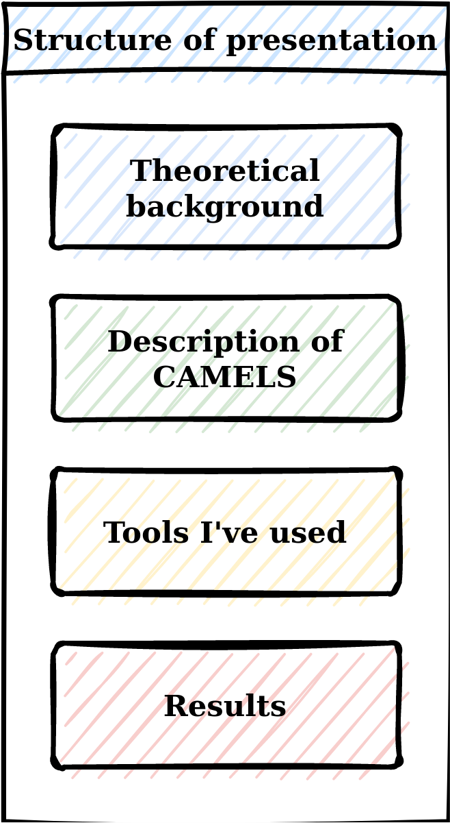
Overview
Astrophysical background
  What’s the physical meaning of what we study here?
Description of the CAMELS dataset
Technical details
  How do we approach the dataset? (CNN model)
  What tools am I using and why I’m using those exactly?
My work and results

Slide 3




Astrophysical background
Goals of modern cosmology
  Improve the standard model of cosmology
  Yes, that’s it basically
Solve challanges of the ΛCDM model
  Ωm – σ8 tension
  H0 tension (CMB vs. SN)
  …

Slide 4
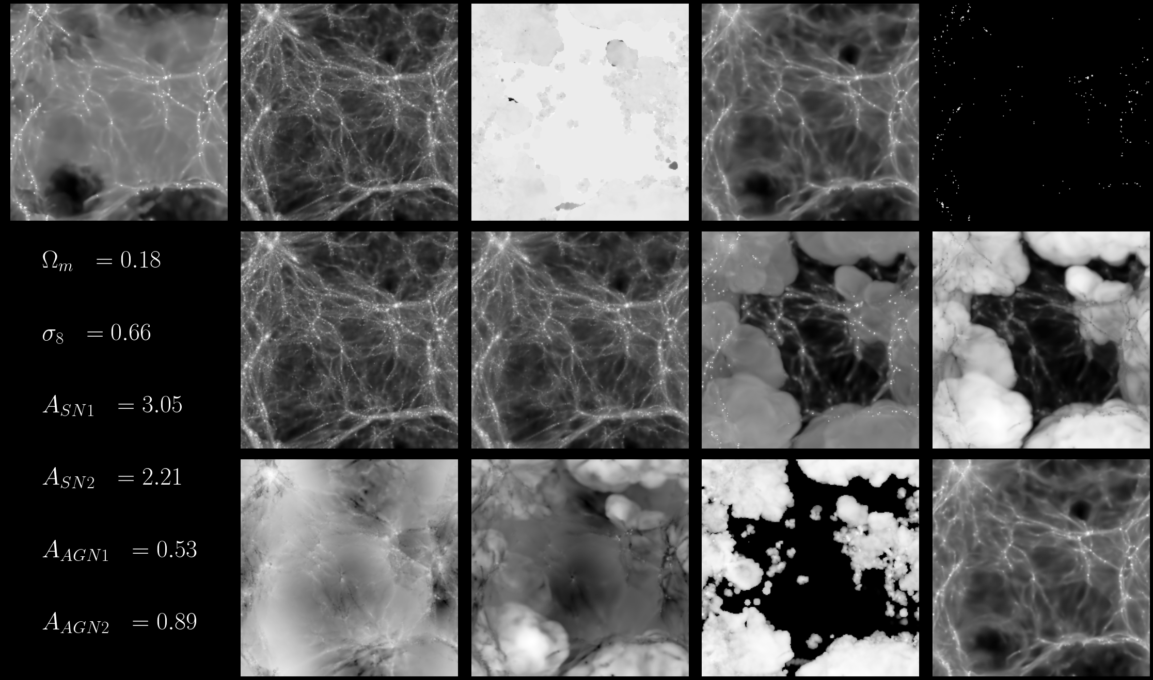
Description of the CAMELS dataset
Comprehensive collection of simulations
Purposefully designed for machine learning (Cosmology and Astrophysics with MachinE Learning Simulation)
The CAMELS Multifield Dataset contains 1,000 HD and 1,000 MHD simulations
15 slices (5 Mpc/h) each for every different channel for every simulation

Slide 5
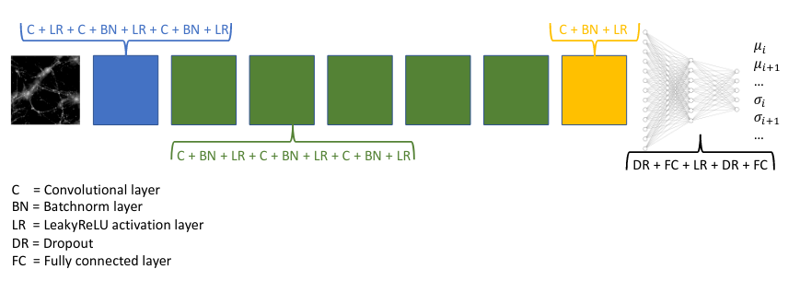
Technical details
A basic CNN architecture was used
256² pixel images were reduced to 12 output values (6-6 values for the mean and variance of the posterior)
The model was trained on all target parameters at the same time
Source: Villaescusa-Navarro, Francisco, et al. "Multifield Cosmology with Artificial Intelligence." arXiv preprint arXiv:2109.09747 (2021).

Slide 6
Technical details
Two loss functions were used to get both mean and variance values during training

Slide 7
Technical details
The architecture was constructed in Pytorch
Pros:
  Behaviour of TensorFlow is „strange” in this first half of 2022
  There is already an existing Pytorch implementation of the network used in the article
Cons:
  Pytorch requires the input data to be in a very specific form, which means we need much more data preprocessing
  Since we’re using multifield data, it needs even more preprocessing

Slide 8
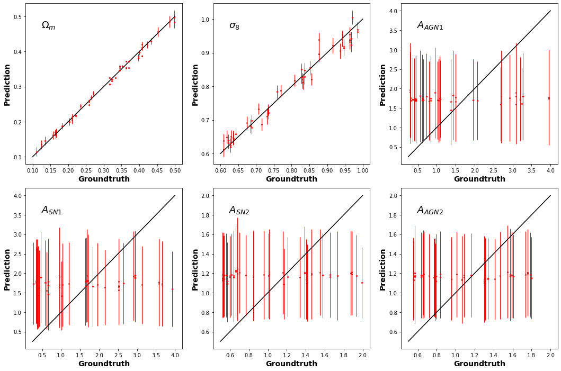
My work and results

Slide 9
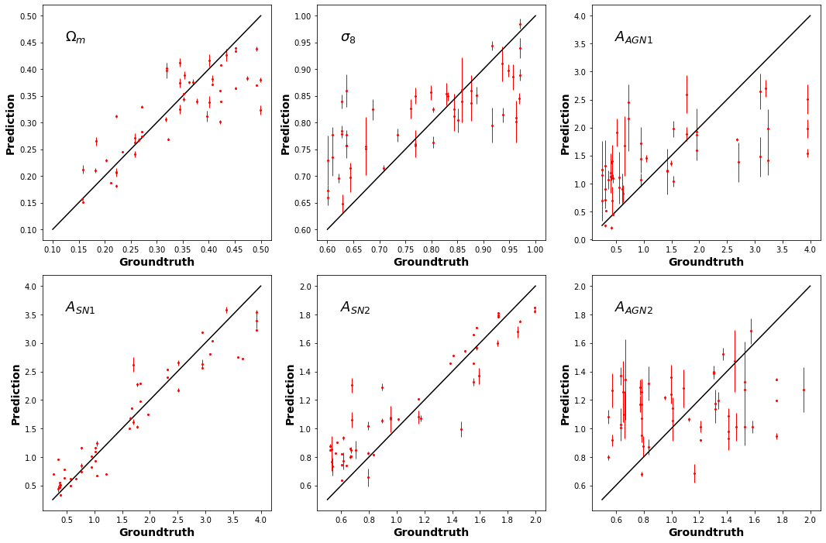
My work and results

Slide 10
My work and results

