Slide 1


Computer Simulations
Balázs PÁL^{1,2}
¹Department of Physics of Complex Systems, Eötvös Loránd University
²Heavy-ion Research Group, Wigner Research Centre of Physics

Slide 2
Goals of this lecture
To give a general overview of computer simulations
Why are we using computer simulations?
What can they tell us about the world around us that we cannot learn from other methods?
How do they even do this?

Slide 3


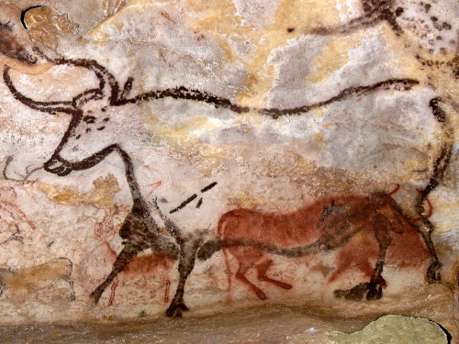

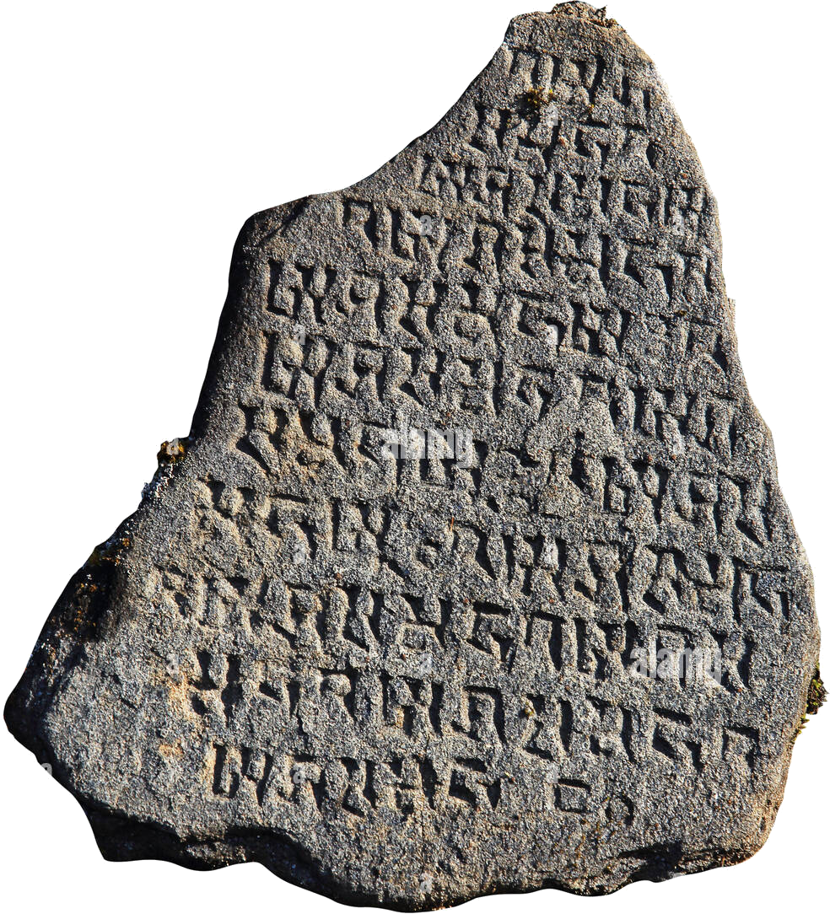
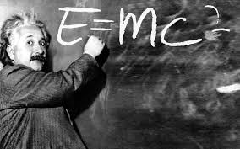

50,000 (±13.787 billion) years of science history
Observation
Simulation
Experience (Empiricism)
Theory (Modelling)
Simulation
Data-driven Science

Slide 4
Scientific Computation ≠ Computer Simulations

Slide 5
Scientific Computation ≠ Computer Simulations

Slide 6
Scientific Computation ≠ Computer Simulations

Slide 7
Scientific Computation ≠ Computer Simulations

