Slide 1
Welcome to nginx!
If you see this page, the nginx web server is successfully installed and
working. Further configuration is required.
For online documentation and support please refer to nginx.org.
Commercial support is available at nginx.com.
Thank you for using nginx.

Slide 2


Az NGINX web szerver
Pál Balázs

Slide 3
Mi az a web szerver?
Hardver? Szoftver?

Slide 4
Mi az a web szerver?
WWW kliensek kéréseit teljesíti^{[1]}
Hardver? Szoftver?

Slide 5
Mi az a web szerver?
Hardver? Szoftver?
WWW kliensek kéréseit teljesíti^{[1]}
DE:
A Web működése ennél árnyaltabb

Slide 6
TCP/IP? IETF? HTML? DNS? SMTP? SSL? …
Transmission Control Protocol/Internet Protocol^{[2]}
Datalink: Node-ok közötti kapocs (Ethernet, ARP)
Internet: Node-ok hálózata közötti (IP, ICPM)
Transport: Kommunikáció (TCP és UDP)
Software: Hostok közti adatok (HTTP, FTP, POP3, SMTP, és SNMP)

Slide 7
TCP/IP? IETF? HTML? DNS? SMTP? SSL? …
Transmission Control Protocol/Internet Protocol^{[2]}
Datalink: Node-ok közötti kapocs (Ethernet, ARP)
Internet: Node-ok hálózata közötti (IP, ICPM)
Transport: Kommunikáció (TCP és UDP)
Software: Hostok közti adatok (HTTP, FTP, POP3, SMTP, és SNMP)
Transfer Protocol: Két eszköz közötti adatküldés standardizált, kölcsönösen elfogadott formátuma
HyperText: Ez maga a formátum neve (Hyperlinks)
HyperText Markup Language^{[4]}
HTTPS: Secure Sockets Layer/Transport Layer Security
HyperText Transfer Protocol^{[3]}

Slide 8
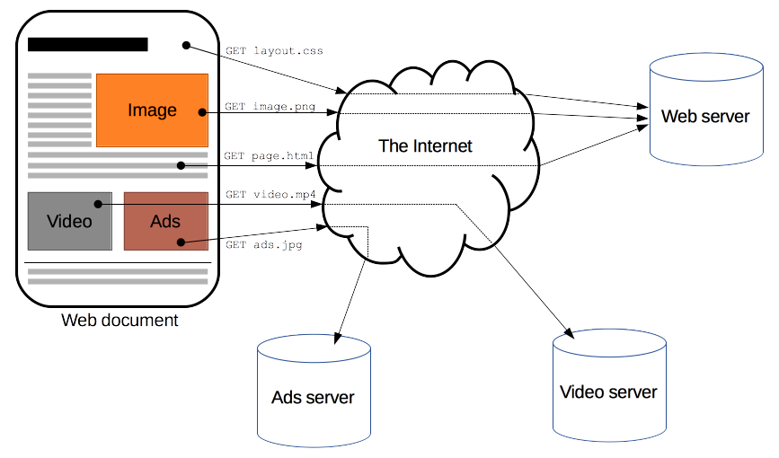
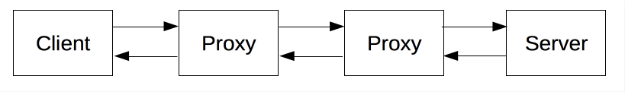
HyperText Transfer Protocol

Slide 9
HTTP parancsok
Proxy-k az útban!
Gateway/Proxy server
HTTP/Web cache
Auth., Filter
Mail proxy
Egyéb (modem, router, stb.)
Stb…
Ezekhez különböző szerverek és szoftverek
HyperText Transfer Protocol

Slide 10
Egyszerre használható majdnem minden említettre^{[5]}
Web caching (C10k probléma)
Reverse proxy
SMTP
Load balancing
Igor Sysoev, 2004: Unix
Szinte monopólium^{[6]}
Top 1., 2019. 03.: Apache (44%)
Top 2., 2019. 03.: NGINX (41.4%)
Top 3., 2019. 03.: Microsoft-IIS (8.8%)
ELTE ^{[7]}
Linux szerverek: NGINX
Windows szerverek: IIS
NGINX

Slide 11
[1]: NGINX. What Is a Web Server?. Mar, 2015. https://www.nginx.com/resources/glossary/web-server/ [Online; accessed March 3, 2019]
[2]: Lifewire. Understanding Transmission Control Protocol/Internet Protocol (TCP/IP). Dec, 2018. https://www.lifewire.com/transmission-control-protocol-and-internet-protocol-816255 [Online; accessed March 3, 2019]
[3]: MDN web docs. An overview of HTTP. Feb, 2019. https://developer.mozilla.org/en-US/docs/Web/HTTP/Overview [Online; accessed March 3, 2019]
[4]: Vangie Beal. HTML - HyperText Markup Language. Webopedia. Feb, 2001. https://www.webopedia.com/TERM/H/HTML.html [Online; accessed March 3, 2019]
[5]: NGINX. Welcome to NGINX!. Mar, 2009. https://www.nginx.com/resources/wiki/ [Online; accessed March 3, 2019]
[6]: W3Techs. Usage of web servers for websites. https://w3techs.com/technologies/overview/web_server/all [Online; accessed March 4, 2019]
[7]: Dobos László. ELTE - Felhasználói tudnivalók http://www.vo.elte.hu/ [Online; accessed March 4, 2019]
Források

Slide 12
Tom Scott. YouTube Channel. [Online]. https://www.youtube.com/user/enyay
Computerphile. YouTube Channel. [Online]. https://www.youtube.com/channel/Computerphile
Wikipedia. [Online; accessed on March 3, 2019].
Internet protocol suite. https://en.wikipedia.org/wiki/Internet_protocol_suite
Web server. https://en.wikipedia.org/wiki/Web_server
Web cache. https://en.wikipedia.org/wiki/Web_cache
Nginx. https://en.wikipedia.org/wiki/Nginx
Apache HTTP Server. https://en.wikipedia.org/wiki/Apache_HTTP_Server
Load balancing. https://en.wikipedia.org/wiki/Load_balancing_(computing)
Reverse proxy. https://en.wikipedia.org/wiki/Reverse_proxy
C10k problem. https://en.wikipedia.org/wiki/C10k_problem
Webopedia. [Online; accessed on March 3, 2019].
Protocol. https://www.webopedia.com/TERM/P/protocol.html
TLS – Transport Layer Security. https://www.webopedia.com/TERM/T/TLS.html
SSL - Secure Sockets Layer. https://www.webopedia.com/TERM/S/SSL.html
Nem indexelt
források

Slide 13
Köszönöm a figyelmet!
If you see this page, the presentation on the topic „nginx web server” is successfully finished. Further questions are welcomed.
For online documentation and support please refer to github.com/masterdesky.
Commercial support is not available.
Thank you for your attention.

