Slide 1

TOR network
Pál Balázs, 2018.02.28.

Slide 2
Key features
TOR = The Onion Router
Free software
Volunteer-operated overlay network
Provides anonymity
But: Anonymity != Encryption

Slide 3
History
Onion Routing: mid-1990 by US Naval Research Lab
DARPA (1997)
2004: Free license
EFF (Electronic Frontier Foundation)
The Tor Project
Later fiscal sponsor: US Goverment

Slide 4
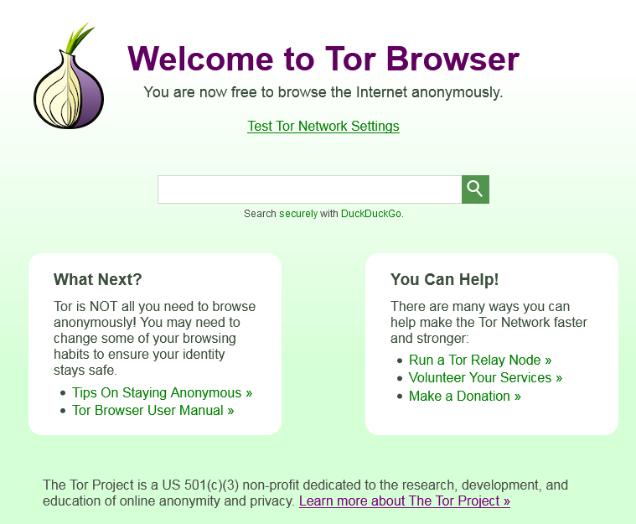
Structure of TOR network
TOR Browser
Initiator
Nodes
Circuit
Path
Tor-exit

Slide 5
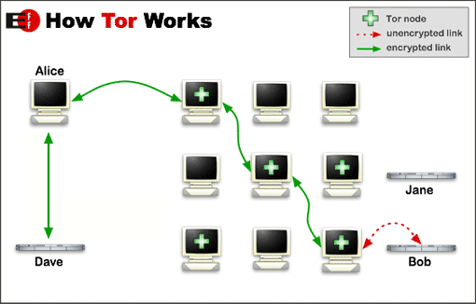
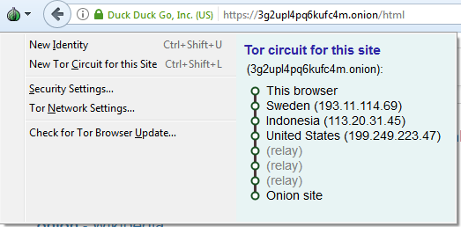
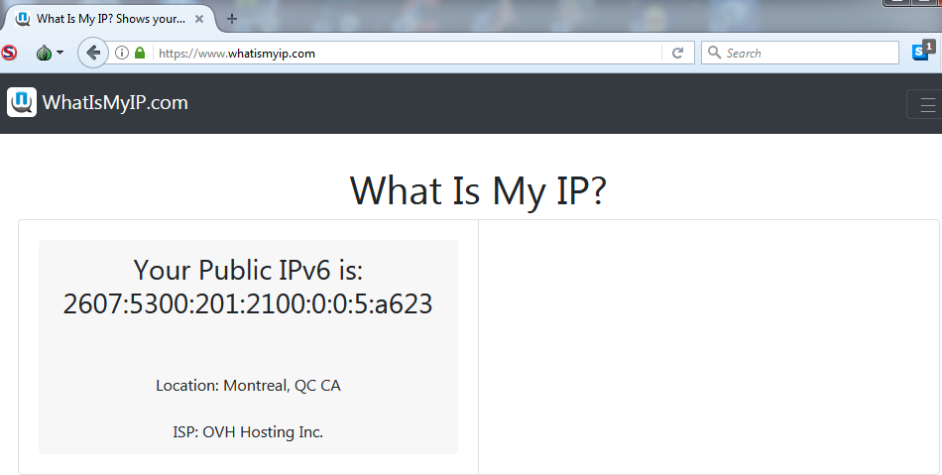
Structure of TOR network
Initiator
Path
Adress
Directory
Tor-exit

Slide 6
Structure of TOR network
.onion top-level domain suffix (2004)
Isn’t part of the internet DNS root zone → eg. TOR Browser needed
16-character alpha-semi-numeric hashes
a-z,A-Z,2-7
base32 encoded 80-bit numbers

Slide 7
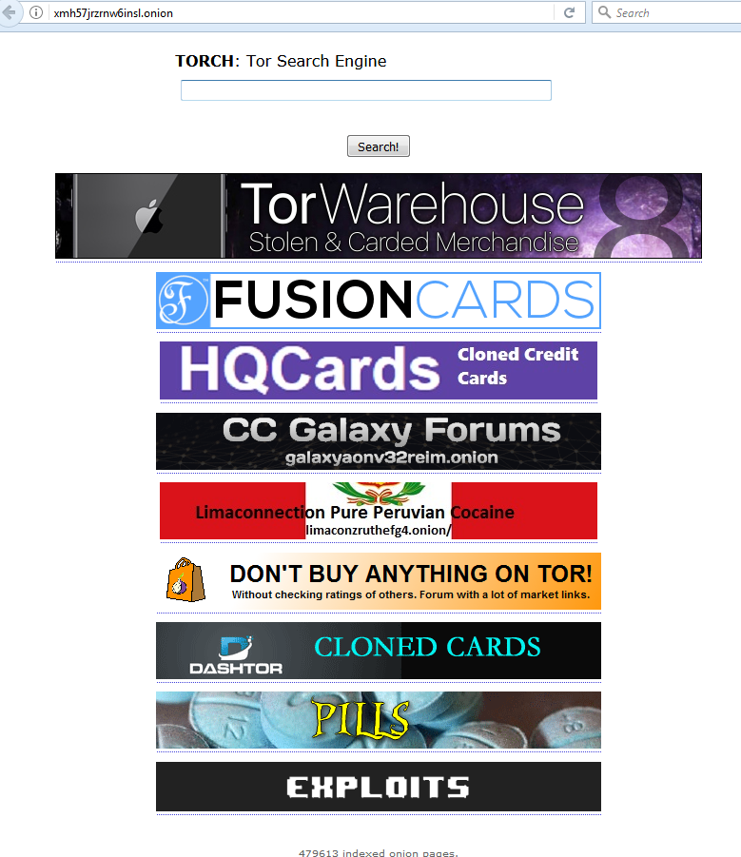
What could be used for?

Slide 8
Weaknesses
Eavesdropping
Exit node (2007)
Bad apple (P2P)
Other (theoretical : (?))
Mouse fingerprinting(?)
DDoS on exit node(?)
(OpenSSL, Heartbleed (2014, April))
Operation Onymous

Slide 9
Future?
Continuously developing software
Goals:
As many user as possible (+Security!)
As high anonymity as possible
As reliable and fast network as possible
„Each new user and relay provides additional diversity, enhancing Tor's ability to put control over your security and privacy back into your hands”.

Slide 10
Future?
BUT: computing capacity will increase! → Greatest problem of modern cryptography, or not???
TOR communication rely on encripted messages!

Slide 11
Conclusions
Original purpose: Give back anonimity to people
Instead: Haven for crime and illegal activities
But why is it founded then?

Slide 12
References
[1] TOR’s official website: https://www.torproject.org
[2] Wikipedia articles
[3] Hidden Wiki: https://zqktlwi4fecvo6ri.onion/
[4] EFF’s online security page: https://ssd.eff.org/

Slide 13
THANKS FOR WATCHING!

