Slide 1



AI learns stellar spectroscopy
Balázs PÁL^{1,2}, PFS Galactic Archaeology Team³
¹Department of Physics of Complex Systems, Eötvös Loránd University
²Heavy-ion Research Group, Wigner Research Centre of Physics
³Johns Hopkins University
Wigner Scientific Computation Laboratory, Wigner RCP
XIII. GPU Day – 2023

Slide 2




Goals of modern cosmology
Improve the standard model of cosmology
Solve challanges of the ΛCDM model
  Eg. H0 tension (CMB vs SNe)
  Eg. violations of homogeneity and isotropy
  ...and lots of other problems...
Tweaks?
Alternative cosmologies?

Slide 3
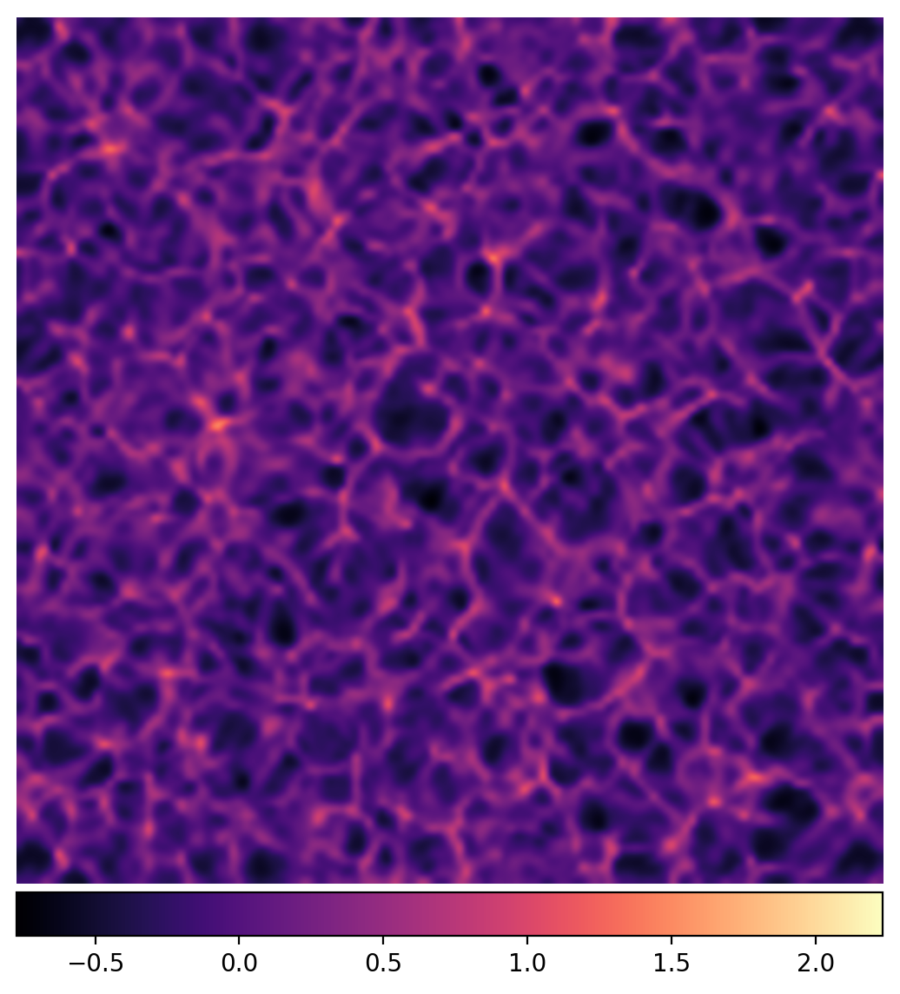
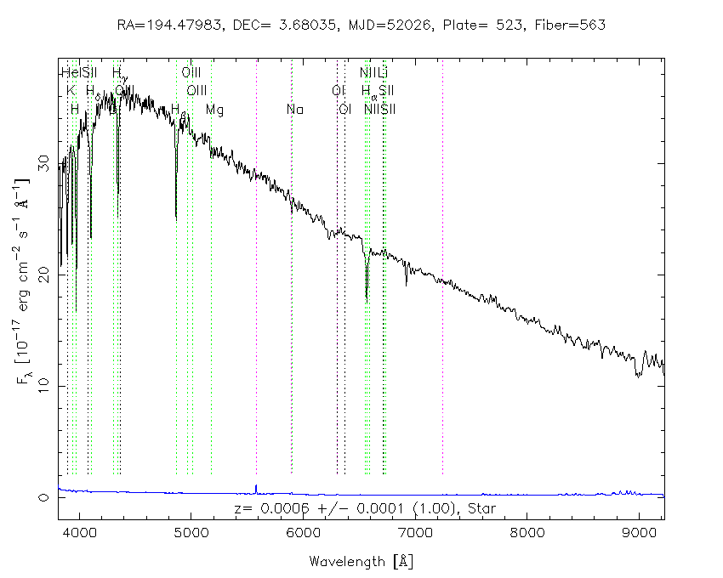
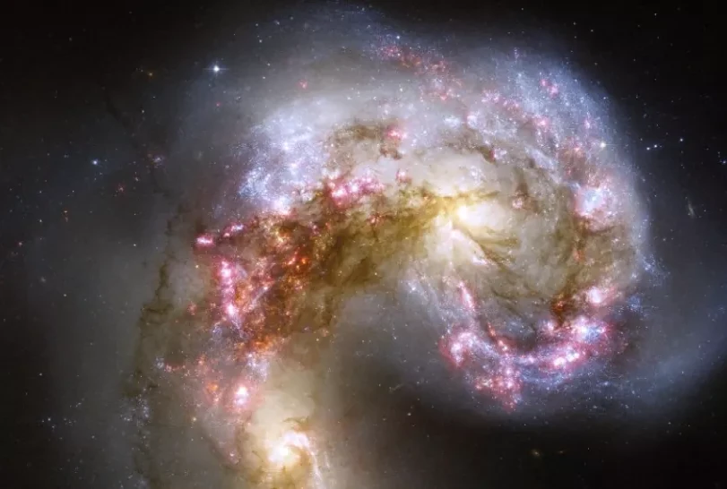
Galactic Archeology and the Subaru PFS
Source: NASA, ESA, and the Hubble Heritage Team (STScI/AURA)-ESA/Hubble Collaboration
Source: Sloan Digital Sky Survey / SkyServer
General relativistic cosmological simulation using the BSSN formalism – Own work
1. Stellar attributes
2. Galactic evolution
3. Cosmological implications

Slide 4
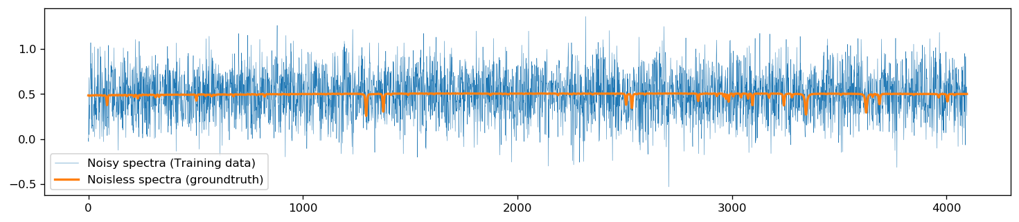
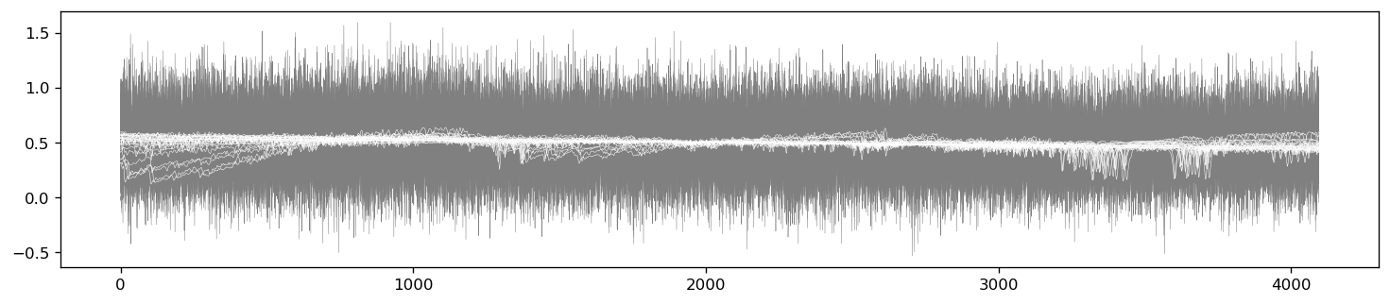
Input and target spectra

Slide 5
Using AI for... what?
In case of stellar spectra
  Learn the physical information stored in a spectrum (Reconstruction)
  Subtract any noise that pollute the spectrum (Denoising)
  Learn to separate the signal from the background (Continuum normalization)
  ...

Slide 6
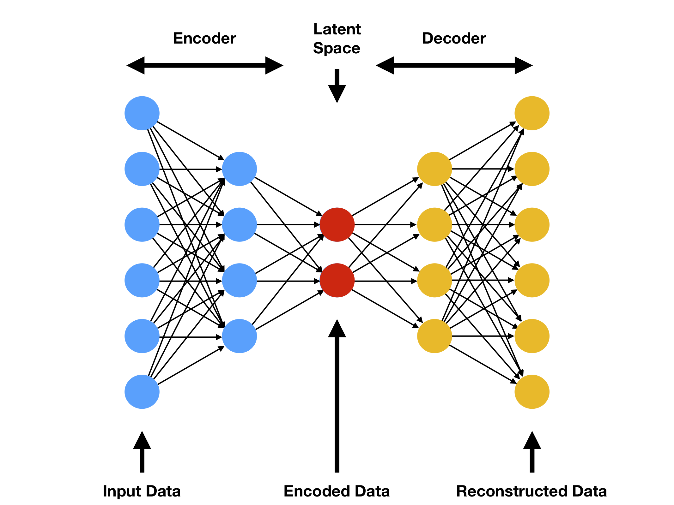
Structure of the base autoencoder
Dense Autoencoder
Dimensions
  Input/output: 4096
  Latent space: < 4096
Encoder and the Decoder
  4+4 layers
  Same amount of neurons
  No batch normalization
  No dropout layers
Source: Mahony, Niall O., et al. "Representation learning for fine-grained change detection." Sensors 21.13 (2021): 4486.

Slide 7
Example for reconstruction

Slide 8
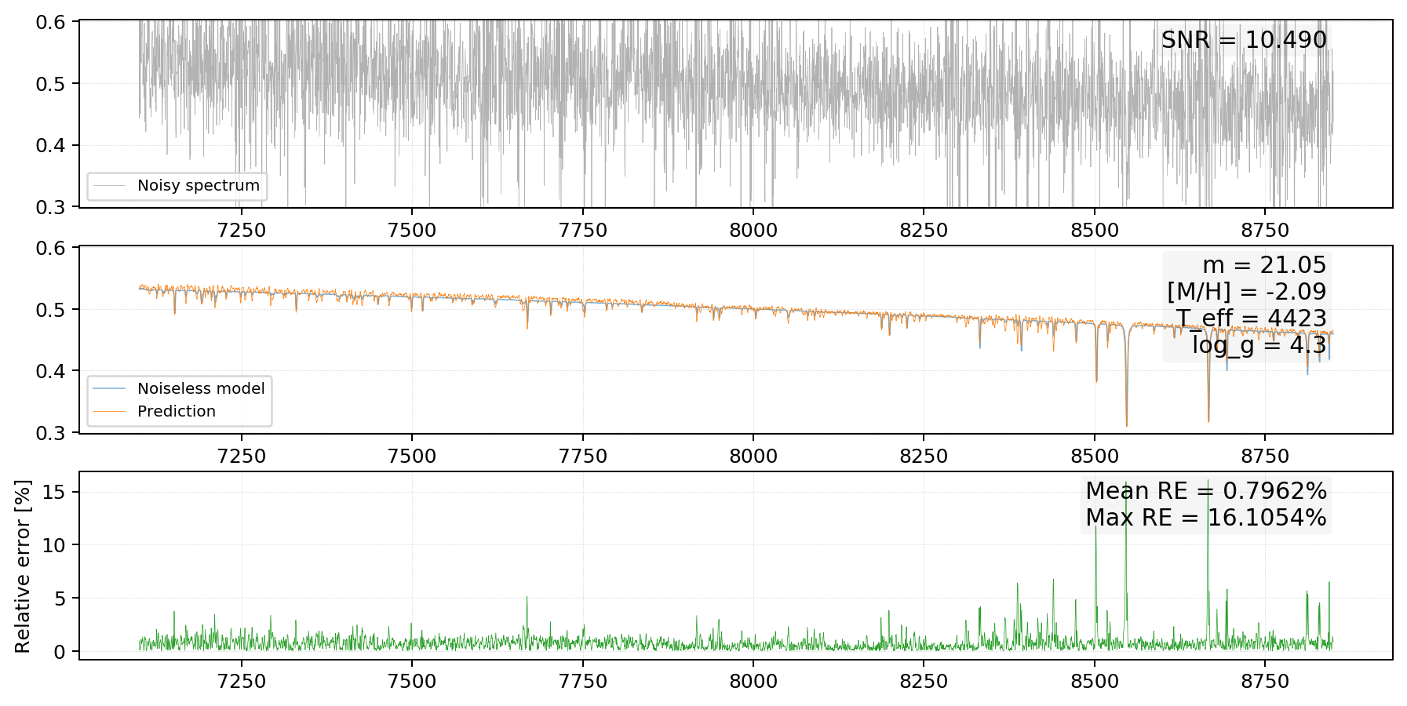
Example for denoising

Slide 9
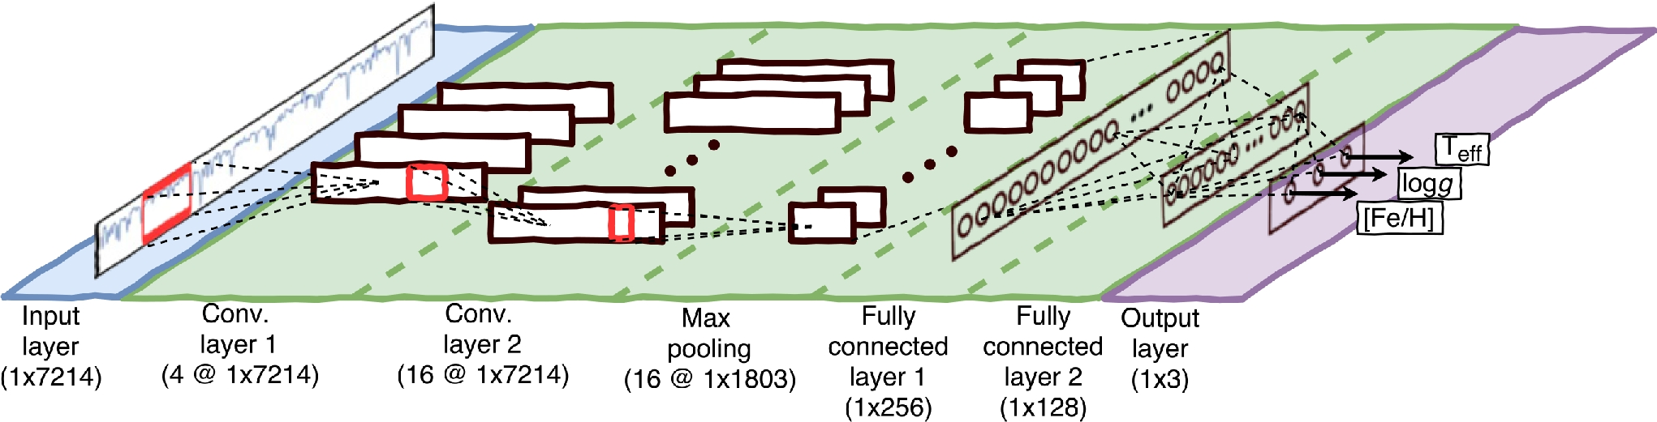
Future considerations
Convolutional Autoencoders
  Translation invariance! (Invariant for redshift)
  CNNs outperform
  dense models and PCA methods in stellar parameter reconstruction
Continuum normalization
  Does it really work?
StarNet CNN – Fabbro, S., et al. "An application of deep learning in the analysis of stellar spectra." Monthly Notices of the Royal Astronomical Society 475.3 (2018): 2978-2993.

Slide 10
Thank you for your attention!

