Slide 1



AI learns stellar spectroscopy
Balázs PÁL^{1,2}, PFS Galactic Archaeology Team³
¹Department of Physics of Complex Systems, Eötvös Loránd University
²Heavy-ion Research Group, Wigner Research Centre of Physics
³Johns Hopkins University
Theory and Experiment in High Energy Physics, Bratislava
V4-HEP Workshops – 2023

Slide 2




Goals of modern cosmology
Improve the standard model of cosmology
Solve challanges of the ΛCDM model
  Eg. H0 tension (CMB vs SNe)
  Eg. violations of homogeneity and isotropy
  ...and lots of other problems...
Tweaks?
Alternative cosmologies?

Slide 3
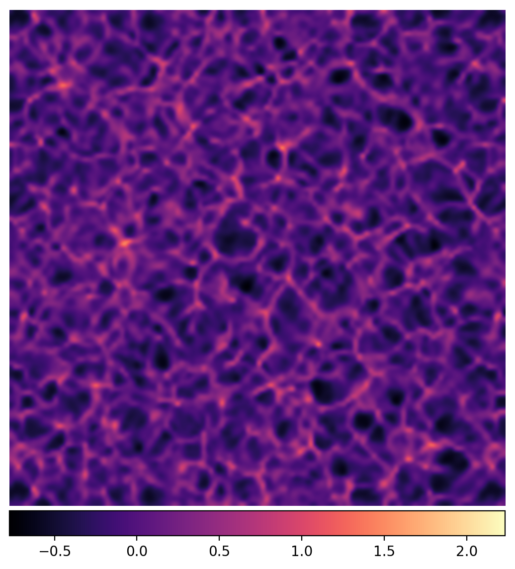
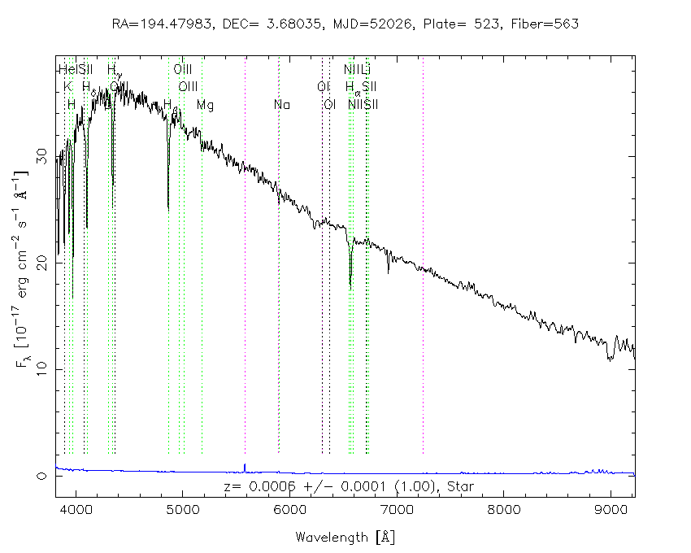
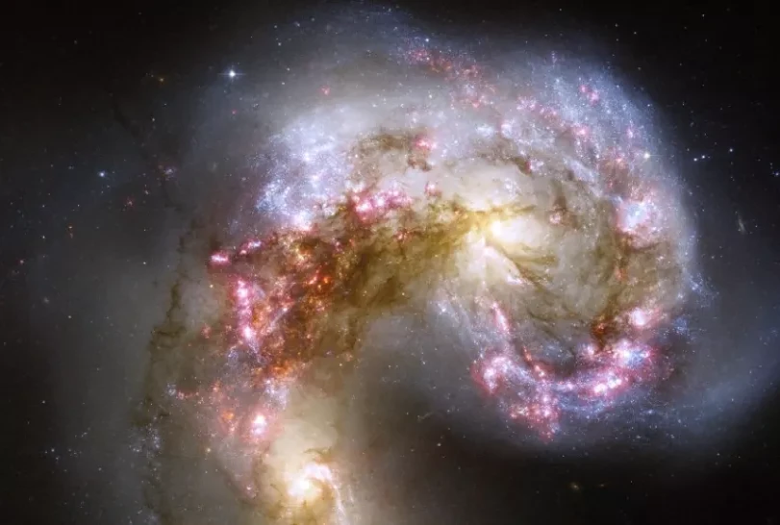
Galactic Archaeology and the Subaru PFS
Source: NASA, ESA, and the Hubble Heritage Team (STScI/AURA)-ESA/Hubble Collaboration
Source: Sloan Digital Sky Survey / SkyServer
General relativistic cosmological simulation using the BSSN formalism – Own work
1. Stellar attributes
2. Galactic evolution
3. Cosmological implications

Slide 4
GA with the Subaru PFS (in reality)

Slide 5
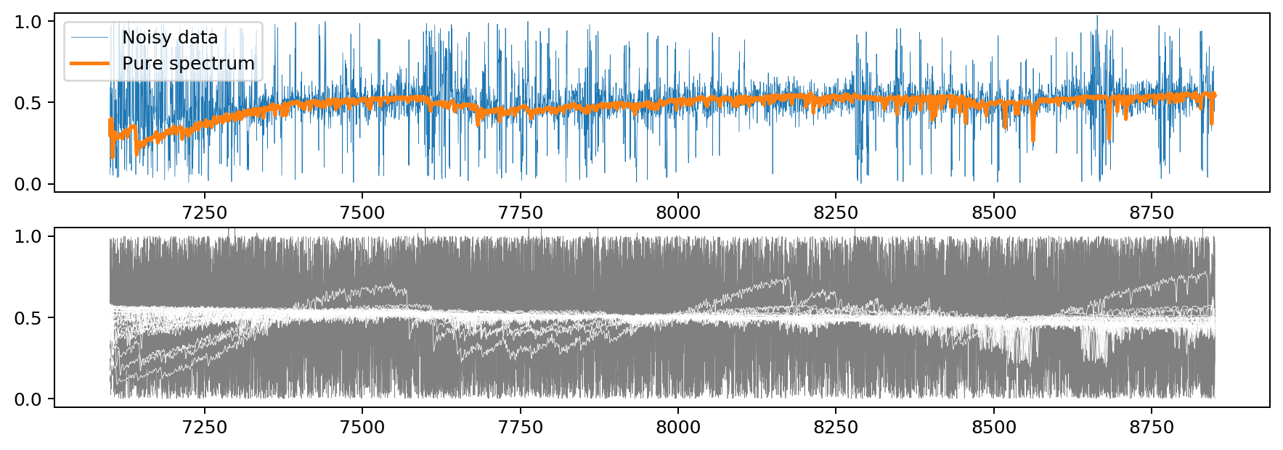
Example synthetic spectra

Slide 6
Using AI for... what?
In case of stellar spectra
  Learn the physical information stored in a spectrum (Reconstruction)
  Subtract any noise that pollute the spectrum (Denoising)
    Greatly assists classical methods
    Saves a lot of time and money
    ...
  ...

Slide 7
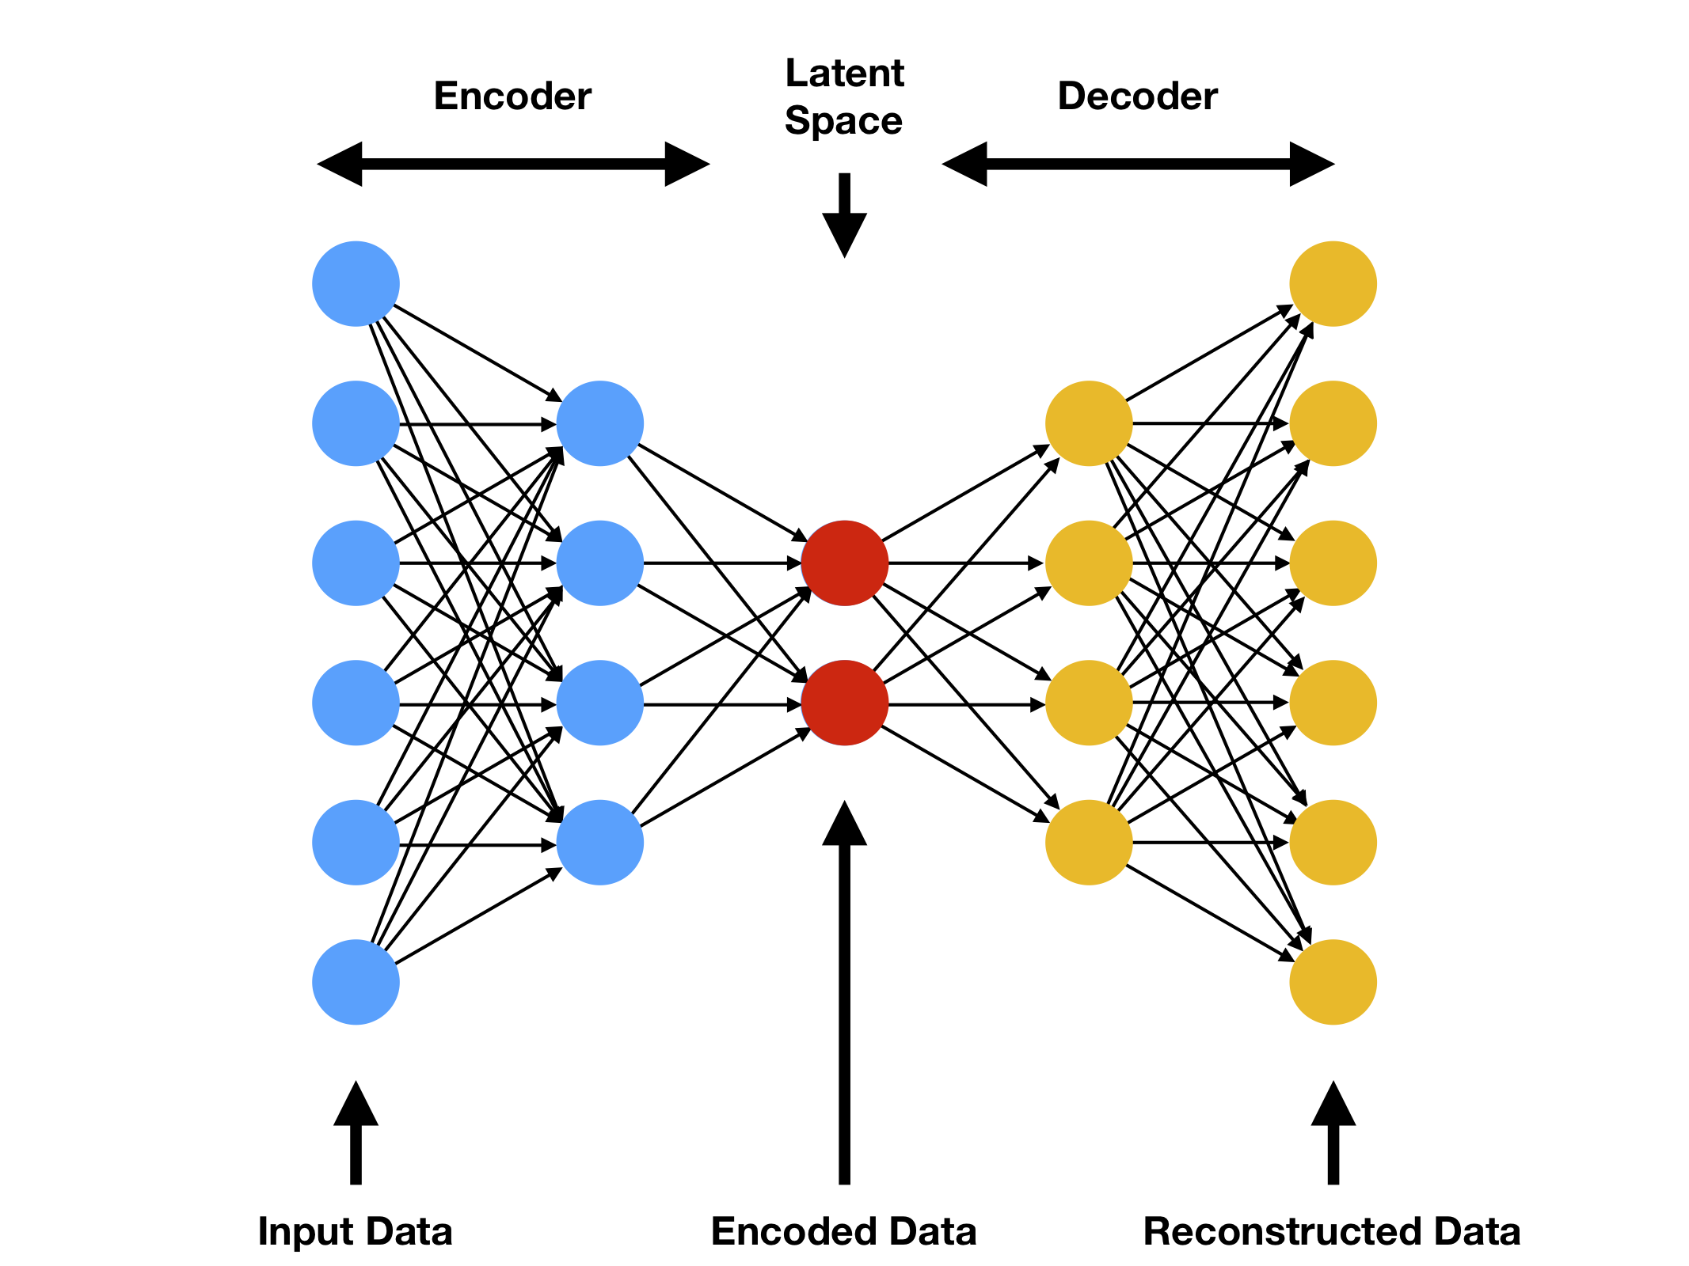
Structure of the base autoencoder
Dense Autoencoder
Dimensions
  Input/output: 4096
  Latent space: < 4096
Encoder and the Decoder
  4+4 layers
  Same amount of neurons
  No batch normalization
  No dropout layers
Source: Mahony, Niall O., et al. "Representation learning for fine-grained change detection." Sensors 21.13 (2021): 4486.

Slide 8
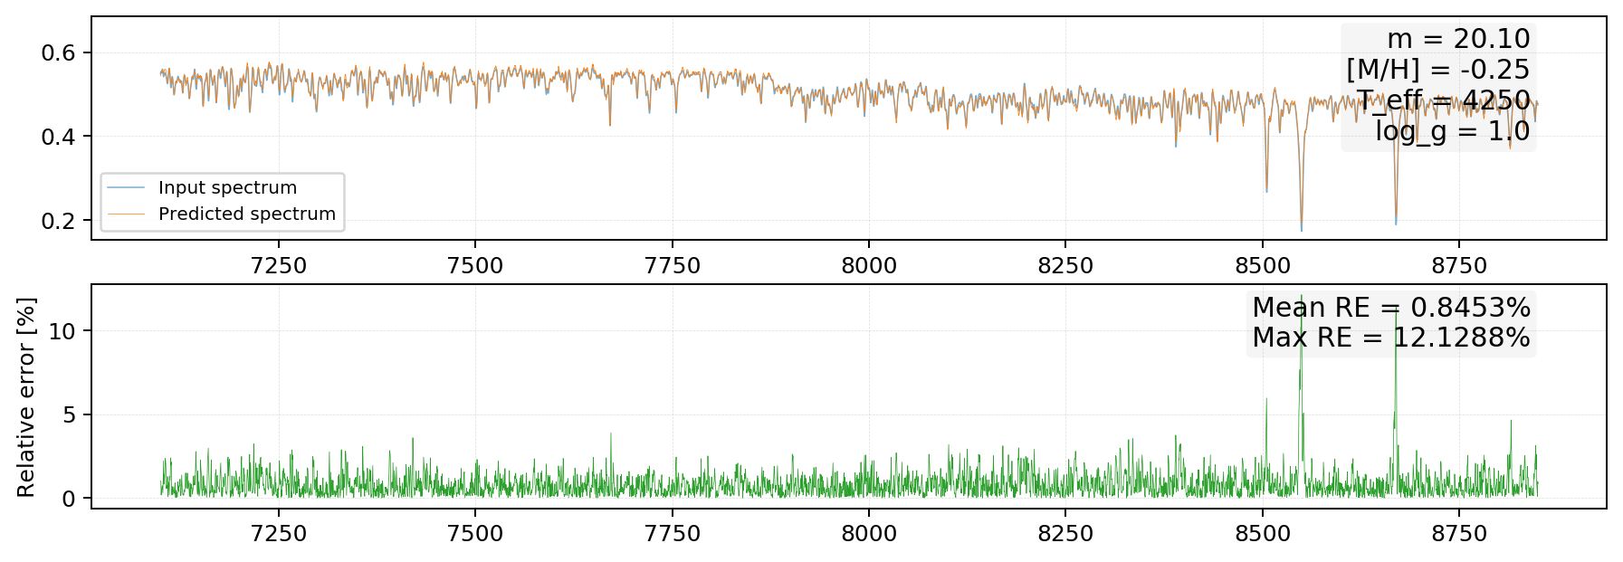
Example for reconstruction

Slide 9
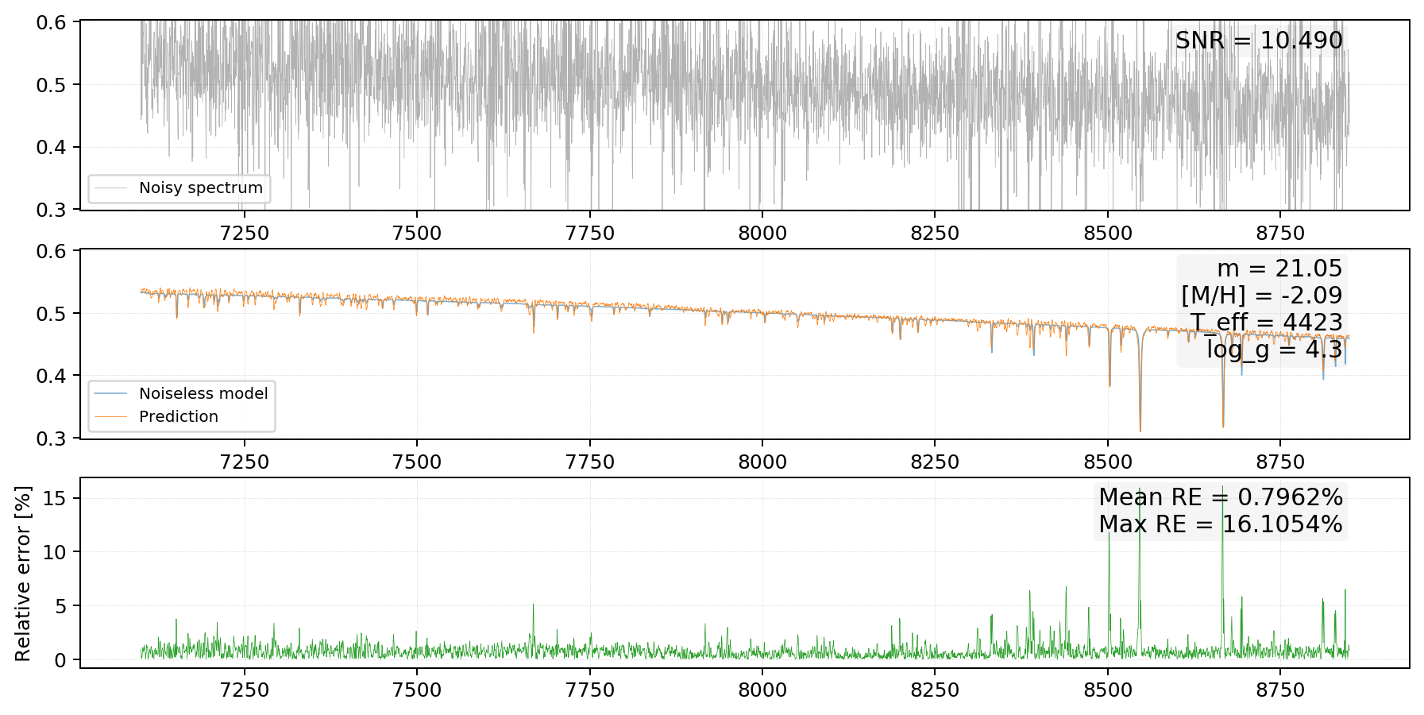
Example for denoising

Slide 10
Thank you for your attention!

