Slide 1
Learning stellar spectra with AI
Balázs PÁL
¹Department of Physics of Complex Systems, Eötvös Loránd University
²Wigner Research Centre for Phyics

Slide 2
Using AI for... what?
In case of complex stellar spectra:
  Learn the physical information stored in a spectrum (Reconstruction)
  Learn to separate the signal from the background (Continuum normalization)
  Subtract any other noise that pollute the spectrum (Denoising)
  ...

Slide 3
Using AI for... what?
In case of complex stellar spectra:
  Learn the physical information stored in a spectrum (Reconstruction)
  Learn to separate the signal from the background (Continuum normalization)
  Subtract any other noise that pollute the spectrum (Denoising)
  ...

Slide 4
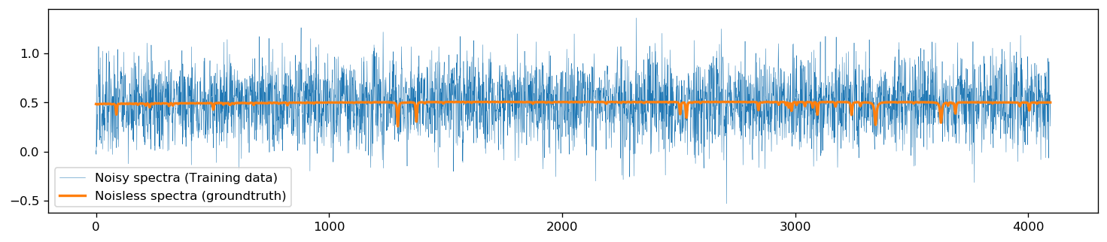
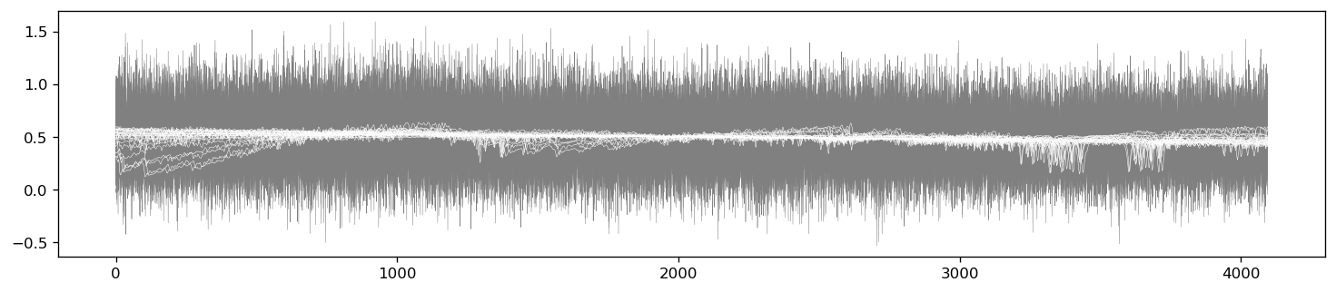
Input and target spectra

Slide 5
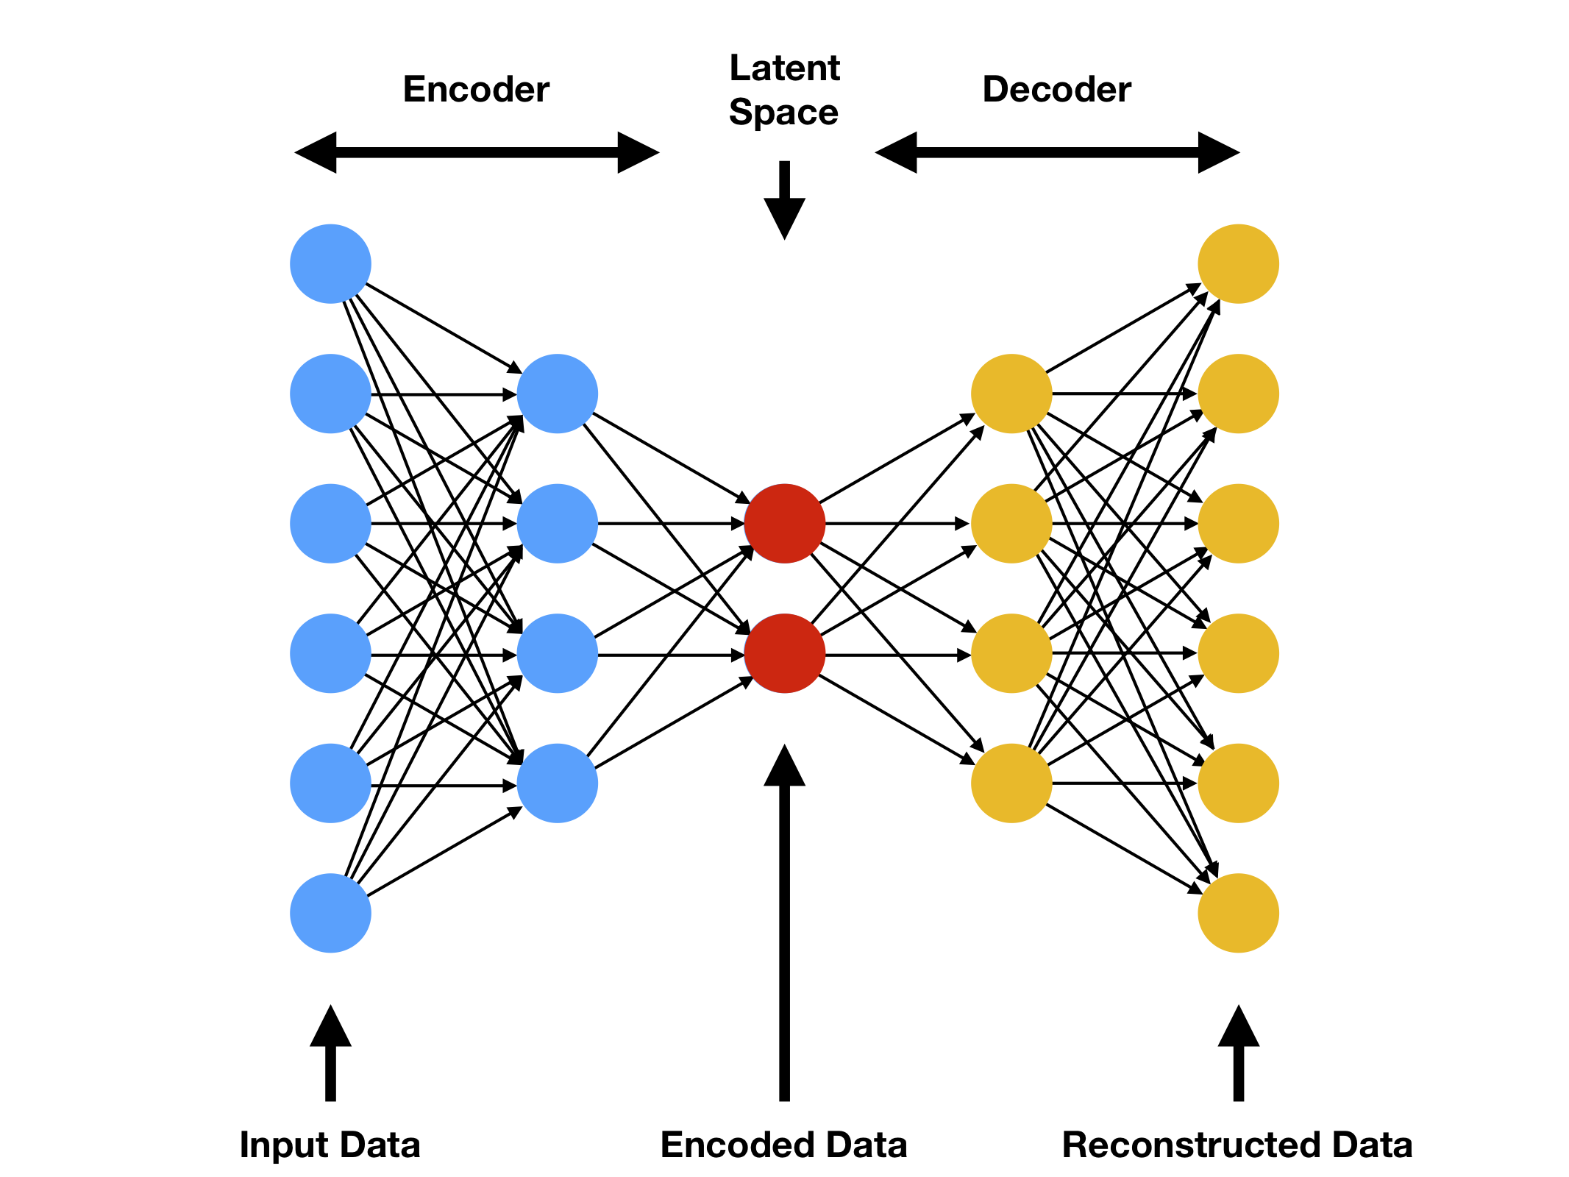
Structure of the base AE
Dim. of input data: 4096
Dim. of latent space: < 4096 (How many?)
Same amount of hidden layers and neurons in the Encoder and the Decoder side

Slide 6
Other models considered
Variational Autoencoders
  Much harder to fit into the current deep learning framework
  Would they be even a good choice?
Convolutional Autoencoders
  Translation invariance! (Invariant for redshift)
  Main candidate to test later in the project

Slide 7
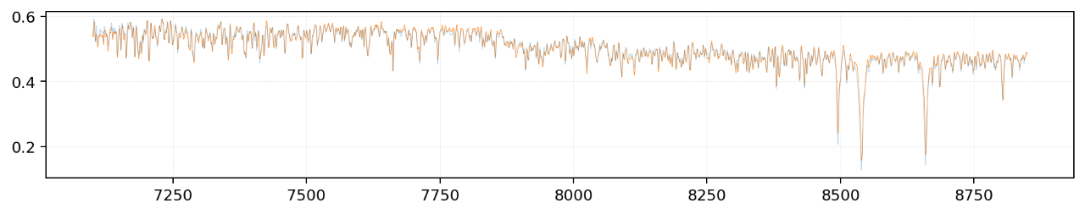
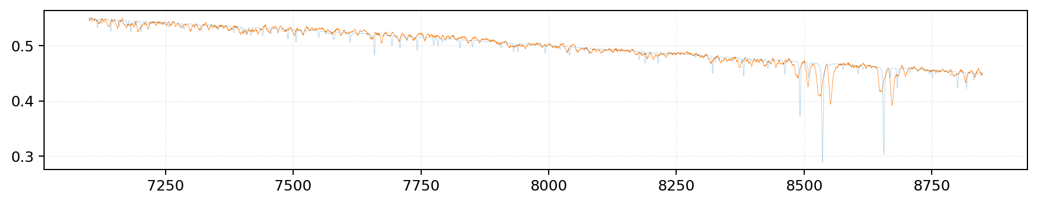
Some examples I.

Slide 8
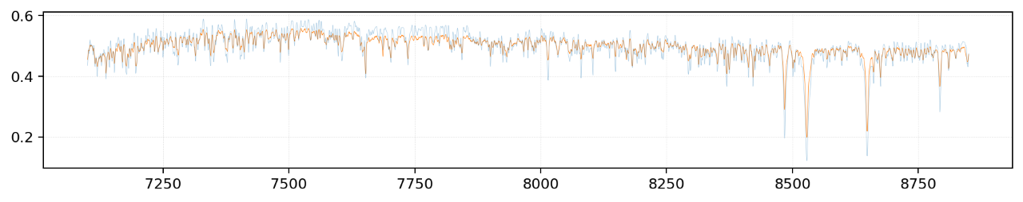
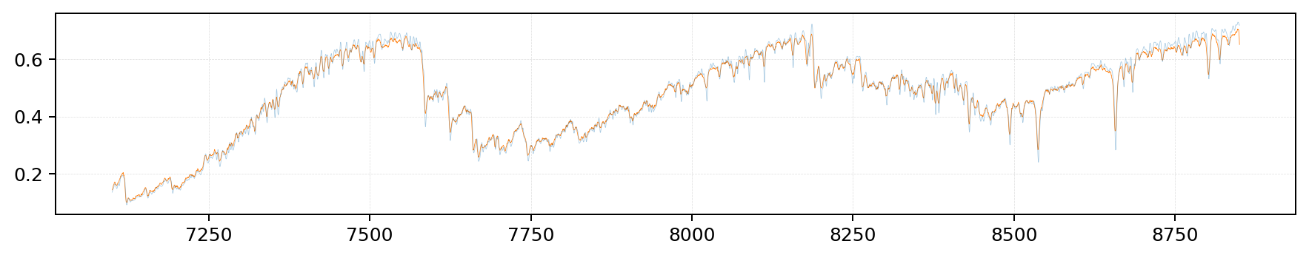
Some examples II.

Slide 9
What to focus on next?
Test robustness
  Dependence of accuracy on physical parameters
  Dependence of accuracy on the model structure
  Translation invariance (Convolutional AE)
Explainability
  Is it really a “denoiser”?
...

