Slide 1


Template Article
Balázs PÁL^{1,2}
¹Department of Physics of Complex Systems, Eötvös Loránd University
²Heavy-ion Research Group, Wigner Research Centre of Physics

Slide 2
Goals of this lecture
Usually I have the goals, motivation, reasoning behind giving this lecture on the first slide.
Why ...?
What ...?
How ...?

Slide 3
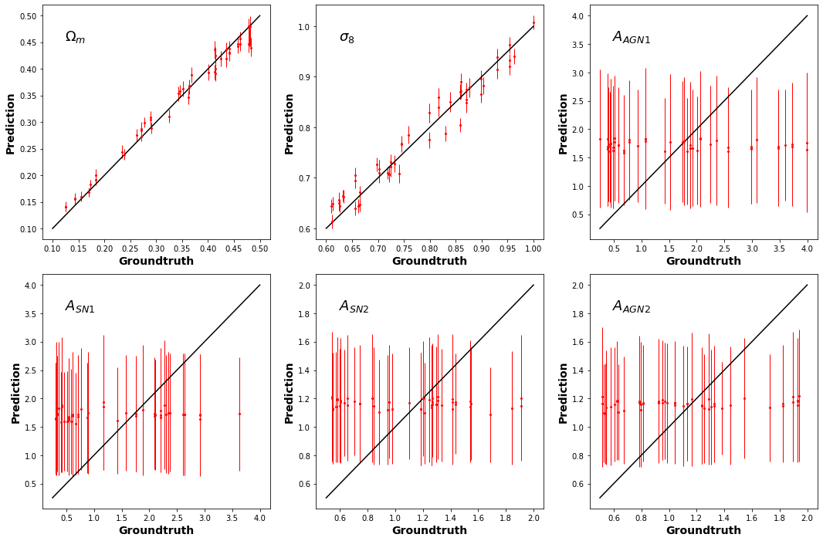
A case study – Cosmological simulations
Fig. This is just a template figure.

