Slide 1

First M87 Event Horizon
Telescope Results
Balázs PÁL
¹Department of Physics of Complex Systems, Eötvös Loránd University

Slide 2

Context I.
On April 10, 2019 the Event Horizon Telescope (EHT) collaboration published the first image an SMBH at the center of the M87 galaxy
The measurements were made possible by the cooperation of the EHT and the GMVA radio telescope arrays (VLBI)
Fig. 1. EHT image of the candidate SMBH M87* in the center of the M87 galaxy. The brighter regions are plasma rotating toward Earth and getting Doppler booster in the process. The dark region in the center is what we refer to as the “shadow” of the black hole.
Source: https://www.eso.org/public/images/eso1907a/

Slide 3




Why? The goals of modern cosmology
Improve the standard model of cosmology
Solve challenges of the ΛCDM model
  Eg. H0 tension (CMB vs. SN)
  Eg. violations of homogeneity and isotropy
  …and lots of other problems…
Conduct tests of Einstein’s General Relativity

Slide 4
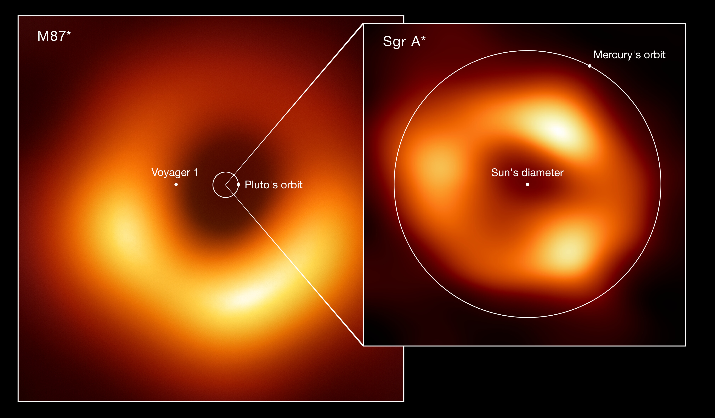
But what is it?
Source: https://www.eso.org/public/images/eso2208-eht-mwe/

Slide 5
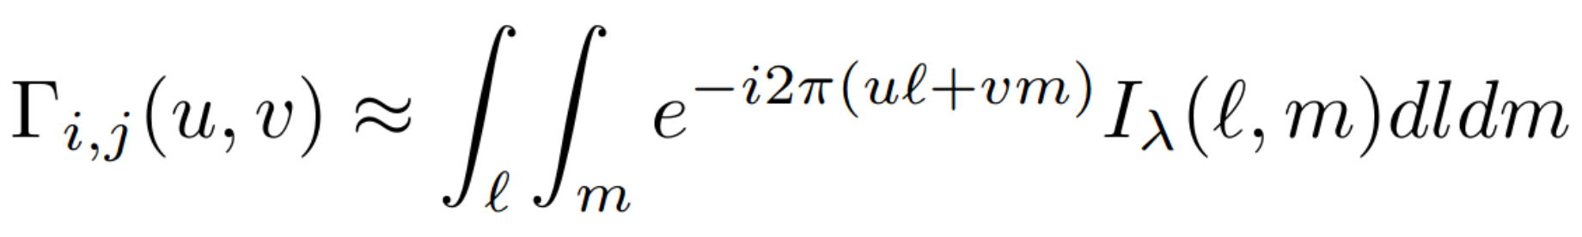
VLBI
Very-long baseline interferometry
  Telescopes are at great distance from each other
  Multiple measured signals are cross-correlated
Cross-correlation is equivalent to a single complex Fourier component in the original signal’s frequency domain at the position (u, v)
“Visibilities”

Slide 6
Context II.
On April 10, 2019 the Event Horizon Telescope (EHT) collaboration published the first image an SMBH at the center of the M87 galaxy
The measurements were made possible by the cooperation of the EHT and the GMVA radio telescope arrays (VLBI)
Fig. 1. EHT image of the candidate SMBH M87* in the center of the M87 galaxy. The brighter regions are plasma rotating toward Earth and getting Doppler booster in the process. The dark region in the center is what we refer to as the “shadow” of the black hole.
Source: https://www.eso.org/public/images/eso1907a/

Slide 7
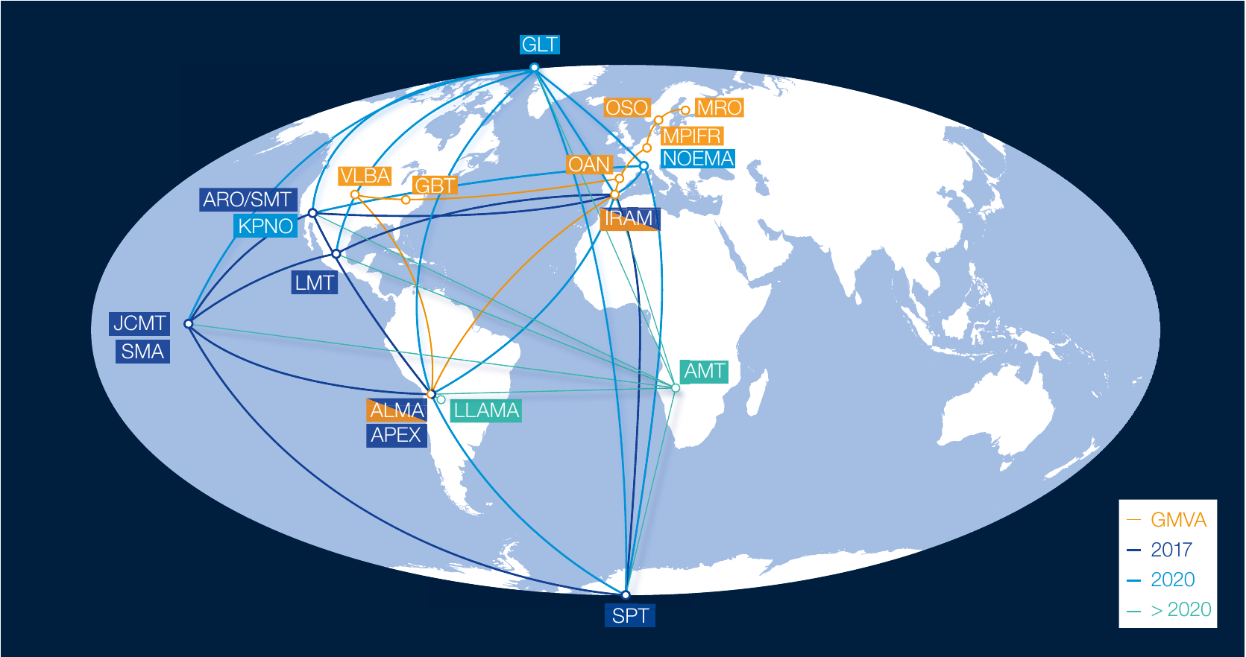
The EHT and GVMA telescope array
Source: Goddi, Ciriaco, et al. (2019)

Slide 8

Important components
Credit: Y. Beletsky/ESO
Atacama Large Millimeter/Submillimeter Array (ALMA)
  First use in a VLBI measurement
  Flagship in the ETH observations of M87*
  Increased EHT’s sensitivity by an order of magnitude
CLEAN and CHIRP
  Deconvolution algorithms used in prior parameter survey for final image reconstruction

Slide 9
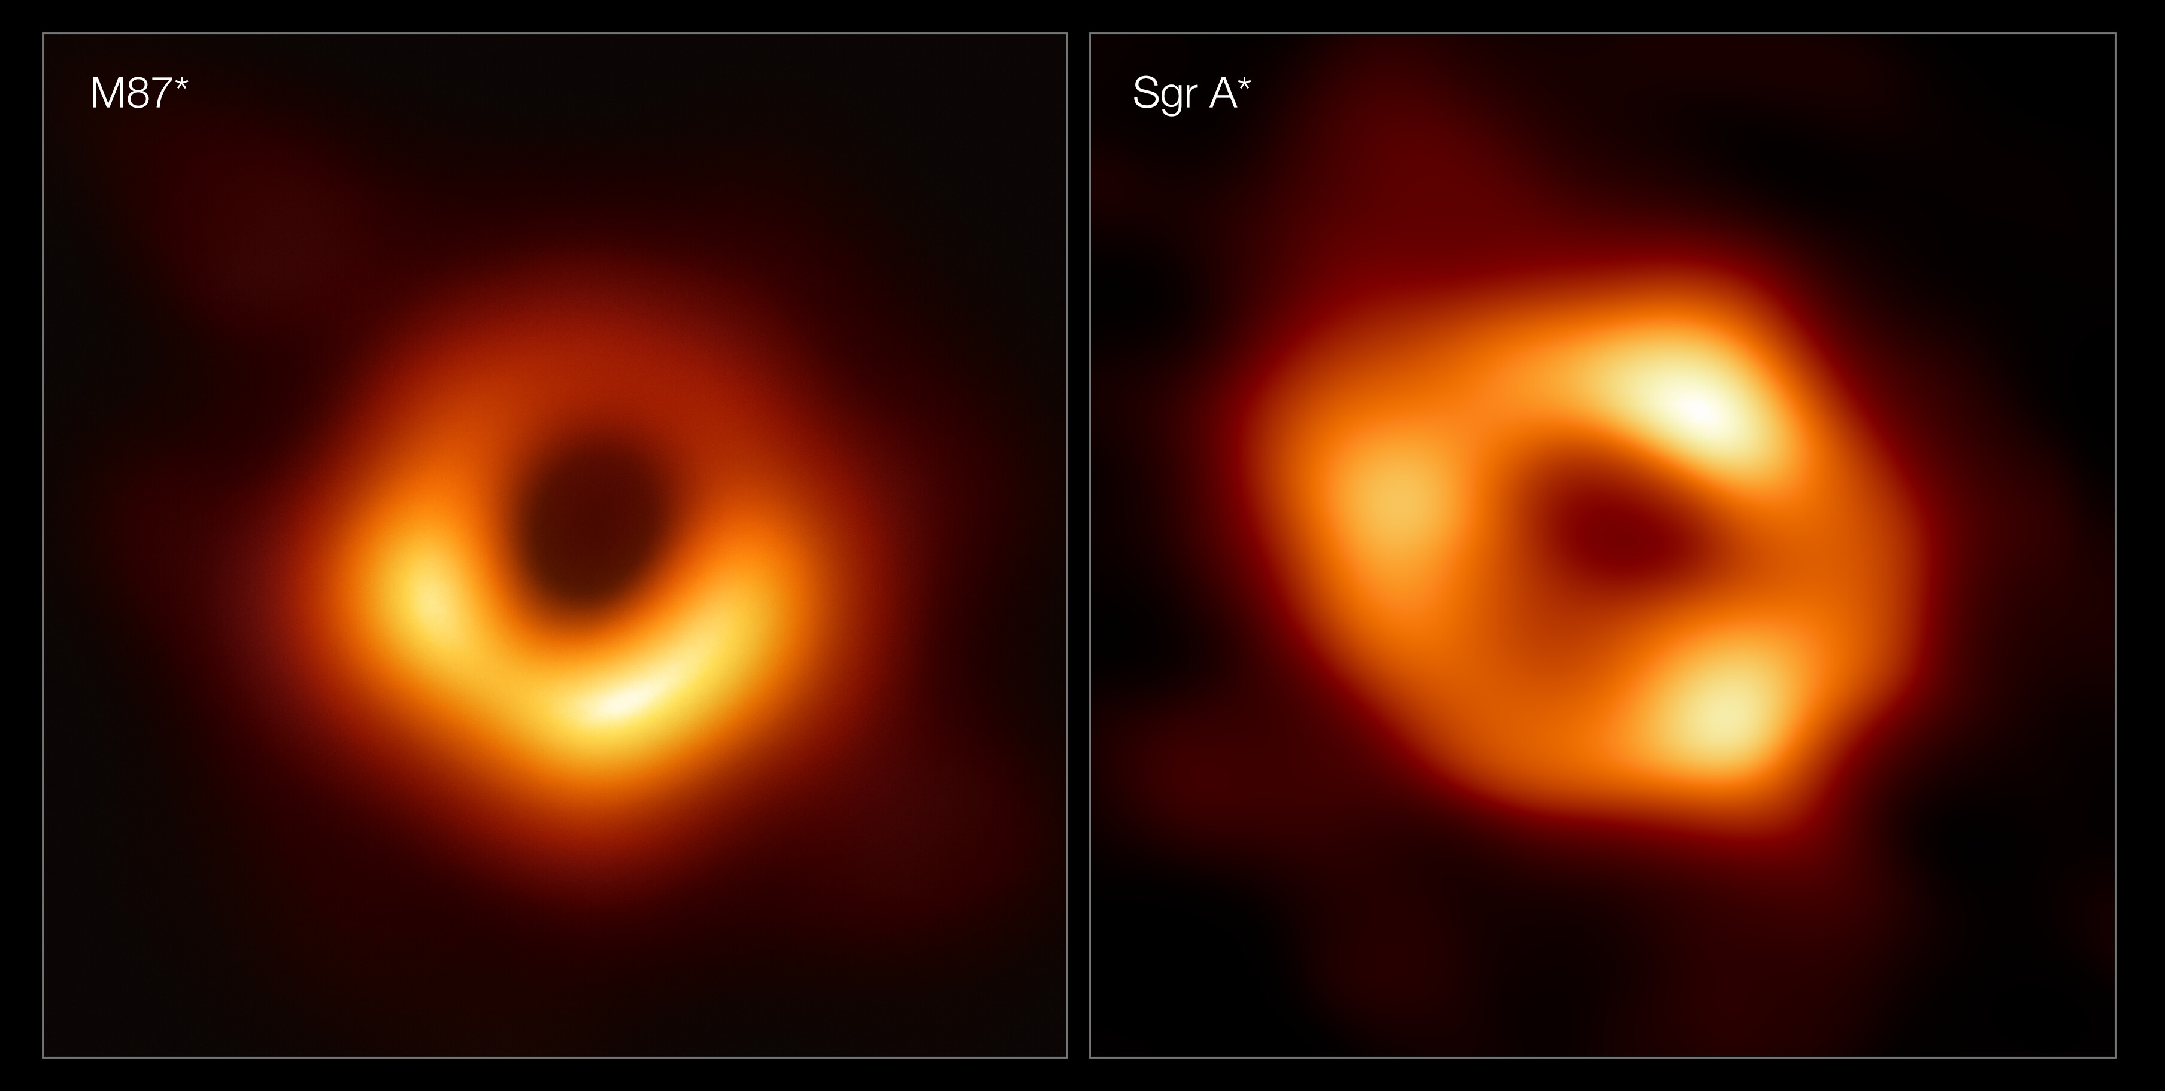
Source: https://www.eso.org/public/images/eso2208-eht-mwd/

