Slide 1

AR VS AP
SUMMARY REPORT
Smoot Motor Indonesia x BML | SWAP Energi x BML
Update: 20 Mei 2026
CONFIDENTIAL
TOTAL AR (Piutang)
TOTAL AP (Hutang)
NET POSITION (AP-AR)
Rp 3,626,894,700
Rp 8,045,129,361
Rp 4,418,234,661

Slide 2
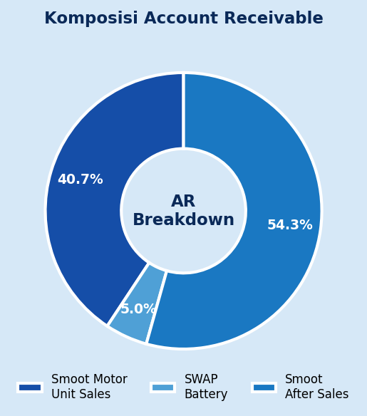
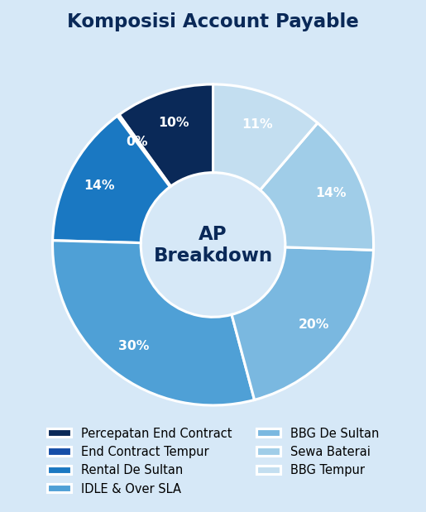
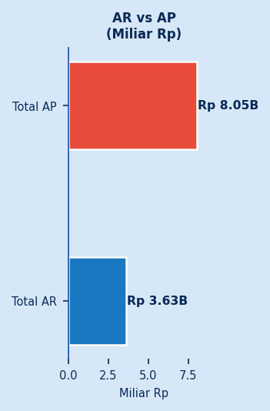
EXECUTIVE SUMMARY
20 Mei 2026 | AR vs AP Report
Total AR (Piutang BML)
Total AP (Hutang ke BML)
Net Position (AP - AR)
Rp 3.626.894.700
Rp 8.045.129.361
Rp 4.418.234.661
Piutang aktif
Tagihan outstanding
Hutang > Piutang

Slide 3
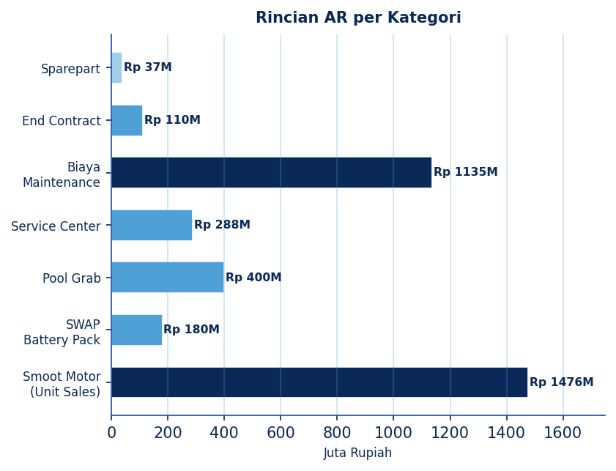
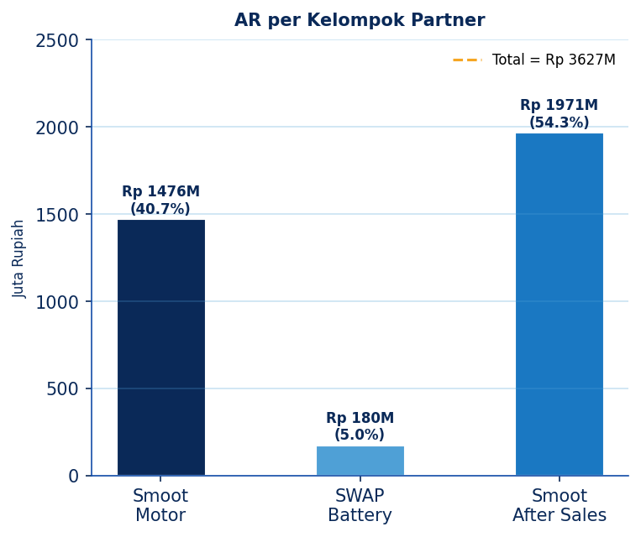
ACCOUNT RECEIVABLE (AR) - DETAIL
Total AR: Rp 3,626,894,700

Slide 4
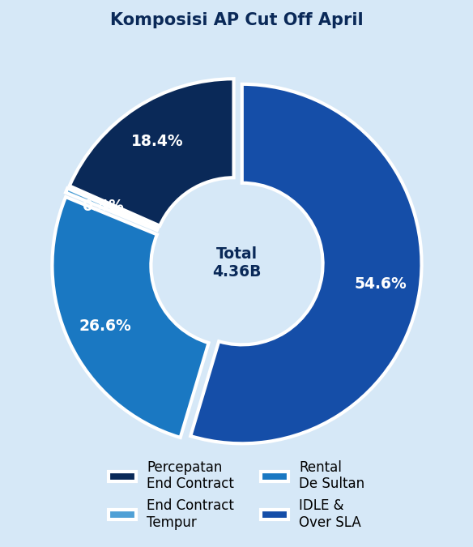
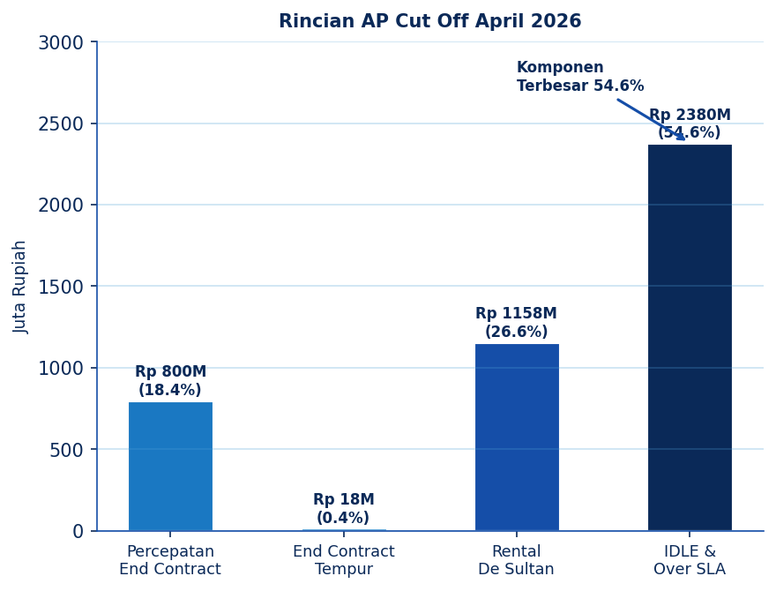
ACCOUNT PAYABLE - CUT OFF APRIL 2026
Smoot Motor x BML | Total AP: Rp 4,356,460,290

Slide 5
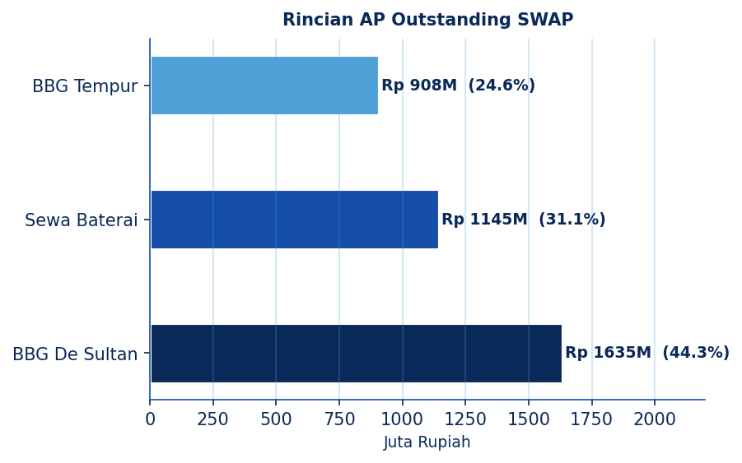
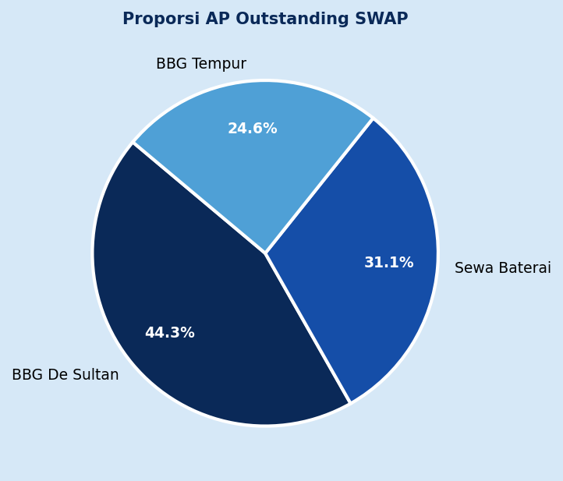
ACCOUNT PAYABLE - OUTSTANDING SWAP
SWAP Energi x BML | Total AP: Rp 3,688,669,071
BBG De Sultan
Sewa Baterai
BBG Tempur
Rp 1.635.350.001 | 44.3%
Rp 1.145.420.100 | 31.1%
Rp 907.898.970 | 24.6%

Slide 6
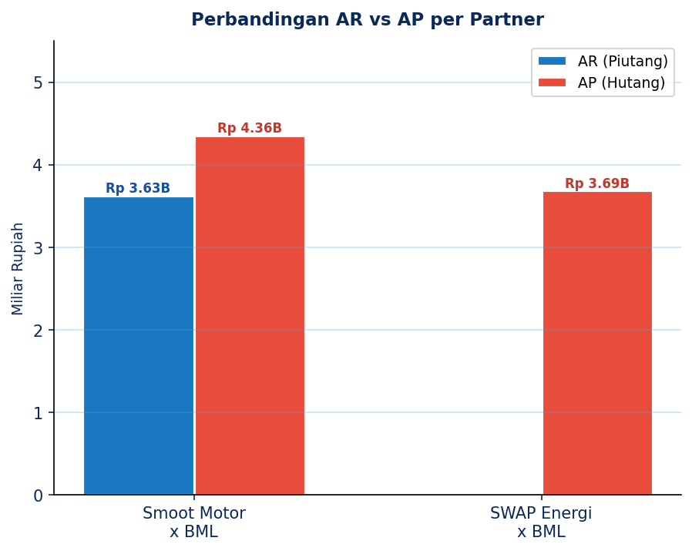
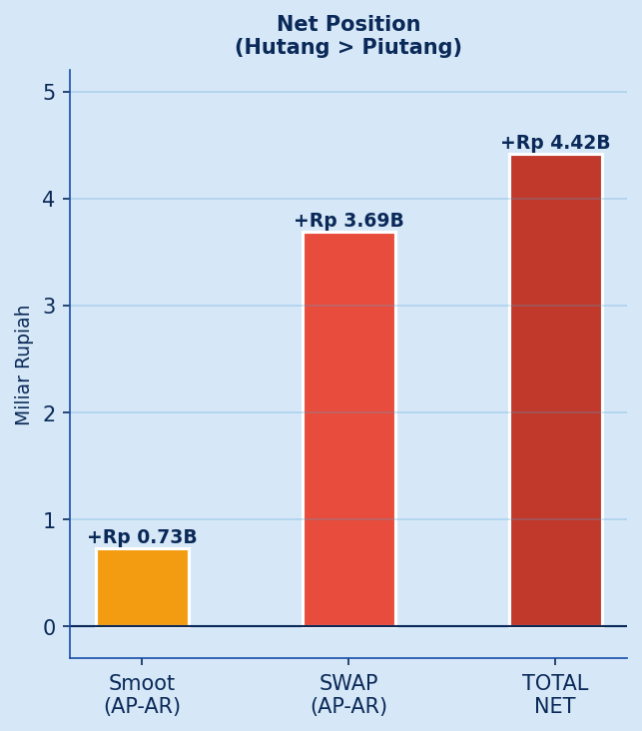
AR VS AP - PERBANDINGAN & POSISI NET
Analisis perbandingan piutang vs hutang per partner

Slide 7
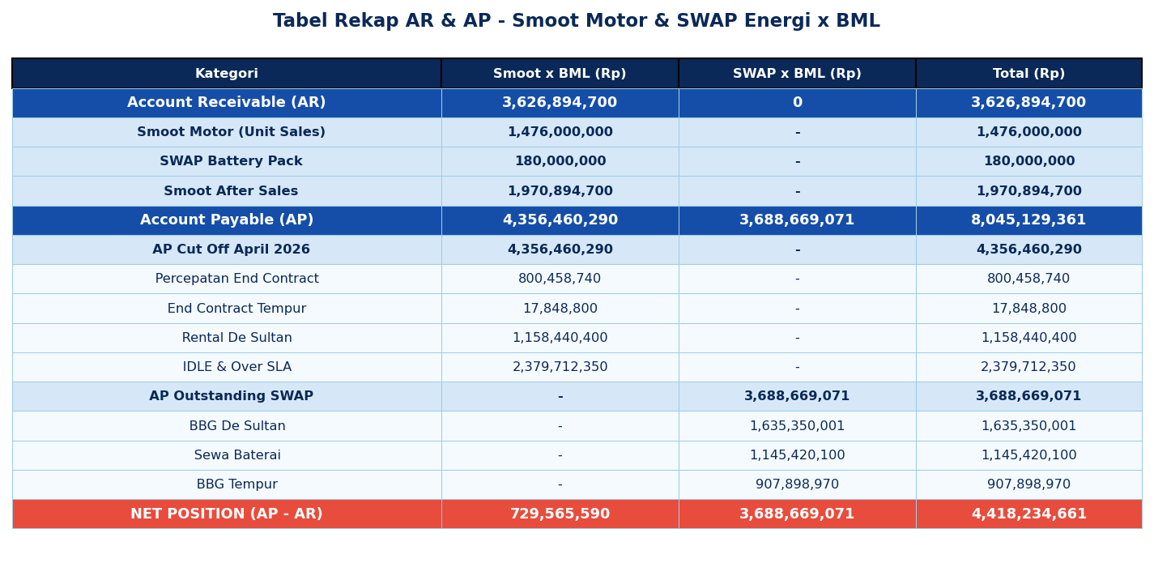
TABEL RINGKASAN - AR & AP DETAIL
Rekap lengkap per kategori per partner

Slide 8
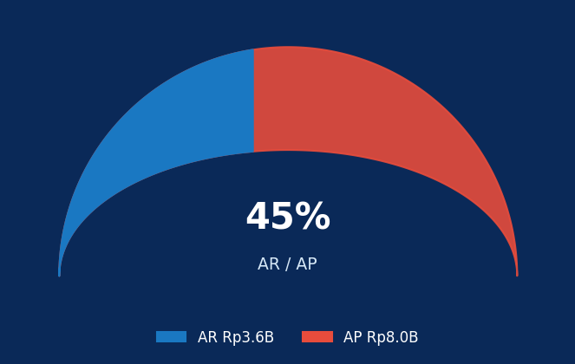
KESIMPULAN
NET POSITION
& REKOMENDASI
AP - AR
Rp 4,418,234,661
1
Total AR
Rp 3,626,894,700 Piutang dari Smoot Motor & SWAP
Hutang Bersih kepada BML
2
Total AP
Rp 8,045,129,361 Hutang ke BML dari Smoot & SWAP
3
Net Position
Rp 4,418,234,661 AP melebihi AR - perlu perhatian
4
Prioritas
IDLE & Over SLA (Rp 2.38B) merupakan komponen AP terbesar
(c) 2026 Confidential | Smoot Motor x BML | SWAP Energi x BML

