Slide 1
JAMstack
Santana Bonache Antonio Jesus
Friedel Robert Edward
March 03, 2023

Slide 2
What is Jamstack?
Jamstack usually spelled “JAMstack” might bring to mind any othe well-known web development stacks like LAMP , MEAN, MERN, MEVN etc. It is not.
According to their oficial website:
“Jamstack is an architectural approach that decouples the web experience layer from data and business logic, improving flexibility, scalability, performance, and maintainability. Jamstack removes the need for business logic to dictate the web experience It enables a composable architecture for the web where custom logic and 3rd party services are consumed through APIs”
Notes:
Jasmtack mean LAMP MERN…. Not
Oficcial desc: ARCHITECTURAL APPROACH to imporove perfomance scalability security more link website.
JAM: JS API MARKDOwn compiled

Slide 3
JAM
- What is JAM? Stands for JavaScript, APIs and Markdown (compiled).
JavaScript
Client focused architecture, with browser logic, meaning routes, dynamic content.
Enhanced user experience.
APIs
One or many decoupled servers
Microservices architecture, headless CMS, serverless, BaaS, FaaS… etc
Markdown (compiled)
Refers to the HTML, static content and assets.
Also known as pre-render, the generation of content files is done in the build process so it is available as soon as there is a request from a client.
JAMstack
In practice what it attempts to do is serve static pre-rendered content from a highly available CDN, while data is shared and handled through micro services (APIs), and everything made available and interactive to the user with Javascript.
Notes:
js.- Dynamic website user activity routes all in all UX
API- many decoupled api microservices headless CMS EJ. tienda pan microserv +auth service serverless
Markdown = static html + assets (no requests or Dynamic data) compiled= pre-rendered build time to asap availability. Later on demo
Pillar jamstack attemps to serve cdn compiled markdown with Mservices DATA made available and enhanced view with js.

Slide 4
MVC and MVVM trends
Controller
Model
View
Model
ViewModel
View
Model View Controller Architecture
User interacts
Event from View to Controller
Controller updates Model
Model notifies View
View updates from Model data
Model View View-Model
View-Model bidirectional-binding. Highly reactive and operates with subscriber-observer pattern.
View and Model decoupled better abstraction and also the single responsabillity principle for architecture.
Notes:
Wont explain in detail, mvvm but diferences and tendency
Final example: LAMP stack BE serves FE content vs MEAN SPA content BE/FE
User interact with view Translates to: render

Slide 5
When do we render? Ssr, csr and ssg
Server Side Rendering
Renders one page per client request dynamically.
Slower than CSR for many user interactions, being better suited for static content delivery.
Search Engine Optimized
For example a monolith application.
Client Side Rendering
Renders content in the client’s browser
Single Page Applications, highly dynamic content
Slower initial loading times
Not Search Engine Optimized
Static Site Generation
Also known as pre-render, the generation of content files is done in the build process so it is available as soon as there is a request from a client.
For example angular-universal, gatsby(react)
Incremental Static Regeneration
Next step in SSG where content gets periodically updated.
Notes:
SSG is the compiled stuff from before
Runtime runtime buildtime!!

Slide 6
DEMO TIME

Slide 7
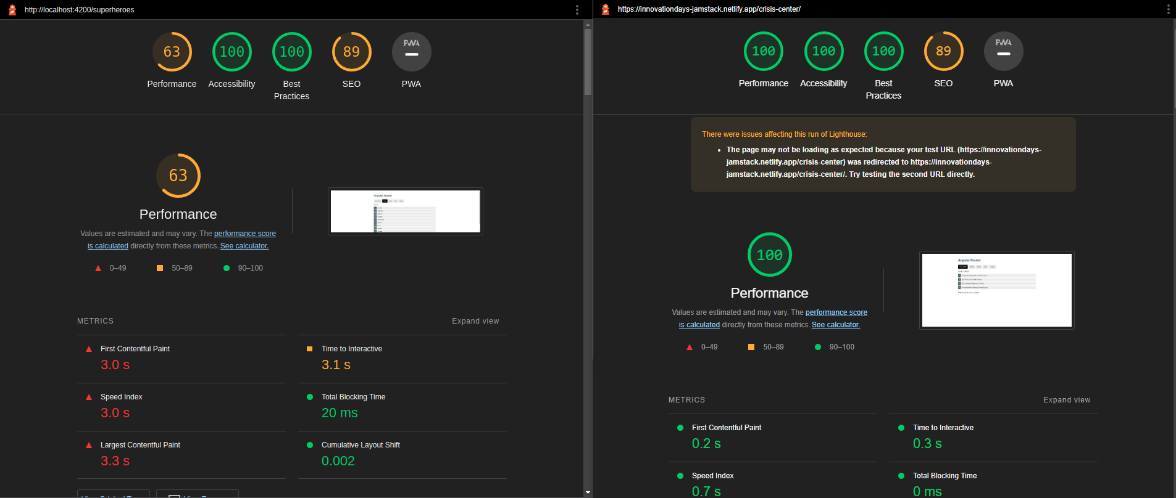

Slide 8
Q & A - Feel free to raise any questions
Is MUSE a JAMstack architecture?

Slide 9
Thank you
Any additional information can be found at
JAMstack.org/
scully.io/
Contact us : antonio-jesus.santana-bonache@hpe.com or robert-edward.friedel@hpe.com
Notes:
Asdf test asdasdasdas

