Slide 1

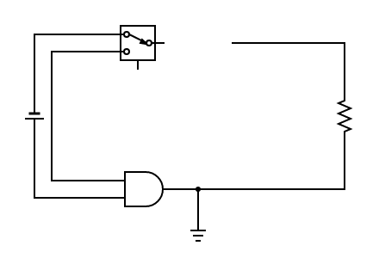

INTRODUCTION TO
REINFORCEMENT LEARNING

Slide 2


