Slide 2

Environment Preparation
 | Attacker Host | Linux victim(Caladan)
VM OS and edition | Ubuntu-22.04(Kali-2019.1) | CentOS-7
Required dependencies | sshpass, curl, smbclient, xfreerdp, xdotool | Usermod, visudo(NOPASSWD)
Additional server | Caldera C2 Server(git, python3.7+ with pip3, golang 1.17+)
Notes:
Use different machine since RDP windows will need to be in the forefront when performing certain automated keystrokes.

Slide 3
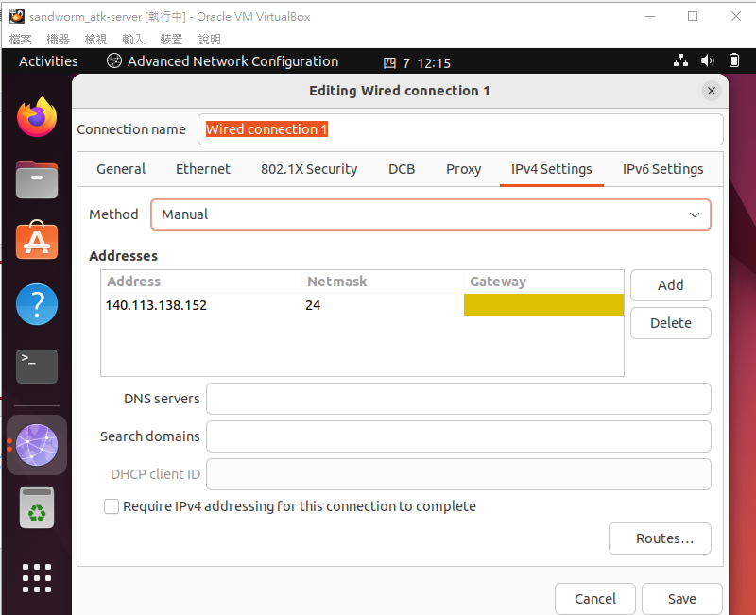
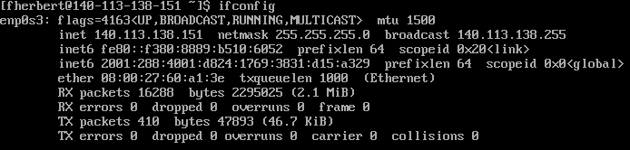


IP Configuration
All VMs are configured into bridge mode.(connected to the same LAN)
To allocate different IP to the VMs using the same network interface card, we need to assign static IP to each VM.

Slide 4
Prerequisite Commands on attacker host
Command | Usage
apt-get install git sshpass curl smbclient freerdp2-x11 xdotool | Install dependencies
scp sandworm/Resources/setup/setup_caladan.sh fherbert@10.0.1.5:/tmp/setup_caladan.sh (and chmod +x) | Send configuration of Caladan host via scp(ex. Enable httpd)
scp sandworm/Resources/suid-binary/suid-binary fherbert@10.0.1.5:/tmp/suid-binary | Essential utility used by setup_caladan.sh(to escalate privilege of Exaramel)
./setup_caladan.sh | Execute the shell script

Slide 5
Prerequisite Commands on Linux Victim
Command | Usage
Usermod –aG wheel fherbert(in root account) | Add fherbert into wheel group(wheel=root privilege of group in centOS)
Visudo(in root account) | Change the wheel group into no password required when typing sudo command.

Slide 6
Prerequisite Commands on Caldera C2 server
Command | Usage
git clone --depth 1 https://github.com/mitre/caldera.git --recursive cd caldera git checkout master && git pull cp conf/default.yml conf/local.yml Vi conf/local.yml(add emu into plugin) | Preparing C2 server
pip3 install --upgrade setuptools pip3 install --upgrade pip pip3 install -r requirements.txt | Download pip dependencies
cd plugins/emu git checkout master && git pull ./download_payloads.sh cd ../.. | Download required payloads for emu plugin
python3 server.py --log DEBUG | Run C2 server

