Slide 1
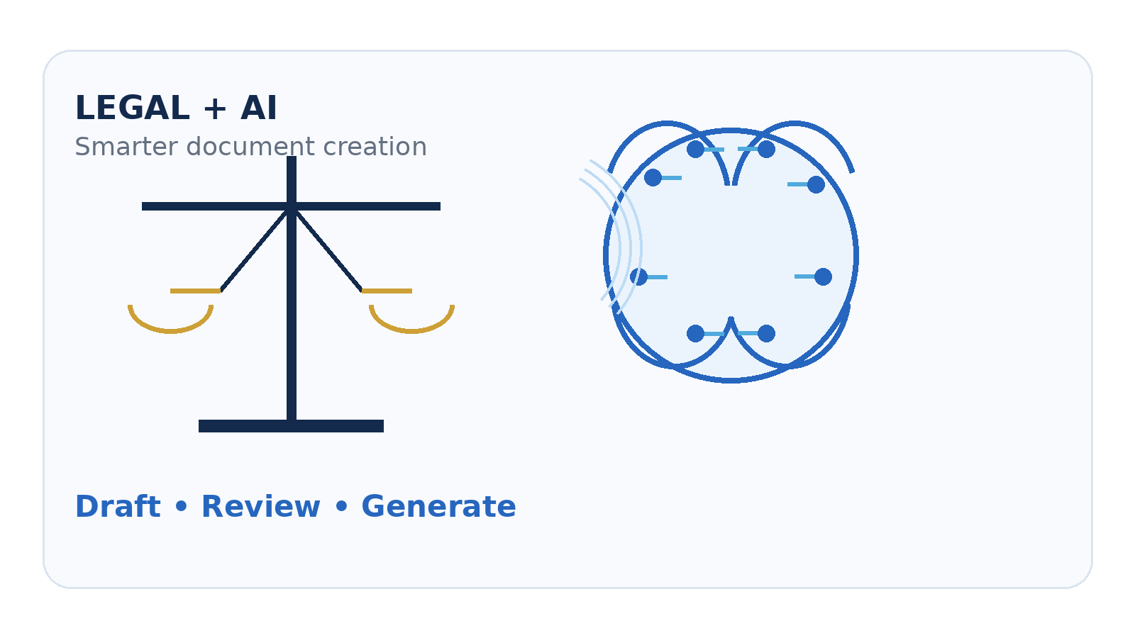
LEGALEASE
AI-Powered Legal Document Generator
A smart platform for faster, structured and user-friendly legal document drafting.
TEAM LEADER
JAGATHEESH KUMAR.B
Team Members
KARTHICKRAJA.S • KARTHICK.A • JAI SURYA.AV
JAITHARUN.D
PROJECT PRESENTATION

Slide 2
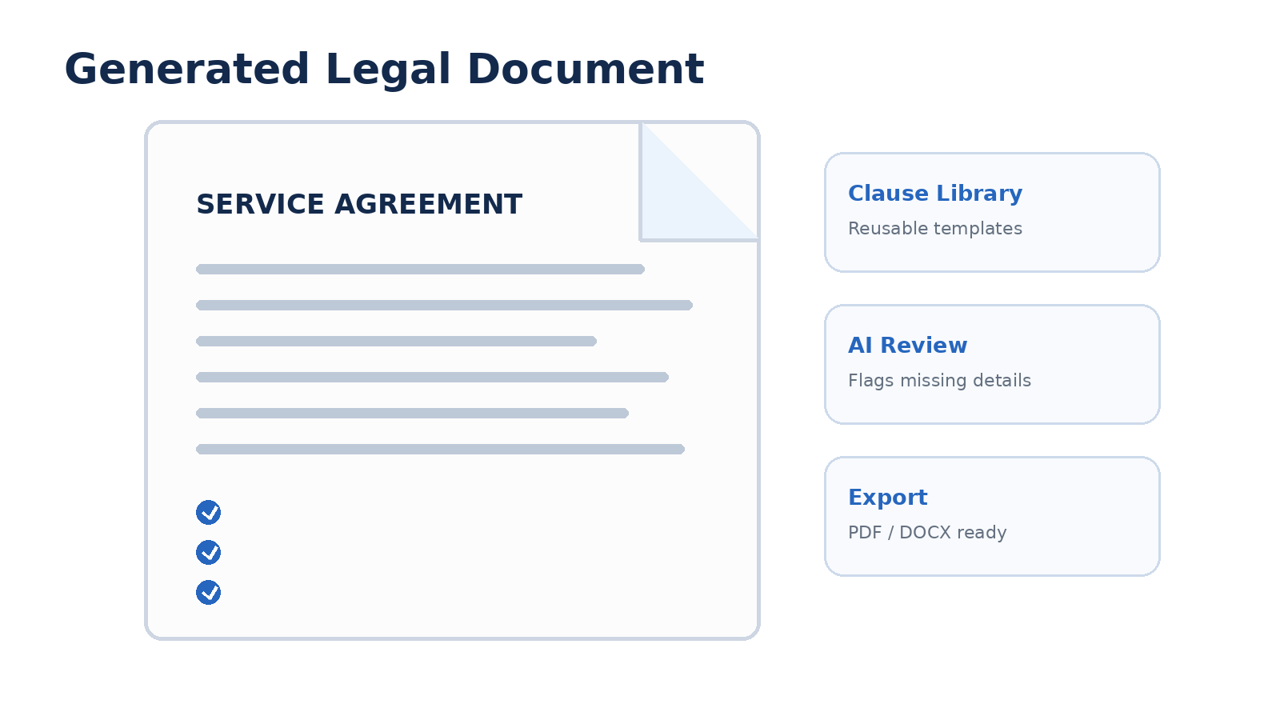
1. Problem Statement
Why legal document preparation can be difficult
• Manual drafting can take significant time for common document types.
• Users may struggle with legal terminology, structure and required clauses.
• Repeated document creation often leads to inconsistent formatting.
• Missing information or clauses can require multiple revisions.
• There is a need for a simple guided workflow that supports human review.

Slide 3
2. Proposed Solution
Legalease combines guided input, AI-assisted drafting and document export
01
Guided Input
AI
AI Drafting
✓
Review Support
Collects key facts, parties, dates and clauses in a structured form.
Transforms user-provided information into a structured legal-document draft.
Helps identify missing fields and areas that may need human attention.
T
Templates
C
Clause Library
PDF
Export
Supports reusable formats for common legal documents.
Provides reusable clauses to improve consistency and speed.
Produces a clean document suitable for further editing and review.

Slide 4
3. Key Features
Core capabilities of the Legalease concept
•
Smart Templates
•
Natural-Language Input
•
AI-Assisted Drafting
Start from predefined structures for frequently used legal documents.
Users can describe requirements in simple language.
Generates organized clauses and document sections from provided details.
•
Validation Checks
•
Editable Output
•
Document Export
Highlights incomplete or inconsistent information before export.
Allows users to review and modify the generated content.
Supports presentation-ready PDF/DOCX-style output workflows.

Slide 5
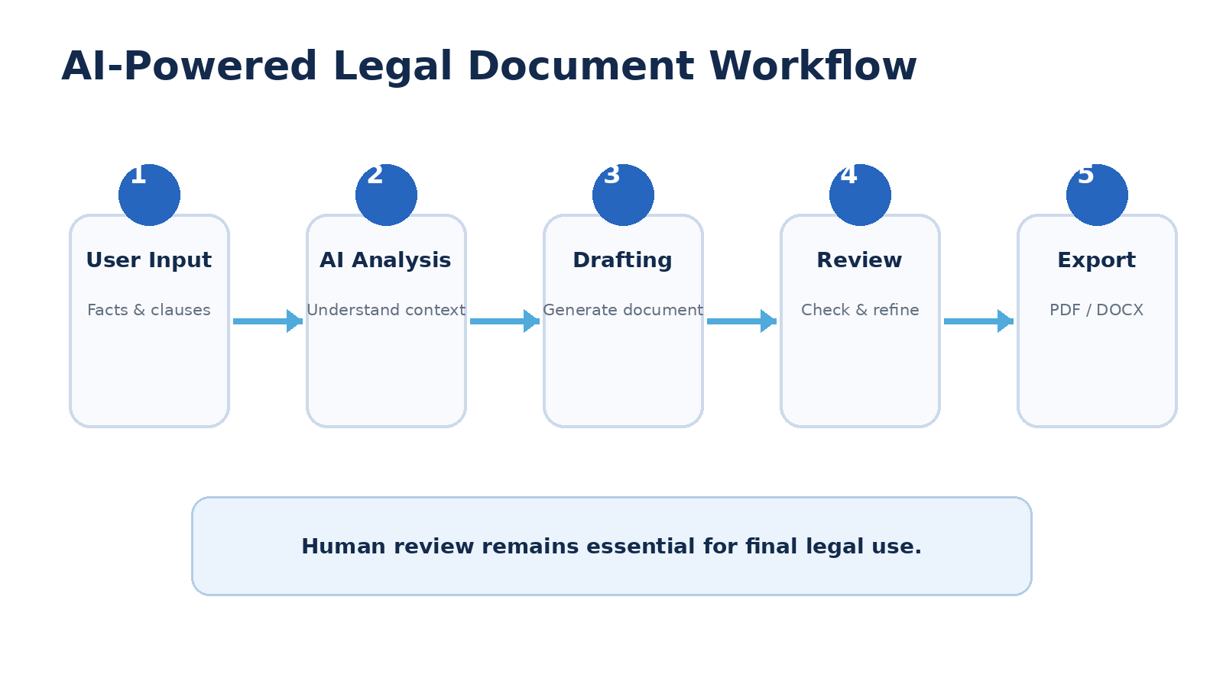
4. System Workflow
From user requirement to a structured document
Possible stack: Web UI • Backend API • LLM/NLP layer • Template engine • Document/PDF generation • Secure storage

Slide 6
5. Benefits & Future Scope
A practical direction for AI-assisted legal document workflows
+
Time Efficiency
✓
Consistency
◎
Accessibility
Reduces repetitive drafting effort and streamlines document preparation.
Reusable templates and clauses can improve document structure and formatting.
A guided interface can make document drafting easier for non-expert users.
→
Future: More Templates
→
Future: Better Review
→
Future: Security
Expand coverage across agreements, notices, applications and business documents.
Add stronger validation, clause comparison and human-review checkpoints.
Add privacy controls, access management and secure document handling.
THANK YOU
Legalease — Making legal document drafting smarter, simpler and more structured.

