Slide 1
Concept Remote-Streaming
Streaming audio,video and meta information for automotive development tasks
Schleißheimer Soft- und Hardware Entwicklung GmbH

Slide 2
Foreword
C++ (11)
Clear namespace usage
Git as revision software
Doxygen documentation

Slide 3
Git Repositories
RemoteWorkstation (Parent)
Childs
RemoteApp
RemoteView
RemoteService
RemoteDoc
RemoteStreamServer
RemoteStreamClient
RemoteUtil
RemoteControlBox

Slide 4
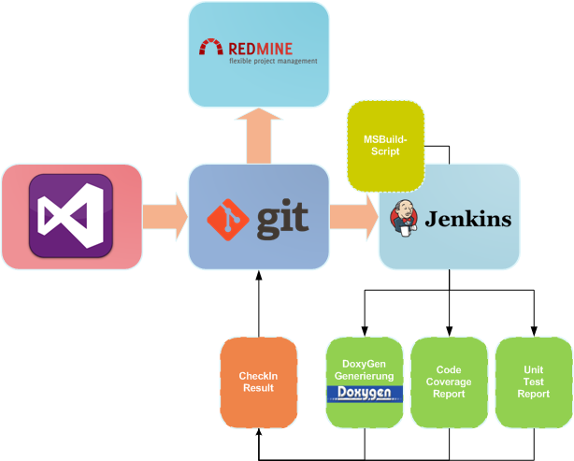
Build-Toolchain

Slide 5
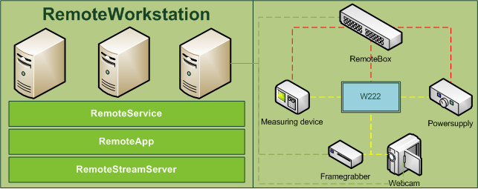
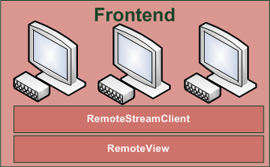
General Structure
Server
Client

Slide 6
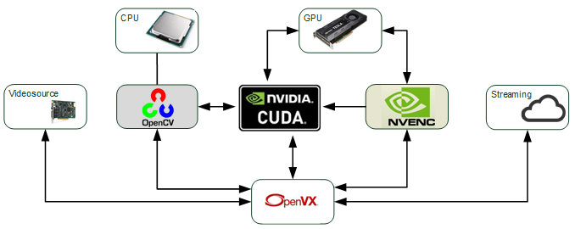
Software Components
Server(RemoteWorkstation)

Slide 7
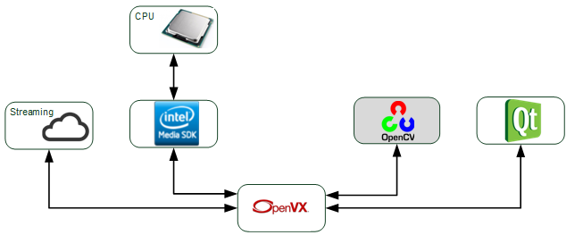
Software Components
Client(Frontend)

Slide 8
OpenVX
C-Framework (C++ Wrapper needed)
Based on graph concept
Kernel include the real function

Slide 9
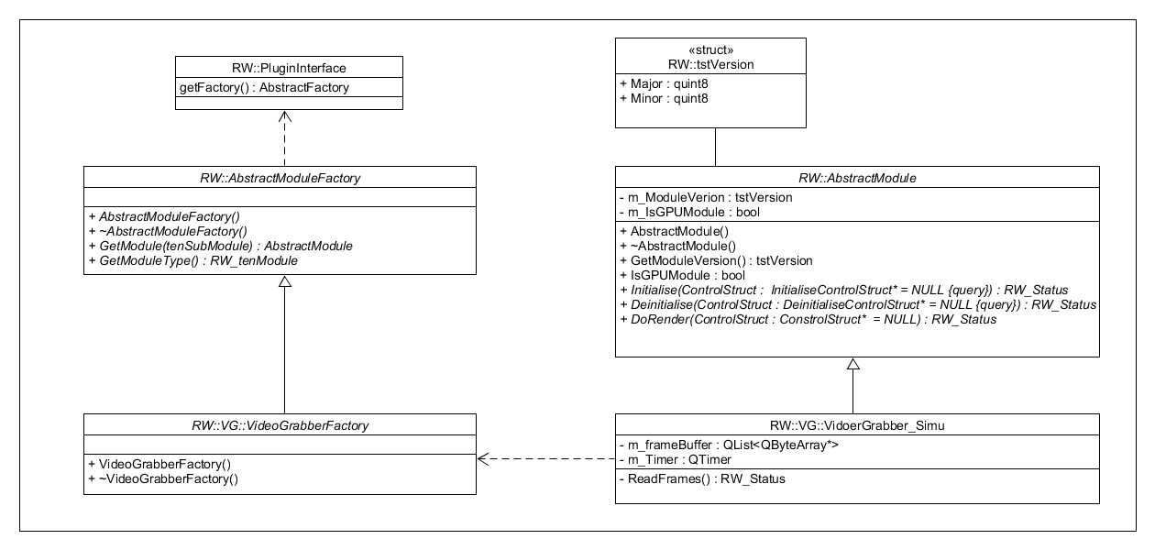
Module Structure
Enclosure of functionality in modules
Each module has them same interface
Init, DoRender, Deinit

Slide 10
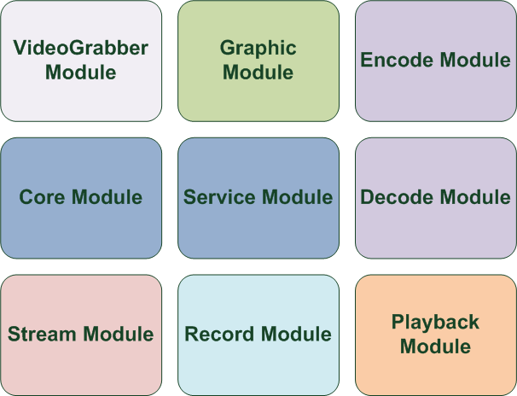
Module Structure

Slide 11
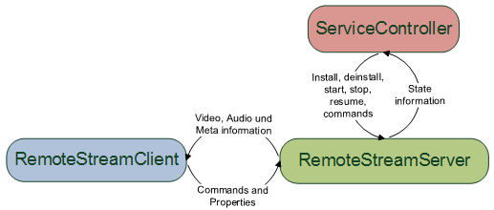
SERVICE Module
Abstraction Layer between Windows service and Remote Framework

Slide 12
CORE Module
Configloader
XML and SQL (Administration, Dynamic Load Control) version
Fallback is XML
PluginLoader
ModulConnector/Builder
Connect the nodes and sets the correct parameter for the funcation calls
ClientCommunicator
Logging
Logging File
SQL Logging
Performance Meassure

Slide 13
VideoGrabber Module
4 Types
DirectShow WebCam
USB3 Framegrabber
PCI Framegrabber
Simulation

Slide 14
Graphic Module
Color space conversion
Frame merge
Frame split
ROI

Slide 15
Encode/Decode Module
NVIDIA NVENC encoder solution
Intel Media Lib decoder solution
Possibile compare of Intel encoder and NVIDIA encoder

Slide 16
Stream Module
Simple socket based solution
RTPS Live555 library
Multicast

Slide 17
PlayBack Module
Strongly QT based application
Playback of audio, video and metadata
Control of the playback

Slide 18
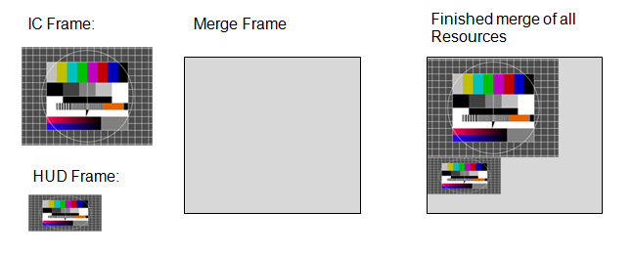
Audio, Video and Meta-Information
Solution 1:
Seperate Streaming of each Source
One audio & video stream + additional video streams
Solution 2:

Slide 19
Audio, Video and Meta-Information
Audio and video synchronisation through timestamps
Allocation of timestamps as fast as possible
Alternative method: Initial sequence with known audio and video informations
Player need a container

Slide 20
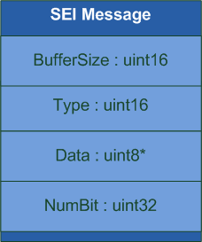
Audio, Video and Meta-Information
Meta-Information will be transported in the H264 Frame
SEI or VUI Messages
Player or separate Module „decode“ Meta Information

Slide 21
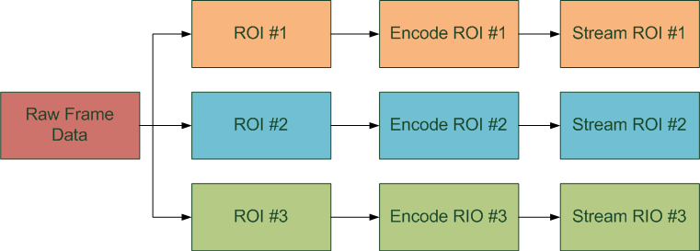
ROI – Region of Interrest
Solution 1:

Slide 22

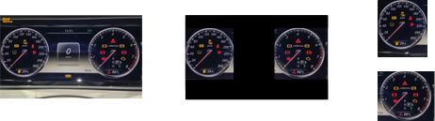
ROI – Region of Interrest
Solution 2:
Server:
Client:

Slide 23
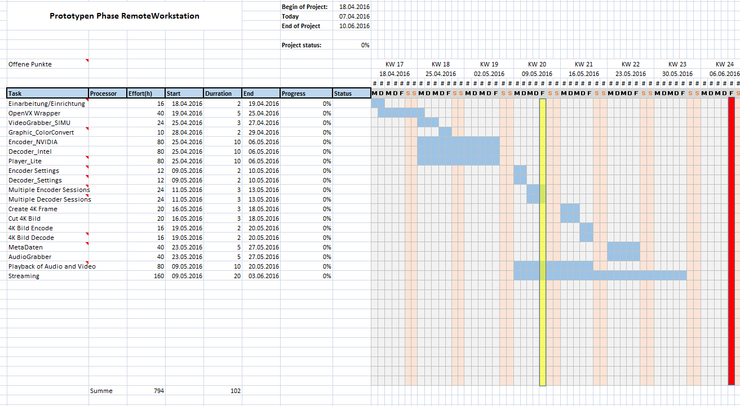
Timeplan

Slide 24
Timeplan
Einführung
Besprechen des Konzepts
Installation der benötigten Tools
Abstimmung
Wöchentliches Meeting
Eventuell täglich Update Runden (15min), falls erforderlich

