Slide 1
date: 2021-11 author: “Chéyo Jiménez, MSE” title: “Career Quest Engineering” output: powerpoint_presentation: reference_doc: reference_one.pptx marp: true

Slide 2
Why?
Since Pandemic I started to feel disconnected with work; I was worried about my career in these times.
I started on quest for quest to make my job more enjoyable.
The behaviors that make work/job more enjoyable are also the behaviors that have greatest positive impact in our careers.

Slide 3
How
We will discuss (3) behaviors groups that helped me feel back in control of my projects and career.
These are things that worked for me and I hope can get something out of these ideas to develop your own behaviors.
Everybody’s context is different. I hope to transmit the general idea which can motivate you to come up with specific implementations.

Slide 4
System Dimensionality (Scalar Nodes)
Human Agents (Person, Team, System)
Software Agents (Component, Cluster, System)

Slide 5
Temporal System
Time scalar (Short, Medium, Long)
Change is the only constant

Slide 6
Complex system
Engineering is very interesting in the aspect that while we humans are part of the system that we create, we are also able to create agents to remove toil and pain from our system. (There are trade offs)

Slide 7
Agent grouping distributions
While we have different names for human vs software we will standardize Singular, Group, System
A singular agent across time forms a Group. Temporal distributed group.
Multiple agents that exist with the same temporal short term are a Group. They do not have to be active at the same time but must be available to become active. Temporal Concurrent group (distributed over space)
An agent group (same identity) across time form a System. Temporal distributed system.

Slide 8
Scope
People and Software from same singular system.
Out of scope: The system over time.
Time scale of short to medium term.

Slide 9
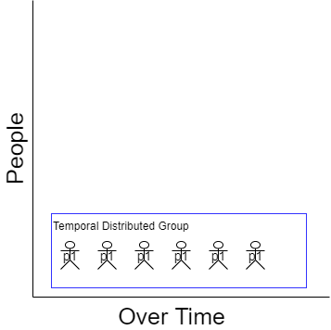
Staging
Notes:
We will start with the individual person and a singular project (component).
We will explore current, short term future, medium term future
We will do a temporal shift to past (current), present (short term), future (medium term)
This part is well understood

Slide 10
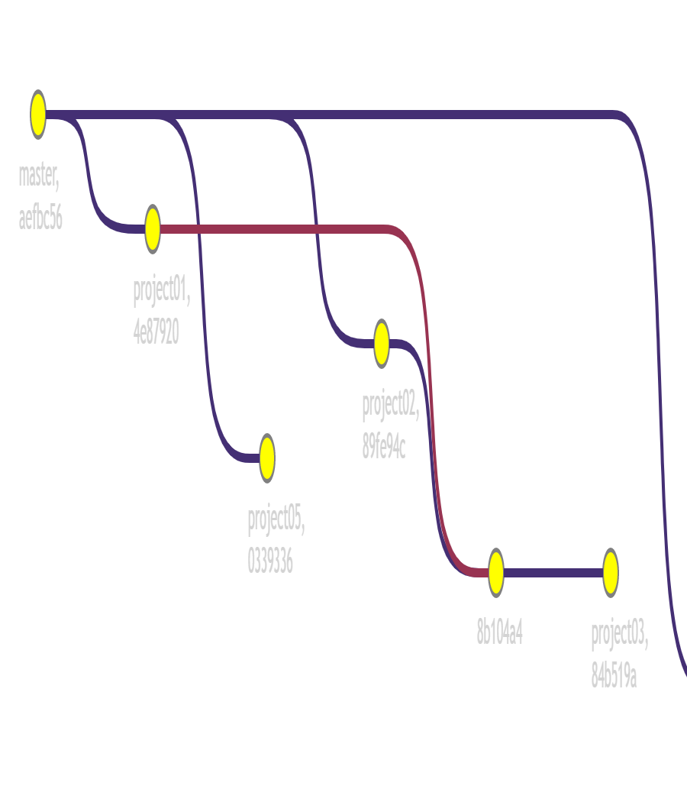
Staging Projects
Notes:
We will continue with the singular person but we will introduce multiple projects at different levels of progress.
Some projects are fun while others are not.
How does this individual feel motivated? (now add a pandemic on top of this)
This part is somewhat understood.

Slide 11
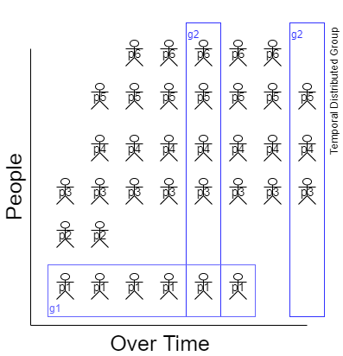
Staging Groups

Slide 12
::: notes - We will imagine a team of individuals (each with different systems of components) that need to interact with each other. - New people being added, and people moving teams, projects changing ownership. - People agents and software agents over time. - This part is somewhat understood. :::

Slide 13
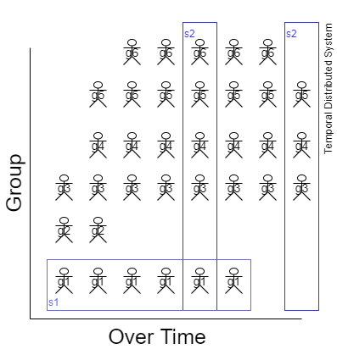
Staging Groups

Slide 14
Behavior #1: Clear Strategy
Clear goals. (Know what to do next).
Clear signal of progression towards goals (Tight feedback loop)
Challenging within margin of skill (Not too hard or easy. Just right)
Full control over the activity (Ownership / Authority)
Notes:
Attribution: Mihaly Csikszentmihályi (1990). Flow: The Psychology of Optimal Experience. https://en.wikipedia.org/wiki/Flow_(psychology)

Slide 15
Clear Strategy
Agile methodology attempts to address this.
Definition of done
User Stories
Iterative progress
Well understood as Ability.
Can I do it?

Slide 16
Behavior #2: Intrinsic Drive
Sense of Ownership
Feeling of Autonomy.
Mastery (always improving)
Somewhat understood as Motivation
Is it worth it?
Notes:
Attribution:
Drive: The Surprising Truth About What Motivates Us by Daniel H. Pink 2011
Start with Why: How Great Leaders Inspire Everyone to Take Action by Simon Sinek

Slide 17
Intrinsic Drive
Beyond Mission, Vision statement from company.
Motivation that can only be intrinsic to the individual.
Can not come directly from delegation.
External motivations like money only temporarily boots motivation.

Slide 18
Behavior #3: Contextual Awareness
The act of seeking awareness (as input) across the scalar dimensionality of people, software components, and time.
The act of transporting awareness outside of their contextual environment into the future short term and medium term.
Visibility of work over time.
Somewhat understood as DCog (Distributed Cognition)
Notes:
Attribution:
Now: The Physics of Time by Richard A. Muller
Distributed Cognition https://en.wikipedia.org/wiki/Distributed_cognition
Cognitive System https://ise.osu.edu/faculty-research/human-systems-integration/cognitive-systems-engineering
https://www.researchgate.net/profile/David-Woods-19 https://github.com/lorin/resilience-engineering#david-woods

Slide 19
Contextual Awareness
Shared awareness of the group
Cognitive Artifacts
Share understanding of the group
Notes:
Focus on concrete behaviors that somebody can adopt.
Understanding of the inner system. HOw to get understanding.

Slide 20
Cognitive Systems
The trade off of Cognitive Artifacts is that is easier for somebody else to do your job.

Slide 21
How does this related to career?
What are your Career OKR.
Well being of the agent.

Slide 22
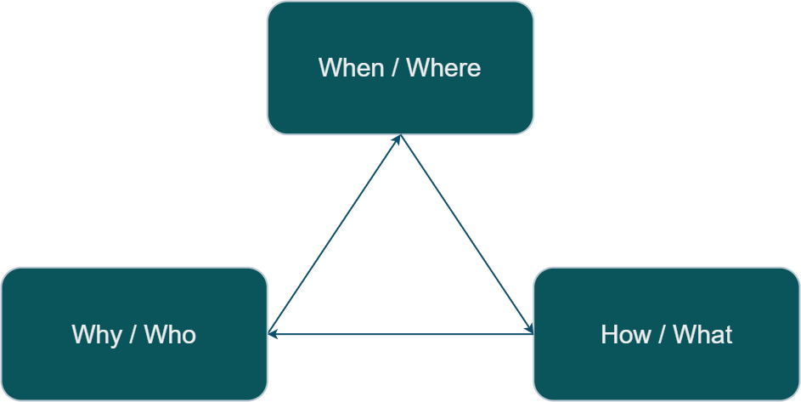
Quest[ions]

Slide 23
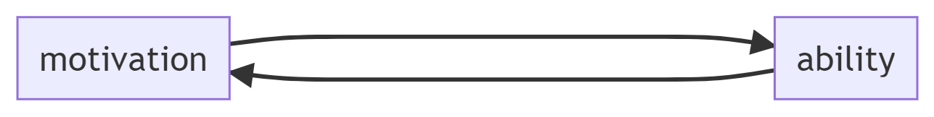
Path

Slide 24
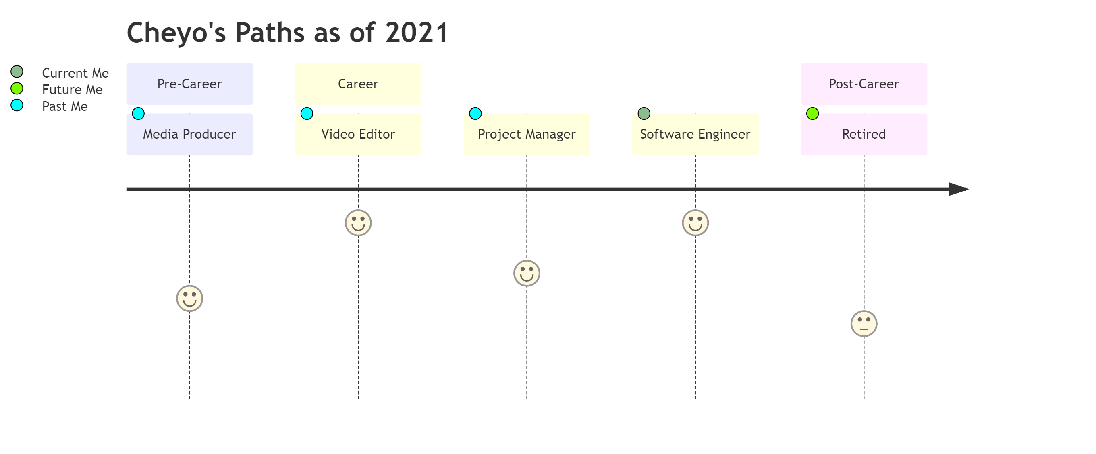
Back[Story]
Notes:
Not included here are college jobs that would not qualify. For example, working at as a package loader motivated me to not want to do that as a career. The same goes for summer helping family with home construction projects.

Slide 25
Career: insights about levels
Level in your career are more akin to different roles.
It is not a ladder, is a different role.

