Slide 1
marp: true

Slide 2
The software engineering quest
Chéyo Jiménez, MSE Oct, 2021

Slide 3
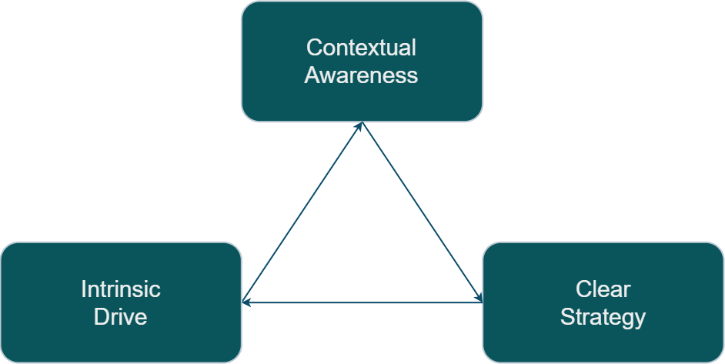
Engineering Quest Engine

