Slide 1
marp: true

Slide 2
Career Quest Engineering
Chéyo Jiménez, MSE Nov, 2021

Slide 3
Definitions
Career
Quest
Engineering
I am going to try to convince you that this soup of words are related.

Slide 4
Career
According to wikipedia the word career comes from the latin carrus which means chariot. The chariots of our time (cars) are powered by engines. The main purpose of a car is to provide movement in a similar manner that a career is meant to provide progression of one’s profession.
Most folks think of a career ladder when thinking bout this.

Slide 5
Quest
According etymonline the word quest come from the latin root quaere which means “to ask, inquire” and from Old French queste “search, quest, chase, hunt, pursuit; inquest, inquiry”
English words with the same root: request, require, conquest, question, query, acquire

Slide 6
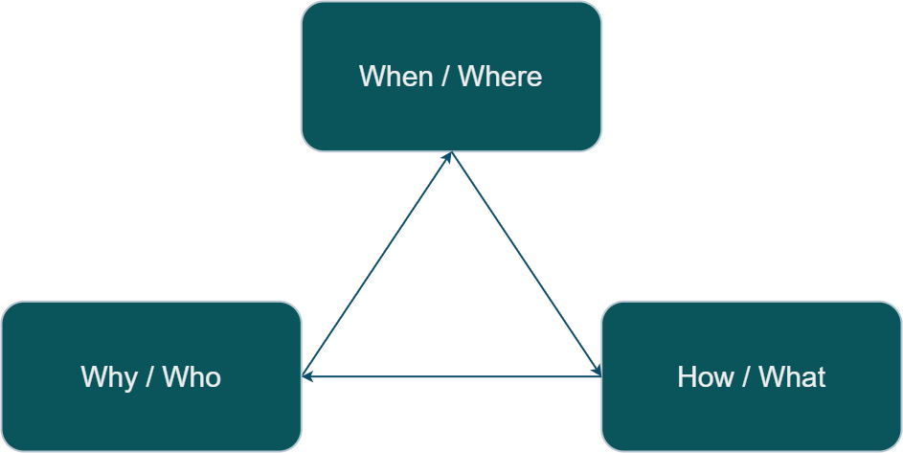
Quest[ions]

Slide 7
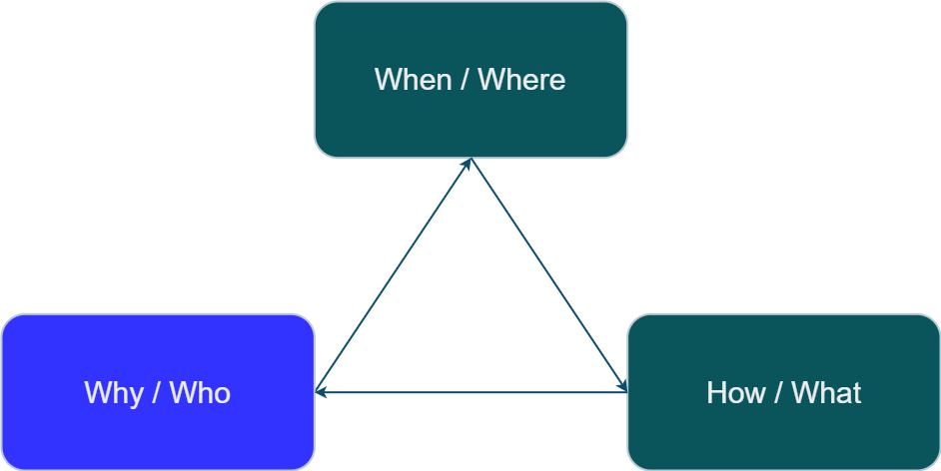
Quest[why]: the main quest[ino]

Slide 8
Career [when][where]
In the career space-time continuum, where/when is a point somewhere in space-time career.
The arrow of time is constant and it is always moving forward.

Slide 9
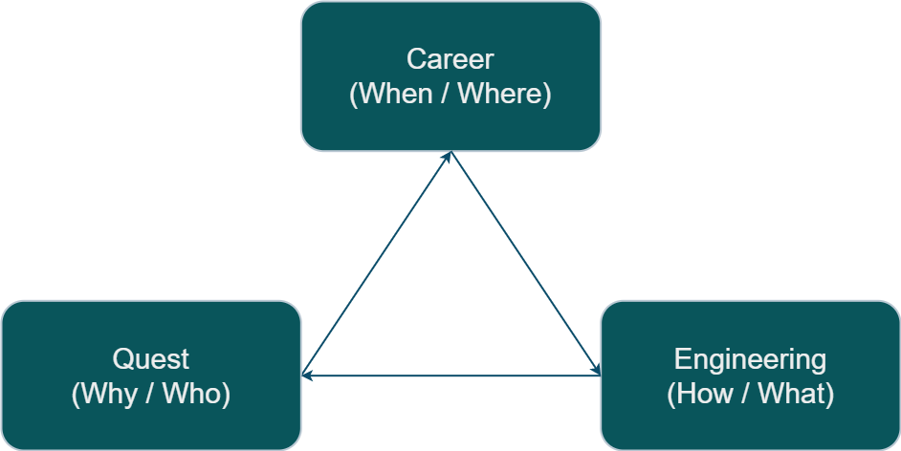
Engineering

Slide 10
Engineering
According to wikipedia, the word engine comes from the Latin ingenium which is the root word for ingenious.
It is not a coincidence that engine and engineer only differ by the letters er at the end. The word engineer shares the same latin root of ingenium with engine. According to wikipedia an engine’er literally meant someone one who operates an engine.

Slide 11
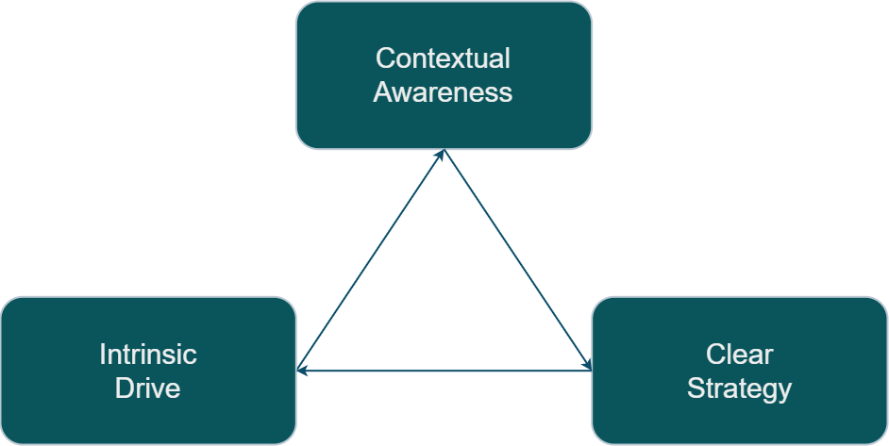
Quest Engine

