Slide 1
The software engineering quest
Chéyo Jiménez, MSE Oct, 2021

Slide 2
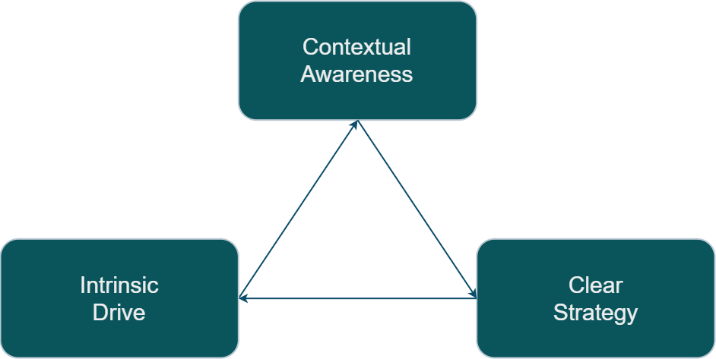
Engineering Quest Engine

