Slide 1
q
w
e
r
t
y
u
i
o
p
a
s
d
f
g
h
j
k
l
.
z
x
c
v
b
n
m
`
’
,

Slide 2
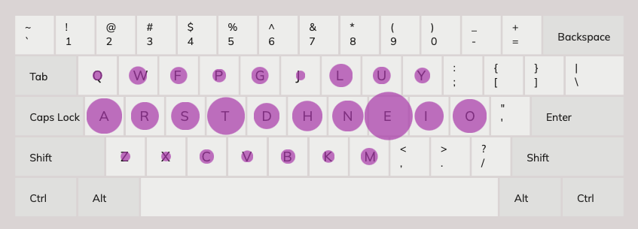
cole
q
w
;
f
g
y
u
k
l
p
a
s
d
r
t
h
n
e
i
o
z
x
c
v
b
j
m
`
.
,
new asdrt hneio

Slide 3
colo cheyo 01
q
w
e
r
t
y
u
i
o
a
s
d
f
g
h
j
k
l
n
z
x
c
v
b
p
m
`
’
,
.

Slide 4



colo cheyo 02
`
w
e
r
t
y
u
i
o
’
a
s
d
f
g
h
j
k
l
.
z
x
c
v
b
n
m
q
p
,

Slide 5
colo cheyo 03
`
w
e
r
t
y
u
i
o
’
a
s
d
f
g
h
j
n
l
.
z
x
c
v
b
q
m
k
p
,

Slide 6




colo cheyo 04
b
g
t
y
h
n
q
w
e
r
u
i
o
p
a
s
d
f
j
k
l
.
z
x
c
v
m
`
’
,

Slide 7
colo cheyo Thumb 01
`
w
a
r
t
y
u
i
o
’
esc
,
s
d
f
g
h
j
k
l
.
enter
z
x
c
v
b
n
m
e
q
p
Left
Up
Down
Right
e
_
Left
Shift
R
Shift
alt
win

Slide 8
colo cheyo Thumb 02
`
w
e
r
t
y
u
i
o
’
esc
a
s
d
f
g
h
j
k
l
.
enter
z
x
c
v
b
n
m
q
p
,
Left
Up
Down
Right
e
_
Left
Shift
R
Shift
alt
win

Slide 9
colo cheyo Thumb 03
!
?
`
~
-
_
=
+
/
%
\
|^
[
{
]
}
(
<
)
>
w
e
r
$
&
u
i
o
’
“
esc
a
s
d
f
#
*
j
k
l
.
:
enter
z
x
c
v
@
|
m
q
p
,
;
t
g
b
n
h
y
e
space
Left
Shift
R
Shift
alt
win

Slide 10
colo cheyo Thumb 04
!
?
-
_
=
+
/
%
\
|^
`
~
w
e
r
[
{
$
&
]
}
u
i
o
’
“
esc
a
s
d
f
.
:
#
*
,
;
j
k
l
;
:
enter
z
x
c
v
(
<
@
|
)
>
m
q
p
t
g
b
n
h
y
e
space
Left
Shift
R
Shift
alt
win

Slide 11
colo cheyo Thumb 05
!
?
b
g
t
/
%
\
^
y
h
n
`
~
w
e
r
[
{
$
]
}
u
i
o
’
“
&
esc
a
s
d
f
.
:
#
*
,
;
j
k
l
;
:
enter
z
x
c
v
(
<
@
|
)
>
m
q
p
-
_
=
+
Left
Up
Down
Right
e
space
Left
Shift
R
Shift
alt
win

Slide 12
colo cheyo Thumb 06
b
g
t
/
%
\
^
y
h
n
q
w
e
r
Left
$
Right
u
i
o
p
&
esc
a
s
d
f
Up
#
*
Down
j
k
l
.
:
enter
z
x
c
v
Page
Up
@
|
Page
Down
m
’
“
,
;
!
?
`
~
-
_
=
+
[
{
]
}
(
<
)
>
e
space
Left
Shift
R
Shift
alt
win

Slide 13
colo cheyo Thumb B01
!
`
~
_
_
=
+
/
?
%
^
\
|
[
{
]
}
(
<
)
>
q
w
e
r
t
$
y
u
i
o
p
&
esc
a
s
d
f
g
#
*
h
j
k
l
.
:
enter
z
x
c
v
b
@
|
n
m
’
“
,
;
c4
c3
c2
c1
Left
Up
Down
Right
back space
space
Left
Shift
R
Shift
alt
win

Slide 14
colo cheyo Thumb B02
_
_
=
+
/
?
%
^
\
!
[
{
]
}
(
<
)
>
`
~
w
k
r
t
$
y
u
i
o
’
“
&
esc
q
s
d
f
g
#
*
h
j
e
l
p
enter
z
x
c
v
b
@
|
n
m
a
,
;
.
:
c4
c3
c2
c1
Left
Up
Down
Right
back space
space
Left
Shift
R
Shift
alt
win

Slide 15
colo cheyo Thumb C01
!
`
~
_
_
=
+
/
?
%
^
\
|
[
{
]
}
(
<
)
>
q
w
e
r
t
$
y
u
i
o
p
&
esc
a
s
d
f
g
#
*
h
j
k
l
.
:
enter
z
x
c
v
b
@
|
n
m
’
“
,
;
c4
c3
c2
c1
win
alt
Left
Up
Down
Right
esc/
kpshift
enter/
kpshift
crl
del
bkSpc
/LShift
Space
/RShift
e
tab
alt
win

Slide 16
2022 keys with issues in wpm counts in qwerty
P 35
Q 33
F 36 ???
J 38 ??
W 41
B 43
C 46
L 46
X 47

Slide 17
2022 error
I seem to confuse y and t
I seem to confuse g and h
I seem to confuse the location of t and n
TY
GH
BN

Slide 18
colo cheyo Thumb D01 (
`
‘
~
“
_
_
=
+
/
?
%
^
\
!
[
{
]
}
(
<
)
>
v
w
d
l
`
‘
$
&
~
“
u
c
y
b
esc
n
s
t
r
.
:
#
*
,
;
a
e
i
o
enter
p
f
m
h
z
@
|
q
k
j
g
x
c4
c3
c2
c1
lwin
esc
Left
Up
Down
Right
KPshift
KPshift
lcrtl
tab
Delete
bkSpc
Enter
Space
lshift
rshift
lalt
rwin

Slide 19
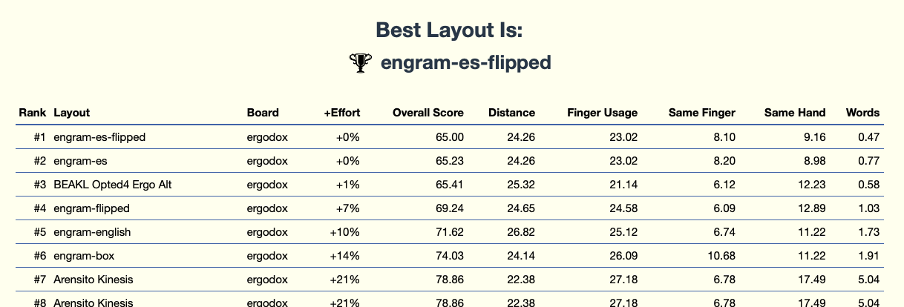
TODO: there is weird error between layouts

Slide 20
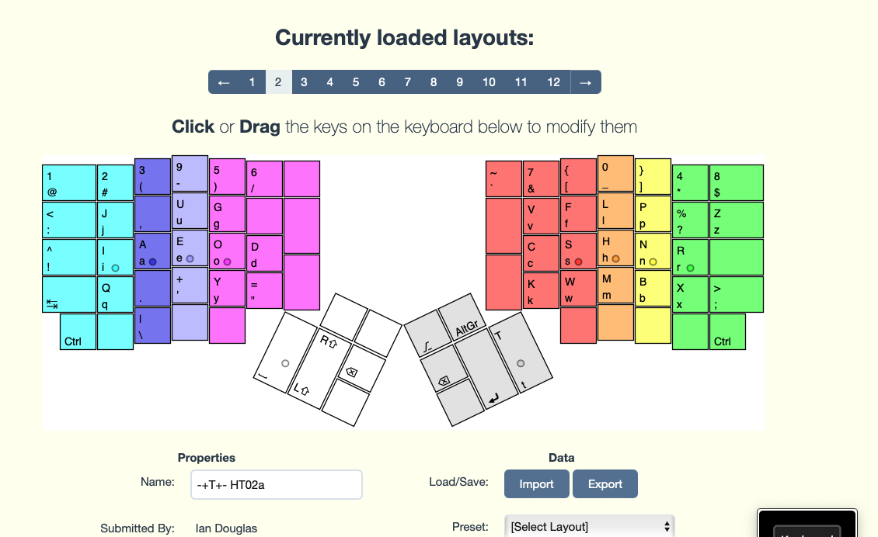

Slide 21
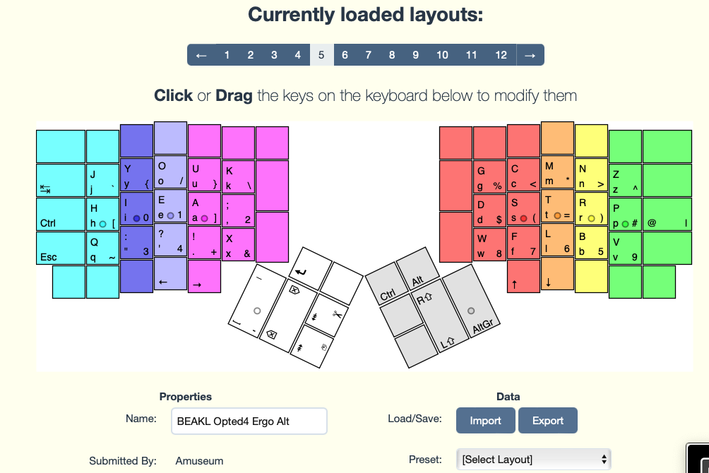
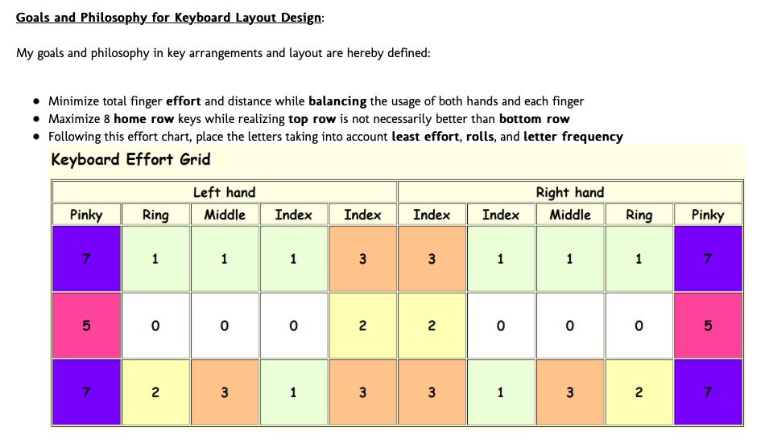
https://web.archive.org/web/20190906214047/http://shenafu.com/smf/index.php?topic=89.0

Slide 22
Typing Training
Do the test with all the keys in https://www.keybr.com
Use https://www.typingclub.com and start with the shifted keys and move on to typing special characters.
Typing clubs seems to take a lot of resources because it is loading a bunch of ads and it is a full blown game.
https://www.typing.com/student/lessons
Use validation and tests use:
https://monkeytype.com
https://play.typeracer.com
You can play typing games here
https://www.typelit.io/typing-console/Don_Quixote/0/125

